Slide 1

`
Computational Modelling in Multiphase Reactive Flows
Group - 4
Droplet Generation Microfluidic T Junction
Aryan Poonia (21CH30050)
Rajeev Verma
Anish Joshi (21CH3FP03)
Sameer Sen (21CH30042)
Atishay Jain (21CH3EP06)
Tushar Kumar (21CH30035)
November 16, 2024

Slide 2
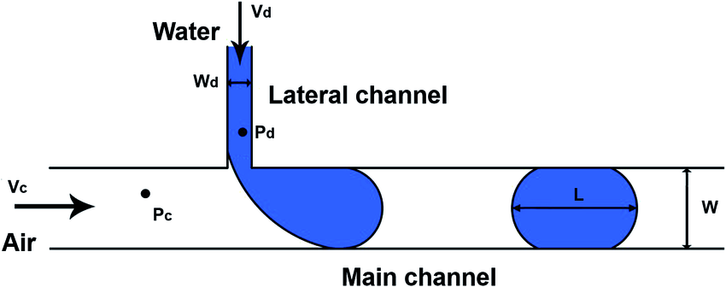
Geometry of T junction
d1( Main Channel Length) = 1600 μm
Cross Section: 100μmX100μm
d2 (branch Channel length = 250μm
CMMRF

Slide 3
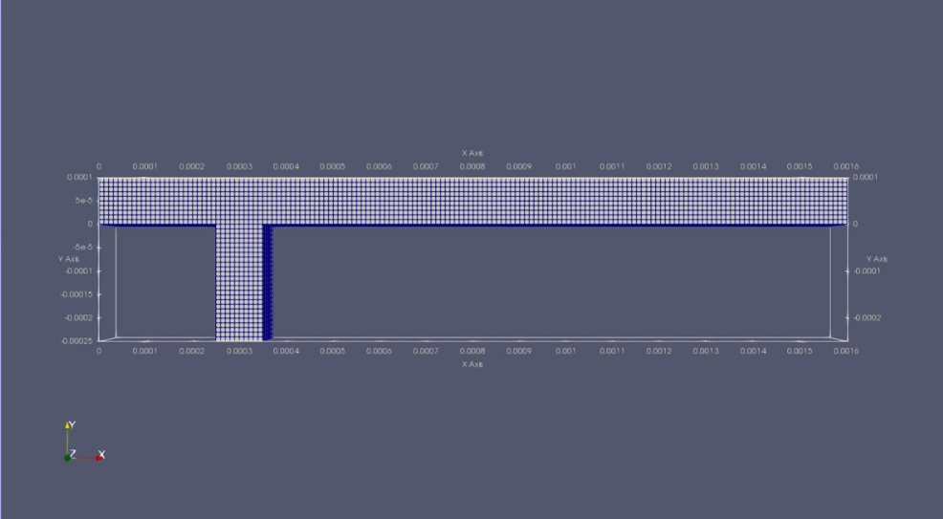
Meshing of T junction
Number of points: 22506
Number of cells: 18500
Number of Faces: 59300
Number of Internal Faces: 51700
CMMRF

Slide 4
Fluid Properties & Process
Viscous Model : LAMINAR
Phase Model : VOF(Volume of Fluid)
Primary Phase : Water
Secondary Phase : Oil
Water-Oil Surface Tension Coefficient : 0.035N/m
OIL PROPERTIES
Density of Oil = 870 kg/m³
Viscosity of Oil = 4.5e-0.5 kg/m.s
WATER PROPERTIES
Density of water= 997 kg/m³
Viscosity of water= 8.9e-0.7 kg/m.s
Process Parameters
Inlet velocity of oil : 0.016 m/s
Inlet velocity of water : 0.025 m/s
Contact Angle : 145°
CMMRF

Slide 5
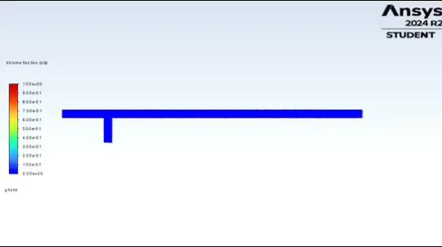
Results
Key Learnings
The process of droplet formation in microfluidic T-junctions.
Droplet generation regimes and their correlation with the capillary number.
Overview of ANSYS and OpenFOAM software.
Applications of various multiphase modeling approaches.
CMMRF

