Slide 1
Social Network and Application
Professor : Chuan-Ju Wang
UBike Recommended Route
9916009 莊惟翔
9916023 許惟富
9916024 林孟論

Slide 2

Outline
Goal
Tools
The difficulties

Slide 3
Goal
Save money scheme
  Route planning
    start to finish
Login with Facebook ,
you can use within ten seconds.
Group traveling, together with friends.

Slide 4
Tools
Taipei API, Facebook API, Google Maps API
Bootstrap, JAVA Script, JQuery, CSS, HTML5, PHP,JSON
Apache , SQL
Sublime

Slide 5
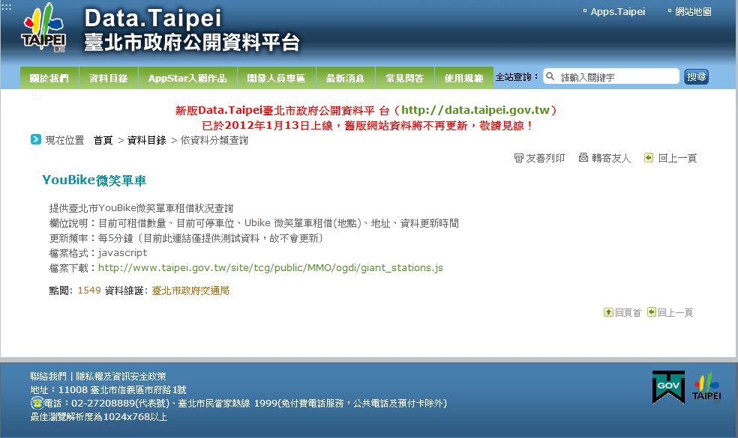
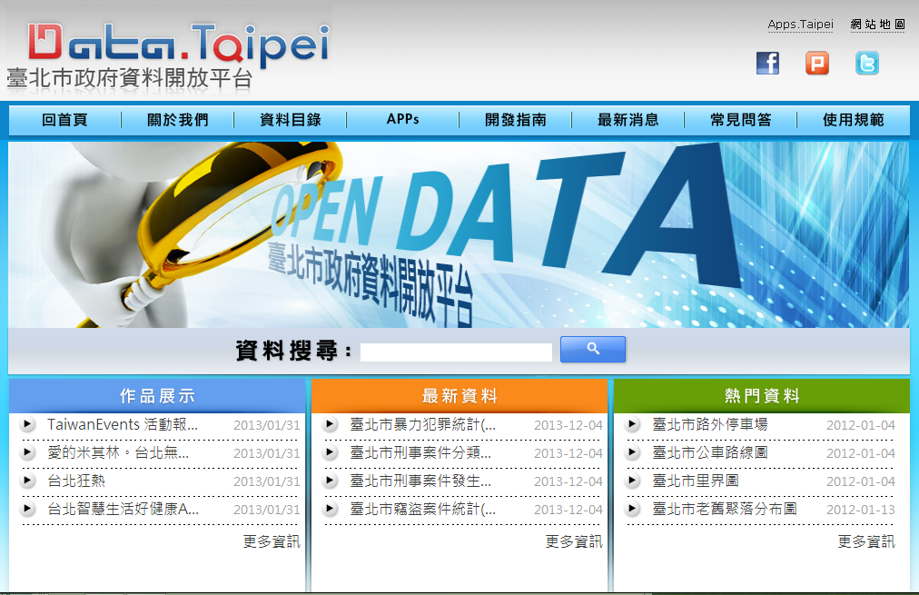
Taipei API
http://210.69.61.60:8080/you/gwjs_cityhall.json

Slide 6
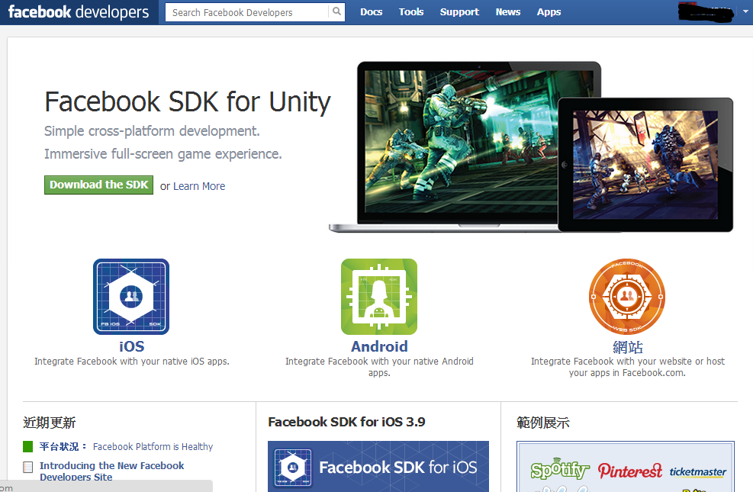
Facebook API
Connected with FB, add a location to post,
comment.

Slide 7
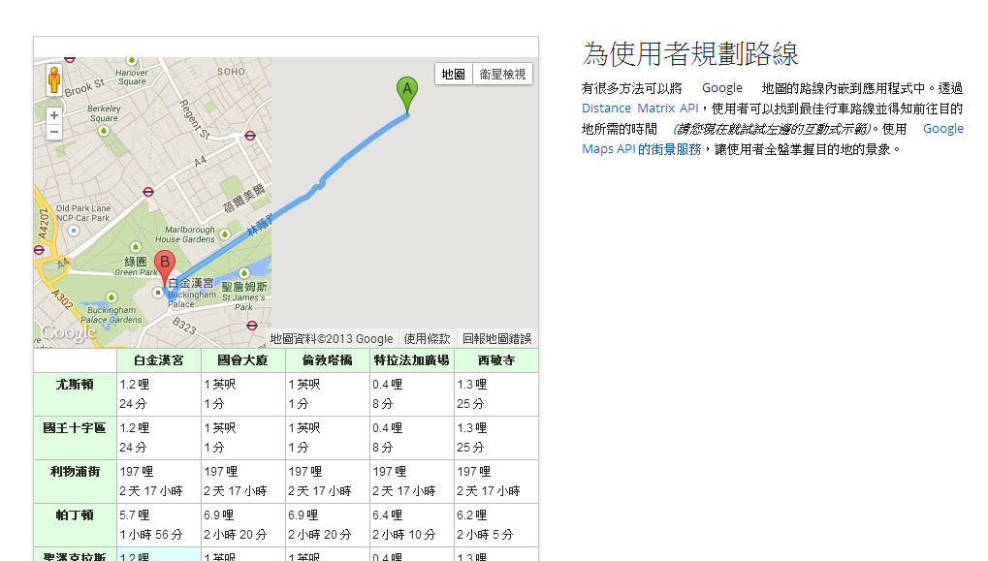
Google Maps API
Use Google Maps positioning system, helping us
save money route.

Slide 8
The difficulties
Regularly updated information
Parsing JSON file
How to create a saving money algorithm

Slide 9
Solution
Regularly updated information
Parsing JSON file

Slide 10
Solution(con’d) saving money algorithm
A:start B:finish
1.set V(speed) & T(time) get D(distance)
2.set point A as center, D as radius,
draw circle A, if point B in circle A, end process;
otherwise continue to the next step
3.get sites in circle A, calculate the distance
between point B and each site
4.find the point C which has the shortest
distance to point B
5.set point C as point A, repeat step 2 to 4

Slide 11
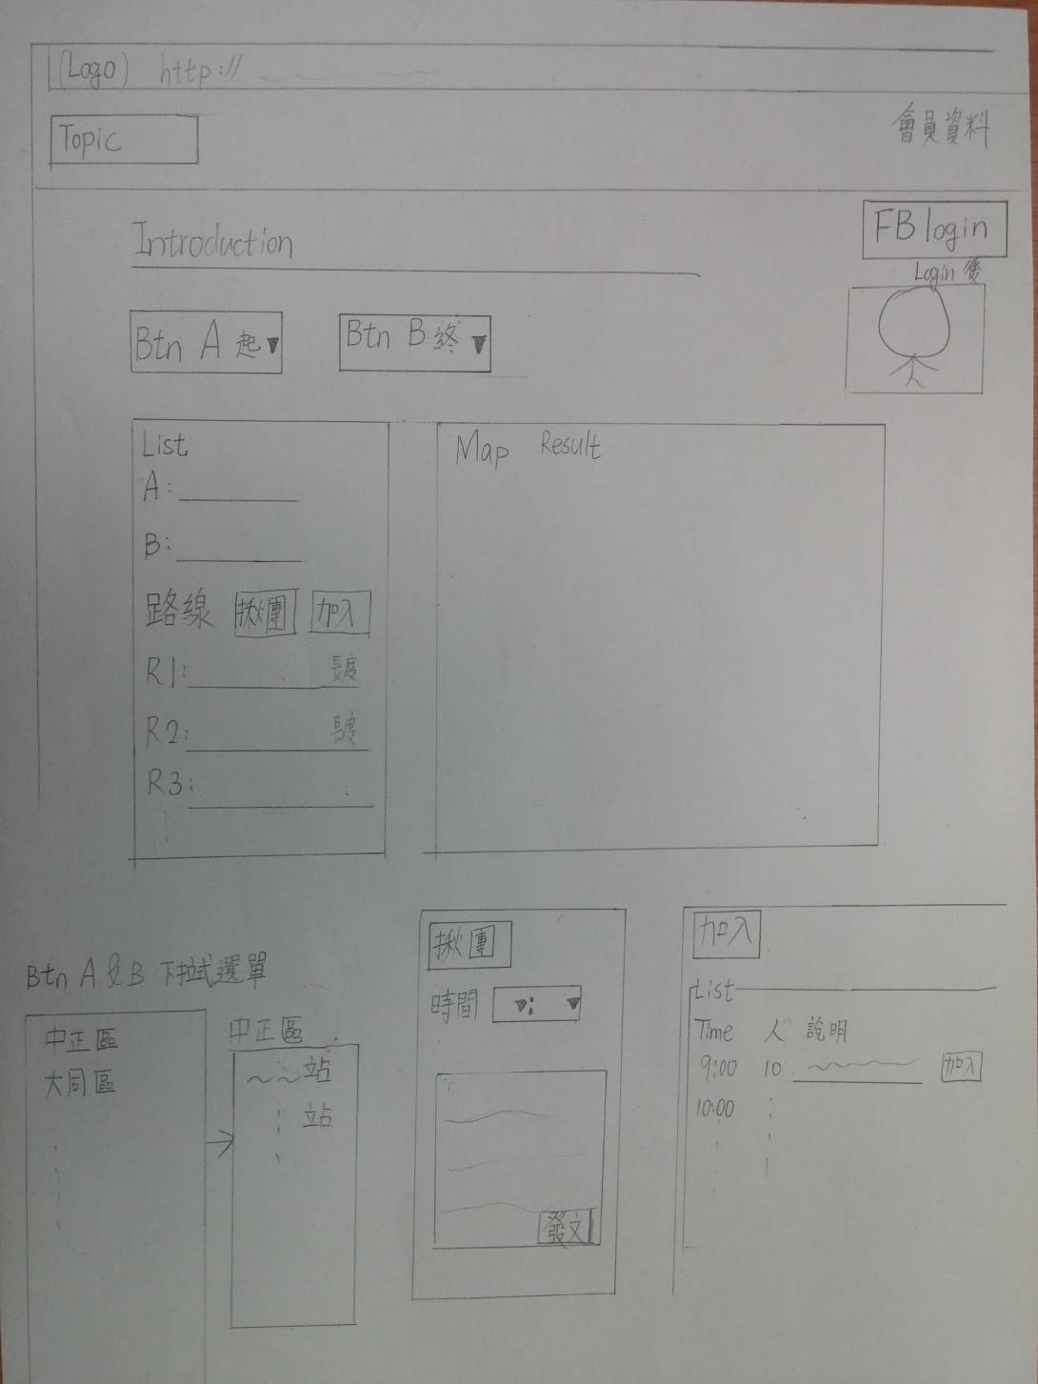
介面圖

Slide 12
THE END

