Slide 1
NASA SPACE APPS 2026
SoilSight
Earth data. Farm wisdom.
An explainable crop-rotation and climate-adaptation planner that turns NASA Earth data into field-level planning conversations.
FIELD SHIFT
Adapting Farms with NASA Data
Independent challenge prototype · November 2026

Slide 2
THE PROBLEM
02
Farm decisions are local. Climate data is not.
Farmers must act before uncertainty becomes visible in the field.
1
CLIMATE VOLATILITY
2
FRAGMENTED EVIDENCE
3
COMPETING PRIORITIES
4
TRUST GAP
Changing heat and rainfall shift sowing windows, water demand and seasonal risk.
NASA observations, soil estimates and crop requirements live in separate technical systems.
Water, soil health, market value and resilience rarely point to the same rotation.
A score without sources, assumptions or explanations is difficult to act on.
THE DESIGN QUESTION
How might we turn regional Earth data into an understandable, farmer-controlled crop-rotation decision?
SOILSIGHT · NASA SPACE APPS 2026 · INDEPENDENT CHALLENGE PROTOTYPE
02

Slide 3
OFFICIAL RESOURCE ALIGNMENT
03
What the Field Shift challenge asks us to connect
The solution must be a decision-support tool—not simply another agricultural dashboard.
1
NASA Earth observations
Regional environmental context
THE REQUIRED COMPARISON
Local soil information
Field conditions and limitations
At least three rotation strategies—including the farmer’s existing practice.
2
3
Crop characteristics
Growing windows and agronomic traits
SoilSight now evaluates editable current practice beside Soil-first and Water-saver alternatives.
4
Farmer priorities
Water, soil, market and resilience
CORE NOW
NASA POWER · MODIS via GIBS
ROADMAP
SMAP · GPM · HLS · ECOSTRESS · GRACE · SRTM · GEDI
SOILSIGHT · NASA SPACE APPS 2026 · INDEPENDENT CHALLENGE PROTOTYPE
03

Slide 4
THE SOLUTION
04
From a drawn boundary to an explainable plan
One continuous workflow keeps data, decisions and uncertainty connected.
1
2
3
4
5
6
7
DRAW
LOAD
SCREEN
COMPARE
WEIGH
STRESS
ACT
Field boundary
NASA climate
12-month risk
Three rotations
Farmer priorities
Hotter / drier
Season plan
OUTPUT
A ranked rotation, monthly water gaps, plain-language “why”, assumptions, and an exportable action plan.
SOILSIGHT · NASA SPACE APPS 2026 · INDEPENDENT CHALLENGE PROTOTYPE
04

Slide 5
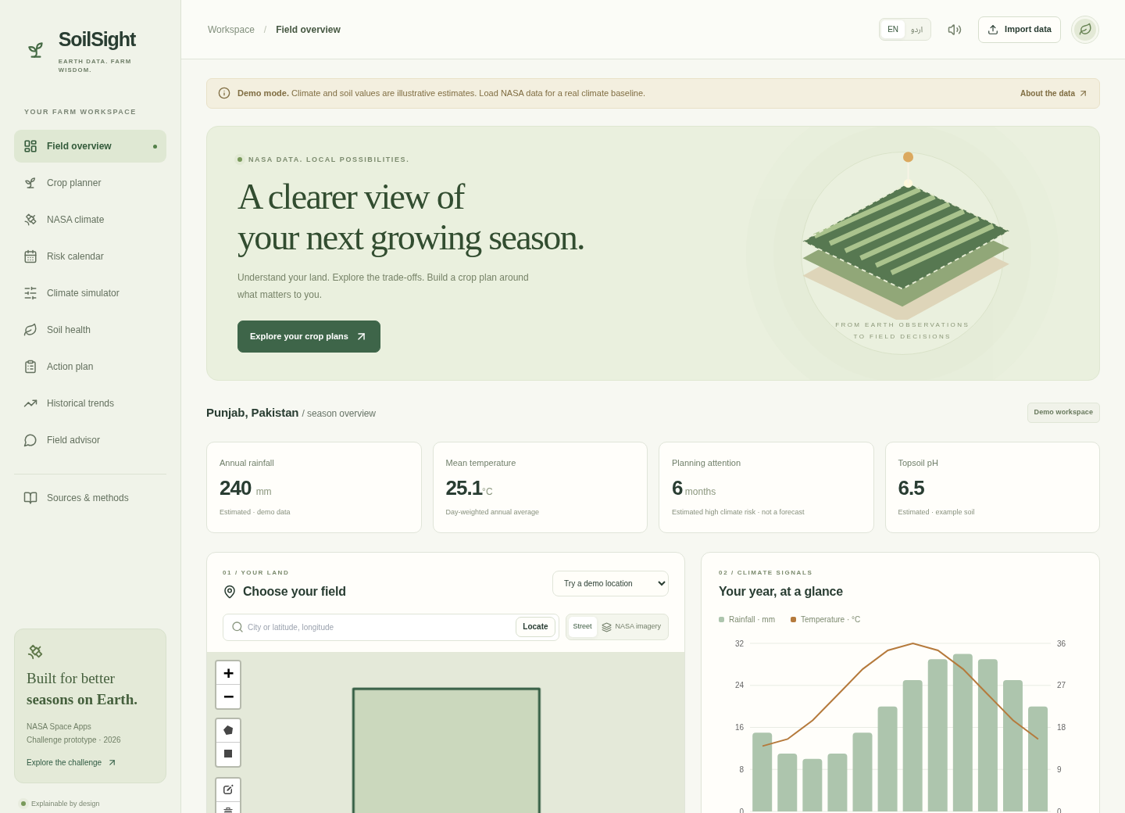
THE PRODUCT
05
A farm workspace built around one selected field
FIELD CONTEXT
The farmer draws or edits a polygon. Its area is calculated, and its centre selects the regional NASA grid cell.
VISIBLE AT A GLANCE
• Annual rainfall
• Mean temperature
• Months needing attention
• Estimated topsoil pH
Demo values remain visibly labelled until live NASA data is loaded.
SOILSIGHT · NASA SPACE APPS 2026 · INDEPENDENT CHALLENGE PROTOTYPE
05

Slide 6
THE EVIDENCE
06
NASA resources: what drives the score—and what does not
A precise boundary between implemented evidence and future layers protects scientific credibility.
CORE QUANTITATIVE SOURCE
CONTEXTUAL MAP
CHALLENGE RESOURCE ROADMAP
NASA POWER
MODIS Terra imagery via NASA GIBS. Visible behind the boundary; never used to calculate a recommendation.
SMAP / ECOSTRESS
Water stress
• Temperature: T2M_MIN / MAX / MEAN
• Precipitation: PRECTOTCORR
• Wetness indices: GWETROOT / GWETPROF
• 15 complete years for descriptive trends
GPM IMERG
Rainfall detail
Landsat / HLS
Cover history
COMPLEMENTARY INPUT
GRACE-FO
Groundwater trend
ISRIC SoilGrids estimates for 0–30 cm plus an illustrative crop library. Both labelled non-NASA and estimated.
SRTM / GEDI
Terrain / structure
Regional model grid ≈ 0.5° × 0.625°
Future datasets are disclosed as roadmap items—not silently implied in today’s score.
SOILSIGHT · NASA SPACE APPS 2026 · INDEPENDENT CHALLENGE PROTOTYPE
06

Slide 7
CLIMATE INTERPRETATION
07
A 12-month risk calendar, not a weather forecast
Monthly climate patterns become planning attention signals.
J
F
M
A
M
J
J
A
S
O
N
D
COLD STRESS
Monthly minimum temperatures
HEAT STRESS
Monthly maximum temperatures
RAINFALL DEFICIT
Low monthly precipitation
EXCESS RAIN
High monthly precipitation
IMPORTANT
Monthly averages cannot predict flooding, frost events or next week’s weather.
SOILSIGHT · NASA SPACE APPS 2026 · INDEPENDENT CHALLENGE PROTOTYPE
07

Slide 8
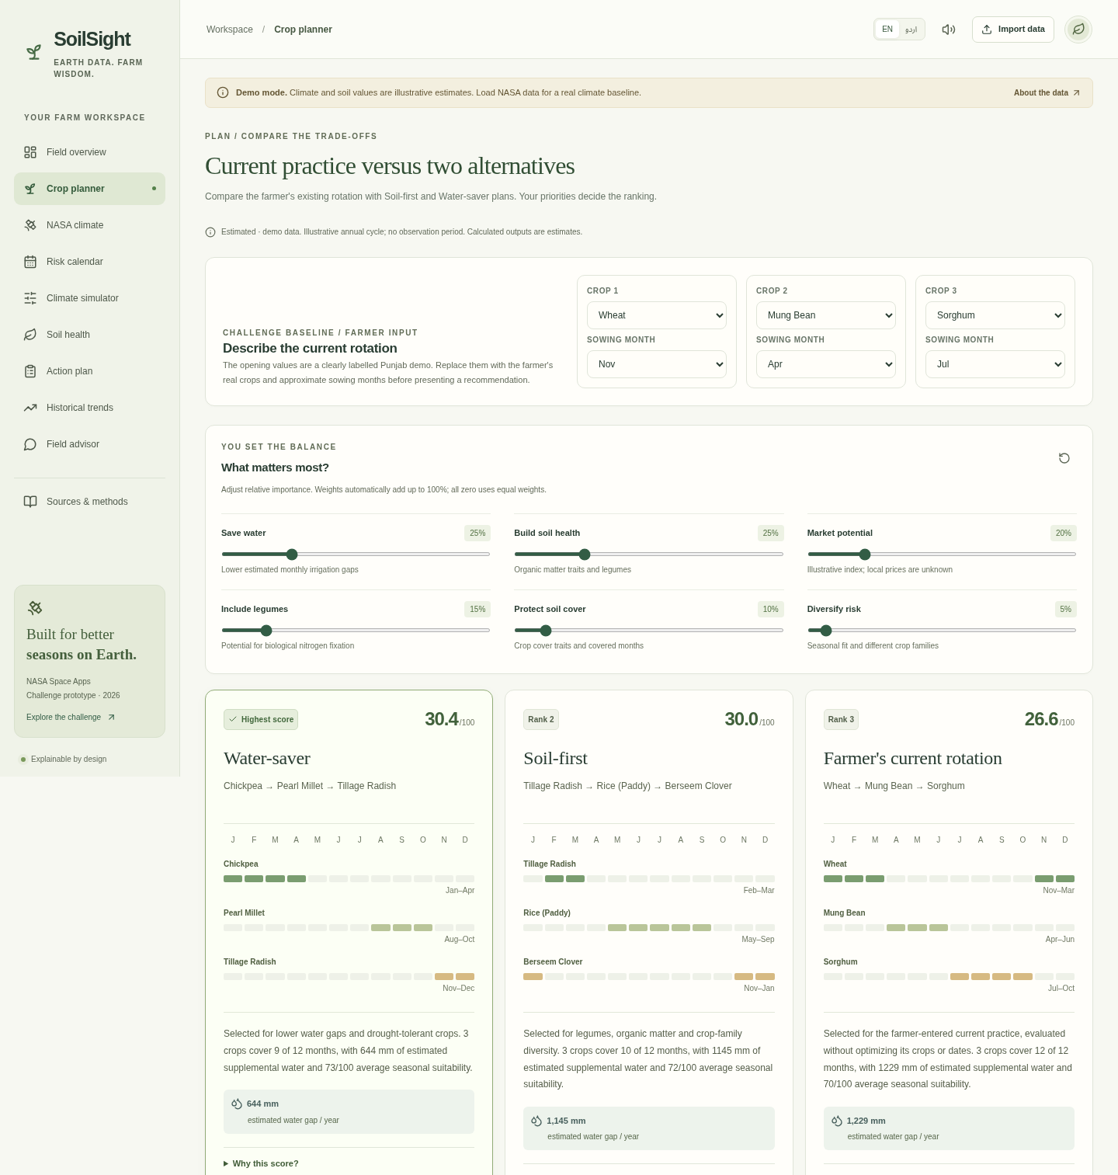
THE DECISION
08
Current practice versus two generated alternatives
1 CURRENT PRACTICE
Editable crops + sowing months. Evaluated as entered.
2 SOIL-FIRST
Rewards legumes, organic-matter traits and family diversity.
3 WATER-SAVER
Favors drought tolerance and lower monthly water gaps.
The farmer’s priorities rank all three using the same transparent score.
SOILSIGHT · NASA SPACE APPS 2026 · INDEPENDENT CHALLENGE PROTOTYPE
08

Slide 9
EXPLAINABILITY
09
Every ranking can be taken apart
Six user-controlled priorities become normalized weights and visible score contributions.
SAVE WATER
25%
EXAMPLE SCORE TRACE
SOIL HEALTH
25%
Water conservation
82.0
MARKET
20%
× 25% normalized weight
LEGUMES
15%
20.5 points
SOIL COVER
10%
The displayed overall score is the actual weighted sum used to rank plans—not a success probability.
DIVERSITY
5%
All-zero priorities → equal weights. Every criterion, weight and contribution remains visible.
SOILSIGHT · NASA SPACE APPS 2026 · INDEPENDENT CHALLENGE PROTOTYPE
09

Slide 10
STRESS TESTING
10
What if the same plan faces a hotter, drier season?
The simulator holds crops and dates fixed, then recalculates suitability, ET₀, water gaps and rank.
MONTHLY WATER BALANCE
SENSITIVITY CONTROLS
Crop need
=
ET₀ × Kc × stage factor
Temperature
+2.0°C
Water gap
=
max(0, need − 80% rain)
Rainfall
−20%
Field volume = water gap × area
Not an IPCC scenario or forecast. It answers: “Does this exact plan remain competitive under changed assumptions?”
Planning estimate—not an irrigation schedule.
SOILSIGHT · NASA SPACE APPS 2026 · INDEPENDENT CHALLENGE PROTOTYPE
10

Slide 11
TRUST BY DESIGN
11
Every figure says what kind of evidence it is
Confidence labels travel with the data, calculations and exported plan.
OBSERVED
MODELLED
ESTIMATED
Direct measurements with documented provenance.
Live NASA POWER regional reanalysis.
SoilGrids, crop traits, scores and scenarios.
Currently reserved—no field-observation claim.
Not a field sensor or weather forecast.
Requires local validation before action.
EXPERT REVIEW BANNER
Validate cultivars, planting windows, water access, prices and a current soil test with a local agronomist.
SOILSIGHT · NASA SPACE APPS 2026 · INDEPENDENT CHALLENGE PROTOTYPE
11

Slide 12
ENGINEERING
12
A deployable browser application with no API secrets
Static architecture reduces cost, deployment risk and demo-day failure points.
INTERFACE
React · TypeScript · responsive · Urdu / RTL
VERIFIED BUILD
44
calculation & data tests
GEOSPATIAL
Leaflet · drawing · spherical area · centroid
8
browser journeys
DECISION ENGINE
Seasonal screening · scoring · irrigation · stress
0
known npm vulnerabilities
PUBLIC DATA
NASA POWER · GIBS · SoilGrids · OSM / Nominatim
Static dist/ deploy · no backend required
SOILSIGHT · NASA SPACE APPS 2026 · INDEPENDENT CHALLENGE PROTOTYPE
12

Slide 13
WHY IT MATTERS
13
SoilSight continues where a dashboard usually stops
The innovation is the connection between evidence, trade-offs and farmer agency.
1
CONTEXT
2
EVIDENCE
3
CHOICE
A real field boundary anchors every query.
NASA climate becomes seasonal signals.
Priorities change the result transparently.
4
EXPLANATION
5
ADAPTATION
6
ACTION
Every rank exposes its contributions.
The same plan can be stress-tested.
The winner becomes a portable season plan.
NASA sees the environment. Farmers define what matters. SoilSight makes the trade-off visible.
SOILSIGHT · NASA SPACE APPS 2026 · INDEPENDENT CHALLENGE PROTOTYPE
13

Slide 14
NEXT
14
From challenge prototype to locally validated tool
A focused roadmap deepens evidence without hiding uncertainty.
NOW
POWER climate · current rotation · 3-way comparison · water gaps · stress test
1
VALIDATE
Local agronomist review · cultivar windows · soil tests · market assumptions
2
ENRICH
SMAP / GPM / ECOSTRESS validation · SRTM erosion · HLS field-cover history
3
REACH
Complete Urdu review · voice testing · low-bandwidth deployment · farmer trials
4
SUCCESS MEASURE · A farmer can explain why one rotation fits their priorities better than another.
SOILSIGHT · NASA SPACE APPS 2026 · INDEPENDENT CHALLENGE PROTOTYPE
14

Slide 15
SOILSIGHT
A planning conversation,
before a planting decision.
NASA Earth data + local knowledge + farmer priorities
THE PROMISE
Explainable by design. Honest about uncertainty. Built for better seasons on Earth.
Thank you

Slide 16
APPENDIX
16
Primary sources and methods
URLs remain editable and clickable in the presentation.
Official Field Shift resources
spaceappschallenge.org/2026/challenges/adapting-farms-with-nasa-data/?tab=resources
NASA POWER API
power.larc.nasa.gov/docs/services/api/
NASA GIBS
nasa-gibs.github.io/gibs-api-docs/
NASA SMAP / GPM
smap.jpl.nasa.gov/data/ · gpm.nasa.gov/data
NASA HLS / ECOSTRESS
earthdata.nasa.gov/data/projects/hls · ecostress.jpl.nasa.gov
NASA GRACE / SRTM / GEDI
grace.jpl.nasa.gov/data · earthdata.nasa.gov/data/instruments/srtm · gedi.umd.edu
ISRIC SoilGrids
docs.isric.org/globaldata/soilgrids/
FAO-56 / EcoCrop context
fao.org/4/x0490e/x0490e00.htm · gaez.fao.org/pages/ecocrop
NASA supplies data; it has not validated or endorsed SoilSight’s crop recommendations.
SOILSIGHT · NASA SPACE APPS 2026 · INDEPENDENT CHALLENGE PROTOTYPE
16

