Slide 1
Food and Drug Safety in the US
Damien Amzallag, Skye Nadel

Slide 2
Food Questions
What are the safest food industries?
Those with the least amount of recalls, and negative effect cases reported
Analysis of outcome of top 5 worst industries
Most amount of recalls and analyze what these have in common
What are the states with the most food recalls?

Slide 3
Drugs Questions
What are the most recalled drug companies and industries
Are over the counter drugs as safe or less safe than prescription drugs?
Percentage wise which has more recalls over the years, least complaints as well
Do certain years have an unusual spike in recall numbers or adverse effect reports?
What are the states with the most recalls?

Slide 4
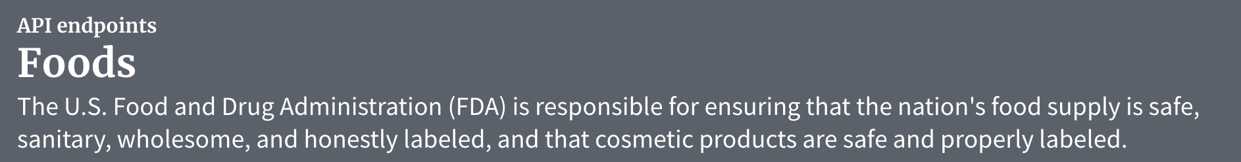
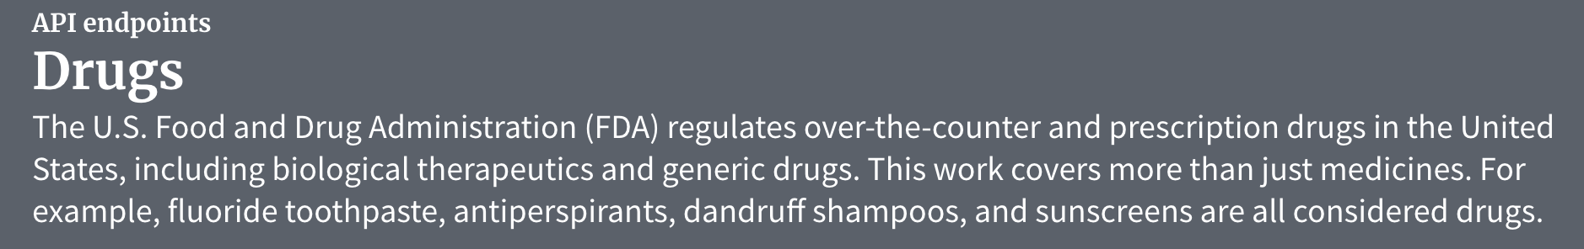
Data collection
Data.gov has datasets regarding food and drug recalls, as well as recorded side effects for certain industries.

Slide 5
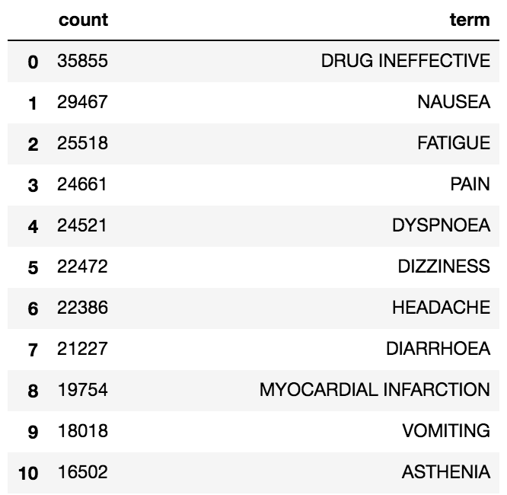
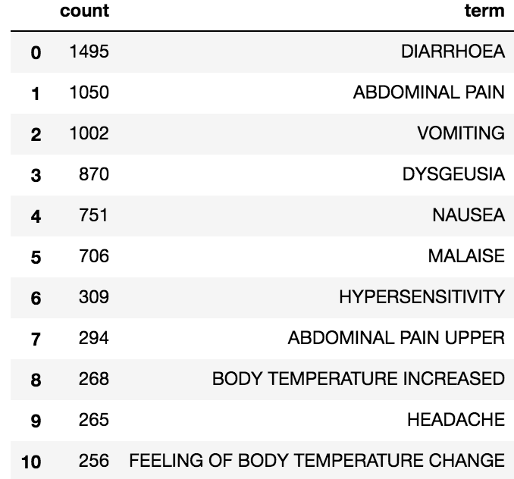
Example: preliminary results for types of complaints
Complaints all Drugs since 2004
Breakfast food complaints since 2004

Slide 6
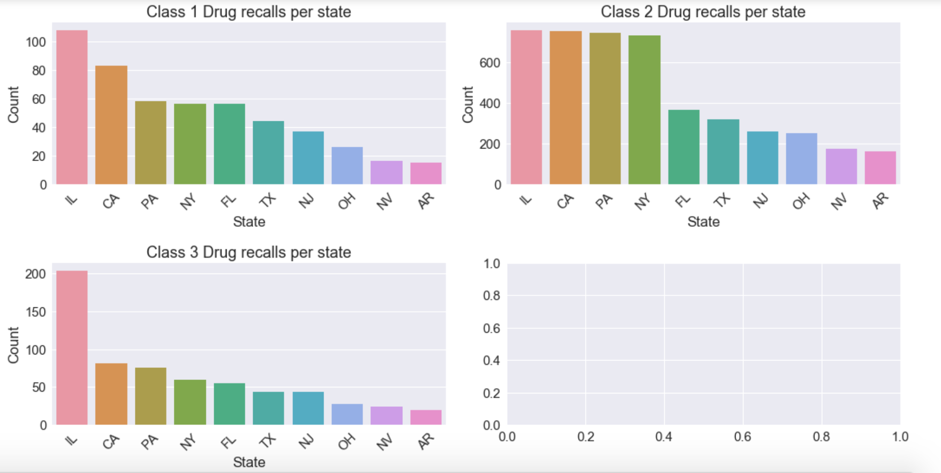
Example: drug recalls per state
Class 1: Reasonable probability that using the drug will cause serious adverse health consequences or death.
Class 2: Using the drug may cause temporary or medical reversible adverse health consequences, the probability of serious adverse health consequences is remote
Class 3: Using the drug is not likely to cause adverse health consequences.

