Slide 1
Implementing
Active contours without edges
Tony F. Chan & Luminita A. Vese
A logic framework for active contours on multi-channel images
Berta Sandberg & Tony F. Chan
Project by: Sarah Nadi & Karim Ali
Dec. 13Th 2010 – CS 870

Slide 2
Outline
Active contours without edges
  Motivation
  Model
  Level set formulation
  Experimental results
Logic framework for multichannel images
  Motivation
  Logic operations
  Level set formulation
  Experimental results
Conclusions

Slide 3
Active Contour Models
Overview
  Detect objects in an image
  Use image gradient to evaluate the stopping condition
Limitations
  Can only detect edges defined by a gradient
    Edges can be smoothed
    Contour may pass through the boundary

Slide 4
Active Contours Without Edges (Chan-Vese)
Region based technique
Stopping is based on Mumford-Shah segmentation techniques
  No longer depends on gradient
  Detects smooth or discontinuous boundaries
Interior contours are automatically detected
Initial curve can be anywhere in the image

Slide 5
Region Based View
Imageu₀
(x₂,y₂)
(x₁,y₁)
Inside C
(x₃,y₃)
C
Outside C
(x₄,y₄)
Object

Slide 6
Region Based View
Imageu₀
To fit C to our object,
we want:
(x₂,y₂)
(x₁,y₁)
Inside C
(x₁,y₁) to be outside C
(x₂,y₂) to be outside C
(x₃,y₃) to be inside C
(x₄,y₄) to be inside C
(x₃,y₃)
C
Outside C
(x₄,y₄)
Object

Slide 7
Region Based View
Imageu₀
To fit C to our object,
we want:
(x₂,y₂)
(x₁,y₁)
c₁ = avg(u₀) inside
(x₁,y₁) to be outside C
(x₂,y₂) to be outside C
(x₃,y₃) to be inside C
(x₄,y₄) to be inside C
(x₃,y₃)
C
c₂ = avg(u₀) outside
(x₄,y₄)
Object

Slide 8
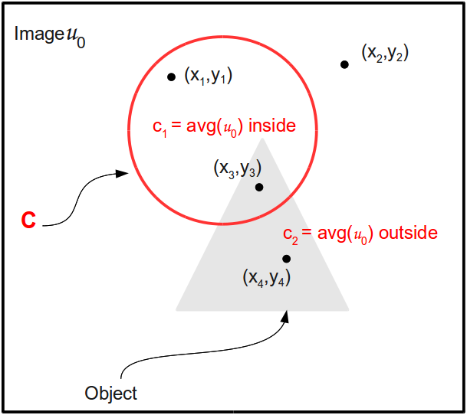
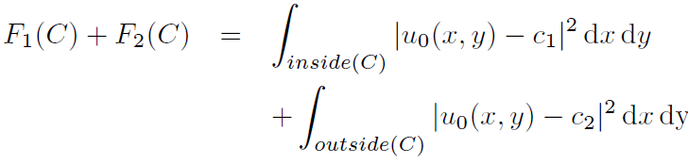
Curve Fitting
Fitting inside:
Fitting outside:
Overall fitting of C:

Slide 9


Intuition
C should stop evolving
when C = Object
To achieve that:
Fitting ≈ 0
F1(C) > 0, F2(C) ≈ 0
Fitting > 0
F1(C) ≈ 0, F2(C) > 0
Fitting > 0
F1(C) > 0, F2(C) > 0
Fitting > 0
F1(C) ≈ 0, F2(C) ≈ 0
Fitting ≈ 0

Slide 10
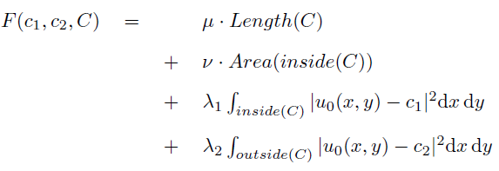




Level Set Formulation of Energy Function
Look at minimization problem:

Slide 11
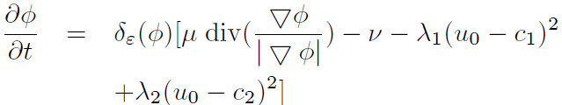
Chan-Vese Technique
  Initialize Φ⁰ by Φ₀, n = 0
  Compute c1(Φ^{n}) and c2(Φ^{n})
  Solve the PDE to obtain Φn+1
  Reinitialize Φ locally to the signed distance function to the curve (optional)
  Check whether the solution is stationary. If not n = n + 1 and repeat

Slide 12



Implementation
Finite difference discretization with an explicit time stepping scheme
Stopping condition:

Slide 13
Experimental Results

Slide 14
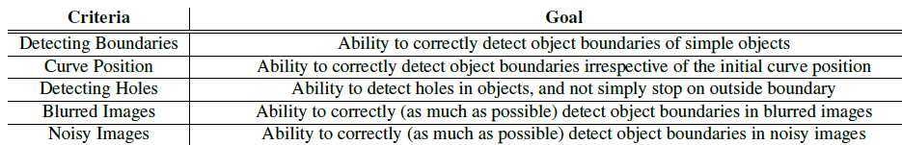
Evaluation Criteria

Slide 15
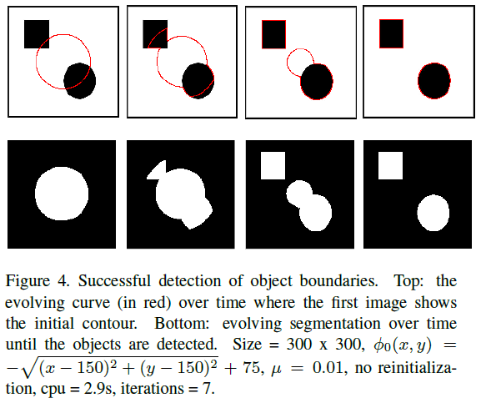
Detecting Boundaries

Slide 16
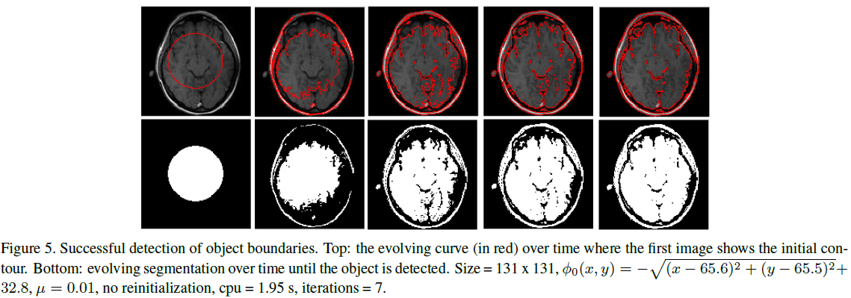
Detecting Boundaries Cont'd

Slide 17
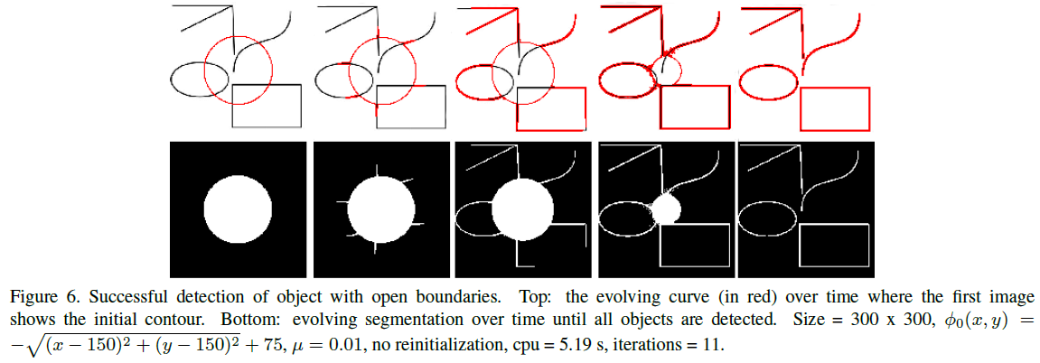
Detecting Boundaries Cont'd

Slide 18
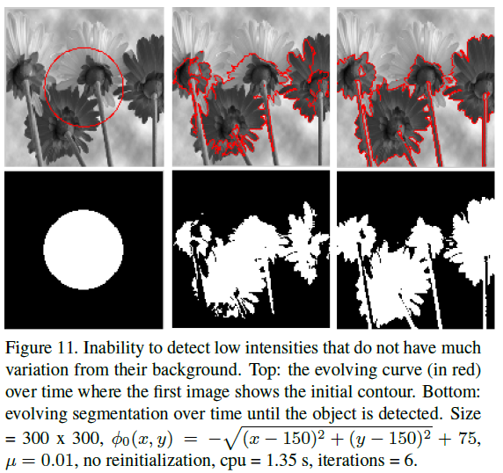
Detecting Boundaries Cont'd

Slide 19
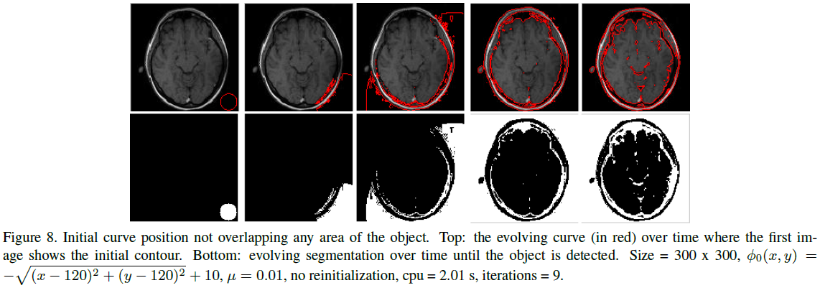
Initial Curve Position

Slide 20
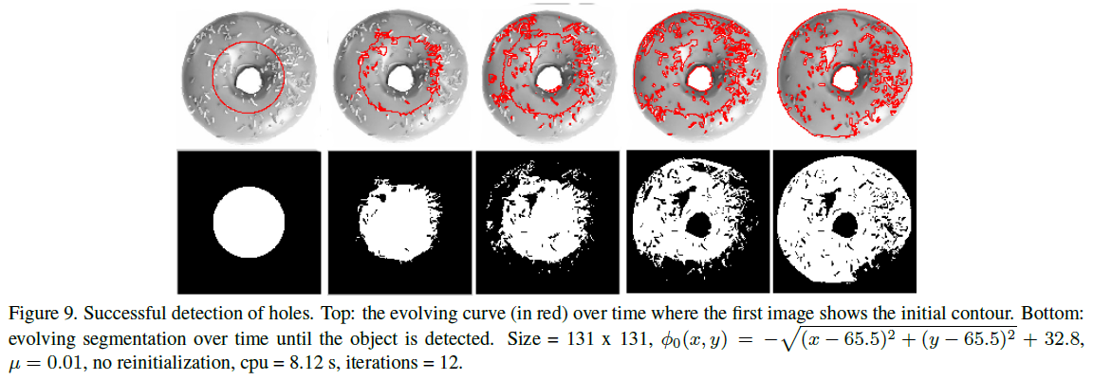
Detecting Holes

Slide 21
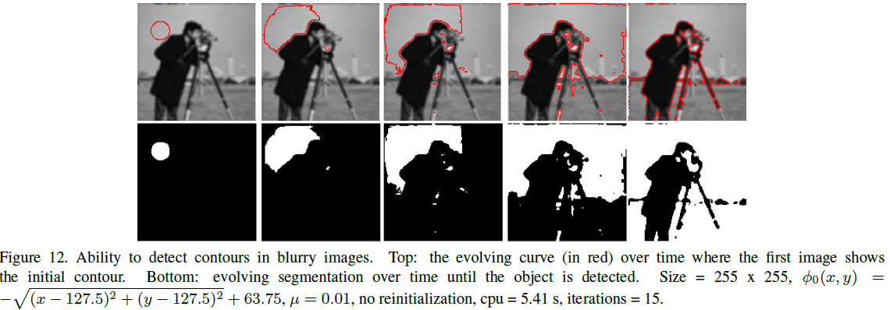
Blurry Images

Slide 22
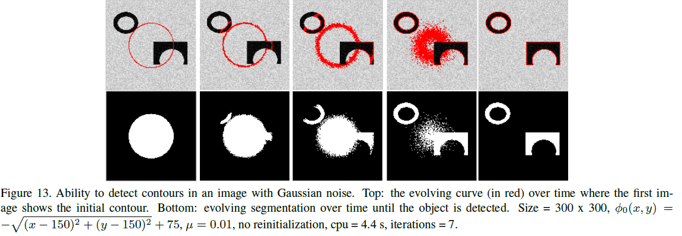
Noisy Images - Gaussian

Slide 23
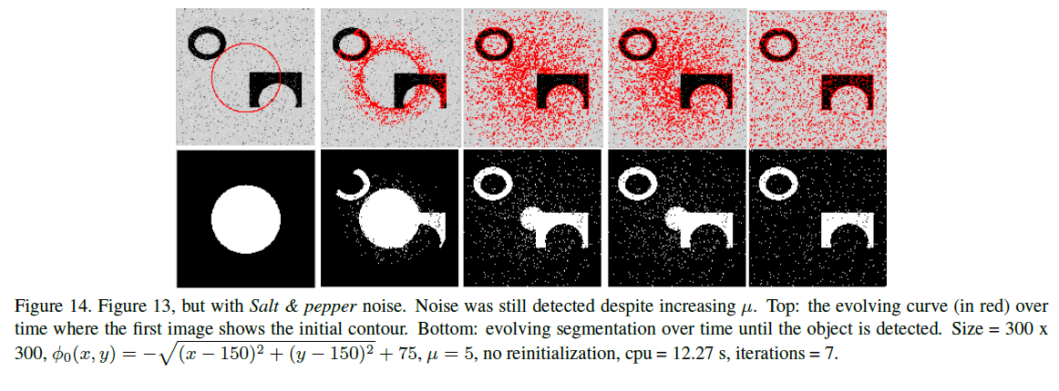
Noisy Images – Salt & Pepper

Slide 24
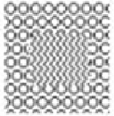
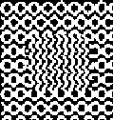
Textured Images
Image
Segmentation

Slide 25
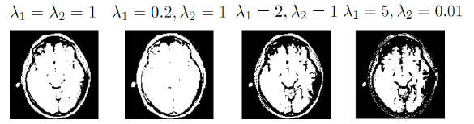
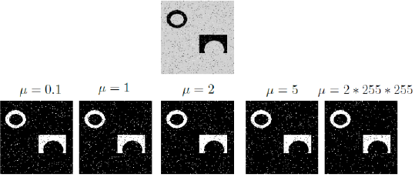
Varying Parameters

Slide 26
Summary of Results
Able to detect all kinds of boundaries including holes and open boundaries.
Able to perform well with blurry images
Able to perform well with Gaussian noise, but not “Salt & Pepper”
Inability to detect objects with small variation from background
Good response to change λ but not μ

Slide 27
Applying the Chan-Vese Model to Multi-channel Images

Slide 28
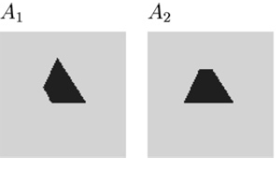
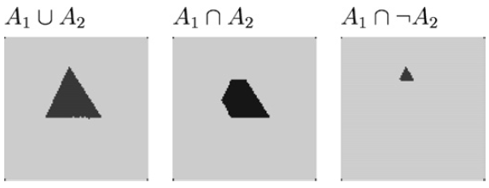
The Sandberg-Chan Framework
Allows the user to produce any logical combination of object channels

Slide 29
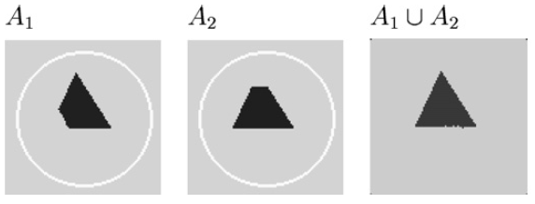
Proposed Solution
Use the Chan-Vese model, and compare the contour fitting on each channel
  Start with the same contour on each channel
  Fit contour to the object on ALL channels according to the logic operator & based on regions

Slide 30
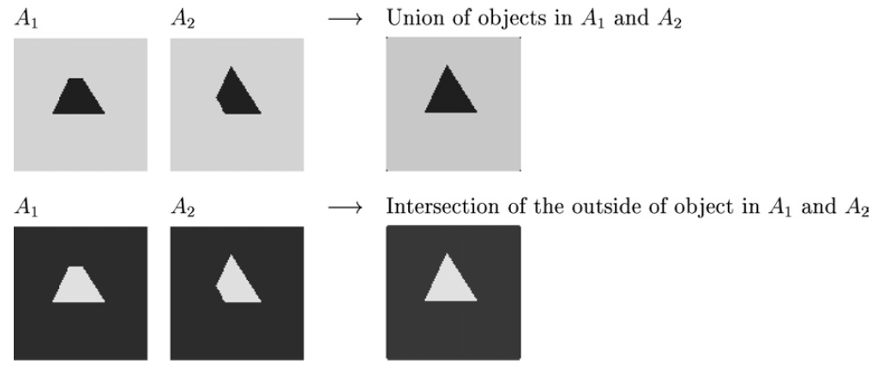
Region Based Logic Operations

Slide 31
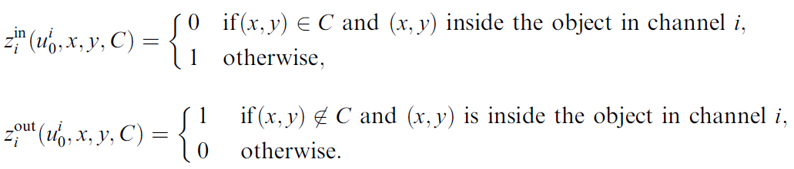
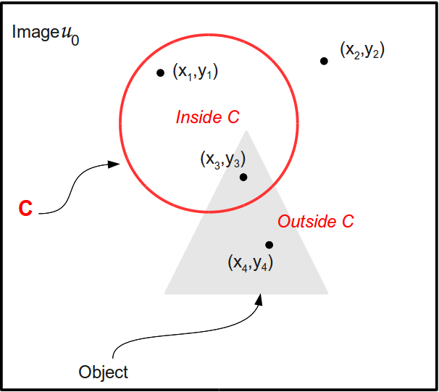
Logic Variables
Note:
0 is true because
we want to minimize
the fitting term
i

Slide 32
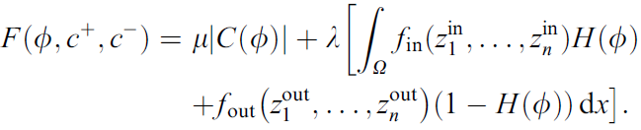


Level Set Formulation
Objective function
We want to minimize F
with the boundary condition
Notes:
Noisy image --> set λ in order of
Clean image --> set λ smaller so that noise is not included in the segmentation

Slide 33

Implementation
Finite difference discretization with an explicit time stepping scheme
Stopping condition:

Slide 34
Experiments

Slide 35
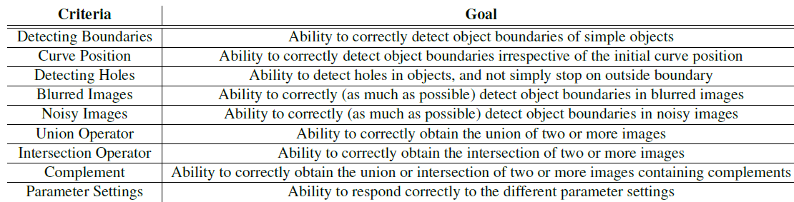
Evaluation Criteria

Slide 36
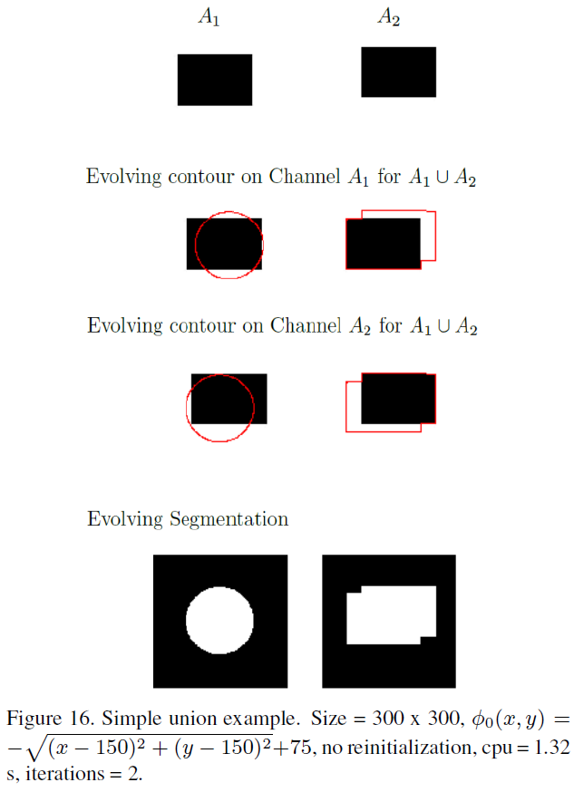
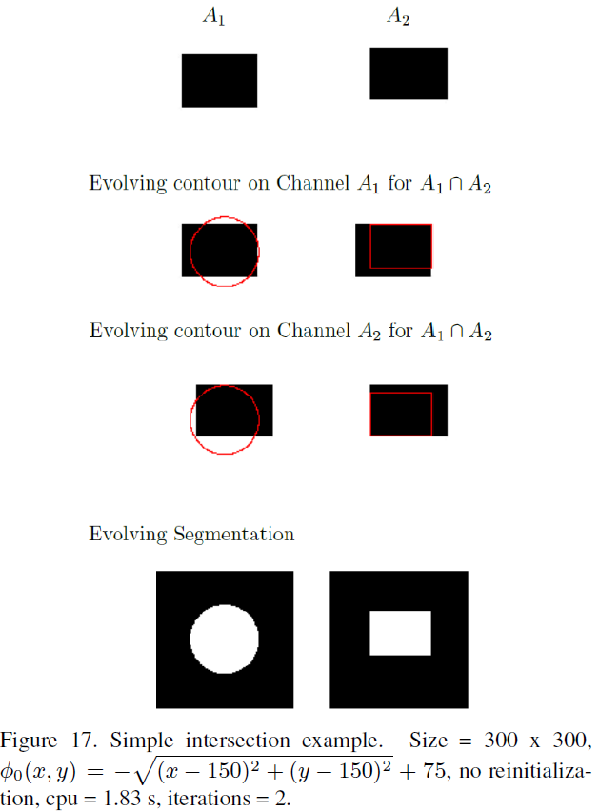
Simple Union & Intersection

Slide 37
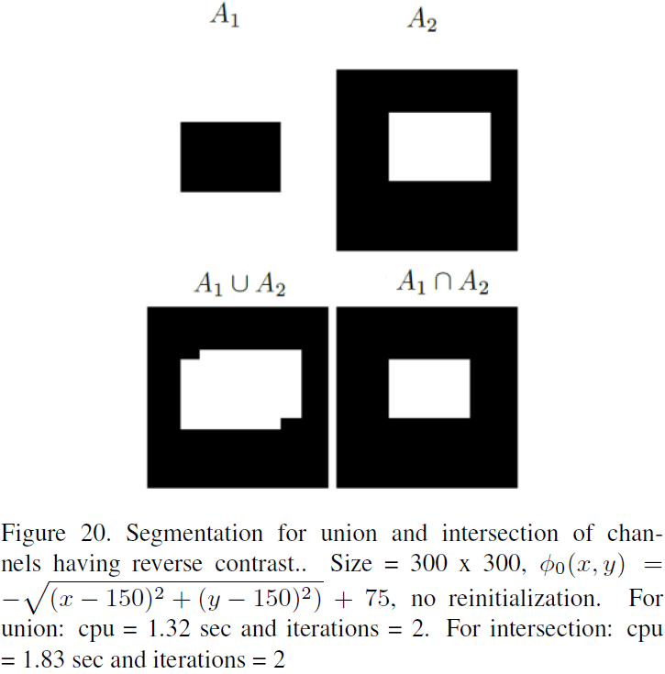
Simple Union & Intersection – Flipped Intensities

Slide 38
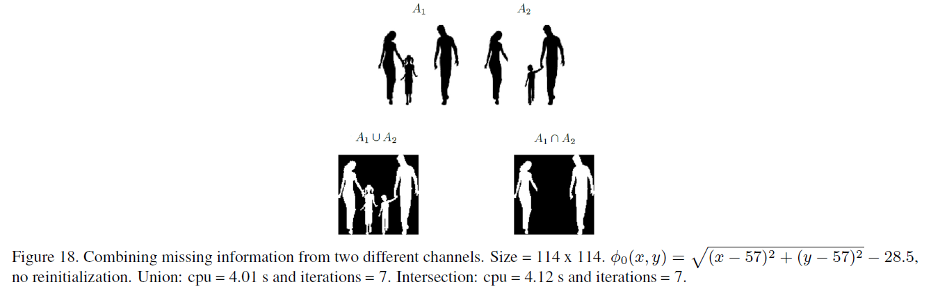
Occlusions

Slide 39
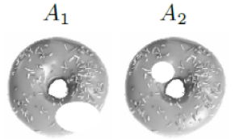
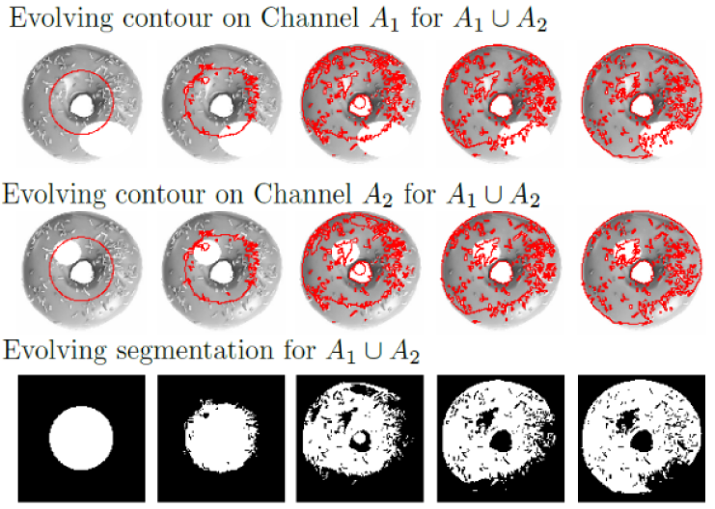
Union & Intersection with Holes

Slide 40
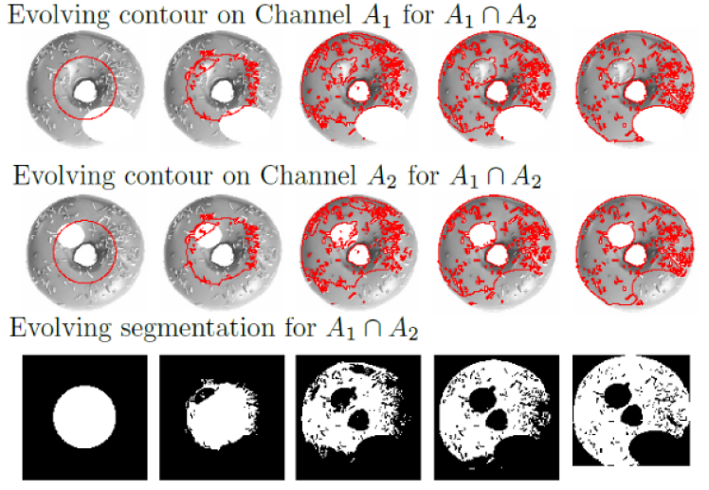
Union & Intersection with Holes

Slide 41
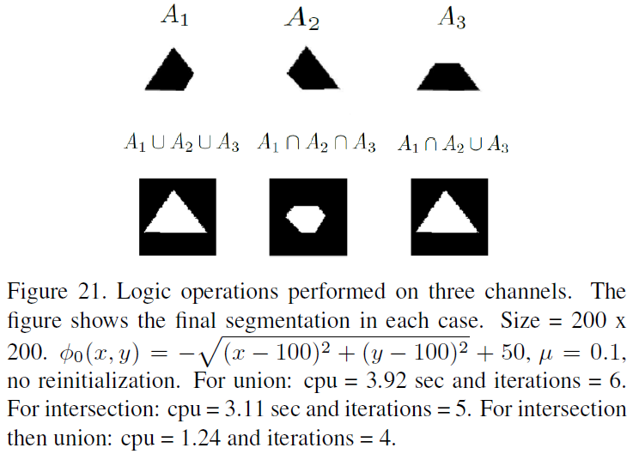
3 Channels

Slide 42
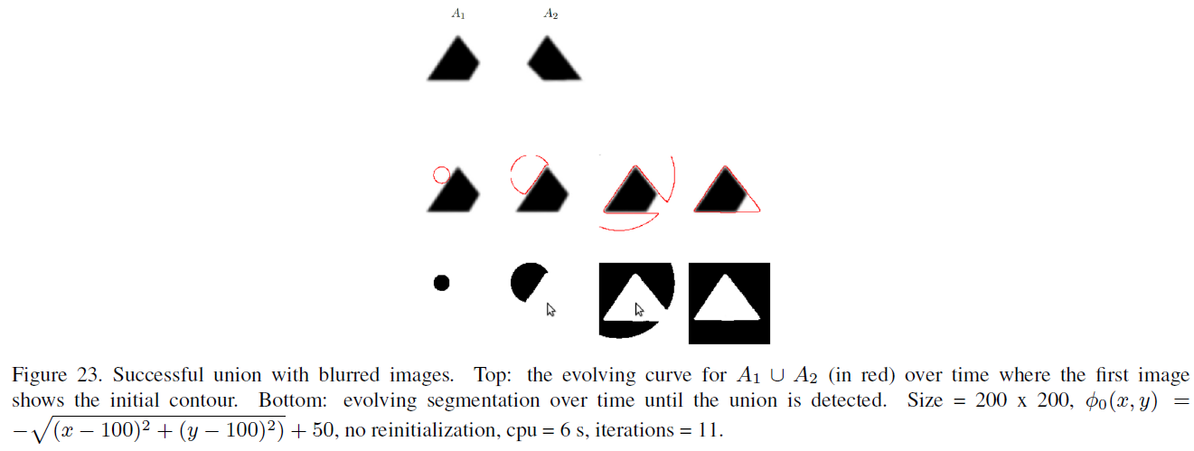
Blurred Edges

Slide 43
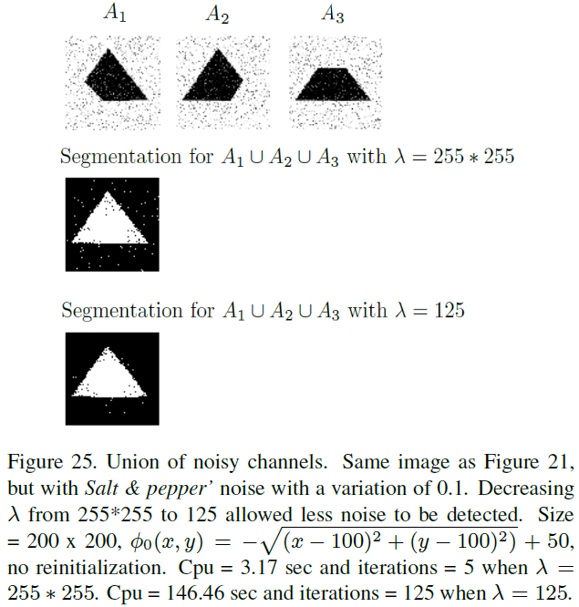
Noisy Images

Slide 44
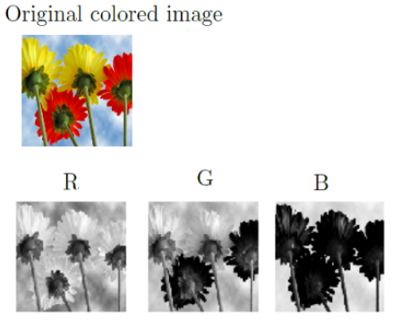
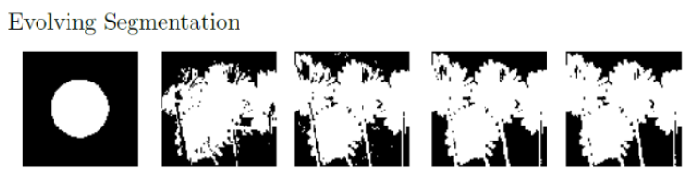
RGB Channels

Slide 45
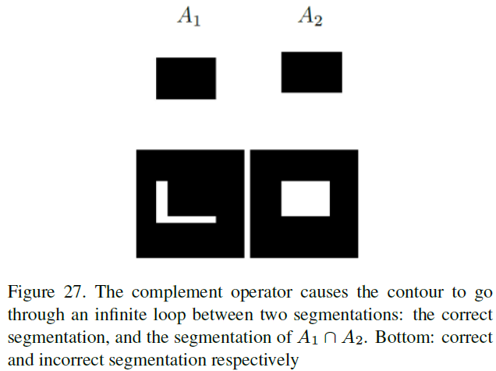
Complement

Slide 46
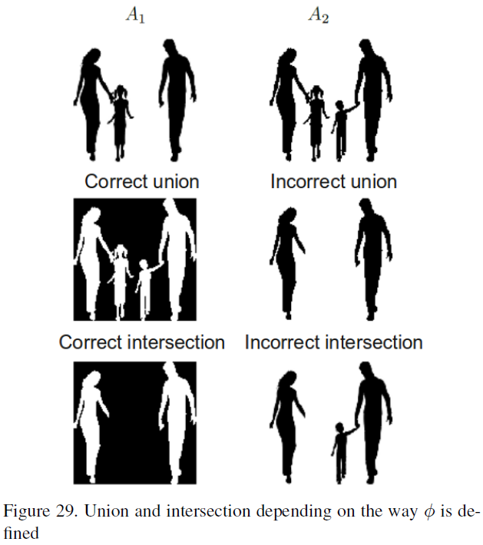
Defining Initial Phi

Slide 47
Summary of Results
Able to perform union & intersection on multiple channels
Able to perform well with blurry images
Able to perform well with noise
Detecting objects in RGB images
Good response to change in λ
Complement not working
Definition of initial phi varies results

Slide 48
Conclusions
Chan-Vese model
  Detects objects without edge information
  Must have variations in intensities to work
Sandberg-Chan logic framework
  Can combine multiple images using different logic operations

Slide 49
Thank you
???

