Slide 1
Active contours without edges
Tony F. Chan & Luminita A. Vese
A logic framework for active contours on multi-channel images
Berta Sandberg & Tony F. Chan
Presented by: Sarah Nadi & Karim Ali
Oct. 28Th 2010 – CS 870

Slide 2
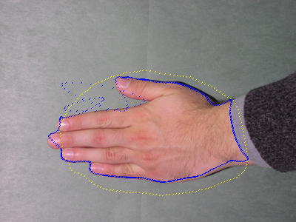

Big Picture
&
Combining multiple channels
Detecting objects in an image

Slide 3
Big Picture
&
Combining multiple channels
Detecting objects in an image
Chan-Vese model

Slide 4
Big Picture
&
Combining multiple channels
Detecting objects in an image
Chan-Vese model

Slide 5
Big Picture
&
Combining multiple channels
Detecting objects in an image
Sandberg-Chan framework
Chan-Vese model

Slide 6
Outline
Active contours without edges
  Motivation
  Model
  Level set formulation
  Experimental results
Logic framework for multichannel images
  Motivation
  Logic operations
  Level set formulation
  Experimental results
Conclusions

Slide 7
Active Contour Models
Overview
  Detect objects in an image
  Use image gradient to evaluate the stopping condition
Limitations
  Can only detect edges defined by a gradient
    Edges can be smoothed
    Contour may pass through the boundary

Slide 8
Active Contours Without Edges (Chan-Vese)
Region based technique
Stopping is based on Mumford-Shah segmentation techniques
  No longer depends on gradient
  Detects smooth or discontinuous boundaries
Interior contours are automatically detected
Initial curve can be anywhere in the image

Slide 9
Region Based View
Imageu₀
(x₂,y₂)
(x₁,y₁)
Inside C
(x₃,y₃)
C
Outside C
(x₄,y₄)
Object

Slide 10
Region Based View
Imageu₀
To fit C to our object,
we want:
(x₂,y₂)
(x₁,y₁)
Inside C
(x₁,y₁) to be outside C
(x₂,y₂) to be outside C
(x₃,y₃) to be inside C
(x₄,y₄) to be inside C
(x₃,y₃)
C
Outside C
(x₄,y₄)
Object

Slide 11
Region Based View
Imageu₀
To fit C to our object,
we want:
(x₂,y₂)
(x₁,y₁)
c₁ = avg(u₀) inside
(x₁,y₁) to be outside C
(x₂,y₂) to be outside C
(x₃,y₃) to be inside C
(x₄,y₄) to be inside C
(x₃,y₃)
C
c₂ = avg(u₀) outside
(x₄,y₄)
Object

Slide 12
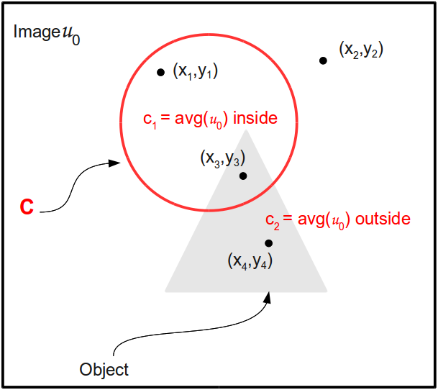
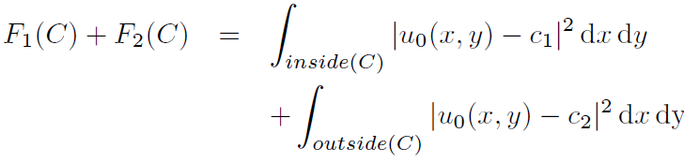
Curve Fitting
Fitting inside:
Fitting outside:
Overall fitting of C:

Slide 13


Intuition
C should stop evolving
when C = Object
To achieve that:
Fitting ≈ 0
F1(C) > 0, F2(C) ≈ 0
Fitting > 0
F1(C) ≈ 0, F2(C) > 0
Fitting > 0
F1(C) > 0, F2(C) > 0
Fitting > 0
F1(C) ≈ 0, F2(C) ≈ 0
Fitting ≈ 0

Slide 14
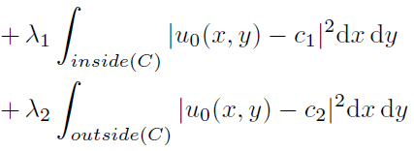
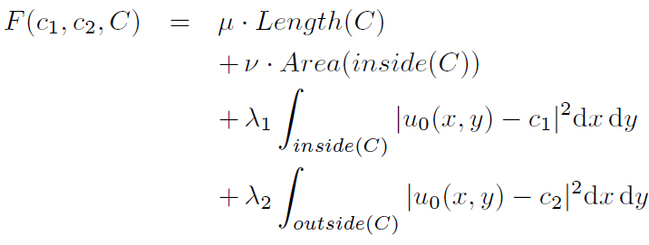
Energy Function
Notes:
If μ is small, length can increase & we can detect small objects. If μ is large, we only detect large objects
If ν is small, area can increase. ν is usually set to 0 to remove the effect of the area.
λ₁ and λ₂ are set to 1 to give equal weight to interior & exterior

Slide 15
Energy Function
Notes:
If μ is small, length can increase & we can detect small objects. If μ is large, we only detect large objects
If ν is small, area can increase. ν is usually set to 0 to remove the effect of the area.
λ₁ and λ₂ are set to 1 to give equal weight to interior & exterior

Slide 16

Energy Function
Look at minimization problem:
Notes:
If μ is small, length can increase & we can detect small objects. If μ is large, we only detect large objects
If ν is small, area can increase. ν is usually set to 0 to remove the effect of the area.
λ₁ and λ₂ are set to 1 to give equal weight to interior & exterior

Slide 17
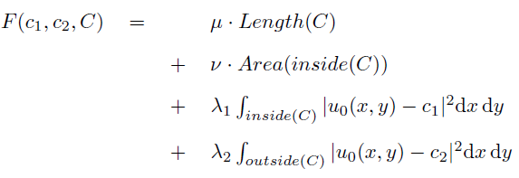
Level Set Formulation of Energy Function

Slide 18

Level Set Formulation of Energy Function

Slide 19

Level Set Formulation of Energy Function

Slide 20

Level Set Formulation of Energy Function

Slide 21
Level Set Formulation of Energy Function

Slide 22
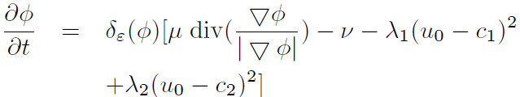
Chan-Vese Technique
  Initialize Φ⁰ by Φ₀, n = 0
  Compute c1(Φ^{n}) and c2(Φ^{n})
  Solve the PDE to obtain Φn+1
  Reinitialize Φ locally to the signed distance function to the curve (optional)
  Check whether the solution is stationary. If not n = n + 1 and repeat

Slide 23
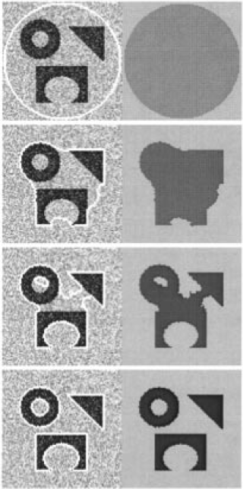
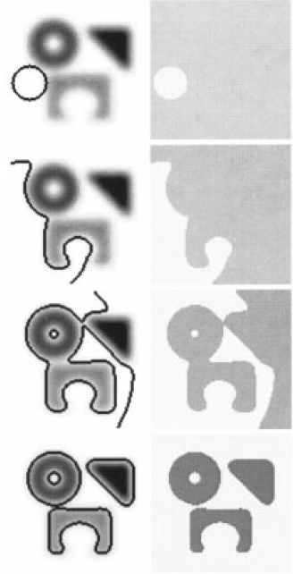
Experimental Results
Noisy Image
Blurry Image

Slide 24
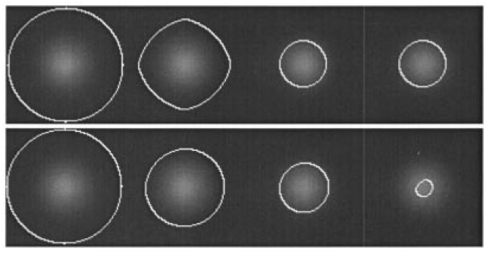
Comparing Models
Chan-Vese
Gradient based
active contour

Slide 25
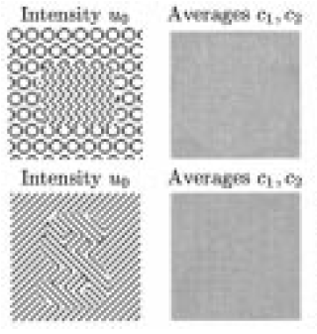
Limitations

Slide 26
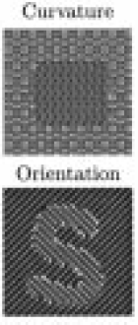
Limitations

Slide 27
Limitations
Or implement general case of Mumford-Shah function

Slide 28
Applying the Chan-Vese Model to Multi-channel Images

Slide 29
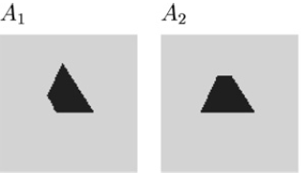
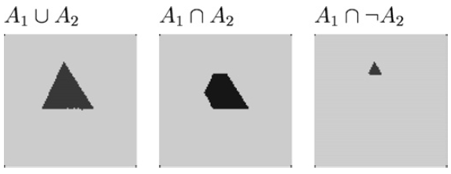
The Sandberg-Chan Framework
Allows the user to produce any logical combination of object channels

Slide 30
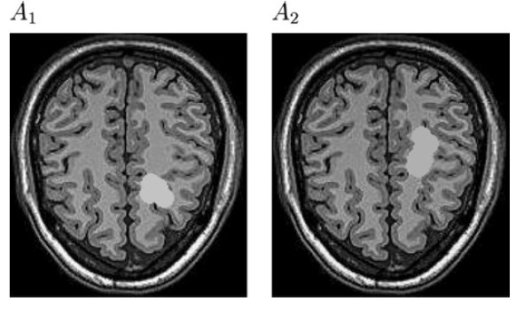


Motivating Example
New tumor growth
Tumor shrinking

Slide 31
Existing Techniques
Segment each channel independently followed by bitwise operations
  Costly
Perform logic operations on channels forming a combined image followed by segmentation
  Requires a lot of information about intensity

Slide 32
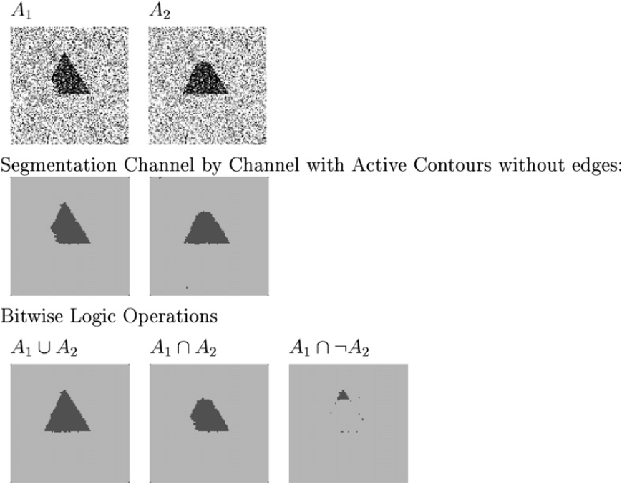
Technique 1

Slide 33
Technique 1

Slide 34
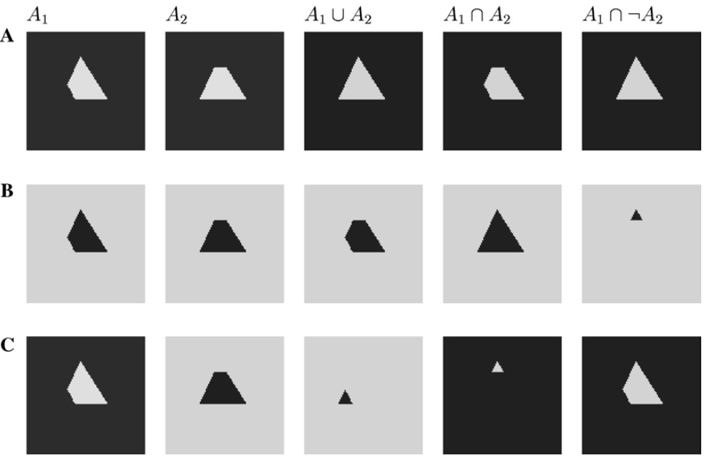
Technique 2

Slide 35
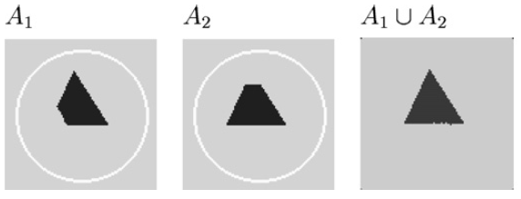
Proposed Solution
Use the Chan-Vese model, and compare the contour fitting on each channel
  Start with the same contour on each channel
  Fit contour to the object on ALL channels according to the logic operator & based on regions

Slide 36
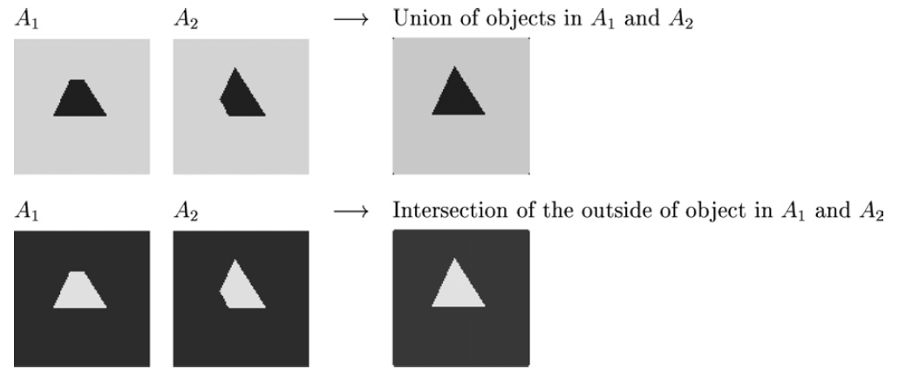
Region Based Logic Operations

Slide 37
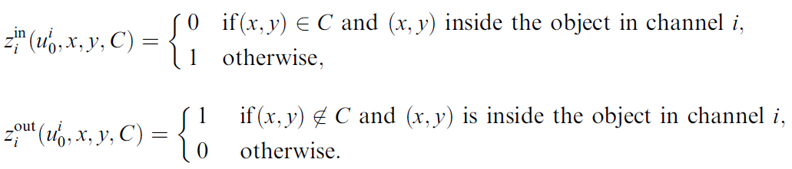
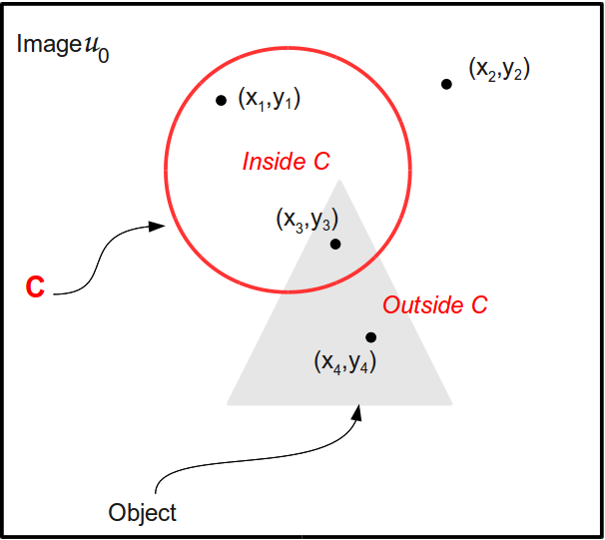
Logic Variables
Note:
0 is true because
we want to minimize
the fitting term

Slide 38
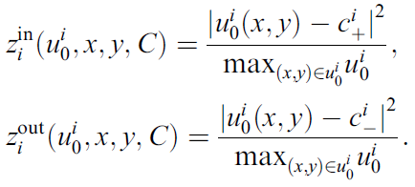

Chan-Vese Formulation

Slide 39
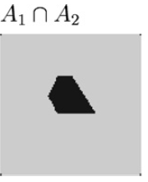
Concentrate on Intersection

Slide 40


Interpolation Functions
Intersection of inside
Union of outside

Slide 41

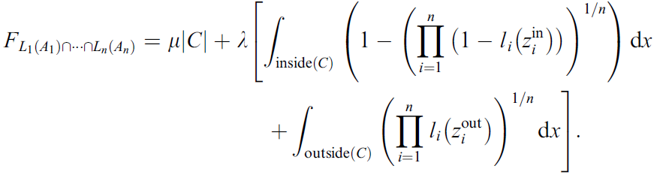
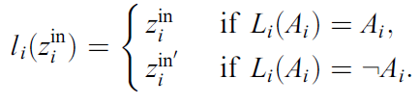
General Case

Slide 42
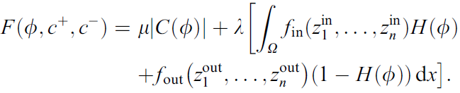
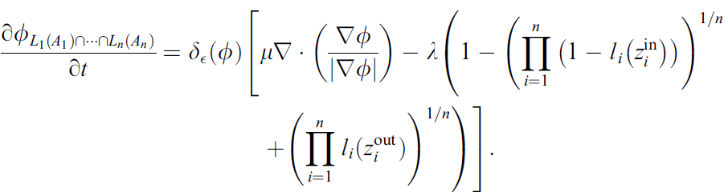
Level Set Formulation
Objective function
We want to minimize F
Notes:
Noisy image --> set λ in order of
Clean image --> set λ smaller so that noise is not included in the segmentation

Slide 43
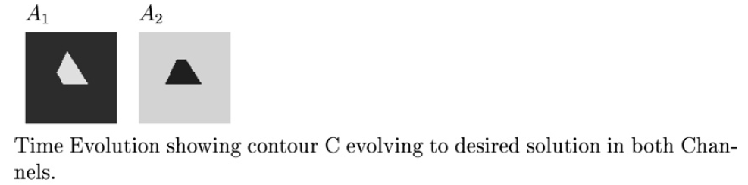
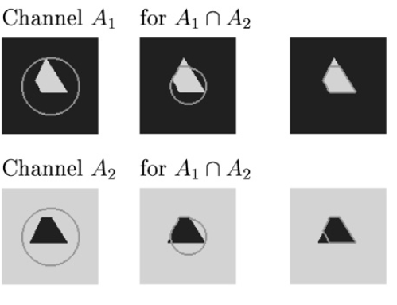
Experiments – 2 Channels

Slide 44
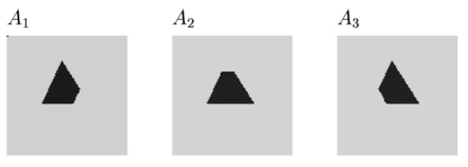
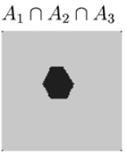
Experiments – 3 Channels

Slide 45
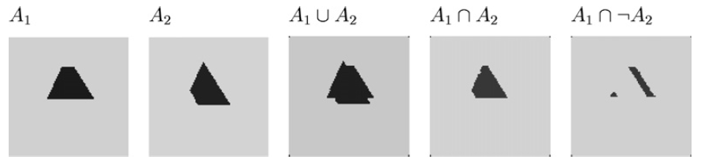
Experiments – Unregistered Images

Slide 46
Experiments – Unregistered images

Slide 47
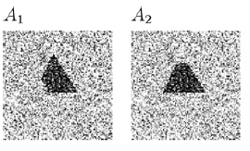
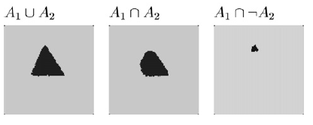
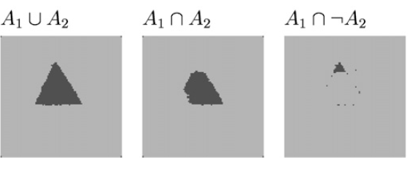
Experiments - Noise
Region based logic
model
Channel by channel case

Slide 48
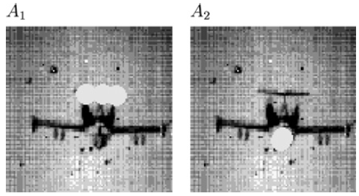
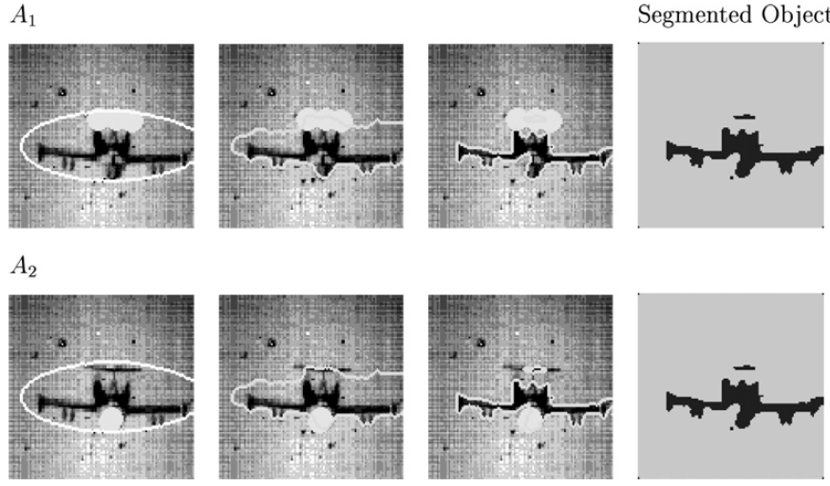
Experiments - Real Images
A₁ U A₂

Slide 49
Conclusions
Chan-Vese model
  Detects objects without edge information
  Compares image intensities inside & outside the contour
  Can detect “holes” in objects
Sandberg-Chan logic framework
  Can combine multiple images using different logic operations
  Performs segmentation & logic operation at the same step

Slide 50
Thank you
???

