Slide 2
Outline
Introduction

Slide 3
Problem Overview
Σ*
Σ
oac
o
a
occ
oacac
c
coa
oc

Slide 4

Existing Techniques
N-grams
  Markov assumption applies
  Given n-1 characters, what is the probability vector of the n^{th} character (given our vocabulary)
  Problems:
    Determining optimal value of n
    We need more training data (especially with longer sequences)

Slide 5
Solution
Use a non-Markov model
  Next value in sequence is conditionally dependent on all preceding values
  This introduces a large number of latent variables
  Use hierarchial Bayesian prior to allow sharing between different sequences

Slide 6
Stochastic Memoizing

Slide 7
Stochastic Memoizing
Probabilistic

Slide 8
Stochastic Memoizing
Probabilistic
Can return a previous return value or a new value

Slide 9
Stochastic Memoizing
Probabilistic
Can return a previous return value or a new value
abc

Slide 10
Goals
Relate shorter sequences with longer sequences
Use a hierarchical Pitman-Yor process that is tractable

Slide 11
Hierarchial Formulation
v Є Σ
v1 v2 v3 ......
s1
s2
s3
G[s]
s Є Σ*
...

Slide 12
Hierarchial Formulation Cont'd
Want to use observations of shorter sequences to estimate predictive probabilities of related longer sequences and vice versa
Use a Pitman-Yor prior on initial vector representing the empty sequence, G[ ]
Input: ab
Observation: abcd

Slide 13



Hierarchial Formulation Cont'd
H
H is the base measure
dn is the discount parameter
cn is the precision paramter
G[ ]
G[s` ]
Fix length!!
G[s]
[s] = [vs`]

Slide 14
Hierarchial Formulation Cont'd
H
H is the base measure
dn is the discount parameter
cn is the precision paramter
G[ ]
G[aca ]
G[oaca]
[s] = [vs`]

Slide 15
Hierarchial Formulation Cont'd
H
H is the base measure
dn is the discount parameter
cn is the precision paramter
G[ ]
G[s` ]
G[s]
[s] = [vs`]

Slide 16
Hierarchial Formulation Cont'd
H
H is the base measure
dn is the discount parameter
cn is the precision paramter
G[ ]
G[s` ]
...
G[s]
[s] = [vs`]

Slide 17
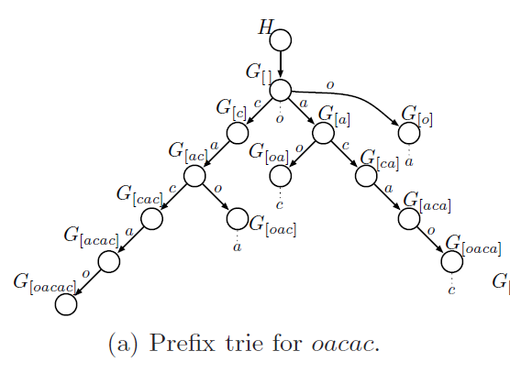
Prefix Tries

Slide 18
Prefix Tries
O(T²)

Slide 19
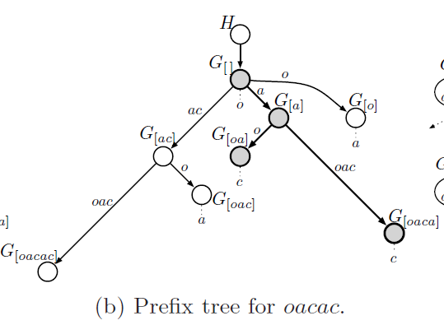
Prefix Trees

Slide 20
?

Slide 21
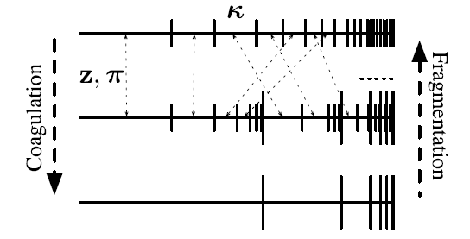
Coagulation & Fragmentation

Slide 22
Coagulation & Fragmentation
Construct collapsed
model
Test sequences not
in training data

Slide 23
Coagulation & Fragmentation
Construct collapsed
model

Slide 24
Inference & Prediction
Same as Pitman-Yor process model
Use Gibbs sampling in the Chinese restaurant franchise
E(G[s](v)) = E(G[s`](v)) where s` is the longest suffix of s that occurs in the prefix trie
Need to be able to compute the probabilityof a symbol v given a sequence s that is not in the training data

Slide 25
Unseen Sequences
Consider s = [oca]
Longest suffix is s` = [ca]
Need to reinstantiate G[ca]
Fragment G[oaca]|G[a] into G[ca]| G[a] and G[oaca]|G[ca]

Slide 26
Reinstantiating G[ca]|G[c] ”restaurant”
Restaurant G[oaca]|G[a]
K
...
nk

Slide 27
Experiments

Slide 28
Evaluation Questions
Do prefix trees provide computational savings?
Does the sequence memoizer's performance compare to that of a Marvok model?

Slide 29
Data Sets
New York Times (NYT) corpus
  Vocabulary: 1 million words
  Training: 15 million words
  Testing: 1 million words
  Preprocessing: Replace low frequency words with a single ”unknown word” symbol
Associated Press (AP) corpus
  Vocabulary: 150,000 words
  Training: 13 million words
  Testing: 200,000 words
  Preprocessing: none

Slide 30
Computational Savings
Use the NYT data set & compare with n-gram model
Metropolis-Hastings updated used for discount parameters
Use distinct discount parameters for each of the first 4 levels of the trie, while levels below use a single shared discount parameter
10 burn-in iterations
Collected 5 samples

Slide 31
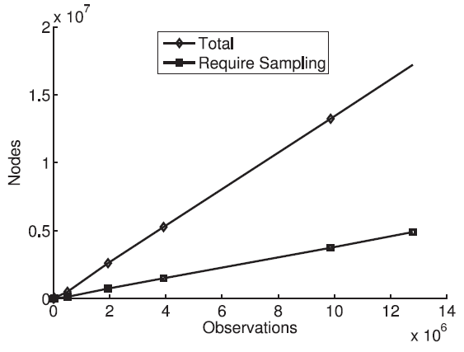
Computational Savings Results
Produced same perplexity scores as 3-gram & 4-gram models with 125 burn-in iterations & 175 samples

Slide 32
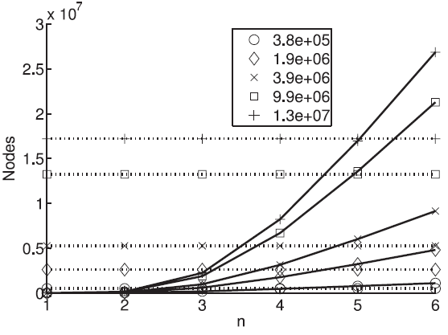
Computational Savings Results Cont'd

Slide 33
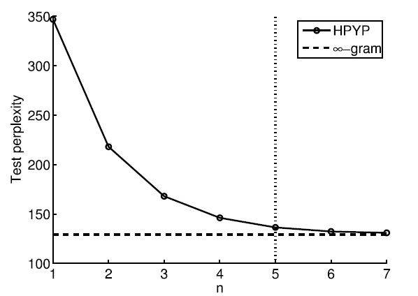
Performance Results

Slide 34
