Slide 1
A Stochastic Memoizer for Sequence Data
F. Wood, C. Archabeau, L. James, Y.W Teh
Presented by: Sarah Nadi & Karim Ali
Nov. 1st 2010 – CS 886

Slide 2
Outline
Problem Overview
Existing Techniques
Proposed Solution
Contributions
Model Used
Inference & Prediction
Experiments
Summary & Discussion

Slide 3
Problem Overview
Σ*
Σ
oac
...
o
a
oca
occ
oacac
c
coaa
oa ?
c
o
a

Slide 4
Existing Techniques
N-grams
  Markov assumption applies
  Given n-1 characters, what is the probability vector of the n^{th} character (given our vocabulary)
  Very good perplexity rates
  Problems:
    Determining optimal value of n
    We need more training data

Slide 5
Proposed Solution
Use a non-Markov model
  Next value in sequence is conditionally dependent on all preceding values → ∞-gram
  This introduces a large number of latent variables
  Use Pitman-Yor (PY) process with concentration parameter = 0
  Use Hierarchial PY Process (HPYP) to allow comparing common suffixes

Slide 6
Contribution
Stochastic Memoizer
  Probabilistic technique
  Remembers previously returned values
    Return previously returned symbols or a new symbol
  Goals
    Relate shorter sequences with longer sequences
    Use a HPYP that is tractable

Slide 7
Hierarchial Formulation
v Є Σ
v1 v2 v3 ......
s1
s2
s3
G[s]
s Є Σ*
...

Slide 8



Hierarchial Formulation Cont'd
H
~ Uniform Distribution
H is the base measure
dn is the discount parameter
cn is the precision paramter
G[ ]
G[aca ]
G[oaca]
[s] = [vs']

Slide 9
Hierarchial Formulation Cont'd
H
~ Uniform Distribution
H is the base measure
dn is the discount parameter
cn is the precision paramter
G[ ]
G[s` ]
G[s]
[s] = [vs']

Slide 10
Hierarchial Formulation Cont'd
H
~ Uniform Distribution
H is the base measure
dn is the discount parameter
cn is the precision paramter
G[ ]
G[s` ]
G[s]
[s] = [vs']
...

Slide 11
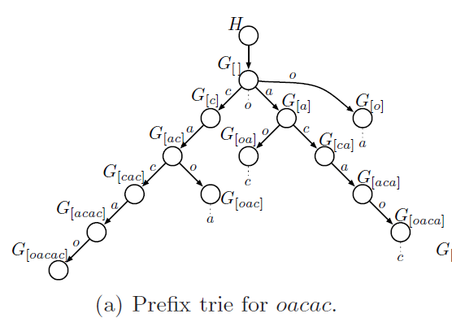
Prefix Tries

Slide 12
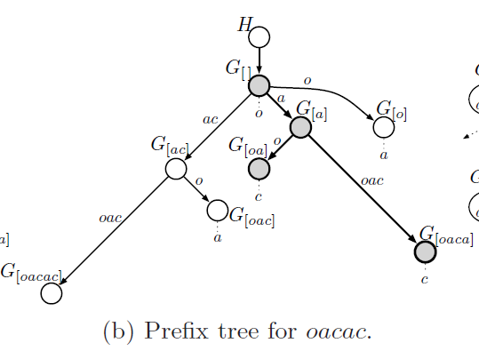
Prefix Trees

Slide 13
Trie to Tree Conversion
?

Slide 14
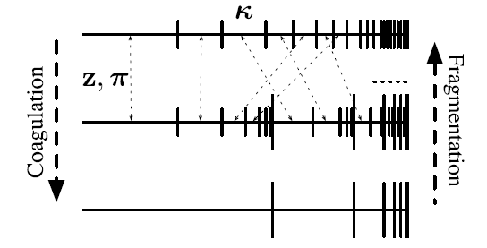
Coagulation & Fragmentation

Slide 15
Coagulation & Fragmentation
Construct collapsed
model

Slide 16
Coagulation & Fragmentation
Construct collapsed
model
Test sequences not
in training data

Slide 17

Coagulation & Fragmentation Cont'd
G1
G2
G3

Slide 18

Coagulation & Fragmentation Cont'd
G1
G1
Marginalize out G2
G2
G3
G3

Slide 19
Inference & Prediction
Same as HPYP
Use Gibbs sampling in the Chinese Restaurant Franchise (CRF) representation
E(G[ s ](v)) = E(G[ s ' ](v)) where s' is the longest common suffix of s
Need to be able to compute the probability of a symbol v given a sequence s that is not in the training data

Slide 20
Unseen Sequences
Consider s = [oca]
Longest common suffix is s' = [ca]
Need to reinstantiate G[ca]
Fragment G[oaca]|G[a] into
(G[ca] | G[a]) and
(G[oaca] | G[ca])

Slide 21
Experiments

Slide 22
Evaluation Questions
Do prefix trees provide computational savings?
Does the sequence memoizer's (∞-gram) performance compare to that of an n-gram model?

Slide 23
Data Sets
Associated Press (AP) corpus
  Vocabulary: 1 million words
  Training: 15 million words
  Testing: 1 million words
  Preprocessing: Replace low frequency words with a single ”unknown word” symbol
New York Times (NYT) corpus
  Vocabulary: 150,000 words
  Training: 13 million words
  Testing: 200,000 words
  Preprocessing: none

Slide 24
1) Computational Savings
Use the NYT data set & compare with n-gram model
Metropolis-Hastings updates used for discount parameters
Use distinct discount parameters for each of the first 4 levels of the trie, while levels below use a single shared discount parameter

Slide 25
Computational Savings Results
An ∞-gram with 10 burn-in iterations & 5 samples produced same perplexity scores as a 3-gram model with 125 burn-in iterations & 175 samples

Slide 26
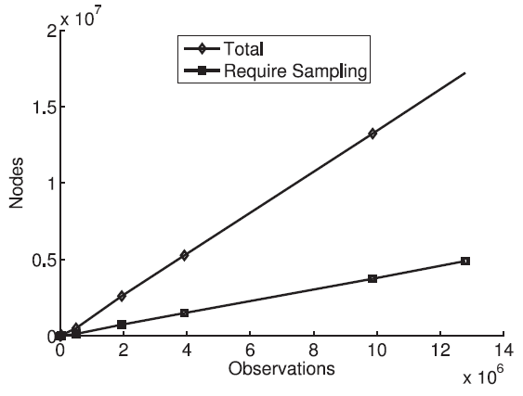
Computational Savings Results Cont'd
NYT data set

Slide 27
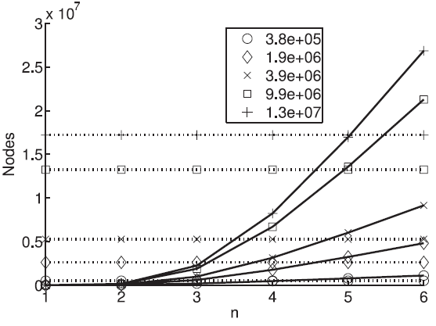
Computational Savings Results Cont'd
NYT data set

Slide 28
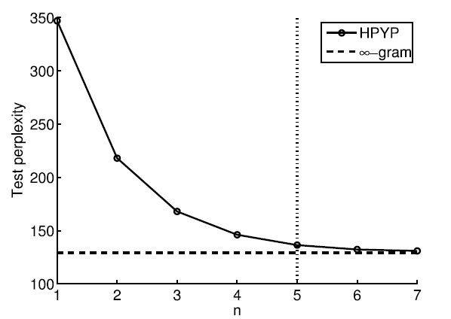
2) Performance Results
NYT data set

Slide 29
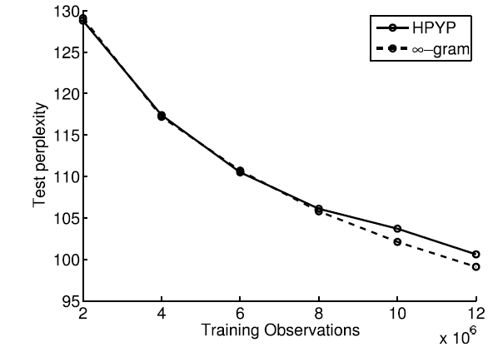
Performance Results Cont'd
AP data set

Slide 30
Take Home Message
N-gram models perform based on the choice of n
An ∞-gram model relieves this constraint
  Common suffixes used to collapse prefix trie
  Achieves at least same perplexity as n-gram
  In most cases, saves computation & storage

Slide 31
Discussion
Complexity of coagulation & fragmentation processes
Frequency of fragmentation during experiments
Intuition of setting concentration parameters to 0
Computational savings on AP corpus
Did not mention which n-gram sampler had 125 burn-in & 175 samples
Different values for discount parameters in lower levels

Slide 32
Thank You
??

Slide 33
Reinstantiating G[ca]|G[c] ”restaurant”
Restaurant G[oaca]|G[a]
K
...
nk

