Slide 1
Electronic Patient
Consent Management
Atif Khan & Sarah Nadi
CS898 - Health Informatics
July 29th, 2010

Slide 2
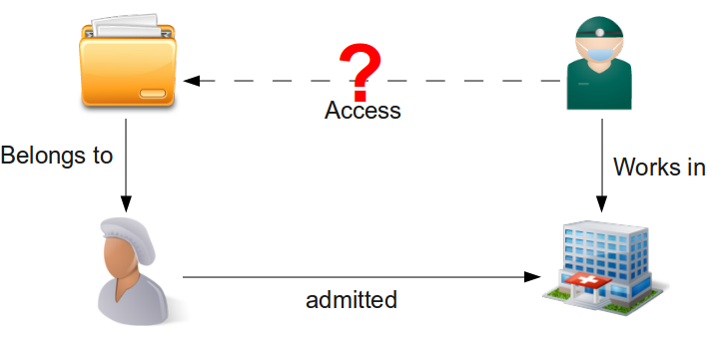
The Big Picture
Notes:
Sarah

Slide 3
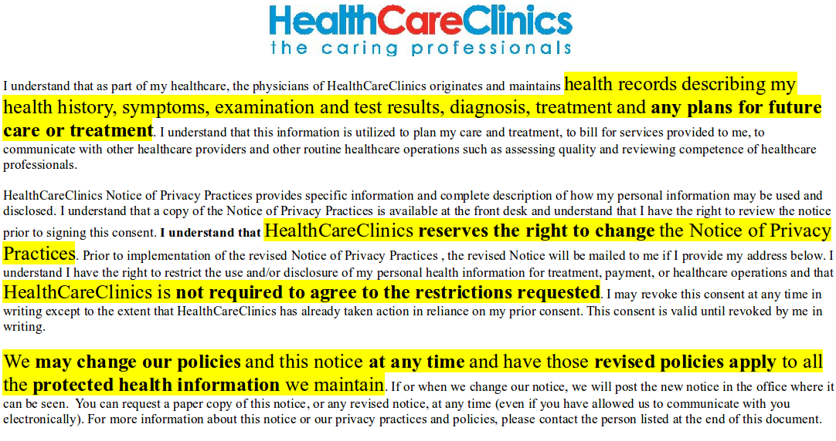
Patient Consent Example
Notes:
Sarah

Slide 4
Outline
Electronic Patient Consent
Current Approaches
Our Proposed Solution: Consentir
  Supported Policies
  Example Facts
Demo
Future Work
Notes:
Sarah

Slide 5
Electronic Patient Consent
Patients need to control:
  Who can access their information
  When their information can be accessed
  What can be accessed
Electronic Patient Consent Management System:
  Defining effective consent policies
  Accurately capturing patient consent electronically
  Representing policies
  Processing facts & policies
Notes:
Atif

Slide 6
Challenges
Balancing patient privacy & health care
Trust & acceptance of electronic consent
  Healthcare providers
  Patients
Minimal impact on clinical work flow
Combining policies from different levels
Notes:
Atif

Slide 7
Current Approaches
Security oriented
  Focus on security aspects & ignore semantics
Technology oriented
  Consent rules defined within the confines of technology
    e-Consent objects [1]
Whats missing?
  Semantics
  Proof of correctness & decision
Notes:
Atif

Slide 8
Learning from the Semantic Web
Semantic Web
  Describe data with meaning
    (RDF + OWL + XML) → ability to describe anything
  Use Notation 3
    RDF shorthand + ability to define rules
<rdf:RDF
xmlns:rdf="http://www.w3.org/1999/02/22-rdf-syntax-ns#"
xmlns:dc="http://purl.org/dc/elements/1.1/">
<rdf:Description
rdf:about="http://en.wikipedia.org/wiki/Tony_Benn">
<dc:title>Tony Benn</dc:title>
<dc:publisher>Wikipedia</dc:publisher>
</rdf:Description>
</rdf:RDF>
@prefix dc: <http://purl.org/dc/elements/1.1/>.
<http://en.wikipedia.org/wiki/Tony_Benn>
dc:title "Tony Benn";
dc:publisher "Wikipedia".
Notes:
Atif

Slide 9
Reasoning Engine
Semantic Reasoner
  Infer logical consequences from a set of asserted facts
Euler [2]
  “Euler is an inference engine supporting logic based proofs”
  Backward-chaining
    Start form the list of goals
    Work backwards from consequent to antecedent

Slide 10
Consentir
A rule-based system which:
  Uses N3 notation for patient facts & policies
    Benefits:
      Simple notation
      Supports facts & rules
  Uses Euler for access control reasoning
    Benefits:
      Already established reasoning process
      Provides proofs → can be used for verification

Slide 11



System Overview
Policies
N3
rules
file
Euler Engine
Load
Generates proof
N3
facts
file
Load
Proof
Attribute-based
Query
Facts & Patient Consent
Dynamically
generates
Consentir
Notes:
Architecture - atif

Slide 12
Supported Policies
Hospital policies
  Members only
  By shift
  Must be treating doctor/nurse (except in emergencies)
Patient consent policies
  Opt in
  Opt in except for sensitive documents
  Opt in except for certain people
  Opt out
  Opt out with emergency override
Notes:
Sarah

Slide 13
Example Rules
a has possible access to p's records
  a member of o & o has a by shift policy & o is on shift & p is treated in o
a is authenticated to access p's records
  a has possible access to p's records & a treats p
a can access d
  a is authenticated to access p's records & d belongs to p & p has an opt in policy

Slide 14
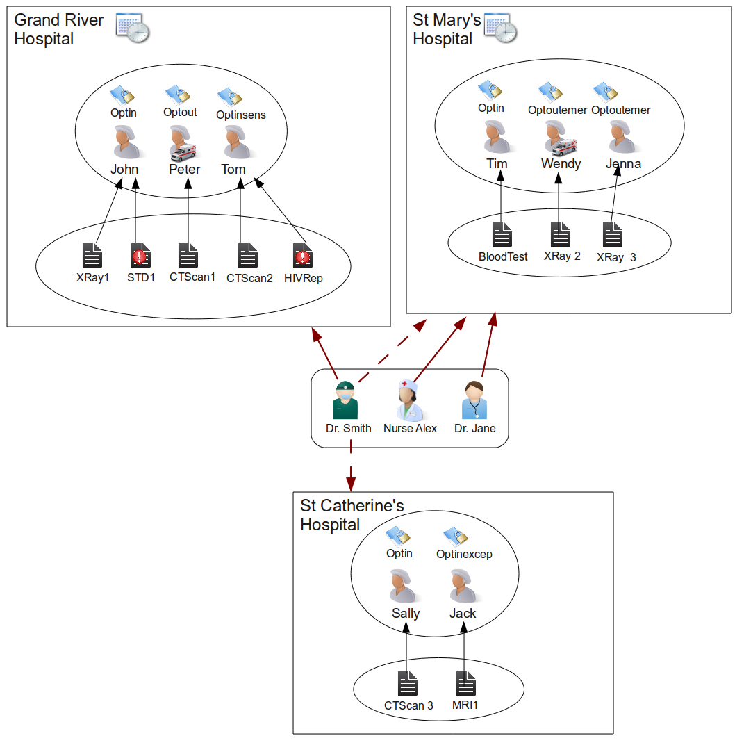
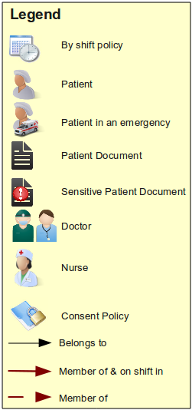
Example
Facts
Notes:
Sarah

Slide 15
DEMO
“the proof is in the pudding”
Notes:
Divide it

Slide 16
Future Work
Formalize ontology
  Extend rules for
    Institutional policies
    Patient consent
More sophisticated N3 rules
Integrate with existing systems
Multiple Policies
  Discover policy conflicts
  Policy overrides
Notes:
Atif

Slide 17
Thank you

Slide 18
References
T. Berners-lee, D. Connolly, L. Kagal, Y. Scharf, and J. Hendler, “N3logic: A logical framework for the world wide web,” Theory Pract. Log. Program, vol. 8, no. 3, pp. 249–269, 2008.
http://www.agfa.com/w3c/euler/

Slide 19
Euler Backward Chaining
my pet croaks and eats flies
If X croaks and eats flies – Then X is a frog
If X chirps and sings – Then X is a canary
If X is a frog – Then X is green
If X is a canary – Then X is yellow
what colour is my pet?

