Slide 1
CSE 591 Final Project Analysis of Coin Change Problem, Convex Hull
-Sharath Kumar Naeni
110950172

Slide 2
Coin change problem
What’s the problem?
Given certain coin denominations, how many different ways can you make change for an amount N.
Project’s focus:
Study existing methods, design an iterative implementation using III approach. Analyze clarity, time and space complexities.
How to solve?
Clearer and intuitive approach: Recursion
Efficient Approach: Memoization or Dynamic programming
Our approach: an iterative approach using III method.(0-1 Knapsack method in chapter 4 would be referred)
Where to find?
http://www.geeksforgeeks.org/dynamic-programming-set-7-coin-change/
http://algorithms.tutorialhorizon.com/dynamic-programming-coin-change-problem/

Slide 3
Convex Hull
What’s the problem?
Given a set P of n points on a plane, find smallest convex polygon containing all points.
Project’s focus:
Study Jarvis’s Algorithm, Graham’s Algorithm and compare the clarity and efficiency.
Most of the problems taught in class deal with optimizations starting from clear recursive definitions to efficient iterative/incremental(book-keeping) approach. Study whether we can apply systematic methods on Iterative approach like Jarvis and optimize the algorithm in terms of space and complexity.
How to solve?
Jarvis’s Algorithm
Graham’s Algorithm
Where to find?
https://en.wikipedia.org/wiki/Convex_hull (last modified 5th Nov 2016)
http://jeffe.cs.illinois.edu/teaching/373/notes/x05-convexhull.pdf
http://www.geeksforgeeks.org/convex-hull-set-1-jarviss-algorithm-or-wrapping/
http://www.geeksforgeeks.org/convex-hull-set-2-graham-scan/

Slide 4
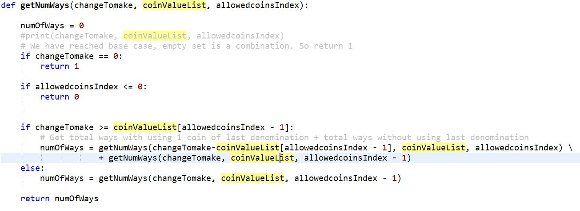
Coin change problem
Recursive Solution:
Checked correctness using sample inputs.
Reference java code from: http://algorithms.tutorialhorizon.com/dynamic-programming-coin-change-problem/

Slide 5
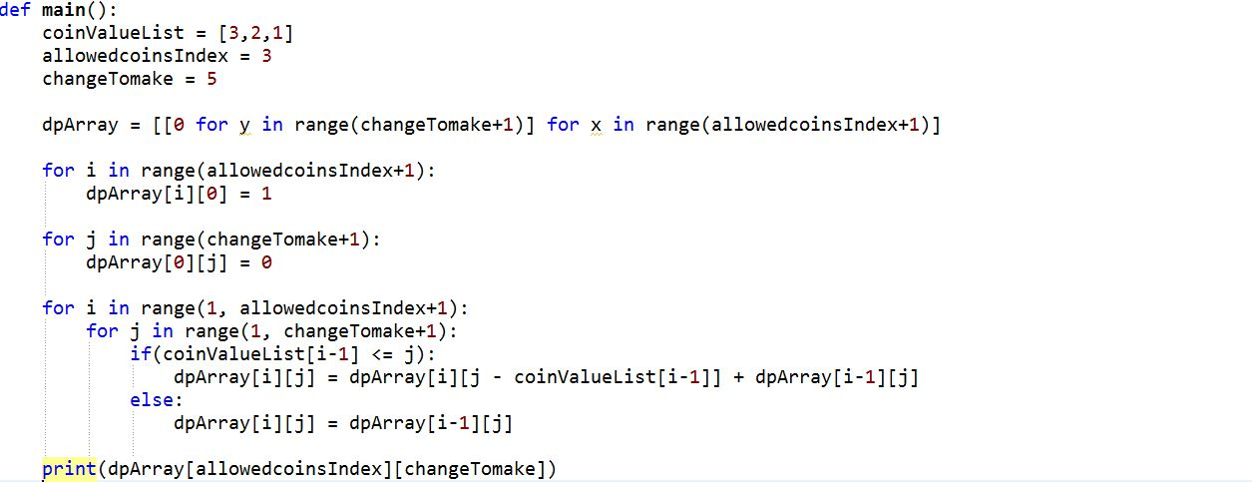
Coin change problem
Efficient DP Solution:
Checked correctness using sample inputs.
Reference java code from: http://algorithms.tutorialhorizon.com/dynamic-programming-coin-change-problem/

Slide 6
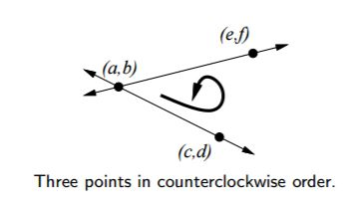

Convex Hull: Jarvis Algorithm
Input: List of n points on a 2-D Plane
Ouput: Ordered list of convexHull points
Running Time: O(n²), Space : O(n)
Source: https://en.wikipedia.org/wiki/Gift_wrapping_algorithm
http://jeffe.cs.illinois.edu/teaching/373/notes/x05-convexhull.pdf
http://www.geeksforgeeks.org/convex-hull-set-1-jarviss-algorithm-or-wrapping/

Slide 7
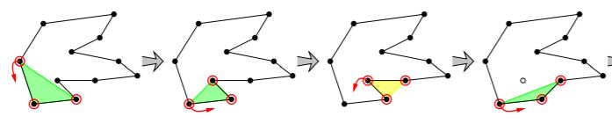
Convex Hull: Grahams Algorithm
Input: List of n points on a 2-D Plane
Ouput: Ordered list of convexHull points
Running Time: O(nlogn), Space : O(n)
Source: http://jeffe.cs.illinois.edu/teaching/373/notes/x05-convexhull.pdf
http://www.geeksforgeeks.org/convex-hull-set-2-graham-scan/

Slide 8
To Do:
Coin Change Problem:
Design Iterative approach for “Coin change problem” using III method.
Test Correctness of the above implementation.
Compare clarity, efficiency of the three implementations.
Convex Hull:
Compare clarity, efficiency for implementations of Jarvis, Grahams (http://www.geeksforgeeks.org/ c++ implementations)
Improvise on the clarity or efficiency of Jarvis Approach (Internal points Optimization)

