Slide 1
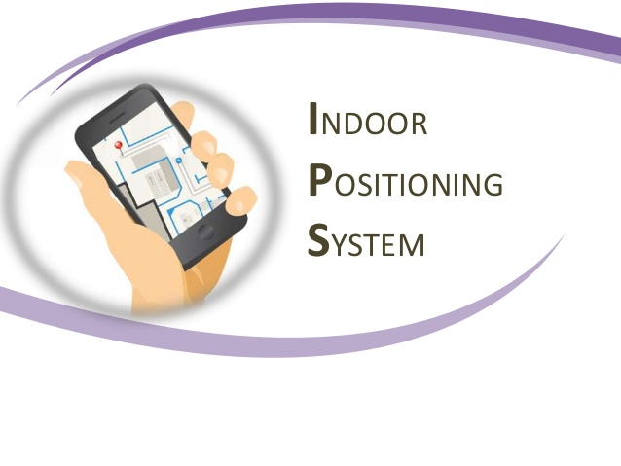
Samira Naghiloo
IOT analytics
Samira.naghiloo@gmail.com

Slide 2
Indoor Localization
Many real world applications need to know the localization of a user in indoor environment.
Why Not GPS:
Doesn’t work indoors
Operate just in two dimension
Indoor Localization Technique:
Ultra Wideband
Wi-Fi
Bluetooth
RFID
Camera
…
Goal: Build models that predict the location of user from the WAPs signal in indoor

Slide 3
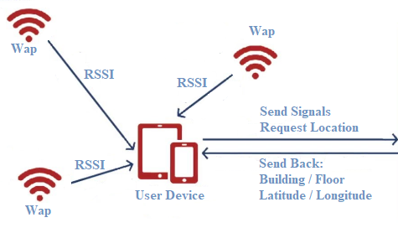
Wifi positioning system
Aggregation & Computation
Server

Slide 4
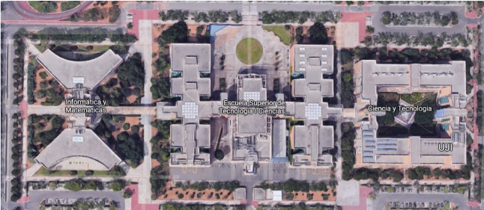
Data Explanation
Data Set Includes three buildings of Jaume I university in Spain, with 4 or 5 floors
Includes:
19937 records in training data set
1111 records in validation data set
529 variables
Variables:
520 Waps
Longitude/ Latitude
Building ID/ Floor
Space ID
Relative Position
User ID/ Phone ID
Timestamp

Slide 5
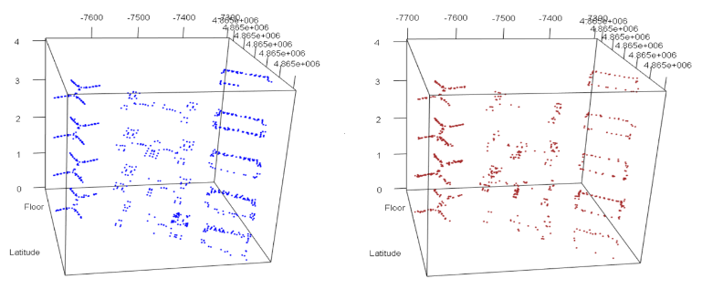
Training data set
Validation data set

Slide 6
Initial Preprocessing
Transformed the type of some variable
Converted undetected signals to -105 (-104 to 0)
Removed all WAPs (column) and records (row) with zero variance values
Removed repeated observations
Converted signals less than -90 to -105 (Unusable)
Converted signals higher than -30 to -105 (Amazing but not typical or desirable in the real world)
We didn’t find any missing value

Slide 7
Initial Result
 | KNN |  | C5.0 |  | SVM
 | Accuracy | Kappa | Accuracy | Kappa | Accuracy | Kappa
Building ID | 0.9784 | 0.9660 | 0.9919 | 0.9872 | 0.9937 | 0.9900
Floor | 0.865 | 0.8141 | 0.7858 | 0.7069 | 0.8893 | 0.8458
 | KNN |  |  | Ranger |  |  | SVM
 | RMSE | R2 | MAE | RMSE | R2 | MAE | RMSE | R2 | MAE
Latitude | 14.298 | 0.958 | 7.72 | 10.198 | 0.9805 | 7.17 | 28.548 | 0.8348 | 20.85
Longitude | 19.624 | 0.9734 | 8.60 | 10.727 | 0.992 | 7.63 | 58.557 | 0.7986 | 39.66

Slide 8
Final Result (Building ID)
Preprocessing:
Remove the waps which are not in the validation data
Add highest wap for each record
Remove waps that are among the highest waps in validation data but never provide the best signal in training data
Remove waps that selected as HighWap in more than 1 building
Selected feature:
Highest Wap + Building ID
ranger |  | C5.0 |  | SVM
Accuracy | Kappa | Accuracy | Kappa | Accuracy | Kappa
1 | 1 | 1 | 1 | 1 | 1

Slide 9
Final Preprocessing Floor/Latitude/Longitude
Preprocessing:
Removed the waps which are not in the validation data
Found the model per each building separately
Normalized the waps value between (0-1) and chose strongest signal )Building 1(
Find the acceptable RSSI range per building
Transform waps value to exponential (Latitude/Longitude)
Exclude relocated waps

Slide 10
Final Result (Floor)
Selected feature:
Waps + Building ID + Floor
Floor | KNN |  | Ranger |  | SVM
 | Accuracy | Kappa | Accuracy | Kappa | Accuracy | Kappa
Building 0 | 0.9627 | 0.9473 | 0.972 | 0.9604 | 0.9646 | 0.9499
Building 1 | 0.9251 | 0.8892 | 0.9511 | 0.9268 | 0.9251 | 0.89
Building 2 | 0.959 | 0.9444 | 0.944 | 0.9239 | 0.9515 | 0.9342

Slide 11
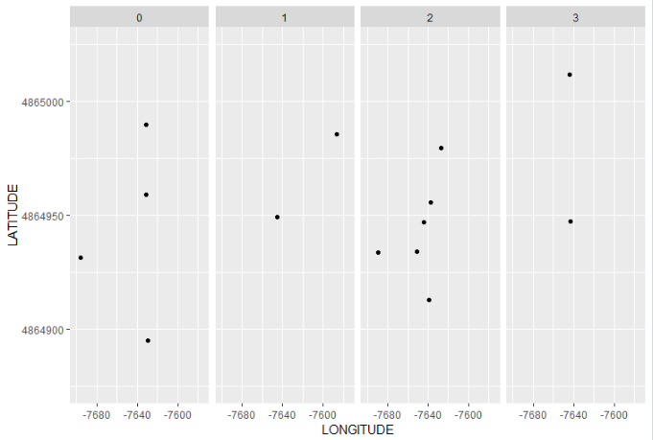
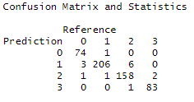
Error Point Building_0(Floor Prediction)

Slide 12
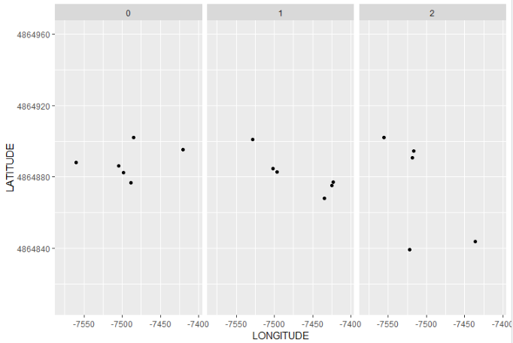
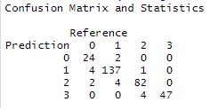
Error Point Building_1(Floor Prediction)

Slide 13
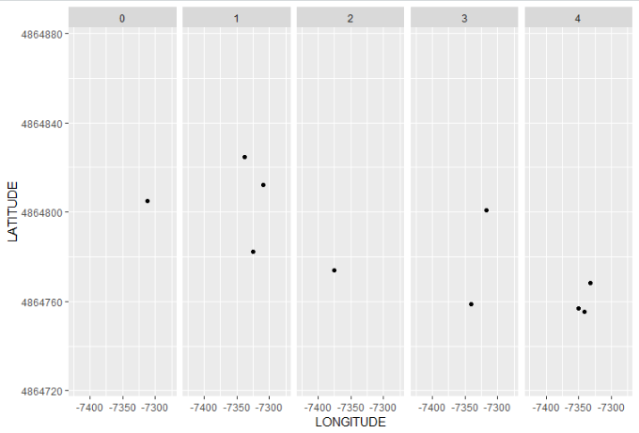
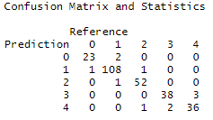
Error Point Building_2(Floor Prediction)

Slide 14
Final Result (Latitude/Longitude)
Latitude | KNN |  |  | xgbTree |  |  | Ranger
 | RMSE | R2 | MAE | RMSE | R2 | MAE | RMSE | R2 | MAE
Building 0 | 4.8295 | 0.9772 | 3.08 | 5.33 | 0.9729 | 3.78 | 7.4534 | 0.9453 | 5.42
Building 1 | 9.2365 | 0.9311 | 6.38 | 15.505 | 0.8796 | 10.91 | 9.483 | 0.9273 | 6.69
Building 2 | 8.1180 | 0.9226 | 5.30 | 10.863 | 0.864 | 8.113 | 8.8588 | 0.9072 | 5.89
Longitude | KNN |  |  | xgbTree |  |  | Ranger
 | RMSE | R2 | MAE | RMSE | R2 | MAE | RMSE | R2 | MAE
Building 0 | 5.676 | 0.9541 | 3.451 | 8.4112 | 0.8978 | 6.06 | 6.640 | 0.9399 | 4.60
Building 1 | 9.2727 | 0.9595 | 5.97 | 13.164 | 0.9196 | 9.82 | 8.4308 | 0.966 | 6.04
Building 2 | 10.019 | 0.9034 | 6.47 | 12.969 | 0.8370 | 9.19 | 10.014 | 0.8985 | 6.61

Slide 15
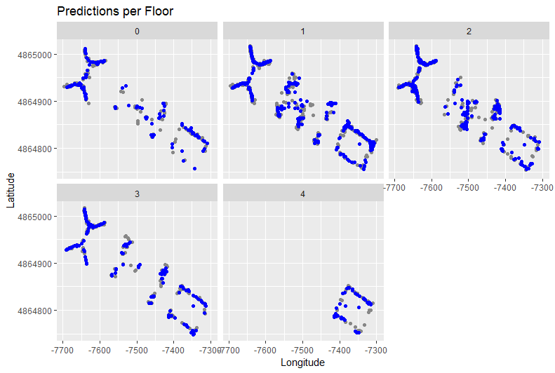

Slide 16
Predict Floor
Ranger
Predict Latitude
KNN
Building 0
Predict Longitude
KNN
Predict Floor
Ranger
Waps Value
Predict Building
SVM
Highest Wap
Building 1
Indoor Position:
Building/Floor
Latitude/Longitude
Predict Latitude
KNN
Predict Longitude
KNN
Building 2
Predict Floor
KNN
Predict Latitude
KNN
Predict Longitude
KNN

Slide 17
Conclusion
WAPs signal can be a good resource for indoor positioning
The best way of predicting building is using the WAP with the highest RSSI
For predicting Floor, Latitude and Longitude we need Building ID and all signals value
Indoor Positioning Application:
Indoor Navigation ( control robots, find places)
People (personnel) tracking
Asset tracking (Staff, supply chain, high value items)
Museum tours: Give you contextual information based on your location
….

