Slide 1
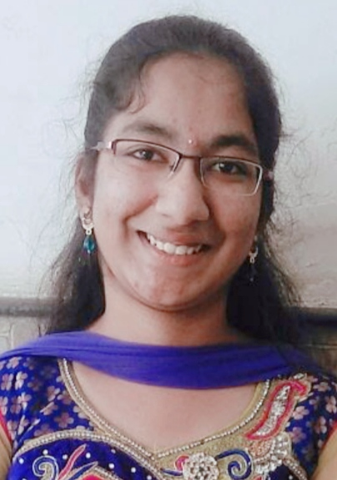

Lavu Sravya
Email
Phone
Location
LinkedIn
: lavu.sravya@zensar.com
: 9182884051
: Guntur, Andhra Pradesh
: https://www.linkedin.com/in/lavu-sravya-5b34801bb
Personal & Professional details
Key projects & achievements
Role & experience
Web designer, College management system project [Btech 2nd year]
Web developer, Eco riders team website [Btech 3rd year]
Database connection and Encryption, Data sharing platform [Btech 4th year]
Front end developer, Company profile Analysis [Hive Training]
Company profile analysis by crawling different websites providing critical information about company to detect whether company is fake or not – [HIVE TRAINING]
Responsive UI in Angular with MongoDb as backend.
Crawled data with cheerio to provide score basing reviews.
Database connection and Encryption in a data sharing platform by securely accessing data from cloud –[Btech 4th year]
Connecting java files with MySQL database using JDBC.
Advanced encryption standard algorithm is used to semantically secure the model.
Website development for technical team Eco riders in NIT Jamshedpur with automated chatbot for solving queries –[Btech 3rd year]
For user authentication, created registration and login using PHP and MySQL.
For solving queries about team automated bot was added.
Web designing for project on college management system –[Btech 2nd year]
Gathered necessary information about layout and design expectations.
Worked on the front end with HTML and CSS.
Education
NIT Jamshedpur, BTech (Hons) in CSE
2016-2020 CGPA-8.29/10
Core competencies
Category | Primary Skills | Secondary skills
Domains | Front end development | Backend development
Programming skills | C,C++,HTML, CSS | JavaScript, Angular, Python, Java
Databases | MySQL, MongoDB
Tools & Techniques | MS OFFICE, Putty | Visual studio, Jupyter notebook
Achievements/Certifications
Finalist in Code sense, WebMatrix events of Ojass’18 (Technical fest of NIT Jamshedpur)
Appreciation certificate as CSE Branch head in NIT Jamshedpur
AI Master class participation: PS-AI-PYTHON-0722
Data Science free course completion certificate: cert_qbtl92jh
Employment History
Sr. Software Engineer at Zensar Technologies [Nov’2020 – Present]

