Slide 1

Backend RAG Multipurpose Platform
Production-Ready AI Chatbot Infrastructure with Multi-Provider Orchestration

Slide 2







The Problem
Fragmented Integrations
Security & Compliance Gaps
Multiple AI providers require custom code and different API patterns. Switching providers means rewriting substantial application logic.
Most implementations lack enterprise-grade authentication, rate limiting, and audit trails. This creates compliance risks and vulnerability to data exfiltration.
Document Complexity
Retrieval Accuracy Crisis
Ingesting DOCX, CSV, XLSX, Markdown, and PDFs requires multiple parsers and normalization logic.
Weak retrieval from vocabulary mismatch and single-pass limitations leads to hallucinated or irrelevant responses. Production chatbots fail without evaluation-driven development.
No Observability & Feedback
Vendor Lock-In & Privacy Concerns
Without monitoring, teams cannot measure performance or identify failure patterns. There is no visibility into why queries fail or how to improve.
Cloud-only LLM dependencies prevent on-premise deployment. Organizations handling PII or regulated data lack a privacy-first option with local models like Ollama or Llama.

Slide 3
The Solution: Unified Chatbot Platform
Provider Abstraction Layer
Enterprise Security by Default
Unified API for OpenAI, Gemini, Ollama, NVIDIA NIM, able to extend to more provider, avoid Vendor Lock-in
Runtime provider switching without code changes
Cost optimization through provider selection per deployment profile
JWT authentication, role-based access control, API key management
Rate limiting and quota enforcement via Redis
Audit trails for compliance
Universal Document Ingestion
Advanced Retrieval with Adjudication
Native support for DOCX, PDF, CSV, XLSX, Markdown, JSON
Automatic format detection and standardized extraction
Intelligent chunking with metadata preservation
Multi-query decomposition for improved recall
Cross-encoder reranking for relevance
Binary adjudication gate prevents hallucination propagation
Chat Guardrails
Privacy-First Option
Multi-layered protection against prompt injection, data dumping attempts, and abusive inputs.
Blocked phrase filtering
Repeated prompt detection
Input/output size caps
Deploy with local LLM service (Ollama, Llama, Mistral)
Utilize local network for the service call
Self-host on premise

Slide 4




Use Cases
API-First
Headless, language-agnostic interface enabling integration across heterogeneous client applications without coupling to specific UI frameworks.
Knowledge Base
Data Analysis
Technical documentation and domain-specific manuals
Structured datasets and analytical queries
Vendor Agnostic
Abstracts LLM provider differences, allowing runtime selection and switching without architectural changes or data migration.
Support
Internal Tools
Deterministic Bridge
FAQ systems and customer inquiry resolution
Project documentation and organizational knowledge
Enforces strict grounding constraints by mapping outputs to source documents with verifiable citations and confidence metrics.

Slide 5
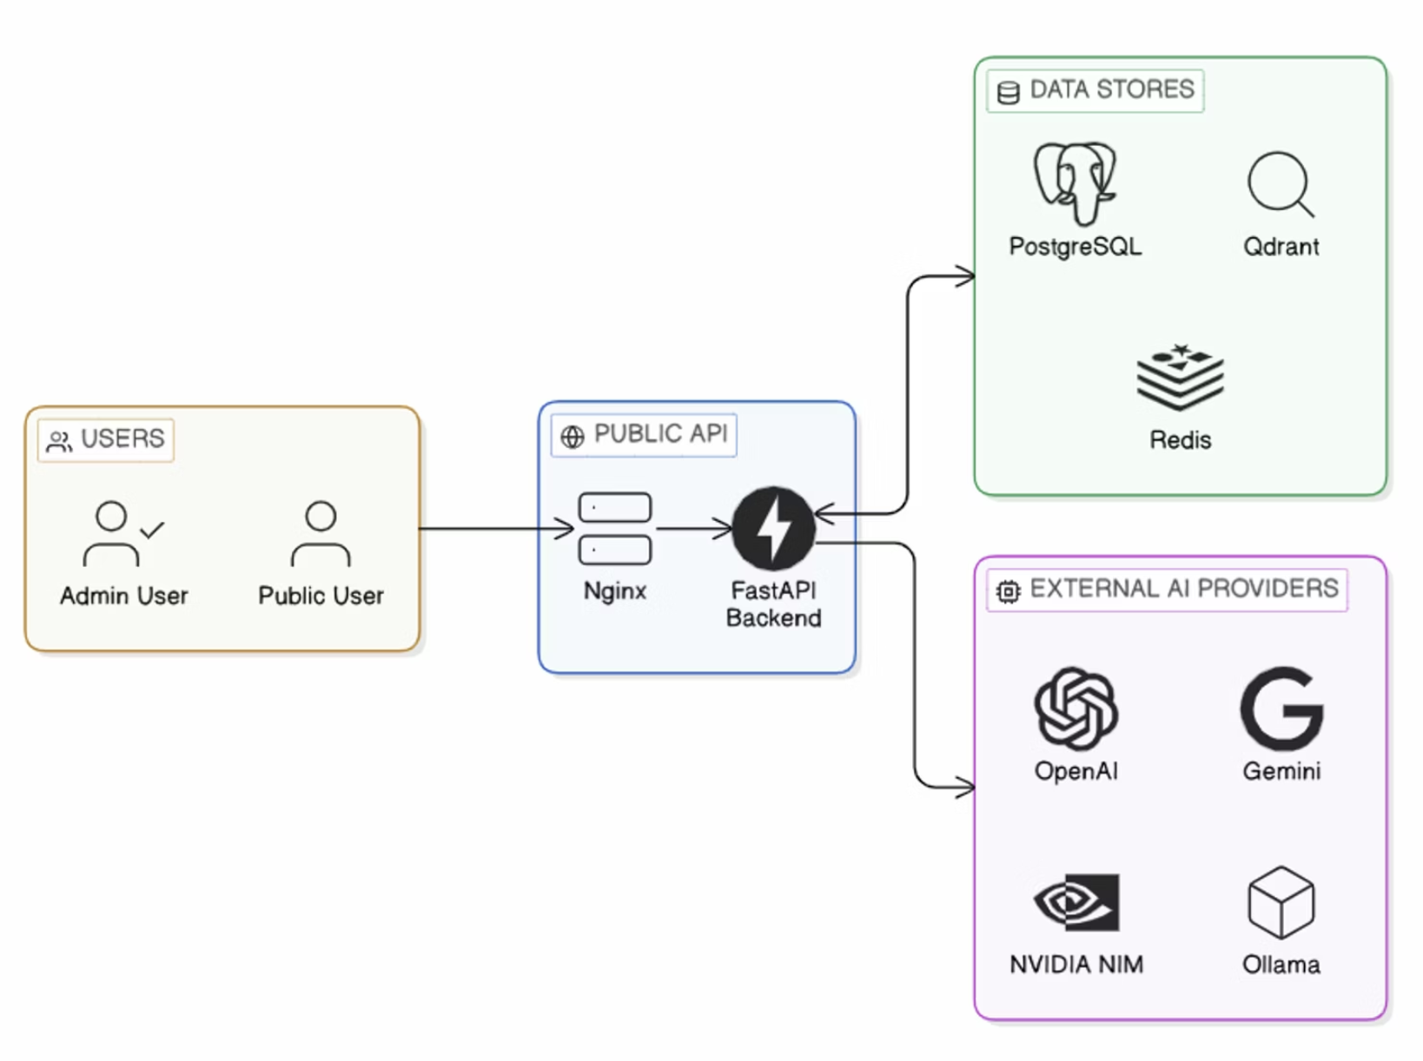
Highlevel System Architecture
Application Layer
FastAPI serves as the core application framework, handling HTTP request routing and async request processing for the RAG pipeline.
Data & Storage Layer
PostgreSQL stores configuration, audit logs, and metadata. Qdrant manages embedding vectors and enables similarity search for retrieval. Redis handles rate limiting, caching, and optional session state.
Provider Adapters
Modular adapters abstract OpenAI, Gemini, and Ollama, enabling runtime provider selection and switching without architectural changes.
Security & Authentication
JWT bearer tokens and hashed API keys enforce access control. Rate limiting via Redis prevents abuse and ensures fair resource allocation across users.

Slide 6
Complete RAG Pipeline
A comprehensive two-phase architecture showing how data is prepared for retrieval and how user queries are answered in real time using the same vector space.
Phase 1: Knowledge Base Preparation (Offline)
Phase 2: Query Processing & Response (Real-Time)
1. Authentication
2. Data Ingestion
1. Authentication
2. User Query
JWT token generation via API key
Upload documents (PDFs, DOCX, CSV, XLSX, Markdown)
Validate JWT token
Submit natural language question
3. Query Embedding
4. Semantic Search
3. Text Parsing
4. Normalization
Convert query to vector using same model
Retrieve top-k similar chunks from Qdrant
Extract raw text from various formats
Standardize text and remove noise
5. Chunking
6. Embedding Generation
5. Augmentation
6. Generation
Segment into 250-500 token chunks
Convert chunks to vectors (OpenAI, HuggingFace)
Combine context with query into prompt
Send to LLM (GPT-4, Gemini, Ollama, Llama 3)
7. Storage
7. Response Display
Documents → PostgreSQL, Vectors → Qdrant, Cache → Redis
Return answer with citations

Slide 7
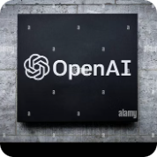
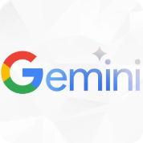

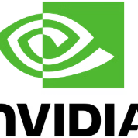
Provider Integrated
OpenAI
Gemini
GPT-4 and GPT-3.5-turbo with text-embedding-3-large. Suitable for general-purpose retrieval and generation with strong instruction-following capabilities.
Gemini Pro and Ultra models with extended context windows and multimodal support. Cost-effective for long-document processing and cross-modal reasoning.
Ollama
NVIDIA NIM
Open-source models (Llama, Mistral) with local embedding generation. Enables on-premise deployment for sensitive data and compliance-constrained environments.
Nemotron Super 49B optimized for reranking and retrieval-augmented tasks. Enterprise-grade performance for high-throughput production systems.
Provider selection is configured via admin API endpoint. Per-request overrides allow dynamic provider switching. Vector collections are created dynamically per embedding dimension to maintain index efficiency.

Slide 8
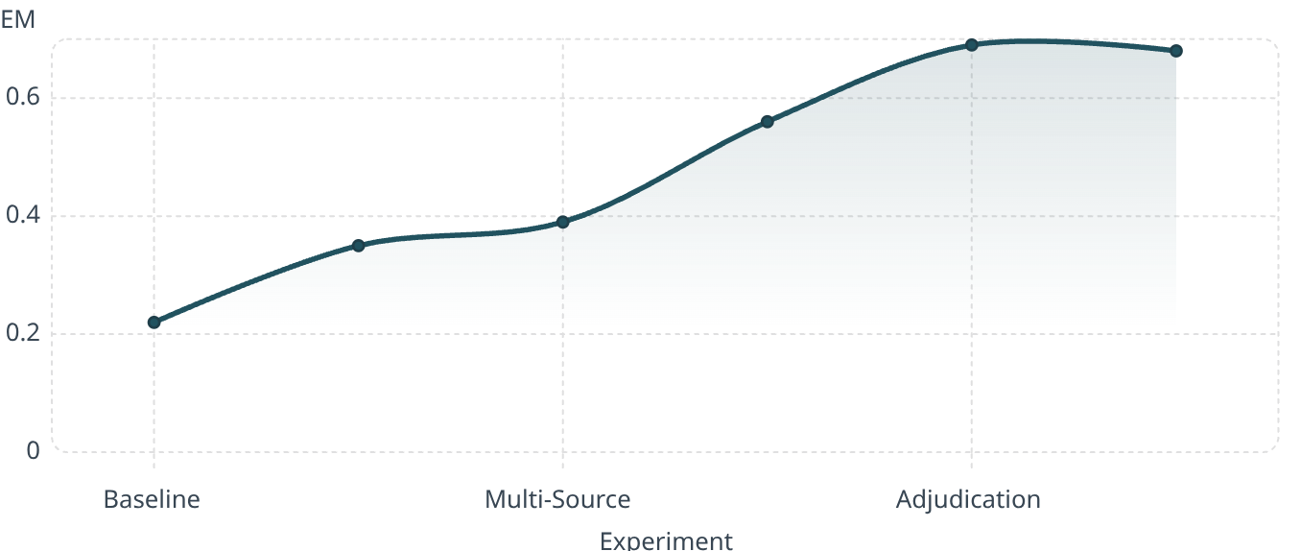

Evaluation Results
69%
90.4%
100%
Exact Match Improvement
Reference Recall @k
Context Match Rate
Accuracy Progression
Key Improvements
0.69
0.68
Reference Recall Hit Rate
0.56
Improved from 0.79 to 0.91
0.35
0.39
Answer Similarity Score
0.22
Improved from 0.42 → 0.59
Baseline
47% improvement
Source:
What Drove Improvement
Prompt Engineering
Hybrid Retrieval
Multi-Stage Filtering
Better query formulation and context assembly
Semantic + lexical search for better coverage
Query decomposition, reranking, adjudication
Evaluation Methodology: MultiHopRAG dataset, 100 samples, GenModel: nvidia/nemotron-3-super-120b-a12b, EmbedModel: nvidia/llama-nemotron-embed-1b-v2, RerankModel: llama-nemotron-rerank-1b-v2

Slide 9
Benchmarking Performance
Our system demonstrates superior performance compared to leading public results on the MultiHopRAG dataset, particularly in Exact Match (EM) and F1/Accuracy scores. The binary adjudication pre-pass proved crucial in achieving significant gains.
System
Dataset
Eval metric
EM
F1 / Accuracy
Notes
nemotron-3-super-120b-a12b
MultiHopRAG train, 100-sample slice
EM, Token F1
0.690
0.701
Best internal run. Binary adjudication pre-pass gave the largest generation-side jump.
LiR3AG, 8B-no-think
MultiHop-RAG
EM, F1
0.658
0.673
Closest public result with same answer metrics. (Huang Junjie’s Homepage)
LiR3AG, 32B-no-think
MultiHop-RAG
EM, F1
0.658
0.668
Slightly below our best run on both EM and F1. (Huang Junjie’s Homepage)
LiR3AG, 32B-think
MultiHop-RAG
EM, F1
0.642
0.654
Also below our best run. (Huang Junjie’s Homepage)

