Slide 1
Nanopore Plasmid Assembly
July 03, 2025
Qinghui Li

Slide 2
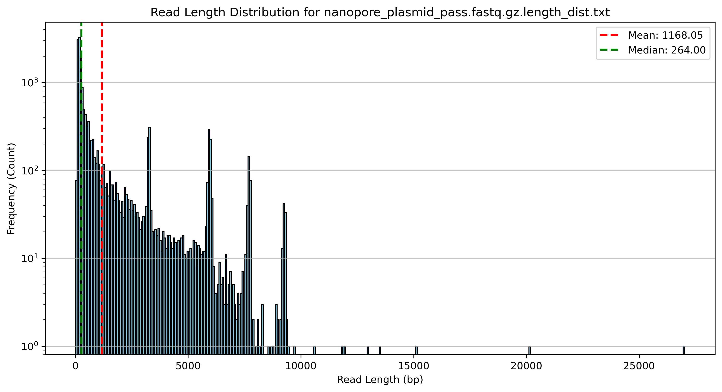

Slide 3
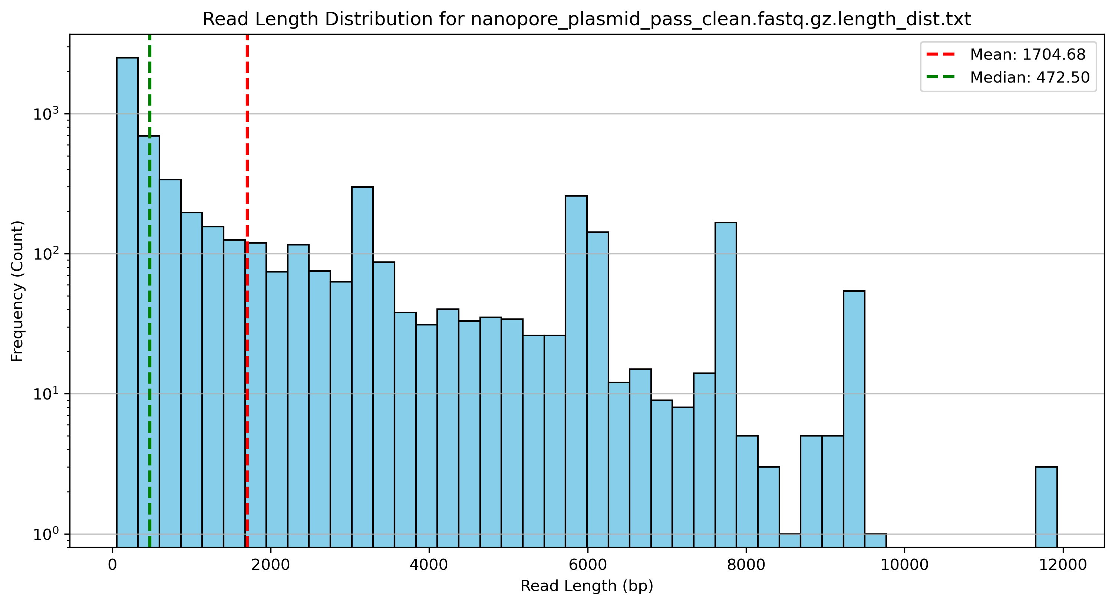

Slide 4
Methods for Nanopore Plasmid Analysis
Raw FASTQ Files
↓
1. Quality Control (fastp)
↓
2. De novo Assembly (Unicycler)
↓
3. Assembly Quality Assessment (QUAST)
↓
4. Genome Annotation (Bakta)
↓
5. Report Generation (This Tool: 11.bacteria_assembly)
1. quality control, filter out low quality/very short reads;
2. assembly and polish, get the consensus reads(long reads);
  based on assembly pipeline “11.bacteria_assembly”;
3. find the location of all the reads (align to the assembled contigs, in current data, there are 5 plasmids)
  every clean read try to map the best hit(assembled contig/plasmid)
  based on amplicon mutation pipeline “13.amplicon_mutation”;

Slide 5
raw reads
clean reads
de novo assembly
(Unicycler)
Annotated plasmid

