Slide 1
Quick ‘n’ Fun Games
Quick Connections – Samuel Najera

Slide 2
PROBLEMS TO SOLVE
How does one find the time to connect with others and have fun as a full-time student?
How does one manage to have fun and connect with others with limited/sporadic bouts of free time?
How can one have fun with friends if they only have a 5-10 minutes between classes?

Slide 3
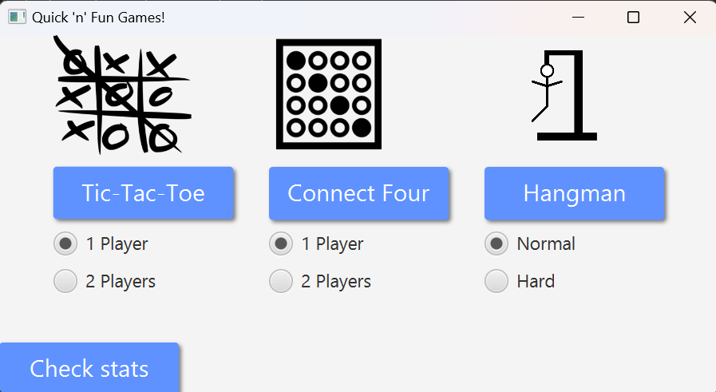
Quick ‘n’ Fun Game Compilation!
A game compilation designed around quickness
Short, intuitive games
Options to play singleplayer or multiplayer
Stats to encourage friendly competition

Slide 4
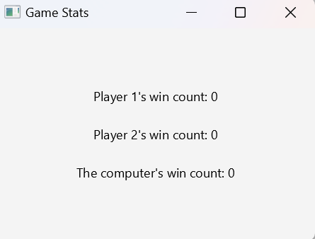
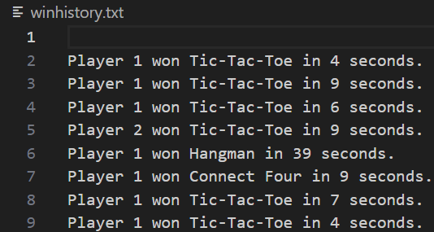
Main Menu & Check Stats UI

Slide 5
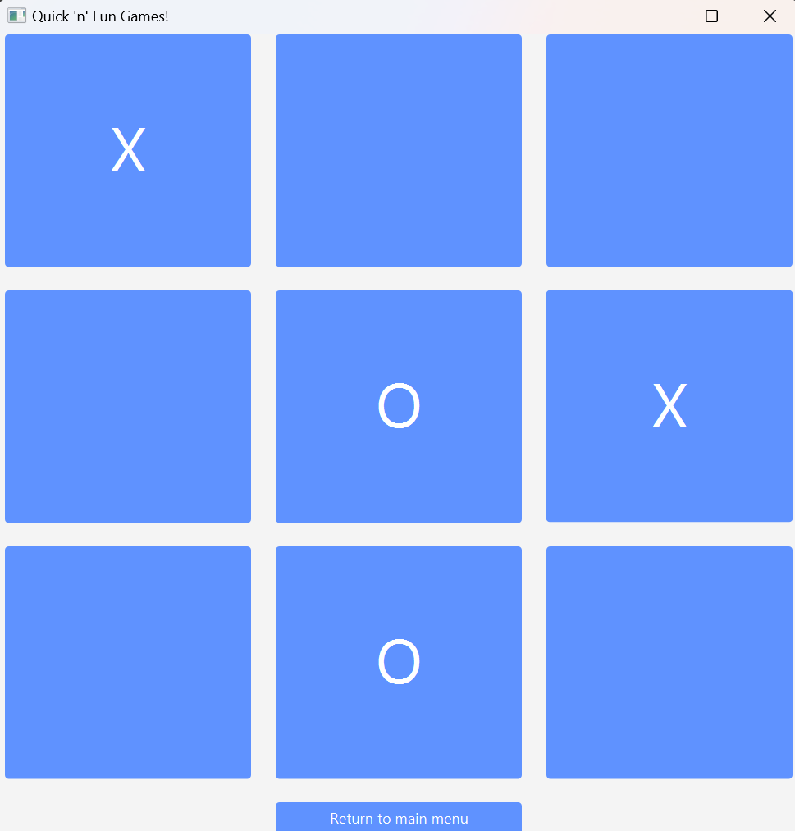
Tic-Tac-Toe UI

Slide 6
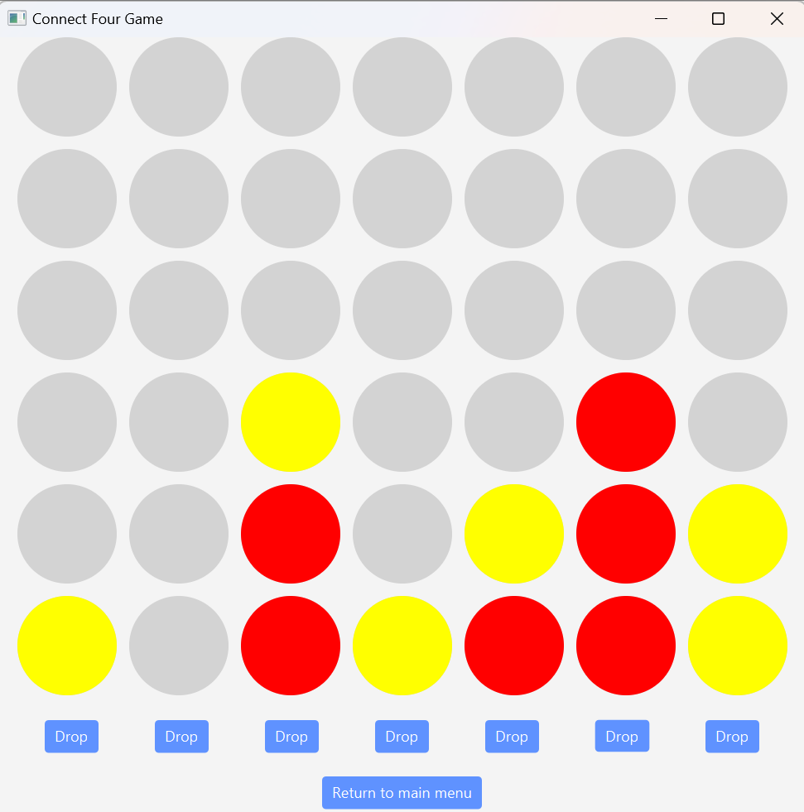
Connect Four UI

Slide 7
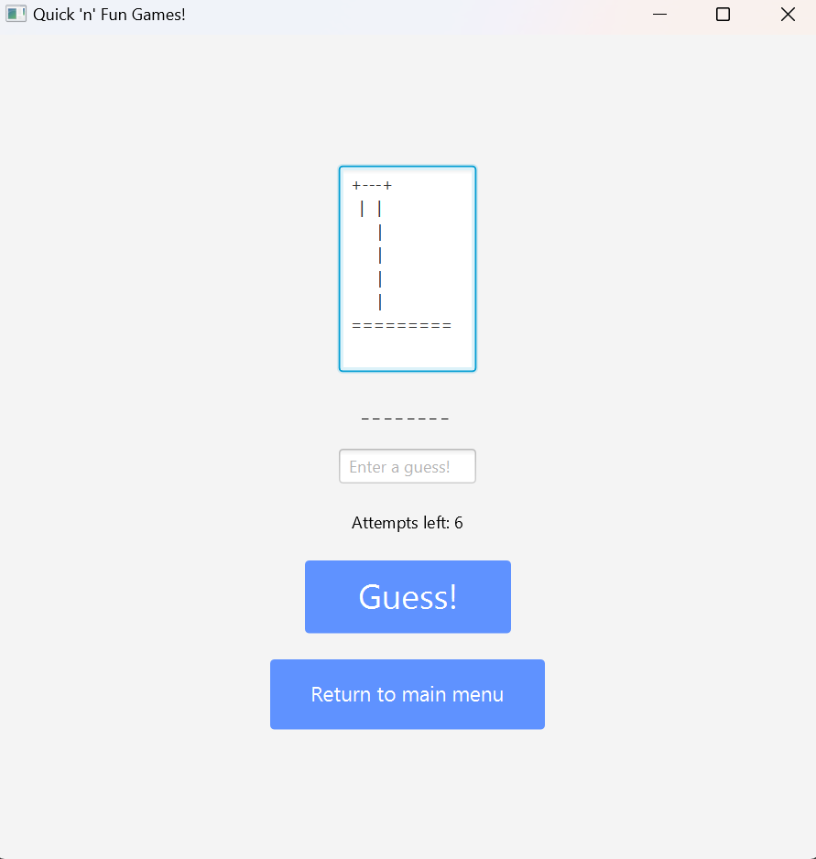
Hangman UI

Slide 8
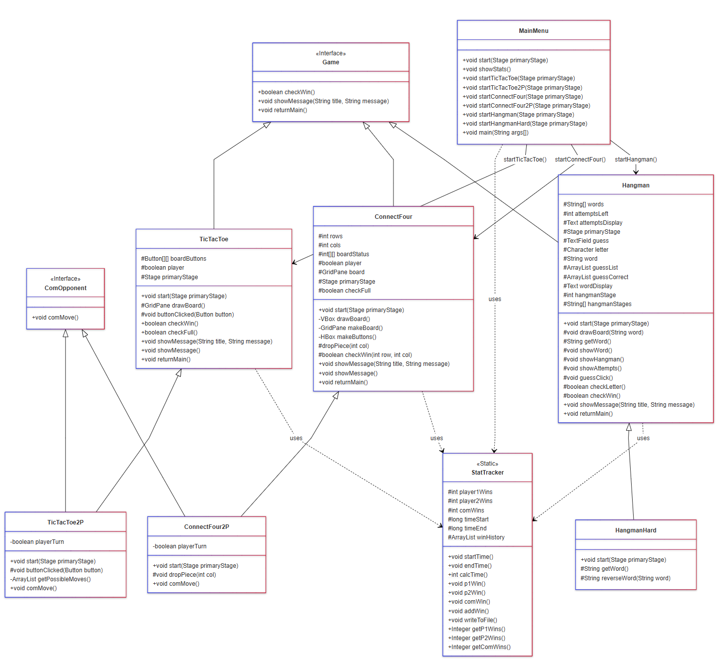
UML Class Diagram

Slide 9
Brief Summary
MainMenu class is the entry point, starts any of the three games
TicTacToe extends Application and implements Game interface
TicTacToe2P extends TicTacToe and implements ComOpponent interface
ConnectFour extends Application and implements Game interface
ConnectFour2P extends ConnectFour and implements ComOpponent interface
Hangman extends Application and implements Game interface
HangmanHard extends Application and implements ComOpponent interface
MainMenu, TicTacToe, ConnectFour, and Hangman all use methods from static class StatTracker

Slide 10
Development process
I first started building MainMenu and UI with temp empty classes to test scene switching
Then I started building the games
TicTacToe and Hangman were easy, but ConnectFour was surprisingly difficult and time consuming
Then I built their subclasses that allowed playing against the computer
Next, I built the StatTracker class and integrated it into all the other classes
Finally, I finalized the UI and added a little CSS styling

Slide 11
What I learned…
How to design a program using UML class diagrams
Concepts involving polymorphism and inheritance
Creating a GUI through JavaFX
Working with resources (images)

Slide 12
Demo time!

