Slide 1

SNAKY PARTICLES
Webfest 2015 @ CERN
The TEAM
Kevin Heinicke Luca Ambroz John Lång Peerut Boonchokchuay Dimar Mironov Jan-Hendrik Arling

Slide 2
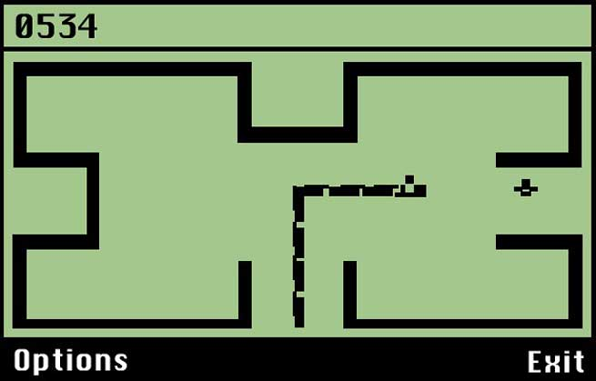
The Idea
create an educational particle physics game based on the „historic“ game play of Snake

Slide 3
The Goals (before)
create a singleplayer
  animations of the snake consisting out of single scientists
  collect particles which can decay
  get more members to your collaboration
create a multiplayer

Slide 4
The Goals (achieved)
a demo game is working
  the scientists are animated
  the snake is growing due to eating particles
  particles are able to decay
  an educational part is included

Slide 5
Future Improvements?
many improvements possible
  integrate more particles with a greater variety of decay modes
  based on the singleplayer expand to a multiplayer version with competing snakes alias collaborations

Slide 6

The Game
let's try it now...

