Slide 1
Membership plan signup response model
Audible Data Science
11/15/2018

Slide 2
Agenda
Problem Statement & Scope
Data manipulation & Modeling
Insights/Recommendations
Appendix

Slide 3
Problem Statement and Scope
Problem Statement:
To predict users who sign up for our membership plan
Scope:
Given total target population :~351K customer
Independent variables: 171 features
Dependent variable : 1, if a user has signed up for the plan,otherwise 0
~91K users have missing response indicator,so dropped those rows
Final data size consists of ~259K users and ~78K responders, having a response rate of 30.09%

Slide 4
Data Manipulation and Modeling
Missing value imputation
Defining train and validation data
Building baseline models using various machine learning techniques
Hyper-parameter tuning for selected techniques
Performance evaluation and model results

Slide 5
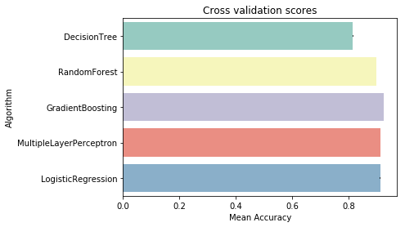
Data Manipulation and Modeling
Missing value imputation is done by replacing nulls with -999
Train and validation data was created by performing random 70-30 split of the entire data set
Baseline models are created using 3 fold cross validation and default hyper parameter settings
Counts | #Contacts | #Response | Response Rate
Train | ~181K | ~54K | ~30%
Validation | ~77K | ~23k | ~30%

Slide 6
Hyper-parameter tuning
Grid search based iterative hyper-parameter tuning is performed for RF and GBM models
Final Parameter metrics for Random Forest:
Mean accuracy increased from 0.8984 to 0.9183
max_depth: 11, max_features: 19, min_samples_leaf: 11, min_samples_split: 200, n_estimators: 200
Final Parameter metrics for Gradient Boosting Machine:
Mean accuracy increased from 0.9239 to 0.9270
learning_rate: 0.01, max_depth: 5, max_features: 11, n_estimators: 3000, subsample: 0.85

Slide 7
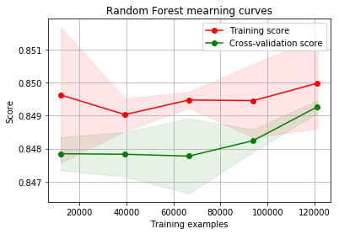
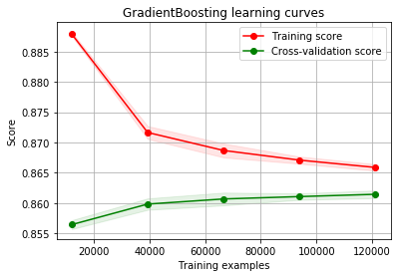
Performance evaluation
As the no of training examples increase both training and cross validation curves tend to come closer and so both the trees seem to better generalize the prediction
roc_auc: 0.767333660615 gini: 0.53466732123
F1 score: 0.84
roc_auc: 0.807658442172 gini: 0.615316884345
F1 score: 0.86

Slide 8
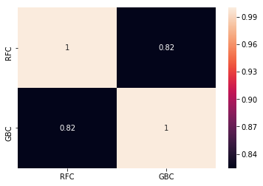
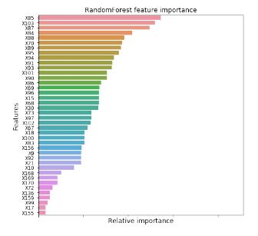
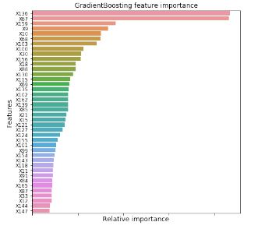
Prediction seems to be quite similar for both classifiers

Slide 9
Recommendations
Model can be testing in three areas:
1) Targeting right customers:
Test top deciles vs random, especially useful in campaigns involving huge budget eg. direct mail campaigns
2) Targeting customers at right time:
Targeting users when a change in the probability score (spikes in the curve) is observed on a daily,weekly or monthly basis depending on the nature of the features
3) Feature importance:
Top features can be used in email creatives (subject lines,placements,designs) or as talking points for customer care representatives (in phone channel)

Slide 10
Thank you!

Slide 11
Appendix
Here is the link to code base

