Slide 1
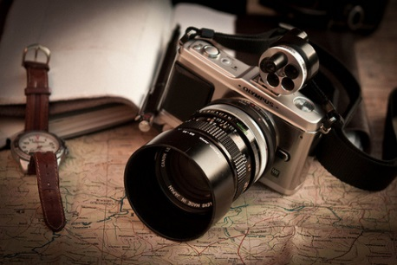
WorldInMyLens
Team 11
Devi Kandasamy
Gayathri Gopalsamy
Silpa Nandipati
Demo: 3rd June 2014

Slide 2
Project idea
An eCommerce website that allows a photographer to -
Sell his work(Photo posters)
Connect with fellow photographers and enthusiasts
Share knowledge and teach budding photographers
[Coming soon] Imprint photographs on memorabilia

Slide 3
Target Users
This eCommerce website targets the following audience groups
Individuals decorating home and office spaces
Interior designers, Home Staging & Event Management companies
Photo collection Hobbyists
Photographer’s admiration group
Enthusiasts bit by the shutter bug ☺
Individuals interested in personalized gift options
Website Admin

Slide 4
Website User Scenarios
Customer Scenarios
Shop to purchase photo posters
Create personalized gifts
View and pursue photography lessons
Connect with photographer through public events
Find store locations
Admin Scenarios (Only accessible with Admin privileges)
Manage photo inventory
View purchase orders

Slide 5
Website Implementation
Each of our menu options uses a different API/GEM
WEBSITE OPTION | API/GEMS USED
Shop – Check out option | Facebook Authentication
Personalized gifts | Web scraping using Nokogiri gem
Meetus | Public API from meetup.com
Learn | FbGraph API
Our Store locations | Google maps API
Admin privileges | Devise

Slide 6
Project breakdown by MVC - Models
User – To store our user information that Facebook returns
Location – To store addresses of various store locations
Admin – To store Admin login(email address) and password
Order – To store information on Order processing
Poster – To store product information (Is the Inventory table)

Slide 7
Project breakdown by MVC - Controllers
Main Controllers - Use special gems and/or integrate public API’s
Learn - Grabs events from Facebook page using access token and page ID
Location – Builds markers for locations on Google maps
Meet
Handles server certificate verification (Since we extracted from https and not http)
Parses XML data from PUBLIC API using REXML
Order – Handles Admin authentication before rendering on the view
Poster – Handles Admin authentication before rendering on the view
Scraping –Handles web scraping. Parses data using Nokogiri Gem
Sessions – Manages user login sessions
Others – Performs standard CRUD operations
Carts and Lineitems

Slide 8
Project breakdown by MVC - Views
Shop - Allows user to purchase posters
Learn - Allows users to view photography lessons schedule
Location - Allows user to view store locations
Meet – Allows users to view and register for photography events
Order – Allows admin to view purchase orders
Poster – Allows admin to manage photo inventory
Scraping – Allows user to view personalized gift options
Contact – Allows users to request/send messages to photographer
About – Allows users to know more about the photographer and the business

Slide 9
Technologies/APIs/Gems Used
Technologies
Ruby On Rails
HTML 5
CSS
Javascript
Jquery
XML/XPATH
API
Meetup.com public API
Facebook Authentication for Users
Event listings from Facebook page
Google maps and locations
Gems
Devise
OmniAuth
Fbgraph
geocoder
Gmaps4rails
Nokogiri

Slide 10
Experiences & Challenges faced
Project integration Challenges
Technical Challenges
Errors & Debugging
Information Resources & Help

Slide 11
Division of labor
Each of us worked on a controller/view and integrated
Each of us researched on different API’s/GEMS, tried and tested the functionality and integrated into our application

Slide 12
Thank you…..
10 weeks of lectures + project challenges + Great team = 3 smarter engineers ☺

