Slide 1
Statistical Tests for Social Sciences
Chaturvedi Prithul Arvind - 1740205
Prakhar Srivastava -1740214
Shristy Katyayen -1740237
6CMS
Guide: V. Vaidhehi
Date: February 14, 2020

Slide 2
Core idea
The website for Social Science Statistics aims to help people with no statistical background.
It will not only guide them with their data but also provide guidelines with the help of examples for their better understanding.
The users will be able to find out the accuracy of their data in a much simpler way.
2

Slide 3
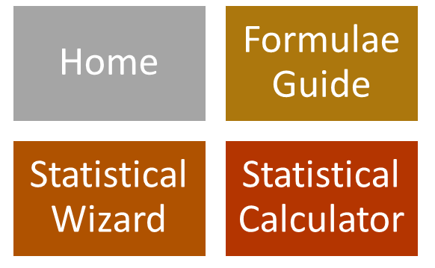
Modules

Slide 4
Module Details
Our website has four major modules/tabs:
Home: The home page of the website consists of the basic description of statistics, its importance and what is the use of statistical tools in a research. It lets the user know that the website is there to help those who are new to the world of statistics.
Formula guide: The map tab will have three tables consisting of the various formulae which will be required in the most of the statistics related studies.
Table 1: Understanding formulae for Common Statistics
Table 2: Surveying Statistical Confidence Intervals
Table 3: Handling Statistical Hypothesis tests
4

Slide 5
Module Details (cont.)
Statistical Wizard: If the user is confused with the type of his data and the test that should be chosen corresponding to that test, this tab comes to the rescue of the user. It will contain a list of all the tests which will be provided in the website with its description and explanation of each test along with an example.
Calculator: When the user has decided which test he or she should use to continue with their research, they will have to fill in the data corresponding to its parameter and the calculator will give the required result.
5

Slide 6
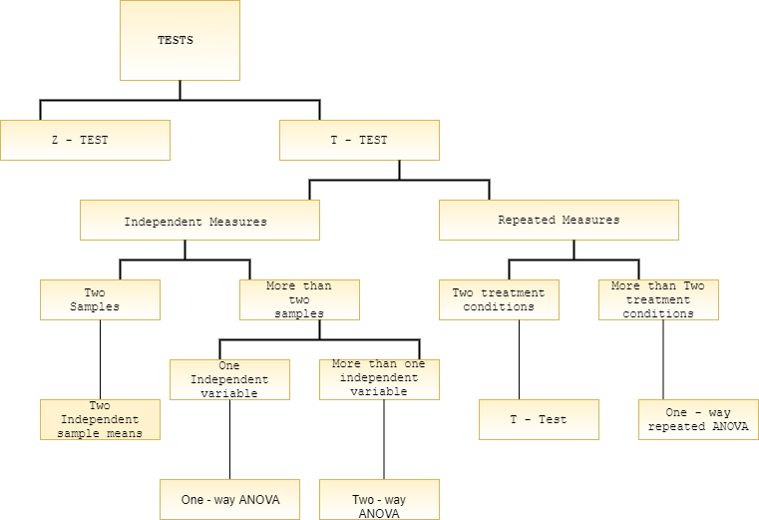
Logic overview
6

Slide 7
Software and Hardware requirements
Software
HTML5, CSS, JavaScript
R (Shiny and RStudio)
Hardware
None
7

Slide 8
Work division
Chaturvedi Prithul:
Overall logic and calculator designing on Shiny (RStudio)
Prakhar Srivastava:
Basic frontend designing
Shristy Katyayen:
CSS, JavaScript and overall UI on HTML5

Slide 9
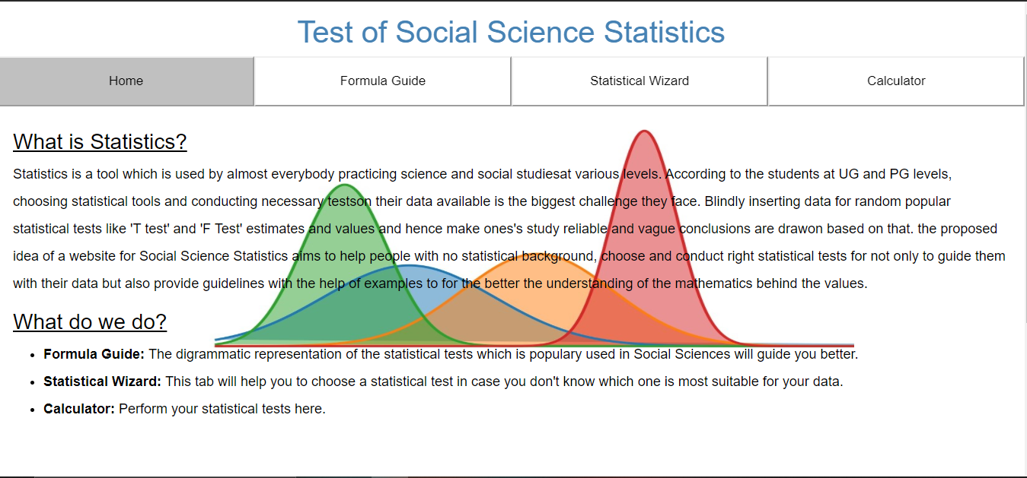
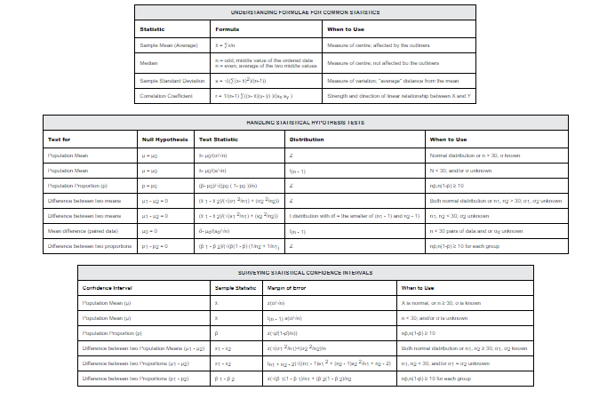
Design Overview (home page and the Formula Guide)

Slide 10
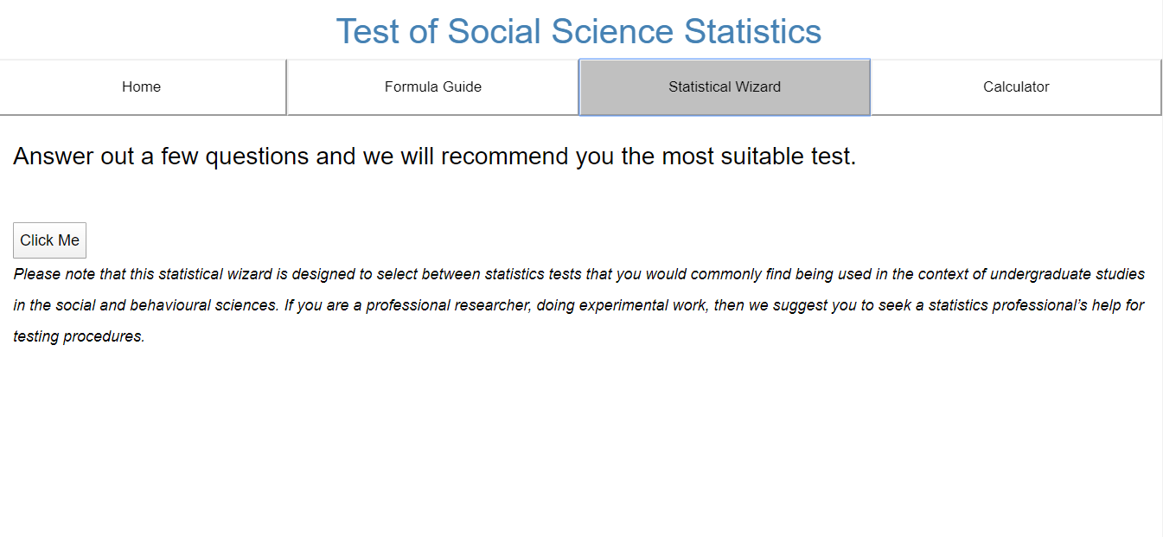
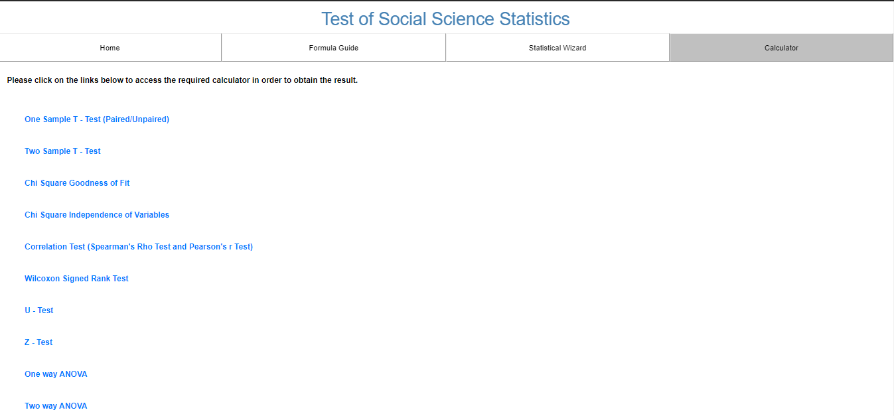
Design Overview (Statistical wizard and the calculator)

Slide 11
Progress report
Tasks | Status
Website | ✓
Modules of the Website | ✓
Statistical Wizard | ✓
Calculator | ✓
Formula Guide | ✓

Slide 12
Future milestones
To make the questionnaire more presentable.
To add a loading page to the website.
To code non-parametric calculators on Shiny.
Adding a feedback section to the website.

Slide 13
THANKYOU !

