Slide 1
EXPLAINABLE PLANT DISEASE DETECTION
via Concept Bottleneck Modelling with Swin Transformer Backbone
URE Research Presentation
Anushka Mahraniya
USN: 20221CSD0151
Guide: Meena Kumari K S
Presidency University, Bengaluru | B.Tech CSE (Data Science) | April 2026
PlantVillage + PlantDoc ● 38 Disease Classes ● 99.91% Accuracy ● Deployed on Hugging Face

Slide 2
The Problem
Why do we need better plant disease detection?
🌿 Plant diseases destroy 20–40% of global crop yield every year
❌ Current AI models are Black Boxes
Farmers get a prediction but no explanation — they don't know WHY the model said what it said.
❌ Lab images ≠ Real field images
Models trained on clean lab photos fail when tested on real, messy, outdoor field photographs.
❌ Too heavy for field devices
Large deep learning models cannot run on the phones and tablets farmers actually use.
Anushka Mahraniya | 20221CSD0151 | Presidency University

Slide 3
Our Solution — PlantDiseaseCBM
One model. Three problems solved.
🧠 Explainability
🌿 Generalisation
⚡ Deployment
🔬 XAI Analysis
Concept Bottleneck Model explains predictions using 12 biological symptoms
Trained on PlantVillage + PlantDoc (real field photos) for real-world robustness
INT8 Quantisation makes the model 23% smaller & 1.3× faster on CPU
4 explanation tools: counterfactuals, faithfulness, intervention, importance
Anushka Mahraniya | 20221CSD0151 | Presidency University

Slide 4
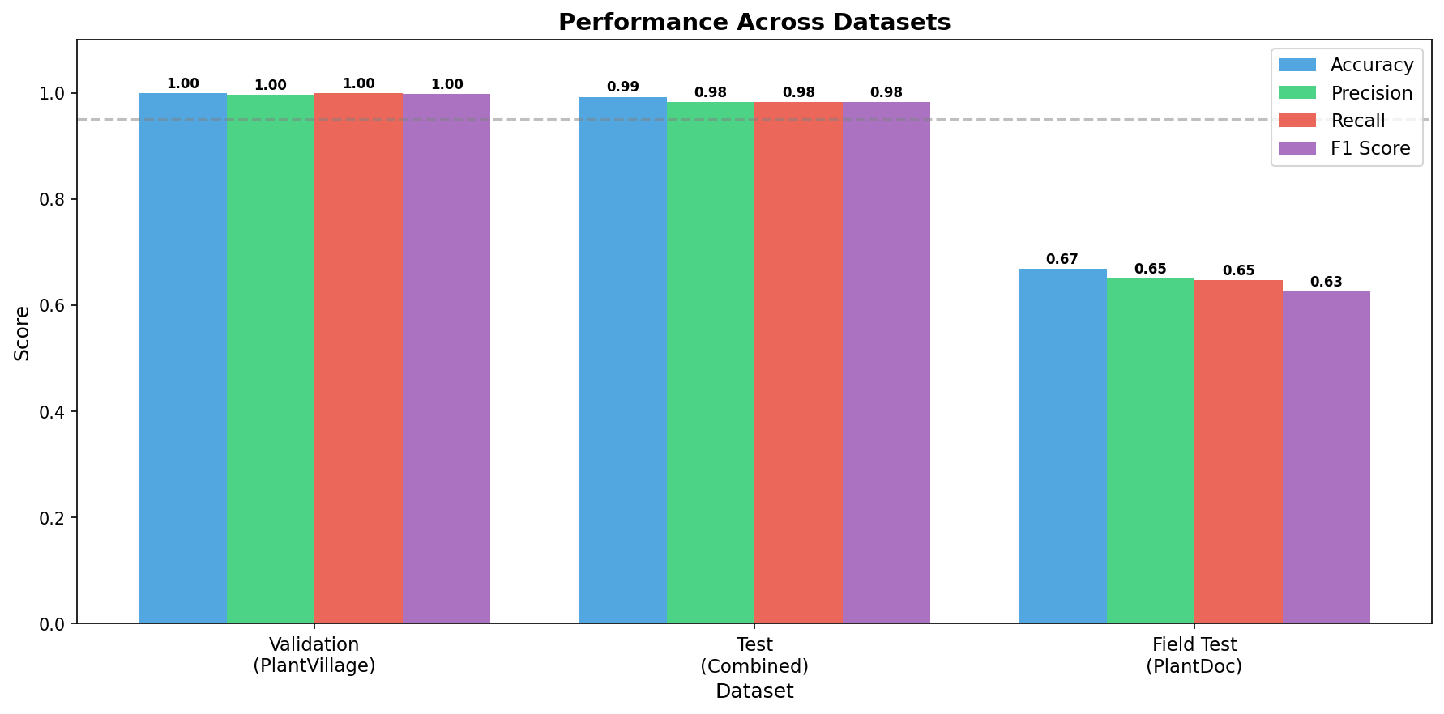
Dataset
What data was the model trained on?
🗂 PlantVillage
🌾 PlantDoc (Field Images)
● 54,306 colour leaf images
● 38 disease-species classes
● 14 crop species (Apple, Tomato, Corn, Grape, Potato…)
● Controlled lab background
● Split: 70% train / 15% val / 15% test
● 2,598 real field photographs
● 27 disease classes
● Natural backgrounds, variable light
● Multiple leaves per frame
● Used for out-of-distribution testing
Anushka Mahraniya | 20221CSD0151 | Presidency University

Slide 5
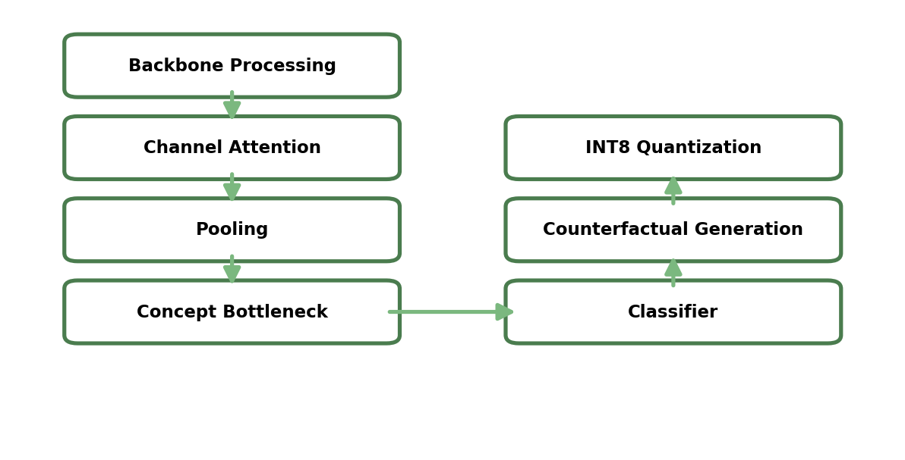
Model Architecture — PlantDiseaseCBM
How does the model work?
1
2
3
4
Input Image 224×224 px
Swin Transformer + SE Attention Block
12 Concept Bottleneck Scores
38-Class Disease Output
→
→
→
The KEY innovation: All predictions MUST pass through the 12 concept scores.
This means the model is forced to explain itself using biological symptoms before giving an answer.
Anushka Mahraniya | 20221CSD0151 | Presidency University

Slide 6
The 12 Biological Concepts
The model thinks in terms of these symptoms — just like a plant doctor
1
Lesion Color
2
Lesion Shape
3
Lesion Spread
4
Necrosis
5
Chlorosis
6
Wilting
7
Spotting
8
Blight Pattern
9
Mold Presence
10
Leaf Curl
11
Vein Discolor.
12
Lesion Texture
Each concept is a biologically meaningful symptom score (0 to 1).
Anushka Mahraniya | 20221CSD0151 | Presidency University

Slide 7
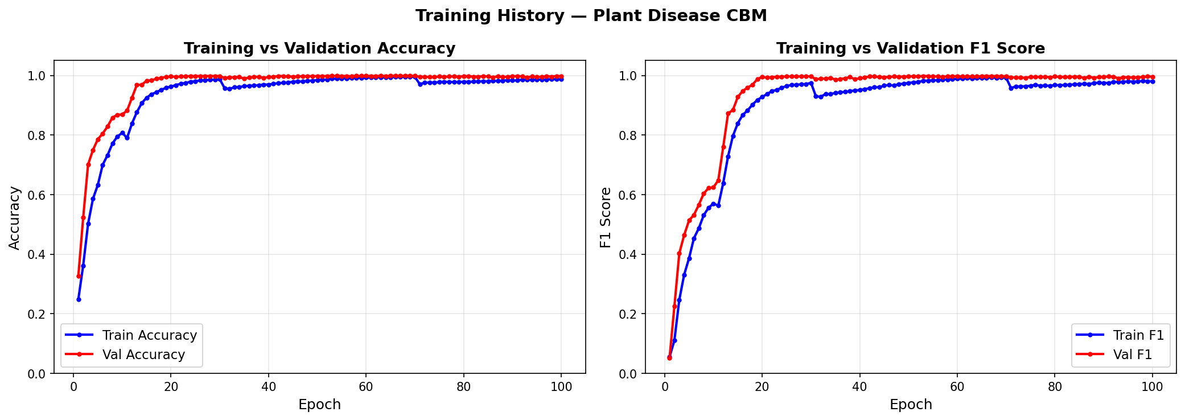
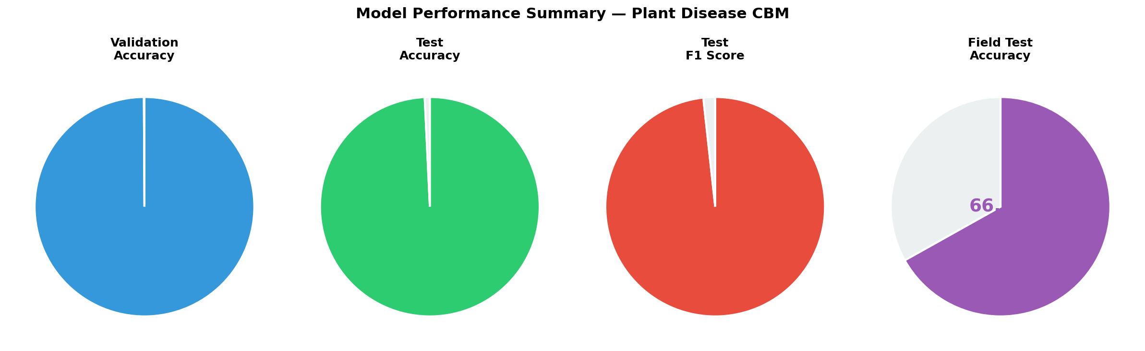
Results — Model Performance
How accurate is the model?
Validation Accuracy
Validation F1 Score
Test Accuracy
Test F1 Score
99.91%
99.78%
99.25%
98.27%
Anushka Mahraniya | 20221CSD0151 | Presidency University

Slide 8
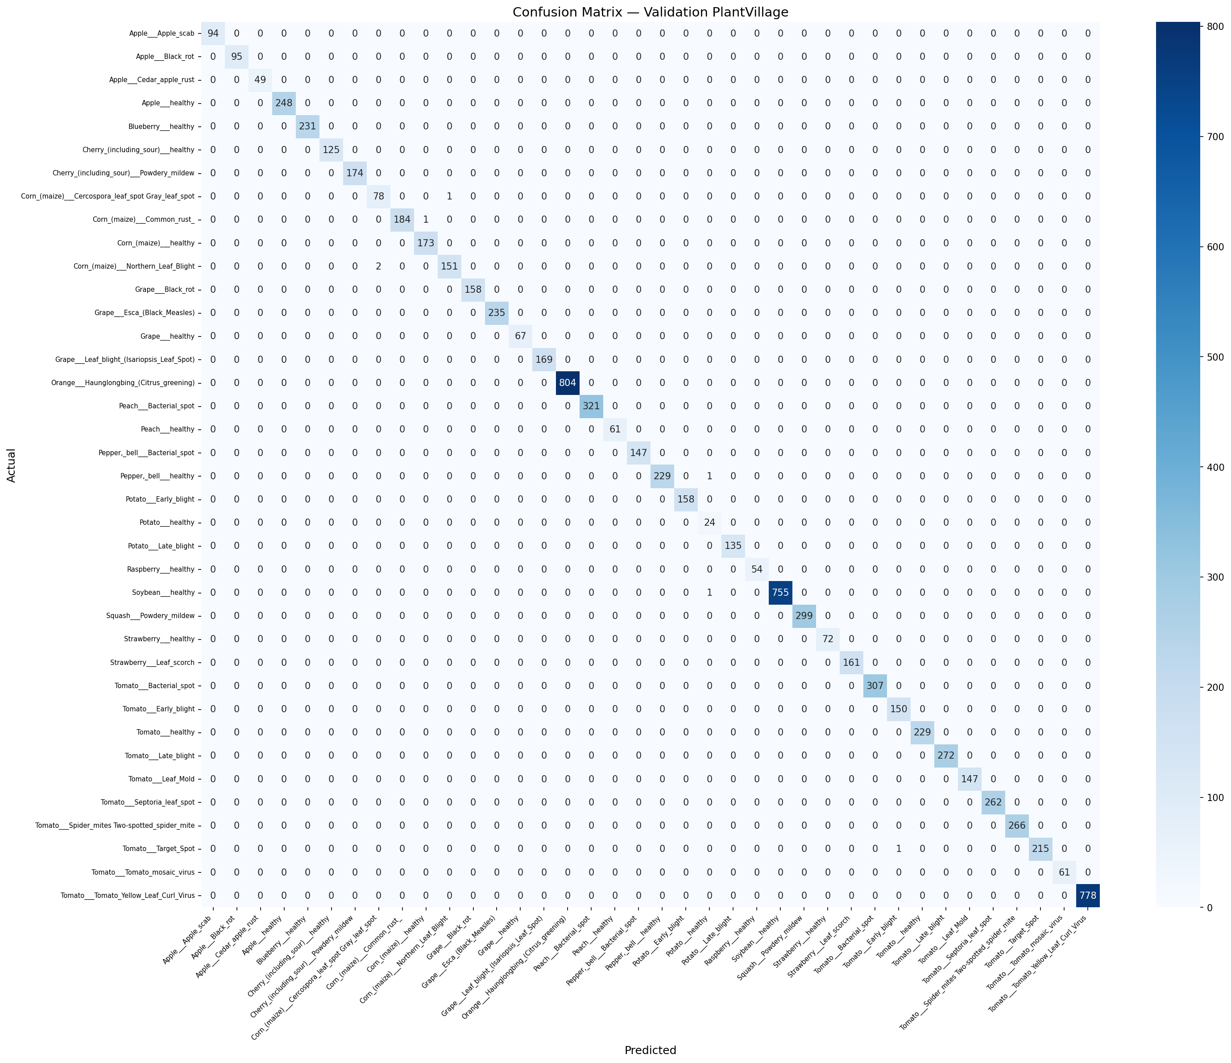

Confusion Matrix
Visual check — did the model confuse any diseases?
PlantVillage Validation Set (8,145 images)
Combined Test Set (8,311 images — includes real field photos)
Almost perfect diagonal — very few misclassifications across all 38 disease classes.
Anushka Mahraniya | 20221CSD0151 | Presidency University

Slide 9
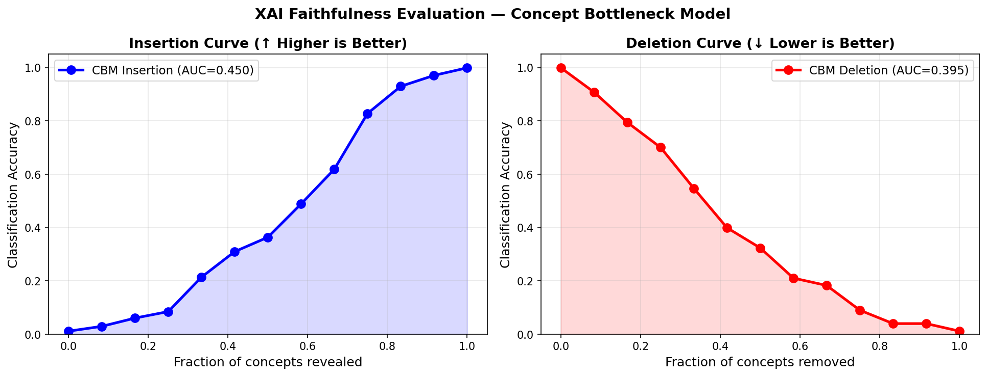
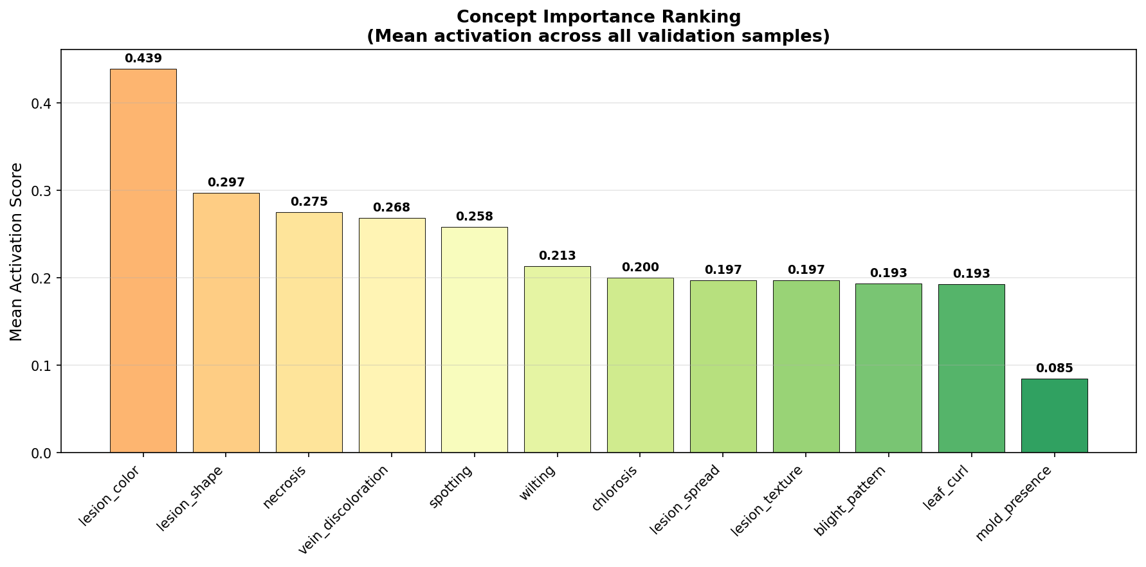
Explainability (XAI) Analysis
How do we know the model truly understands disease?
🔄 Counterfactual
📈 Faithfulness AUC
🎛 Intervention
🏆 Importance Rank
Shows the minimum change to concepts needed to flip a disease → healthy. Tells farmers: 'fix THIS symptom first.'
Insertion AUC: 0.847 Deletion AUC: 0.312 Proves concepts genuinely drive decisions.
Hard-setting each concept to 0 or 1 and measuring accuracy change. Shows which concepts matter most.
Ranks concepts by mean activation across all validation images. Surface the most common symptoms.
Anushka Mahraniya | 20221CSD0151 | Presidency University

Slide 10
Deployment — Live Web Application
Anyone can use it right now, from any browser
🌐 https://anushkamahraniya-palnt-disease-predictor.hf.space
📤 Upload
🔍 Predict
📊 XAI Chart
⚡ Fast
Upload any leaf photo from phone or browser
Get disease name + confidence score instantly
See which symptoms the model detected
INT8 quantised model: 23% smaller, 1.3× faster
Demo: Grape Esca (Black Measles) — 99.5% confidence | XAI shows lesion_spread & wilting activated
Anushka Mahraniya | 20221CSD0151 | Presidency University

Slide 11
Comparison with State-of-the-Art
PlantDiseaseCBM vs other models
Model
Accuracy
F1 Score
Explainability
Field Test
PlantDiseaseCBM (Ours)
99.91%
99.78%
✅ Concept (Full)
✅ Yes
Swin-Small (Black Box)
99.10%
99.01%
❌ None
❌ No
ResNet-50 + GradCAM
98.20%
98.12%
⚠ Post-hoc only
❌ No
Vision Transformer (ViT)
97.80%
97.70%
⚠ Attention map
❌ No
VGG-16
97.80%
97.75%
❌ None
❌ No
MobileNet
93.00%
92.30%
❌ None
✅ Yes
PlantDiseaseCBM is the ONLY model that is accurate AND explainable AND tested on real field images.
Anushka Mahraniya | 20221CSD0151 | Presidency University

Slide 12
Publication
Research accepted at an international conference
Paper Title:
Counterfactual Concept Bottleneck Networks with Squeeze-and-Excitation for Explainable Plant Disease Diagnosis
Conference:
ICDAM 2026 — 7th International Conference on Data Analytics & Management
Paper ID:
1082
Track:
SS-13: AI and ML for Secure, Explainable, and Sustainable Systems
Publisher:
Springer Nature – LNNS Series
Indexed:
SCOPUS, INSPEC, zbMATH, SCImago
Status:
✅ Accepted — Presentation scheduled
Anushka Mahraniya | 20221CSD0151 | Presidency University

Slide 13
Conclusion & Future Work
What was achieved and what comes next?
✅ What We Achieved
🔭 Future Work
● 99.91% accuracy on 38 disease classes
● First CBM applied to multi-class plant disease detection
● 4 XAI tools for biological explanations
● Deployed live on Hugging Face Space
● Published at ICDAM 2026 (Springer LNNS)
● 23% smaller model via INT8 quantisation
● Expert-annotated concept labels from certified plant pathologists
● Expand to 30+ disease concepts
● TensorRT deployment for NVIDIA Jetson edge devices
● Uncertainty estimation to flag low-confidence predictions
● Mobile app for direct farmer use
Anushka Mahraniya | 20221CSD0151 | Presidency University

Slide 14
Thank You
Questions & Discussion
Anushka Mahraniya | 20221CSD0151
Guide: Meena Kumari K S
Presidency University, Bengaluru
🌐 https://anushkamahraniya-palnt-disease-predictor.hf.space
📧 anushkamahraniya@gmail.com

