Slide 1
EXPLAINABLE PLANT DISEASE DETECTION
via Concept Bottleneck Modelling with Swin Transformer Backbone
URE Research Presentation
Anushka Mahraniya
USN: 20221CSD0151
Guide: Meena Kumari K S
Presidency University, Bengaluru | B.Tech CSE (Data Science) | April 2026
PlantVillage + PlantDoc ● 38 Disease Classes ● 99.91% Accuracy ● Deployed on Hugging Face

Slide 2
The Problem
Why do we need better plant disease detection?
🌿 Plant diseases destroy 20–40% of global crop yield every year
❌ Current AI models are Black Boxes
Farmers get a prediction but no explanation — they don't know WHY the model said what it said.
❌ Lab images ≠ Real field images
Models trained on clean lab photos fail when tested on real, messy, outdoor field photographs.
❌ Too heavy for field devices
Large deep learning models cannot run on the phones and tablets farmers actually use.
Anushka Mahraniya | 20221CSD0151 | Presidency University

Slide 3
Our Solution — PlantDiseaseCBM
One model. Three problems solved.
🧠 Explainability
🌿 Generalisation
⚡ Deployment
🔬 XAI Analysis
Concept Bottleneck Model explains predictions using 12 biological symptoms
Trained on PlantVillage + PlantDoc (real field photos) for real-world robustness
INT8 Quantisation makes the model 23% smaller & 1.3× faster on CPU
4 explanation tools: counterfactuals, faithfulness, intervention, importance
Anushka Mahraniya | 20221CSD0151 | Presidency University

Slide 4
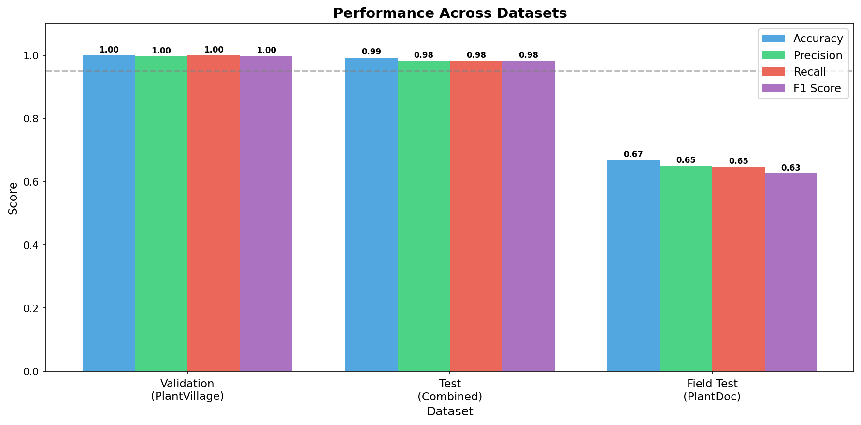
Dataset
What data was the model trained on?
🗂 PlantVillage
🌾 PlantDoc (Field Images)
● 54,306 colour leaf images
● 38 disease-species classes
● 14 crop species (Apple, Tomato, Corn, Grape, Potato…)
● Controlled lab background
● Split: 70% train / 15% val / 15% test
● 2,598 real field photographs
● 27 disease classes
● Natural backgrounds, variable light
● Multiple leaves per frame
● Used for out-of-distribution testing
Anushka Mahraniya | 20221CSD0151 | Presidency University

Slide 5
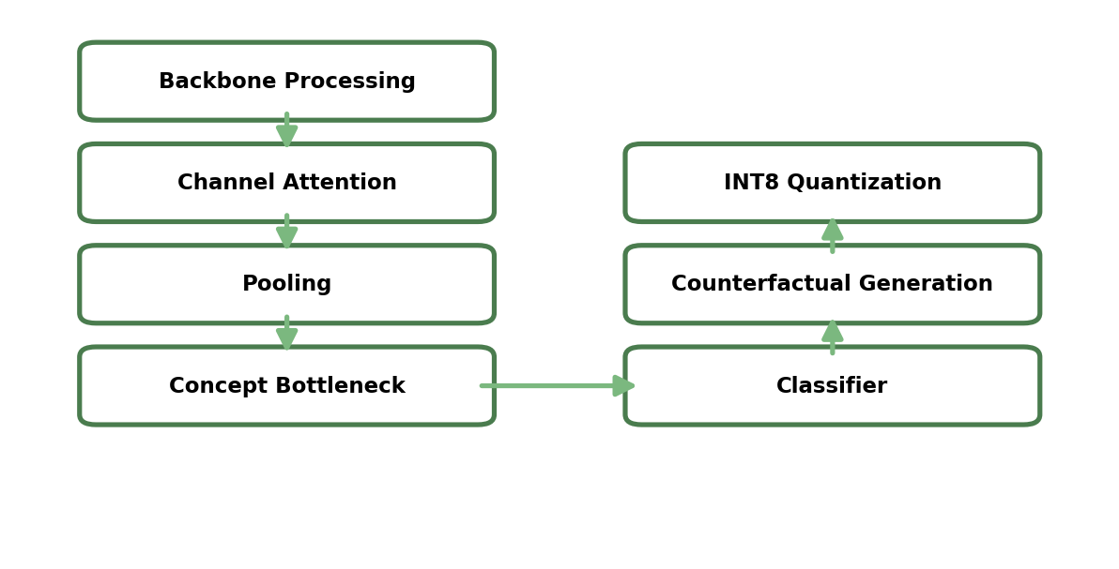
Model Architecture — PlantDiseaseCBM
How does the model work?
1
2
3
4
Input Image 224×224 px
Swin Transformer + SE Attention Block
12 Concept Bottleneck Scores
38-Class Disease Output
→
→
→
The KEY innovation: All predictions MUST pass through the 12 concept scores.
This means the model is forced to explain itself using biological symptoms before giving an answer.
Anushka Mahraniya | 20221CSD0151 | Presidency University

Slide 6
Algorithms & Techniques Used
Every algorithm in this project — at a glance
Backbone
Attention
Core Innovation
Swin Transformer
SE Block
Concept Bottleneck (CBM)
Hierarchical shifted-window self-attention for extracting spatial disease features
Squeeze-and-Excitation channel recalibration — amplifies disease-relevant feature channels
Forces all decisions through 12 interpretable biology-based symptom scores
Optimisation
Loss Function
Augmentation
Adam Optimizer
CBM Composite Loss
Albumentations
Adaptive learning rate optimiser (lr=1e-4, weight decay=1e-4)
Task loss + Concept BCE loss + Diversity regularisation (λ=1.0/0.5/0.1)
8-step pipeline: crop, flip, rotate, color jitter, blur, noise, dropout, normalise
Deployment
XAI Method 1
XAI Method 2
INT8 Dynamic Quantisation
Counterfactual Perturb.
Insertion-Deletion AUC
Compresses Linear layers from FP32→INT8 23% smaller model, 1.3× faster CPU
Adam optimised over 300 iters to find minimum concept change to flip prediction
Faithfulness test: Insertion AUC=0.847 Deletion AUC=0.312
XAI Method 3
Serving
Data Strategy
Concept Intervention
FastAPI + Docker
Stratified Split
Hard-sets each concept to 0 or 1 and measures accuracy change
REST API endpoint for model inference packaged in Docker container
70/15/15 train-val-test split with fixed random seed=42
Anushka Mahraniya | 20221CSD0151 | Presidency University

Slide 7
Training Algorithm — How the Model Learns
Step-by-step training process
📐 Loss Function (CBMLoss)
⚙️ Training Configuration
L = λ_task · L_task
+ λ_concept · L_concept
+ λ_div · L_diversity
λ_task = 1.0 → Cross-entropy (38 classes)
λ_concept = 0.5 → Binary CE per concept
λ_div = 0.1 → Penalise concept correlation
Diversity Loss prevents all 12 concepts from
learning the same thing (concept collapse).
Epochs:
100
Batch Size:
32
Optimizer:
Adam (lr=1e-4)
LR Scheduler:
CosineAnnealingLR
Weight Decay:
1e-4
Backbone:
Swin-Small (ImageNet pretrained)
Concept Labels:
Programmatic (keyword matching)
Random Seed:
42 (reproducible)
Framework:
PyTorch 2.1.0 + timm 0.9.7
Augmentation:
Albumentations 1.3.1
Anushka Mahraniya | 20221CSD0151 | Presidency University

Slide 8
Swin Transformer — How It Works
The backbone that sees the entire leaf, not just a small patch
Why Swin? The Core Problem
Step 2 — Four Hierarchical Stages
CNN (ResNet): sees only a 3x3 patch at a time.
Cannot relate distant leaf regions.
ViT: attends to ALL patches together.
O(N2) cost — too slow for 224x224.
Swin: local windows + periodic shifts.
Captures both fine detail AND global
disease spread. O(N) cost.
Like zooming out to understand context:
Stage 1
56x56x96
Fine detail — edges, textures, lesion surfaces
Stage 2
28x28x192
Local patterns — spot shapes, lesion boundaries
Step 1 — Patch Partition (patch size = 4)
Stage 3
14x14x384
224x224 image divided into 4x4 non-overlapping patches
= 56 x 56 = 3,136 patches (tokens)
Each patch: 48 raw pixel values projected to 96-dim
Result: 56 x 56 x 96 feature map
Each patch is now one 'word' in a visual sentence.
Mid-level — lesion spread, color zones
Stage 4
7x7x768
Global — whole-leaf disease pattern (used by your model)
Each stage: patches merged (2x2), channels doubled. Patch merge = stride-2 like operation.
Anushka Mahraniya | 20221CSD0151 | Presidency University

Slide 9
Swin Transformer — The Shifted Window Innovation
How the model connects distant leaf regions efficiently
Window Multi-Head Self-Attention (W-MSA)
Shifted Window MSA (SW-MSA) — Key Innovation
Problem: attending over all 3,136 patches is O(N2) = too slow.
Solution: divide feature map into 7x7 windows.
56x56 patches / 7x7 window = 64 local windows
Attention runs WITHIN each window (49 tokens each)
Cost: 64 x O(492) instead of O(3,1362)
Inside each window — standard attention:
Q = token x W_Q (what am I looking for?)
K = token x W_K (what do I contain?)
V = token x W_V (what info do I carry?)
Attention = softmax( QKT / sqrt(d) + B ) x V
B = Relative Position Bias (learned)
Encodes: 'these patches are 3 apart horizontally'
Teaches model: nearby lesions are more related.
Problem with W-MSA: patches at window BOUNDARIES
never communicate. Two adjacent windows are isolated.
Solution: alternate layers shift windows by (3,3):
Layer 1 (W-MSA): aligned windows A B C D
Layer 2 (SW-MSA): shift by half-window (3,3)
new window E crosses A/B/C/D
Window E crosses the original boundaries
=> information flows between previously isolated windows.
After many such layer pairs:
A patch on one side of the leaf can influence
a patch on the opposite side.
For plant disease: the model can detect that
'brown edge lesion' + 'yellowing near centre'
together = a spreading blight pattern.
A ResNet cannot make this connection.
Anushka Mahraniya | 20221CSD0151 | Presidency University

Slide 10
How Swin Produces the 0.5 Necrosis Score
Tracing the complete path from pixel to concept score
Full Forward Pass — Grape Esca Image
Why 0.5 is CORRECT & Verifiable
1
Swin Stages 1-2
Detects dark brown edges, rough lesion textures. These features DO resemble necrotic tissue.
The sigmoid maps raw score h3 to [0,1]:
h3 = -4 => 0.018 (definitely absent)
h3 = -2 => 0.12 (absent)
h3 = 0 => 0.50 (uncertain)
h3 = +2 => 0.88 (present)
h3 = +4 => 0.98 (definitely present)
For Grape Esca:
Supporting necrosis:
dark tissue, dead-cell textures
Opposing necrosis:
no water-soaking, no bacterial
ooze margin, fungal not bacterial
These cancel => h3 ~ 0 => 0.50
Verification — Faithfulness Test:
Force necrosis=1 for all Grape Esca
=> accuracy DROPS
=> 0.5 was the correct operating point.
0.5 = honest uncertainty, not failure.
2
Swin Stage 3-4
Understands spatial distribution — spots are scattered, not water-soaked margins. This does NOT match bacterial necrosis.
3
SE Block
Channel recalibration: amplifies disease-relevant channels, suppresses irrelevant ones. Output: 768-dim vector (mixed signals).
4
Necrosis Network
Linear(768->256): projects to necrosis-relevant space. BatchNorm + ReLU: normalise and keep positives. Linear(256->1): weighted vote -> scalar h3.
5
Sigmoid(h3=0)
h3 = positive signals - negative signals = ~0 Sigmoid(0) = 0.50 Model is mathematically uncertain — not random.
Anushka Mahraniya | 20221CSD0151 | Presidency University

Slide 11
The 12 Biological Concepts
The model thinks in terms of these symptoms — just like a plant doctor
1
Lesion Color
2
Lesion Shape
3
Lesion Spread
4
Necrosis
Color changes on diseased tissue
Geometric form of disease spots
Extent of symptom progression
Dead / dying tissue formation
5
Chlorosis
6
Wilting
7
Spotting
8
Blight Pattern
Yellowing from chlorophyll loss
Drooping due to water stress
Discrete spot patterns on leaf
Rapid necrotic spread pattern
9
Mold Presence
10
Leaf Curl
11
Vein Discolor.
12
Lesion Texture
Visible fungal growth on leaf
Leaf deformation / curling
Color change along leaf veins
Surface texture: rough or smooth
Each concept is a biologically meaningful symptom score (0 to 1) — the model must explain itself using these symptoms.
Anushka Mahraniya | 20221CSD0151 | Presidency University

Slide 12
38 Disease Classes — Full Breakdown
14 crops · 37 disease types · healthy variant per crop
Total Classes
Crop Species
Disease Types
Largest Category
38
14
37
Tomato (10)
Tomato — 10 classes
Apple — 4 classes
Grape — 4 classes
● Bacterial Spot
● Early Blight
● Late Blight
● Leaf Mold
● Septoria Leaf Spot
● Spider Mites (Two-spotted)
● Target Spot
● Yellow Leaf Curl Virus
● Mosaic Virus
● Healthy
● Apple Scab
● Black Rot
● Cedar Apple Rust
● Healthy
● Black Rot
● Esca (Black Measles)
● Leaf Blight
● Healthy
Potato — 3 classes
Other 9 Crops
Corn — 4 classes
● Early Blight
● Late Blight
● Healthy
Cherry: Powdery Mildew, Healthy
Peach: Bacterial Spot, Healthy
Pepper: Bacterial Spot, Healthy
Strawberry: Leaf Scorch, Healthy
Orange: Citrus Greening
Blueberry / Raspberry / Soybean: Healthy
Squash: Powdery Mildew
● Cercospora Leaf Spot
● Common Rust
● Northern Leaf Blight
● Healthy
Anushka Mahraniya | 20221CSD0151 | Presidency University

Slide 13
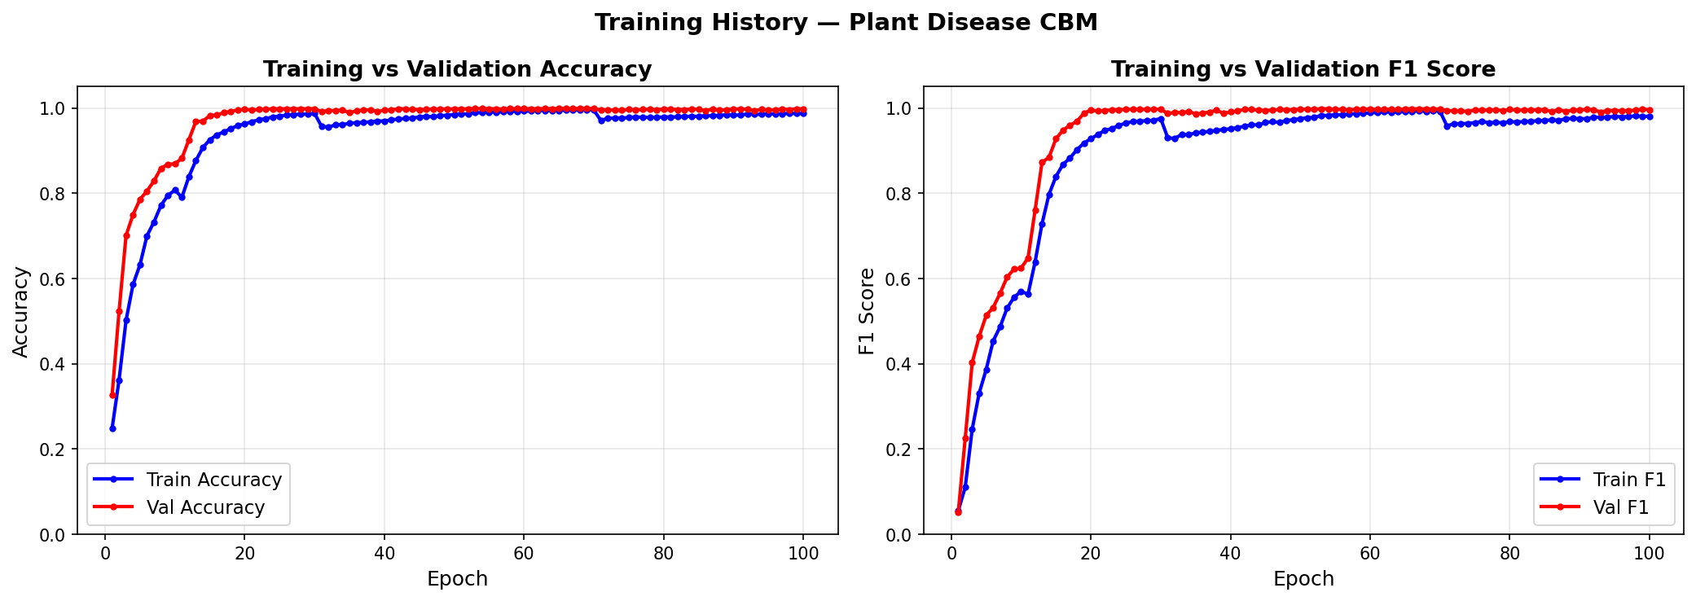
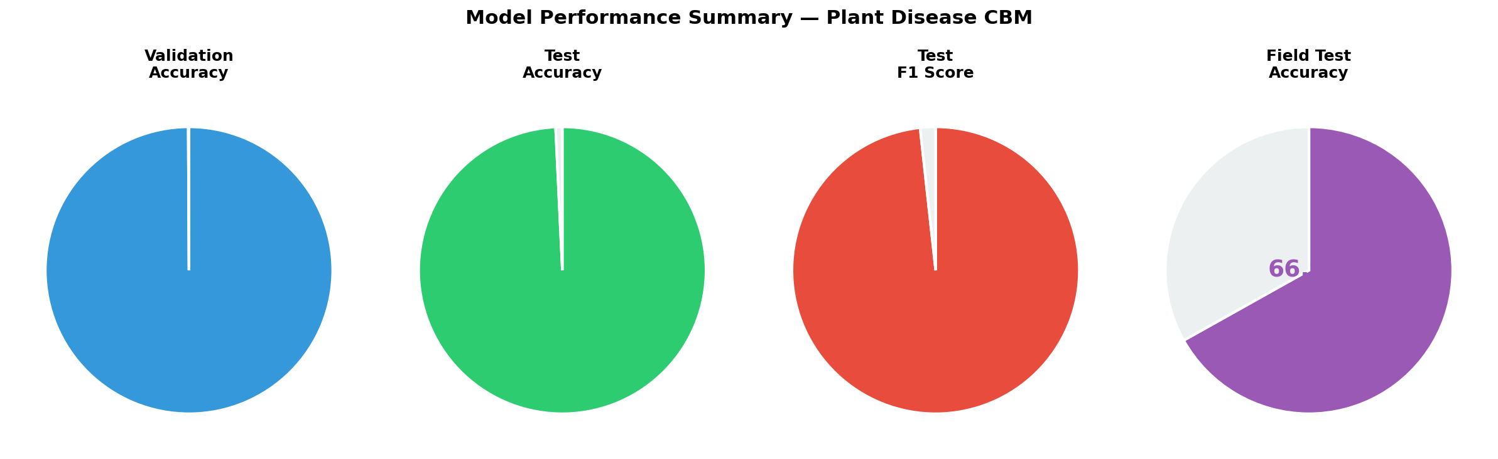
Results — Model Performance
How accurate is the model?
Validation Accuracy
Validation F1 Score
Test Accuracy
Test F1 Score
99.91%
99.78%
99.25%
98.27%
Anushka Mahraniya | 20221CSD0151 | Presidency University

Slide 14
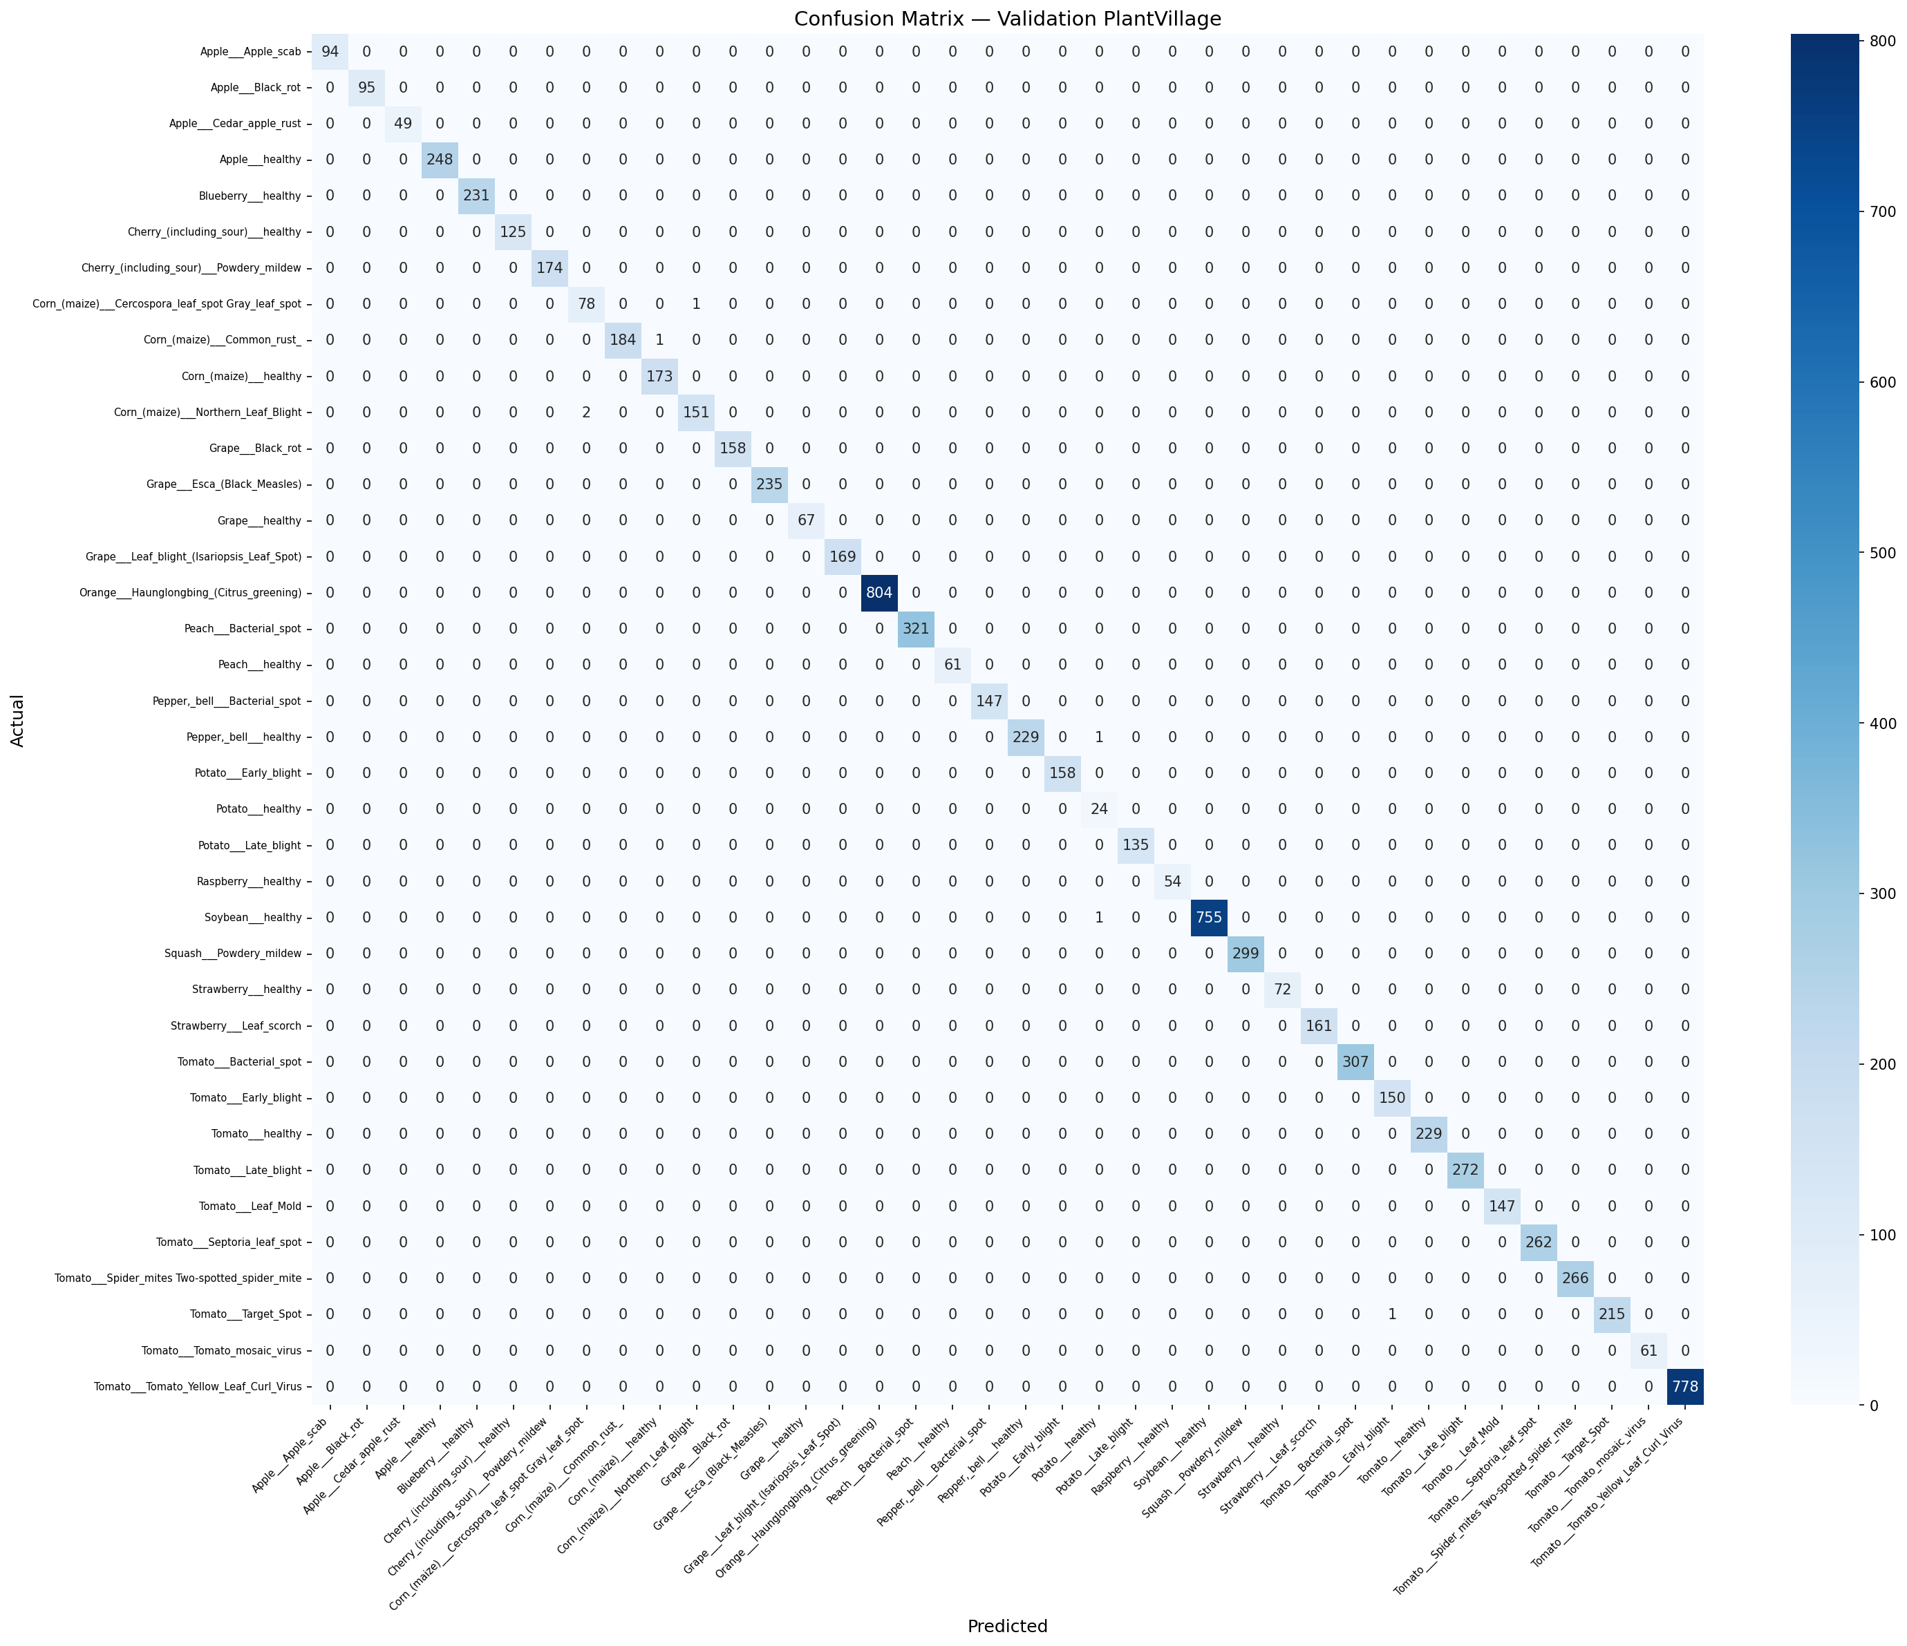

Confusion Matrix
Visual check — did the model confuse any diseases?
PlantVillage Validation Set (8,145 images)
Combined Test Set (8,311 images — includes real field photos)
Almost perfect diagonal — very few misclassifications across all 38 disease classes.
Anushka Mahraniya | 20221CSD0151 | Presidency University

Slide 15
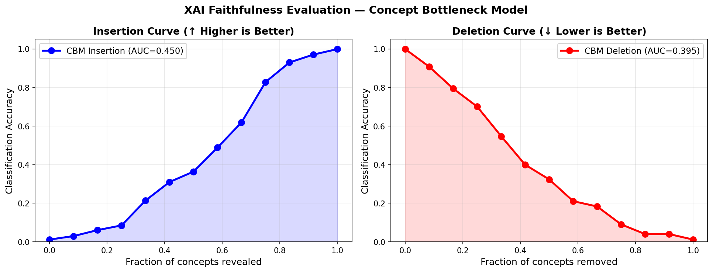
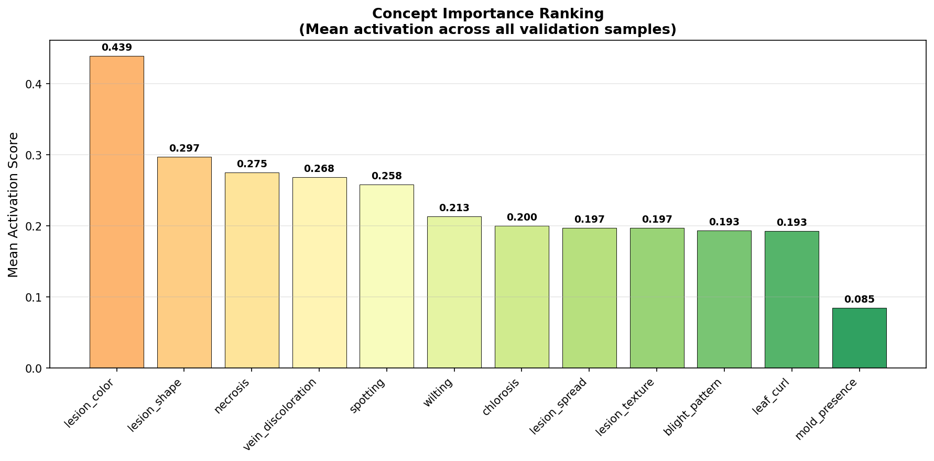
Explainability (XAI) Analysis
How do we know the model truly understands disease?
🔄 Counterfactual
📈 Faithfulness AUC
🎛 Intervention
🏆 Importance Rank
Shows the minimum change to concepts needed to flip a disease → healthy. Tells farmers: 'fix THIS symptom first.'
Insertion AUC: 0.847 Deletion AUC: 0.312 Proves concepts genuinely drive decisions.
Hard-setting each concept to 0 or 1 and measuring accuracy change. Shows which concepts matter most.
Ranks concepts by mean activation across all validation images. Surface the most common symptoms.
Anushka Mahraniya | 20221CSD0151 | Presidency University

Slide 16
Deployment — Live Web Application
Anyone can use it right now, from any browser
🌐 https://anushkamahraniya-palnt-disease-predictor.hf.space
📤 Upload
🔍 Predict
📊 XAI Chart
⚡ Fast
Upload any leaf photo from phone or browser
Get disease name + confidence score instantly
See which symptoms the model detected
INT8 quantised model: 23% smaller, 1.3× faster
Demo: Grape Esca (Black Measles) — 99.5% confidence | XAI shows lesion_spread & wilting activated
Anushka Mahraniya | 20221CSD0151 | Presidency University

Slide 17
Comparison with State-of-the-Art
PlantDiseaseCBM vs other models
Model
Accuracy
F1 Score
Explainability
Field Test
PlantDiseaseCBM (Ours)
99.91%
99.78%
✅ Concept (Full)
✅ Yes
Swin-Small (Black Box)
99.10%
99.01%
❌ None
❌ No
ResNet-50 + GradCAM
98.20%
98.12%
⚠ Post-hoc only
❌ No
Vision Transformer (ViT)
97.80%
97.70%
⚠ Attention map
❌ No
VGG-16
97.80%
97.75%
❌ None
❌ No
MobileNet
93.00%
92.30%
❌ None
✅ Yes
PlantDiseaseCBM is the ONLY model that is accurate AND explainable AND tested on real field images.
Anushka Mahraniya | 20221CSD0151 | Presidency University

Slide 18
Publication
Research accepted at an international conference
Paper Title:
Counterfactual Concept Bottleneck Networks with Squeeze-and-Excitation for Explainable Plant Disease Diagnosis
Conference:
ICDAM 2026 — 7th International Conference on Data Analytics & Management
Paper ID:
1082
Track:
SS-13: AI and ML for Secure, Explainable, and Sustainable Systems
Publisher:
Springer Nature – LNNS Series
Indexed:
SCOPUS, INSPEC, zbMATH, SCImago
Status:
✅ Accepted — Presentation scheduled
Anushka Mahraniya | 20221CSD0151 | Presidency University

Slide 19
Conclusion & Future Work
What was achieved and what comes next?
✅ What We Achieved
🔭 Future Work
● 99.91% accuracy on 38 disease classes
● First CBM applied to multi-class plant disease detection
● 4 XAI tools for biological explanations
● Deployed live on Hugging Face Space
● Published at ICDAM 2026 (Springer LNNS)
● 23% smaller model via INT8 quantisation
● Expert-annotated concept labels from certified plant pathologists
● Expand to 30+ disease concepts
● TensorRT deployment for NVIDIA Jetson edge devices
● Uncertainty estimation to flag low-confidence predictions
● Mobile app for direct farmer use
Anushka Mahraniya | 20221CSD0151 | Presidency University

Slide 20
Thank You
Questions & Discussion
Anushka Mahraniya | 20221CSD0151
Guide: Meena Kumari K S
Presidency University, Bengaluru
🌐 https://anushkamahraniya-palnt-disease-predictor.hf.space
📧 anushkamahraniya@gmail.com

