Slide 1
SNAPFLECT
Assessment Portal
Product Demo Deck
Multi-Tenant B2B / B2B2B Assessment Platform — with an AI Enrichment Roadmap
For Prospects & Customers | Live Product Walkthrough

Slide 2





WHAT WE'LL COVER
Demo Agenda
Platform Overview
Who SnapFlect is for, and the problem we solve
SESSION FORMAT
~45 minutes, live in your browser
Multi-Tenant Architecture
How B2B and B2B2B (partner) models both run on one platform
Screens shown reflect the actual app modules
Live Product Walkthrough
Questions welcome any time — this is a conversation
Login through authoring, delivery, scoring, results & certificates
We'll flag where your team can configure or extend
AI Enrichment Vision
Where generative AI accelerates your admin & reviewer workflows
02
Engagement & Next Steps
Pricing models and how to get started

Slide 3




WHY SNAPFLECT EXISTS
Assessment programs outgrow spreadsheets and static tools fast
Fragmented tenant setup
Separate instances or manual data walls per client and per partner sub-client
Loose access control
Hard to guarantee an Assessment Manager only sees their own Business Unit's candidates
Slow, manual authoring & grading
Blueprints built by hand; essays and code queued for slow manual review
Shallow analytics
Pass/fail counts, but little insight into competency gaps or question quality
03

Slide 4
SNAPFLECT AT A GLANCE
One platform, built for enterprises and the partners who serve them
SnapFlect is a multi-tenant SaaS assessment portal covering the full lifecycle: authoring, publication, candidate delivery, scoring, results and certification — with strict tenant isolation from day one.
Platform (SnapFlect)
Organizations (Tenants)
5-Level
Tenancy hierarchy: Platform → Org → Business Unit → Department → Location
Business Units
8
Core modules: Governance, Assessment, Delivery, Results, Analytics, Reporting, Certificates, Billing
Departments / Locations
Governed publication lifecycle: Draft → Review → Approved → Published → Archived
Roles & Permissions
State-Machine
04
B2B + B2B2B
Direct-enterprise and partner/reseller models on the same codebase

Slide 5




ARCHITECTURE
A hierarchical tenancy model — strict isolation, flexible structure
One SnapFlect instance serves every customer. Organizations are the primary billing and data-isolation boundary; Business Units let a partner represent each of their own downstream clients underneath a single tenant.
Platform
SnapFlect — Super Admins
Organization (Tenant)
e.g., Hexaware, or a partner agency like Virtusa
Business Unit
A partner's downstream client, or an internal division
Department / Location
Granular org segments, e.g. Engineering — Chennai
05
Roles & Permissions
Scoped access, e.g. a Manager restricted to one Business Unit

Slide 6
DEPLOYMENT MODELS
Two ways to run on SnapFlect — same platform, same guardrails
B2B — Direct Client
B2B2B — Partner / Reseller
Example: Hexaware
Example: Virtusa
SnapFlect provisions a dedicated Organization tenant
Partner's Organization tenant hosts many Business Units
Client Admins self-manage users, departments & locations
Each Business Unit maps to one of the partner's clients
Full data isolation — assessments, candidates, invoices
Partner leadership sees aggregated analytics & billing; a scoped Manager sees only their assigned client
06
Notes:
Talk track: 'Whether your prospect is a direct enterprise buyer or an assessment/training partner reselling to their own clients, it's the same underlying platform — no forked codebase, no special build.' Use this slide to ask the prospect directly which model fits them before the live walkthrough.

Slide 7
ACCESS CONTROL
Every action is governed by role, and scoped to a tenant
Role | Can do | Cannot do
Client Admin | Full control within their Organization: users, roles, billing, assessments | See another Organization's data
Assessment Manager | Create, publish, archive assessments within their scope | Act outside their Business Unit (if scoped)
Content Creator | Author draft questions & assessments | Publish directly — requires review
Reviewer | Approve/reject assessments; manually grade essay & file responses | Publish an assessment
Candidate | Take assigned assessments, view own results & certificates | See other candidates' data or question banks
Super Admin (SnapFlect) | Universal visibility & support tooling across all tenants | — (platform-level oversight role)
07
Notes:
Every transition in the assessment lifecycle (next section) checks both the role AND the organization_id match — cross-tenant access is denied at the policy layer, not just hidden in the UI.

Slide 8
PART TWO
Live Product Walkthrough
Login → Authoring → Publication → Delivery → Scoring → Results → Certificates → Governance
08
Notes:
Transition line: 'Let's stop talking about the architecture and go look at the actual product. I'll walk the same path a real assessment takes — from an admin building it, to a candidate taking it, to a reviewer scoring it.'

Slide 9
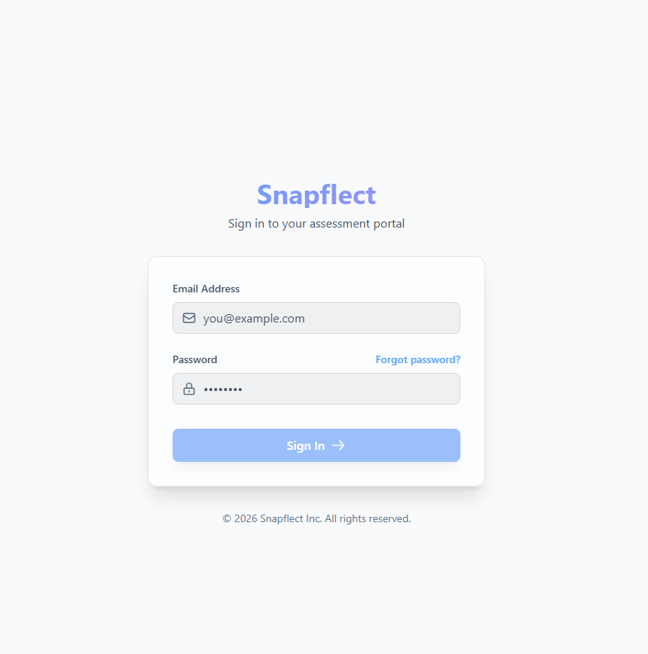



SCREEN 1 OF 12
Login & Multi-Tenant Access
Every session resolves to exactly one Organization — the tenant boundary starts at the login screen.
SNAPFLECT
Tenant-aware routing
The subdomain / org context on login resolves the correct Organization before any query touches the database.
hexaware.snapflect.io
Work email
Role resolves on sign-in
The same login screen serves Client Admins, Assessment Managers, Reviewers, and Candidates — each lands on a role-specific home.
Password
Guards enforce it end to end
Angular auth/tenant/role guards plus Laravel policies both check identity — UI and API agree on who can see what.
Sign in
09
Forgot password? Need an account? Contact your Admin
Notes:
DEMO SCRIPT: Open the login page and point out the tenant subdomain in the URL bar. Log in as a Client Admin first. Mention: 'Notice I never typed which organization I belong to — that's already resolved by how I got here, and everything downstream is scoped to it automatically.' If asked about SSO/SAML, note it as a configuration question for the technical scoping call, not a live-demo item.

Slide 10
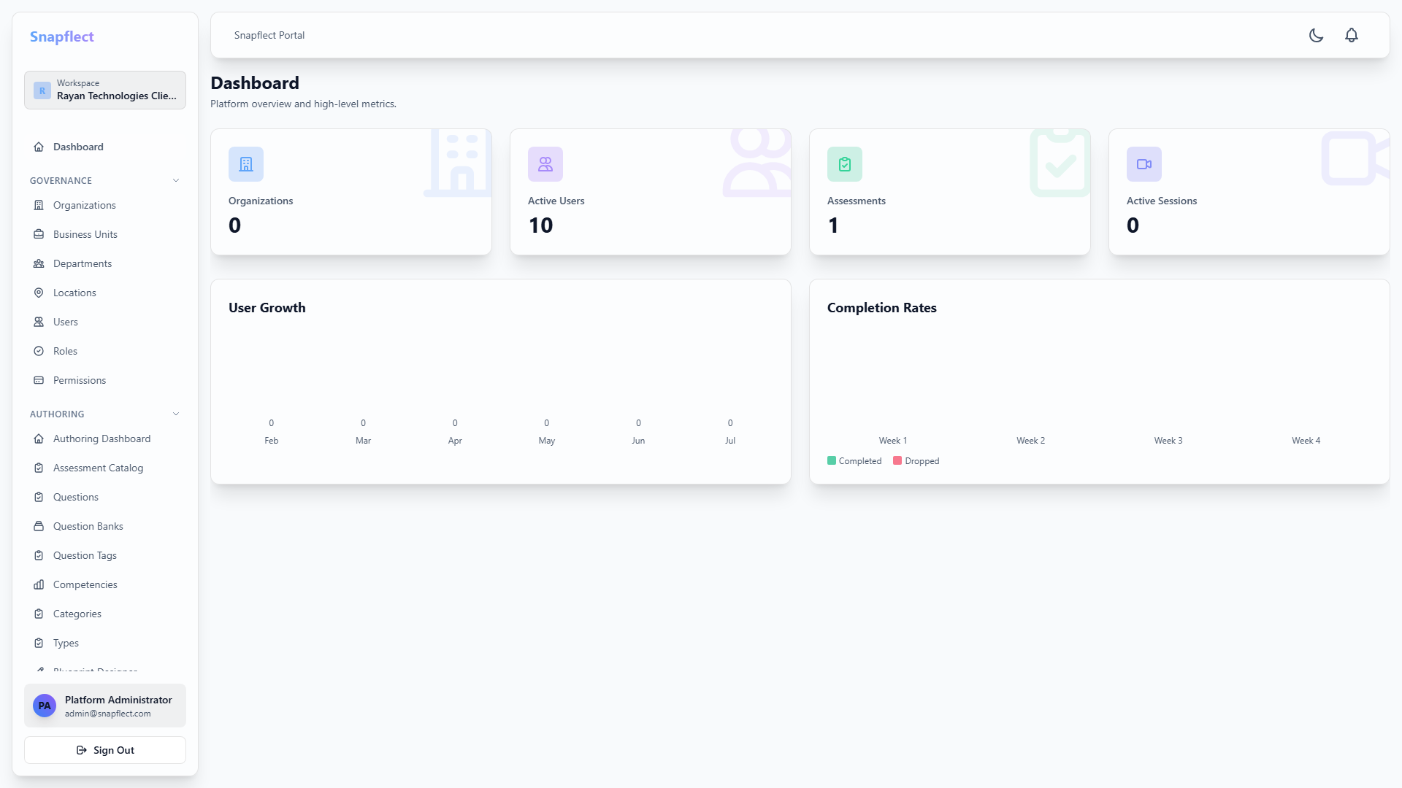
SCREEN 2 OF 12
Admin Dashboard Home
Notes:
DEMO SCRIPT: Land here right after login. Call out that KPIs, the completions chart, and the activity feed are already scoped to this Organization only — a Virtusa partner admin would see the same layout aggregated across their Business Units, while a scoped Business Unit manager sees only their slice.

Slide 11
GOVERNED WORKFLOW
The Assessment Lifecycle — a strict, auditable state machine
DRAFT
IN REVIEW
APPROVED
PUBLISHED
ARCHIVED
→
→
→
→
Author freely
Submit Review
Approve / Reject
Publish (live)
Retire
Content Creator
Assessment Manager
Reviewer
Client Admin
Client Admin
Why this matters for you
Published and Archived assessments cannot be edited or deleted — protects the integrity of anything a candidate has already taken
Publishing auto-validates the full blueprint before it can go live — no incomplete assessment reaches a candidate
11
Every transition is checked against both role AND organization_id — no cross-tenant approvals
Notes:
This is a good slide to slow down on for compliance-minded prospects: emphasize the immutability of Published/Archived states and that publish triggers full blueprint validation automatically.

Slide 12
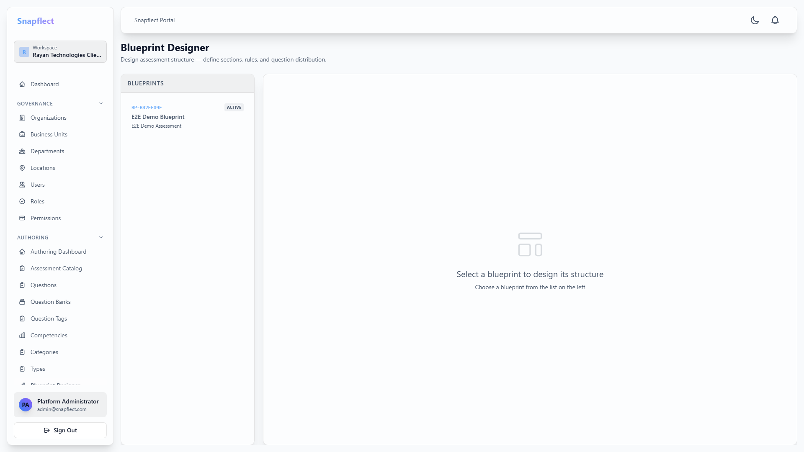
SCREEN 3 OF 12
Blueprint Designer — Assessment Authoring
12
Notes:
DEMO SCRIPT: Build one section live if time allows — add a question type, set negative marking, tag a competency. Emphasize the Submit Review button only appears because the assessment is currently in DRAFT state (tie back to the lifecycle slide).

Slide 13
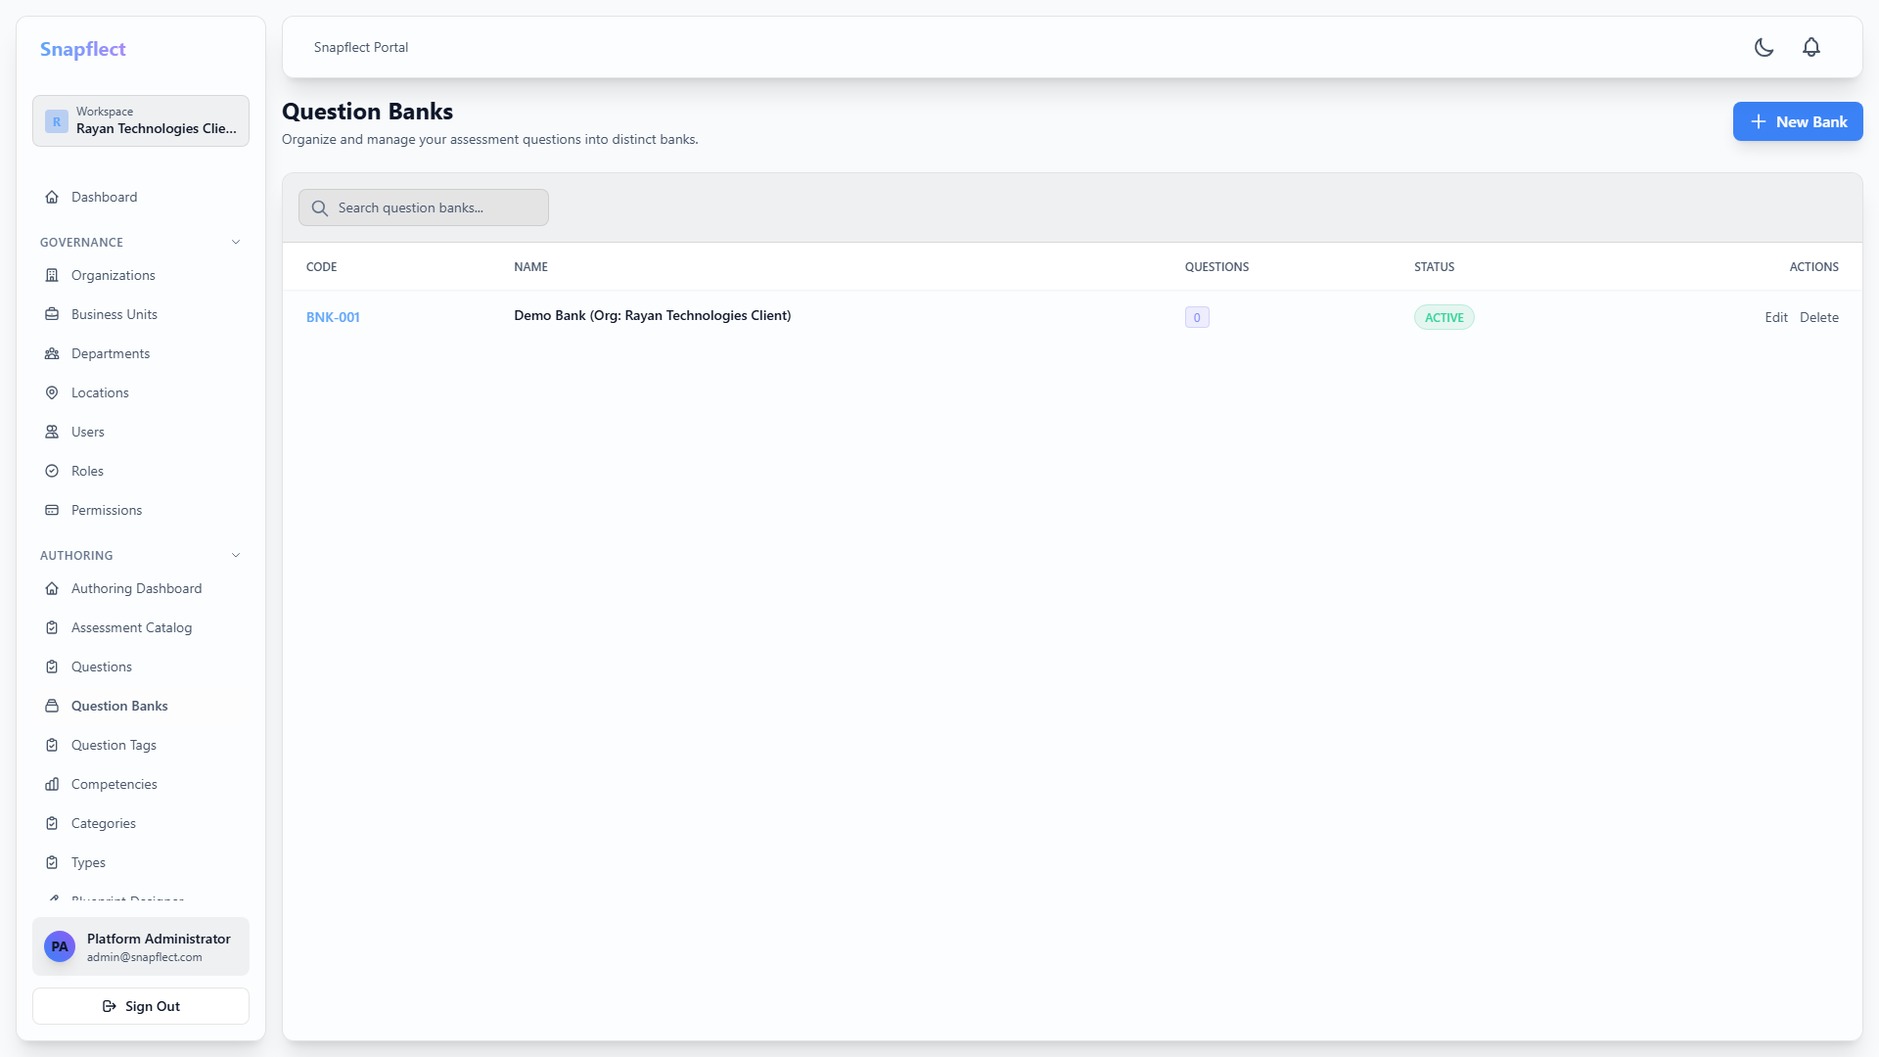
SCREEN 4 OF 12
Question Bank & Competency Mapping
13
Notes:
DEMO SCRIPT: Filter the question bank by competency to show reuse across multiple assessments. Plant the seed for the AI roadmap section by pointing at the auto-tag confidence note without diving into it yet — 'we'll come back to that in Part Three.'

Slide 14
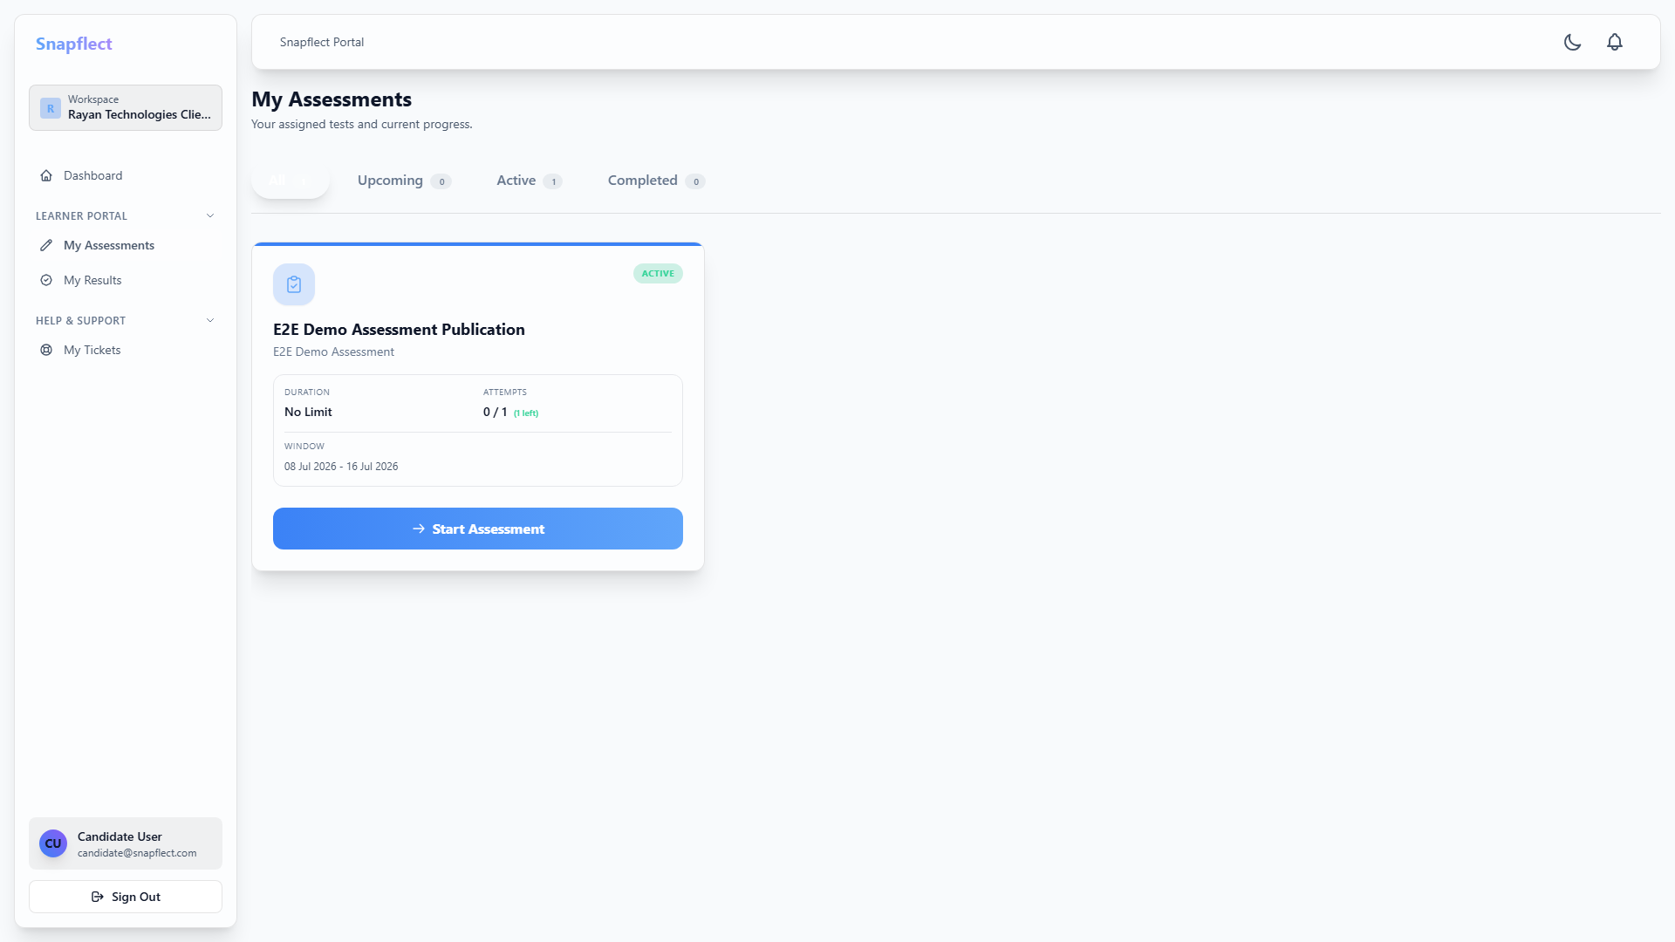
SCREEN 5 OF 12
Candidate Delivery Experience
1
2
3
4
5
6
7
8
9
10
11
12
14
Notes:
DEMO SCRIPT: Switch browser sessions (or use an incognito window) to show the candidate view. Highlight the timer, auto-save (answer already marked before moving on), and the question navigator showing answered/current/unanswered state. Mention resume-after-disconnect as a resilience point if asked.

Slide 15
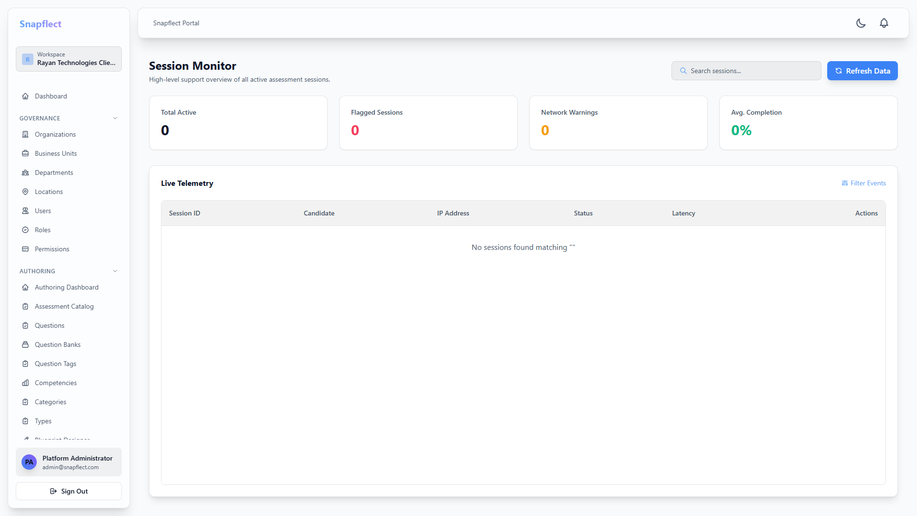
SCREEN 6 OF 12
Session Monitor — Live Delivery Oversight
15
Notes:
DEMO SCRIPT: This is the same screen your Support team uses for the 'candidate's screen froze' scenario — look up the session, verify telemetry, resolve without ever leaving this view. Mention this works identically for a Super Admin looking across Hexaware AND Virtusa's sub-clients.

Slide 16
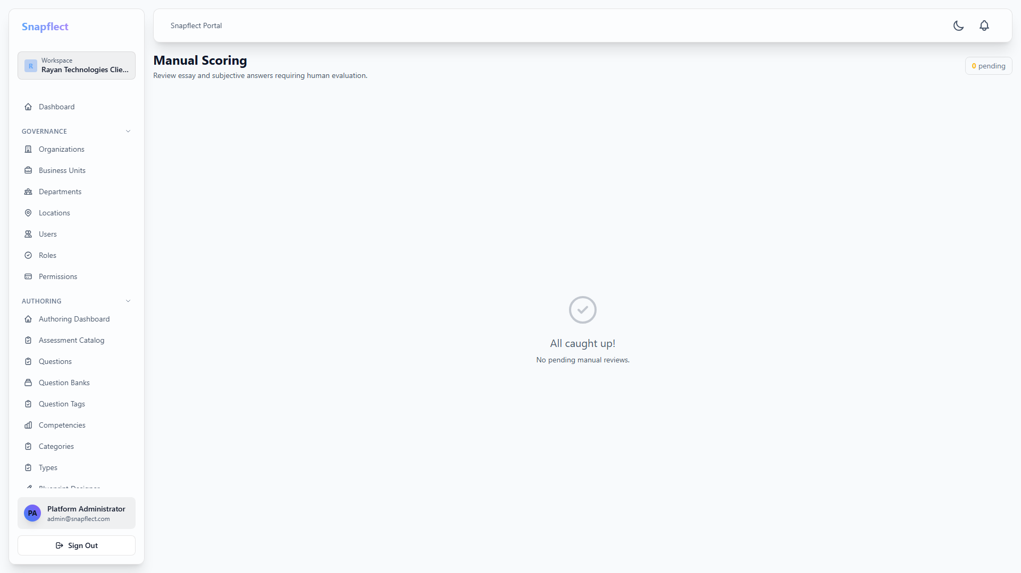
SCREEN 7 OF 12
Reviewer Dashboard & Manual Review
16
Notes:
DEMO SCRIPT: Open one essay response and walk through scoring it against the rubric criteria. This is the exact screen where, in Part Three, an AI-suggested score and justification would appear — today it's 100% human judgment.

Slide 17
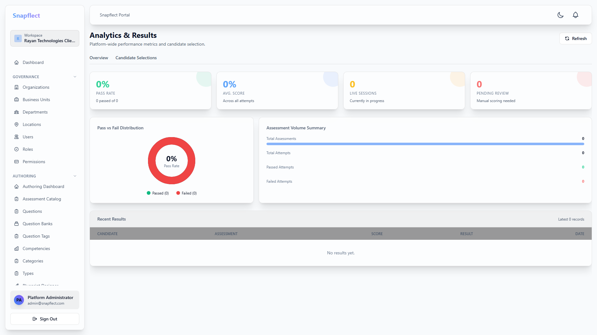
SCREEN 8 OF 12
Results Dashboard & Candidate Score Card
17
Notes:
DEMO SCRIPT: Click into one candidate result. Point out that API Design is flagged red — below the pass threshold for that competency even though overall score passed. This per-competency breakdown is what feeds both hiring decisions and (later) any learning-path recommendations.

Slide 18
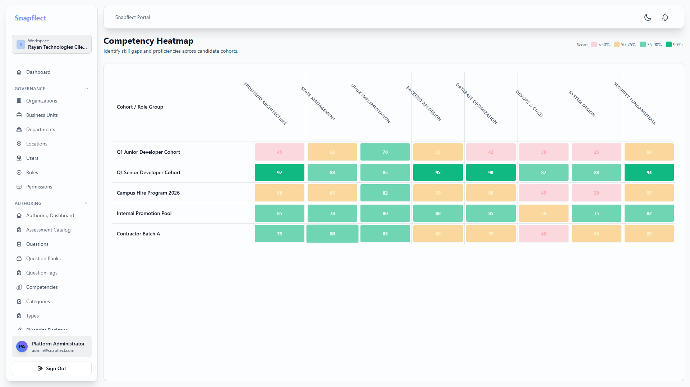
SCREEN 9 OF 12
Analytics Dashboard — KPIs, Heatmaps & Trends
18
Notes:
DEMO SCRIPT: This is a native, editable chart — if the prospect's team wants to slice by department or date range afterwards, that filter lives right on this screen. The heatmap answers 'where are our candidates weakest' at a glance, which is the natural lead-in to the Self-Healing Assessments AI idea in Part Three.

Slide 19
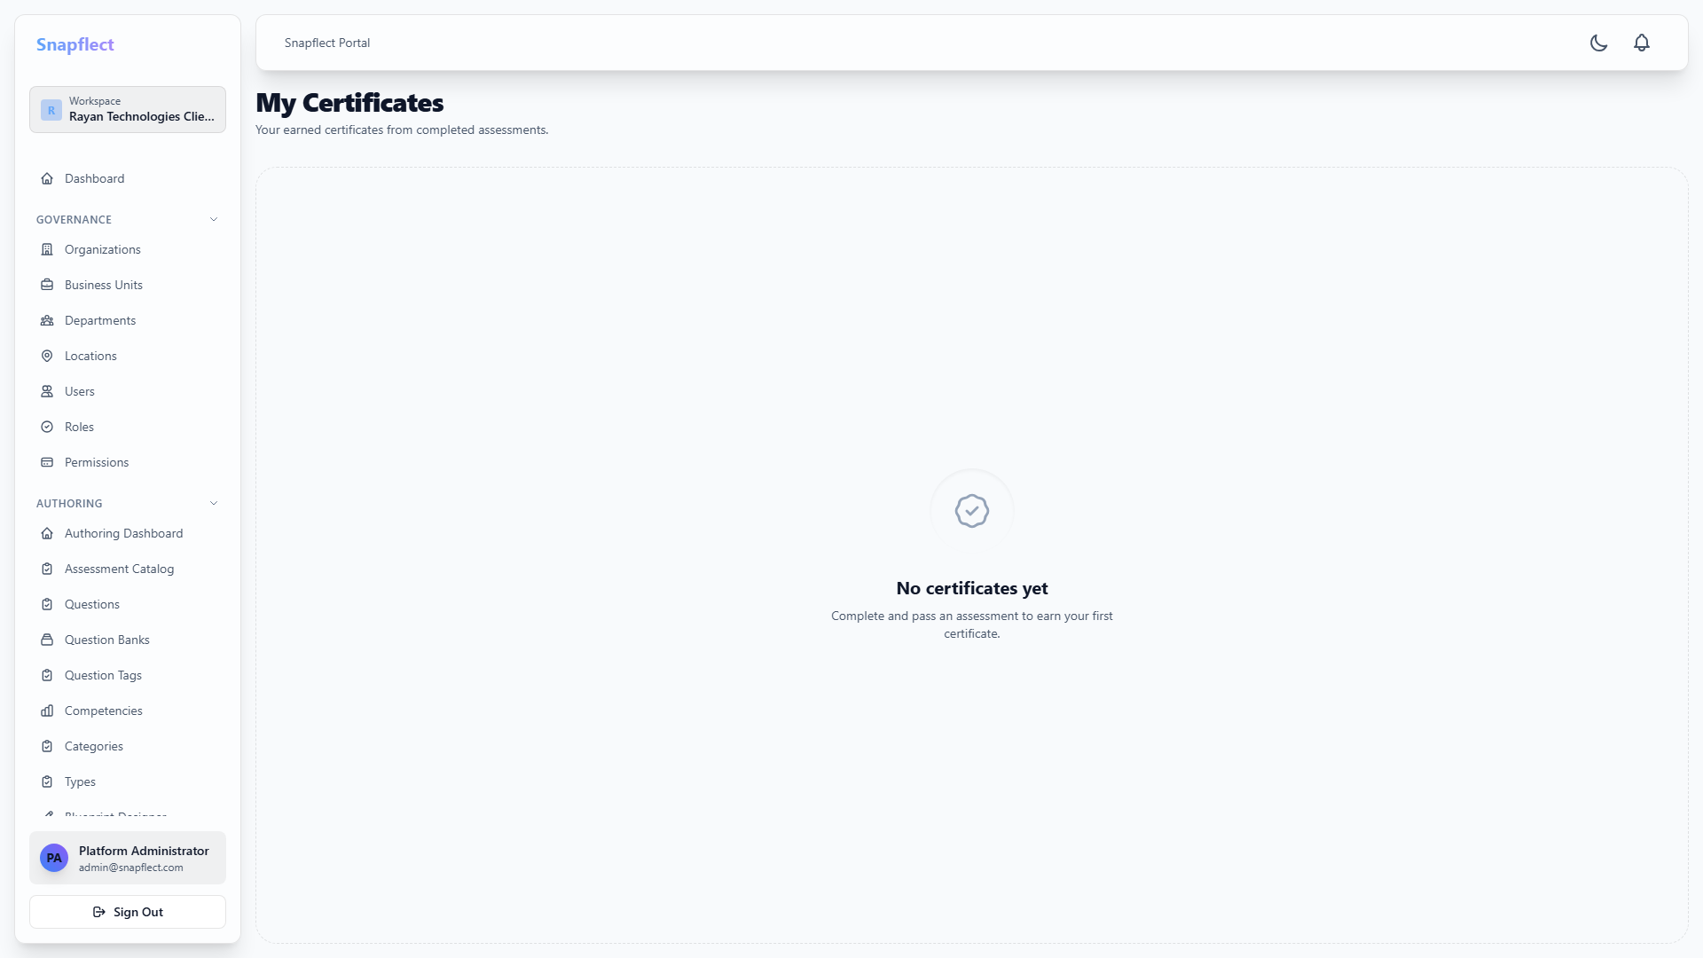
SCREEN 10 OF 12
Reporting, Certificates & Public Verification
19
Notes:
DEMO SCRIPT: Export one report live to show the download. Then open the public verification link in a fresh tab to prove it works with zero authentication — this is often the single most convincing moment for HR/talent-acquisition buyers.

Slide 20
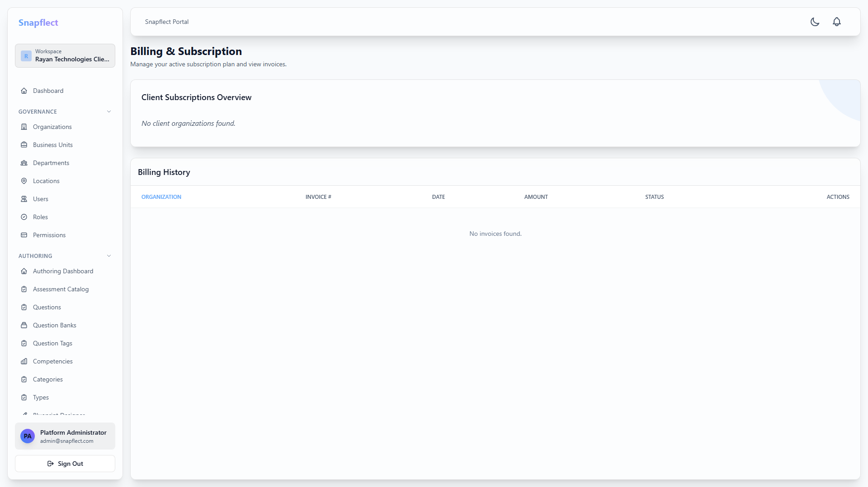
SCREEN 11 OF 12
Governance & Billing
20
Notes:
DEMO SCRIPT: This is the screen a Virtusa-style partner admin lives in — show how Business Units roll up into one subscription and one invoice, while each Business Unit's Assessment Manager never sees billing at all (RBAC in action again).

Slide 21
PART THREE
The AI Enrichment Vision
Where generative AI removes admin and reviewer busywork — without ever touching the candidate directly
21
Notes:
Transition line: 'Everything you've just seen is shipping today. What I want to show you next is the roadmap — where AI plugs into these exact same screens to save your Assessment Managers and Reviewers time.'

Slide 22



ROADMAP PRINCIPLES
AI that assists your team — never a candidate-facing feature
Admin & reviewer-facing only
Every AI feature targets Assessment Managers, Reviewers, and Admins — no AI chatbot or AI-generated report ever reaches a candidate.
AI Gateway (Internal)
Assessment
Results
Analytics
Governance
Human-in-the-loop, always
AI Gateway Service
AI suggests a score, a tag, or a draft — a person confirms it before it counts.
Tenant Scope Enforcer
Tenant isolation by design
One internal AI Gateway enforces that no prompt ever mixes data across Organizations or Business Units.
Rate Limit & Cost Meter
AI Audit Log
Gemini, OpenAI, or Bring-Your-Own-Key
Automatic failover between providers, or route candidate data through your own enterprise LLM contract.
Multi-LLM Failover
22
Notes:
If asked why we're not doing AI proctoring or an in-exam AI chatbot: 'Deliberate choice — anything candidate-facing raises fairness and privacy questions we'd rather not introduce until the internal-facing wins are proven out.'

Slide 23




AI SPOTLIGHT 1 OF 3
Smarter Authoring — minutes instead of hours per blueprint
RAG Question Generation
Upload a job description or HR manual — AI drafts a full blueprint of MCQ, multi-select and essay questions mapped to competencies.
Competency Auto-Tagging
Manually-written questions get suggested competency tags with a confidence score — low-confidence suggestions route for manual confirmation.
Difficulty & Penalty Prediction
AI recommends negative marking and weighting based on semantic complexity — always advisory, author confirms before it applies.
Blueprint Balance Checker
Before publication, AI flags coverage gaps — e.g. zero questions mapped to a stated competency — inside the existing publish workflow.
23
Notes:
Tie back to Slide 12/13 in the live walkthrough: 'Remember the Blueprint Designer and Question Bank screens I showed you? This is the same screen — the AI just pre-fills it.'

Slide 24



AI SPOTLIGHT 2 OF 3
Faster, Fairer Evaluation — AI drafts, your reviewers decide
Reviewer Assist Mode
AI pre-fills a draft rubric score per criterion right inside the Manual Review screen — reviewers edit instead of starting blank.
Automated Essay Evaluation
LLM scores open-text answers against your rubric (grammar, technical accuracy, tone) and shows its justification alongside the score.
Code Evaluation Agent (via MCP)
Candidate code runs in a secure sandbox against hidden test cases; an AI agent reviews quality, complexity and security — beyond pass/fail.
Plagiarism & AI-Content Signal
Flags likely copy-pasted or AI-generated responses as a reviewer signal, never an automatic fail — protects against false positives.
24
Notes:
Reference the reviewer-override tracking guardrail if a technical buyer asks about liability: we track how often reviewers agree with the AI suggestion vs override it, so 'human in the loop' stays real rather than becoming rubber-stamping.

Slide 25




AI SPOTLIGHT 3 OF 3
Actionable Analytics — ask a question, get an answer
Chat-with-Data
Client Admins ask in plain English — “Show candidates who scored above 80% in React but failed API Design” — answered from a tenant-scoped, read-only query engine.
Self-Healing Assessments
AI scans telemetry to flag flawed questions — e.g. 95% of top performers answer incorrectly — and routes them to a human review queue.
Cohort Comparison Narratives
A plain-English summary paragraph on the analytics dashboard turns charts into something a non-technical admin can act on immediately.
AI Cost Forecasting
Projects next-cycle AI spend per tenant from current usage trends — no surprise Pay-As-You-Go invoices.
25
Notes:
Tie back to the Analytics Dashboard walkthrough (Slide 18) — the heatmap you saw is exactly what feeds Self-Healing Assessments.

Slide 26
ENGAGEMENT MODELS
Flexible commercial models — for direct clients and partners alike
Tiered Subscription
Pay-As-You-Go (Credits)
Bring Your Own Key (BYOK)
A baseline number of AI-processed candidates and tokens bundled into Premium and Enterprise tiers.
Token usage (RAG, scoring) and session-minutes metered separately, billed at cycle end as credits.
Enterprise clients supply their own OpenAI / Gemini key — token cost passes to their cloud bill; we charge a flat platform fee.
26
Best for: predictable monthly volume
Best for: variable or seasonal hiring
Best for: large enterprises with existing LLM contracts
Notes:
These map directly to how HackerRank, HireVue, and Mercer Mettl price AI features in this space — buyers in this category will recognize the structure.

Slide 27

DIFFERENTIATORS
Why SnapFlect
One platform, two business models
Isolation enforced at the policy layer
B2B and B2B2B run on the same codebase — no forked deployment for partners.
Not just hidden in the UI — cross-tenant access is denied server-side, every time.
Governed, auditable lifecycle
AI roadmap with guardrails built in
27
A real state machine protects published assessments from accidental change.
Admin/reviewer-facing only, human-in-the-loop, tenant-scoped by design — not bolted on after the fact.

Slide 28



NEXT STEPS
Let's scope your rollout
Technical scoping call
Confirm SSO needs, tenant structure, and which AI features matter most to you
Sandbox pilot
Your team runs a real assessment cycle in a dedicated Organization tenant
Go live
Production rollout with your chosen billing model — tiered, PAYG, or BYOK
28
Thank you — questions welcome anytime.
Notes:
Close by confirming which deployment model (B2B direct or B2B2B partner) fits them, and calendar the technical scoping call before ending the meeting.

