Slide 1
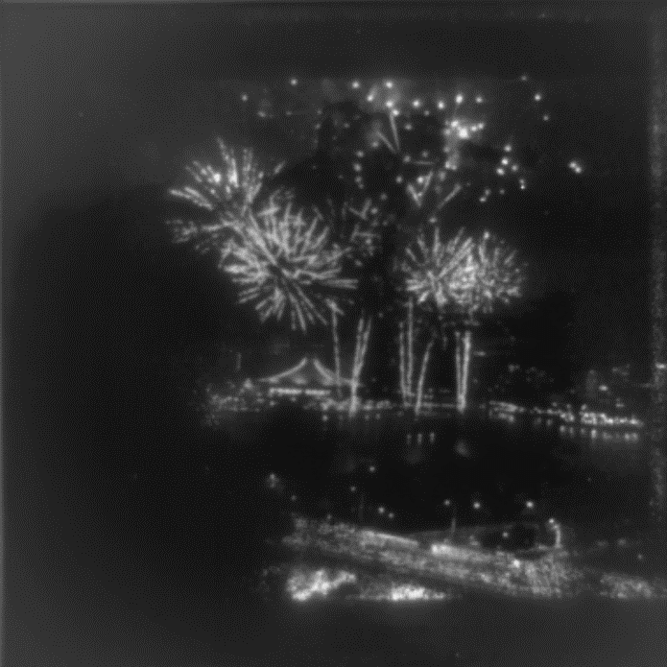
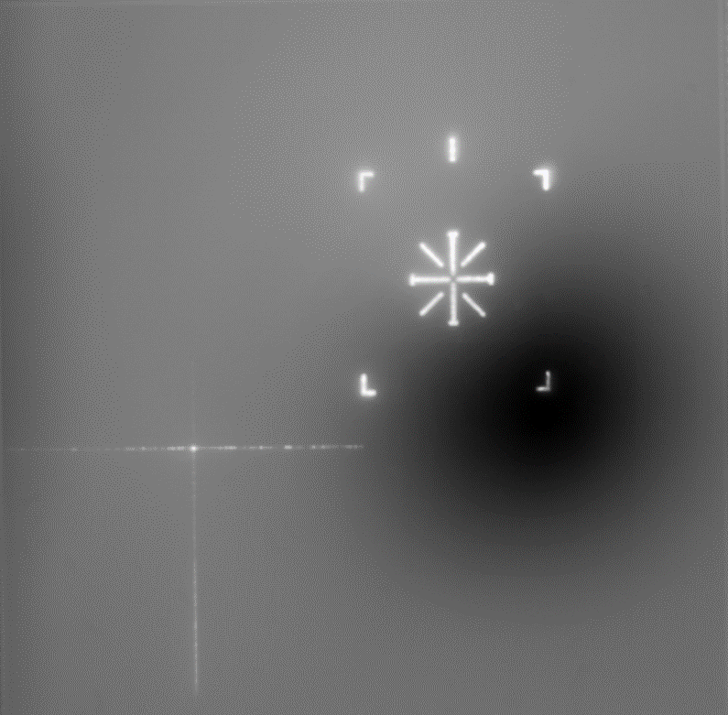
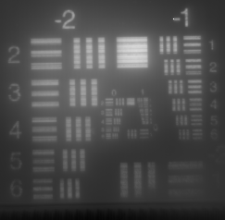
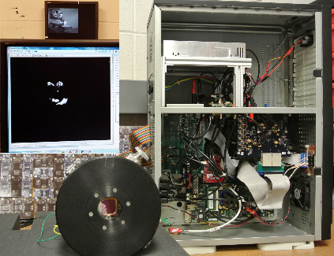
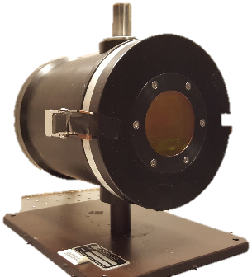
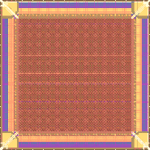

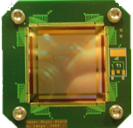
512 x 512 SLEDs array + RIIC +
System to drive array
Projector with 512 x 512 2-color SLEDs array
Projector with 2K x 2K SLEDs array
System to drive SLEDs array
64 x 64 SLEDs array + RIIC
Projector with 1K x 1K SLEDs array
2008 | 2011 | 2014 | 2016 | 2018
Notes:
Finally, in 2018, the team built the 2k x 2k projector. Complete characterization of the systems is ongoing, and having a system capable of running each of the projectors still under development has been key to performing that characterization.

