Slide 1
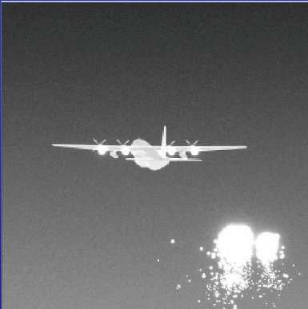
100hz
100hz
100hz
100hz
Scene-Generation
Non-Uniformity Correction
Projection

