Slide 1
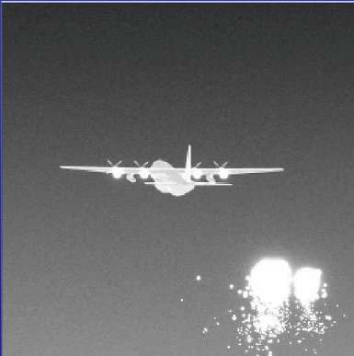
100hz
100hz
100hz
100hz
100hz
Scene-Generation
Non-Uniformity Correction/ Reordering
Digital to Analog Conversion
Projection

