Slide 1
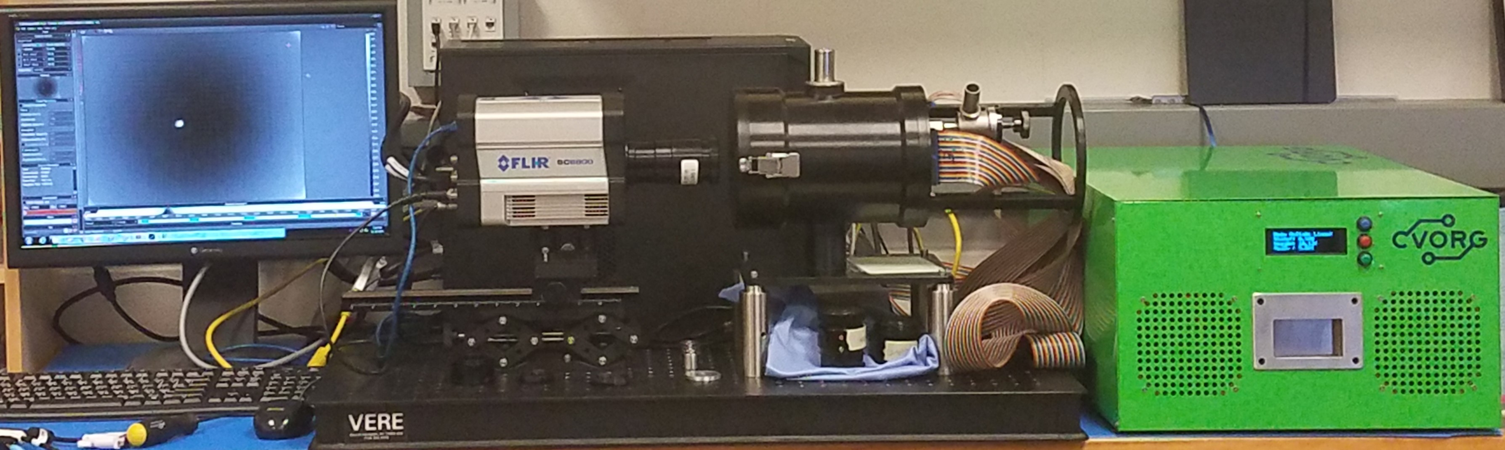
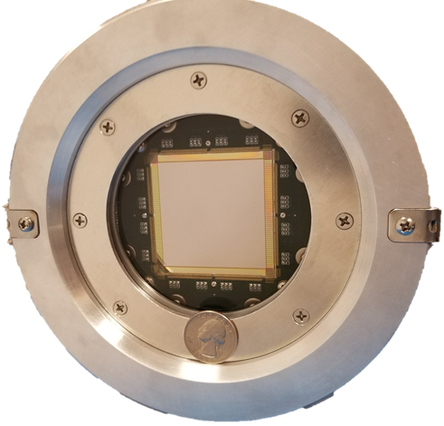
Scene Gen.
1
2
3
4
SLEDS Hybrid
5
NUC
CSE
Dewar
RIIC
IRLED Array
* Not Shown Above
1
2
6
*
5
4
3

