Slide 1

Xamarin

Slide 2
Me
App developer since 2011
iOS, Android, Unity development
Founded Snapp early 2015
Xamarin for 3+ years
15-20+ apps

Slide 3
What to expect
Im a developer
Hands on course
Ask ask ask
Lots to talk about
Ask for more details.
Xamarin intro
How to Xamarin
Cross platform
(Xamarin.Forms)
MVVMCross
iOS + Android (+WP) examples

Slide 4

Xamarin FAQ
Founded in May 2011
(now) Owned by Microsoft
350+ employees*
15,000+ customers*
Used by 1,400,000+ developers*
C# Development for iOS and Android (and WP)
*https://www.xamarin.com/about

Slide 5

IDEs

Slide 6
Why C#
You already have:
skills
tools
code
Framework
Multi purpose language (unlike objective-C / swift)
Generics, Linq, Async and the future…

Slide 7
What xamarin is not
Xamarin is only part of the solution
Learn: Windows Phone
Learn: Android
Learn: iOS
General advice:
You do have to learn the platform lifecycles and know the frameworks!

Slide 8
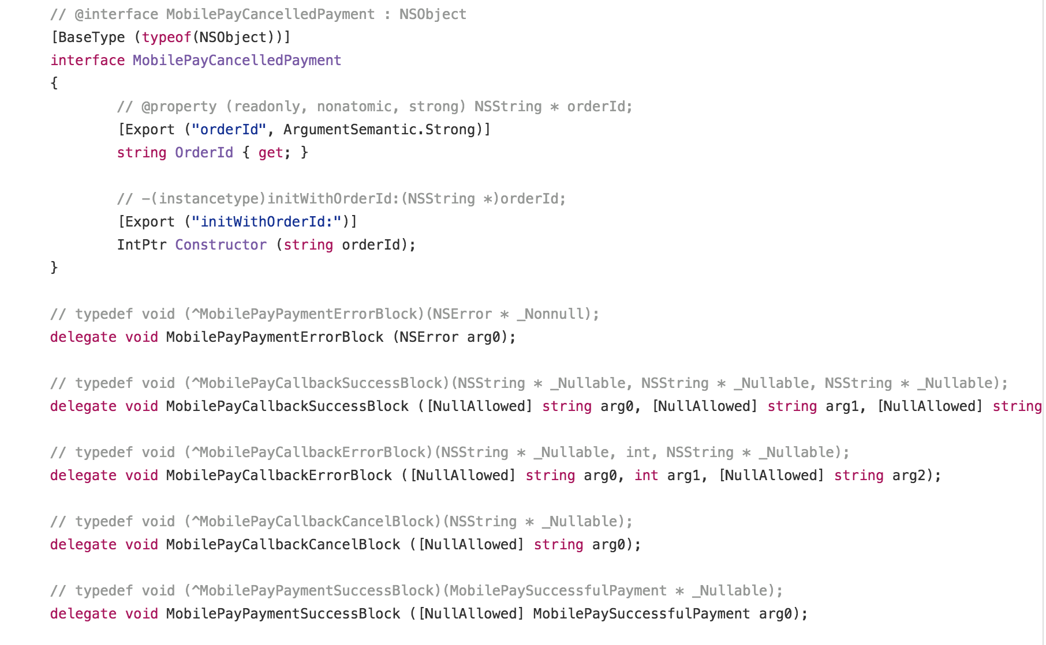
Under the hood: Xamarin bindings

Slide 9
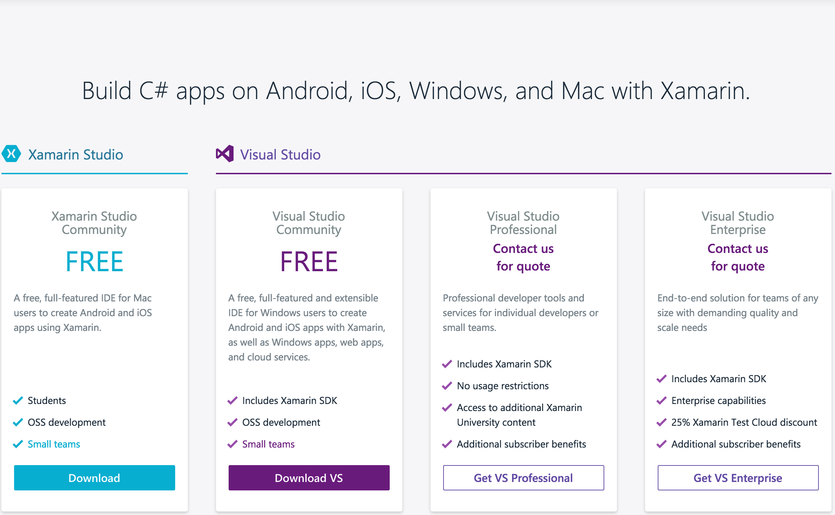
Pricing

Slide 10
Windows
Phone
iOS
Android
UI
UI
UI
ViewModels
ViewModels
ViewModels
Services
Services
Services
APIs
APIs
APIs

Slide 11
Xamarin
Windows
Phone
iOS
Android
UI
UI
UI
ViewModels
Services
APIs

Slide 12
Windows
Phone
iOS
Android
MapKit
Text-to-speech
Microsoft.Phone
UIKit
ActionBar
Windows.Networking
iBeacon
NFC
Windows.Storage
CoreGraphics
Printing
Windows.Foundation
CoreMotion
RenderScript
Microsoft.Devices
System.Net
System
System.IO
System.Xml
System.Linq

Slide 13
Client Apps
Server
SQL
Server
SQLite
UI (Win8)
WinRT
UI (WP8)
Core Logic, including:
REST client
Caching
ViewModels
Custom WebAPI
(JSON + REST)
Umbraco
CMS
Silverlight
UI (Droid)
PCL
.Net4
.Net4
MonoDroid
Shared
Entities
UI (iOS)
PCL
MonoTouch

Slide 14
DEMO: Hello World
(iOS, Android + PCL)

Slide 15
Xamarin.Forms
Windows
Phone
iOS
Android
UI
ViewModels
Services
APIs

Slide 16
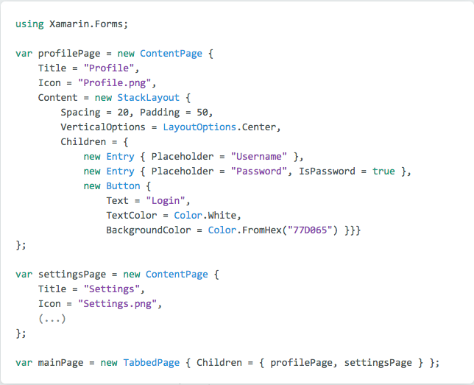
Xamarin.Forms

Slide 17
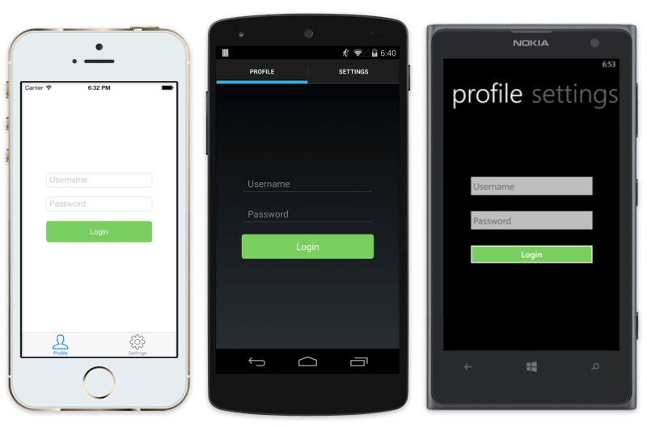
Xamarin.Forms

Slide 18
Code Sharing (MVVM)

Slide 19
Xamarin
Windows
Phone
iOS
Android
UI
UI
UI
ViewModels
Services
APIs

Slide 20
MVVM
get/set Properties
call Commands
View
ViewModel
Whatever C# you like!
View
ViewModel
Model
View
ViewModel
Model
Model
notify changes
some messaging
Platform Specific
Shared

Slide 21
MVVM Technical Details
Properties
INotifyPropertyChanged
INotifyCollectionChanged
Data Binding
IValueConverter
ICommand

Slide 22
MVVMCross Technical Details
IOC Container
Code Injection
Centralised navigation logic
Common view bindings
Plugins

Slide 23
MVVMCross Demo
(Starter pack)

Slide 24
“Pages” in MVVMCross
Android: Activity (MvxActivity)
iOS: UIViewController (MvxViewController)
Windows: Page (MvxPhonePage/ MvxStorePage)
MVVMCross: MvxViewModel

Slide 25
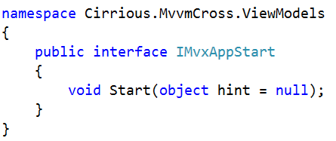
IMvxAppStart

Slide 26
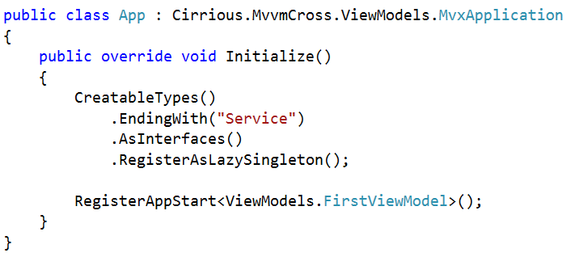
Simple Starts

Slide 27
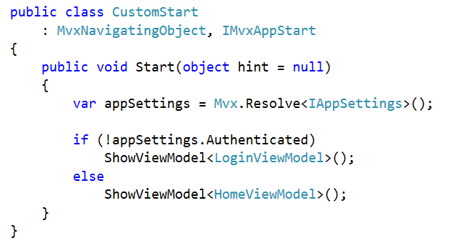
Conditional Starts

Slide 28
Data binding

Slide 29
get/set Properties
call Commands
Whatever C# you like …
… messages work well!
View
ViewModel
Model
View
ViewModel
Model
View
ViewModel
Model
notify changes
some messaging
Platform Specific
Cross Platform

Slide 30
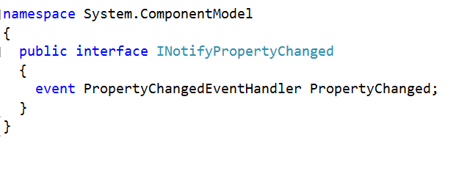
INotifyPropertyChanged

Slide 31
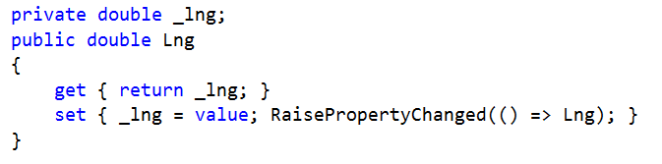
Typical ViewModel Property

Slide 32
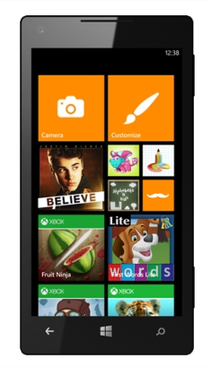
One Way Binding
PersonViewModel
First Name
Jon
Last Name
Doe
Date of birth
12/07/1989
FirstName
LastName
DateOfBirth

Slide 33



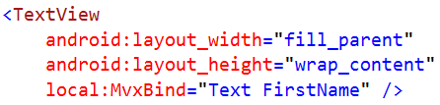

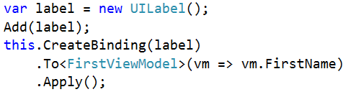
UI Syntax

Slide 34
Two Way Binding
PersonViewModel
First Name
Jon
Last Name
Doe
Date of birth
12/07/1989
FirstName
LastName
DateOfBirth

Slide 35

UI Syntax

Slide 36
Value Conversion
PersonViewModel
First Name
Jon
Last Name
Doe
Age
24
FirstName
LastName
“Age” Conversion
DateOfBirth

Slide 37
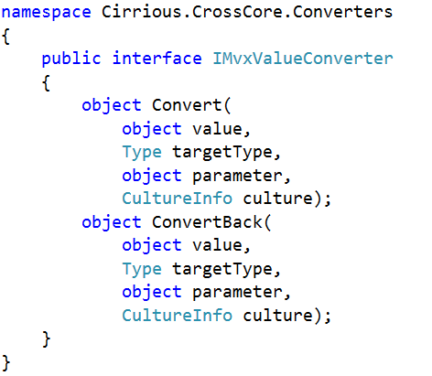
IMvxValueConverter

Slide 38
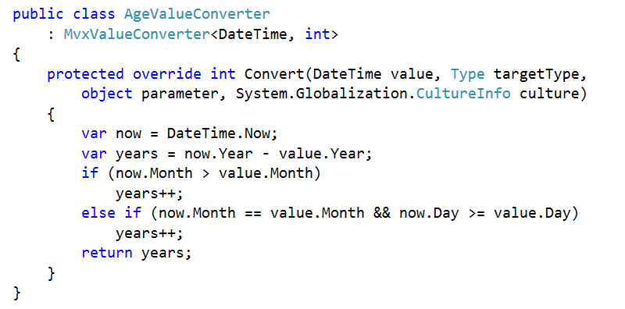
AgeValueConverter

Slide 39
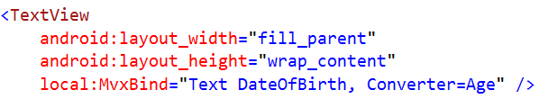
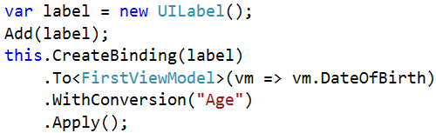
UI Syntax

Slide 40
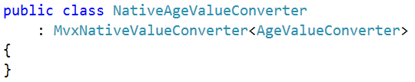

UI Syntax

Slide 41

Binding Actions
PersonViewModel
First Name
Jon
Last Name
Doe
Date of birth
12/07/1989
FirstName
LastName
DateOfBirth
AddCommand

Slide 42
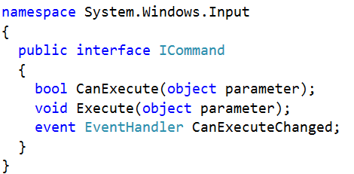
ICommand

Slide 43
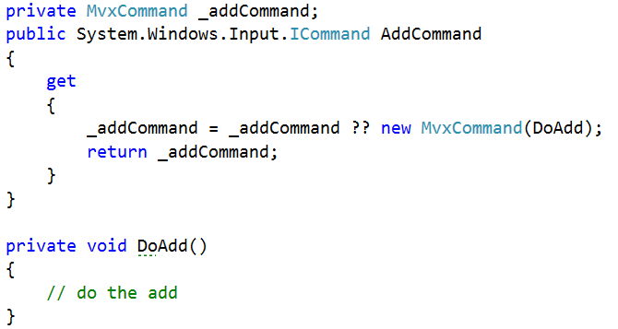
Typical ViewModel Command

Slide 44

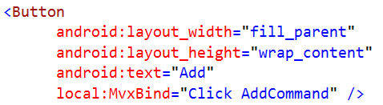
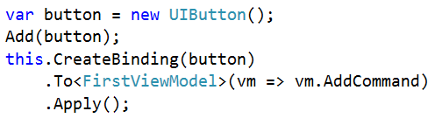
UI Syntax

Slide 45





Collections
PeopleViewModel
Cool Hackers
Greg
@gshackles
Hackers
List<PersonViewModel>
Jon
@redth
Greg
Daniel
@dsplaisted
Jon
Tomasz
@cheesebar
Daniel
Tomasz

Slide 46
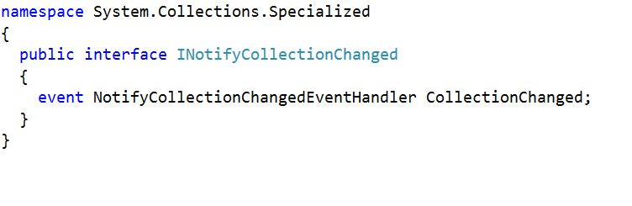
INotifyCollectionChanged

Slide 47
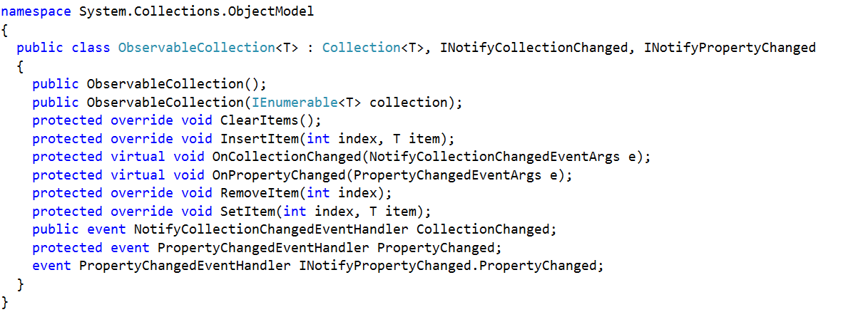
ObservableCollection

Slide 48
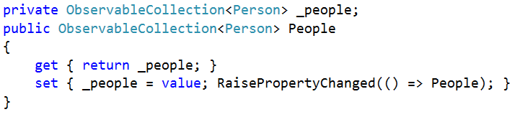
ViewModel Collection Property

Slide 49
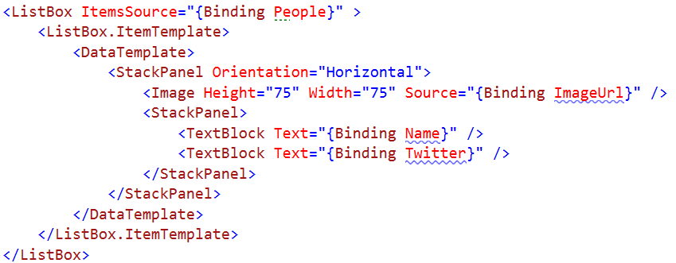
UI Syntax

Slide 50
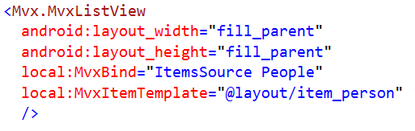
UI Syntax

Slide 51
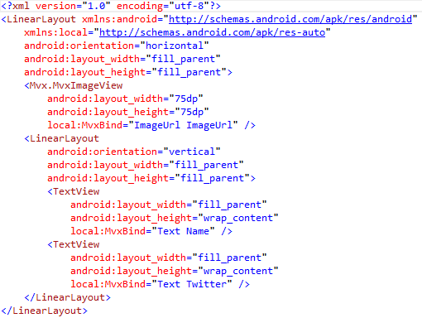
UI Syntax

Slide 52
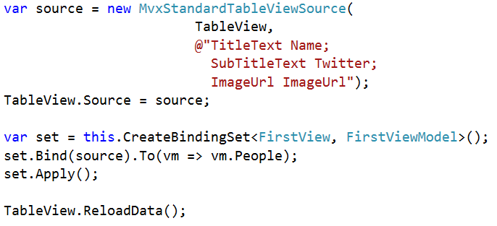
UI Syntax

Slide 53
DEMO
(Pictures)
http://jsonplaceholder.typicode.com/photos?_start=0&_end=30

Slide 54

Mvx.Register<T>
The Container
(Mvx)

Slide 55


Mvx.Register<T>
RegisterSingleton
Lazy - RegisterSingleton
RegisterType

Slide 56
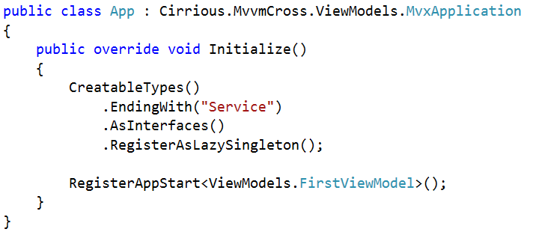
Automatic Registration

Slide 57
Mvx.Resolve<T>

Slide 58

Mvx.Resolve<T>
Resolve
CanResolve
TryResolve

Slide 59
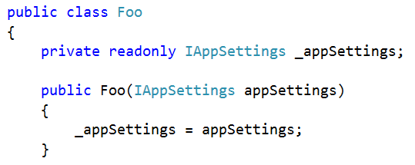
Mvx Construction
Constructor resolution
IoCConstruct

Slide 60
DEMO
(Alert)

