Slide 1
Azure DevOps Pipeline
Azure Pipeline is a cloud service that we can use to build and test our code project automatically. The Azure pipeline has a lot of capabilities such as continuous integration and continuous delivery to regularly and consistently test and builds our code and ship to any target.
There are three key distinct advantages of using Azure DevOps pipelines.
Azure DevOps Pipeline
Version control system: Azure Pipelines integrates with GitHub, GitHub Enterprise, Azure Repos Git & TFVC, Bitbucket Cloud, and Subversion.
Language and application types: We can use Azure Pipeline with most application types and languages, such as Java, JavaScript, Node.js, Python, .Net, C++, Go, PHP, and Xcode.
Deployment target: We can use Azure Pipelines to deploy our code to multiple targets. Targets include - container registries, virtual machines, Azure services, or any on-premises or cloud target.

Slide 2
Azure DevOps Pipeline concepts
Pipeline: It is a workflow that defines how our test, build, and deployment steps are run.
Stage: It is a logical boundary in the pipeline. It can be used to mark the separation of concerns. Each stage contains one or more jobs.
Job: A stage can contain one or more jobs. Each job runs on an agent. It represents an execution boundary of a set of steps.
Step: It is the smallest building block of a pipeline. It can either be a script or a task. A task is simply an already created script offered as a convenience to you.
Agent and Agent pools: An agent is an installable software that runs one job at a time. Instead of managing each agent individually, you organize agents into agent pools.
Artifact: It is a collection of files or packages published by a run. The Artifact is made available to subsequent tasks, such as distribution or deployment.
Trigger: It is something that is set up to tell the pipeline when to run. We can configure a pipeline to run upon a push to the repository, at scheduled times, etc.
Environment: It is a collection of resources, where you deploy your application. It contains one or more virtual machines, containers, web apps, etc.
Checks: Checks define a set of validations required before a deployment can be performed.
Runs: It represents a single execution of a pipeline and collects the logs associated with running the steps and the results of running tests.

Slide 3
Environment:-
An environment is a collection of resources that can be targeted by deployments from a pipeline. Environments can include Kubernetes clusters, Azure web apps, virtual machines, databases. Typical examples of environment names are Dev, Test, QA, Staging, and Production.
The advantages of using environments include the following.
Deployment history — Pipeline name and run details are recorded for deployments to an environment and its resources. In the context of multiple pipelines targeting the same environment or resource, the deployment history of an environment is useful to identify the source of changes.
Traceability of commits and work items — View jobs within the pipeline run that target an environment. You can also view the commits and work items that were newly deployed to the environment. Traceability also allows one to track whether a code change (commit) or feature/bug-fix (work items) reached an environment.
Diagnose resource health — Validate whether the application is functioning at its desired state.
Permissions — Secure environments by specifying which users and pipelines are allowed to target an environment.

Slide 4
Release Pipeline:-
A release pipeline is a conceptual process by which we take committed code into production. As such, a release pipeline can be as ephemeral or as real as we want to make it. The fundamental release pipeline from code change to production software. A means of triggering the pipeline to run.
It’s divided into 2 sections:
Artifacts
Stages
An artifact is a deployable component of your application. Azure Pipelines can deploy artifacts that are produced by a wide range of artifact sources, and stored in different types of artifact repositories.
And stages will include our deployment stages like - dev, test, and prod, etc.
Library :-
A library is a collection of build and release assets for an Azure DevOps project. Assets defined in a library can be used in multiple build and release pipelines of the project. The Library tab can be accessed directly in Azure Pipelines.

Slide 5
Variable groups
Variable groups store values and secrets that you might want to be passed into a YAML pipeline or make available across multiple pipelines. You can share and use variables groups in multiple pipelines in the same project.
Variables groups are protected resources. You can add approvals and checks to these variables and set pipeline permissions.
Secure files
Secure files give you a way to store files that you can share across pipelines. Use the secure files library to store files such as:
signing certificates
Apple Provisioning Profiles
Android Keystore files
SSH keys
These files can be stored on the server without having to commit them to your repository.
The contents of the secure files are encrypted and can only be used when you consume them from a task. Secure files are a protected resource. You can add approvals and checks to them and set pipeline permissions. Secure files also can use the Library security model.

Slide 6
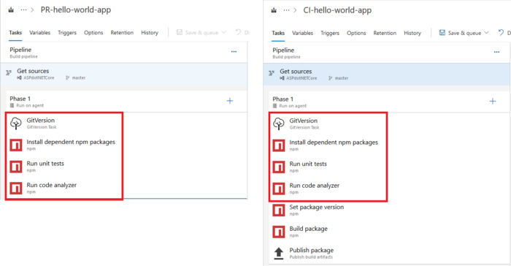
Task groups:-
Task groups are groups of individuals brought together to accomplish a specific action or produce a product
If you take the example of the above shown pipelines, the first four tasks are common to both definitions. In case there is a need for modifying one of the tasks (or remove/add a common task), the change has to be separately applied to both definitions. Now think about it at a larger scale, where there are many pipelines and you have to modify each one’s definition.

Slide 7
If you take the example of the above shown pipelines, the first four tasks are common to both definitions. In case there is a need for modifying one of the tasks (or remove/add a common task), the change has to be separately applied to both definitions. Now think about it at a larger scale, where there are many pipelines and you have to modify each one’s definition.
This is where Azure Pipeline’s Task Groups come in handy. Task Group, as the name suggests, groups a common set of tasks into one single task. Multiple pipelines can now use this new task instead of repeating the steps all over again. Creating task groups is very easy. Just select the tasks that you want to group and choose “Create task group” from the context menu. A popup appears, enter name and description and select category under which this new task should appear and click on the “Create” button. It is also possible to create a task group that encapsulates other task groups.
Deployment group:-
A deployment group is a logical set of deployment target machines that have agents installed on each one. Deployment groups represent the physical environments; for example, "Dev", "Test", or "Production" environment. In effect, a deployment group is just another grouping of agents, much like an agent pool.

