Slide 1
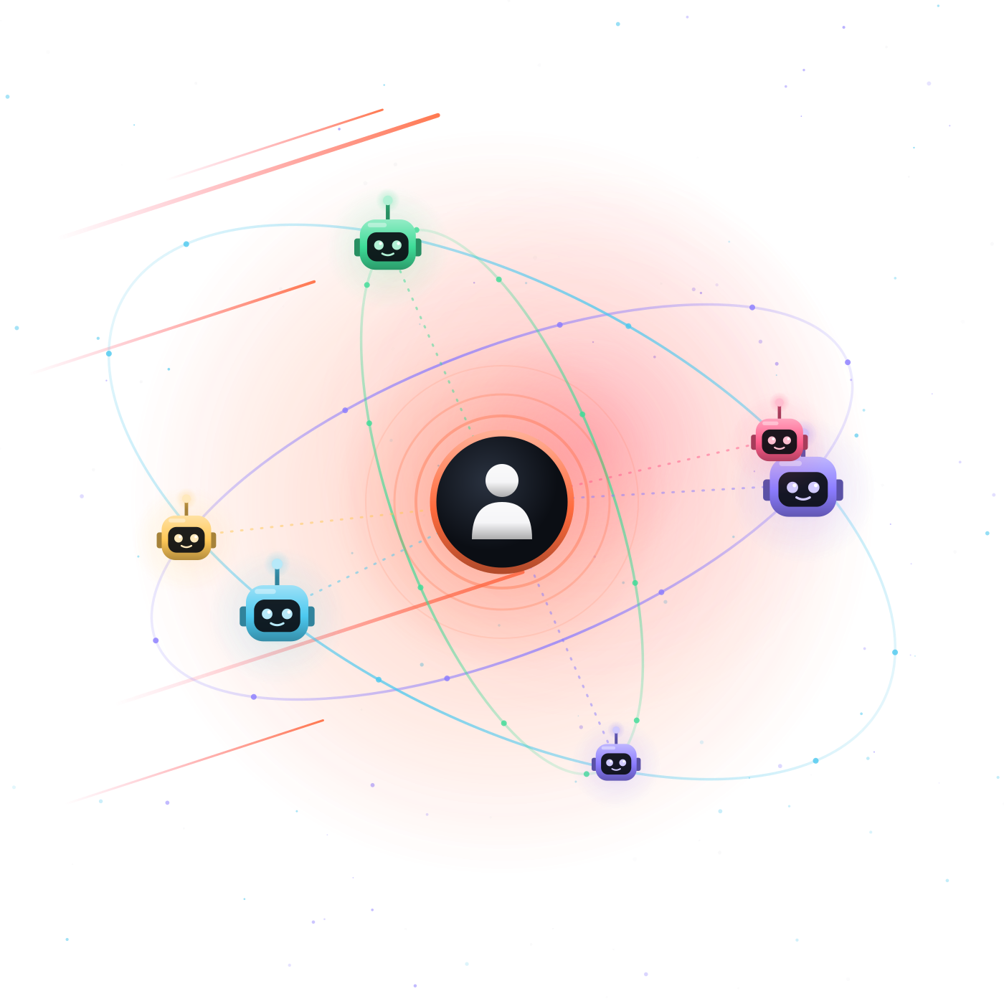
Beyond
Coding
A FIELD REPORT FROM A SOFTWARE TEAM
Engineering with AI Agents
Samet Nargül | Backend Developer | Baden Württemberg, Germany

Slide 2


Two quick questions
SHOW OF HANDS
01
02
Who has used ChatGPT to solve a programming problem?
Who has let an AI agent change a whole project, run the tests, and fix its own mistakes?

Slide 3




You’ll leave with four things
BEFORE WE START
What an agent really is
and how to work with one
What’s changing in the industry
roles that grow, shrink, or come and go
What goes wrong
mostly from my own mistakes, and how to protect yourself
A starter kit
things you can start doing tomorrow

Slide 4
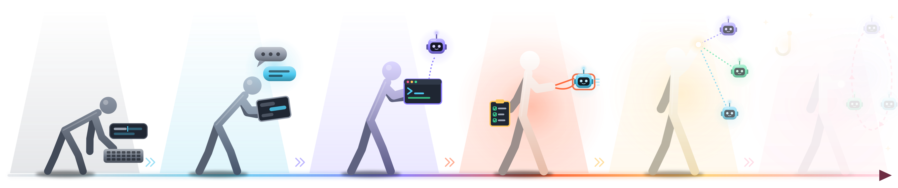
The evolution of AI-assisted engineering
HOW WE GOT HERE
I'M HERE
~2021
~2022
~2025
NOW
EMERGING
NEXT
Autocomplete
Chat
Agents in IDE & CLI
SDD & Harness
Orchestration
?
Suggests the next line
Ask, copy, paste, fix
AI edits, runs, retries
Specs, skills, checks
A lead agent runs many

Slide 5
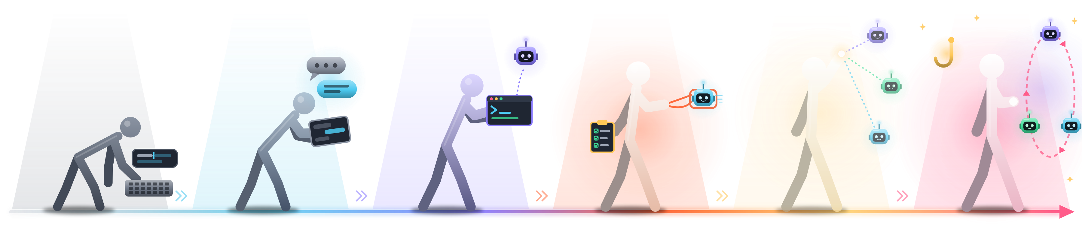



And where it’s heading
HOW WE GOT HERE
I'M HERE
Long-running loops
The system restarts the agent until the tests pass, even overnight.
Hooks
Automatic rules at fixed moments. A prompt asks; a hook guarantees
Humans on the loop
Design the system, set the rules, step in when needed

Slide 6
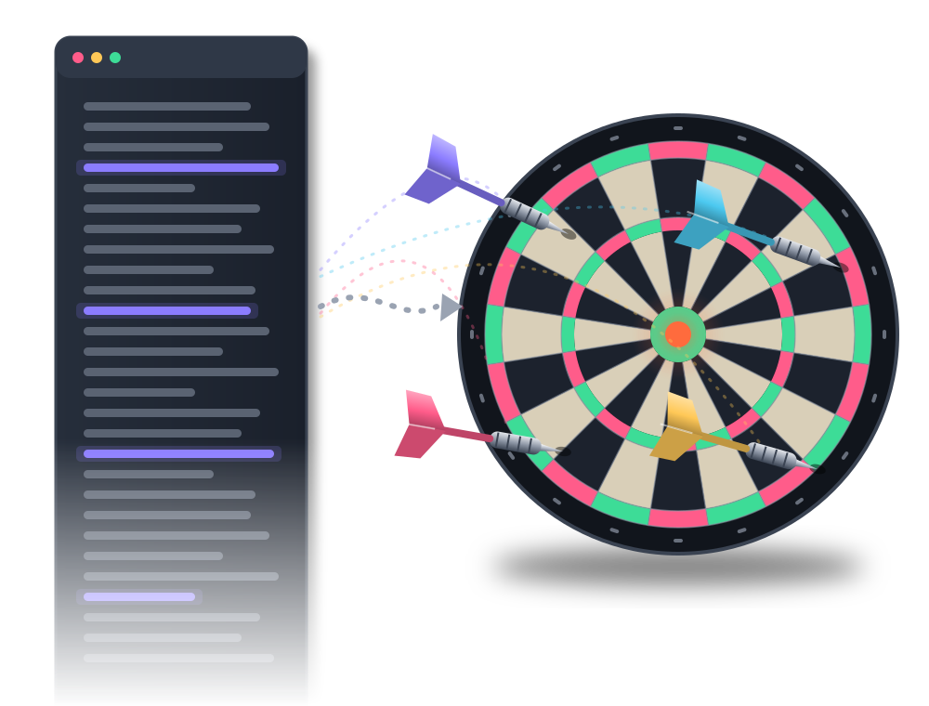



More words didn't mean better aim
THE FIRST PROBLEM
Long prompts hid assumptions
The AI filled gaps with confident guesses
Every session started from zero
Decisions didn't carry over
Nothing to review against
No written plan, so no clear “done”
Great for exploring. Fragile for products.

Slide 7


Adding a harness
WHAT WORKED
A harness doesn't make the model stronger. It makes its strength usable.
PLAN
CLARIFY
BUILD & PROVE
PRD
Roadmap
Epics
Brainstorm
Specs
Implement
Verify
Q&A until ≥95% confident
WHAT CHANGED FOR US
Predictable results
Decisions written down
Clear review criteria

Slide 8
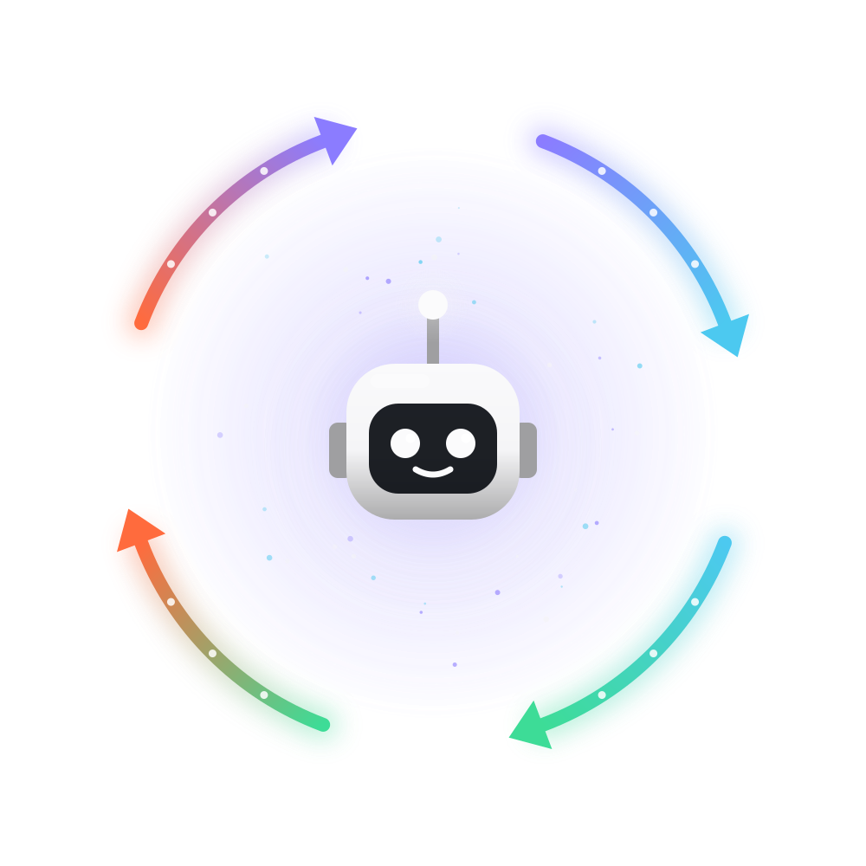







What makes an agent an agent
INSIDE ONE AGENT
You set the goal
ANATOMY
Plan
Model
The brain that reasons
Instructions
Its role and rules, often just a text file
Adjust
Act
Tools
What it may touch: files, terminal, tests
Loop
Plan, act, observe, adjust, until done
Observe
WHAT IT ISN’T
A mind reader. A senior engineer. Accountable for the result.
You decide it’s done

Slide 9
How to work with an agent
WORKING WITH ONE
test-reviewer.md
BRIEF IT WELL
Goal
What should exist when it’s finished?
---
name: test-reviewer
description: Finds untested edge cases
tools: Read, Grep
---
You are a careful test reviewer.
For every change, list the edge
cases that are not tested.
Never edit code. Report only.
Context
Which files, decisions and examples matter?
Constraints
What must it not touch or change?
Done when
Which tests or checks prove it?
Creating one is this simple. Using one well is a skill.
WATCH FOR
Confidently wrong
Changes too much
Says “done” too early
Loops on the same error

Slide 10
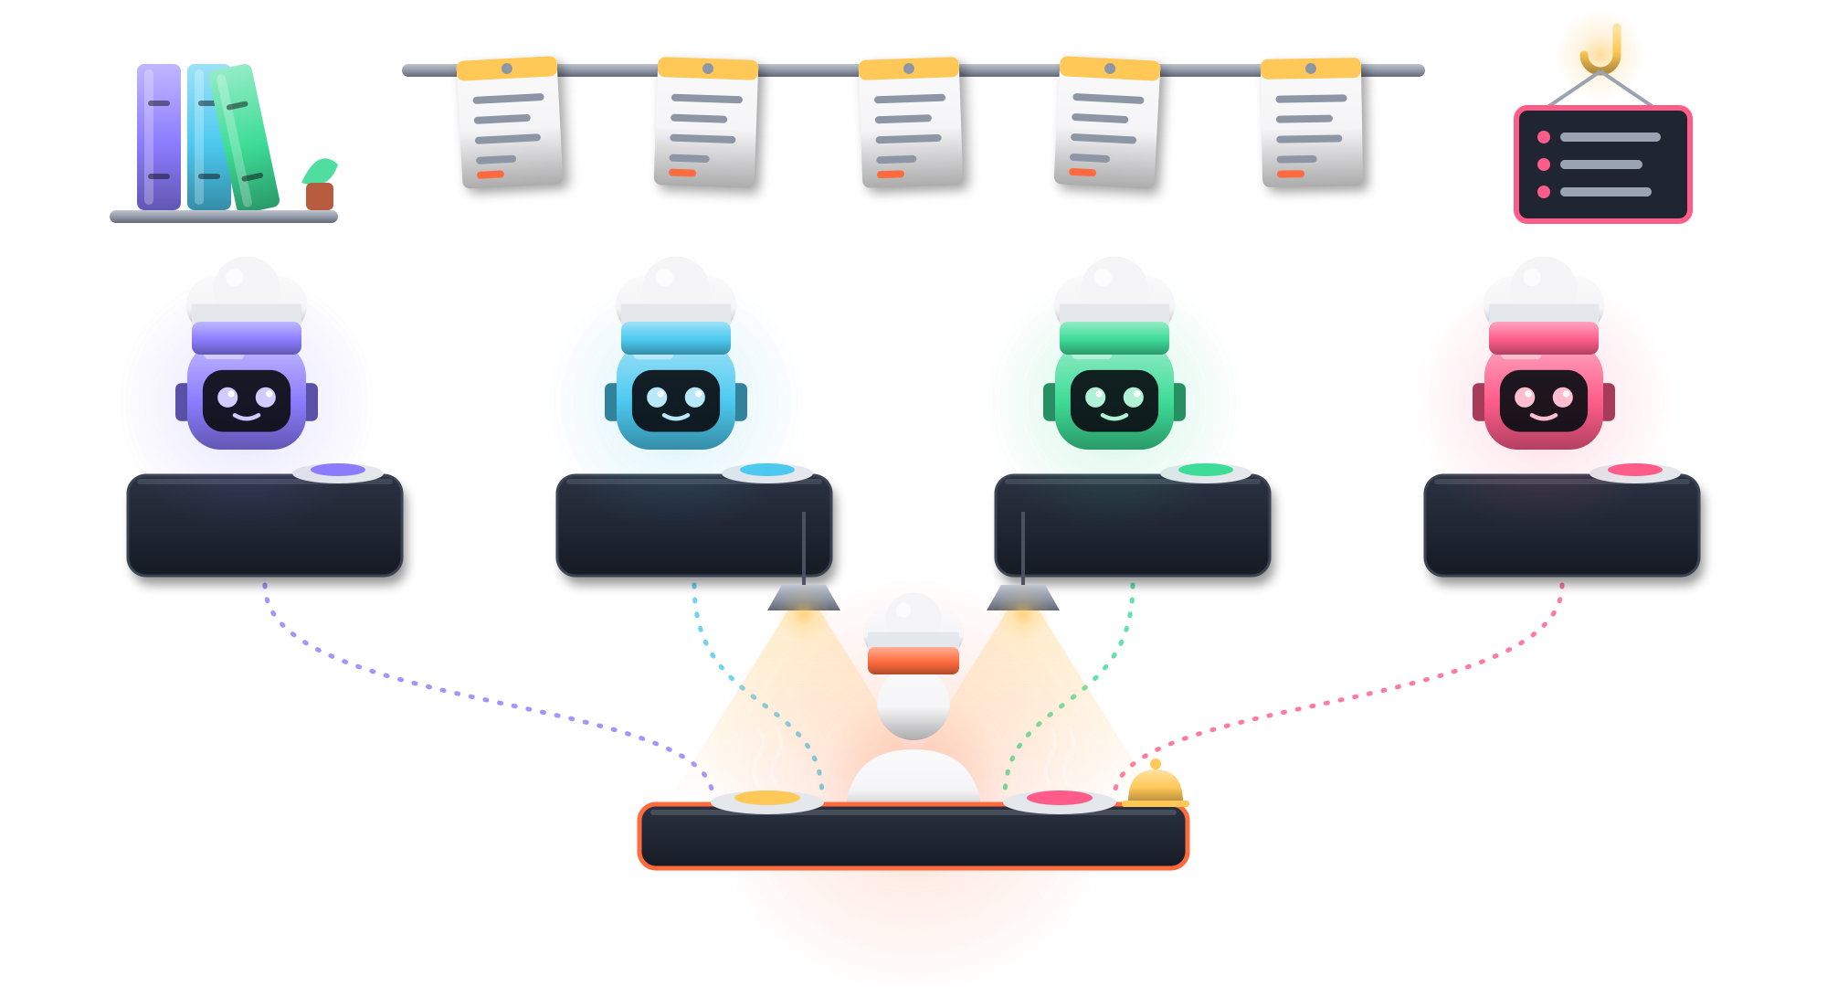
Skills, agents and hooks, as a kitchen
INSIDE THE HARNESS
Recipes
Skills: the know-how
Tickets
Specs: clear orders
Cooks
Architect
Builder
Standards
Tester
Agents: one job each
House rules
Hooks: always enforced
The pass
You, at the pass
You: every plate gets tasted

Slide 11
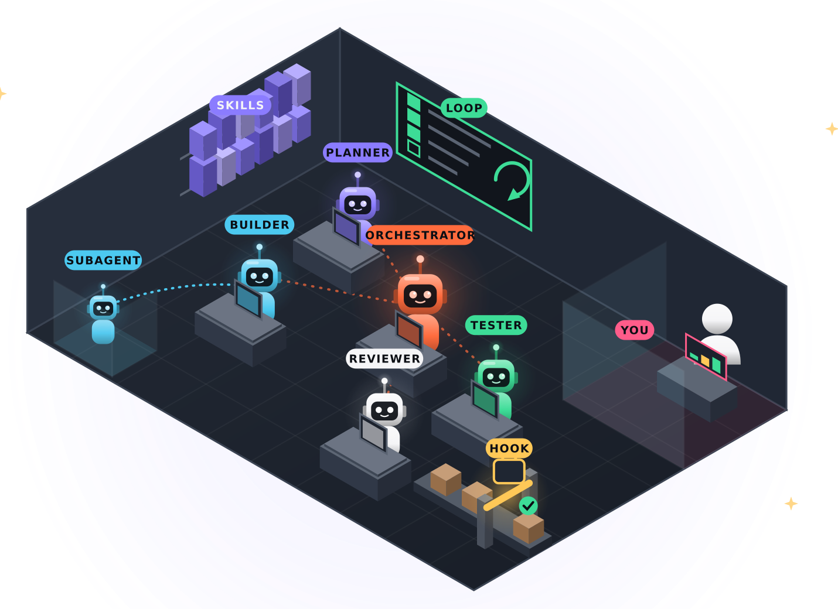







The next level: a team you can watch
BEYOND THE KITCHEN
Agent
A worker with a job and tools
Skill
A procedure binder on the shelf
Subagent
A helper in its own room
Orchestrator
The lead: assigns and decides next
Loop
Repeats until the board is green
Hook
A gate, not a person
You
On the loop: watch and step in
OpenClaw runs agent teams. Tools like OpenClaw Office and OpenClawfice let you watch them as a live office.

Slide 12
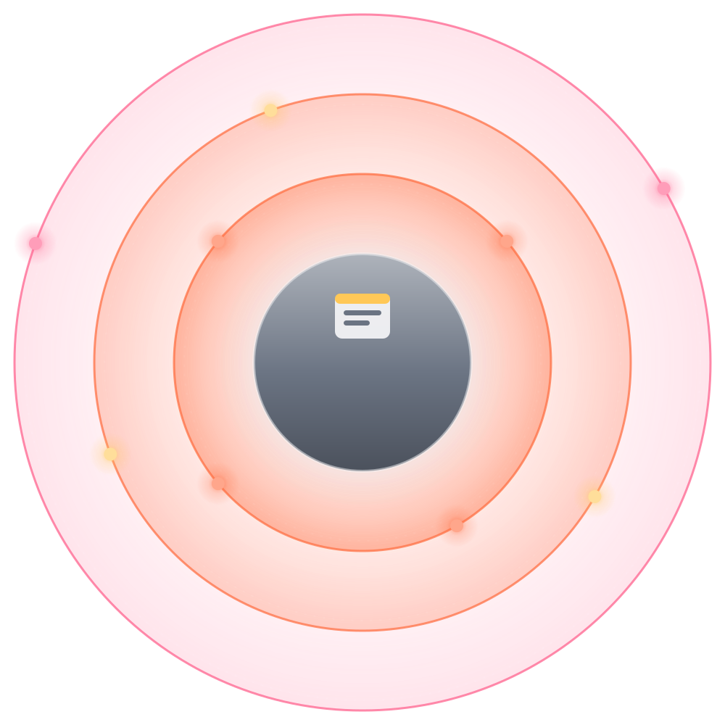

From my ticket to the whole picture
WHAT CHANGED FOR ME
THEN
NOW
Customer
Look at my ticket
See the whole picture
Product
Architecture
Docs ate my time
Docs take minutes
Search, read, compare
Ask, then verify
My ticket
Write most of the code
Specify, review, own the result

Slide 13
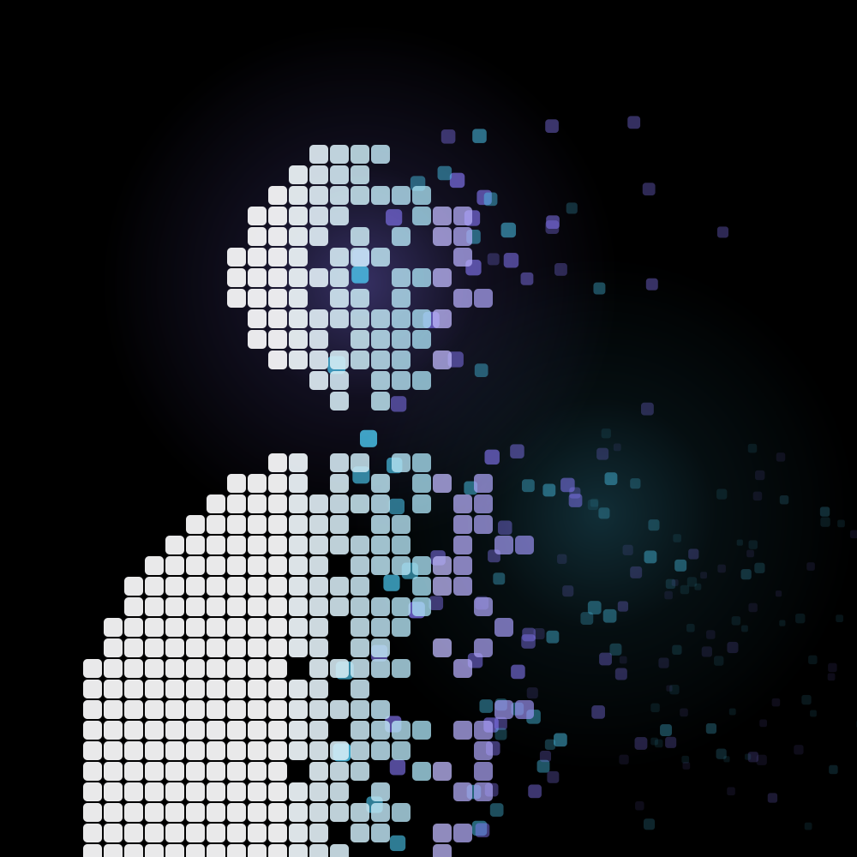



What we’re slowly losing
THE QUIET COST
The review muscle
We read less carefully, so we catch less
The research instinct
Ask and accept, instead of dig and compare
Details and the mental model
We know what the code does, not why
Not a reason to stop. A reason to use AI consciously.

Slide 14

“Done” was only the tip
HITTING THE WALL
AI amplifies your expertise, and your gaps.
The AI says: “Done.”
A technology I didn't know deeply
An approach I couldn't judge
Questions I didn't know to ask
Reviews we rushed
Problems only manual tests caught

Slide 15


STAYING CLOSE TO THE DETAILS
Autopilot flies the route.
You still own the landing.
Read every diff you merge
Explain it back in your own words
Write the core yourself, sometimes

Slide 16

Who sets the pace?
THE INDUSTRY
WHAT THE RACE LOOKS LIKE
Bold promises
Vanity metrics
Hiring framed as AI wins
A new must-have tool every month
Speed
set by the market
Direction
chosen by you
The market sets the speed. You choose the direction.

Slide 17
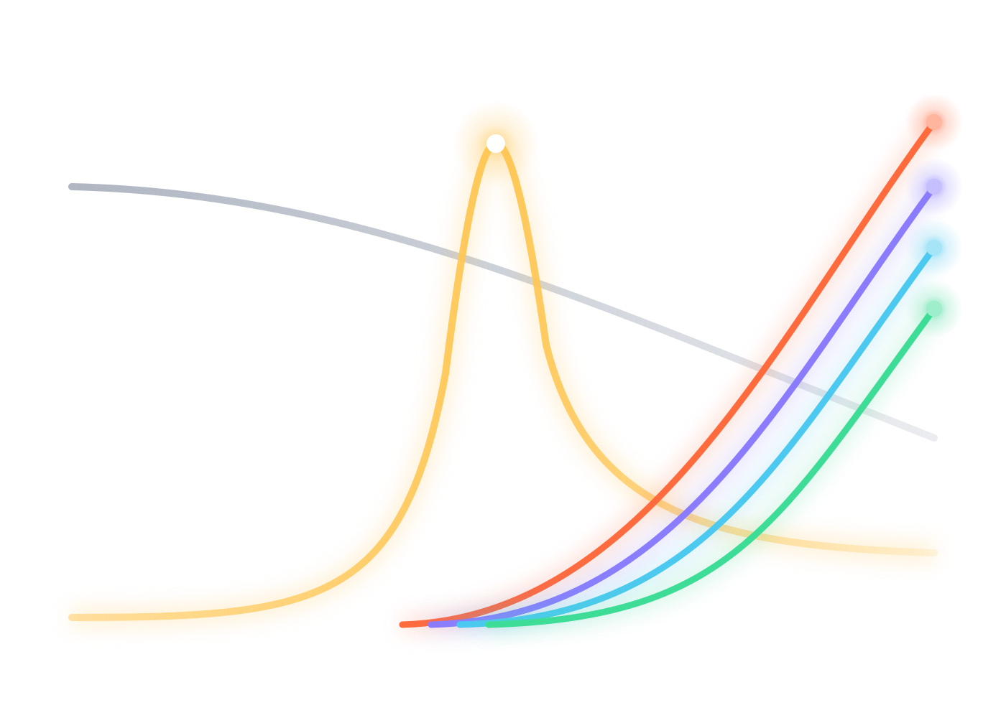




Roles are shifting too
OLD ROLES, NEW ROLES
GROWING
New AI roles
Prompt Engineer
Forward Deployed Engineer
Works with customers until the product truly fits
Routine coding roles
AI Engineer
Builds product features on top of models
Agent Platform Engineer
Builds the company’s harness: tools, guardrails
Evals & Quality Engineer
Tests systems that never answer the same way twice
CAME AND WENT
Prompt Engineer
Now a skill every role needs
Then
Now
UNDER PRESSURE
Illustrative trends, not data
Routine coding, repetitive manual testing

Slide 18




The bar is rising. You can train for it.
WHAT SETS PEOPLE APART
Judgment
Knowing what’s right, not just what runs
Fast learning
Becoming useful in the unfamiliar, quickly
Communication
Turning your thinking into clear words
Ownership
Owning the result, not just the task
TRAIN IT
Ask why. Compare options. Decide, then review the decision.
TRAIN IT
Use AI as a tutor. Go one layer deeper every project.
TRAIN IT
Write specs and READMEs. Present your work, even to two friends.
TRAIN IT
Ship to real users. Fix what breaks. Follow up unasked.
THE SKILLS UNDERNEATH
Fundamentals
System design
Reading code
Clear writing
Verification
Domain sense

Slide 19
Six moves, starting tomorrow
YOUR PLAYBOOK
01
02
03
Write the spec before the prompt
One page: the problem, the user, and how you’ll know it’s done.
Ask for options before code
“Give me 2–3 approaches with trade-offs.” You choose, then it builds.
Review like it’s a stranger’s PR
Read every diff. Explain each change. Write one test yourself.
04
05
06
Start your own mini-harness
Rules, a spec template, a checklist. Begin with Think → Build.
Go one layer deeper
Read the official docs. Debug one bug a week without AI.
Get real users before you graduate
Used beats sellable. Real users find what demos hide.
Use AI well, and be able to explain what it built.

Slide 20
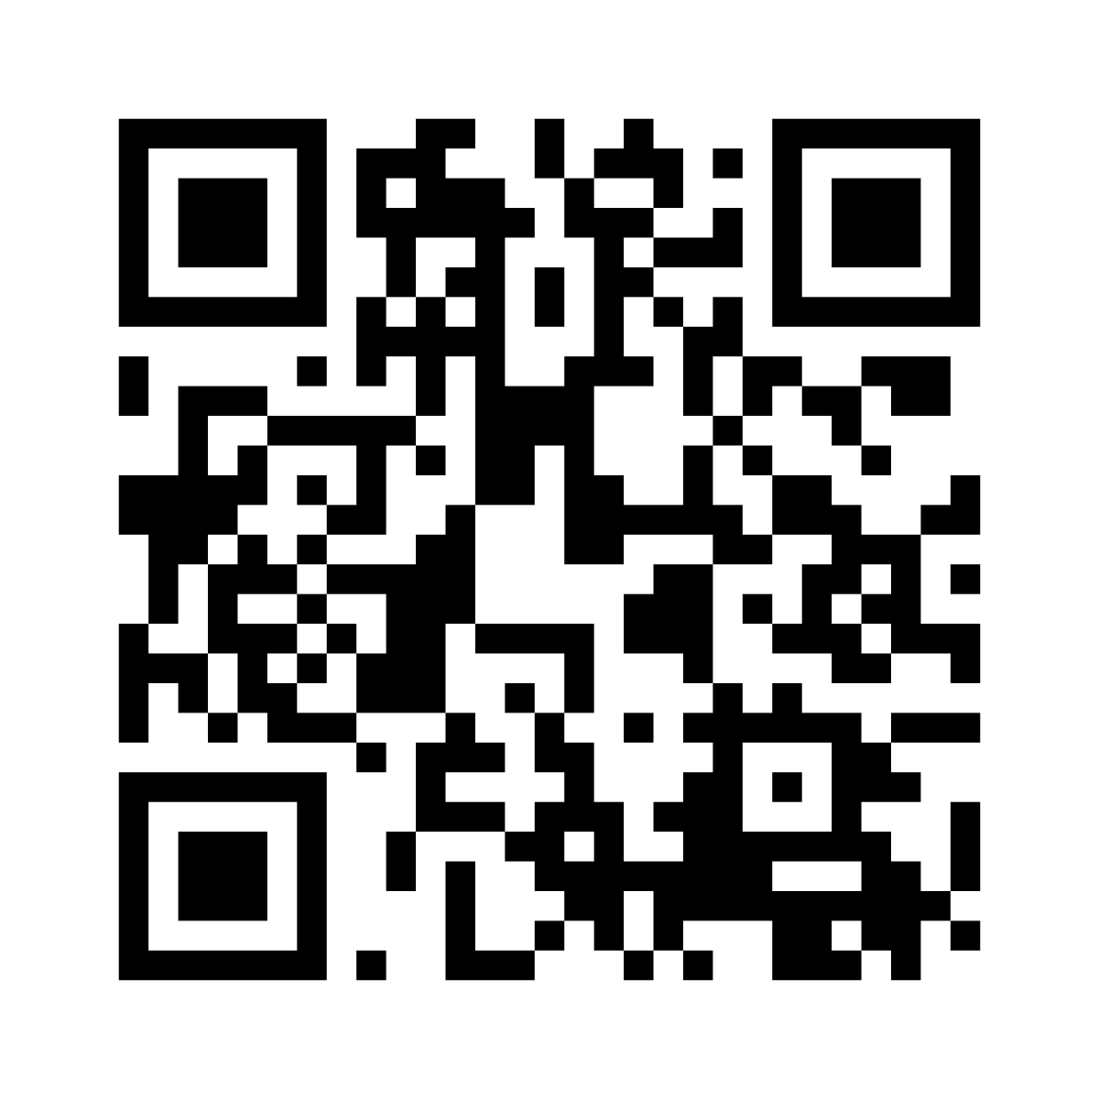
Think → Build: your starter kit
TAKE IT HOME
Two skills that turn an idea into tested code, with you deciding at every step.
idea
WHAT’S INSIDE
PROJECT.md
Your stack and house rules (not your idea)
/clarify
specs/<name>.md
/clarify
Asks until your idea is a clear spec
you read it
/build
Builds test-first, then reports what’s done and what isn’t
/build
clicker
An agent that clicks through your app in a real browser
optional
report
Scan to get the kit
github.com/snargul/think-build
you check it
WORKS WITH
GitHub Copilot · Claude Code · or paste a skill into any AI chat

Slide 21

THANK YOU FOR LISTENNING!
AI writes code.
Engineers own outcomes.
Think → Build kit
THREE THINGS TO REMEMBER
Goal and finish line are yours
Structure beats more words
You choose the direction
Thank you. Questions are very welcome.

