Slide 1
Recurrence Relations

Slide 2
Section – I
Recursion in Sequences

Slide 3
Q1: Domino Tilings
How many ways are there to tile a $1×10$ rectangle using identical $1×1$ tiles and identical $1×2$ tiles?

Slide 4

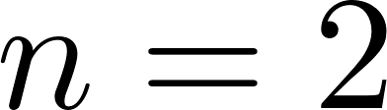
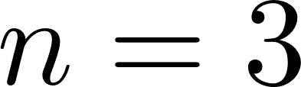
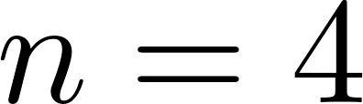
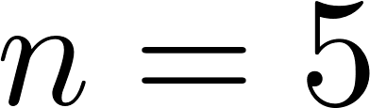
Q1: Domino Tilings
Attempt: Replace $10$ with $n$ and try to find a pattern.
1 way
2 ways
We get a familiar pattern
Next term = sum of previous 2 terms
Question: Why is this true?
3 ways
5 ways
8 ways

Slide 5
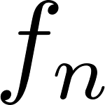
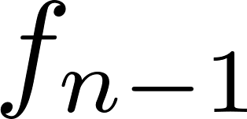
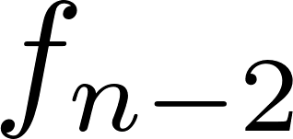

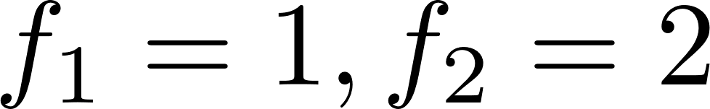
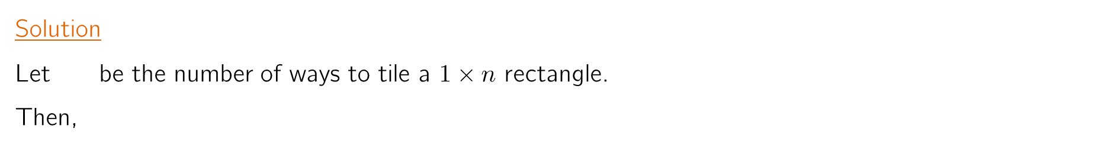

Q1: Domino Tilings
How many ways are there to tile a $1×10$ rectangle using identical $1×1$ tiles and identical $1×2$ tiles?
Solution
Let be the number of ways to tile a $1×n$ rectangle.
Then,
# of tilings
starting with
# of tilings
starting with
=
+
=
+
true for all $n≥3$.
For $n=1, 2$, we have by direct checking.
So, the answer follows by recursive computation: 1, 2, 3, 5, 8, 13, 21, 34, 55, 89, …
Answer

Slide 6


Q2: Heads never touch
How many ways are there to arrange 10 identical coins in a row so that there are no two consecutive heads?

Slide 7

Q2: Heads never touch
Attempt: Again, replace 10 with $n$ and try to find a pattern.
2 ways
3 ways
The same pattern emerges!
Next term = sum of previous 2 terms
Question: Why is this true?
5 ways
8 ways

Slide 8
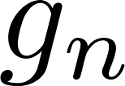
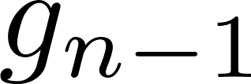
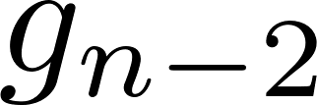
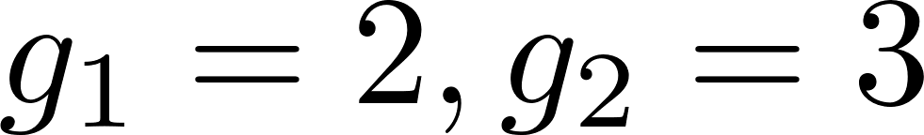

Q2: Heads never touch
How many ways are there arrange 10 coins in a row so that there are no two consecutive heads?
Solution
Let be the number of ways to arrange $n$ coins in a row so that there are no two consecutive heads.
# of arrangements
starting with
# of arrangements
starting with
=
+
=
+
true for all $n≥3$.
start with
start with
For $n=1, 2$, we have by direct checking.
So, the answer follows by recursive computation: 2, 3, 5, 8, 13, 21, 34, 55, 89, 144, …
Answer

Slide 9
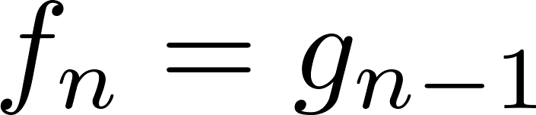
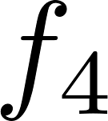
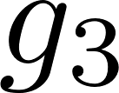
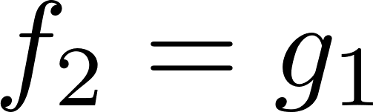
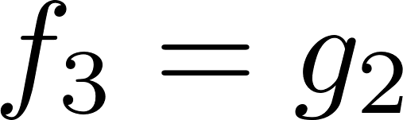
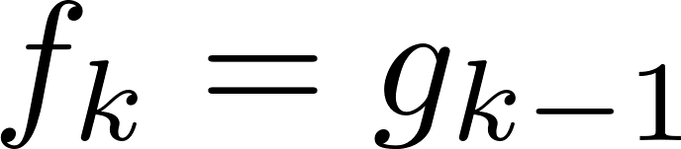
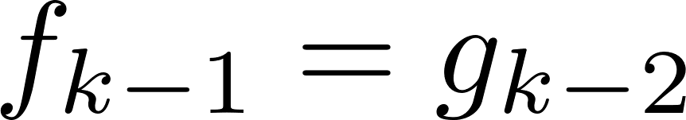
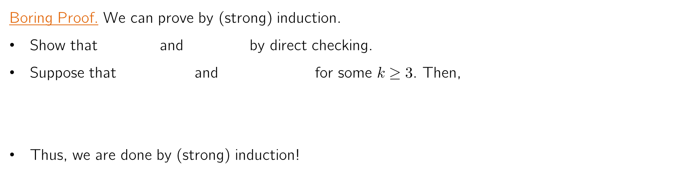
Why does ?
Looking at previous two problems, we see that .
Boring Proof. We can prove by (strong) induction.
Show that and by direct checking.
Suppose that and for some $k≥3$. Then,
Thus, we are done by (strong) induction!
This is too trivial that it shouldn’t need a proof. But, induction is how you make it rigorous.

Slide 10
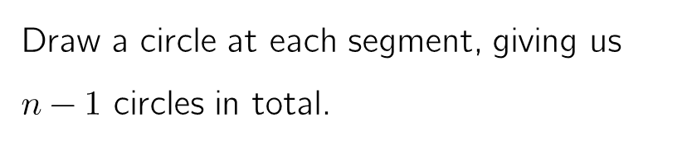


Why does ?
An Alternate (Interesting) Proof.
Idea: Construct a one-to-one correspondence between tilings and coin-arrangements!
Start with a tiling of the $1×n$ rectangle.
Draw a circle at each segment, giving us $n−1$ circles in total.
Change the “crossed” circles into T. Others into H. Then, no two H’s are adjacent!
Why?
This construction can also be reversed.
Hence, . Bingo!
This kind of proof is called a “bijective proof”. We’ll see more in next lesson.

Slide 11
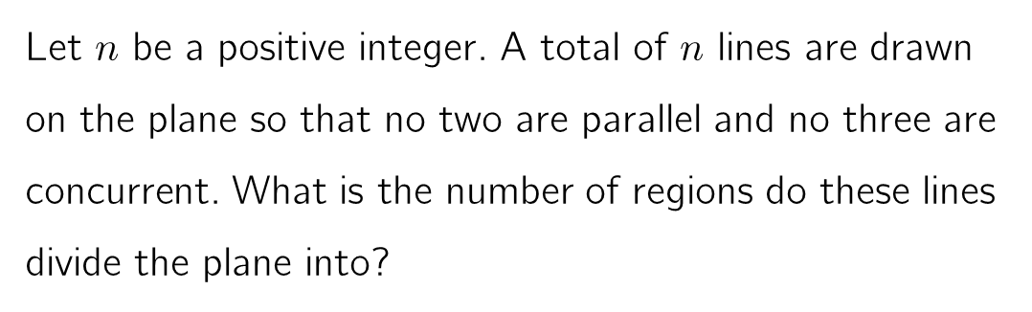
Q3: Slicing a Plane
Let $n$ be a positive integer. A total of $n$ lines are drawn on the plane so that no two are parallel and no three are concurrent. What is the number of regions do these lines divide the plane into?

Slide 12

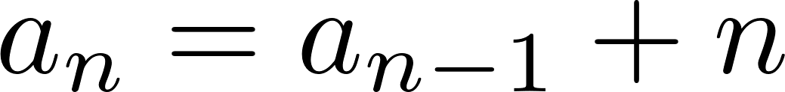
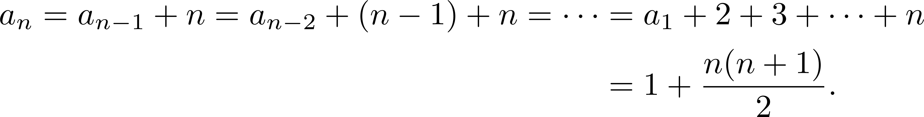

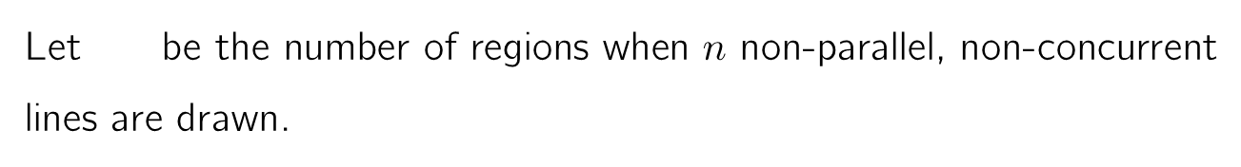
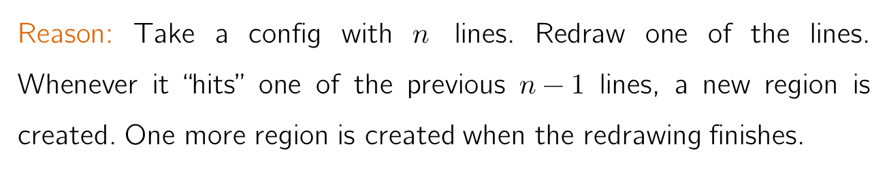
Q3: Slicing a Plane
Let be the number of regions when $n$ non-parallel, non-concurrent lines are drawn.
true for all $n≥2$.
Reason: Take a config with $n$ lines. Redraw one of the lines. Whenever it “hits” one of the previous $n−1$ lines, a new region is created. One more region is created when the redrawing finishes.
Now, finding is just algebra:

Slide 13
Section – II
Recursion with Pictures

Slide 14




Q4: Going around the town
The road map of Townsville is given. Josh wants to go from A to B by going only northwards or eastwards.
In how many ways can Josh go?
If Josh is not allowed to go through C and D, in how many ways can he walk from A to B?

Slide 15

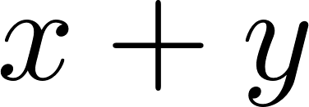

Q4: Going around the town
1
Solution (a)
To each intersection, attach the number of ways to arrive to that intersection using the given moves.
Then, we have the following recurrence:
7
28
84
210
462
924
1
6
21
56
126
252
462
1
5
15
35
70
126
210
1
4
10
20
35
56
84
1
3
6
10
15
21
28
Now, we just compute until we get the value at B!
1
2
3
4
5
6
7
1
1
1
1
1
1

Slide 16
Q4: Going around the town
1
Solution (b)
Simply remove C and D, and redo the recurrence.
Note the following change when we don’t have edges:
7
7
38
122
289
580
1
6
31
84
167
291
1
5
15
31
53
83
124
1
4
10
16
22
30
41
1
3
6
6
6
8
11
1
This problem has a nice “bijective” solution. We’ll see in the next lesson!
2
3
1
2
3
1
1
1
1
1
1

Slide 17
Q5: Standing around a table
Ten people sit around a round table. When a signal is given, some people immediately stand up. In how many ways can they stand so that no two adjacent people stand next to each other?

Slide 18
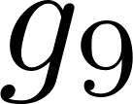
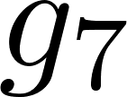
Q5: Standing around a table
Solution: Pick a person A. We have two cases: A remains seated, or A stands. So,
Answer = # ways with A sitting + # ways with A standing
Pictorially, we have this:
=
+
So, # ways with A sitting = # ways to arrange 9 people with no adjacent stands =
# ways with A standing = # ways to arrange 7 people with no adjacent stands =
Thus, by Q2, the answer is 89 + 34 = 123.

Slide 19
Counting Independent Sets
Consider a social network with many users. Any two users are either friends or not friends. Then, the network can be represented by figures like this:
A (possibly empty) subset of users is called independent if no two of them are friends with each other.
Question: How to count the number of independent subsets?
These networks are called graphs. Users are called vertices, and friendships edges.

Slide 20

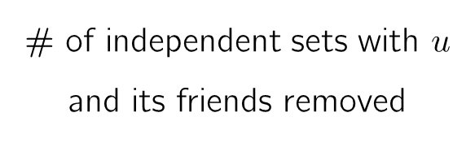
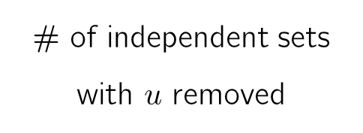
Counting Independent Sets
Answer: Recurrence!
Pick any user $u$. Then, we have the following recurrence:
=
# of independent sets
with $u$ removed
# of independent sets with $u$ and its friends removed
# of independent sets
+

Slide 21
Counting Independent Sets
=
+
=
+
+
+
=
+
+
+
+
=
+
+
+
+
=

Slide 22
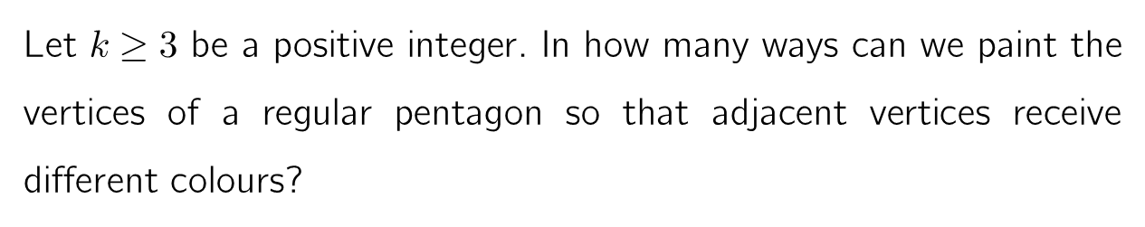
Q6: Colouring a pentagon
Let $k≥3$ be a positive integer. In how many ways can we paint the vertices of a regular pentagon so that adjacent vertices receive different colours?

Slide 23


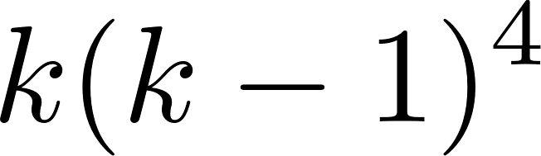
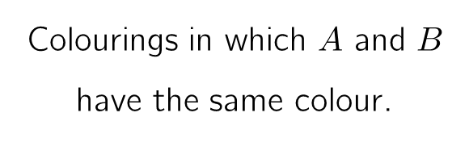
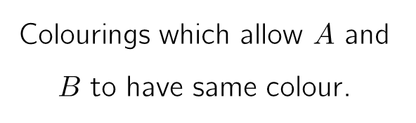
Q6: Colouring a pentagon
=
–
Colourings which allow $A$ and $B$ to have same colour.
Colourings in which $A$ and $B$ have the same colour.
ways
Use the same trick again!!

Slide 24
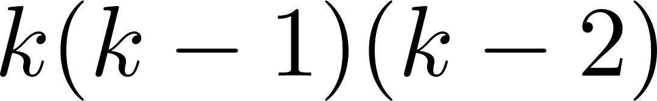
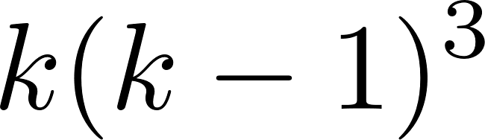
Q6: Colouring a pentagon
Solution
=
–
=
–
–
This process is technically the same with case-bashing. But looks more neat!
ways
ways
ways
Therefore, the answer is
Exercise: Compute the number of ways to colour the vertices of an $n$-gon with $k$ colours.

Slide 25




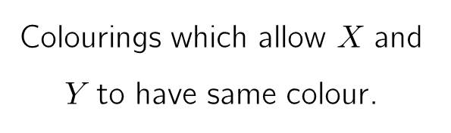
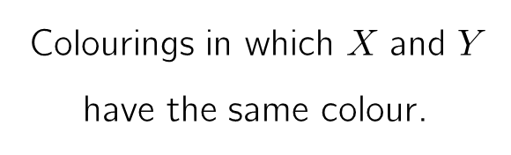
Chromatic recurrence
The same process can be used to compute the number of proper colourings of any graph (network).
Fix any edge $e$ with ends $X$ and $Y$.
=
–
Colourings which allow $X$ and $Y$ to have same colour.
Colourings in which $X$ and $Y$ have the same colour.
Question: Why is this a recurrence? Which quantity decreases?
Number of edges decreases

Slide 26

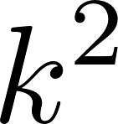
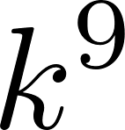
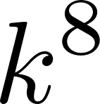
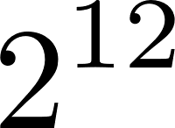
Chromatic recurrence
Therefore, as we recurse more and more, we will be left with graphs with no edges in the end.
=
–
=
=
+
+
+
+
So, number of ways to colour a graph in $k$ colours is always a polynomial of $k$.
about
Question: This recurrence takes too many steps. How many?

Slide 27
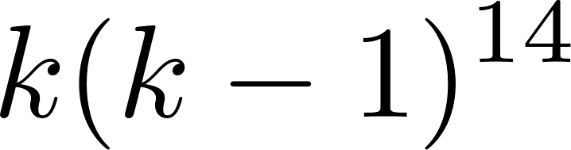
Chromatic recurrence
In practice, we recurse until there are no cycles. At this point, computation is easy.
Question: Find the number of ways to colour this graph with $k$ colours.
Answer:
As an example, we can compute the number of colourings of an “envelope” as follows:
=
–
=
–
–
+
=
–
–
+
+
–
Now you know how to find the number of ways to colour any map!
=

Slide 28
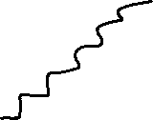






Slide 29
Section – III
Recursive Algorithms

Slide 30
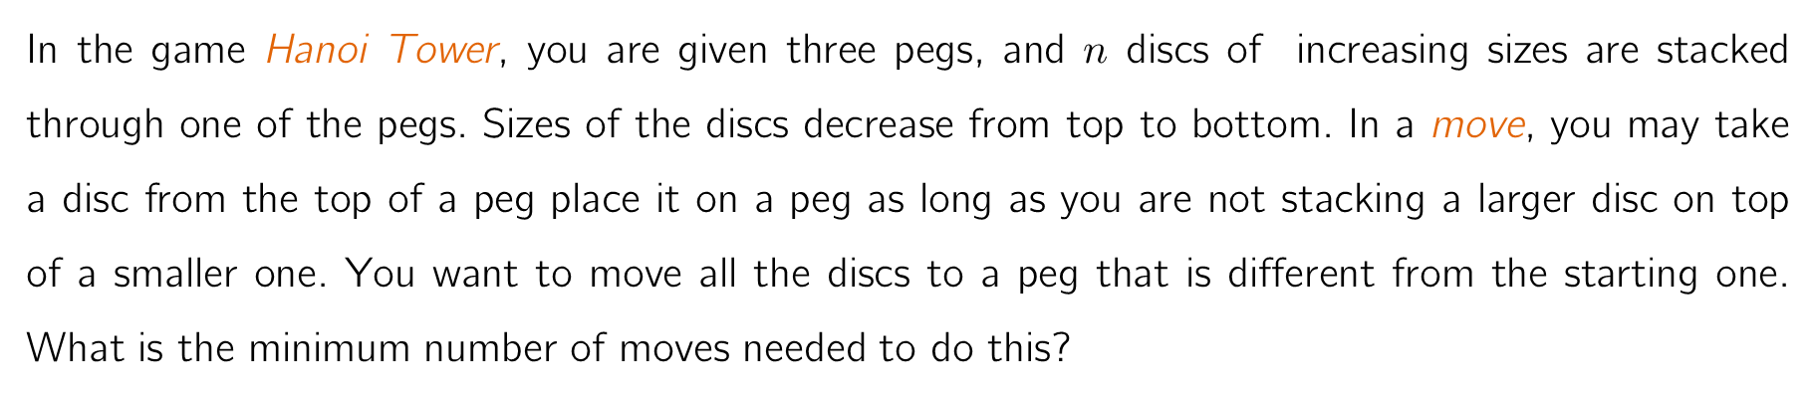
Q7: Hanoi Tower
In the game Hanoi Tower, you are given three pegs, and $n$ discs of increasing sizes are stacked through one of the pegs. Sizes of the discs decrease from top to bottom. In a move, you may take a disc from the top of a peg place it on a peg as long as you are not stacking a larger disc on top of a smaller one. You want to move all the discs to a peg that is different from the starting one. What is the minimum number of moves needed to do this?

Slide 31

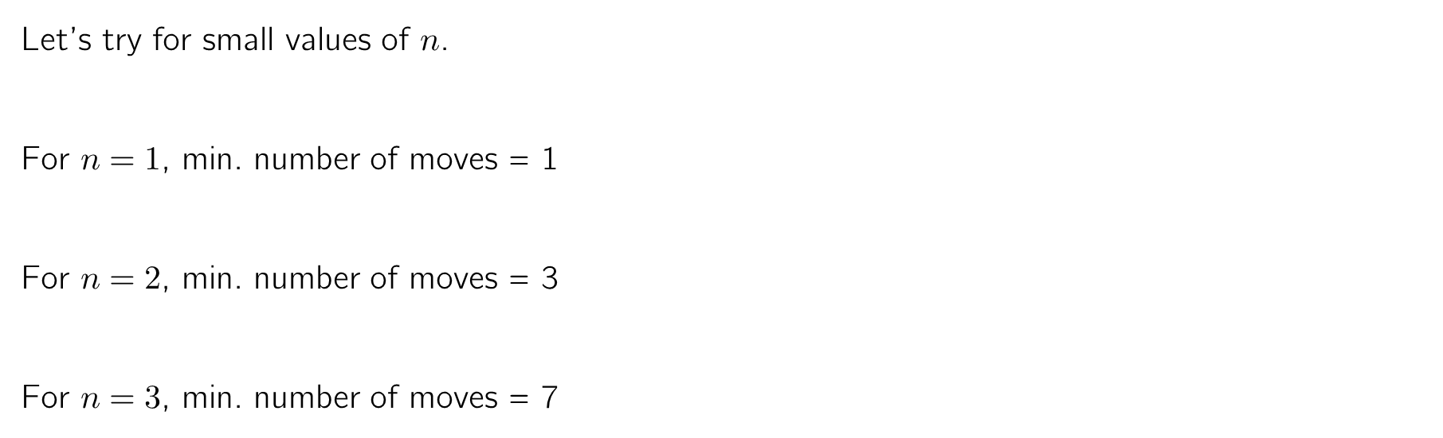
Q7: Hanoi Tower
Let’s try for small values of $n$.
For $n=1$, min. number of moves = 1
For $n=2$, min. number of moves = 3
For $n=3$, min. number of moves = 7
This is too early to say.
But… the answer = ?

Slide 32

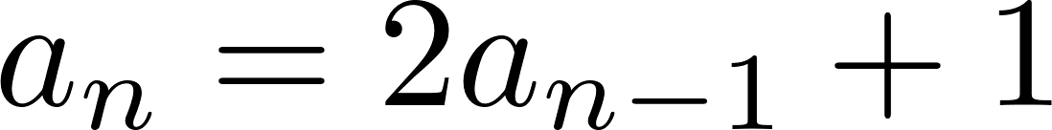
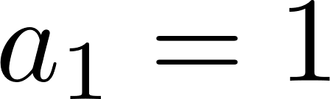



Q7: Hanoi Tower
Solution
Let be the minimum number of moves needed.
To finish the game, we need to move the largest disc onto the last peg.
So, we need to move the first $n−1$ discs onto the middle peg.
Then, move the largest disc to the last peg.
Then, put the $n−1$ discs from middle onto last peg.
All of these needs to be done. So, we have
Solving the recurrence with gives .
moves
1 move
moves
true for all $n≥2$.

Slide 33


Q8: Sheep Sort
There are sixteen sheep with distinct weights, and you have a sheep-scale. You can put two sheep on the sheep-scale at a time, and the sheep-scale tells you which sheep is heavier. We would like to arrange the sheep in increasing order by weights. Can we do this by using the sheep-scale less than 50 times?

Slide 34

Q8: Sheep Sort
The most obvious way: Compare any two of the sheep. Then, find the heaviest sheep, then the 2nd heaviest sheep, etc.
Heaviest
2nd Heaviest
Too many!
Question: How many times do we have to use the sheep scale for this?

Slide 35



Q8: Sheep Sort
Let be the minimum number of times that we need to use the scale for sheep.
Obviously . Let’s try our best for 4 sheep.
Break the sheep into 2 herds of equal size.
We know how to arrange each herd.
Now, with one comparison, we can find the lightest sheep!
With another comparison, we can find the 2nd lightest sheep.
With another comparison, we can find the 3rd lightest sheep.
We used the scale 5 times in total. Therefore, .
We only have $≤$ and not $=$!
We only showed that 5 moves sufficie.
We haven’t showed that 5 moves are necessary!

Slide 36



Q8: Sheep Sort
Similarly, we can do the same for 8 sheep.
Break the sheep into 2 herds of equal size.
We know how to arrange each herd. This takes $2×5=10$ moves.
Now, with one comparison, we can find the lightest sheep!
With another comparison, we can find the 2nd lightest sheep.
…
With another comparison, we can find the heaviest sheep.
We used the scale $2×5+7=17$ times in total. Therefore, .
Question: What if we did the same procedure for 16 sheep?
$2×17+15=49$ moves!

Slide 37



Q8: Sheep Sort
Solution
Let be the minimum number of times needed to use the sheep-scale for sheep. Then, we may follow the following procedure to sort sheep:
Break the sheep into two herds of sheep each.
Sort the sheeps in these herds using moves each.
Then, we can find the lightest sheep by using the scale once.
Then, we can find the 2nd lightest sheep by using the scale one more time.
…
Lastly, we can find second heaviest and the heaviest sheep by using the scale one more time.
In total, we used moves. Hence, we have . Therefore,

Slide 38
Summary of Main Ideas
Main Philosophy: If you can make an object smaller in some way, we are done by induction!
Recursion in Sequences: Let be the number of things that you are interested in. Main idea is to find the relation between and previous terms. To do so, we may
take an object of interest and divide it into many cases,
find the smaller version of the object inside the object of interest.
Recursion with Pictures: Same idea with sequences. The resulting pictures should be “smaller” than the original picture in some sense.
To solve recurrences, always try substituting backwards!

Slide 42
CCP important conversation
Important text
Arrowed text

