Slide 1
Bijective Counting

Slide 2
Section – I
Quick Review of Elementary Counting

Slide 3
Q1: Number of Committees
Let $n$ and $r≤n$ be positive integers. From a committee of $n$ people, we want to select $r$ people and form a subcommittee. In how many ways can we create the subcommittee?

Slide 4

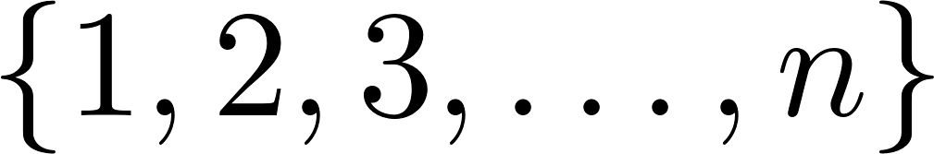
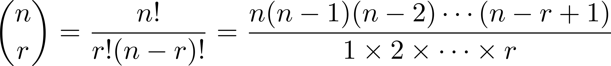
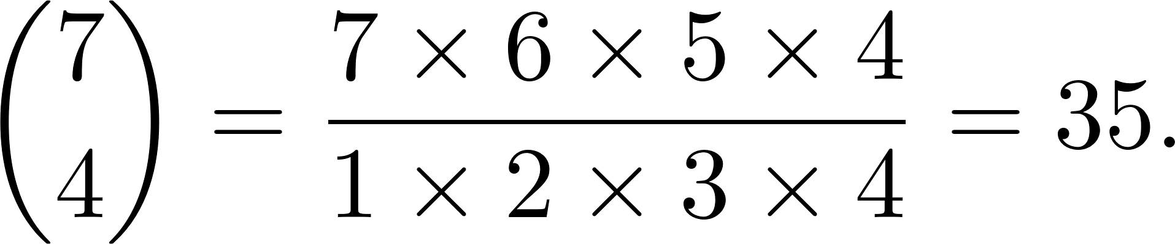
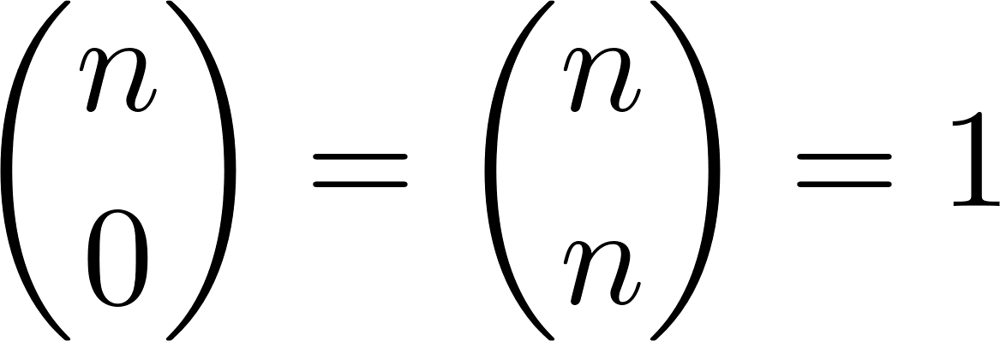
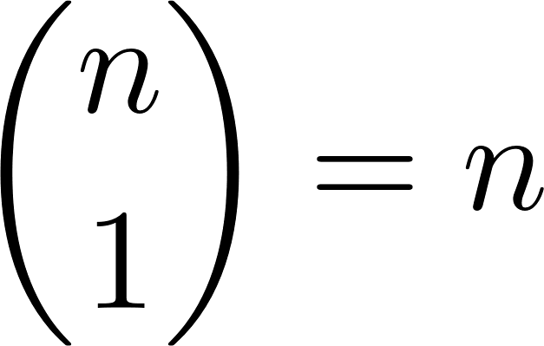

Combinations
Let $n$ be a positive integer and $0≤r≤n$ be an integer. We define (read $n$ choose $r$) to be the number of $r$-element subsets of the set .
We can compute as follows:
For example,
Important special cases: and

Slide 5
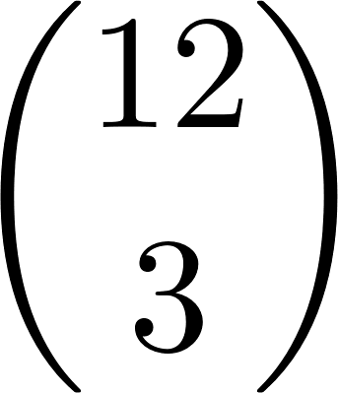


Q2: Number of Words
How many 12-letter words can you make using 3 letter A’s, 4 letter B’s and 5 letter C’s?
Solution
First, prepare 12 spaces for 12 letters.
Choose 3 spaces for letter A’s.
Choose 4 spaces out of the remaining 9 for letter B’s.
Choose 5 spaces out of the remaining 5 for letter C’s.
Therefore, number of possible words is
ways
ways
ways

Slide 6



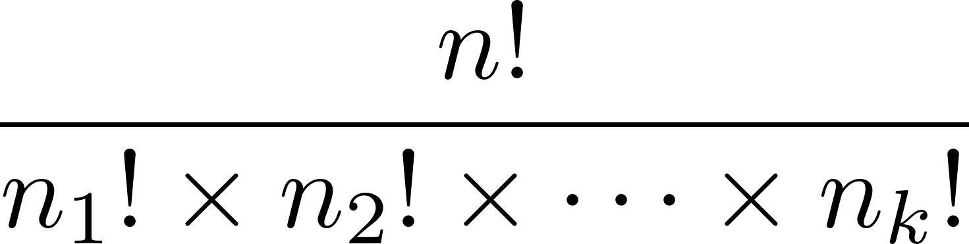

Repeated Permutations
Suppose we want to arrange $n$ objects in a row. Out of these
objects are of type 1,
objects are of type 2,
…
objects are of type $k$.
The remaining objects are all distinct from all other objects. Then, the number of ways to arrange all these $n$ objects in a row is equal to

Slide 7
Section – II
Bijections with Words

Slide 8


Q3: Revisiting Townsville
The road map of Townsville is given. Josh wants to go from A to B by going only northwards or eastwards. In how many ways can Josh go?

Slide 9
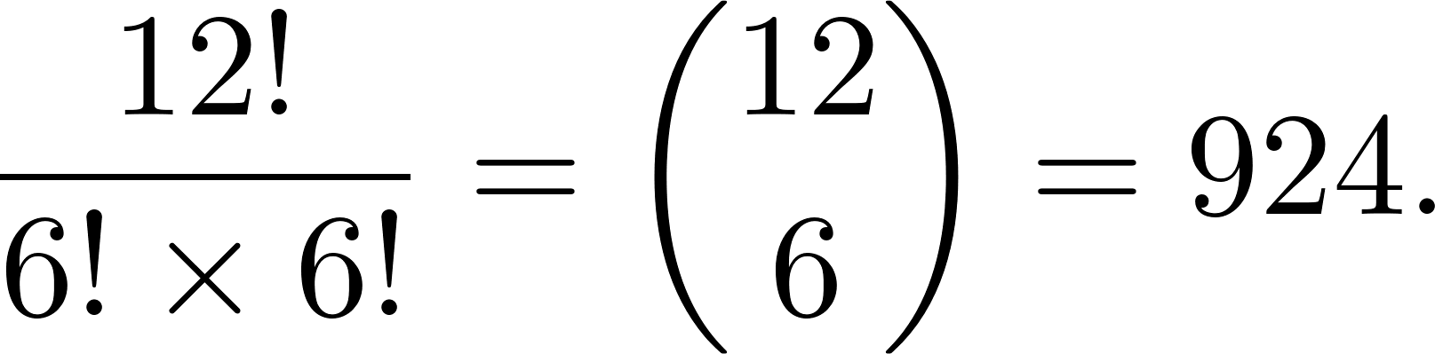
Q3: Revisiting Townsville
Solution
Record the movements: R for eastwards, U for northwards.
Then, a way to go from A to be can be thought of as an 12-letter word with 6 R’s and 6 U’s.
(For example, the path shown is RUUURRRUURRU)
So, the answer is

Slide 10
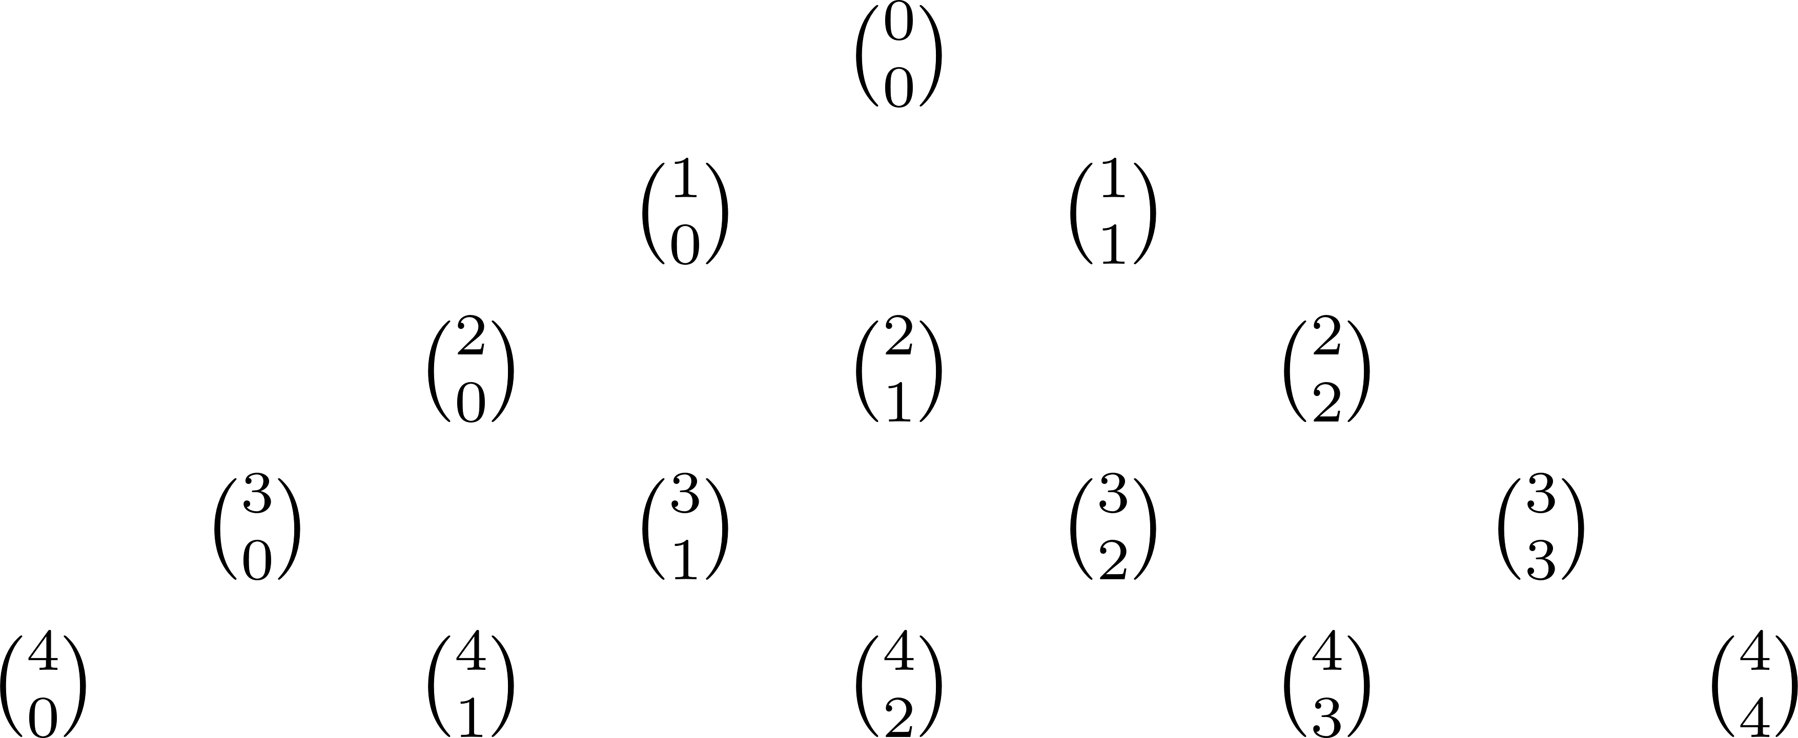
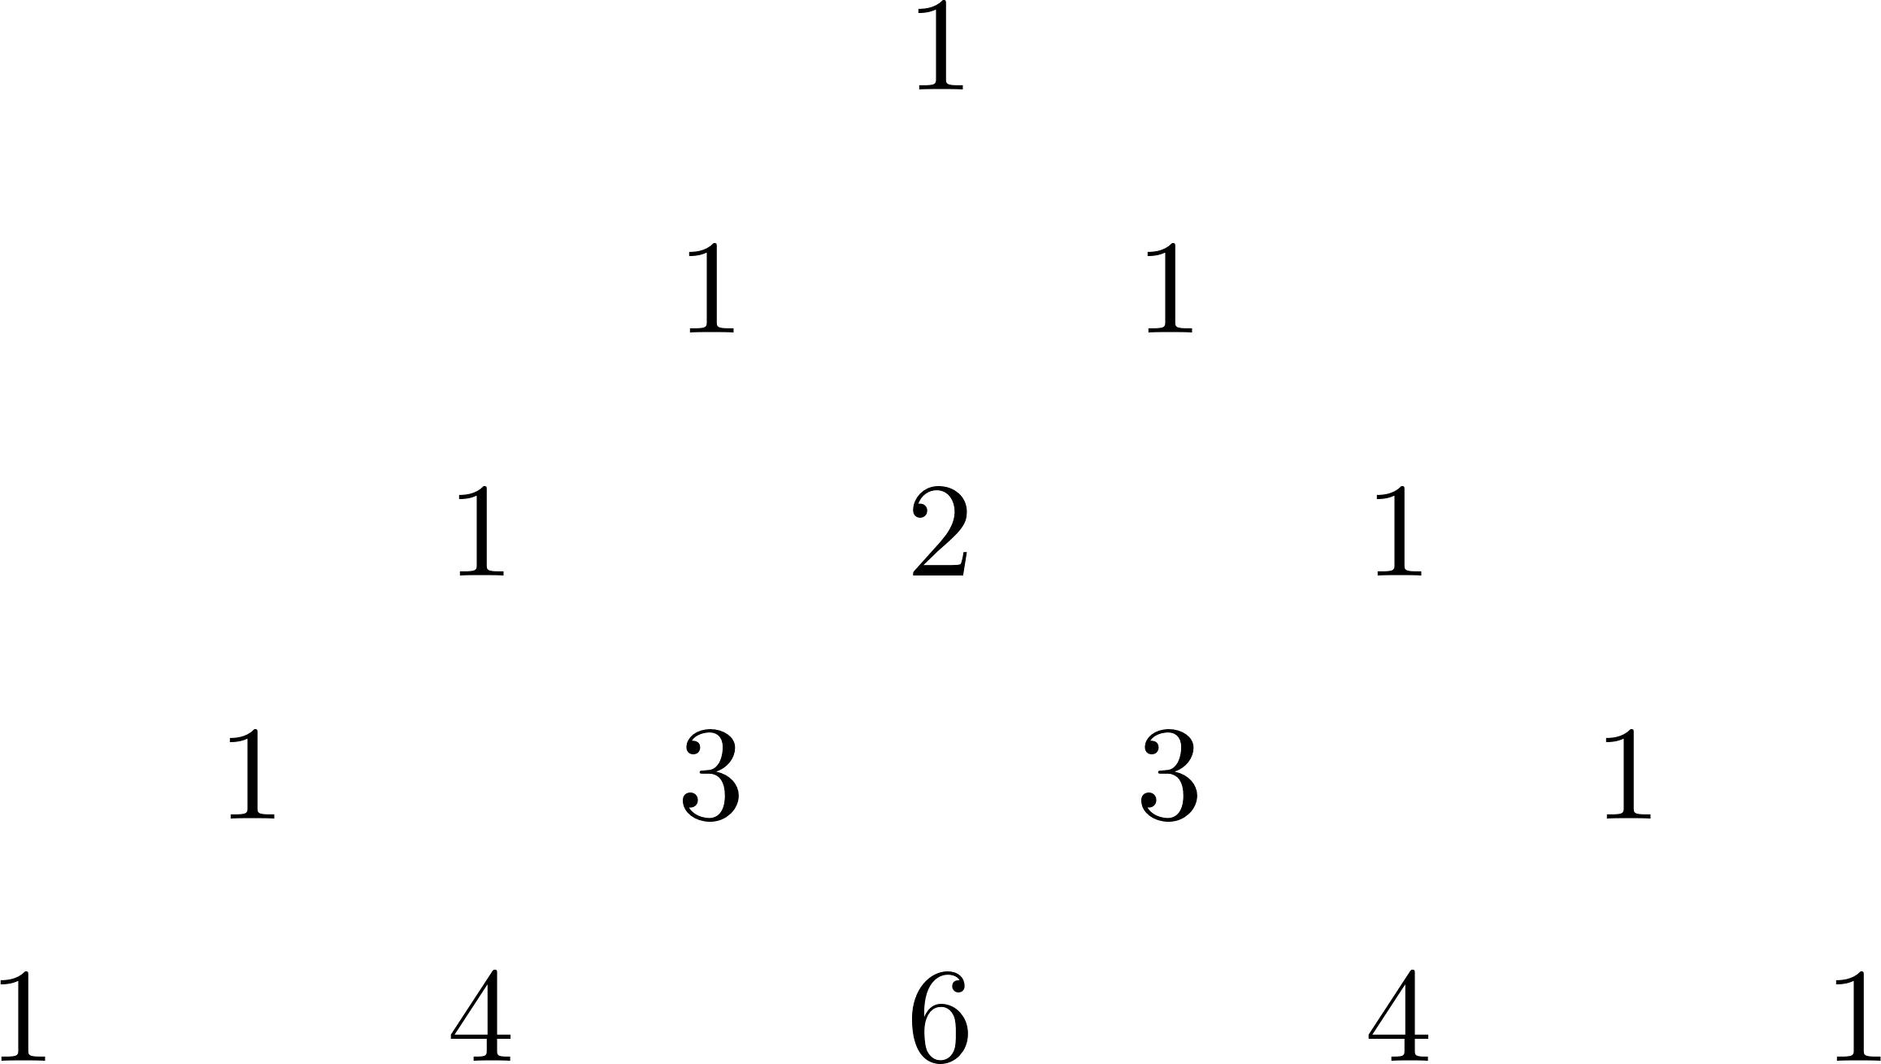
The Pascal’s Triangle
If we write the binomial coefficients in a triangle, we get the Pascal’s triangle!

Slide 11



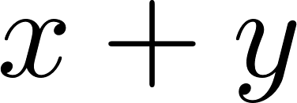
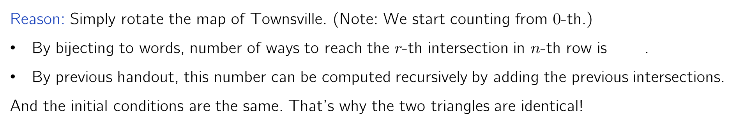
The Pascal’s Triangle
Reason: Simply rotate the map of Townsville. (Note: We start counting from $0$-th.)
By bijecting to words, number of ways to reach the $r$-th intersection in $n$-th row is .
By previous handout, this number can be computed recursively by adding the previous intersections.
And the initial conditions are the same. That’s why the two triangles are identical!
I can’t express how beautiful this is.

Slide 12
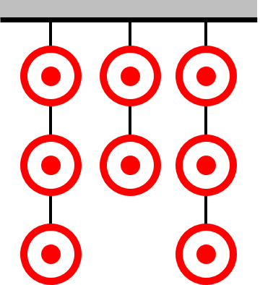
Q4: Target Practice
Eight targets are hung from the ceiling in strings of 3, 2 and 3 respectively. A musketeer wants to shoot down all 8 targets one by one, in a sequence. But they cannot shoot a target unless all the targets below it were already shot. Find the number of ways to shoot all 8 targets.

Slide 13

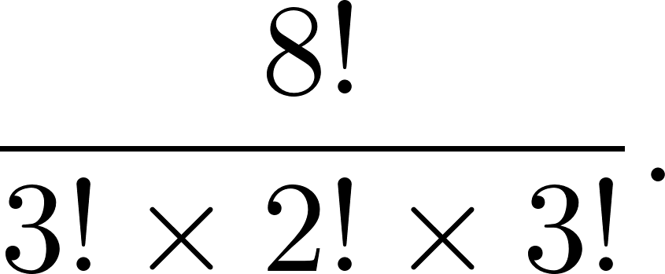
Q4: Target Practice
Solution
Label the strings as A, B and C.
Imagine the musketeer shouting the corresponding string number as she shoots the target down. (e.g. AABCBACC)
Main Observation: We can recover the sequence of targets shot from her sequence of letters!
Therefore, number of ways to shoot is equal to number of permutations of AAABBCCC. So, the answer is

Slide 14
Q5: Counting Integer Solutions
Find the number of non-negative integer solutions to the equation $x+y+z=10$.

Slide 15

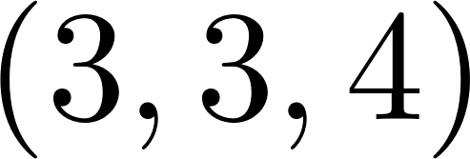
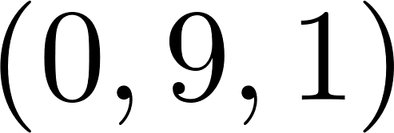
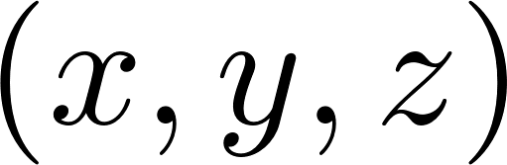
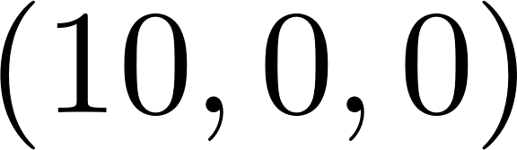
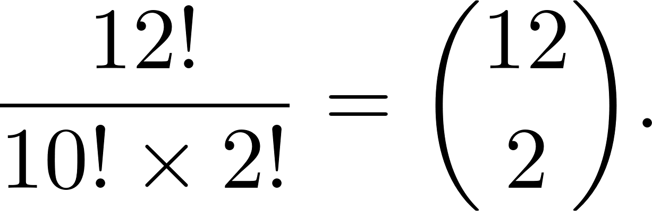
Q5: Counting Integer Solutions
Solution
There is a bijection between solutions and the permutations of 10 stars & 2 bars!!! For example,
Hence, the number of ways is

Slide 16
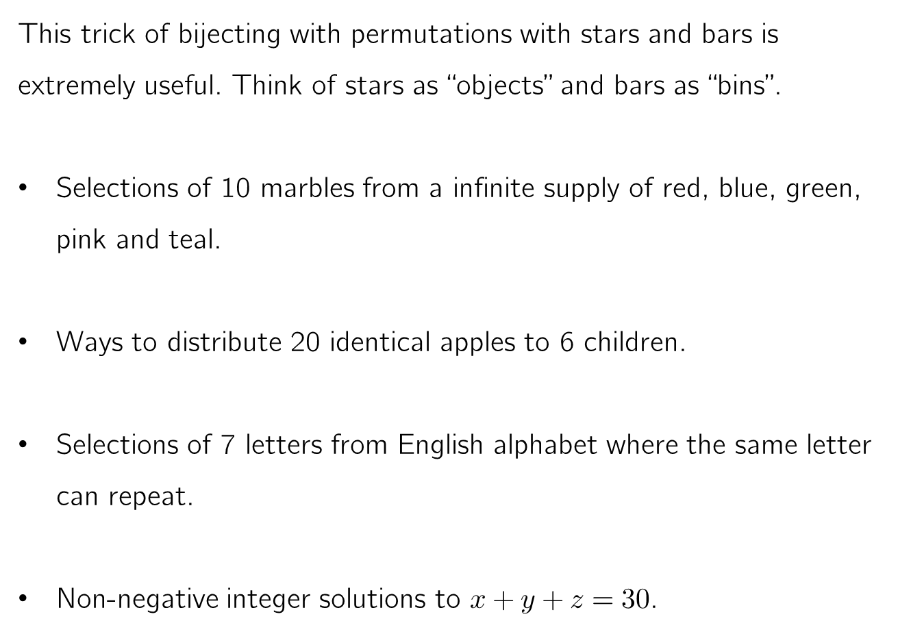
Stars and Bars Trick
This trick of bijecting with permutations with stars and bars is extremely useful. Think of stars as “objects” and bars as “bins”.
Selections of 10 marbles from a infinite supply of red, blue, green, pink and teal.
Ways to distribute 20 identical apples to 6 children.
Selections of 7 letters from English alphabet where the same letter can repeat.
Non-negative integer solutions to $x+y+z=30$.
10 stars, 4 bars
20 stars, 5 bars
7 stars, 25 bars
30 stars, 2 bars

Slide 17
Section – III
Proving Combinatorial Identities

Slide 18
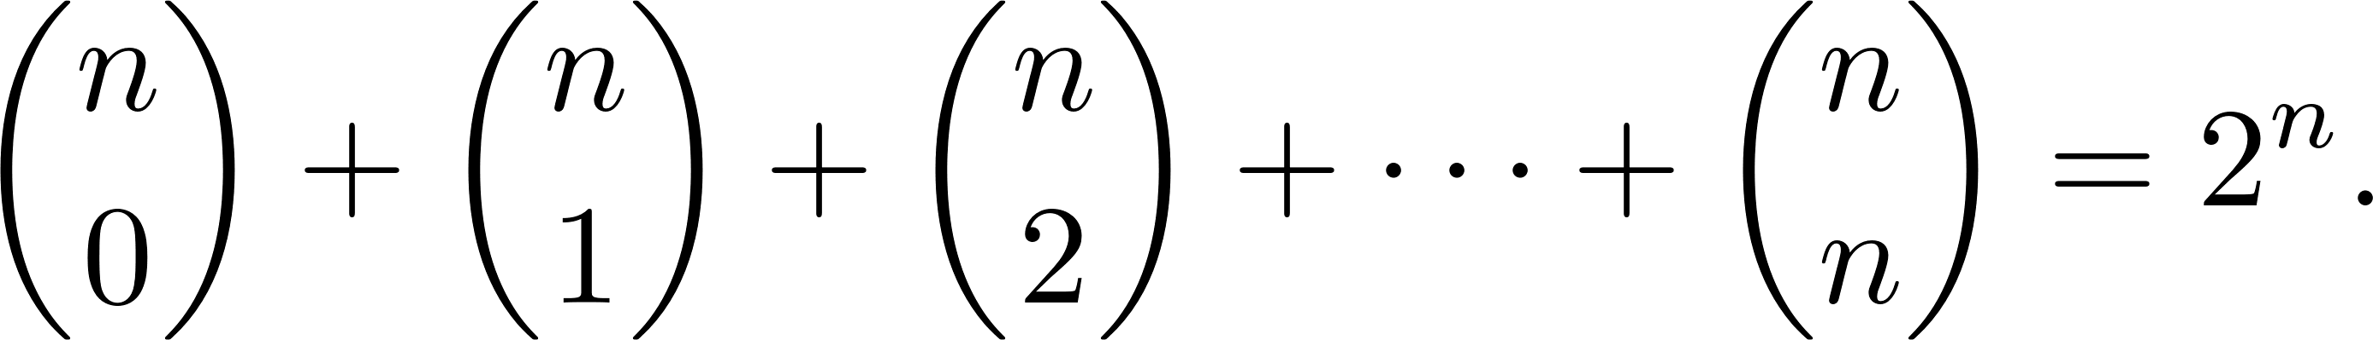
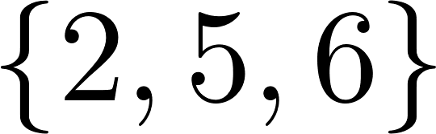
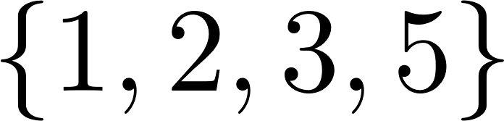

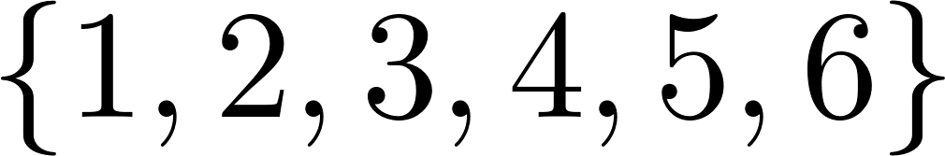
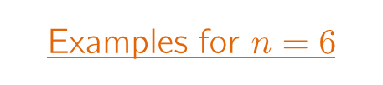
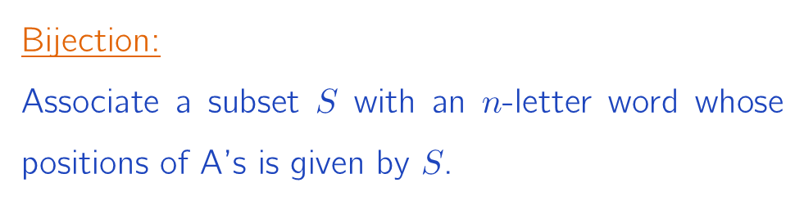
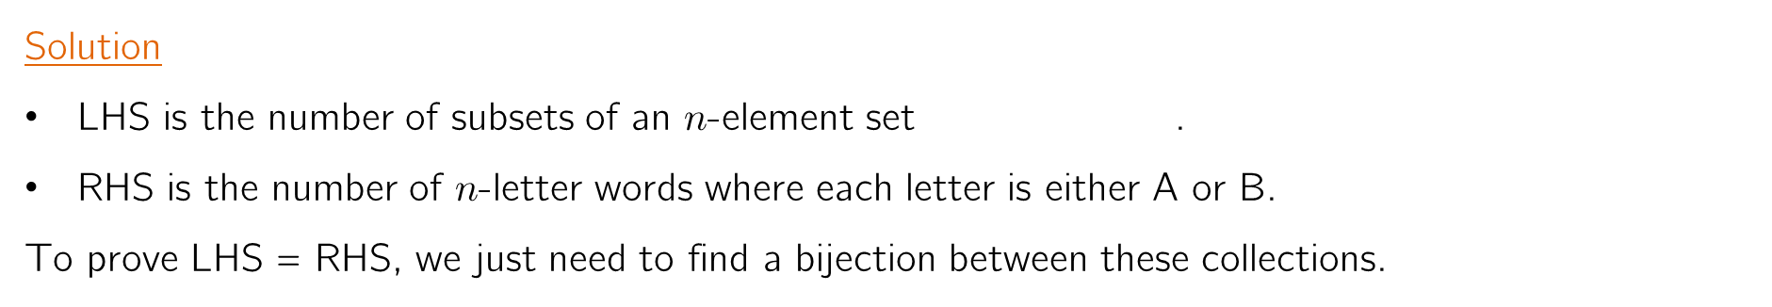
Q6: Number of Subsets
Prove that
Solution
LHS is the number of subsets of an $n$-element set .
RHS is the number of $n$-letter words where each letter is either A or B.
To prove LHS = RHS, we just need to find a bijection between these collections.
Examples for $n=6$
BABBAA
Bijection:
Associate a subset $S$ with an $n$-letter word whose positions of A’s is given by $S$.
AAABAB
BBBBBB
AAAAAA

Slide 19
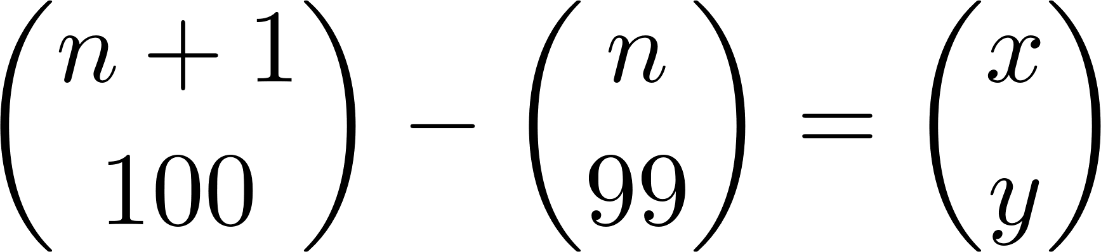
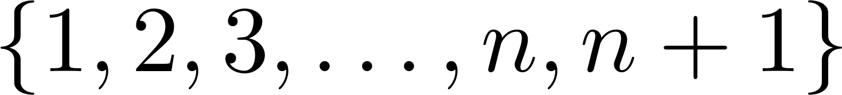
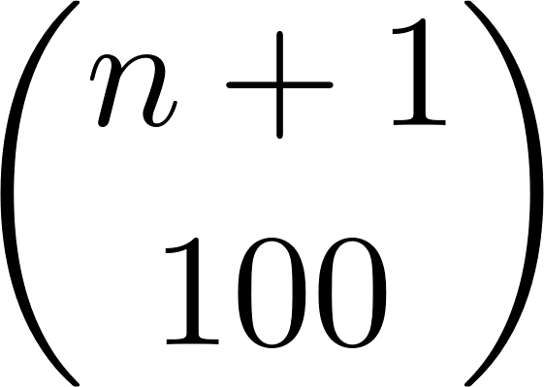
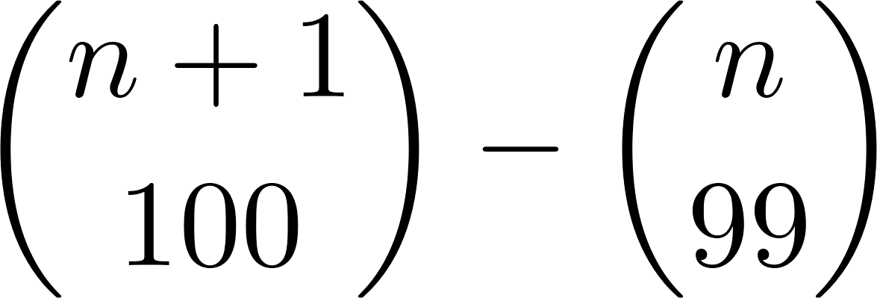
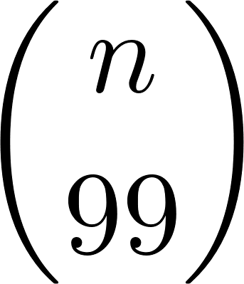
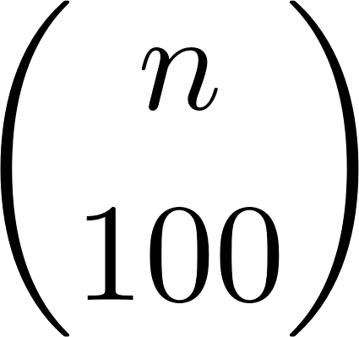
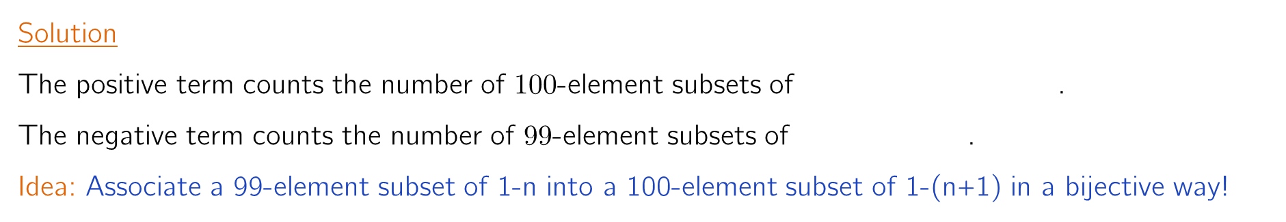
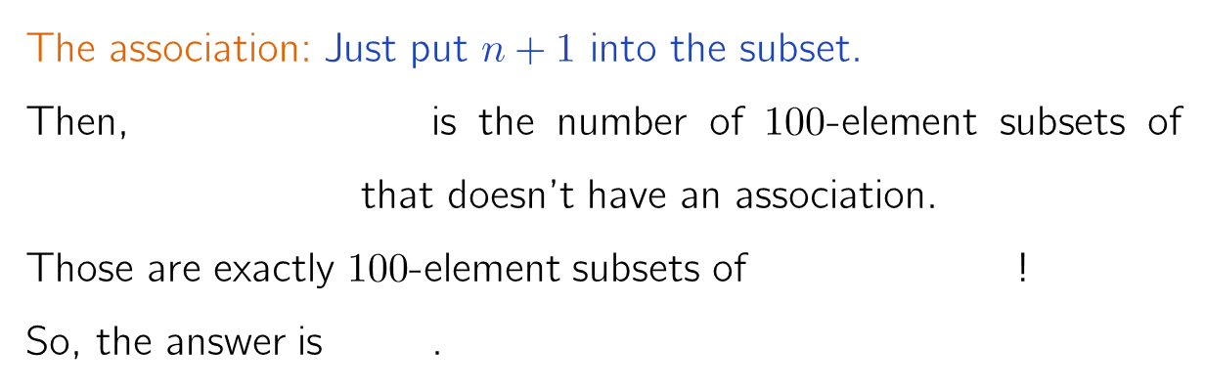
Q7: Combinatorial way to see a difference
Suppose that . Find one possibility for $x$ and $y.$
Solution
The positive term counts the number of $100$-element subsets of .
The negative term counts the number of $99$-element subsets of .
Idea: Associate a 99-element subset of 1-n into a 100-element subset of 1-(n+1) in a bijective way!
The association: Just put $n+1$ into the subset.
Then, is the number of $100$-element subsets of that doesn’t have an association.
Those are exactly $100$-element subsets of !
So, the answer is .
100-element subsets
99-element subsets

Slide 20
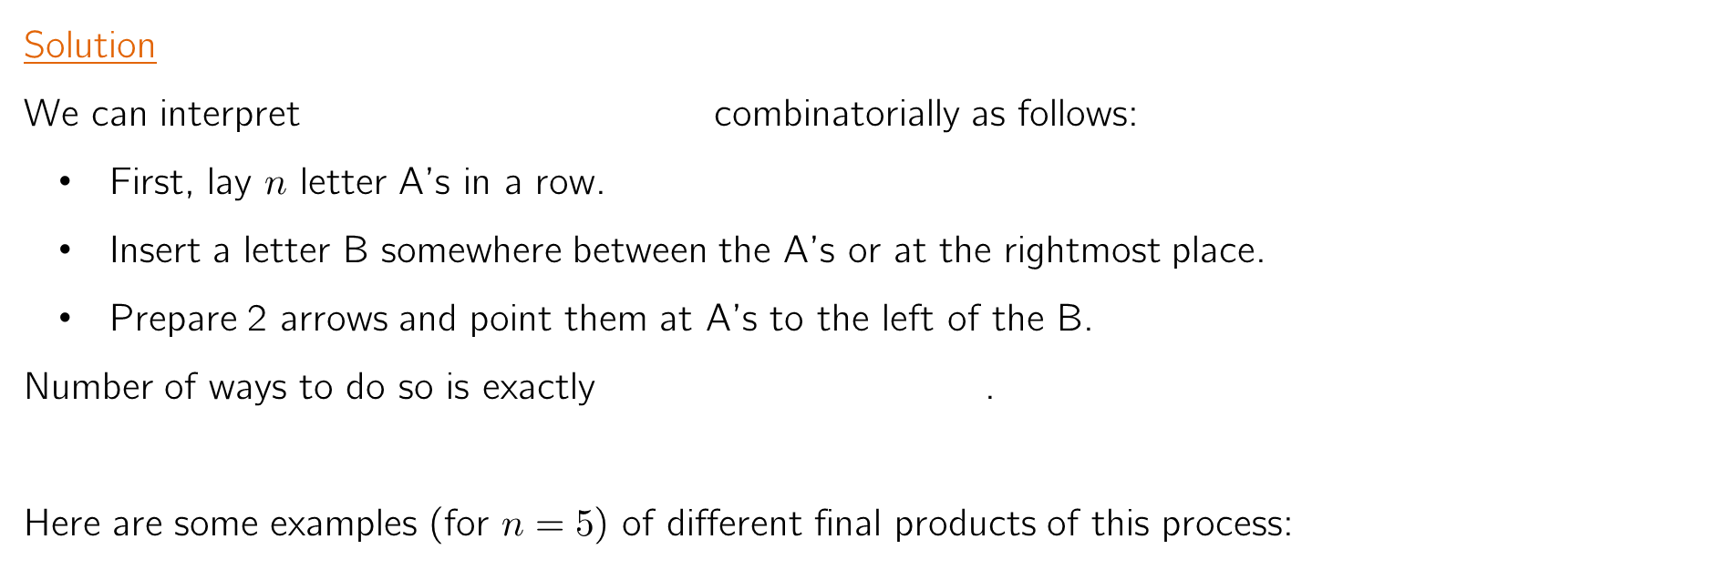
Q8: Sum of Squares
Find a formula for the sum:
Solution
We can interpret combinatorially as follows:
First, lay $n$ letter A’s in a row.
Insert a letter B somewhere between the A’s or at the rightmost place.
Prepare 2 arrows and point them at A’s to the left of the B.
Number of ways to do so is exactly .
Here are some examples (for $n=5$) of different final products of this process:
AAAAA
AAABAA
AAABAA
AAABAA
AAABAA
AAAAAB
ABAAAA

Slide 21
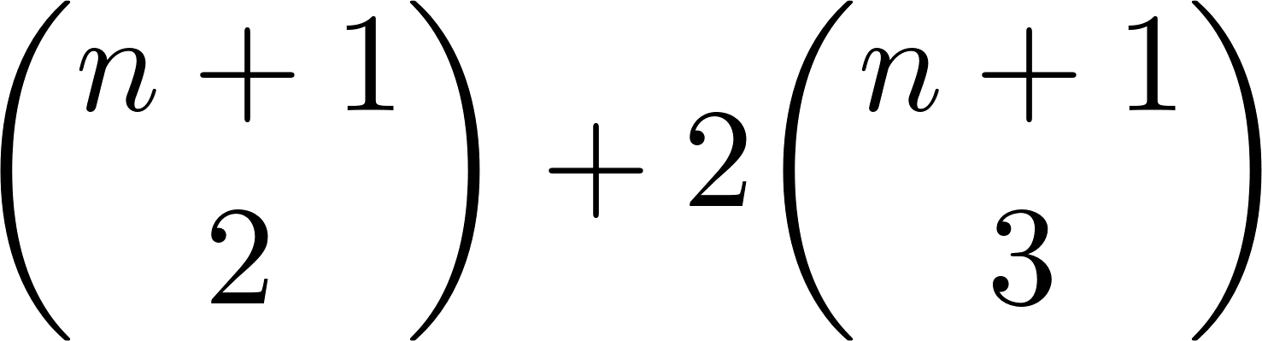
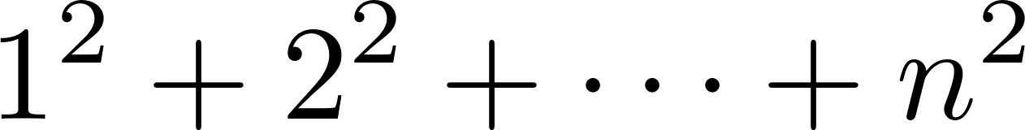
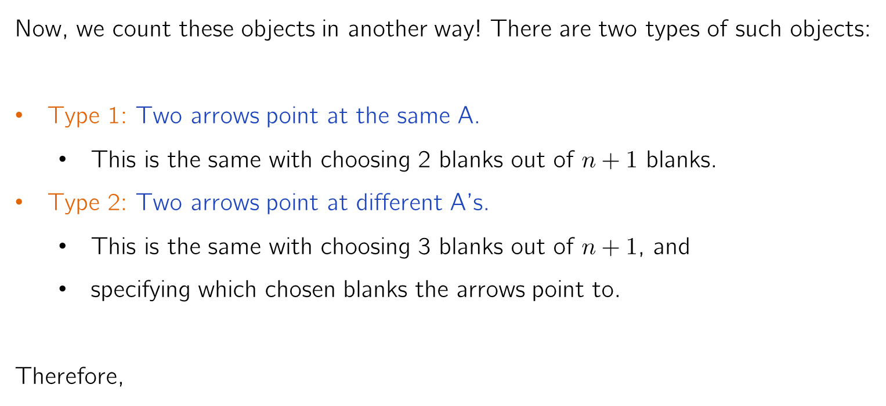
Q8: Sum of Squares
Now, we count these objects in another way! There are two types of such objects:
Type 1: Two arrows point at the same A.
This is the same with choosing 2 blanks out of $n+1$ blanks.
Type 2: Two arrows point at different A’s.
This is the same with choosing 3 blanks out of $n+1$, and
specifying which chosen blanks the arrows point to.
Therefore,
AAABAA
_X_X__
AAABAA
X_XX__
At this point, I do not expect you to come up with this kind of argument by yourself. So, please don’t freak out.
Number of Type 1 objects
Number of Type 2 objects
=
+
=

Slide 22
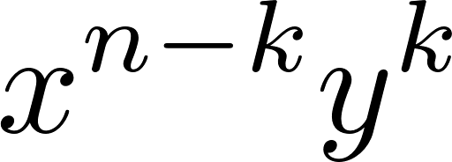
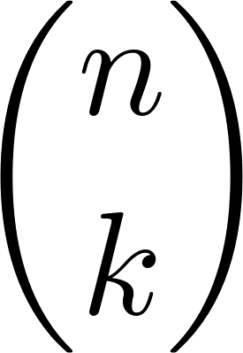
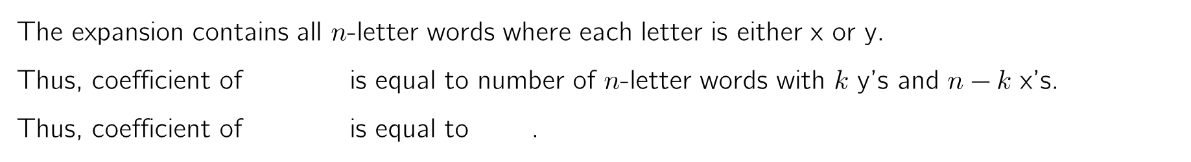
Finale: The Binomial Theorem
Theorem: For all real numbers $x$ and $y$, we have
Simple and Elegant Proof
Simply expand everything:
(x + y)⁴ = (x + y)(x + y)(x + y)(x + y)
= xxxx + xxxy + xxyx + xyxx + yxxx + xxyy + xyxy + xyyx + yxxy + yxyx + yyxx + xyyy + yxyy + yyxy + yyyx + yyyy
The expansion contains all $n$-letter words where each letter is either x or y.
Thus, coefficient of is equal to number of $n$-letter words with $k$ y’s and $n−k$ x’s.
Thus, coefficient of is equal to .

Slide 23
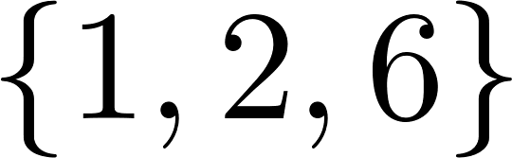
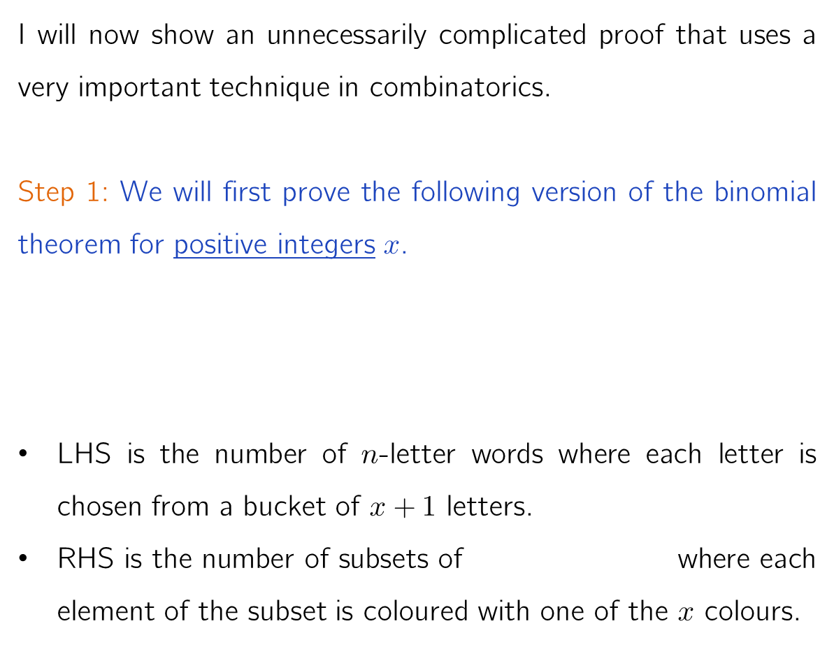
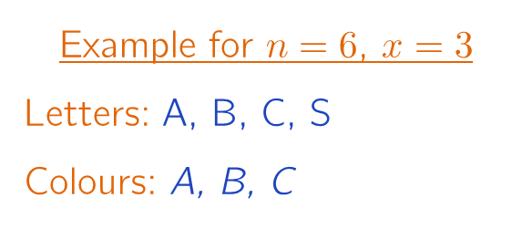
Finale: The Binomial Theorem
I will now show an unnecessarily complicated proof that uses a very important technique in combinatorics.
Step 1: We will first prove the following version of the binomial theorem for positive integers $x$.
LHS is the number of $n$-letter words where each letter is chosen from a bucket of $x+1$ letters.
RHS is the number of subsets of where each element of the subset is coloured with one of the $x$ colours.
Example for $n=6$, $x=3$
Letters: A, B, C, S
Colours: A, B, C
SASSBA
A
B
A
CBBSAS
C
B
B
A
SSSSSS
ABSSSC
A
B
C

Slide 24
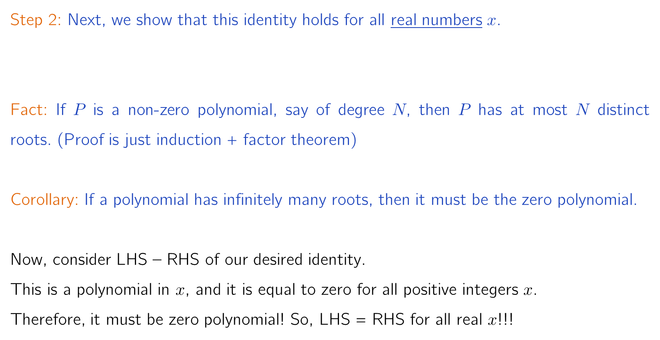
Finale: The Binomial Theorem
Step 2: Next, we show that this identity holds for all real numbers $x$.
Fact: If $P$ is a non-zero polynomial, say of degree $N$, then $P$ has at most $N$ distinct roots. (Proof is just induction + factor theorem)
Corollary: If a polynomial has infinitely many roots, then it must be the zero polynomial.
Now, consider LHS – RHS of our desired identity.
This is a polynomial in $x$, and it is equal to zero for all positive integers $x$.
Therefore, it must be zero polynomial! So, LHS = RHS for all real $x$!!!
This is the black magic of polynomials. Once you know that a polynomial identity is true for all positive integers, you get all reals (in fact all complex) for free!

Slide 25

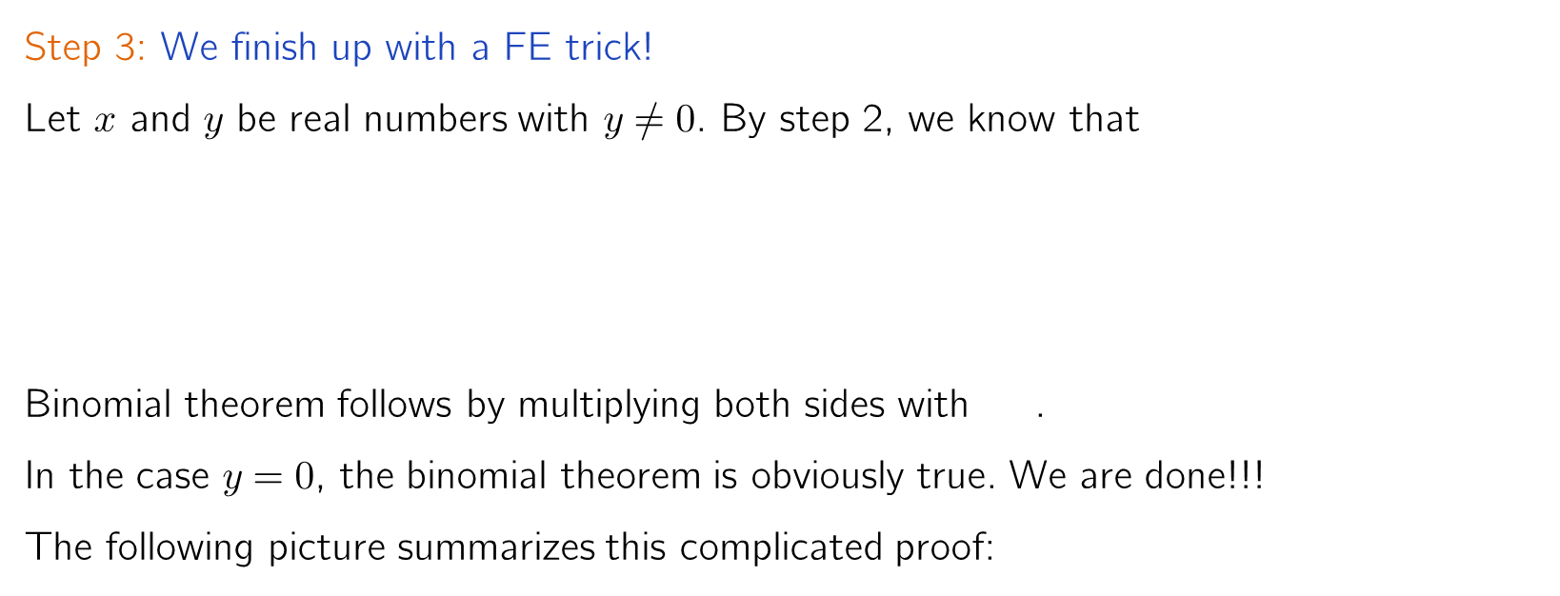
Finale: The Binomial Theorem
Step 3: We finish up with a FE trick!
Let $x$ and $y$ be real numbers with $y≠0$. By step 2, we know that
Binomial theorem follows by multiplying both sides with .
In the case $y=0$, the binomial theorem is obviously true. We are done!!!
The following picture summarizes this complicated proof:
This part is entirely algebra!
Simple binomial theorem for positive integers.
Simple binomial theorem for real numbers
Desired binomial theorem for all real numbers.
Bijective
Proof
Polynomial
black magic
Just a
FE trick
Start

Slide 26
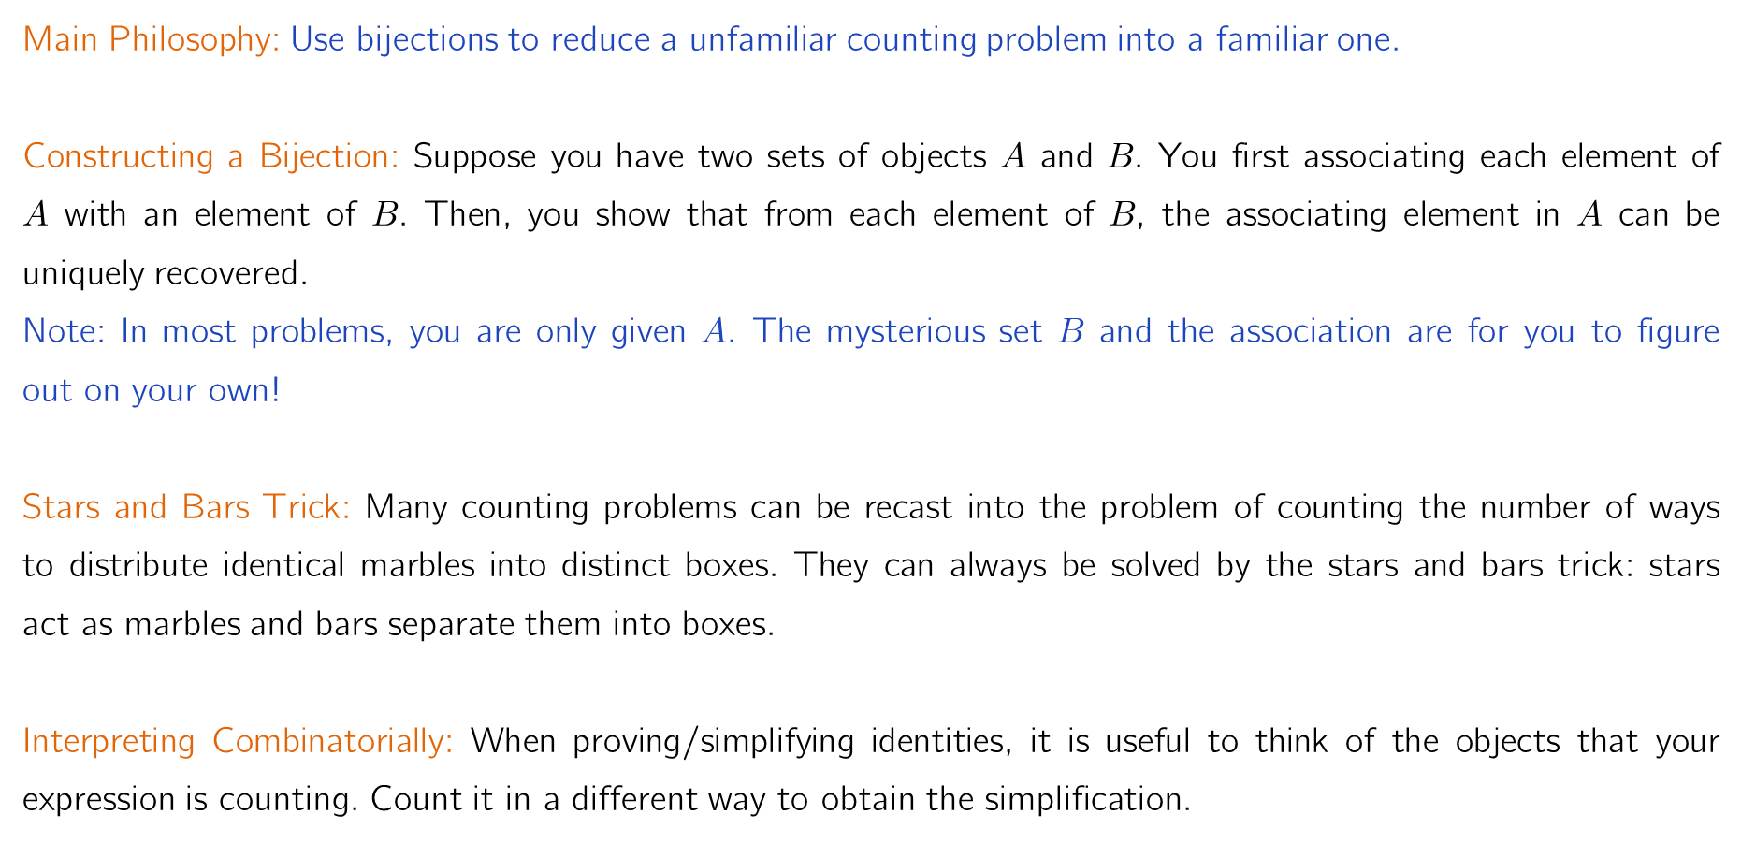
Summary of Important Ideas
Main Philosophy: Use bijections to reduce a unfamiliar counting problem into a familiar one.
Constructing a Bijection: Suppose you have two sets of objects $A$ and $B$. You first associating each element of $A$ with an element of $B$. Then, you show that from each element of $B$, the associating element in $A$ can be uniquely recovered.
Note: In most problems, you are only given $A$. The mysterious set $B$ and the association are for you to figure out on your own!
Stars and Bars Trick: Many counting problems can be recast into the problem of counting the number of ways to distribute identical marbles into distinct boxes. They can always be solved by the stars and bars trick: stars act as marbles and bars separate them into boxes.
Interpreting Combinatorially: When proving/simplifying identities, it is useful to think of the objects that your expression is counting. Count it in a different way to obtain the simplification.

Slide 27
That’s it! I hope my lessons convince you that
combinatorics is a beautiful subject.

