Slide 1
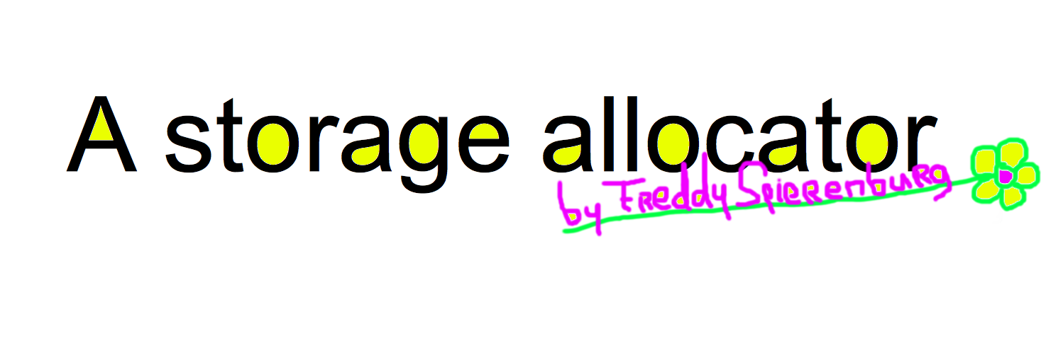
https://github.com/snarlistic/lectures

Slide 2
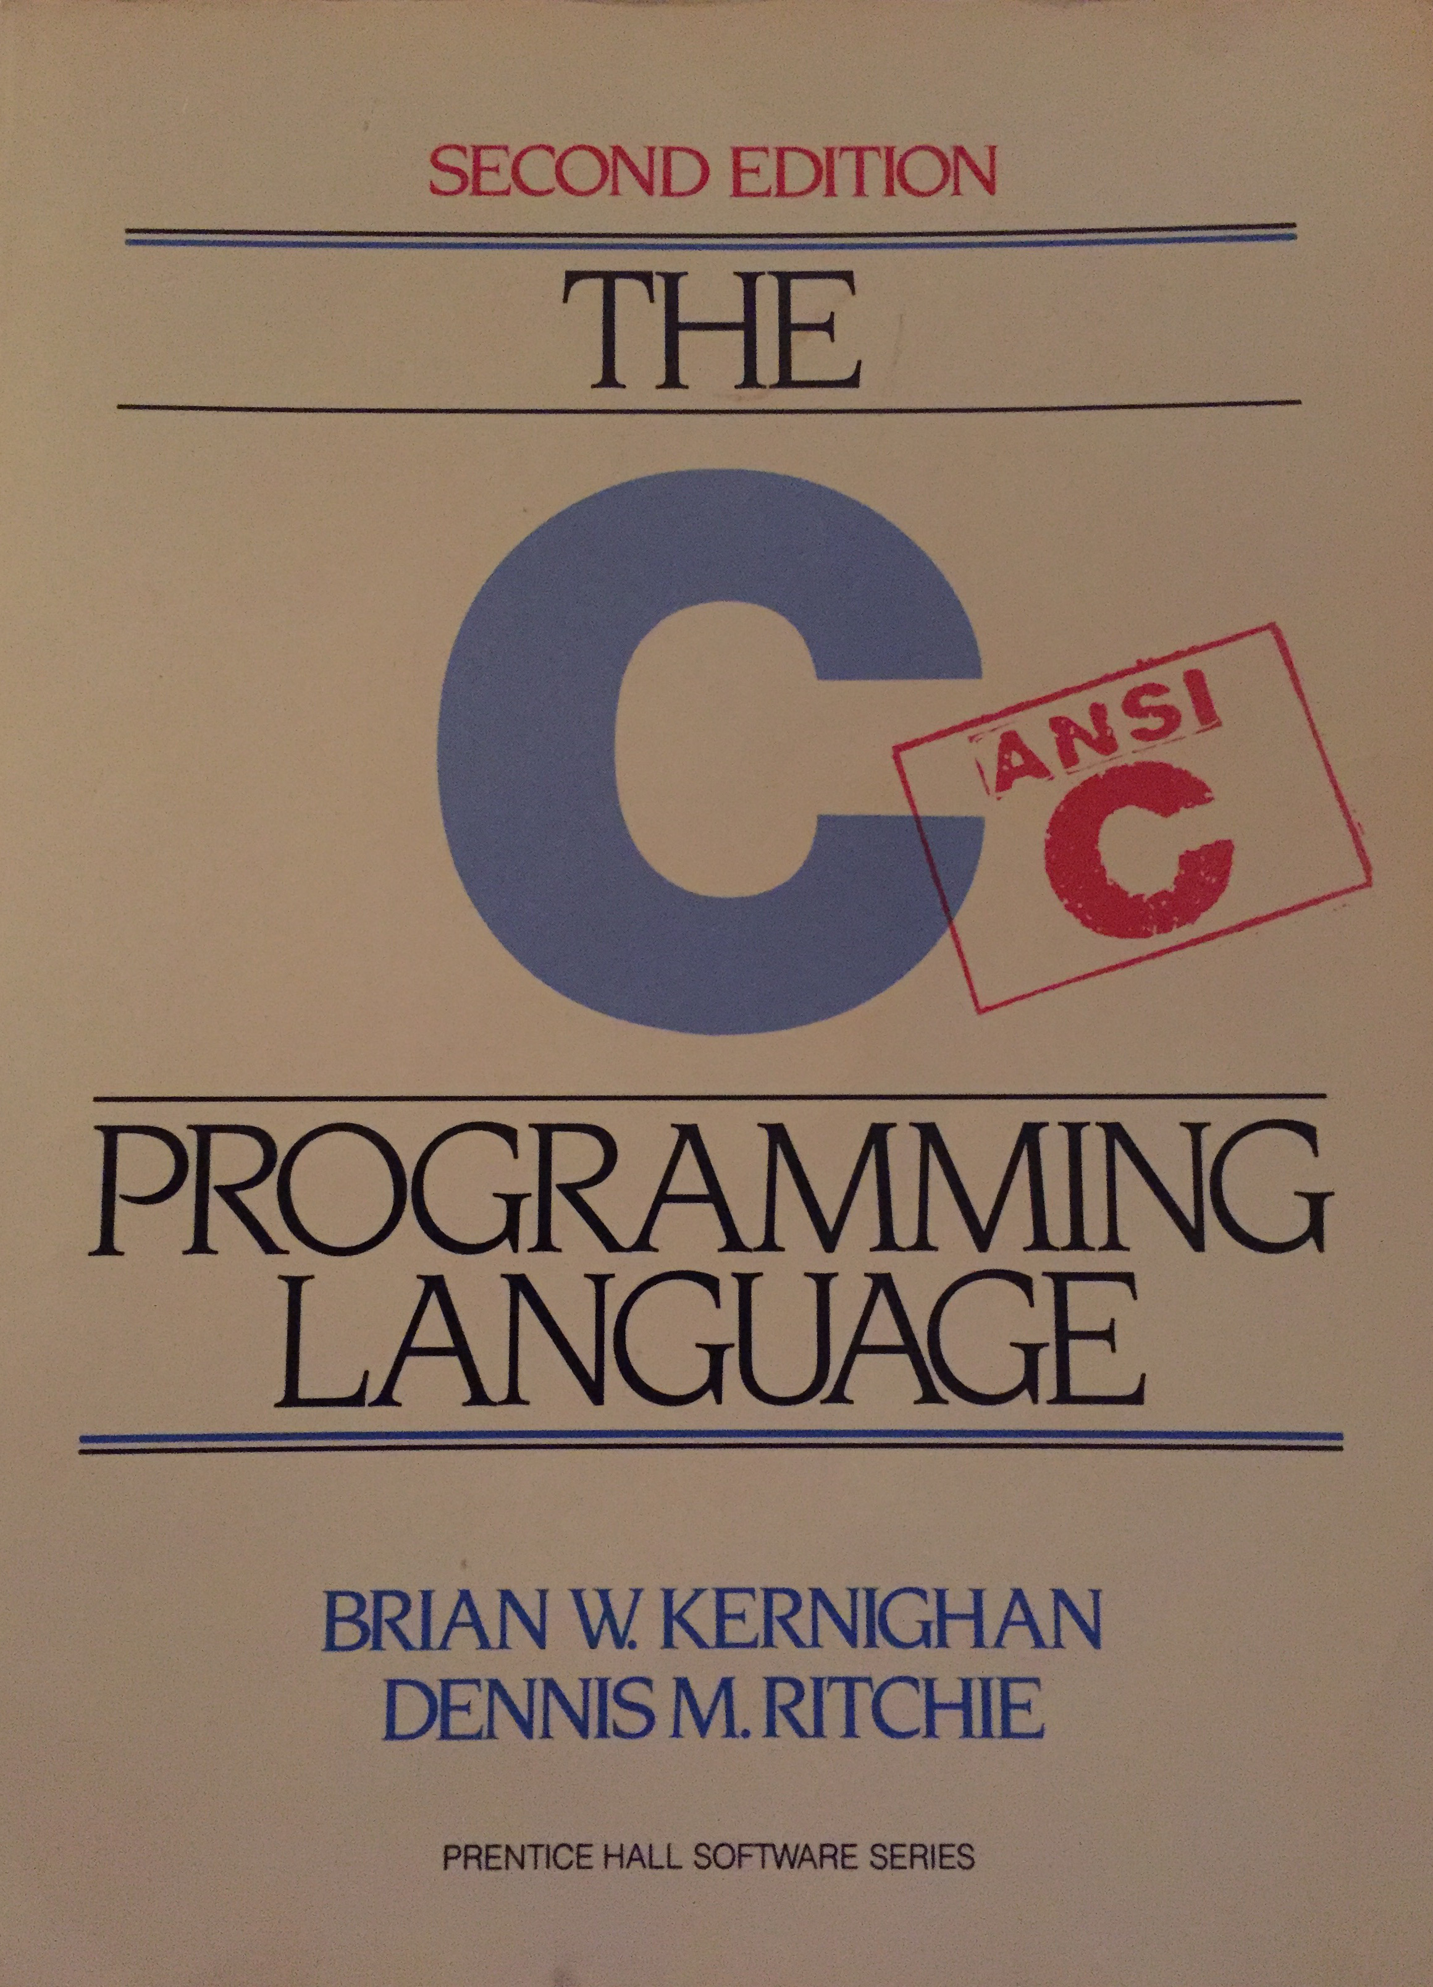

Slide 3
Overview

Slide 4
Introduction

Slide 5
C

Slide 6
Memory

Slide 7
Interface (API)

Slide 8
Schematic

Slide 9
union Header

Slide 10
Example
(step by step)

Slide 11



Slide 12


Slide 13
/* You are not expected to
understand this */
if (rp -> p_flag & SSWAP) {
rp -> p_flag =& ~ SSWAP;
aretu (u.u_ssav);
}
Notes:
Ask people if the know the language. Please raise hands if you do. Don't panic if you don't!
Explanation:
http://orkinos.cmpe.boun.edu.tr/~kosar/odd.html

Slide 14
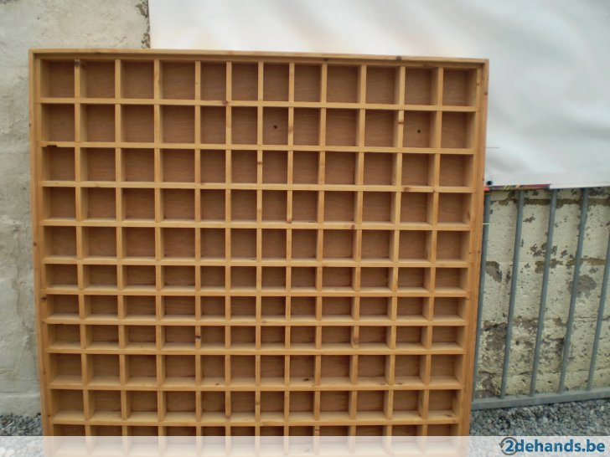

Slide 15
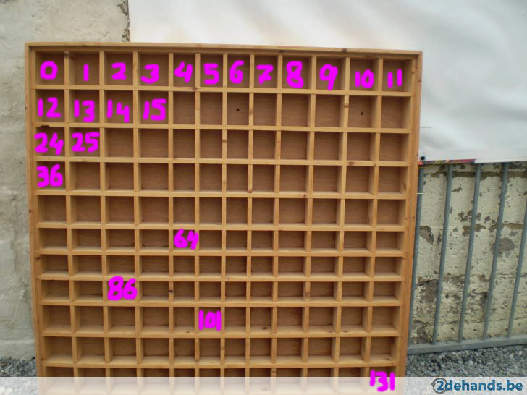

Slide 16
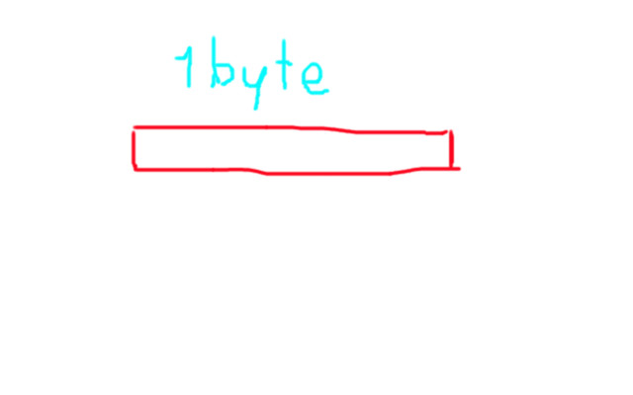

Slide 17
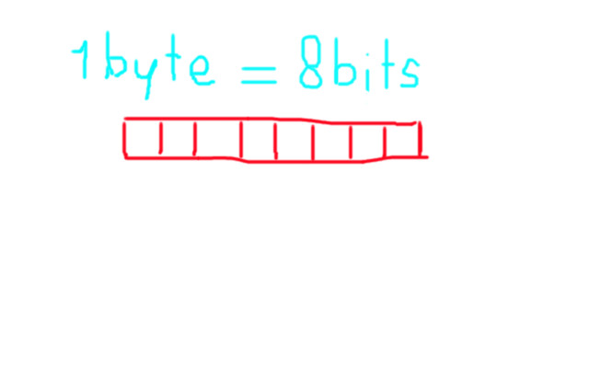

Slide 18
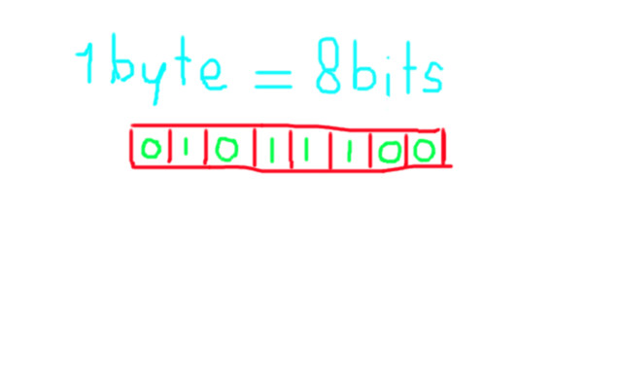

Slide 19
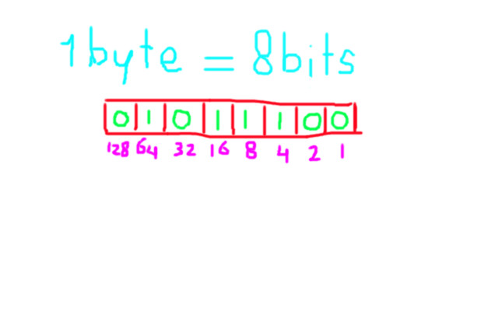

Slide 20
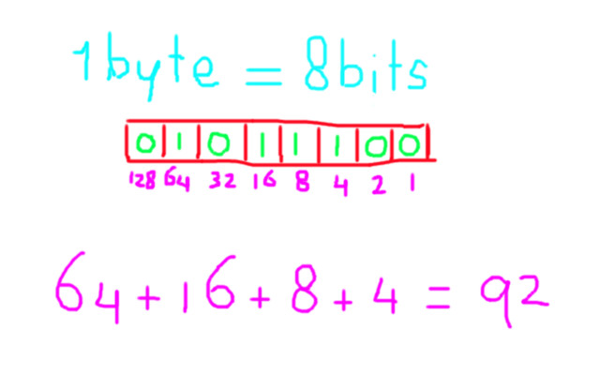

Slide 21
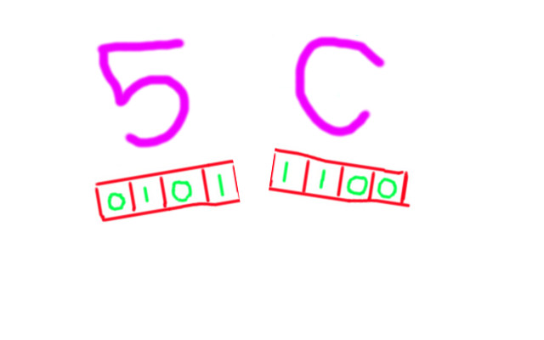

Slide 22
Everything is a number

Slide 23
Char
'B' => 42

Slide 24
Hello, world!
48 65 6C 6C 6F 2C 20
77 6F 72 6C 64 21 00

Slide 25
Int
31337 => 00 00 7A 69

Slide 26
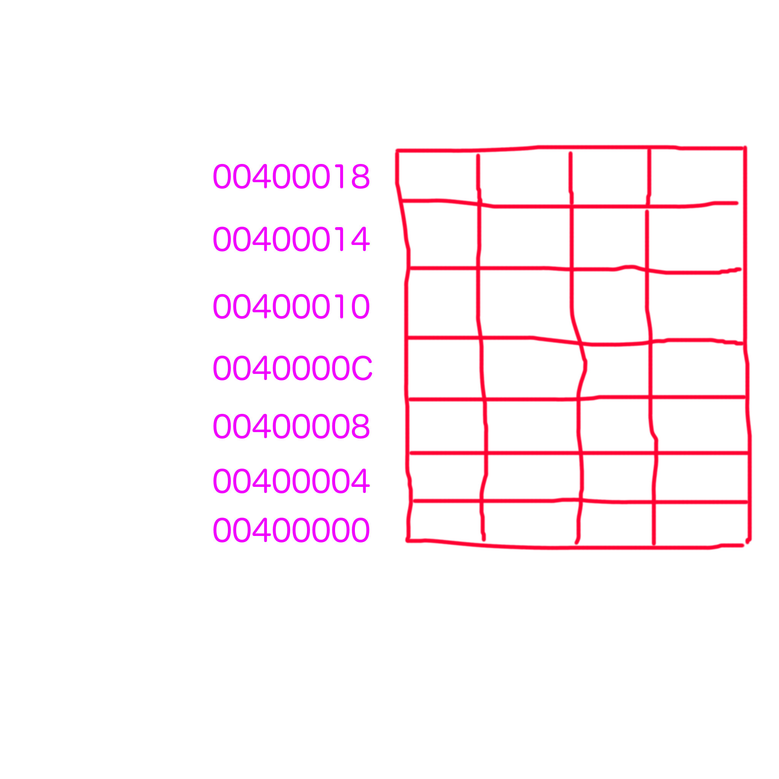

Slide 27
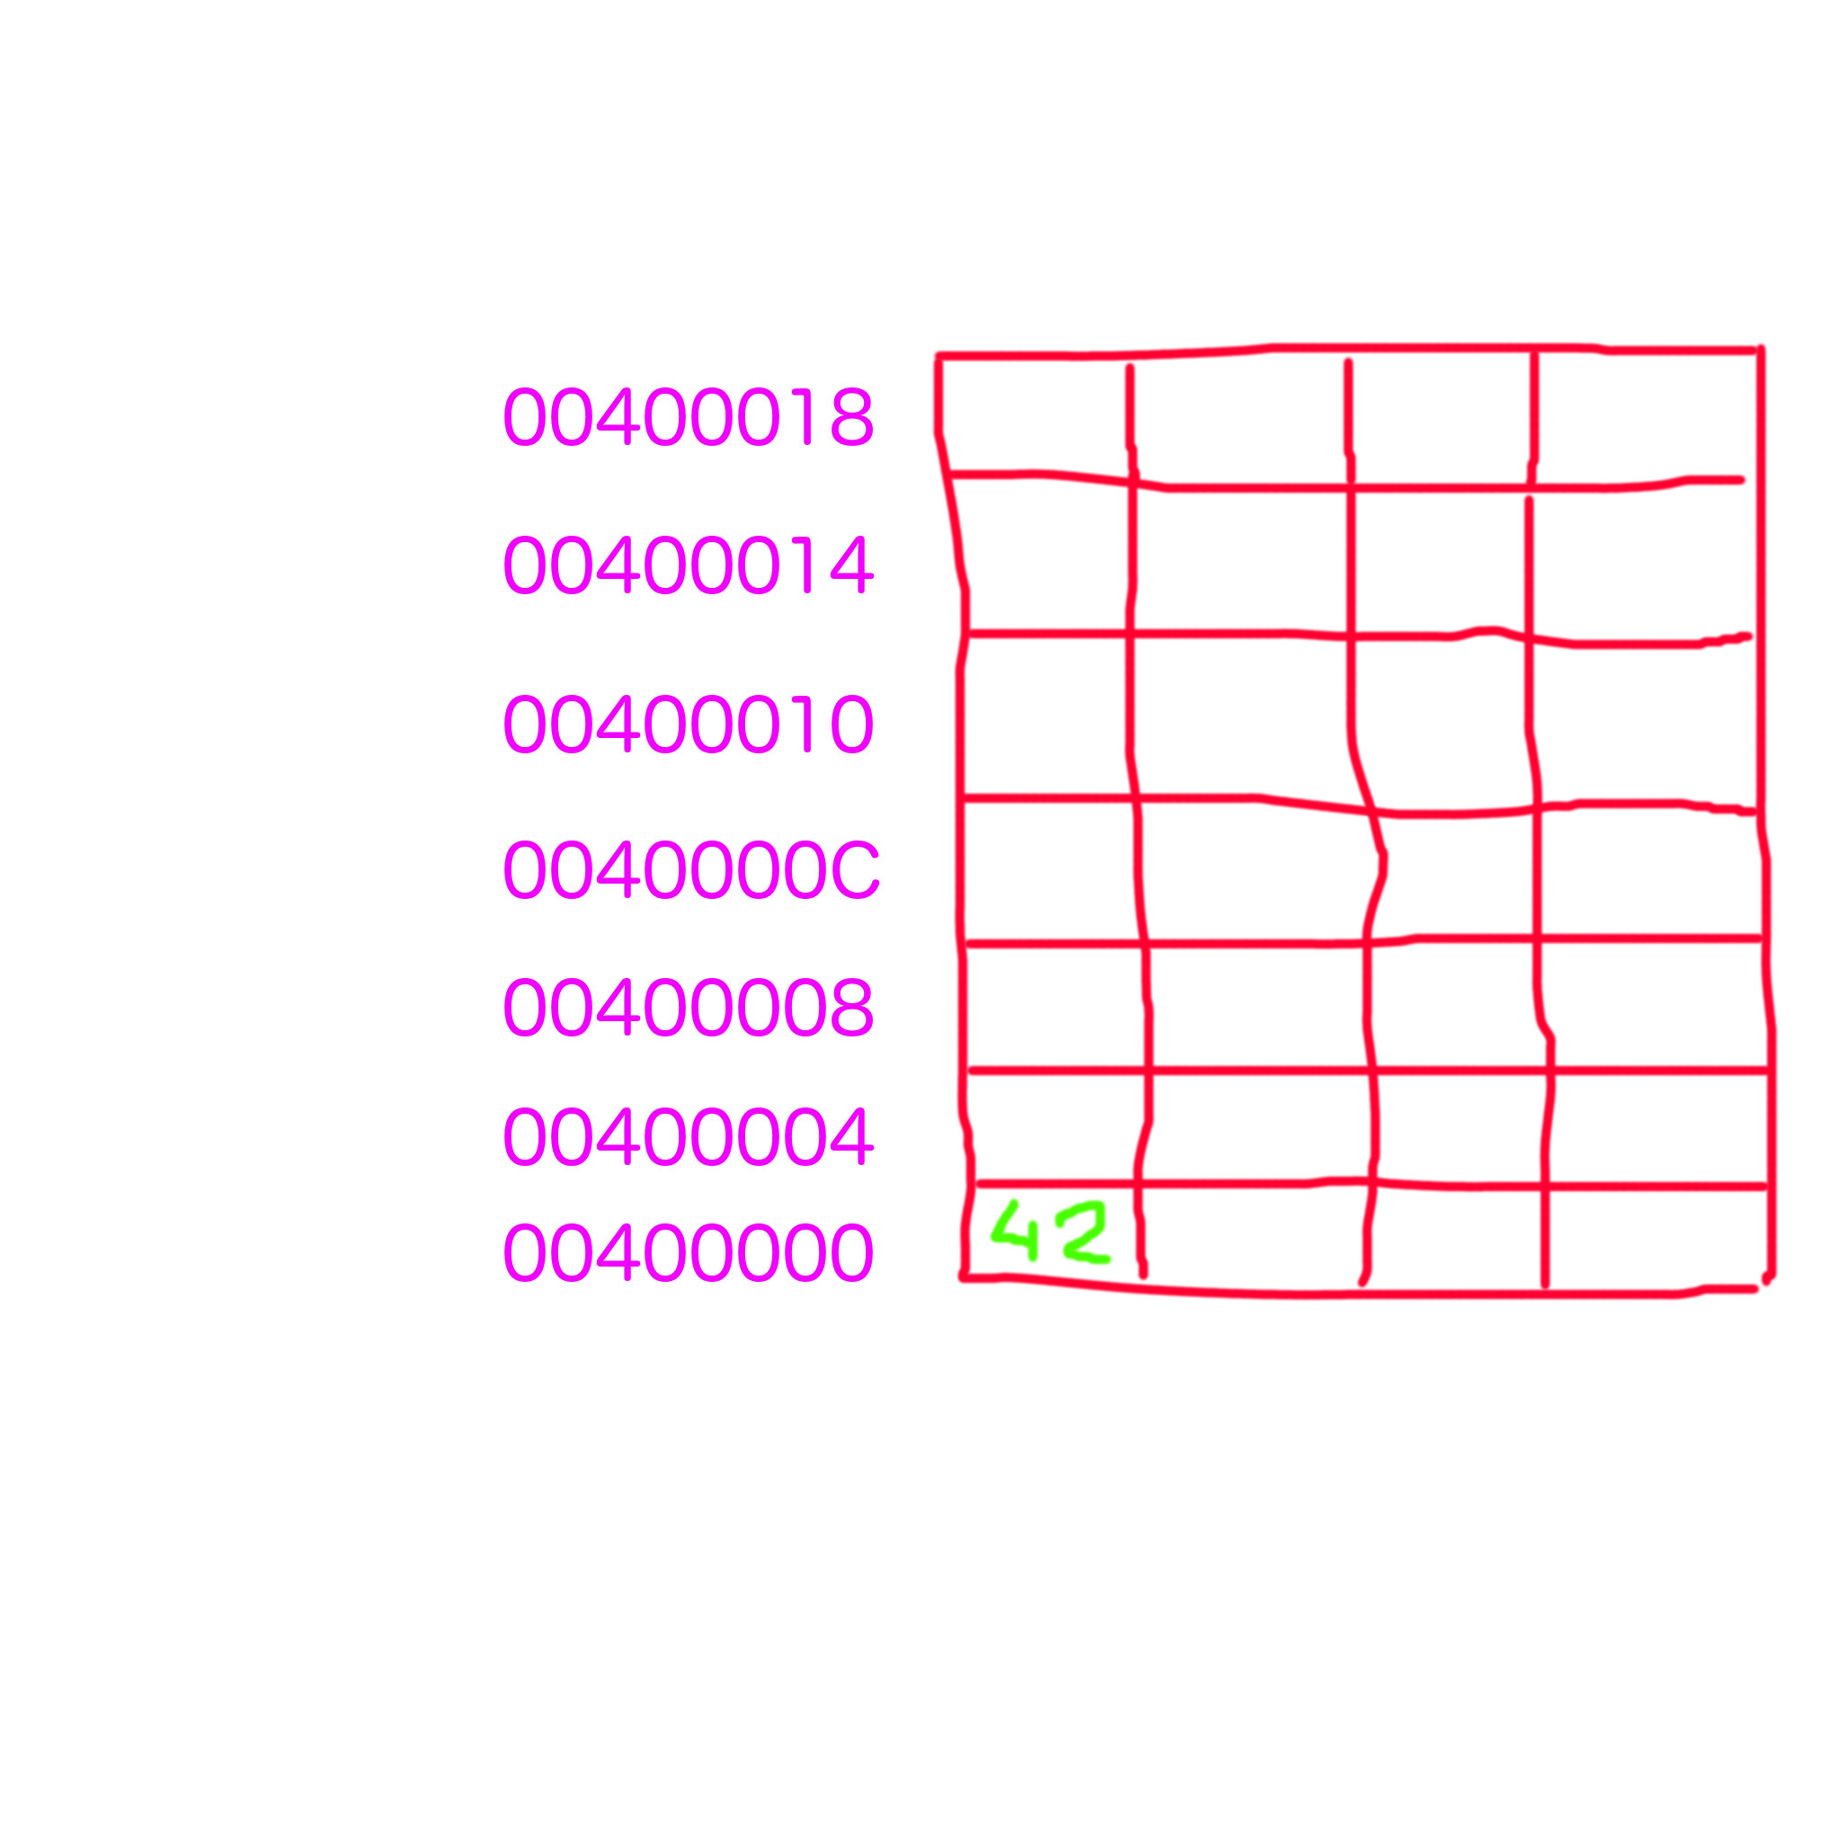

Slide 28
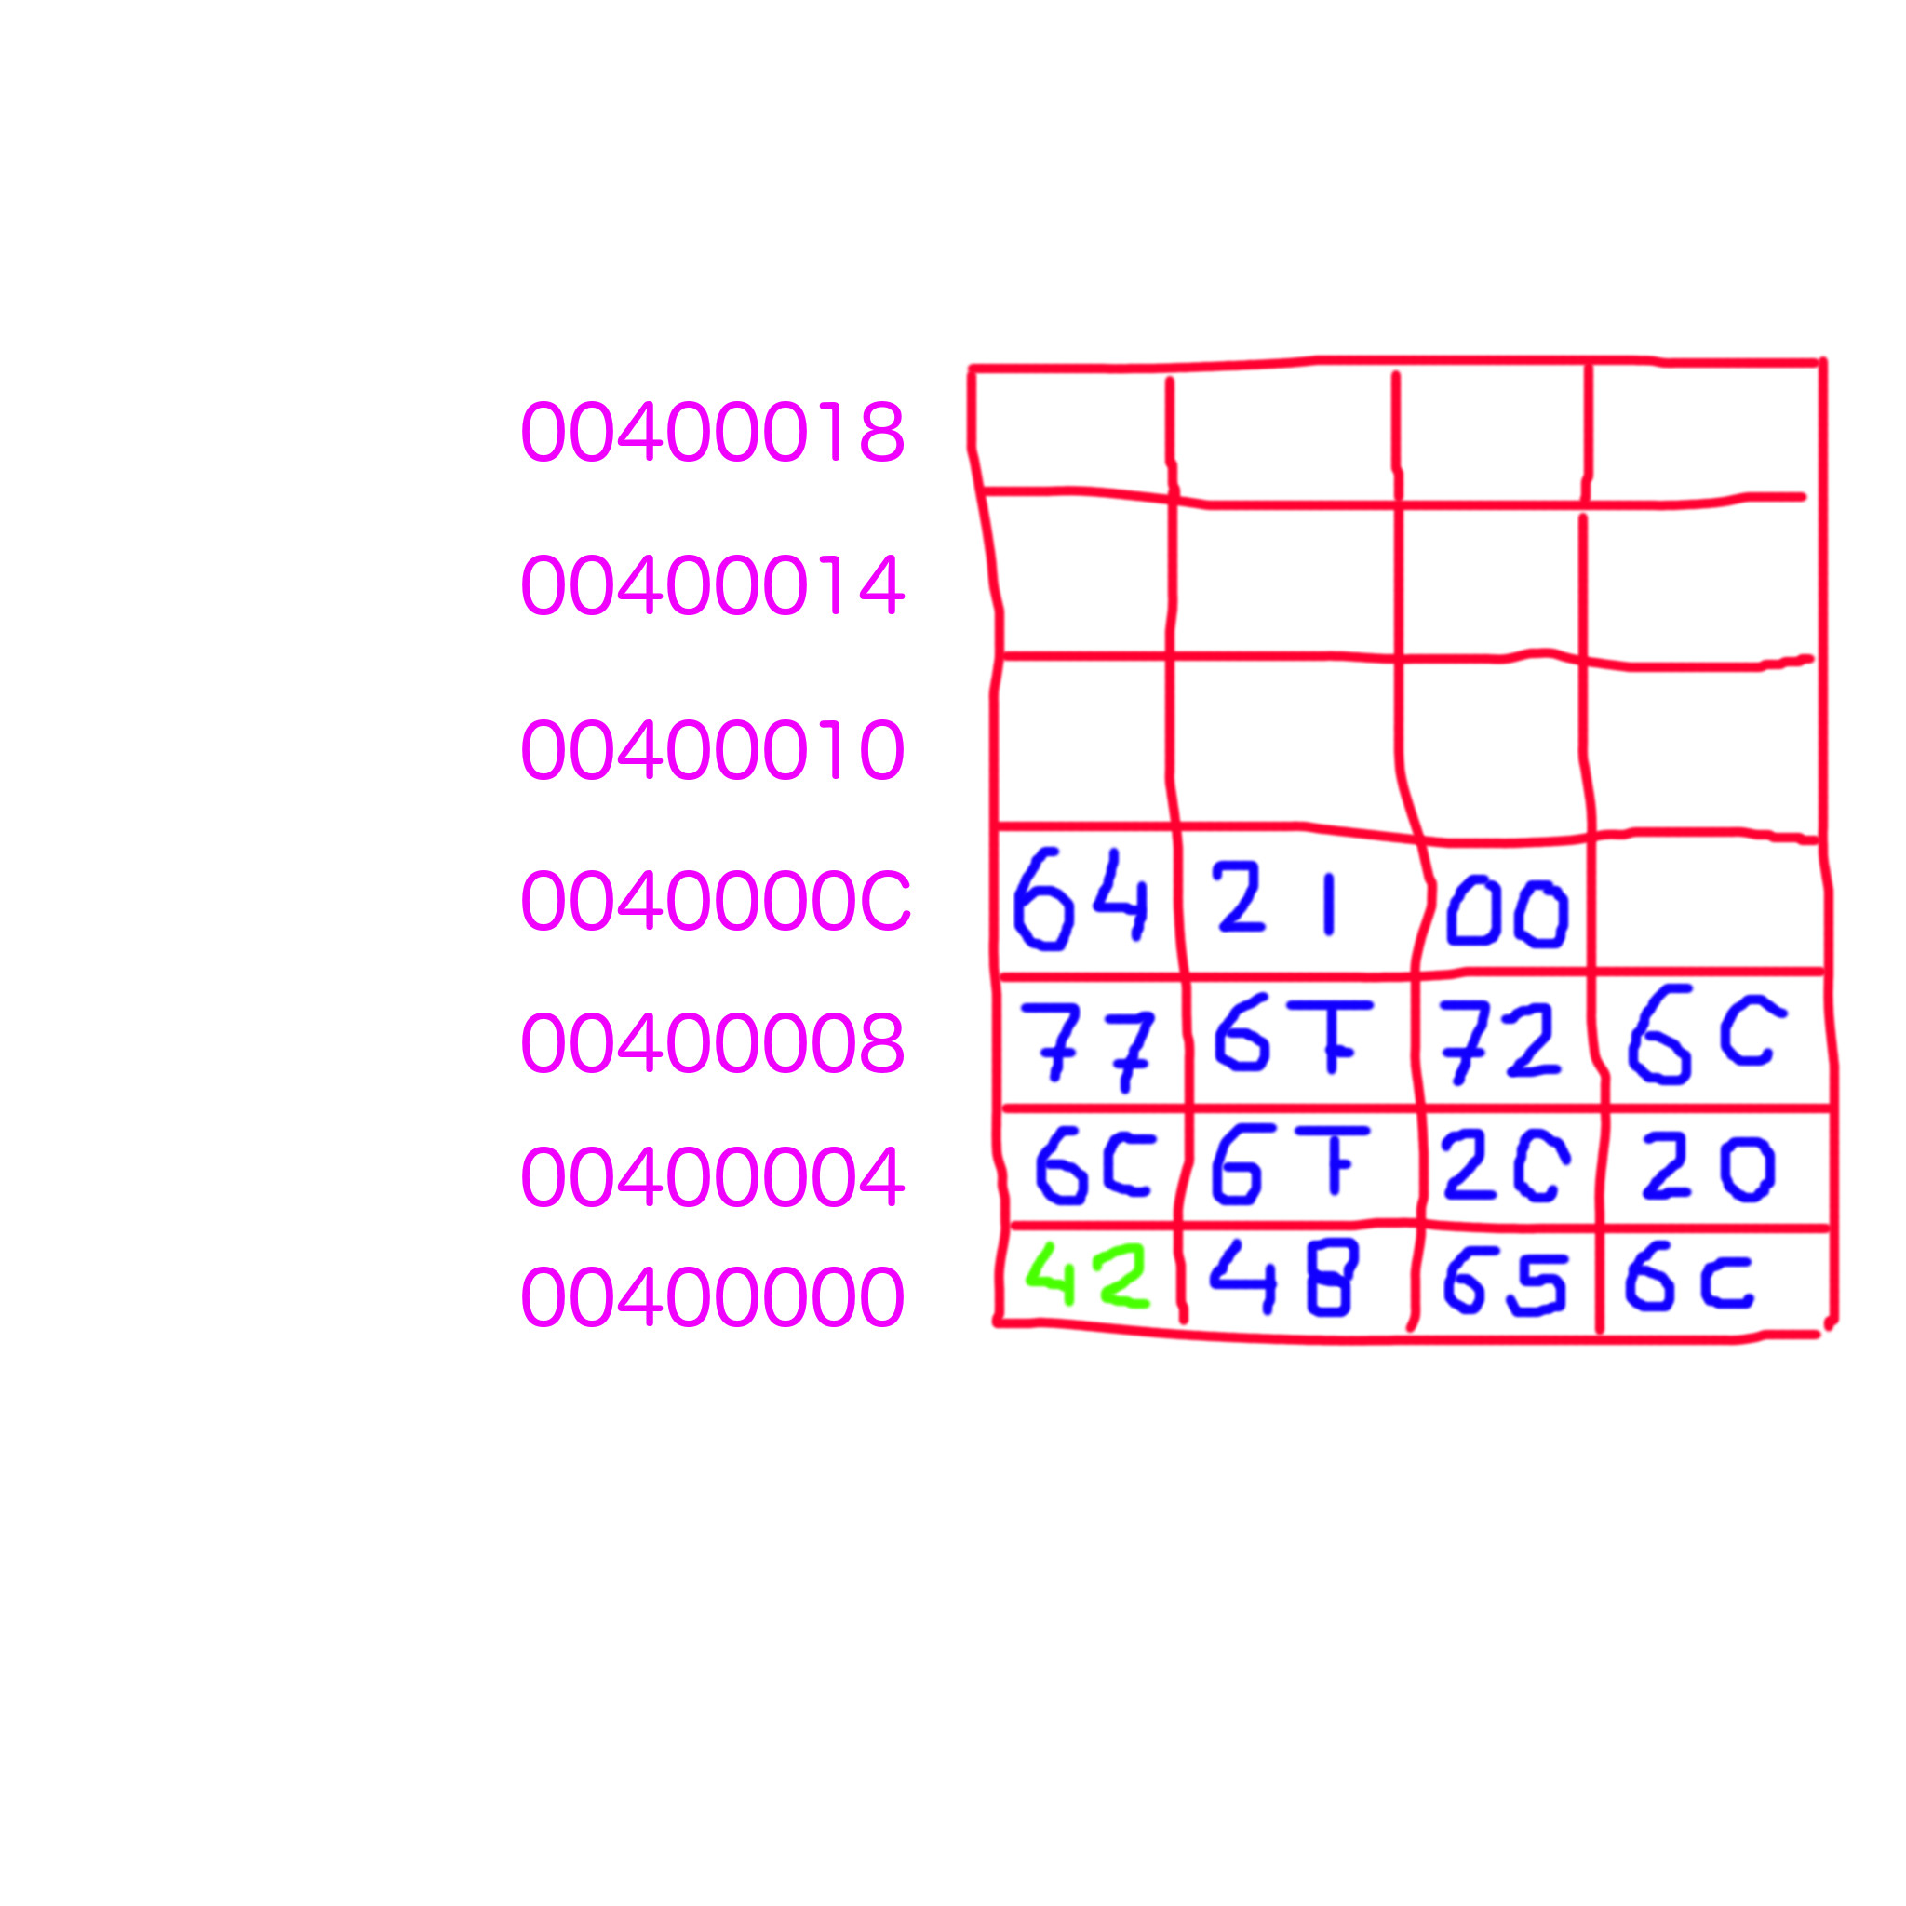

Slide 29
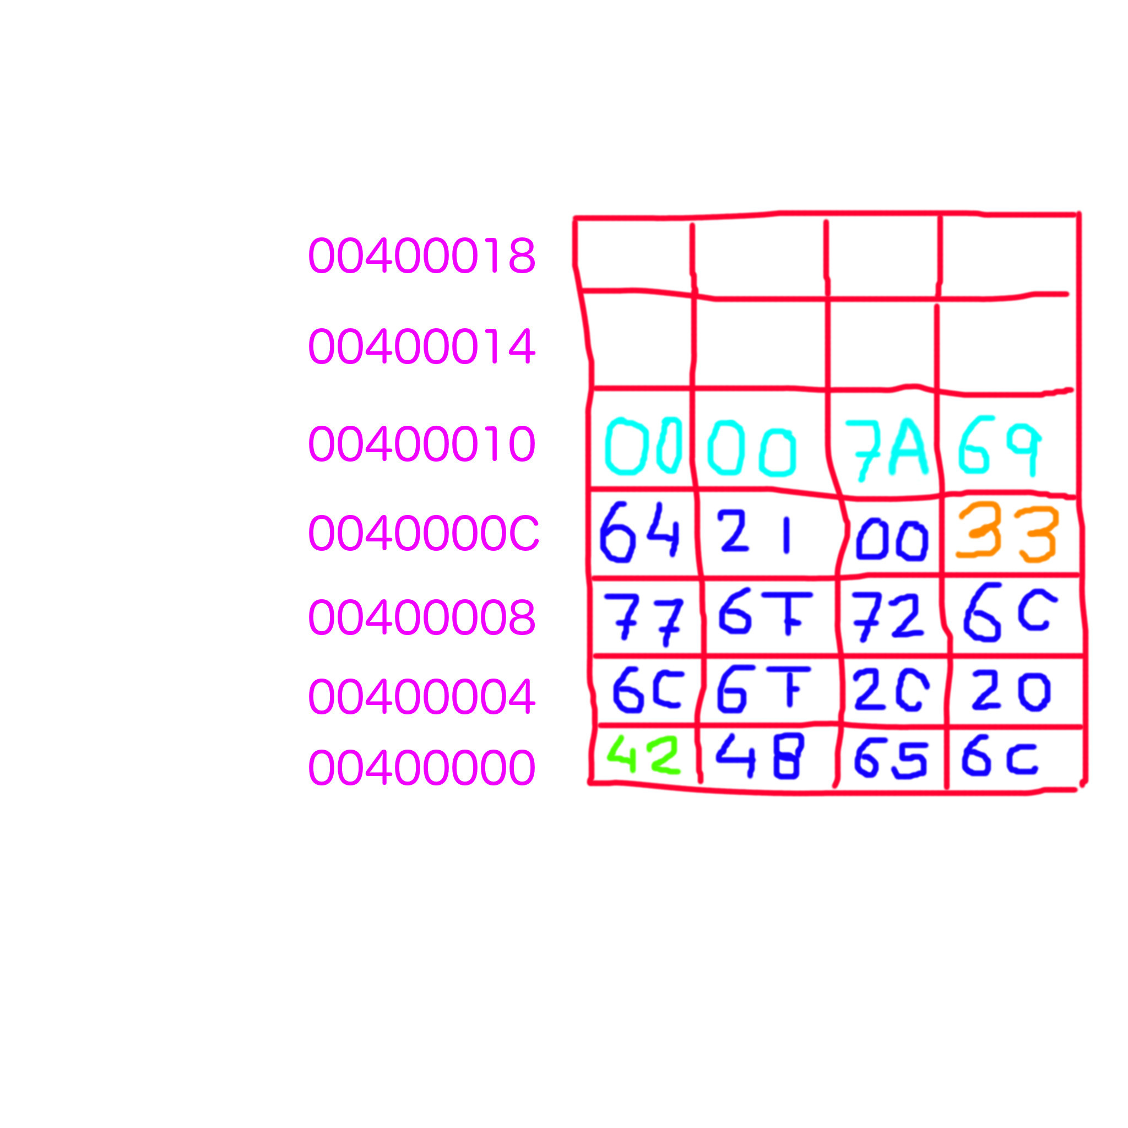

Slide 30
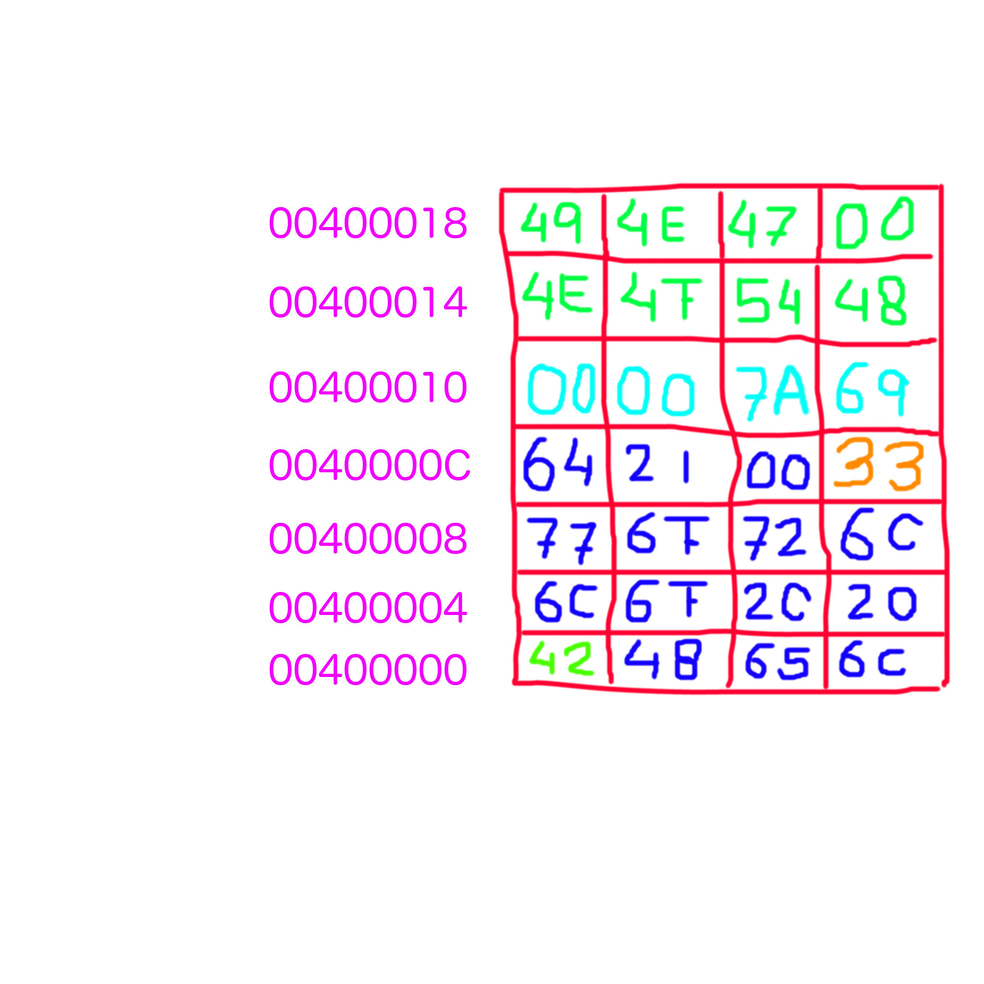

Slide 32
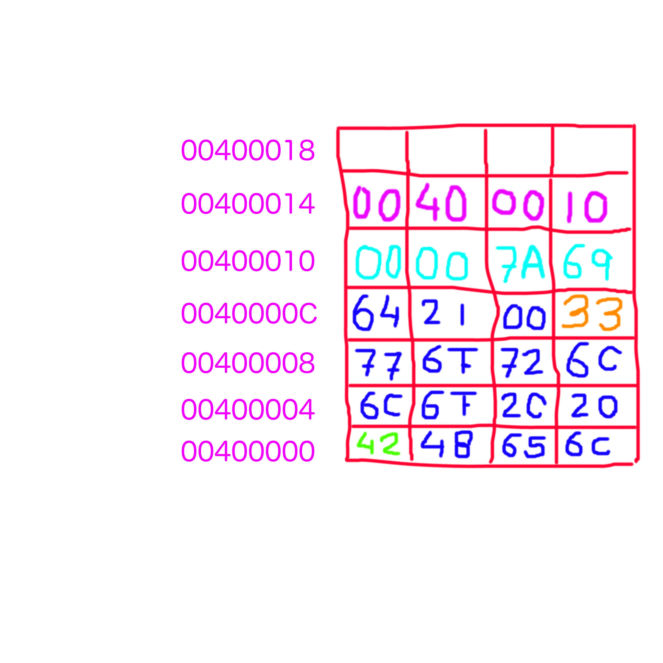

Slide 33
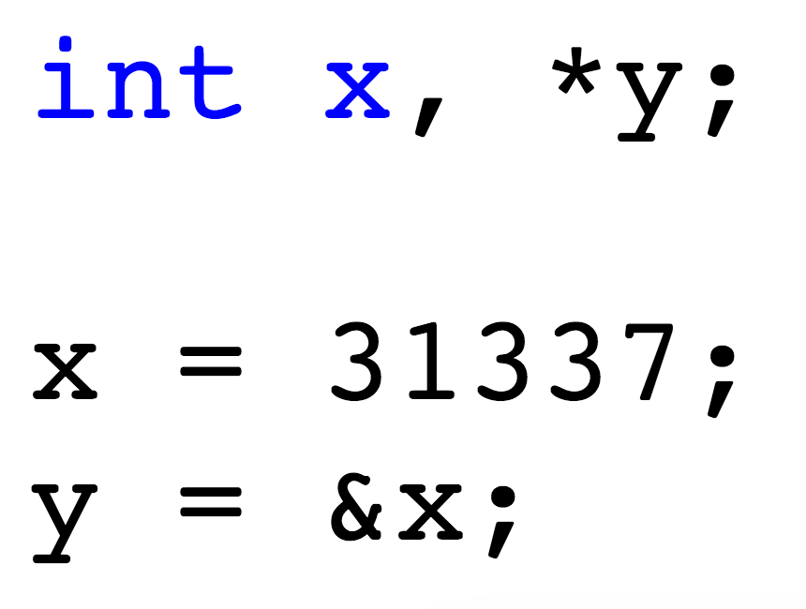

Slide 34
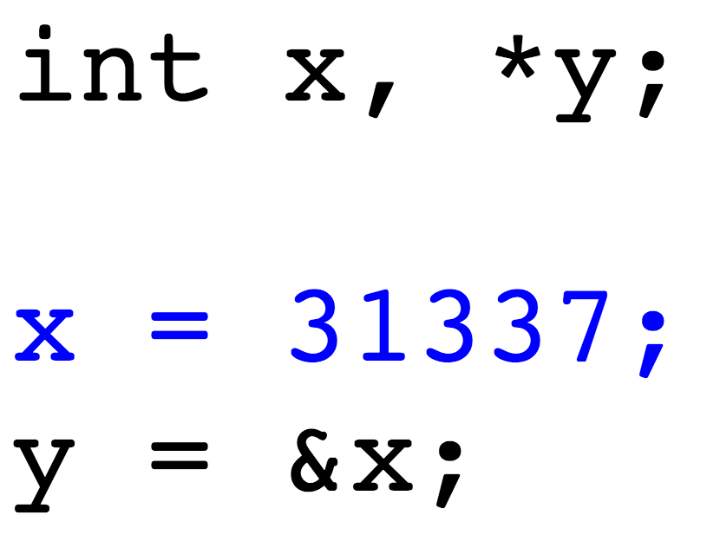

Slide 36
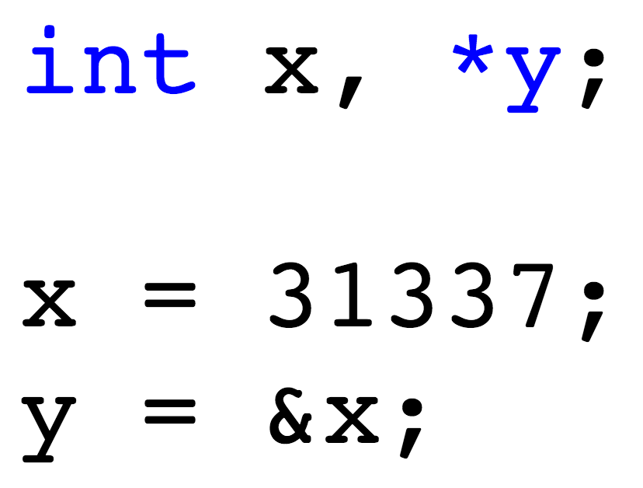

Slide 37
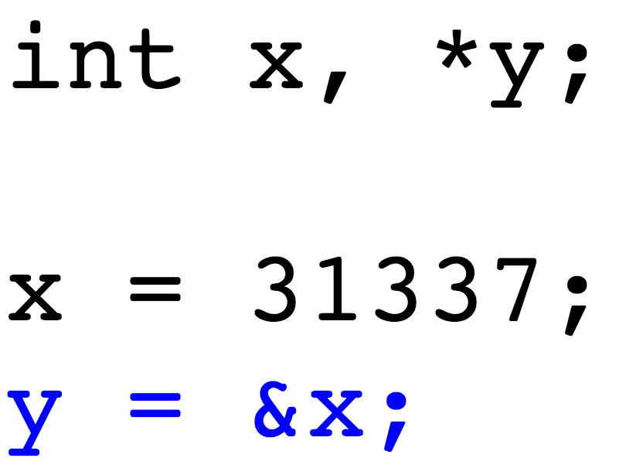

Slide 39
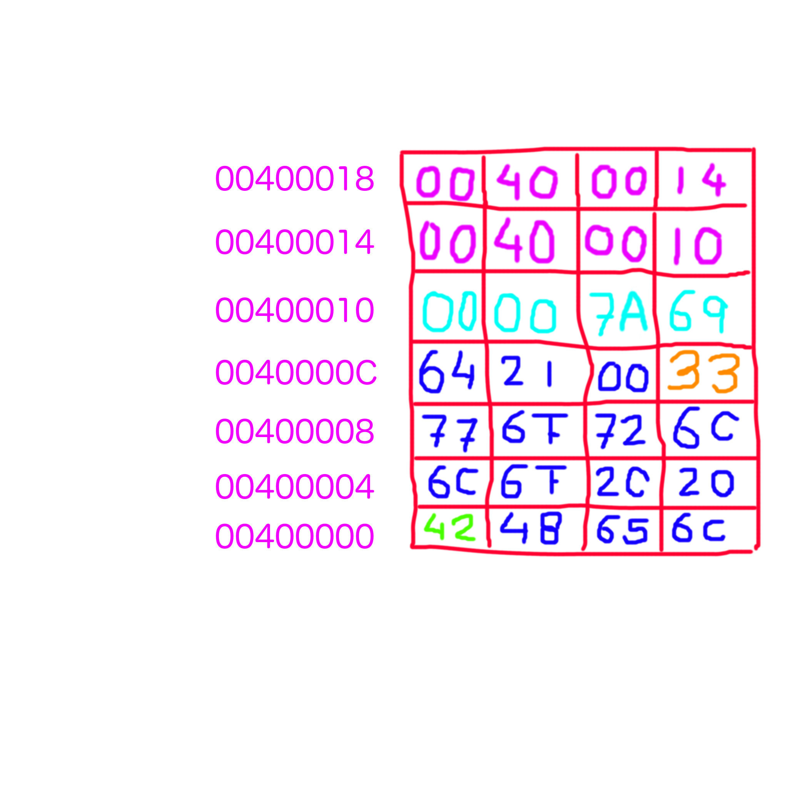

Slide 40
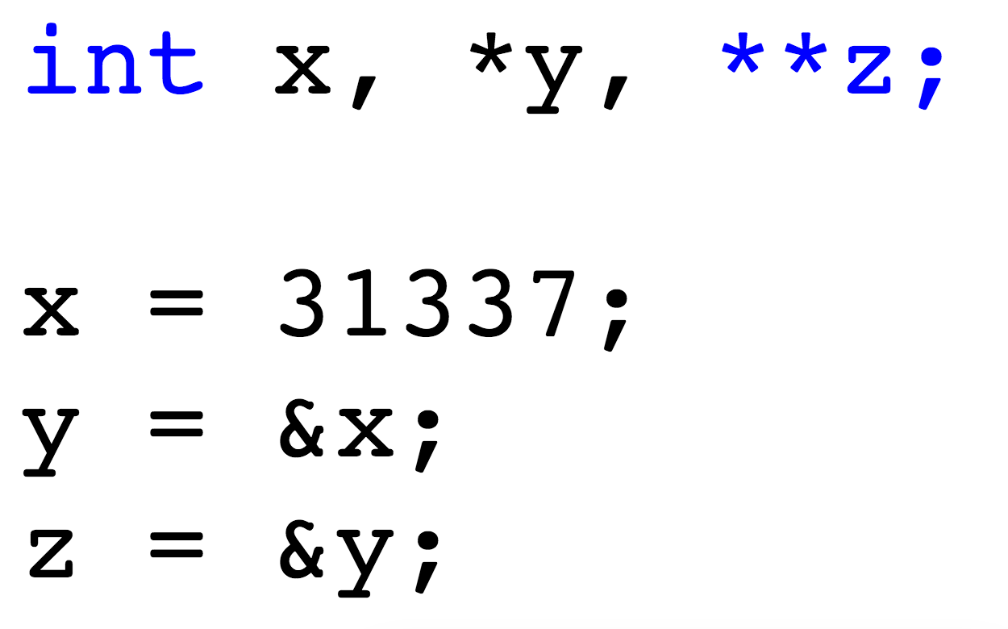

Slide 41
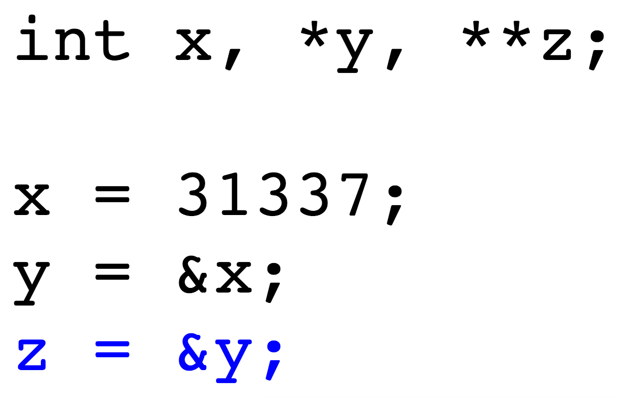

Slide 43
buffer = malloc(32);

Slide 44
free(buffer);

Slide 45
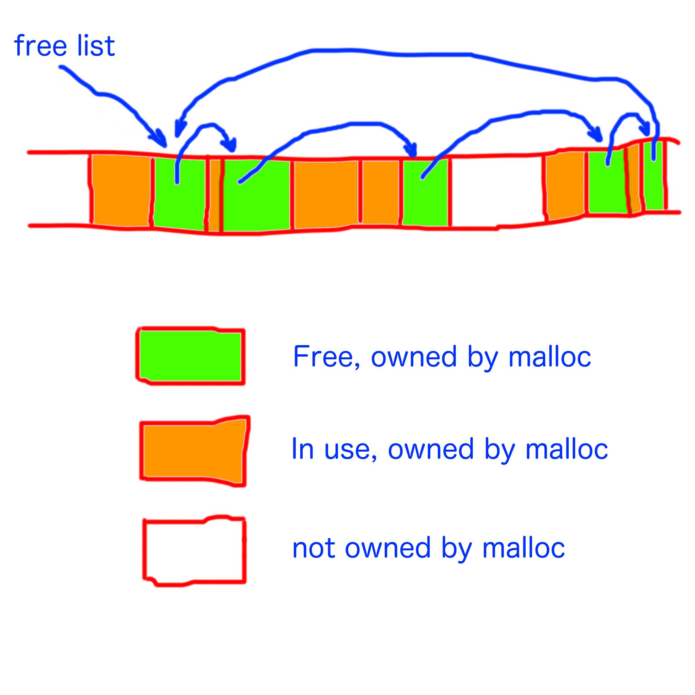

Slide 46
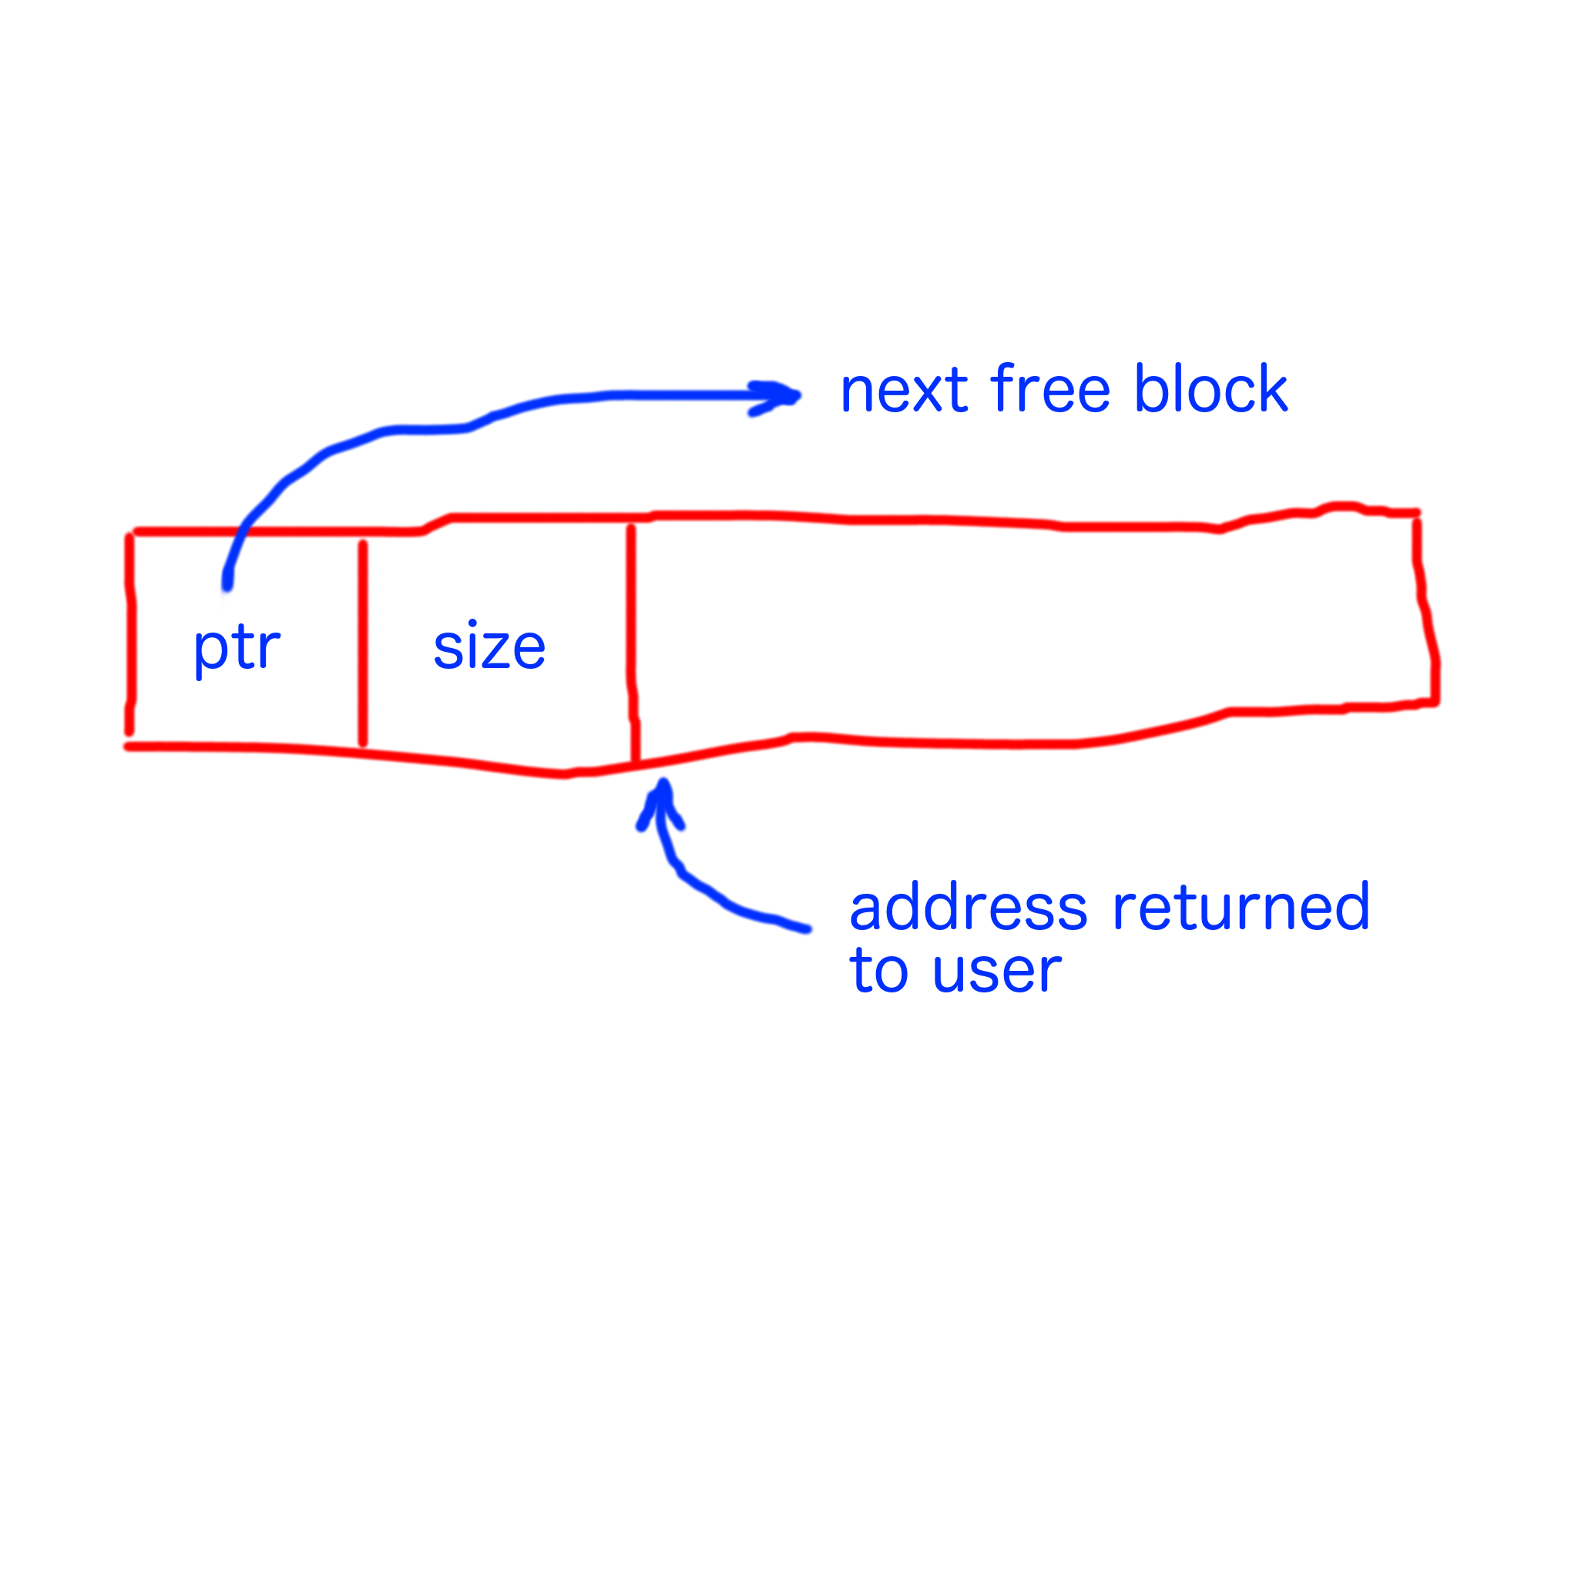

Slide 47
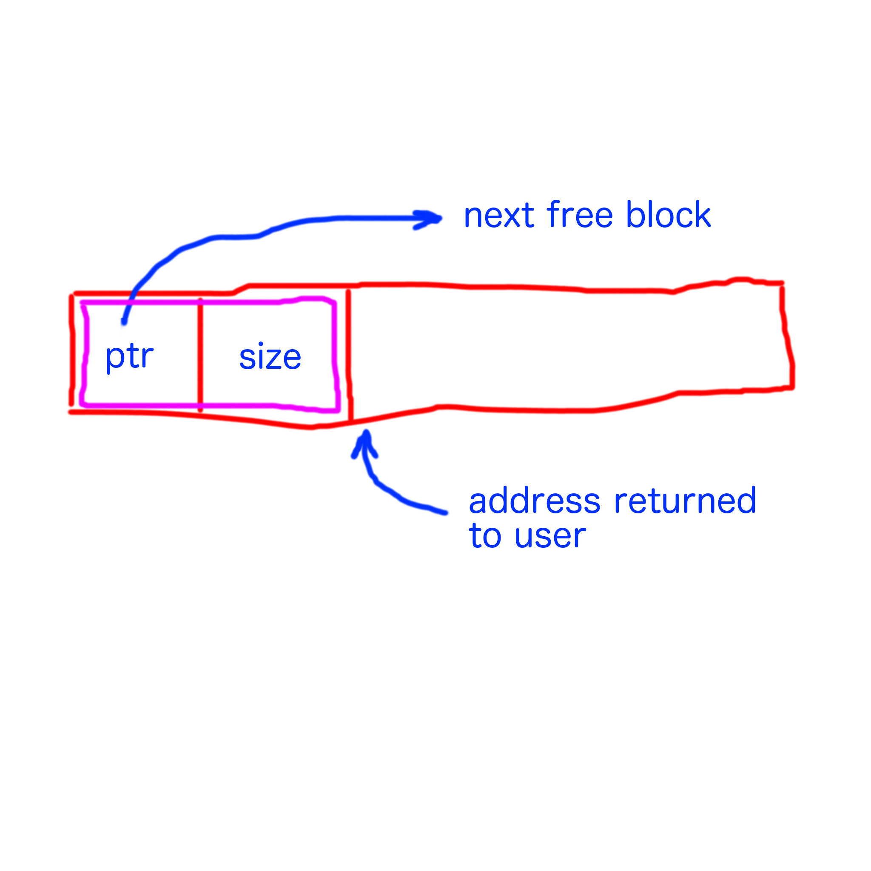

Slide 48
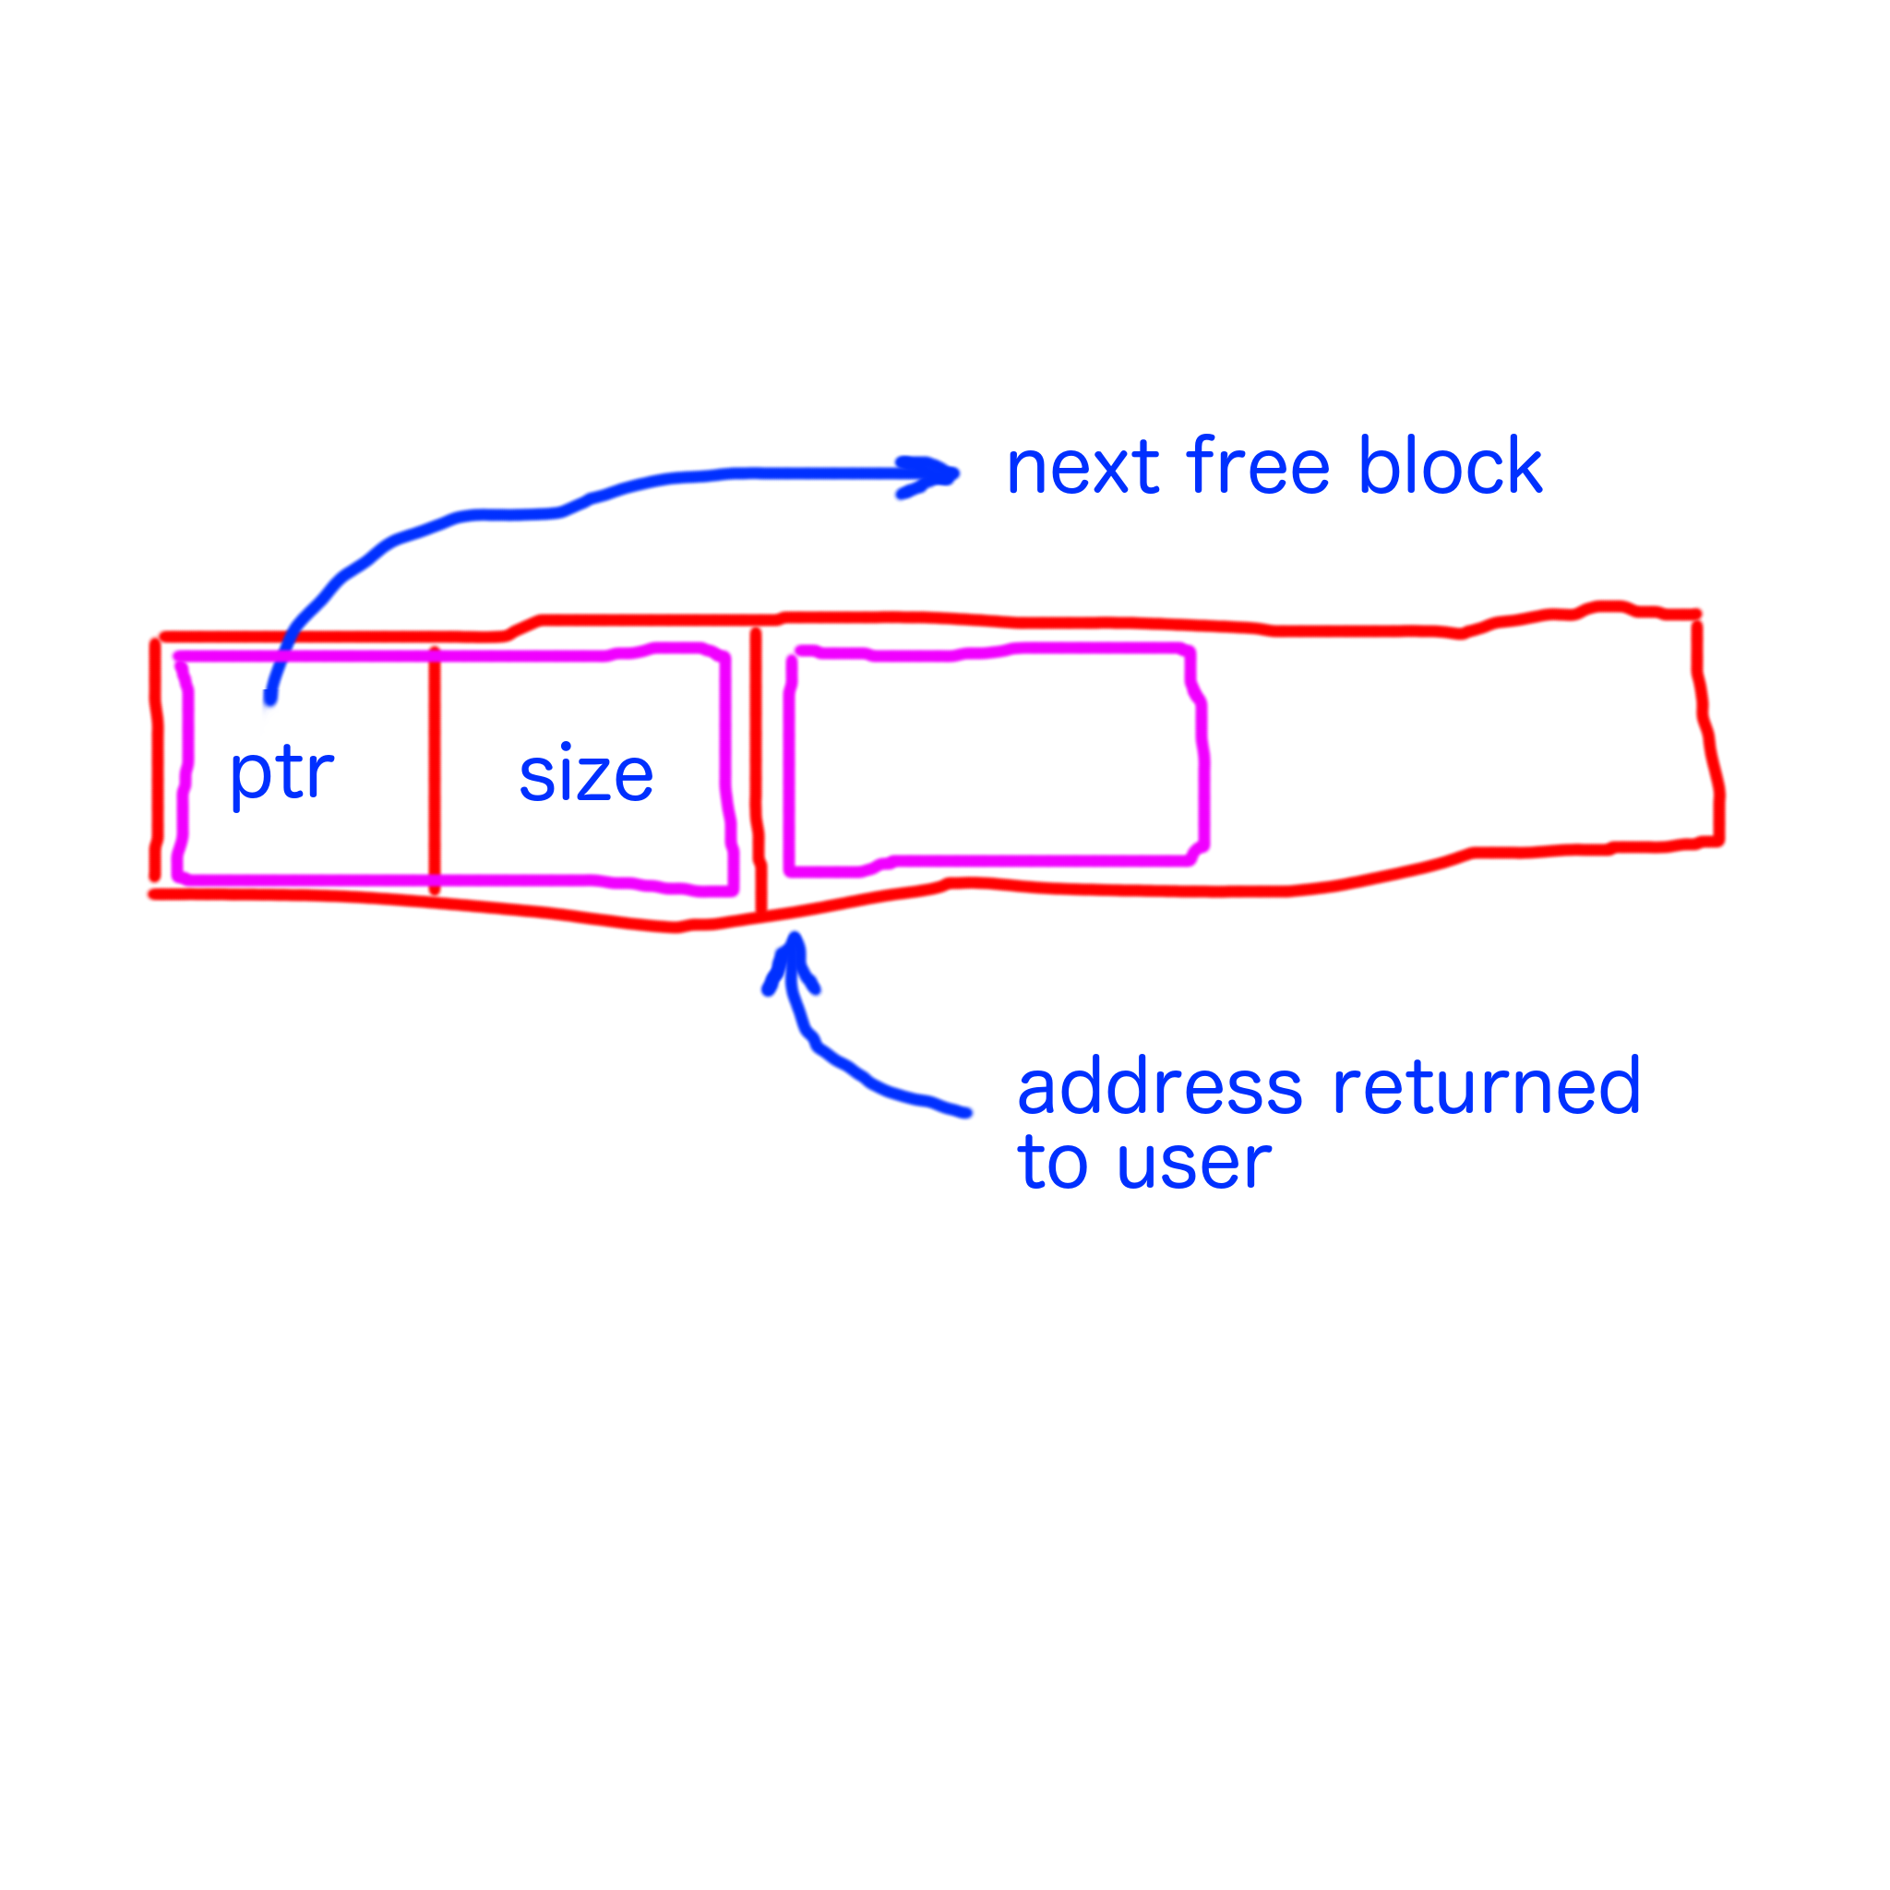

Slide 49
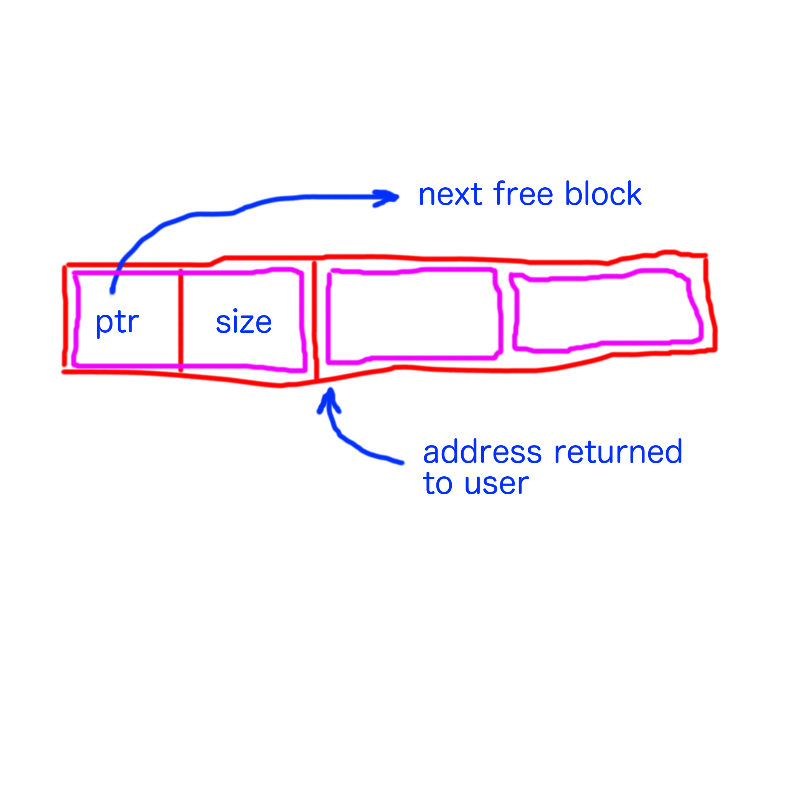

Slide 50
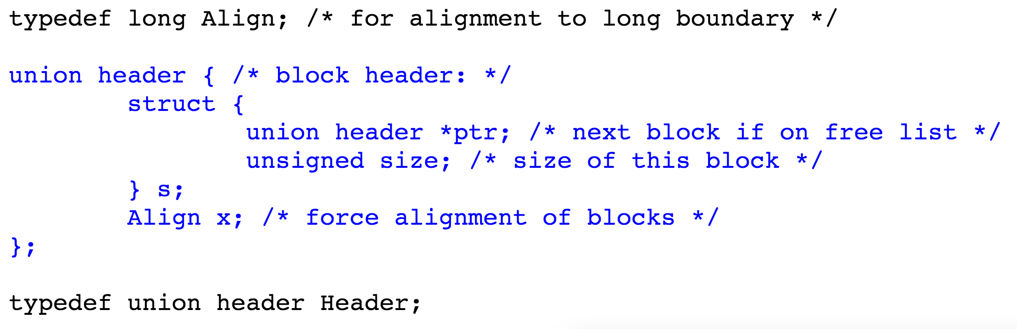

Slide 51
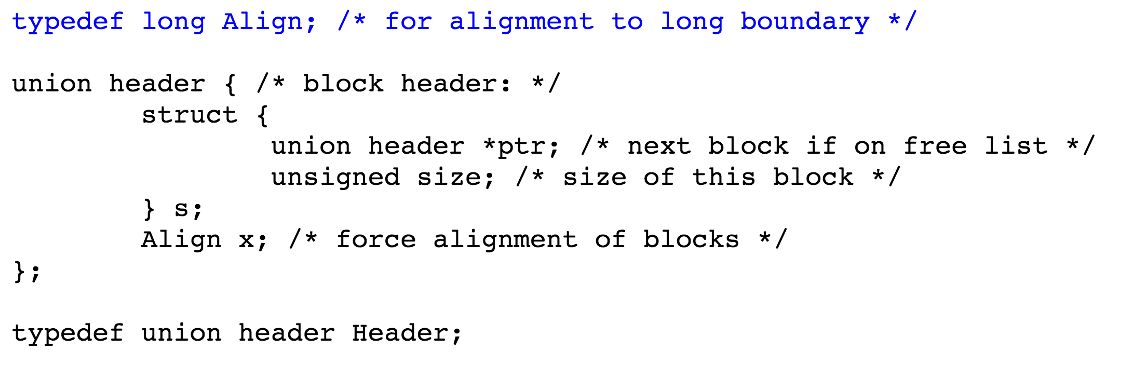

Slide 52
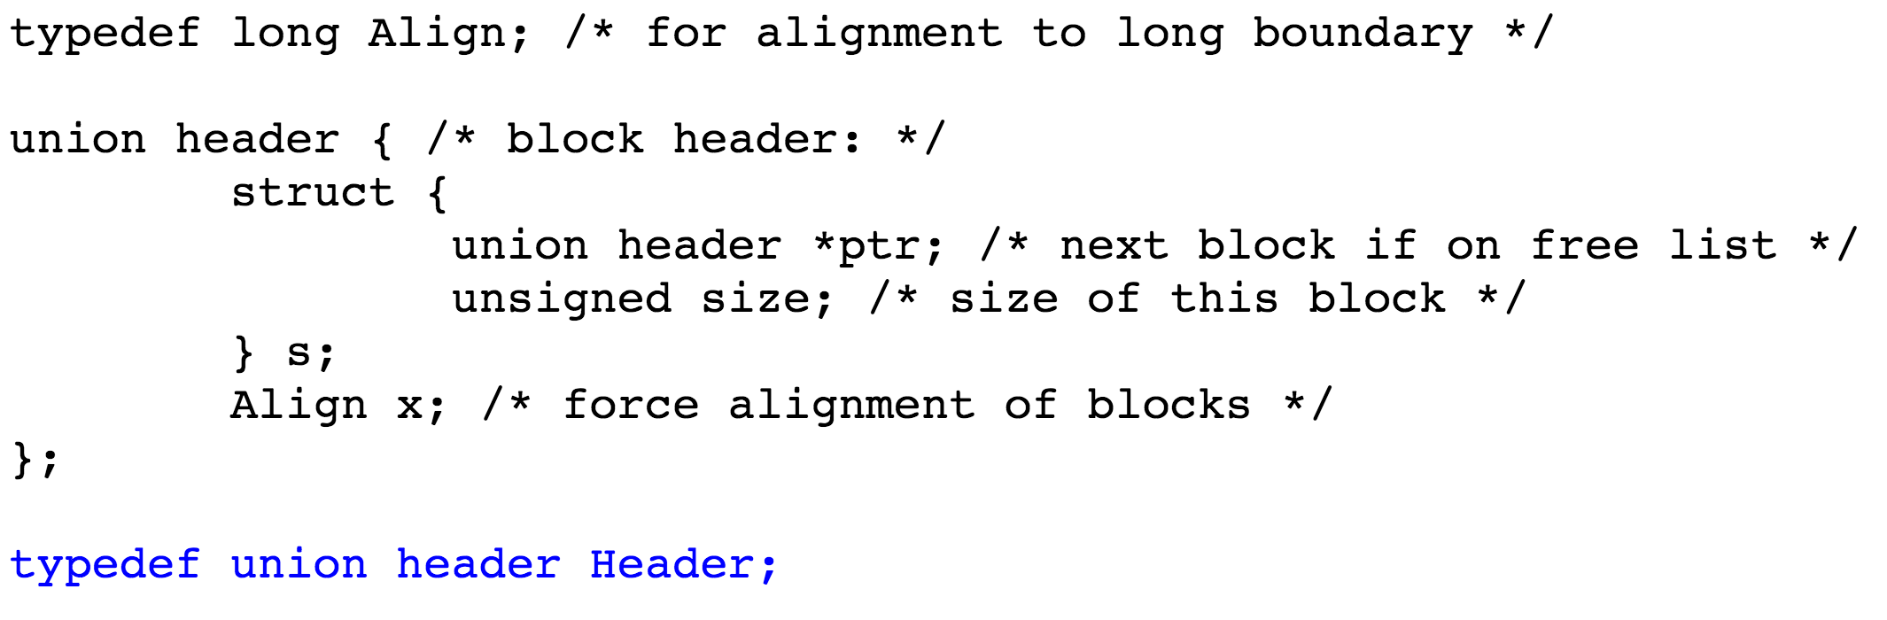

Slide 53
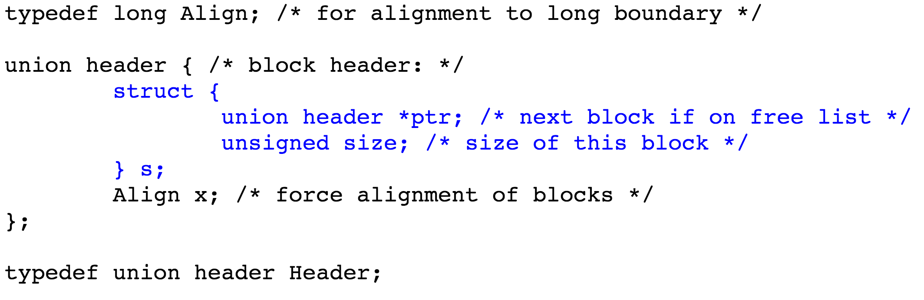

Slide 54
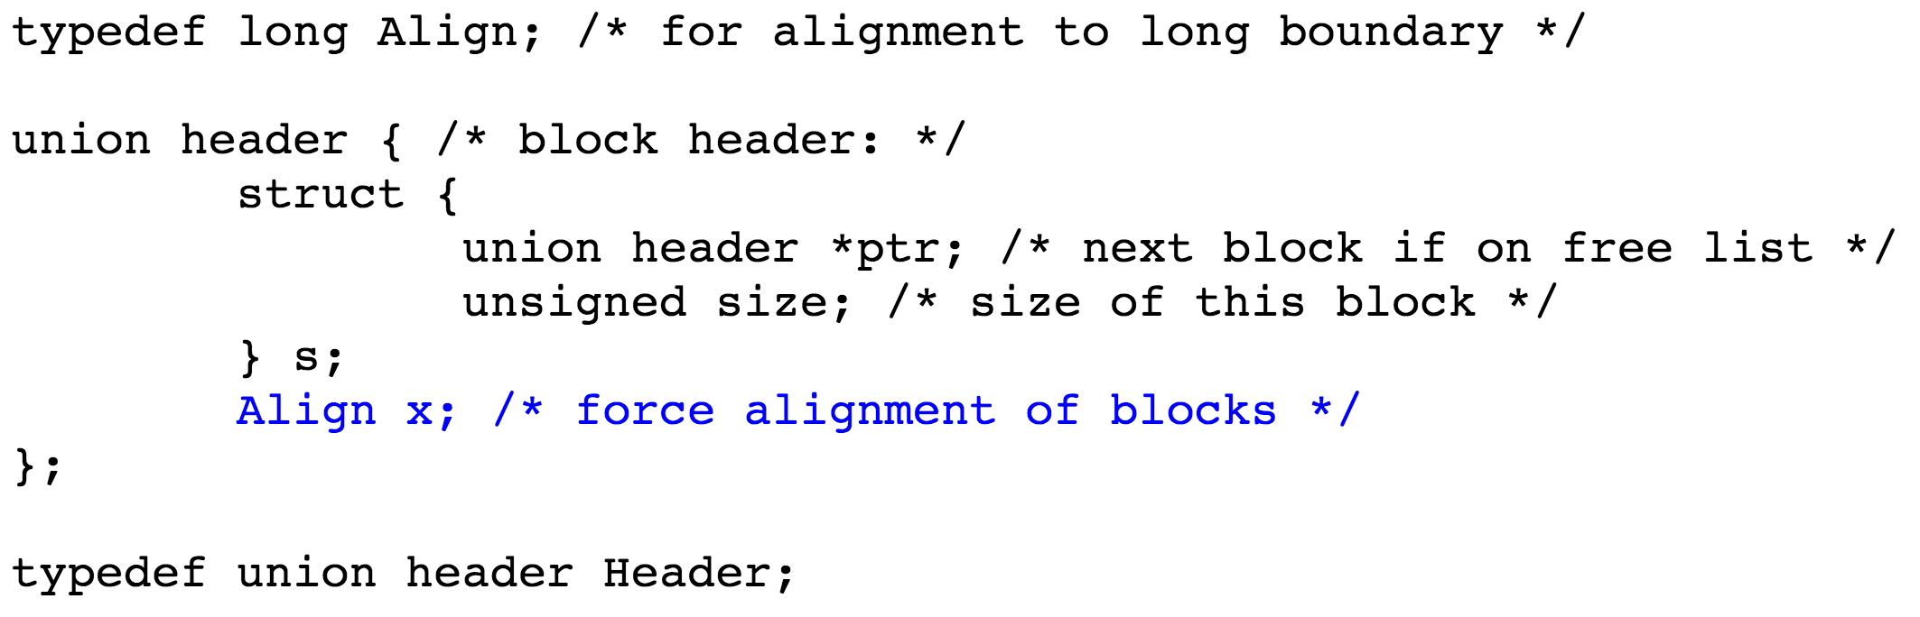

Slide 57
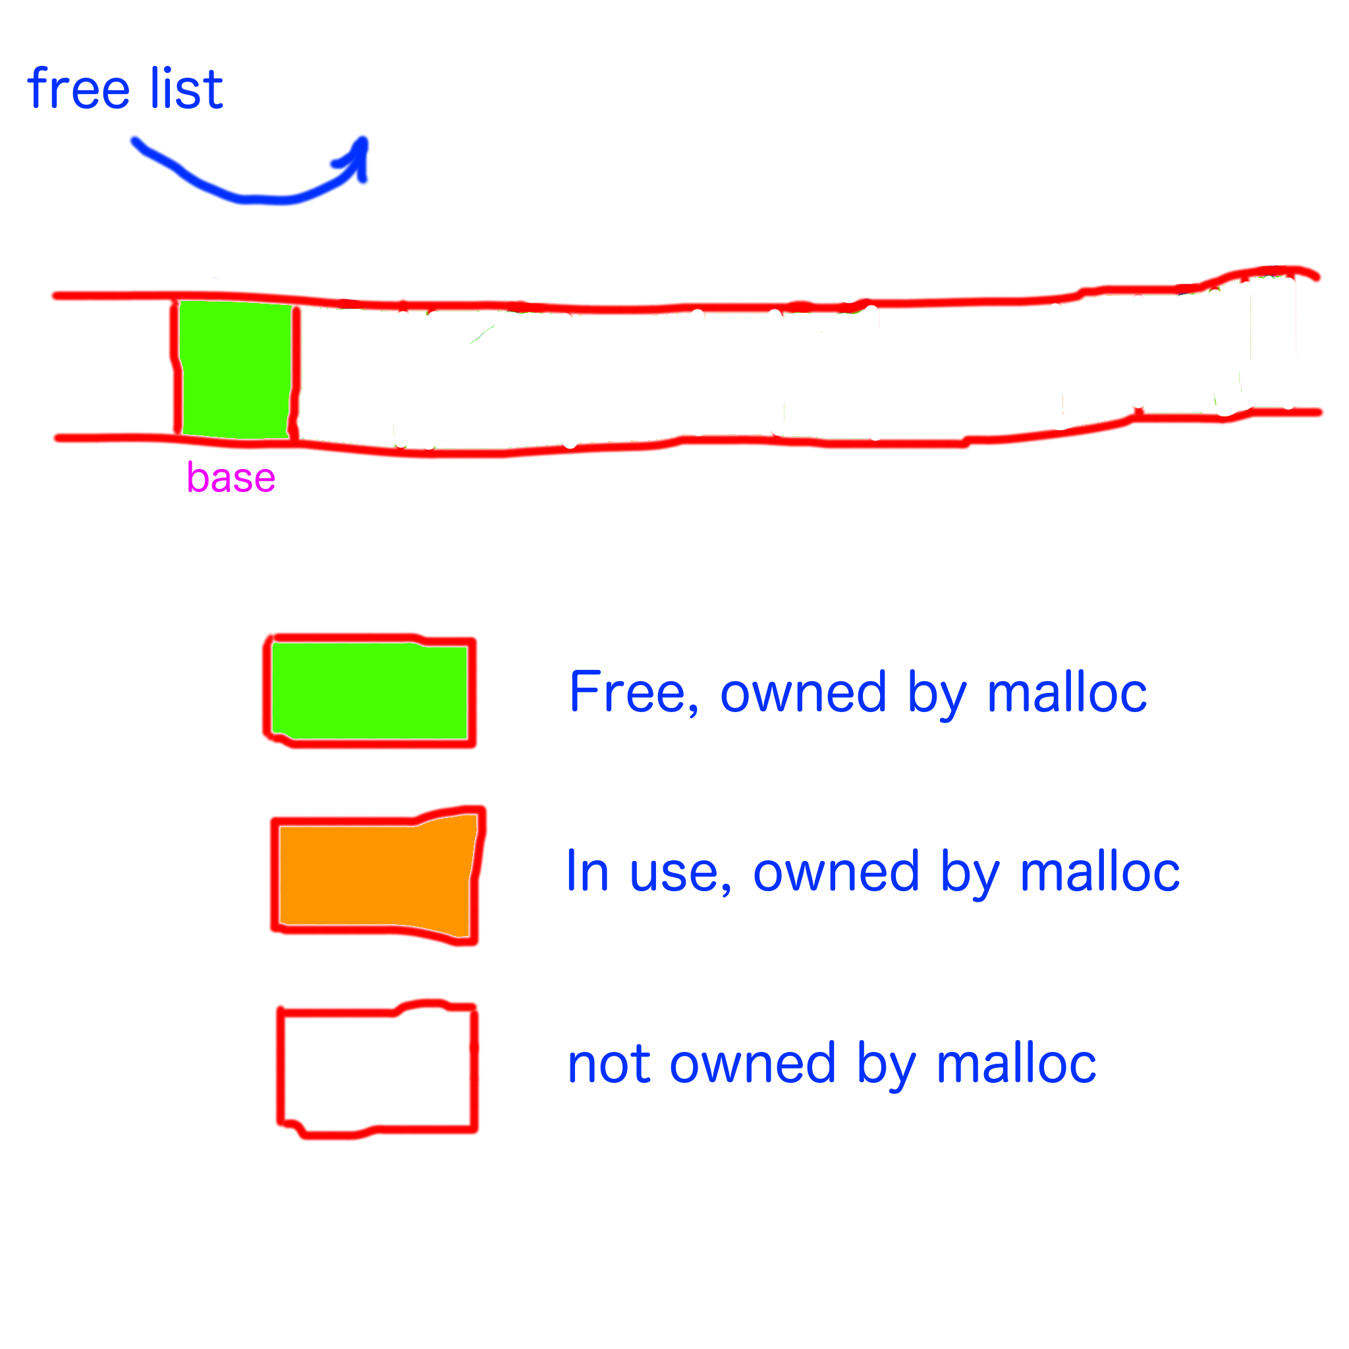

Slide 58
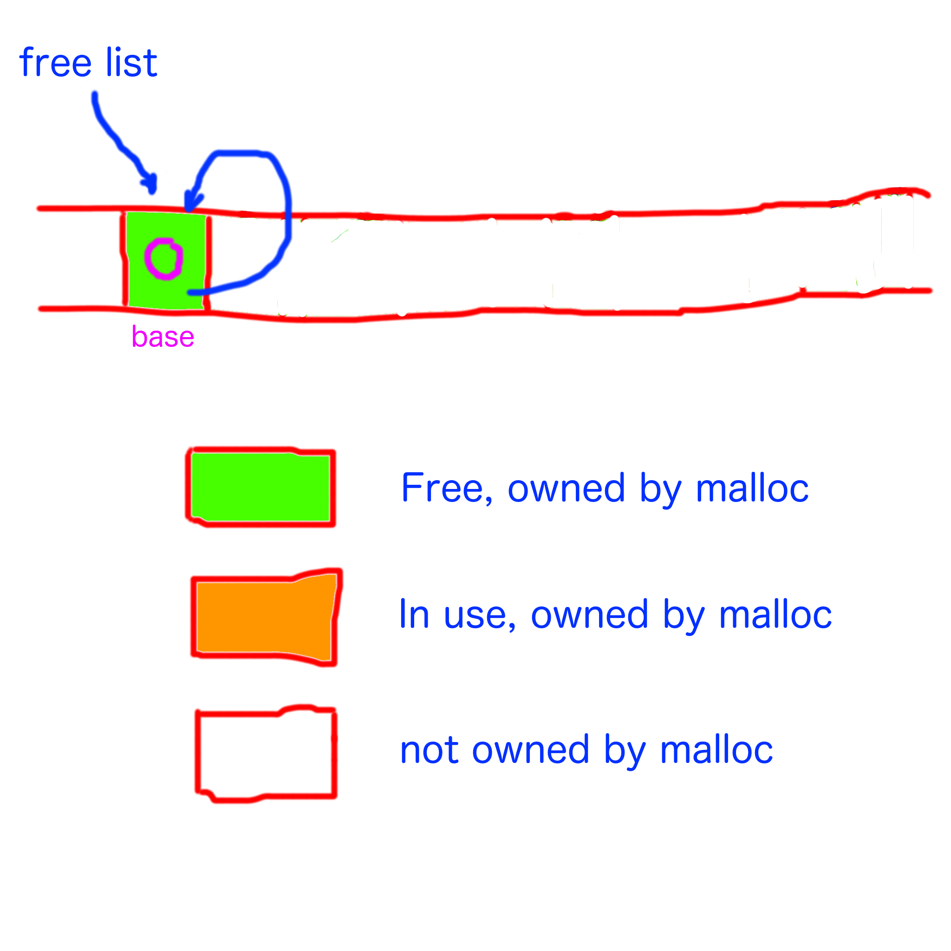

Slide 59
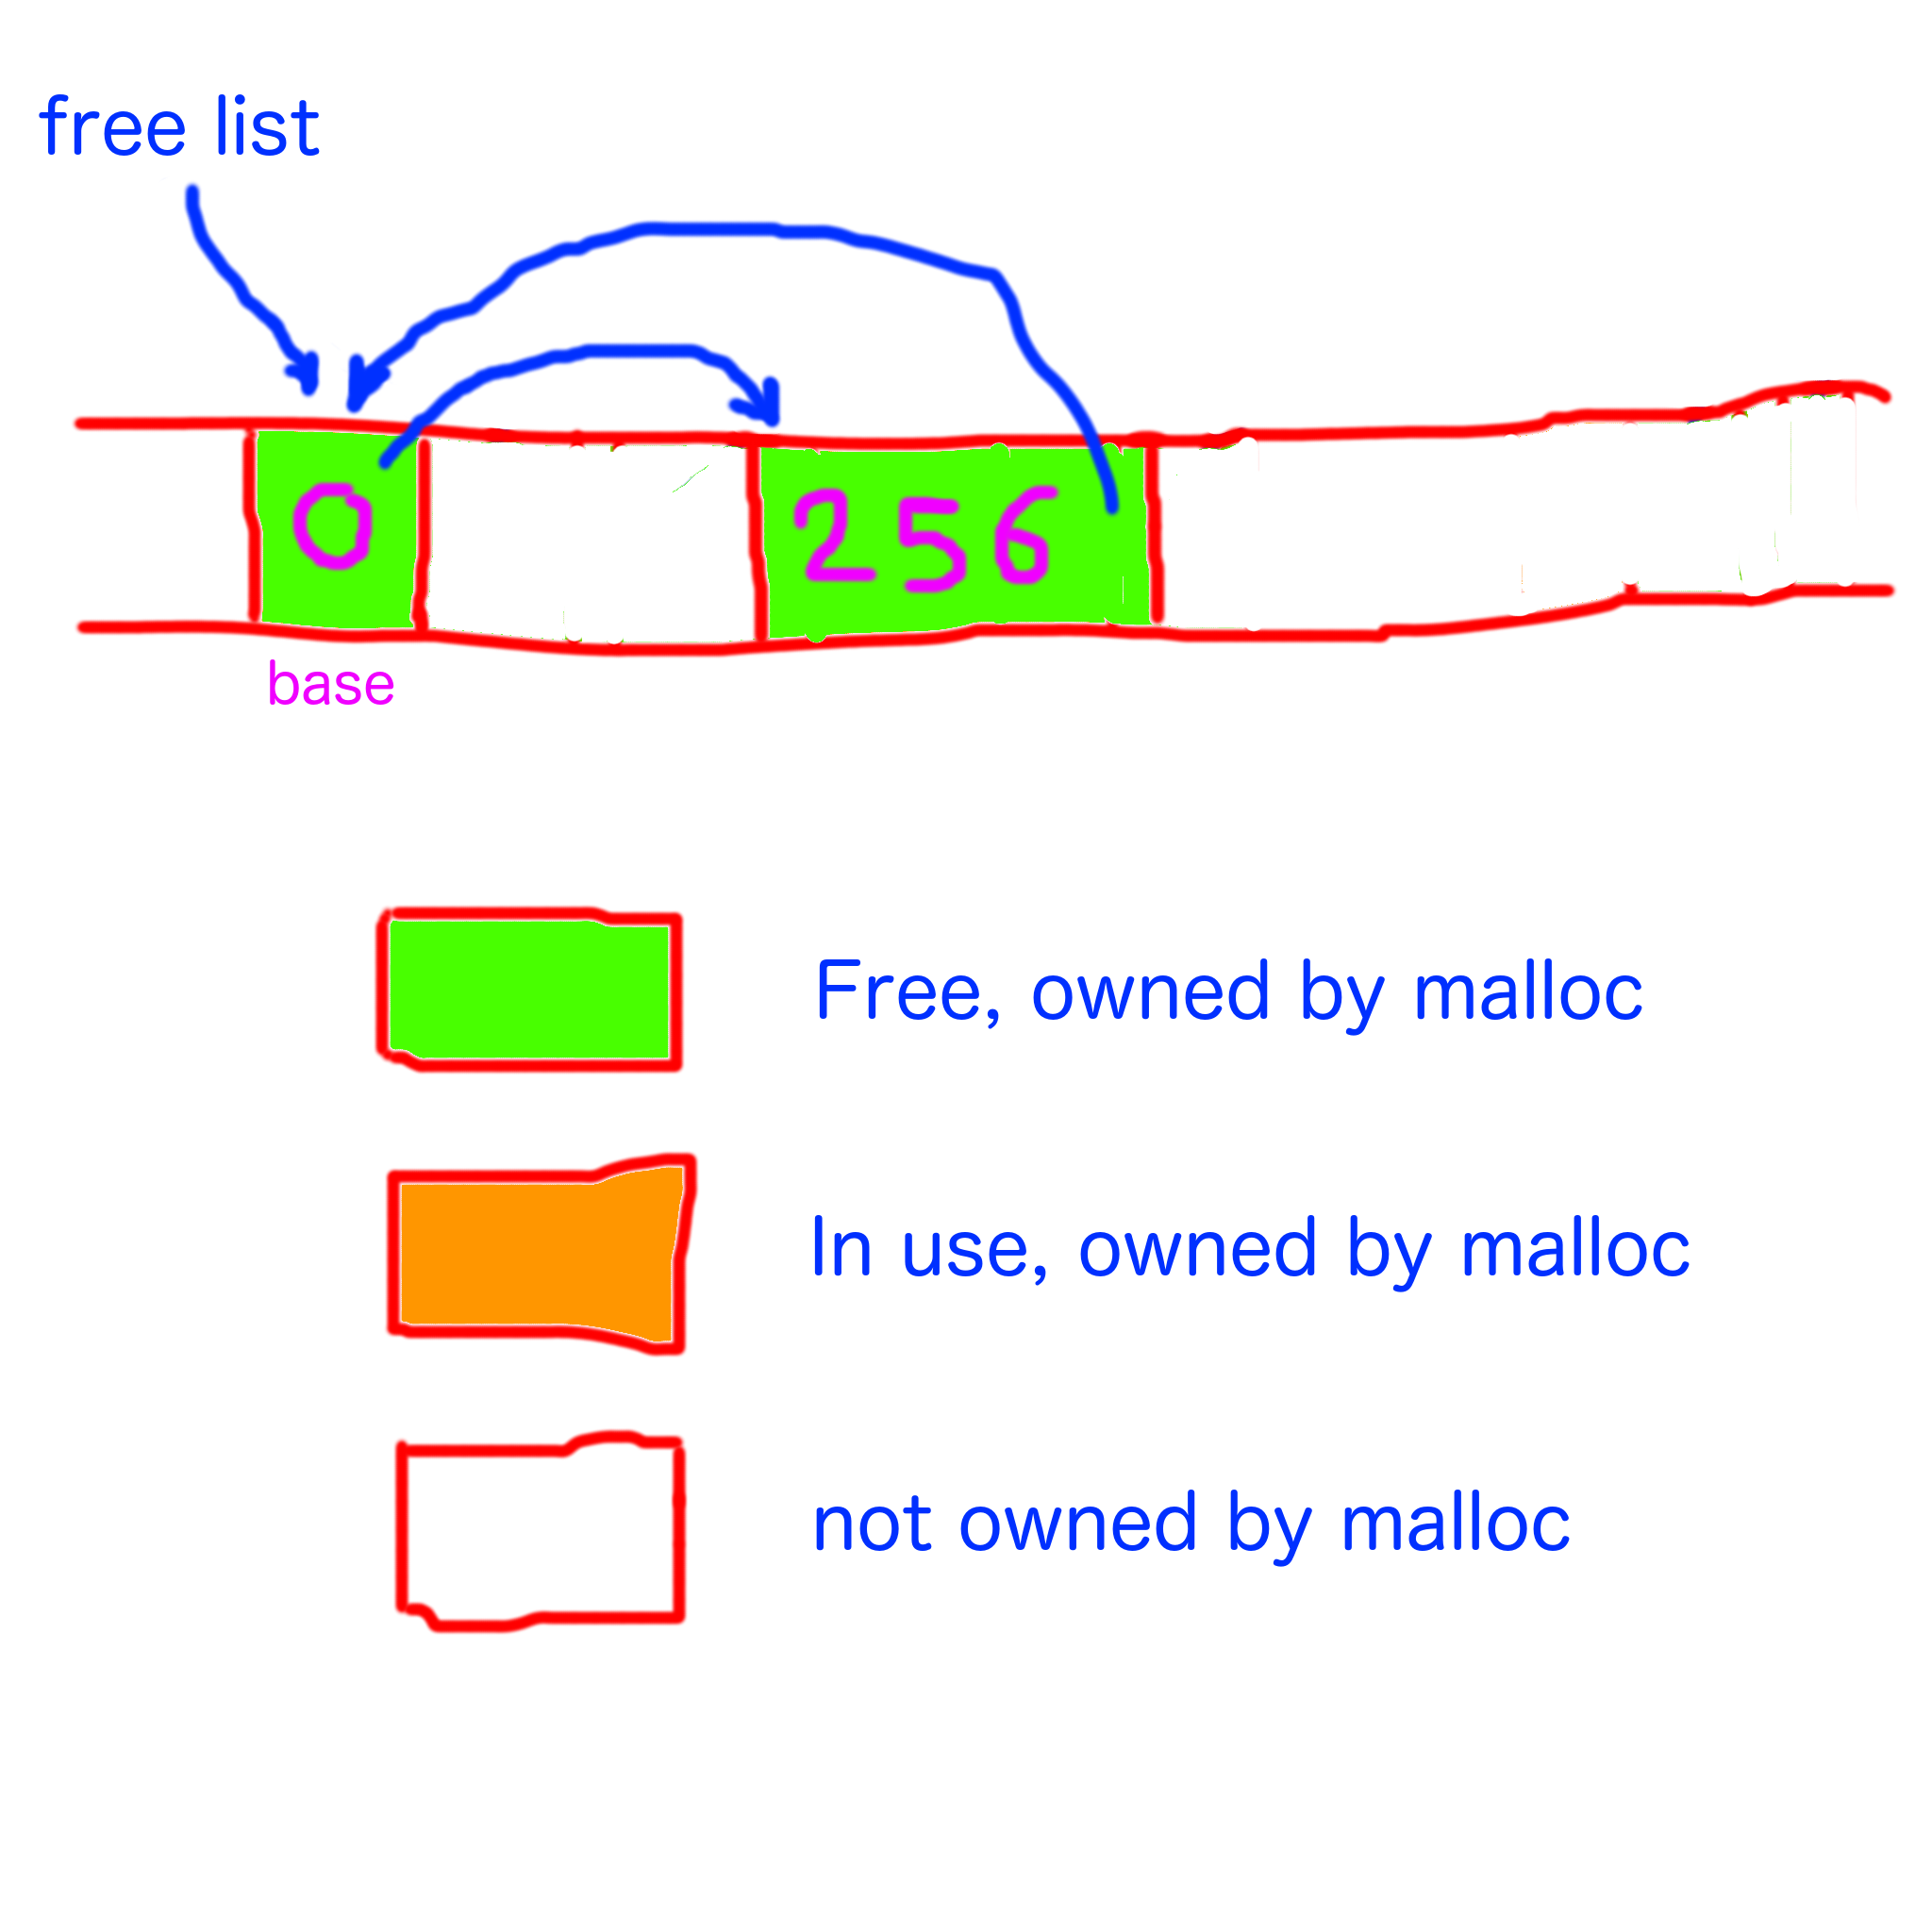

Slide 60
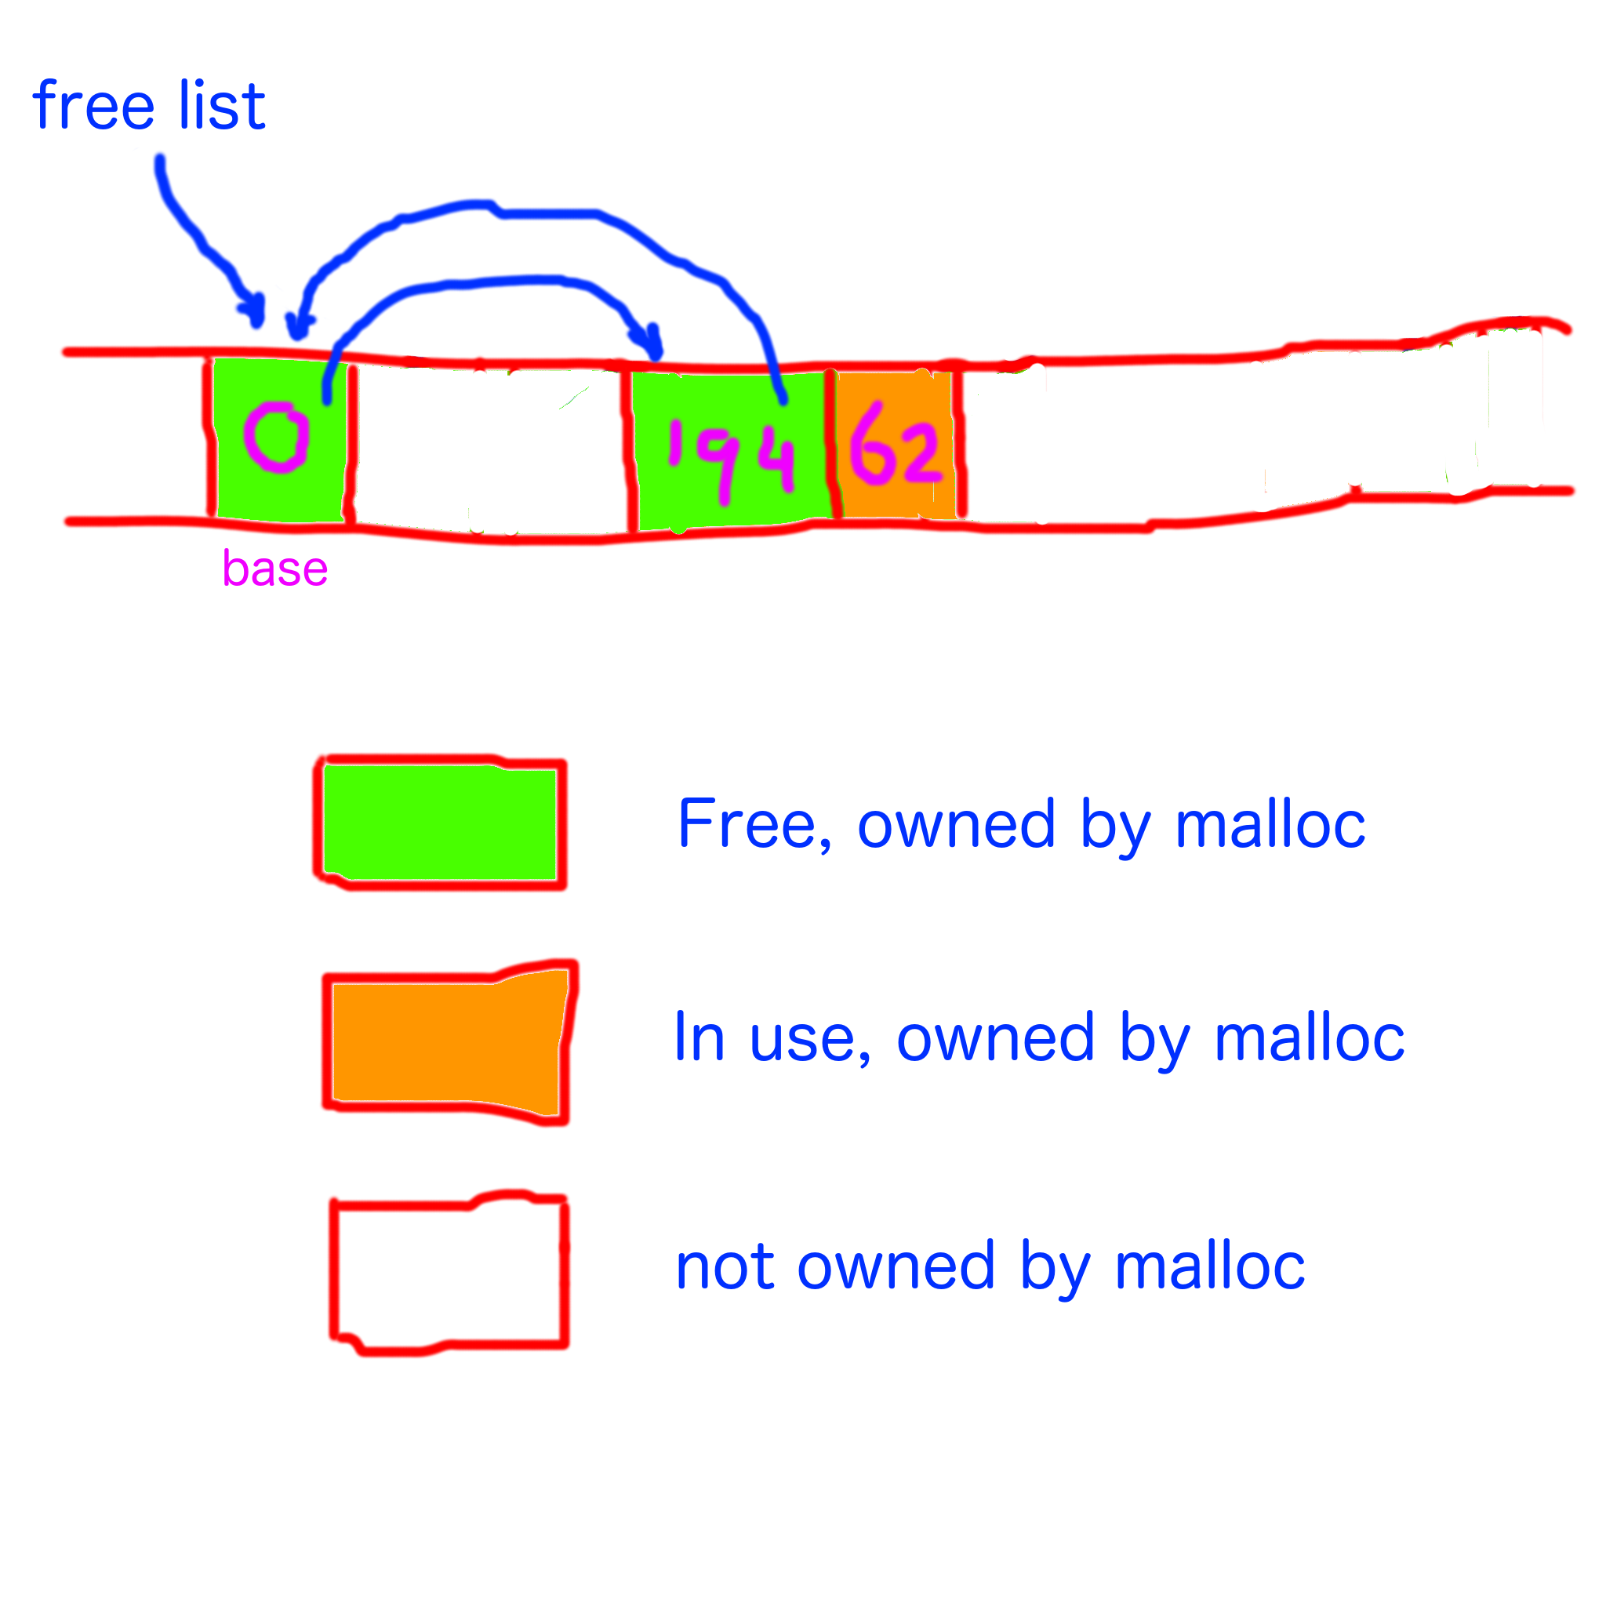

Slide 61
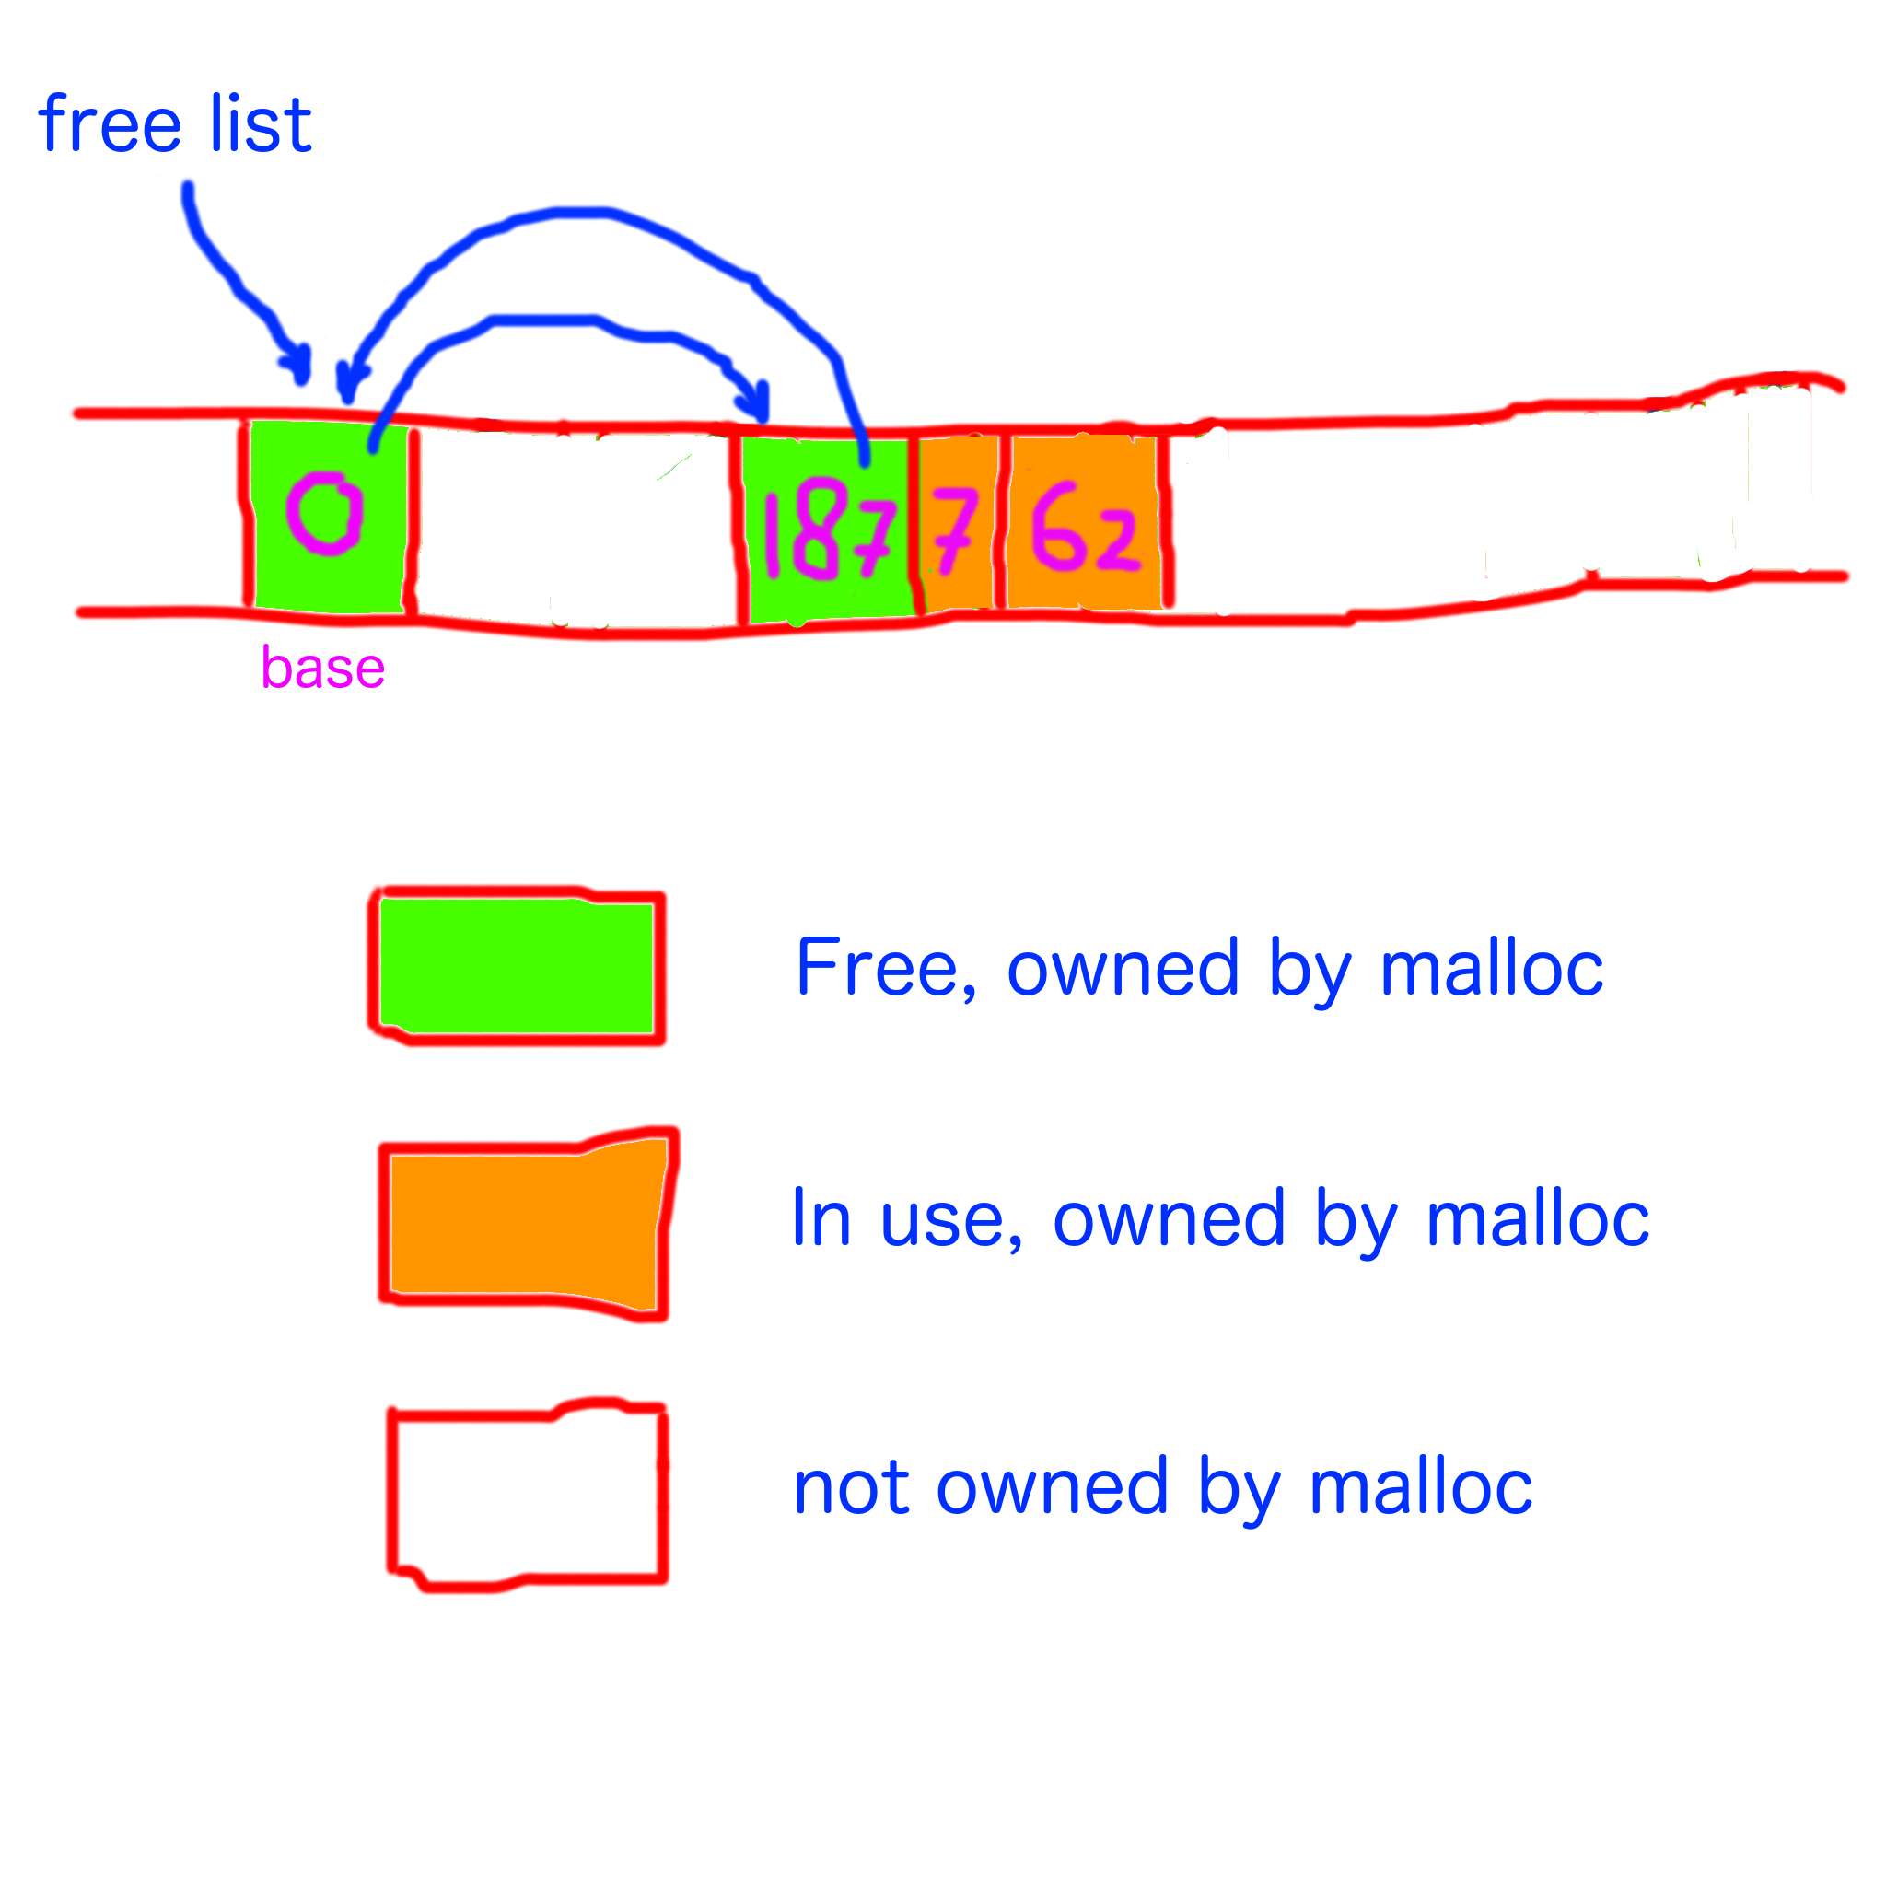

Slide 62
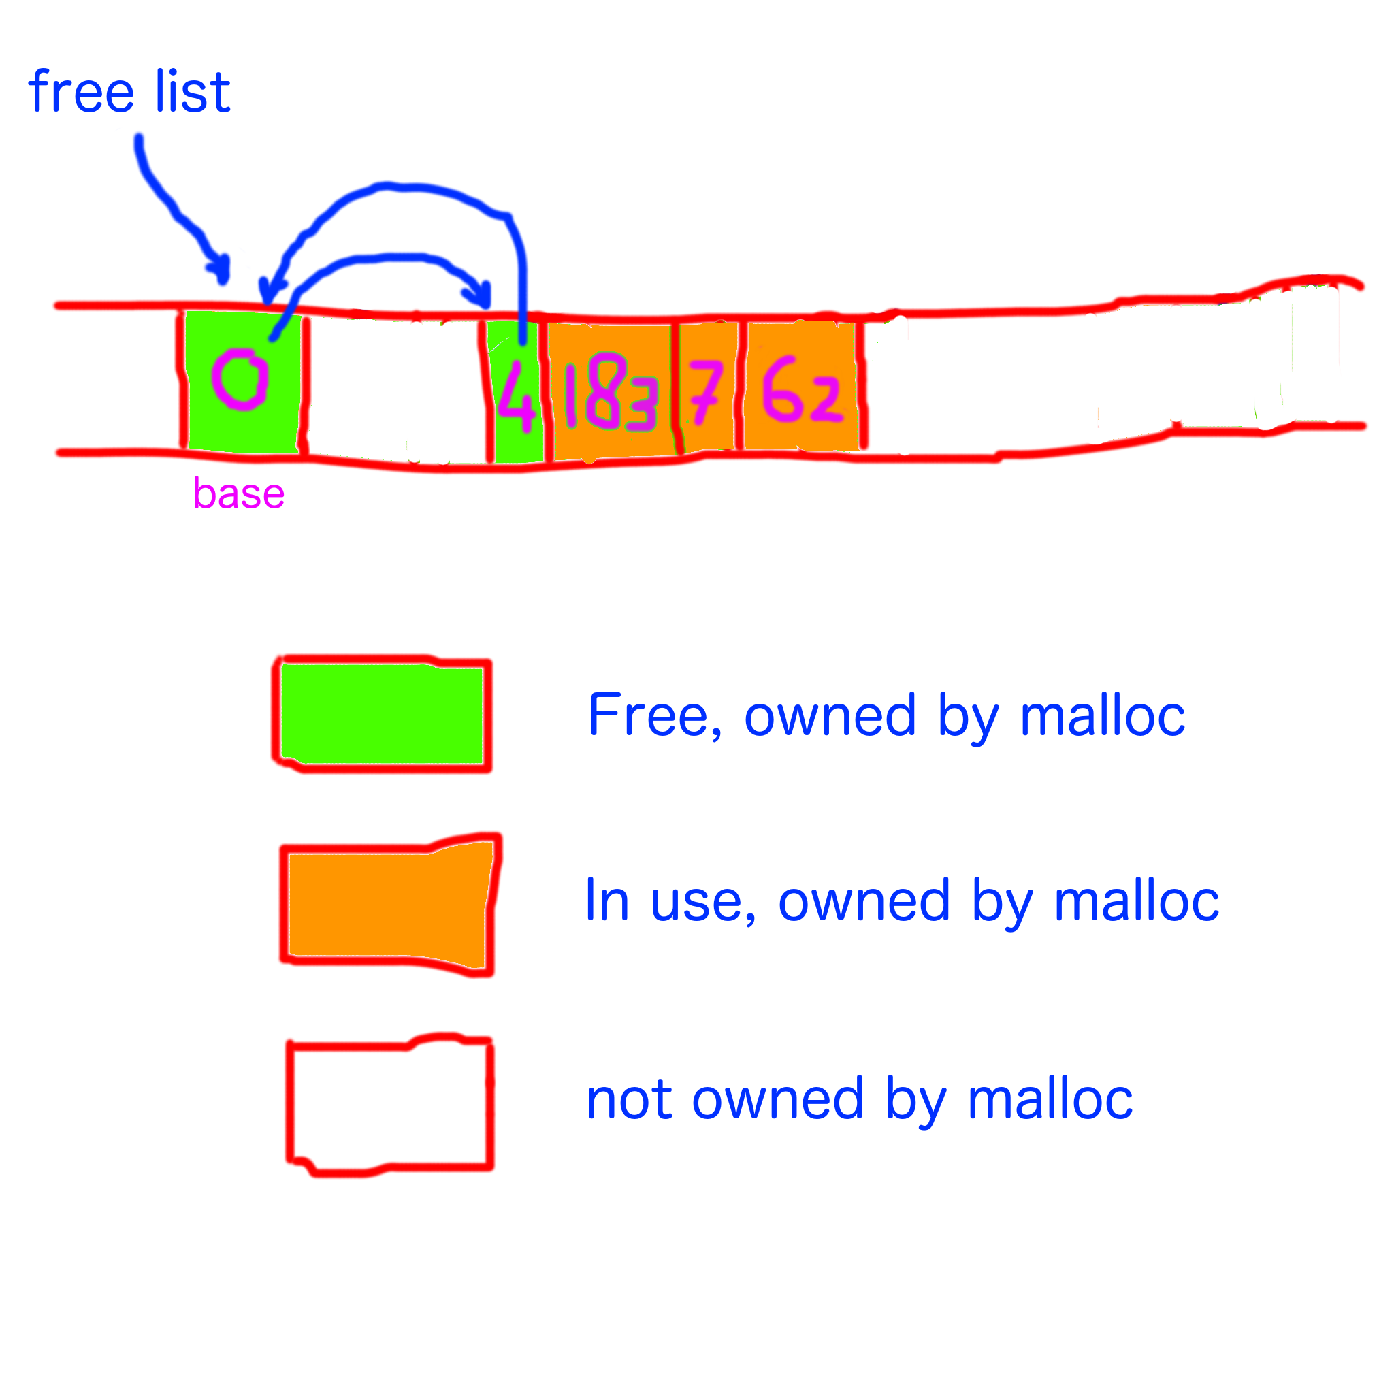

Slide 63
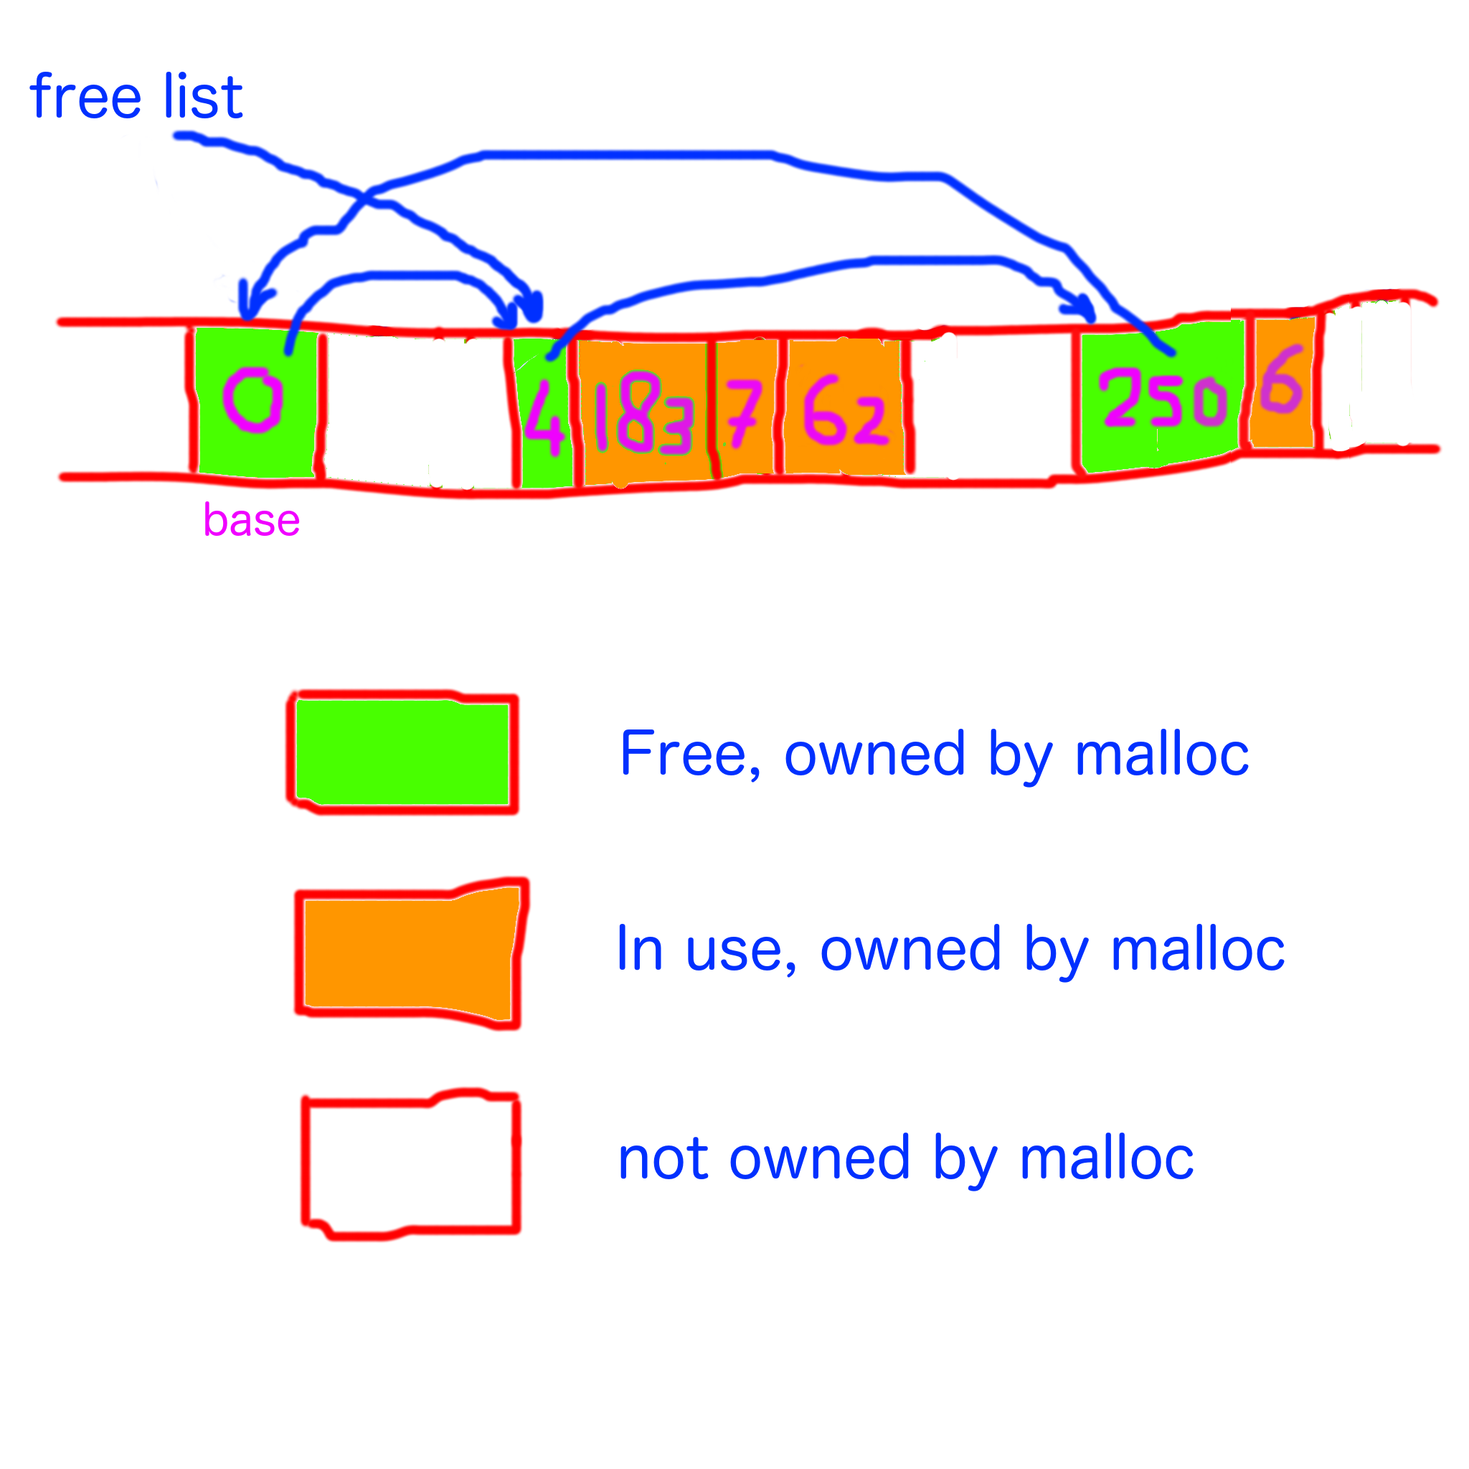

Slide 64


Slide 65
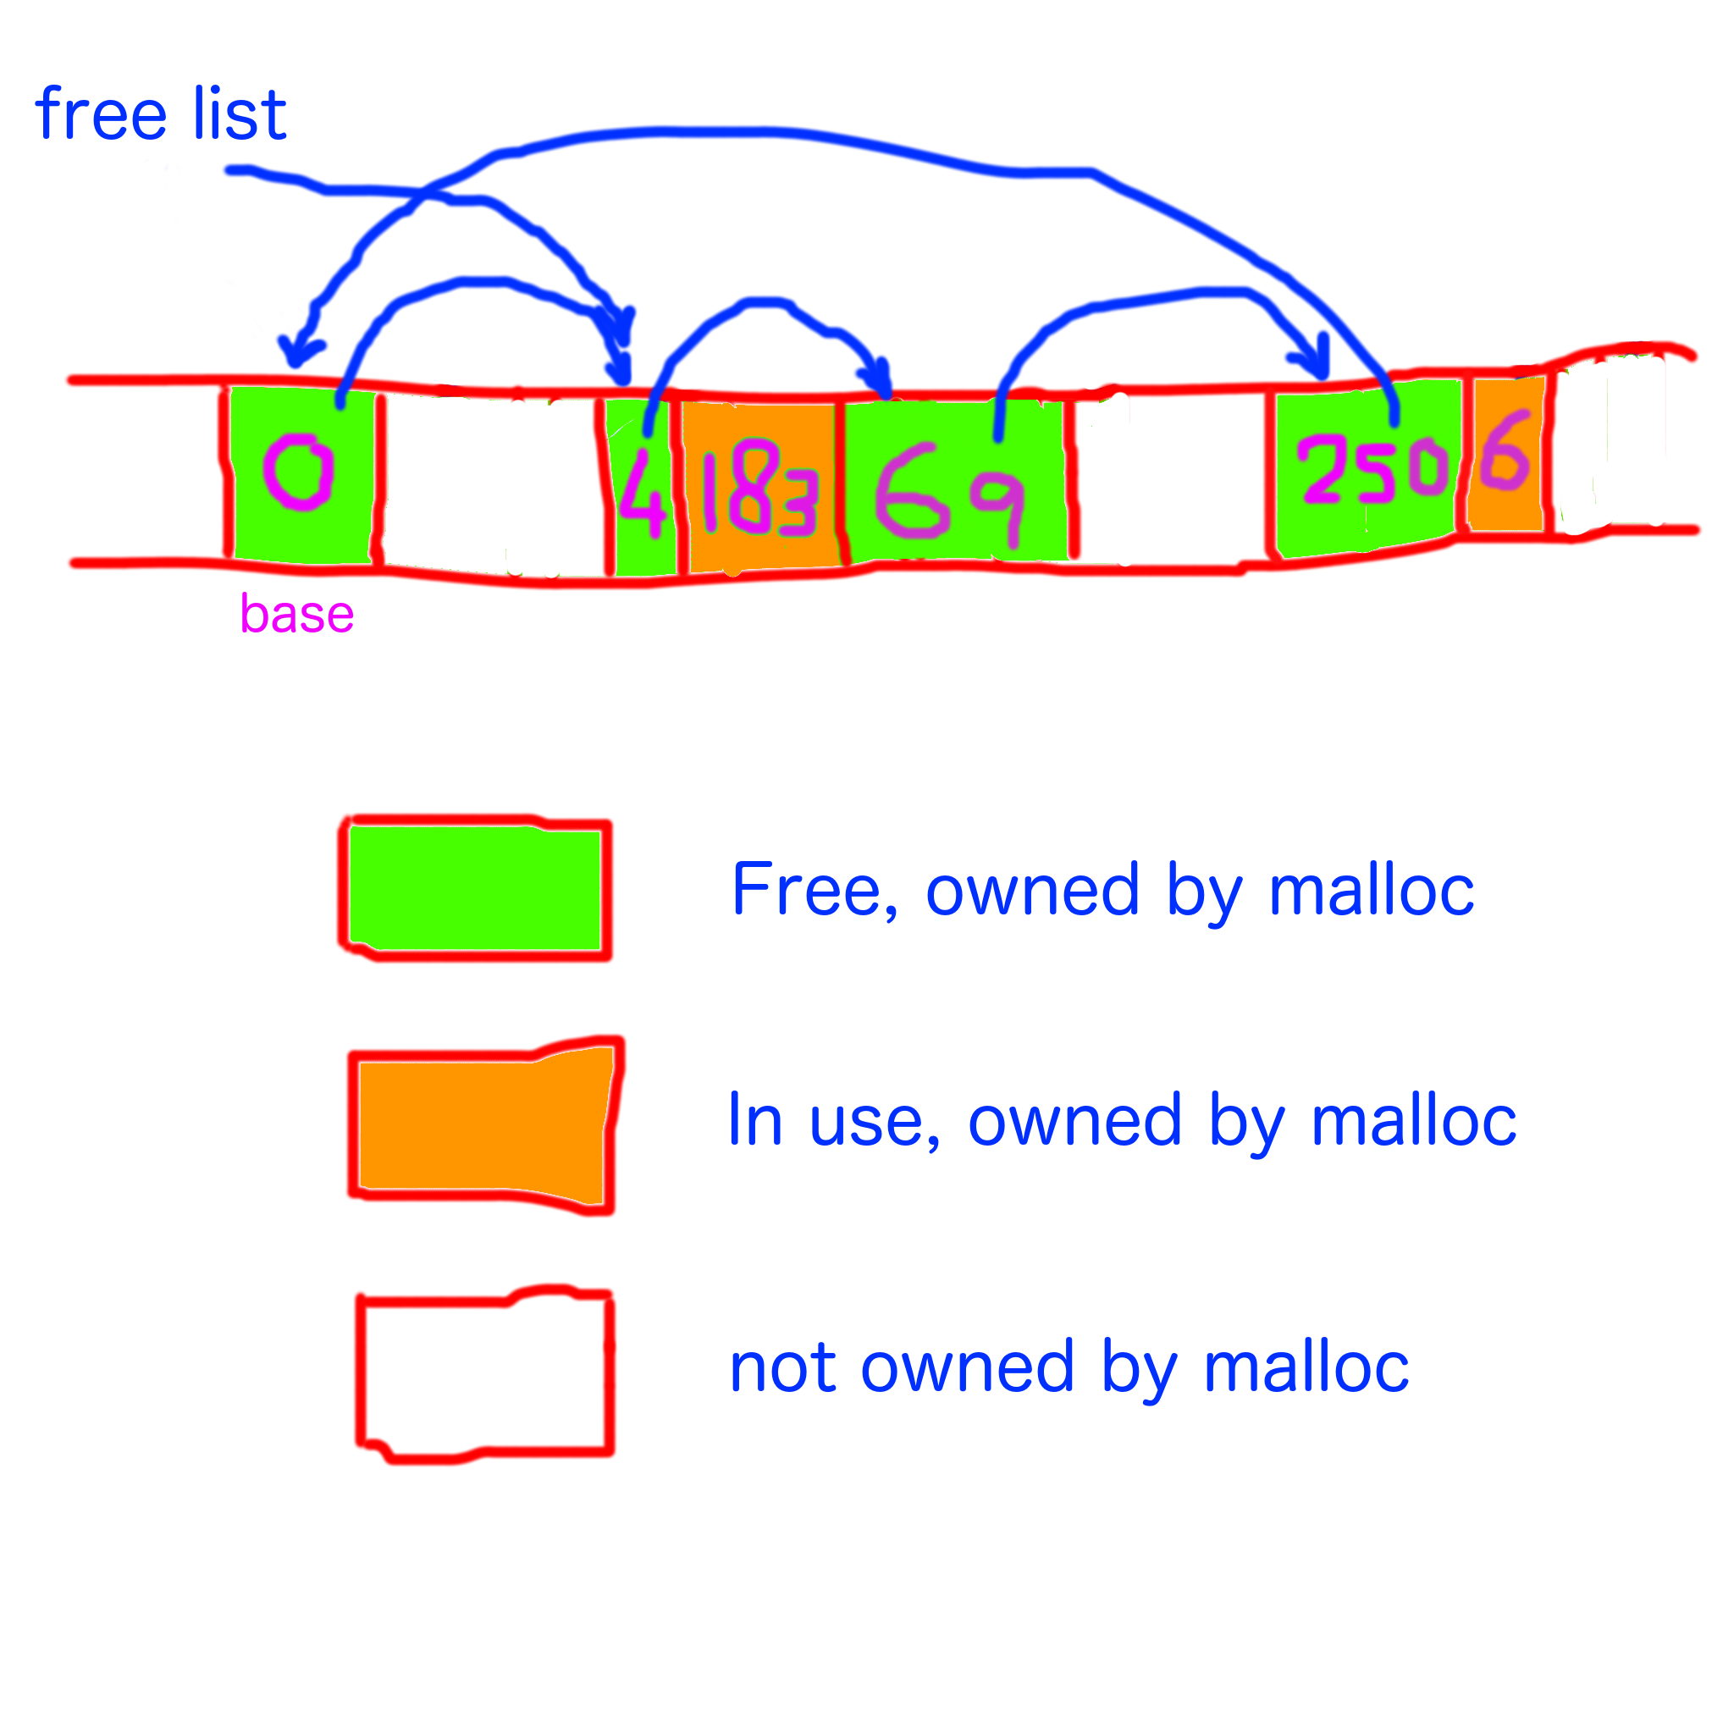

Slide 66


Slide 68
Questions?

Slide 69
Happy hacking!

