Slide 1
Machine Learning Based
Credit Risk Prediction System for Commercial Banks

Slide 2
Project Background
Credit risk continues to be the leading source of problems in banks world-wide
Inaccuracy of human prediction in granting a loan may lead to high credit risk
Inefficient data management makes it harder to access the right data

Slide 3
GOALS
Predict credit risk
Predict allowable amount of loan bank can provide
Provide individual credit performance
Produce annual credit report

Slide 4
Our Approach
Building a Machine Learning based system to predict credit risk for loan applicants, we want to minimize credit risk.
Our system will also evaluate borrower performance based on EMI reports.

Slide 5
GOALS
Predict future defaulter list from current performance of the clients
Persuade the irregular clients (from the predicted defaulter list)
Automating lending and loan management system

Slide 6
USERS
Bank Employees and Clients

Slide 7
Client
Bank Client
Must hold an account in the bank.
Requests for loan
Fills up an application form
On preliminary acceptance, receives appointment from the employee.
If eligible, receives loan.

Slide 8
Bank Employees
Form Reviewer
Negotiator
Client Relation Manager

Slide 9
Bank Employees
Form Reviewer
Reviews application forms
Categorizes clients
Specifies classes of data that should be processed by the predictor
Fits data to the predictor
Collects individual credit performance, monthly credit report
Negotiator
Receives predicted allowable amount of loan for the applicants
Negotiates with clients if necessary
Produces eligible list of clients to receive loan
Collects individual credit performance, monthly credit report

Slide 10
Bank Employees
Client Relation Manager
Views the eligible list
Schedules applicants’ appointments
Informs clients about the appointment
Verifies provided information
On verification, grants loan and prepares loan documents
Collects individual credit performance, monthly credit report
Persuades predicted defaulters

Slide 11
MVC Layout
Model
Client’s information
Loan Information
Employees’ Information(CRM, Negotiator, Form Reviewer)
View
Bank Home Page
Client Login & Home Page
Loan Application Form
Bank Employee Login & Home Page
Controller
Login
Submit Application
Feed Data to ML
Review Form
Negotiate Clients
Verify Documents

Slide 12
Logistic Regression
1

Slide 13

Classification
Email: Spam / Not Spam?
Online Transactions: Fraudulent (Yes / No)?
Tumor: Malignant / Benign ?
0: “Negative Class” (e.g., benign tumor)
1: “Positive Class” (e.g., malignant tumor)

Slide 14



Linear Regression
(Yes) 1
Malignant ?
(No) 0
Tumor Size
Tumor Size
Threshold classifier output at 0.5:
If , predict “y = 1”
If , predict “y = 0”

Slide 15
(Yes) 1
Malignant ?
(No) 0
Tumor Size
Tumor Size
Linear Regression
Threshold classifier output at 0.5:
If , predict “y = 1”
If , predict “y = 0”

Slide 16


Classification: y = 0 or 1
can be > 1 or < 0
Logistic Regression:

Slide 17

Hypothesis Representation
Logistic
Regression
Machine Learning

Slide 18
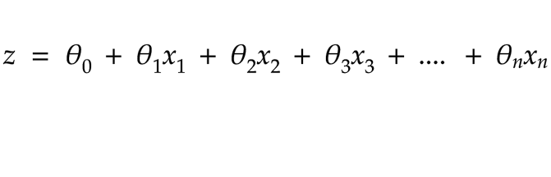
Logistic Regression
Weights
Features
(Assets, Transaction history, Account status etc)

Slide 19
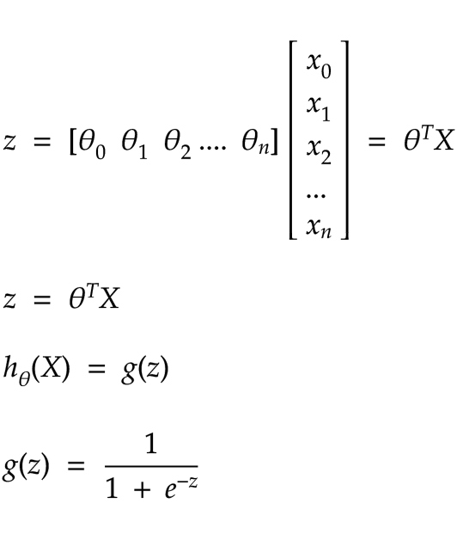
Logistic Regression
(Logistic Function)

Slide 20

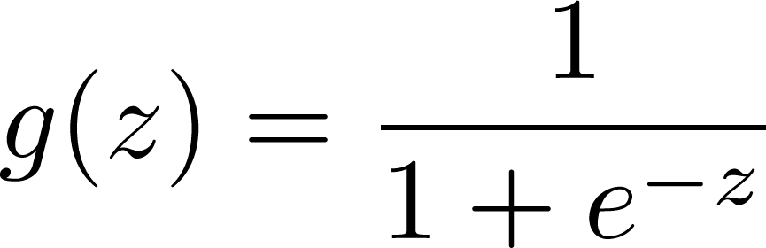
Logistic Regression Model
Want
1
0.5
Logistic function
0

Slide 21
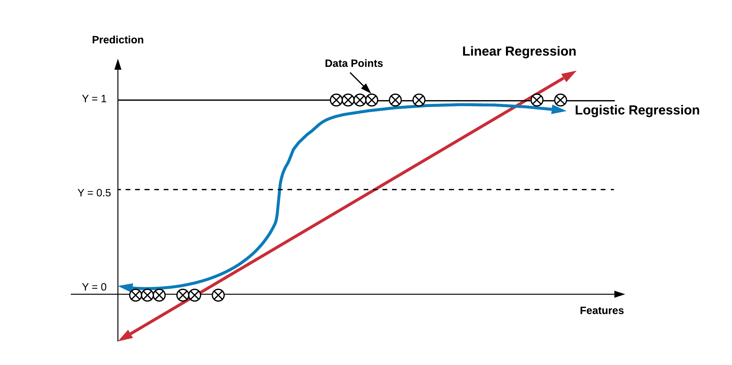
Linear Vs Logistic

Slide 22


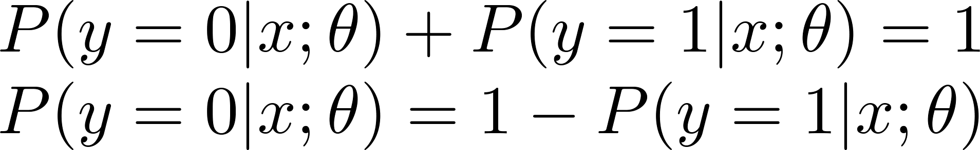
Interpretation of Hypothesis Output
= estimated probability that y = 1 on input x
Example: If
Tell patient that 70% chance of tumor being malignant
“probability that y = 1, given x,
parameterized by ”

Slide 23
Cost function
Logistic
Regression
Machine Learning

Slide 24
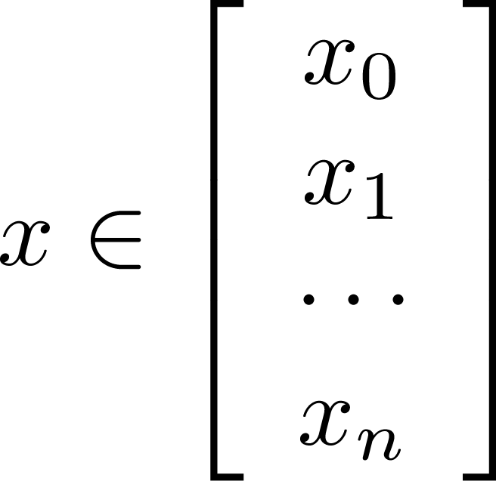

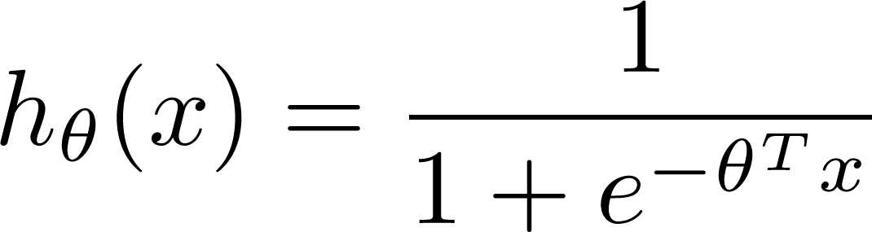

Training set:
m examples
How to choose parameters ?

Slide 25
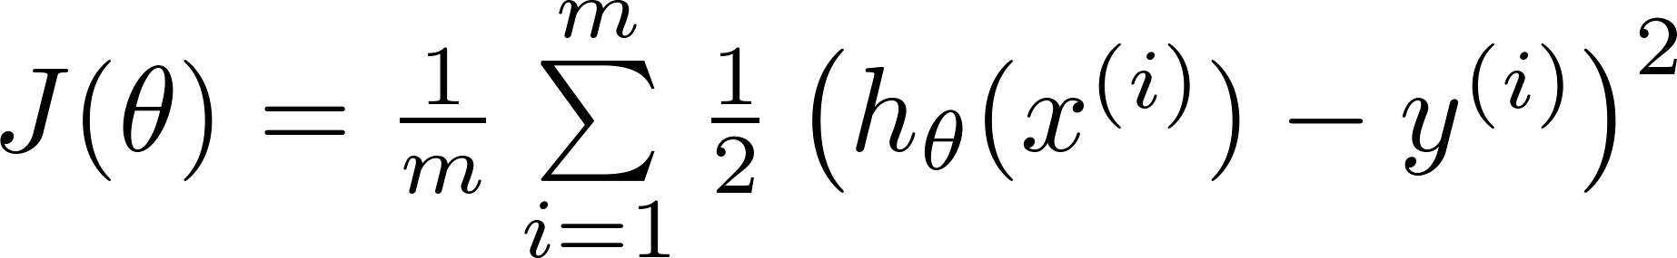
Cost function
= [ 0, 0, 0, 0….0]
Initially
Linear regression:

Slide 26
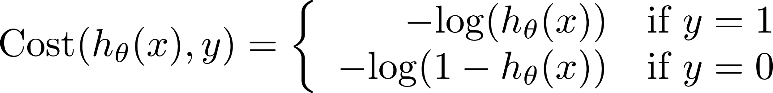
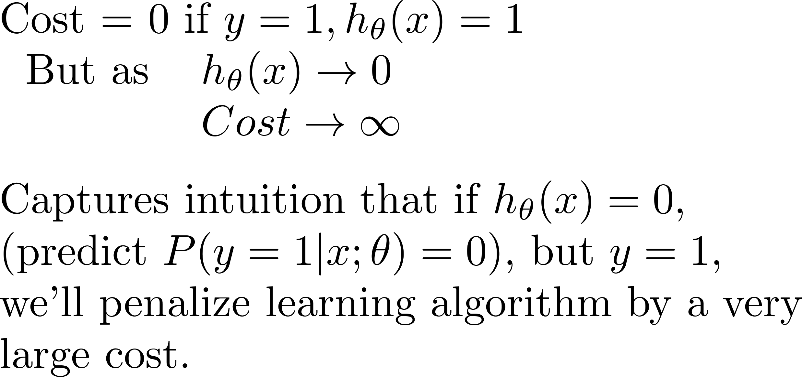
Logistic regression cost function
If y = 1
0
1

Slide 27





Logistic regression cost function
To fit parameters :
To make a prediction given new :
Output

Slide 28





Gradient Descent
Want :
Repeat
(simultaneously update all )

Slide 29

Gradient Descent
Want :
Repeat
(simultaneously update all )
Algorithm looks identical to linear regression!

Slide 30



Optimization algorithm
Cost function . Want .
Given , we have code that can compute
(for )
Gradient descent:
Repeat

Slide 31

Optimization algorithm
Given , we have code that can compute
(for )
Optimization algorithms:
Gradient descent
Advantages:
No need to manually pick
Often faster than gradient descent.
Disadvantages:
More complex
Conjugate gradient
BFGS
L-BFGS

Slide 32
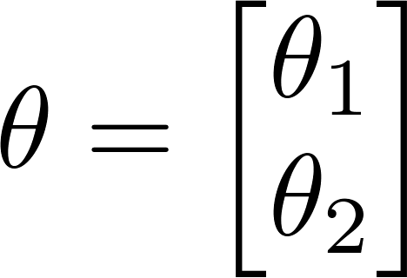


Example:
function [jVal, gradient] = costFunction(theta)
jVal = (theta(1)-5)^2 + ... (theta(2)-5)^2;
gradient = zeros(2,1);
gradient(1) = 2*(theta(1)-5); gradient(2) = 2*(theta(2)-5);
options = optimset(‘GradObj’, ‘on’, ‘MaxIter’, ‘100’);
initialTheta = zeros(2,1); [optTheta, functionVal, exitFlag] ...
= fminunc(@costFunction, initialTheta, options);

Slide 33




theta =
function [jVal, gradient] = costFunction(theta)
code to compute
jVal = [ ];
code to compute
gradient(1) = [ ];
code to compute
gradient(2) = [ ];
code to compute
gradient(n+1) = [ ];

Slide 34
Data Description
2

Slide 35
Data Description
Personal Information
'Home_ownership' : Own, Rent, Mortgage etc.
'Annual_income’ : Annual income
'pub_rec_bankruptcies' : Number of public record bankruptcies
'tax_liens' : Number of tax liens
'addr_state' : The state provided by the borrower in the loan application
'mths_since_last_record' : The number of months since the last public record.
'pub_rec' : Number of derogatory public records

Slide 36
Data Description
Loan Details
'dti' : A ratio calculated using the borrower’s total monthly debt payments on the total debt obligations, excluding mortgage and the requested LC loan, divided by the borrower’s self-reported monthly income.
'open_acc' : The number of open credit lines in the borrower's credit file.
'total_acc' : The total number of credit lines currently in the borrower's credit file
‘bc_open_to_buy' : Total open to buy on revolving bankcards. (If the balance is not paid in full by the end of a monthly billing period, the remaining balance will roll over or "revolve" into the next month. Interest will be charged on that amount and added to the balance. A revolving account is a form of a line of credit, typically subject to a credit limit. The cardholder can spend up to the open to buy amount before reaching the ceiling during any billing period.)

Slide 37
Data Description
Loan Details
'pct_tl_nvr_dlq' : Percent of trades never delinquent
'tot_hi_cred_lim' : Total high credit/credit limit
'total_bal_ex_mort' : Total credit balance excluding mortgage
'total_bc_limit' : Total bankcard high credit/credit limit
'total_il_high_credit_limit' : Total installment high credit/credit limit
'disbursement_method' : The method by which the borrower receives their loan. Possible values are: CASH, DIRECT_PAY,

Slide 38
Data Description
Loan Details
'loan_amount'
‘Term’
'Interest_rate'
'Installment'
'Grade' : Loan grading is a classification system that involves assigning a quality score
to a loan based on a borrower's credit history, quality of collateral and likelihood of repayment of the principal and interest. A score can also be applied to a portfolio of loans.
6. 'purpose'
7. 'Verification_status'
8. 'Pymnt_plan' : Different for monthly payment, credit card plans etc.

Slide 39
Data Description
Total loan details
1. 'acc_open_past_24mths' (integer) : Number of trades opened in past 24 months
2. 'chargeoff_within_12_mths' (integer) : Number of charge-offs within 12 months (A charge-off or charge-off is the declaration by a creditor (usually a credit card account) that an amount of debt is unlikely to be collected. This occurs when a consumer becomes severely delinquent on a debt. Traditionally, creditors will make this declaration at the point of six months without payment. A charge-off is a form of write-off.)
3. 'mo_sin_old_il_acct' : Months since oldest bank installment account opened
4. 'mo_sin_rcnt_tl' : Months since most recent installment accounts opened

Slide 40
Data Description
Hardship Plan
'hardship_flag' : Flags whether or not the borrower is on a hardship plan
'hardship_type' : Describes the hardship plan offering
'hardship_reason' : Describes the reason the hardship plan was offered
'hardship_status' : Describes if the hardship plan is active, pending, canceled, completed, or broken
'deferral_term' : Amount of months that the borrower is expected to pay less than the contractual monthly payment amount due to a hardship plan
'hardship_amount' : The interest payment that the borrower has committed to make each month while they are on a hardship plan
'hardship_start_date' : The start date of the hardship plan period

Slide 41
Data Description
Hardship Plan
'hardship_end_date' : The end date of the hardship plan period
'payment_plan_start_date' : The day the first hardship plan payment is due. For example, if a borrower has a hardship plan period of 3 months : e start date is the start of the three-month period in which the borrower is allowed to make interest-only payments.
'hardship_length' : The number of months the borrower will make smaller payments than normally obligated due to a hardship plan
'hardship_dpd' : Account days past due as of the hardship plan start date
'hardship_loan_status' : Loan Status as of the hardship plan start date

Slide 42
Data Description
Hardship Plan
'orig_projected_additional_accrued_interest' : The original projected additional interest amount that will accrue for the given hardship payment plan as of the Hardship Start Date. This field will be null if the borrower has broken their hardship payment plan.
'hardship_payoff_balance_amount' : The payoff balance amount as of the hardship plan start date
'hardship_last_payment_amount' : The last payment amount as of the hardship plan start date

Slide 43
Data Description
Transaction history
1. 'open_act_il' (integer) : Number of currently active installment trades
2. 'delinq_amnt' : The past-due amount owed for the accounts on which the borrower is now delinquent.
3. 'percent_bc_gt_75' : Percentage of all bankcard accounts > 75% of limit
4. 'delinq_2yrs' : The number of 30+ days past-due incidences of delinquency in the borrower's credit file for the past 2 years
5. 'mths_since_last_delinq' : The number of months since the borrower's last delinquency.
6. 'revol_bal' : Total credit revolving balance
7. 'revol_util' : Revolving line utilization rate, or the amount of credit the borrower is using relative to all available revolving credit.
8. 'num_rev_tl_bal_gt_0' : Number of revolving trades with balance >0

Slide 44
Data Description
Transaction history
8. 'num_tl_120dpd_2m' : Number of accounts currently 120 days past due (updated in past 2 months)
9. 'num_tl_30dpd' : Number of accounts currently 30 days past due (updated in past 2 months)
10. ‘num_tl_90g_dpd_24m' : Number of accounts 90 or more days past due in last 24 months

Slide 45
Data Description
Secondary Applicant Details
'Sec_app_earliest_cr_line' : Earliest credit line at time of application for the secondary applicant
'sec_app_inq_last_6mths' : Credit inquiries in the last 6 months at time of application for the secondary applicant
'Sec_app_mort_acc' : Number of mortgage accounts at time of application for the secondary applicant
'Sec_app_open_acc' : Number of open trades at time of application for the secondary applicant
'Sec_app_revol_util' : Ratio of total current balance to high credit/credit limit for all revolving accounts

Slide 46
Data Description
Secondary Applicant Details
'Sec_app_open_act_il' : Number of currently active installment trades at time of application for the secondary applicant
'Sec_app_num_rev_accts' : Number of revolving accounts at time of application for the secondary applicant
'Sec_app_chargeoff_within_12_mths' : Number of charge-offs within last 12 months at time of application for the secondary applicant
'sec_app_collections_12_mths_ex_med' : Number of collections within last 12 months excluding medical collections at time of application for the secondary applicant
'sec_app_mths_since_last_major_derog' : Months since most recent 90-day or worse rating at time of application for the secondary applicant

Slide 47
Data Description
Account details
'Mo_sin_rcnt_rev_tl_op' : Months since most recent revolving account opened
'mo_sin_rcnt_tl’ : Months since most recent account opened
'Mort_acc' : Number of mortgage accounts
'Mths_since_recent_bc' : Months since most recent bankcard account opened.
'Mths_since_recent_bc_dlq' : Months since most recent bankcard delinquency
'Mths_since_recent_revol_delinq' : Months since most recent revolving delinquency.
'Num_accts_ever_120_pd' : Number of accounts ever 120 or more days past due.
'Num_actv_bc_tl' : Number of currently active bankcard accounts
'Num_actv_rev_tl' : Number of currently active revolving trades

Slide 48
Data Description
Account details
1. 'avg_cur_bal' (integer) : Average current balance of all accounts
2. 'mort_acc' : Number of mortgage accounts
3. 'num_tl_op_past_12m' : Number of accounts opened in past 12 months
4 'num_bc_sats' : Number of satisfactory bankcard accounts
5. 'num_bc_tl' : Number of bankcard accounts
6. 'num_il_tl' : Number of installment accounts
7. 'num_op_rev_tl' : Number of open revolving accounts
8. 'num_rev_accts' : Number of revolving accounts
9. 'num_sats' : Number of satisfactory accounts

Slide 49
Data Description
Revolving account
'mo_sin_old_rev_tl_op' : Months since oldest revolving account opened
'mo_sin_rcnt_rev_tl_op' : Months since most recent revolving account opened
'revol_bal_joint' : Sum of revolving credit balance of the co-borrowers, net of duplicate balances

Slide 50
Data Description
Debt-settlement
'debt_settlement_flag' : Flags whether or not the borrower, who has charged-off, is working with a debt-settlement company
'debt_settlement_flag_date' : The most recent date that the Debt_Settlement_Flag has been set
'settlement_status' : The status of the borrower’s settlement plan. Possible values are: COMPLETE, ACTIVE, BROKEN, CANCELLED, DENIED, DRAFT
'settlement_date' : The date that the borrower agrees to the settlement plan
'settlement_amount' : The loan amount that the borrower has agreed to settle for
'settlement_percentage' : The settlement amount as a percentage of the payoff balance amount on the loan
'settlement_term' : The number of months that the borrower will be on the settlement plan

Slide 51
Data Description
Denotations
Revolving account: An account where borrower can pay the remaining of current months installment in the next month. Credit card
Mortgage account : A mortgage is a loan in which property or real estate is used as collateral.
Payment plan : A plan for paying any outstanding debts. Different types of financing involve payment plans including mortgage loans,vehicle loans, and student loans. Within a payment plan, the borrower agrees to pay back a certain amount of money each month to repay the debt. Other types of payment plans, such as credit cards, will require a more flexible payment plan, with different amounts due each month. Prepayments may also be part of a payment plan where customers prepay for merchandise on a specified plan before actually receiving the merchandise.

Slide 52
THANKS!

Slide 53
Use Case Diagram
3

Slide 54
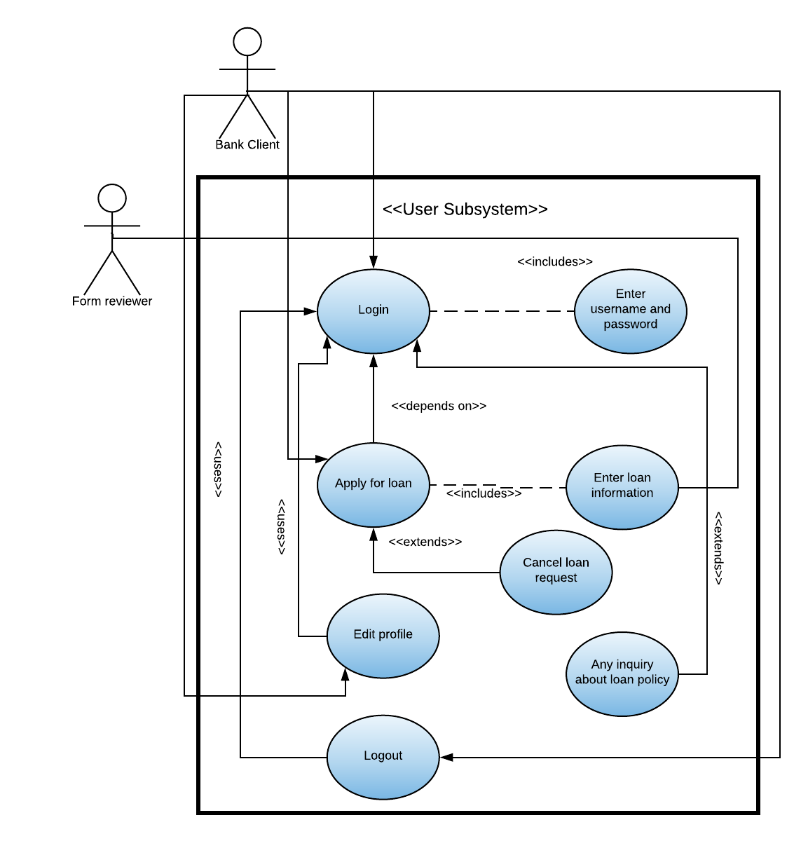
User Sub-system

Slide 55
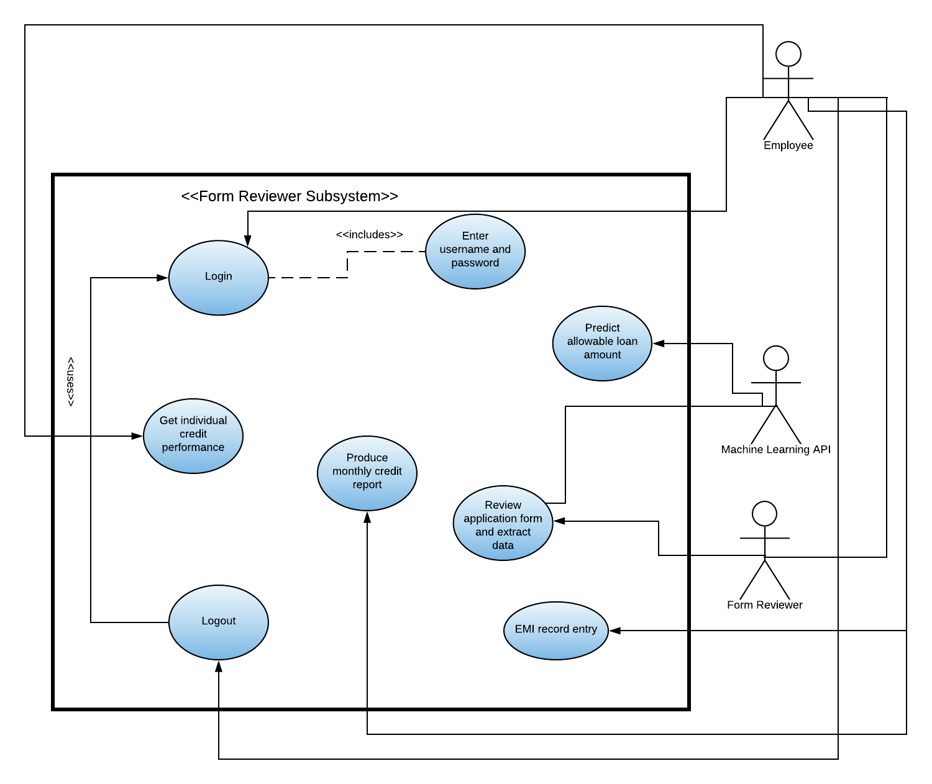
Form Reviewer

Slide 56
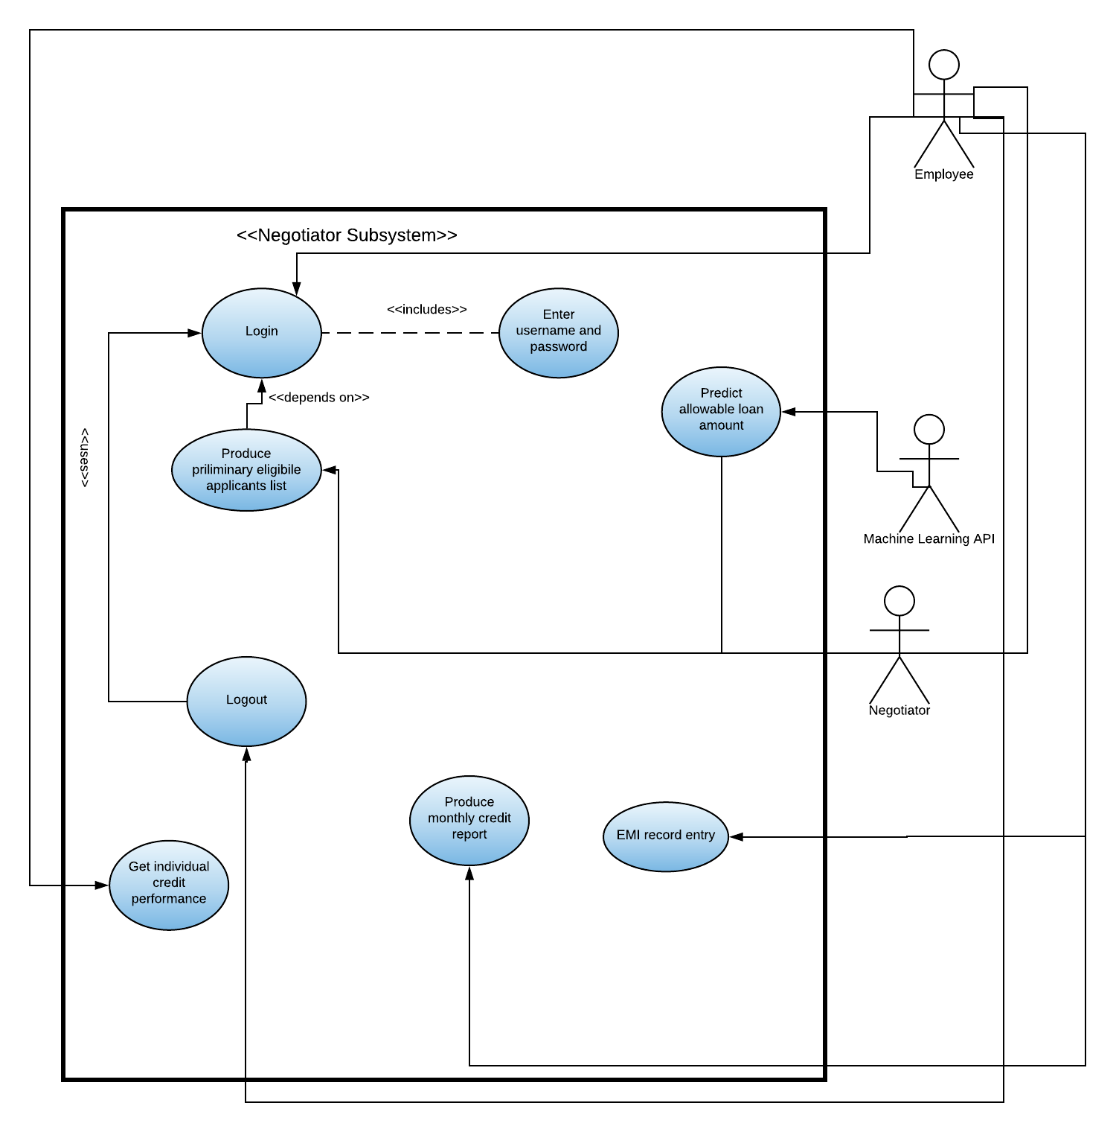
Negotiator

Slide 57
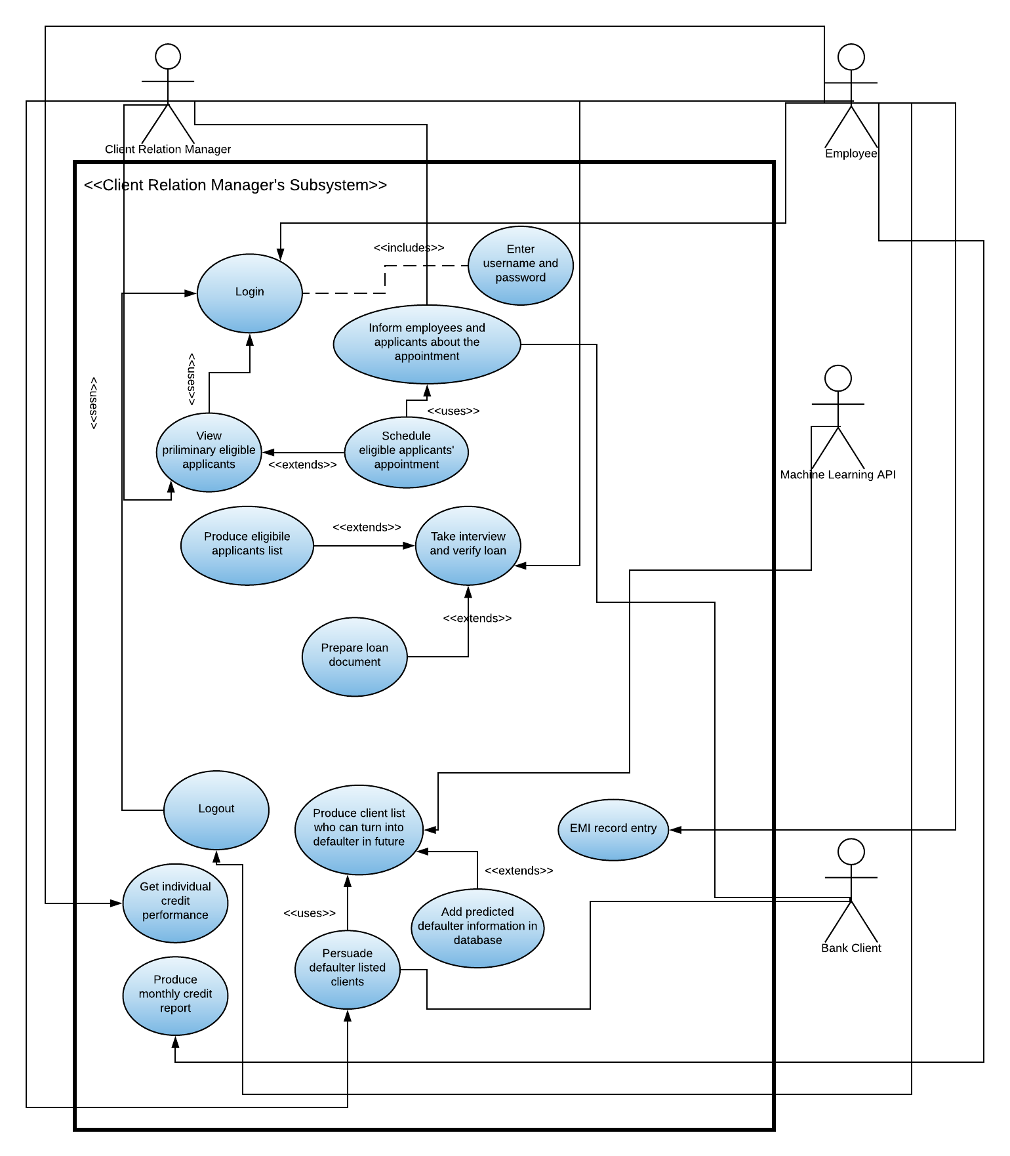
CRM

Slide 58
Entity Relationship Diagram
4

Slide 59
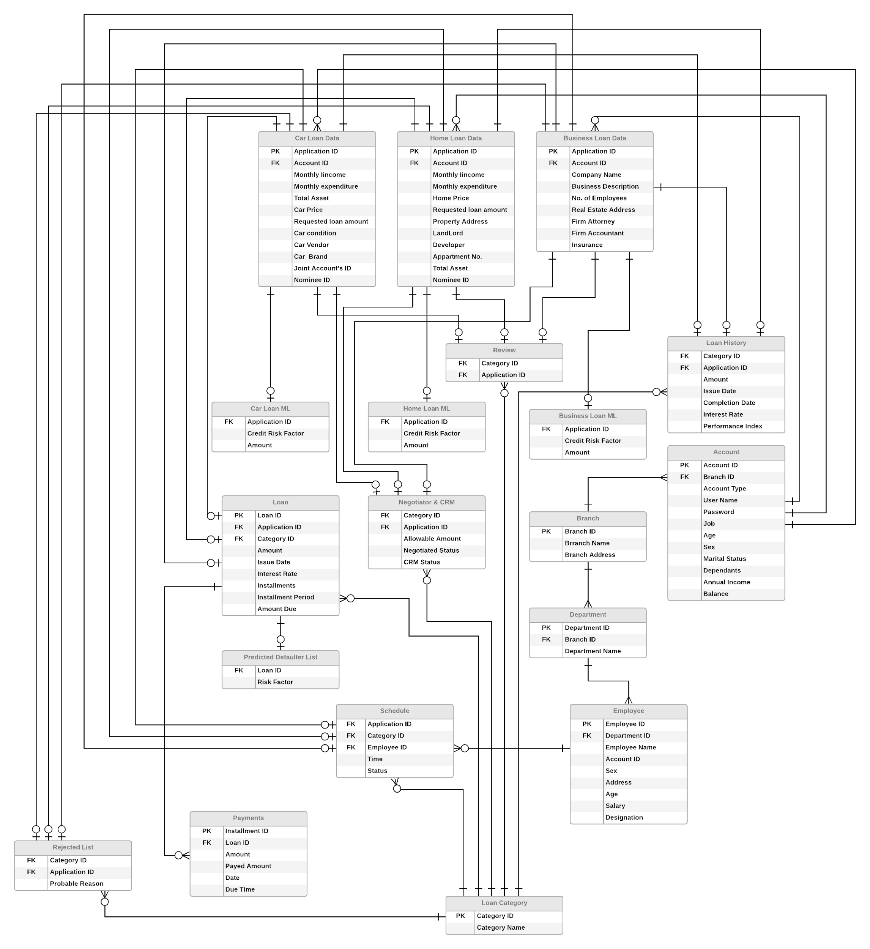
ERD

Slide 60
Class Diagram
5

Slide 61
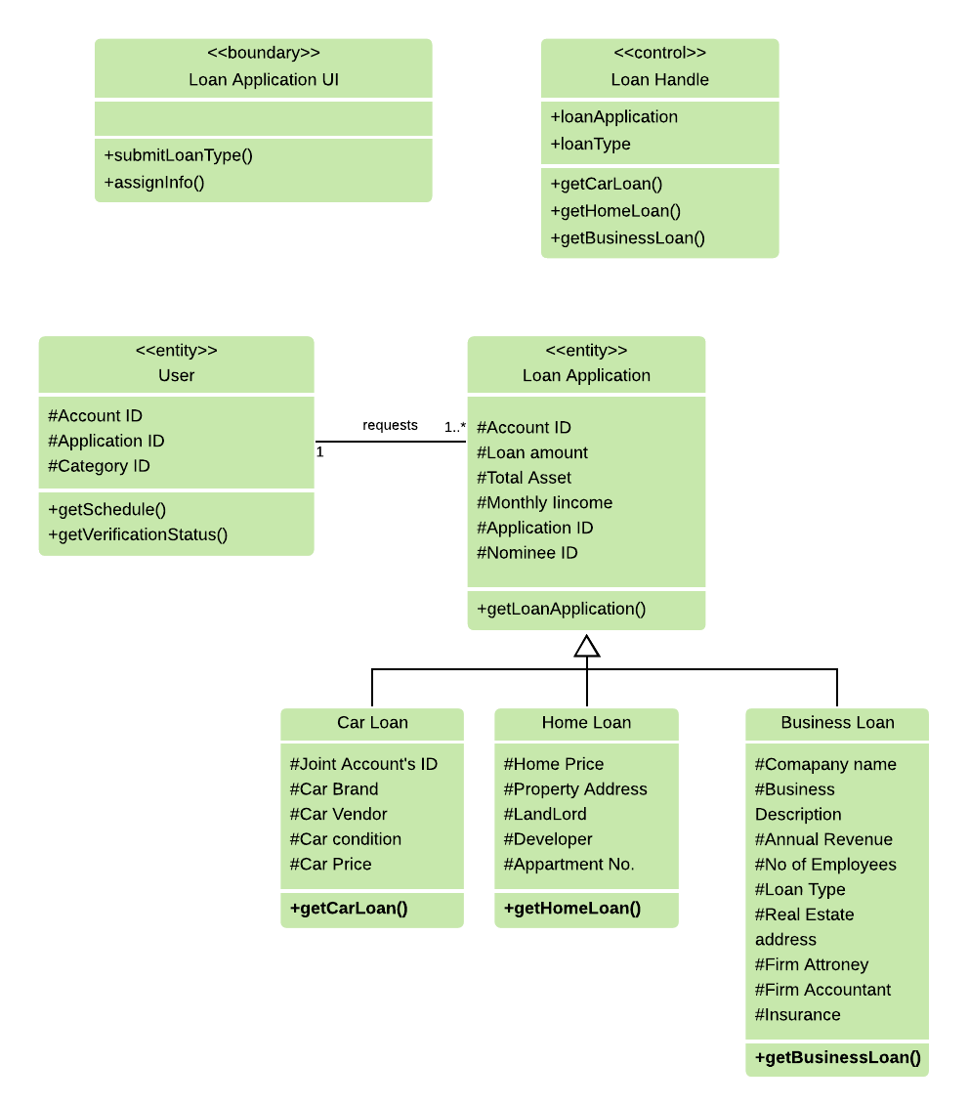
User Subsystem

Slide 62
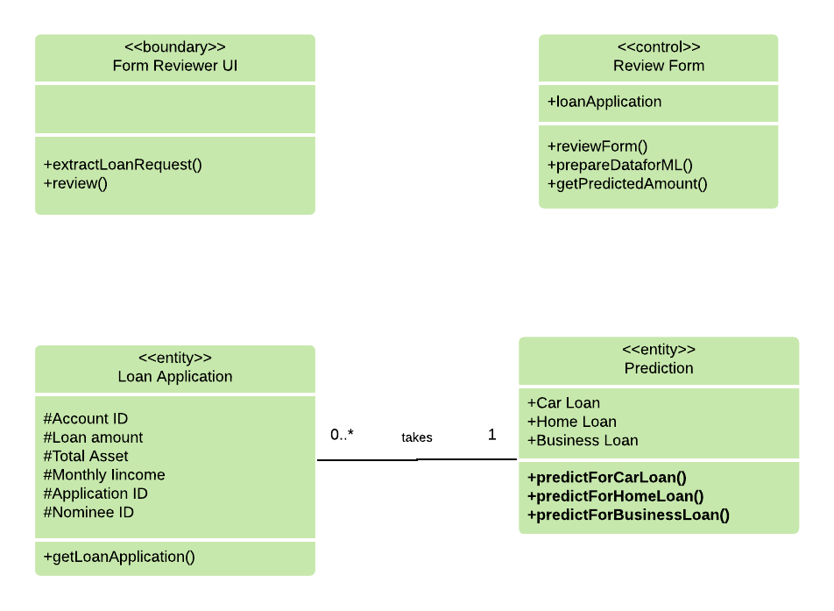
Form Reviewer Subsystem

Slide 63
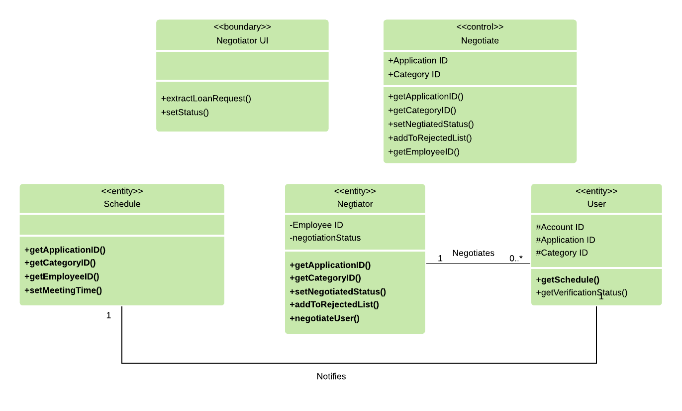
Negotiator Subsystem

Slide 64
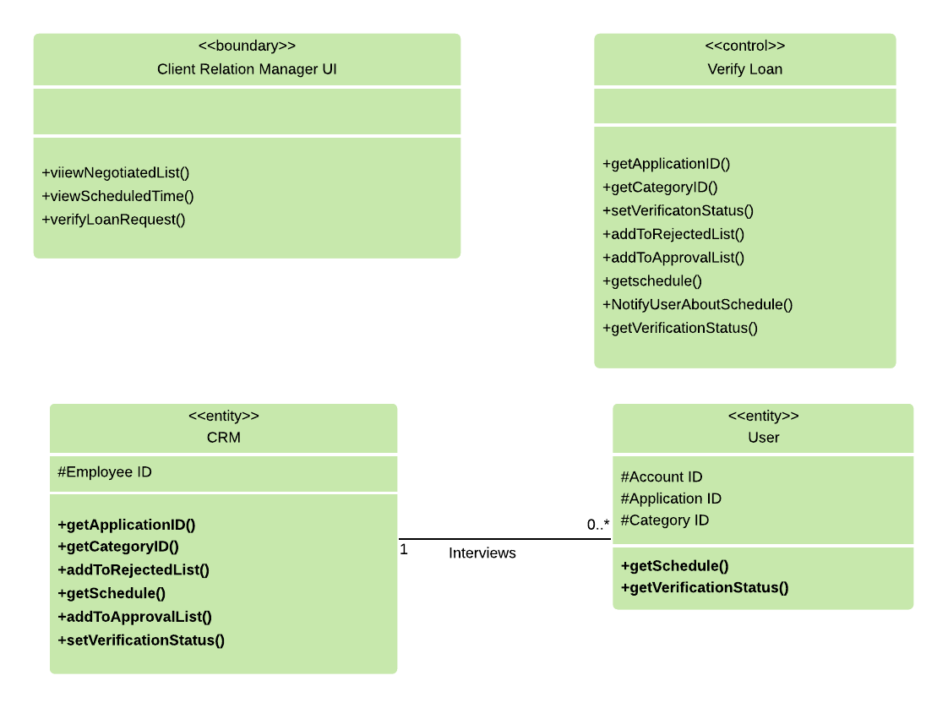
CRM’s Subsystem

Slide 65
Sequence Diagram
6

Slide 66
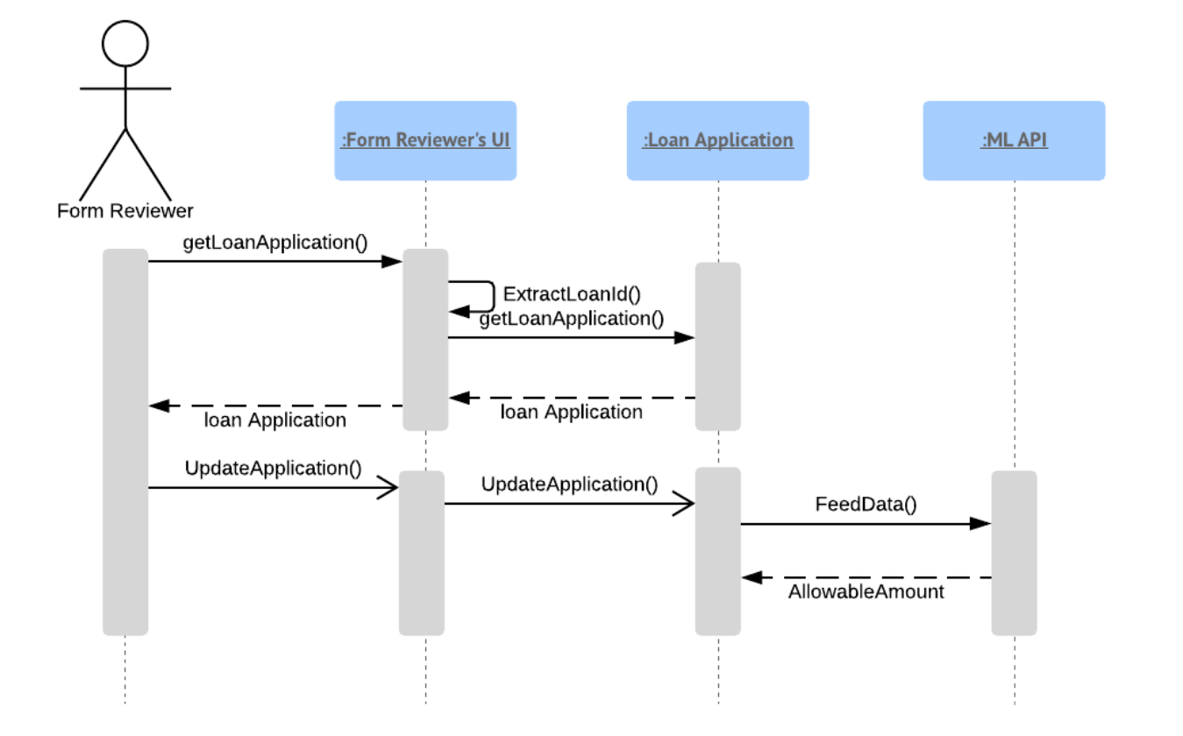
Review and feed data

Slide 67
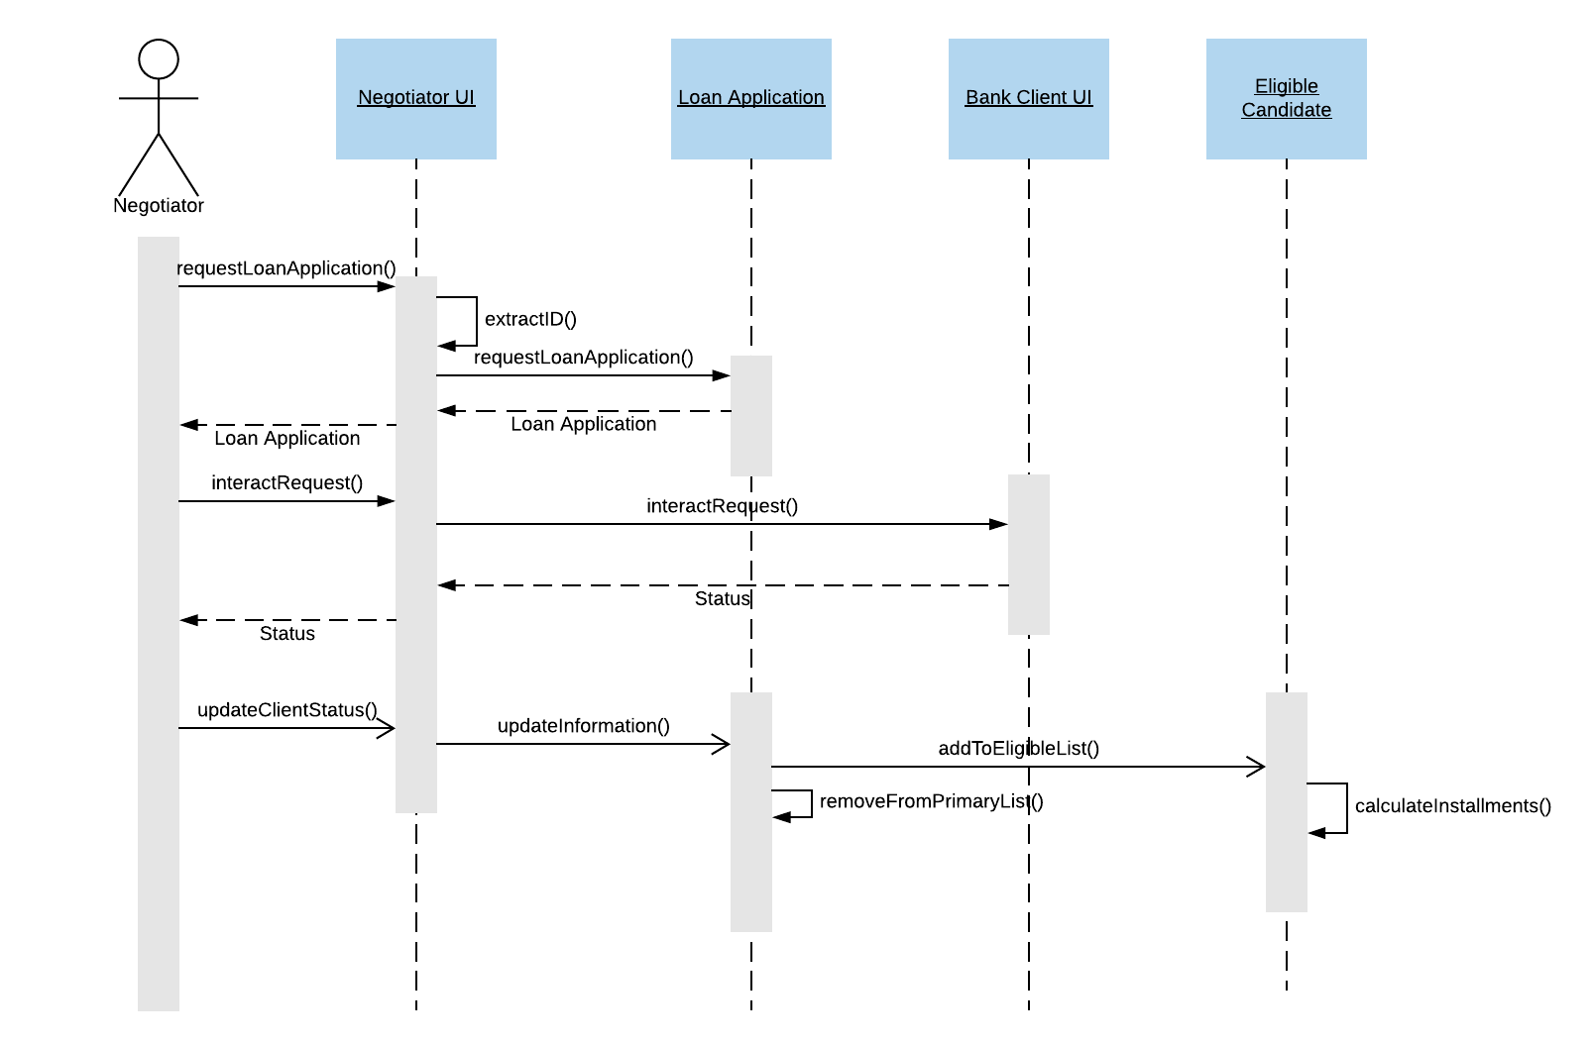
Negotiate Client

Slide 68
Data Flow Diagram
7

Slide 69
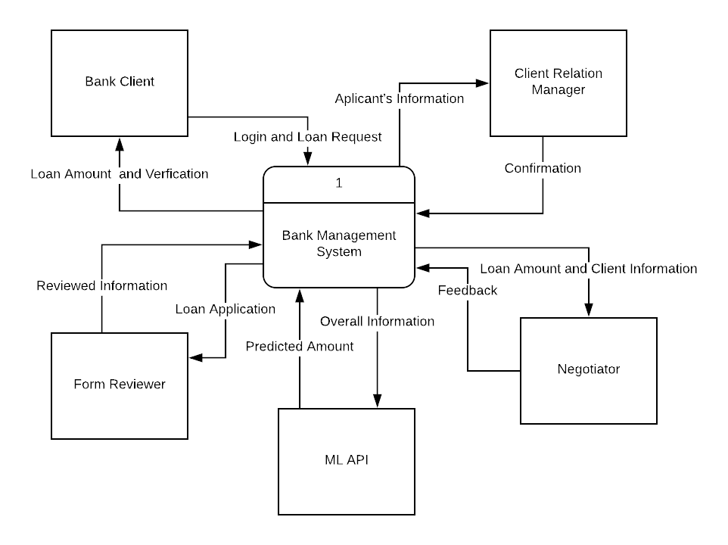
Context Diagram

Slide 70
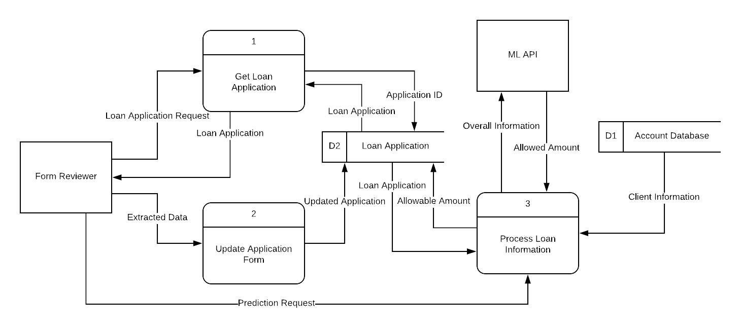
Form Reviewer

Slide 71
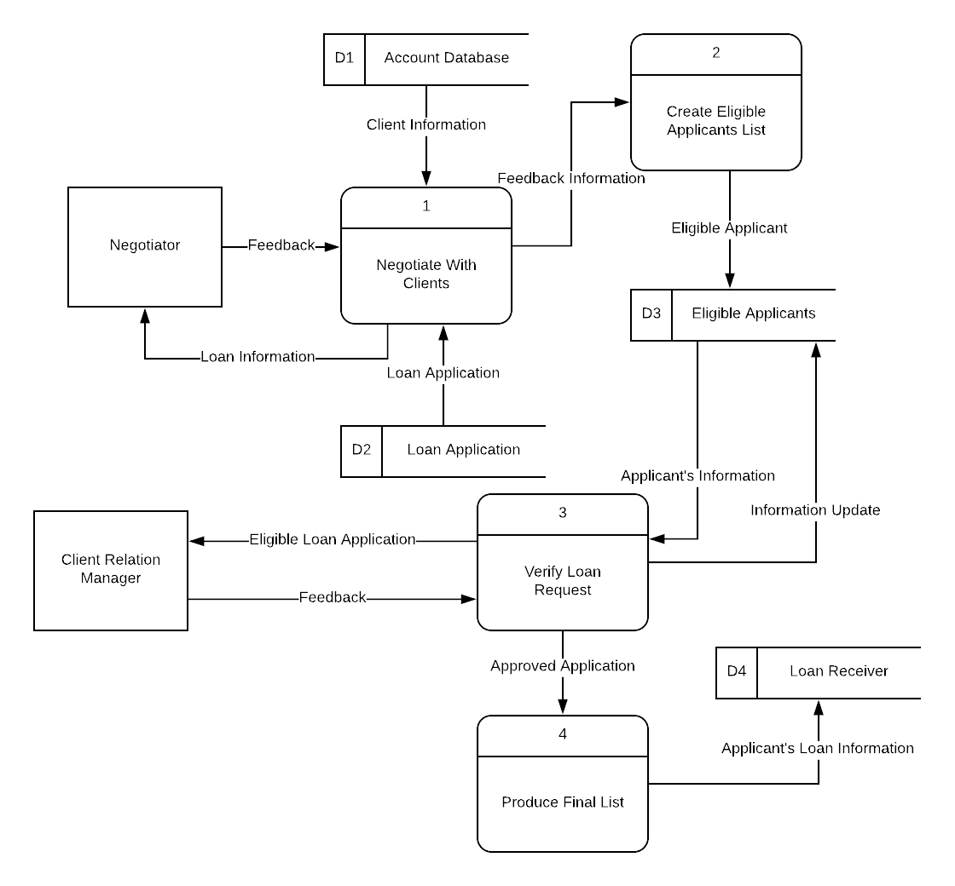
Negotiator and CRM

Slide 72
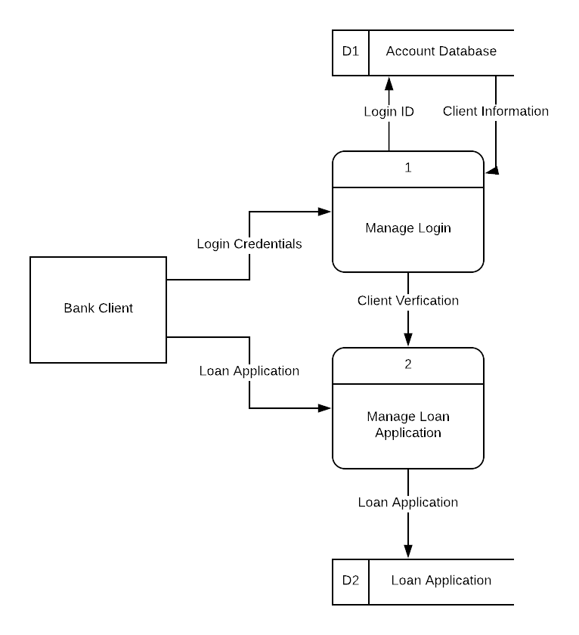
Login and Loan Request

Slide 73
Gantt Chart
8

Slide 74
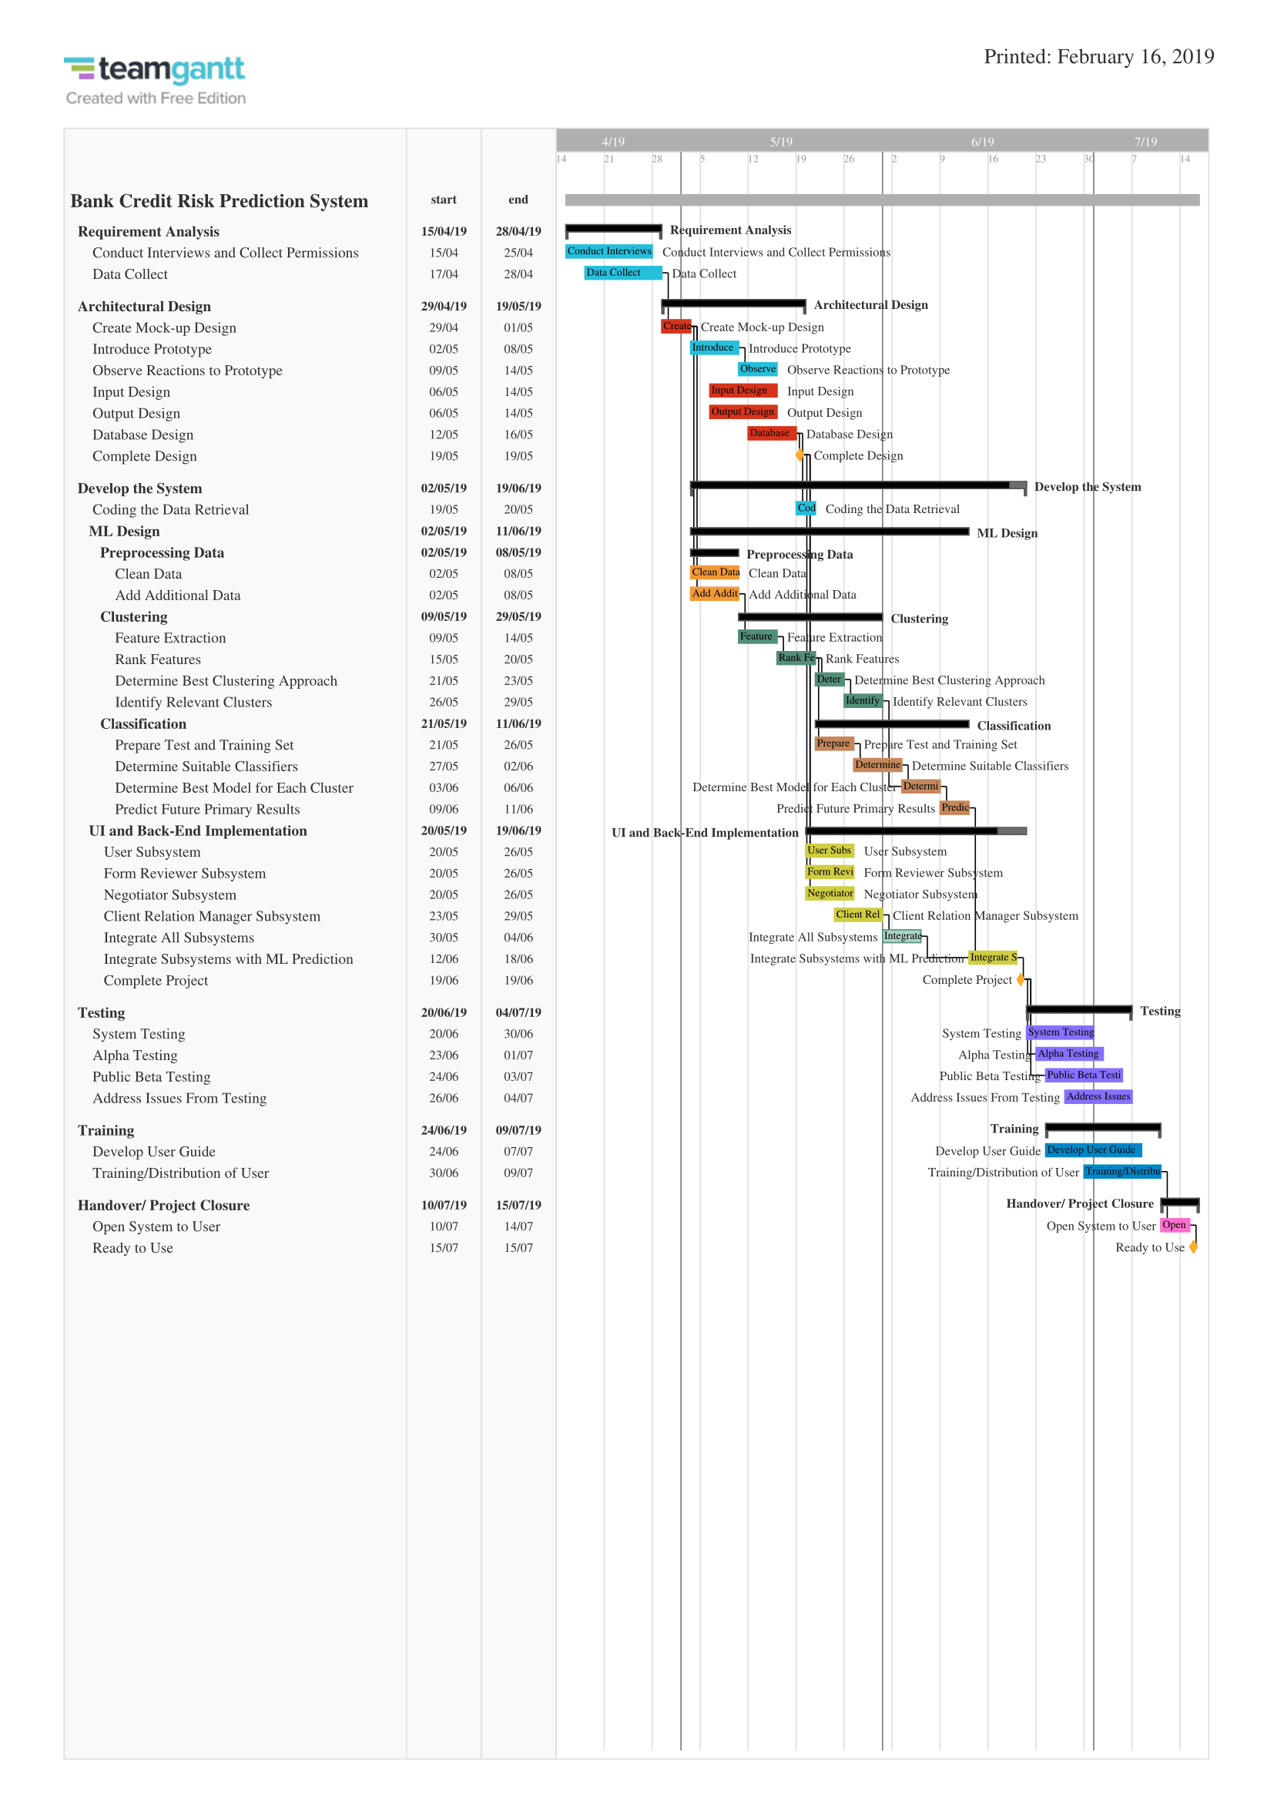
Gantt Chart

Slide 75
Review and Feed Data
Negotiate Client
Login and Request Loan
Form Reviewer
Negotiator and CRM
Links to Use Case Diagrams

Slide 76
THANKS!

