Slide 1

Energy-Efficient Real-Time Task Scheduling
YDS ALGORITHM

Slide 2
Origin of the algorithm
Energy has become a scarce and expensive resource. Power dissipation is also critical in computer systems.
Google representatives report that if power consumption continues to grow, power costs can easily overtake hardware costs by a large margin.
As a result engineers are now interested in low power rather than speed.

Slide 3
Problems
High speeds result in high performance but also high energy consumption.
1
Lower speeds save energy but performance degrades.
2
Our goal is to minimize energy consumption, while still providing a desired quality of service.
3

Slide 4
YDS algorithm
YDS is a scheduling algorithm for dynamic speed scaling processors which minimizes the total energy consumption.
It was named after and developed by Frances Yao, Alan Demers and Scott Shenker.
There is both an online and an offline version of the algorithm.
Yao, Demers and Shenker make two simplifying assumptions. (1) There is no upper bound on the allowed processor speed. Hence a feasible schedule always exists. (2) The processor has a continuous spectrum of speeds.
Pre-emption of jobs is allowed, i.e. the processing of a job may be stopped and resumed later.

Slide 5
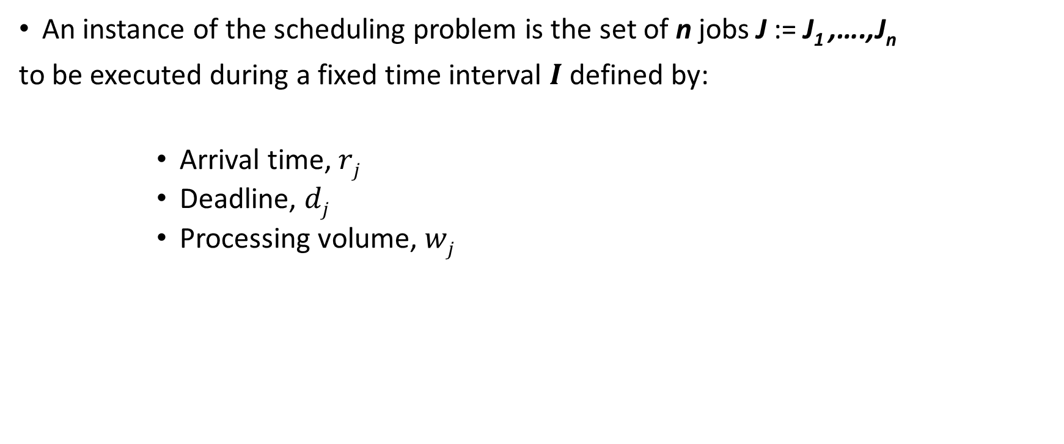
Offline YDS algorithm
An instance of the scheduling problem is the set of n jobs J := J₁ ,….,J_{n}
to be executed during a fixed time interval $I$defined by:
Arrival time, $rj$
Deadline, $dj$
Processing volume, $wj$

Slide 6
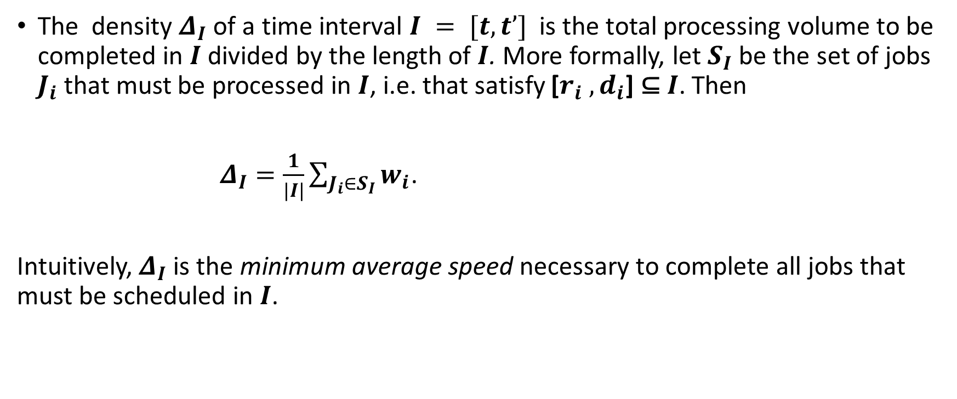
Offline YDS algorithm
The density $Δ_{I}$ of a time interval $I = [t,t’]$ is the total processing volume to be completed in $I$ divided by the length of $I$. More formally, let $S_{I}$ be the set of jobs $J_{i}$ that must be processed in $I$, i.e. that satisfy [$r_{i} , d_{i}$] ⊆ $I$. Then
$Δ_{I}=\frac{1}{|I|}\sum_{J_{i}∈S_{I}}{w_{i}}$.
Intuitively,${ Δ}_{I}$ is the minimum average speed necessary to complete all jobs that must be scheduled in $I$.

Slide 7
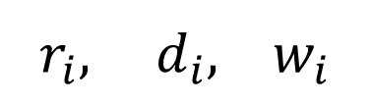

Offline YDS algorithm
Step 1: In each round, YDS determines the interval $I$ of maximum density $∆_{I}.$
$r_{i},$ $d_{i}, w_{i}$
3, 6, 5
2, 6, 3
6, 14, 6
0, 8, 2
3, 6, 5
12, 17, 2
6, 14, 6
2, 6, 3
11, 17, 2
10, 14, 6
10, 14, 6
11, 17, 2
0, 8, 2
12, 17, 2
0
1
2
3
4
5
6
7
8
9
10
11
12
13
14
15
16
17
time

Slide 8
Offline YDS algorithm
INTERVAL | INTENSITY | INTERVAL | INTENSITY
0 – 6 | (5+3)/6 = 8/6 | 3 – 6 | 5/(6-3) = 5/3
0 – 8 | (5+3+2)/8 = 10/8 | 3 – 14 | (5+6+6)/(14-3) = 17/11
0 – 14 | (5+3+2+6+6)/14 = 11/7 | 3 – 17 | (5+6+6+2+2)/(17-3) = 21/14
0 – 17 | (5+3+2+6+6+2+2)/17 = 26/17 | 6 – 14 | (6+6)/(14-6) = 12/8
2 – 6 | (5+3)/(6-2) = 2 | 6 – 17 | (6+6+2+2)/(17-6) = 16/11
2 – 14 | (5+3+6+6)/(14-2) = 5/3 | 10 – 14 | 6/(14-10) = 6/4
2 – 17 | (5+3+6+6+2+2)/(17-2) = 24/15 | 10 – 17 | (6+2+2)/(17-10) = 10/7
2 – 8 | (5+3)/(8-2) = 8/6 | 11 – 17 | (2+2)/(17-11) = 4/6
3 – 8 | 5/(8-3) = 1 | 12 – 17 | 2/(17-12) = 2/5
Table 1: Intensity of Intervals

Slide 9
Offline YDS algorithm
Step 2: Execute jobs in the interval with the highest intensity by using the earliest-deadline first(*EDF algorithm) schedule and running at the intensity as the frequency.
1. Table 1 shows that interval [2,6] holds the highest intensity 2. It contains 2 tasks below,
2. Sort them using EDF algorithm
(here they remain the same as
before as they have the same deadline)
*the job inside this interval whose deadline will arrive soonest is scheduled first
3, 6, 5
2, 6, 3
3, 6, 5
2, 6, 3

Slide 10

Offline YDS algorithm
$r_{i},$ $d_{i}, w_{i}$
6, 14, 6
3, 6, 5
3, 6, 5
12, 17, 2
2, 6, 3
2, 6, 3
11, 17, 2
0, 8, 2
10, 14, 6
0, 8, 2
6, 14, 6
0
1
2
3
4
5
6
7
8
9
10
11
12
13
14
15
16
17
10, 14, 6
time
11, 17, 2
3,6,5
2, 6, 3
12, 17, 2
0
1
2
3
4
5
6
7
8
9
10
11
12
13
14
15
16
17
time

Slide 11

Offline YDS algorithm
Step 3: The interval is removed from the timeline, as no more calculations can be scheduled here. Adjust the arrival times and deadlines by excluding the possibility to execute at the previous critical intervals.
$r_{i},$ $d_{i}, w_{i}$
3, 6, 5
2, 6, 3
0, 8, 2
0, 4, 2
6, 14, 6
2, 10, 6
10, 14, 6
6, 10, 6
11, 17, 2
7, 13, 2
12, 17, 2
8, 13, 2

Slide 12
Offline YDS algorithm
6, 14, 6
3, 6, 5
12, 17, 2
2, 6, 3
11, 17, 2
10, 14, 6
0, 8, 2
0
1
2
3
4
5
6
7
8
9
10
11
12
13
14
15
16
17
time
7, 13, 2
2, 10, 6
8, 13, 2
0, 4, 2
6, 10, 6
0
1
2
3
4
5
6
7
8
9
10
11
12
13
14
15
16
17
time

Slide 13

Offline YDS algorithm
Step 3: Run the algorithm for the revised input again.
INTERVAL | INTENSITY | INTERVAL | INTENSITY
0 – 4 | 2/4 | 2 – 13 | (6+6+2+2)/(13-2) = 16/11
0 – 10 | (6+6+2)/10 = 14/10 | 6 – 10 | 6/(10-6) = 6/4
0 – 13 | (2+6+6+2+2)/13 = 18/13 | 6 – 13 | (6+2+2)/(13-6) = 10/7
2 – 10 | (6+6)/(10-2) = 12/8 | 7 – 13 | (2+2)/(13-7) = 4/6
- | - | 8 – 13 | 2/(13-8) = 2/5
$r_{i},$ $d_{i}, w_{i}$
0, 4, 2
2, 10, 6
6, 10, 6
7, 13, 2
8, 13, 2
Maximum intensity interval [2,10]
Table 2: Intensity of Intervals

Slide 14

Offline YDS algorithm
7, 13, 2
2, 10, 6
$r_{i},$ $d_{i}, w_{i}$
8, 13, 2
0, 4, 2
0, 4, 2
6, 10, 6
2, 10, 6
0
1
2
3
4
5
6
7
8
9
10
11
12
13
14
15
16
17
6, 10, 6
time
7, 13, 2
8, 13, 2
2, 10, 6
6, 10, 6
0
1
2
3
4
5
6
7
8
9
10
11
12
13
14
15
16
17
time

Slide 15

Offline YDS algorithm
7, 13, 2
$r_{i},$ $d_{i}, w_{i}$
2, 10, 6
0, 4, 2
0, 2, 2
8, 13, 2
0, 4, 2
2, 10, 6
6, 10, 6
6, 10, 6
0
1
2
3
4
5
6
7
8
9
10
11
12
13
14
15
16
17
time
7, 13, 2
2, 5, 2
2, 5, 2
8, 13, 2
2, 5, 2
2, 5, 2
0, 2, 2
0
1
2
3
4
5
6
7
8
9
10
11
12
13
14
15
16
17
time

Slide 16

Offline YDS algorithm
$r_{i},$ $d_{i}, w_{i}$
INTERVAL | INTENSITY
0 – 2 | 2/2 = 1
0 – 5 | (2+2+2)/5 = 6/5
2 – 5 | (2+2)/3 = 4/3
0, 2, 2
2, 5, 2
2, 5, 2
Table 3: Intensity of Intervals
Maximum intensity interval [2,5]

Slide 17

Offline YDS algorithm
2, 5, 2
2, 5, 2
$r_{i},$ $d_{i}, w_{i}$
0, 2, 2
0, 2, 2
0
1
2
3
4
5
6
7
8
9
10
11
12
13
14
15
16
17
2, 5, 2
time
2, 5, 2
2, 5, 2
2, 5, 2
0
1
2
3
4
5
6
7
8
9
10
11
12
13
14
15
16
17
time

Slide 18

Offline YDS algorithm
2, 5, 2
2, 5, 2
$r_{i},$ $d_{i}, w_{i}$
0, 2, 2
0, 2, 2
0, 2, 2
2
4
12
13
14
15
16
17
2, 5, 2
0
1
3
5
6
7
8
9
10
11
time
2, 5, 2
0, 2, 2
0
1
2
3
4
5
6
7
8
9
10
11
12
13
14
15
16
17
time

Slide 19
Offline YDS algorithm
Step 4: Put scheduled tasks together.
frequency
time
2
1.5
1.33
3, 6, 5
2, 6, 3
6, 14, 6
10, 14, 6
11, 17, 2
12,
17,2
0, 8, 2
0
1
2
3
4
5
6
7
8
9
10
11
12
13
14
15
16
17
Task | 1 | 2 | 3 | 4 | 5 | 6 | 7
frequency | 2 | 2 | 1 | 1.5 | 1.5 | 1.333 | 1.333
Table 4: Final frequency of scheduled tasks

Slide 20
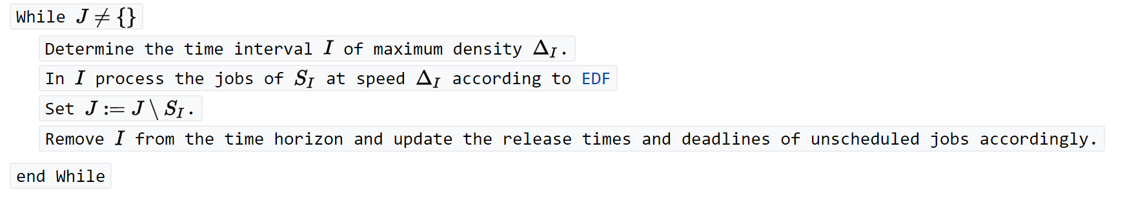
Offline YDS algorithm
A summary of YDS in pseudo-code is given below:

Slide 21
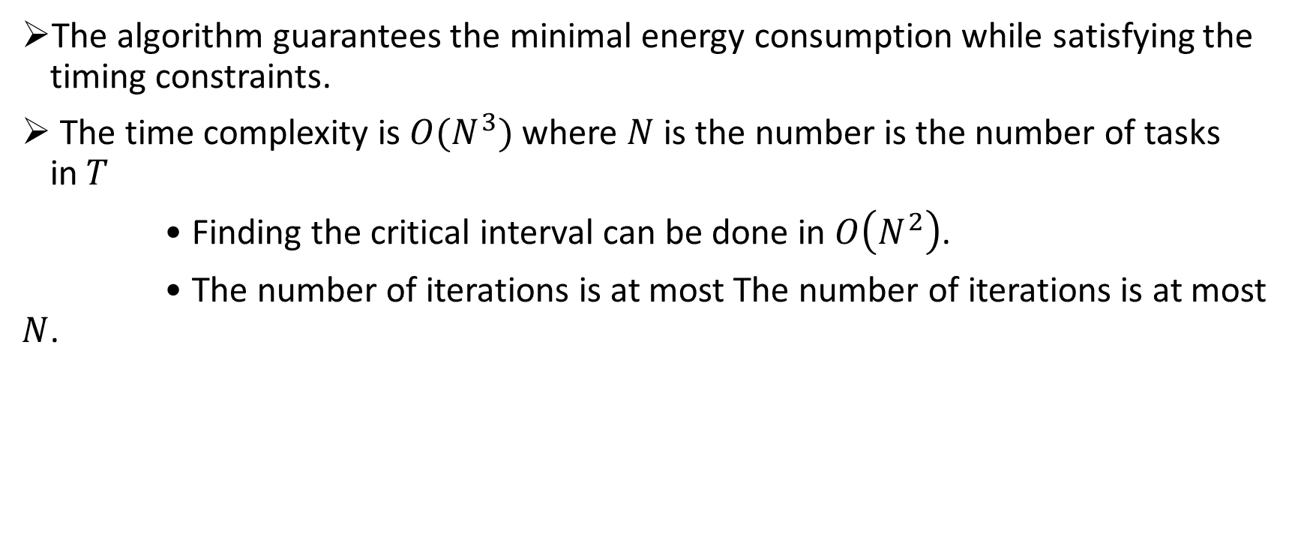
Offline YDS algorithm
The algorithm guarantees the minimal energy consumption while satisfying the timing constraints.
The time complexity is $O(N^{3})$ where $N$ is the number is the number of tasks in$T$
• Finding the critical interval can be done in $O\left(N^{2}\right)$.
• The number of iterations is at most The number of iterations is at most $N$.

Slide 22
THE END

