Slide 1
WELCOME….
INTRODUCTION
NAME :- ARCHIT JAIN,NISCHAY RAJPAL,SHIVAM JAIN ,TUSHAR BANSAL
ROLL NO :- CSE/17/121 ,CSE/17/206,CSE/17/128,CSE/17/248
DOMAIN OF TRAINING :- CORE JAVA USING MYSQL

Slide 2
INTRODUCTION OF JAVA
Java was originally developed by James Gosling at Sun Microsystems
It was brought in the market to overcome the disadvantages of C/C++
It is a completely object oriented language
It is platform independent
It is machine independent
We can design program for both pc and web.

Slide 3
Java virtual machine
The advantage of java is that it not just directly compile and run data.
First it compiles and then convert the file into byte code
Then it interprets the code to run
In this part Java Virtual Machine or JVM is required
The work of JVM is to run code in the form of byte code.

Slide 4
CORE JAVA
In this part of java basically we just design a regular which is easily usable in a pc but not for web.
In design it for offline purpose where no exchange of data is required.
But yes we can still store data using software like mysql, oracle etc.

Slide 5
Hardware And SOFTWARE required
Intel CORE i3
2 GB RAM
Windows 7/8/10,Ubuntu 14.06/16.06/19.06
HDD 5 GB FREE
Eclipse or NetBeans
MySQL or Oracle

Slide 6
PROJECT CONTAINS TWO PARTS
FRONT END
BACK END
FOR GUI
JAVA SWING
JDBC
MYSQL

Slide 7
FRONT end…

Slide 8
Overview
JAVA and GUIs: SWING
Container, Components, Layouts
Using SWING

Slide 9
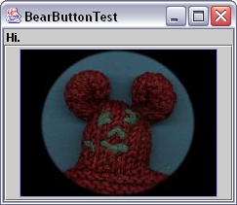
The First Swing Program
Example:
The First Swing Program

Slide 10
The GUI
Container: JFrame
Layout: BorderLayout
North
Center
Components: JLabel JButton, containing
an ImageIcon

Slide 11
Steps to build a GUI
1. import package
2. set up top level container
(e.g. JFrame)
3. apply layout
(e.g. BorderLayout)
4. add components
(e.g. Label, Button)
5. REGISTER listeners
6. show it to the world !

Slide 12
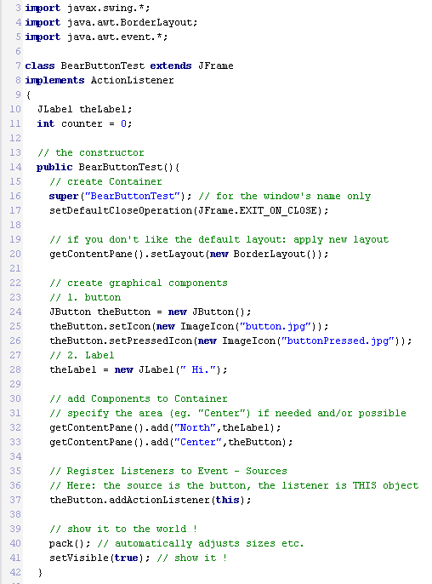
The Source
1. import package
2. set up top level container
(e.g. JFrame)
3. apply layout
(e.g. BorderLayout)
4. add components
(e.g. Label, Button)
5. REGISTER listeners
6. show it to the world !

Slide 13
Swing Components
Top Level Containers
General Purpose Containers
Special Purpose Containers
Basic Controls
Uneditable Information Displays
Interactive Displays of Highly Formatted Information

Slide 14
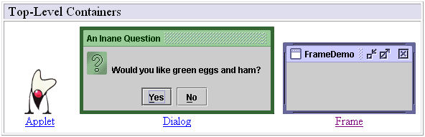
Swing Components
Top Level Containers
Your application usually extends one of these classes !

Slide 15
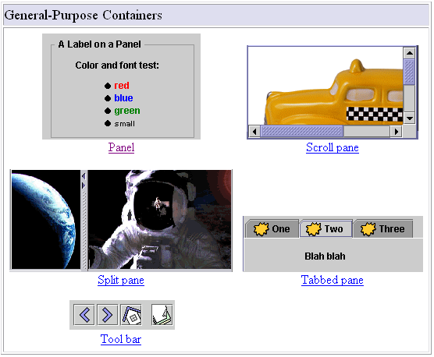
Swing Components
General Purpose Containers

Slide 16
Swing Components
General Purpose Containers
typically used to collect Basic Controls (JButton, JChoiceBox…)
Added to layout of top-level containers
JFrame
JPanel

Slide 17
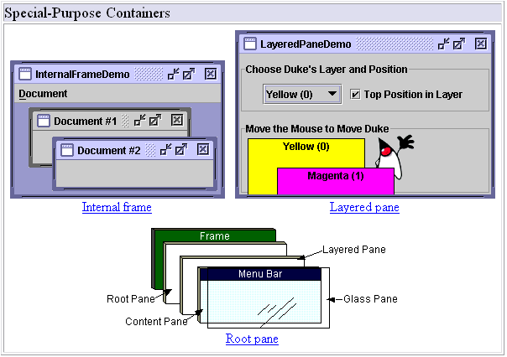
Swing Components
Special Purpose Containers

Slide 18
Swing Components
Special Purpose Containers
If you want to use them, go to java.sun.com

Slide 19
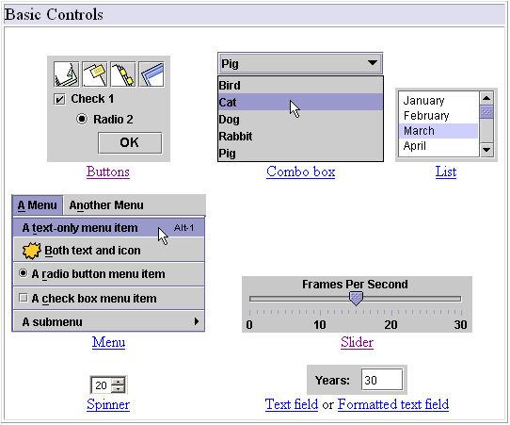
Swing Components
Basic Controls

Slide 20
Swing Components
Basic Controls
Unlike ‘passive’ containers, controls are the ‘active’ part of your GUI
Remark: containers aren’t only ‘passive’, they are also ‘active’ sources of events, eg. Mouse-events.
Being the visible part of your interface, controls bring your application to life
Controls are event sources !
Objects of your application register to controls to handle the events

Slide 21
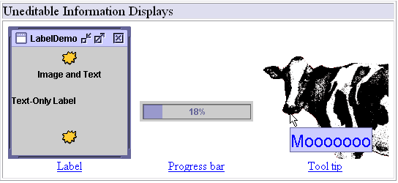
Swing Components
Uneditable Information Displays

Slide 22
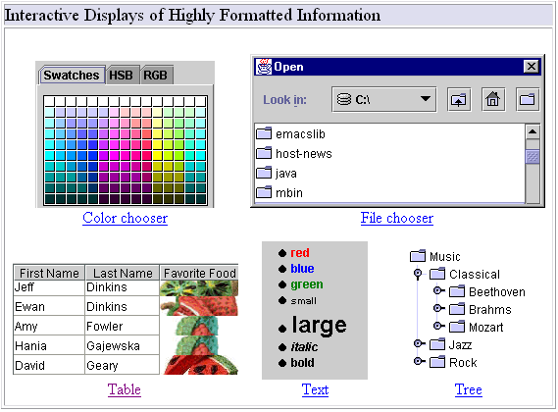
Swing Components
Interactive Displays of Highly Formatted Information

Slide 23
Swing Components
Interactive Displays of Highly Formatted Information
Define standard interfaces for frequently needed tasks
... go to java.sun.com for further information ...

Slide 24
Layout Management
... and finally, the layout manager preserves the world from home made layout-design !

Slide 25
Layout Management
Java supplies five commonly used layout managers:
BorderLayout
BoxLayout
FlowLayout
GridBagLayout
GridLayout

Slide 26
Layouts
BorderLayout
Position must be specified, e.g. add (“North”, myComponent)

Slide 27
Layouts
BoxLayout
The BoxLayout class puts
components in a single row
or column.
It respects the components‘
requested maximum sizes.

Slide 28
Layouts
FlowLayout
FlowLayout is the default layout manager for every JPanel.
It simply lays out components from left to right, starting new
rows if necessary

Slide 29
Layouts
GridBagLayout
GridBagLayout is the most sophisticated, flexible layout manager the
Java platform provides. If you really want to use it, go to java.sun.com …

Slide 30
Layouts
GridLayout
GridLayout simply makes a bunch of components equal in size and
displays them in the requested number of rows and columns .

Slide 31
Using Components
Examples:
Using a JButton
Using a JSlider
Using a JCheckBox

Slide 32
Using a JButton
Some Constructors:
JButton() | Creates a button with no text or icon
JButton(Icon icon) | Creates a button with an icon
JButton(String text) | Creates a button with text
JButton(String text, Icon icon) | Creates a button with initial text and an icon

Slide 33
Using a JButton
Some Methods:
addActionListener(ActionListener a) | Registers ActionListener to JButton Inherited from AbstractButton
setFont(Font font) | Specifies Font (Type, Style, Size) Inherited from JComponent
setBackground( Color color) | Sets background color Inherited from JComponent
setActionCommand(String text) | Used to specify button if listener is registered to multiple buttons (see ActionEvent.getActionCommand())

Slide 34
Back end…

Slide 35
JDBC
Java Database Connectivity

Slide 36
Objectives
Differentiate between databse drivers and know when to use what,
Write Java code to work with RDBMS databases to retrieve, insert, update and delete data

Slide 37
JDBC API
JDBC 4.0 (part of JSE 6) is an API, that provides standard for connectivity to a variety of data sources like SQL databases, spreadsheets and flat.
JDBC provides call-level API for SQL databases; meaning, API defines a set of interfaces and abstract methods. The database vendors (like Oracle, MySQL) must implement the JDBC API.
JDBC is based on the X/Open SQL Call Level Interface (CLI). JDBC 4.0 complies with the SQL 2003 standard.
JDBC 4.0
java.sql
javax.sql
JDBC core API
JDBC Optional Package API
Notes:
Before writing JDBC code, we must make sure that we have the library with respect to the data source that we intend to use.

Slide 38
Steps to write database code
Load the driver
Obtain connection
Create and execute statements
[Use result sets to navigate the results]
Close the connection

Slide 39
Load the driver
java.sql.DriverManager class is used to get drivers and it’s connection to the database.
To register (Load) the driver with the application explicitly:
Class.forName("<driver class name>");
Or
DriverManager.registerDriver( new <driver class name>());
Both of these, register the given driver with the DriverManager.. Static block of the <Driver class> calls DriverManager.registerDriver() method!
With JDBC 4.0, this class also provides a mechanism, to automatically load the database drivers (provided, they are packaged in the specified way).

Slide 40

java.sql.Connection
Connection is an interface.
getConnection()method of DriverManager returns the object, that implements this interface.
Connection class is used to do a variety of tasks
Obtain Statement object
To work with transactions
To get meta-data about the database
For executing a static SQL statement, and returning the results it produces, an object that implements Statement interface is used.
Go through the Connection class API

Slide 41
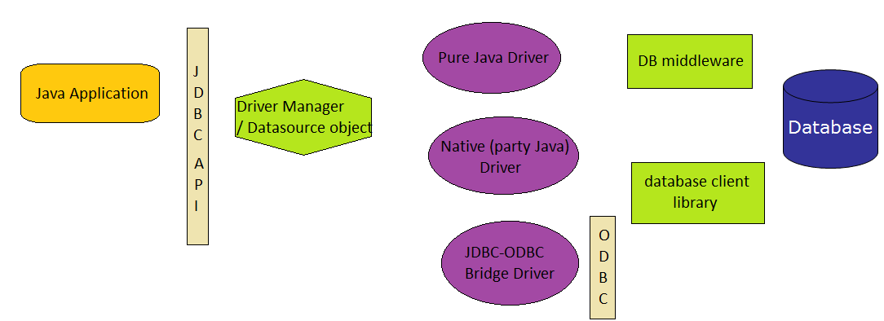
JDBC Architecture
4 Ways to connect to database – through 4 types of driver

Slide 42
Driver Types
JDBC driver are classes, that translate JDBC calls to either vendor-specific database calls or directly invoke database commands.
Types of driver
Type 1- JDBC-ODBC Bridge
Type 2- Part Java, Part Native Driver
Type 3- Intermediate Database Access Server
Type 4- Pure Java Drivers

Slide 43
JDBC-ODBC Bridge
Database
Java
application
JDBC
API
ODBC
API
ODBC
Layer
JDBC-ODBC
Bridge
They are driver classes that implement classes that implement the JDBC API as a mapping to ODBC (Open Database Connectivity) API.
ODBC Microsoft's interface is used for accessing data in a heterogeneous database management system.
ODBC binary code and in many cases, database client code -- must be loaded on each client machine, that uses a JDBC-ODBC Bridge

Slide 44
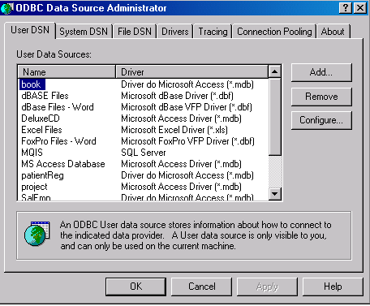
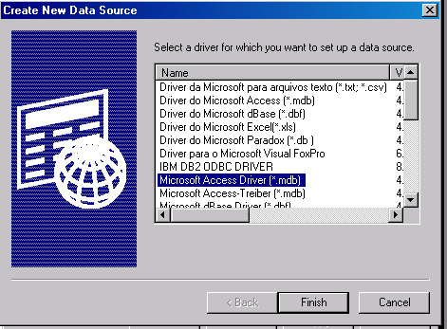
Configure the DSN for ODBC Driver for MS-Access
In control panel, locate “Data Sources (ODBC)” icon (inside Administrative Tools)
Double-click the icon and click on “Add” button in the “User DSN” tab.
Select “Microsoft Access Driver” and click “Finish”

Slide 45
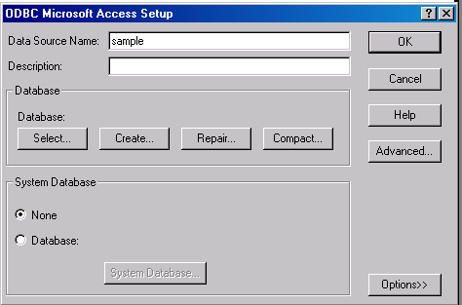
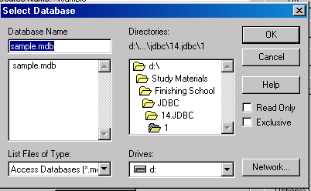
Enter the DSN name as “sample” (we will use this name in the code) and click “Select”.
Browse through and find the access file and click “OK”.
Click “OK” on next two screens and come out of the control panel.

Slide 46
Code to get JDBC-ODBC connection
import java.sql.*;
public class ODBCMain{
Connection con;
public ODBCMain() {
try {
//sample is data source name (DSN)
String url = "jdbc:odbc:sample";
//Load the JDBC-ODBC bridge driver
Class.forName("sun.jdbc.odbc.JdbcOdbcDriver");
//Obtain the connection to the database
con = DriverManager.getConnection(url);
System.out.println (“JDBC-ODBC connection established");
con.close();
}
catch(Exception e){
e.printStackTrace();
} }
public static void main(String str[]){new ODBCMain();}}
Notes:
We will write code to establish the connection with JDBC-ODBC Bridge.
Before we write the code, there are two things we need to do:
Create a database in MS-Access with any name.
Configure the DSN for ODBC Driver, as specified in the next slides
Getting Connection:
static Connection getConnection(String url) throws SQLException
static Connection getConnection(String url, Properties info) throws SQLException
static Connection getConnection(String url, String user, String password) throws SQLException

Slide 47
Disadvantages
ODBC uses a C. The calls from Java to the native C code have a number of drawbacks; in terms of security, robustness and the automatic probability of applications.
Multiple layers of indirection leads to inefficiency.

Slide 48
Type2- Part Java, Part Native Driver
Database
Java
application
Vendor
Specific
API
JDBC
API
JDBC Driver
Much like the bridge driver, this style of driver also requires some binary code to be loaded on each client machine. Therefore, this driver also experiences the same disadvantages. This driver is very rarely used nowadays.

Slide 49
Preferred Database Drivers
Type 3 and Type 4 drivers are the preferred database drivers for Java.
Each of these drivers are used in different architectural situations.
Type 4 Drivers
Used in 2-tier architecture
Connected directly to the Database using Java application
Pure Java Driver
Type 3
Three-tier
Connection to database happens through a middleware. The middleware provides connectivity to many different databases.
JDBC-Net pure Java Driver
Notes:
We will be using Type 4 driver in this session.

Slide 50
Java application
JDBC Driver Manager or Data Source Object
Pure Java Driver
JDBC-Net Pure Java Driver
TYPE 3
TYPE 4
Database middleware
Database

Slide 51
Connecting using type 4 driver
There are two ways the code can be written; in order to obtain connectivity to database, using Type 4 driver:
By specifying class explicitly in the code using Class.forName() or DriverManager.registerDriver().
By using JDBC 4.0 way, we can avoid hard coding the class name in the code.
MySQL database using type 4 driver name is com.mysql.jdbc.Driver .
Download Connector/J driver for mysql-connector-java-5.0.4-bin.jar
Notes:
But before we write the code to connect to MySQL database,
we must have a database. Create a database called test in MySQL.
set the classpath to the jar file with respect to MySQL in the classpath.

Slide 52
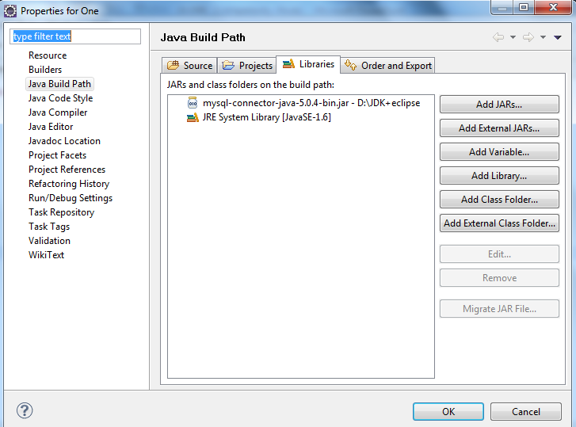
Setting classpath to MySQL driver in eclipse
Select your project, Go to Project menu and select Properties.
Move to “Java Build Path” on the left panel. Click on “Add External JARs”, browse and locate the jar file for MySQL.
Click on Open. This will add the jar file to the Properties Box as shown in the diagram.

Slide 53

Example: Connecting to MySQL – older way
import java.sql.*;
import java.util.Properties;
public class Connect {
public static void main (String[] args) {
Connection conn = null;
try{
String userName = "root";
String password = "root";
String url = "jdbc:mysql://localhost/test";
Class.forName ("com.mysql.jdbc.Driver");
Properties connectionProps = new Properties();
connectionProps.put("user", userName);
connectionProps.put("password",password);
Go through Properties API
Notes:
Properties are strings, that are stored as key-value pairs. These can be stored in a file.
These values are generally used for configuration purpose like application startup parameter values, database configuration values or can be even used to standardize error messages.
Properties class inherits from Hashtable class.
Instead, the methods provided in Properties class like setProperties(), getProperties() are to be used
Properties()
Properties(Properties defaults)
void load(InputStream inStream) throws IOException
void load(Reader reader) throws IOException
Reads a key and element pairs from a character stream or byte stream.
Object setProperty(String key, String value
String getProperty(String key)
String getProperty(String key, String defaultValue)
setProperty() sets the key-value pair in the
getProperty() looks for the property with the specified key in this property list. If the key is not found in this file, the default property list, and its defaults, recursively, are then checked. The method returns null in case of the 1st getProperty() method and defaultValue in case of 2nd if the property is not found.
void store(OutputStream out, String comments) throws IOException
void store(Writer writer, String comments) throws IOException
Write the key-value pairs in the property list to the byte/character stream.

Slide 54
conn = DriverManager.getConnection(url,connectionProps);
System.out.println ("Database connection successful");}
catch (Exception e){
System.err.println ("Failed to connect to database" +e);
}
finally{
if (conn != null) {
try { conn.close ();}
catch (SQLException e) { }
}
}
}
}
Result:
Database connection successful
User name and password can also be sent as part of URL instead of properties. Find out the format in which it can be passed, if sent as a part of URL.

Slide 55
JDBC 4.0 way to connect to database
A JDBC 4-compliant Type 4 Driver JAR is identified, using the Java service provider mechanism. It contains a text a file named “META-INF/services/java.sql.Driver”, which contains the name of the class(es) of the Drivers, which exist in that JAR.
With JDBC 4.0, that uses the Java service provider mechanism, the applications no longer, applications no longer need to explicitly load JDBC drivers using Class.forName().
When the getConnection() is called, the DriverManager attempts to locate a suitable driver from the ones specified in the classpath. (If there are more than one, the first one is used.)
Notes:
Extract the mysql-connector-java-5.0.4-bin.jar to check if there is a file called java.sql.Driver in the folder “META-INF/services”.
If you do not find the file, make it a JDBC 4-complaint, by following the steps given below:Create a folder say MySQLJar. Copy the mysql-connector-java-5.0.4-bin.jar file inside it.
Create a folder called META-INF and then the services, inside META-INF.
Create a file, named java.sql.Driver (without any extension)
Enter the driver name in the file:
com.mysql.jdbc.Driver # Class name of the Driver
Update the jar file by executing the command
jar -uf mysql-connector-java-5.0.4-bin.jar META-INF/services/java.sql.Driver

Slide 56
Code using JDBC 4.0 way
import java.sql.*;
import java.util.Properties;
public class Connect {
public static void main (String[] args)
{
Connection conn = null;
try {
String userName = "root";
String password = "root";
String url = "jdbc:mysql://localhost/test";
Properties connectionProps = new Properties();
connectionProps.put("user", userName);
connectionProps.put("password",password);
conn = DriverManager.getConnection (url,connectionProps);
Notes:
The code is fundamentally same as the previous example- except for the line eliminated is Class.forName ("com.mysql.jdbc.Driver");

Slide 57
System.out.println ("Database connection successful");
}
catch (SQLException e) {
System.err.println ("Failed to connect to database" +e);
}
finally
{
if (conn != null) {
try { conn.close ();}
catch (SQLException e) { }
}
}
}
}

Slide 58
Obtaining Statement
Connection class methods to obtain Statement and its subclasses:
Statement createStatement() throws SQLException
PreparedStatement prepareStatement(String sql) throws SQLException
CallableStatement prepareCall(String sql) throws SQLException
Statement
PreparedStatement
CallableStatement

Slide 59
SQL Exception
Most methods in the java.sql and javax.sql packages throw SQLException.
This object ,can be used to get message describing the error ,SQL state, error code specific to the database, and a reference to any chained exceptions
int getErrorCode()
int getErrorCode()
SQLException getNextException()

Slide 60
Statement
The object of this type is used for executing a static SQL statement and returning its results.
The result of the query statement is returned, in the form of ResultSet object .
Only one ResultSet object per Statement object can be open at the one time.
Therefore, reading data 2 or more ResultSet objects would require, obtaining ResultSets from different Statement objects.
On calling execute methods on Statement object, the ResultSet object obtained from this Statement object (if there are any) is automatically closed.
Go through the Statement class API
Notes:
ResultSet executeQuery(String sql) throws SQLException
sql is typically a static SQL SELECT statement. A ResultSet object always contains the data, produced by the given query and is never null.
int executeUpdate(String sql) throws SQLException
sql is typically a SQL DML (INSERT, UPDATE, or DELETE statement) or DDL like (CREATE, DROP statements)
Returns the row count as number of rows affected, for DML statements or 0 for SQL DDL statement.
int executeUpdate(String sql, int autoGeneratedKeys) throws SQLException
Executes the Sql statement. If auto-generated keys, has value Statement.RETURN_GENERATED_KEYS, then auto-generated keys produced by this object will be made available for retrieval.
Statement.NO_GENERATED_KEYS will not make the auto-generated keys available
Return value is same as the above method
ResultSet getGeneratedKeys() throws SQLException
Retrieves any auto-generated keys created as a result of executing this Statement object.
int executeUpdate(String sql, int[] columnIndexes) throws SQLException
Executes the SQL statement.
columnIndexes array contains the indexes of the columns in the target table that contain the auto-generated keys. These keys are made available for retrieval.
int executeUpdate(String sql, String[] columnNames) throws SQLException
This is same as the above method except that instead of array containing indexes of column it contains column names.
boolean execute(String sql) throws SQLException
Used to execute stored procedure.
Used to execute SQL, that many return multiple result set or update counts.
To get the results - methods getResultSet or getUpdateCount to retrieve the first result, and getMoreResults to move to any subsequent result(s).
ResultSet getResultSet() throws SQLException
int getUpdateCount() throws SQLException
boolean getMoreResults() throws SQLException
Batch execution methods: Multiple updates can be sent to the database for execution as a batch.
void addBatch(String sql) throws SQLException
used to add the given SQL command, to be executed as batch.
int[] executeBatch() throws SQLException
submits a batch of commands, to the database for execution and if all commands, execute successfully, returns an array of update counts

Slide 61
ResultSet methods (default)
ResultSet is an interface, representing table of data that is retrieved from a database
It maintains a cursor initially pointing to the first row. The next method moves the cursor to the next row, until returns false when there are no rows to read.
A default ResultSet object is not updatable and has a cursor that moves forward only.
boolean next() throws SQLException
void close() throws SQLException
XXX getXXX(int colndex)throws SQLException
XXX getXXX(String colname)throws SQLException
where XXX is any primitive type, String, java.sql.Date (subclass of java.util.Date), Object
colIndex begins from 1
colname as specified with the SQL AS clause

Slide 62
Code to insert and fetch records
Assuming a table in MYSQL named Student with regNo(int(11)), name(varchar(45)), degree(name(varchar(45)) and semester((int(11))
import java.sql.*;
import java.util.Properties;
public class Connect {
public static void main (String[] args) {
Connection conn = null;
try
{
String userName = "root";
String password = "root";
String url = "jdbc:mysql://localhost/test";
Properties props = new Properties();
props.put("user", userName);
props.put("password",password);
conn = DriverManager.getConnection(url,props);
Statement s= conn.createStatement();

Slide 63
s.executeUpdate("INSERT INTO STUDENT VALUES (1,'Rama','M.C.A.', 1)");
s.executeUpdate("INSERT INTO STUDENT VALUES (2,'Sita','B.Tech', 2)");
ResultSet rs=s.executeQuery("SELECT * FROM STUDENT");
System.out.println("ID Name Degree Semester");
while (rs.next() ) {
System.out.println( rs.getInt(1) +" "+rs.getString(2)+" "+rs.getString(3)+" "+rs.getInt(4)); }
} catch (SQLException e){
System.err.println ("Failed to connect to database" +e);
}
finally {
if (conn != null) {
try { conn.close ();}catch (SQLException e) { }
} } } }

Slide 64
Advanced ResultSet
A default ResultSet object is not updatable and has a cursor that moves forward only.
In order to have ResultSet which are scrollable and updatable, a different createStatement() method has to be used.
public Statement createStatement(int resSetType,int resSetConcurrency) throws SQLException
resSetType :
ResultSet.TYPE_FORWARD_ONLY
cursor may move only forward (default)
ResultSet.TYPE_SCROLL_INSENSITIVE
scrollable, but not sensitive to changes to the underlying data in the database, which happens outside the purview of this object.
ResultSet.TYPE_SCROLL_SENSITIVE
scrollable but not sensitive to changes to the underlying data

Slide 65
resSetConcurrency :
ResultSet.CONCUR_READ_ONLY
makes the result set read only
ResultSet.CONCUR_UPDATABLE
makes the result set updateable. Using this object, the rows can be inserted, updated, and deleted in the object itself, which automatically synchronizes with the database.

Slide 66
More ResultSet methods
Go through various navigational methods of ResultSet class
Notes:
void afterLast() throws SQLException
void beforeFirst() throws SQLException
boolean first() throws SQLException
boolean last() throws SQLException
boolean isAfterLast()
boolean isBeforeFirst()
boolean isFirst()
boolean isLast()
boolean rowUpdated() throws SQLException
boolean rowInserted() throws SQLException
boolean rowDeleted() throws SQLException
void updateXXX(int columnIndex, byte x) throws SQLException
Where XXX is primitives or String, java.sql.Date, Object
void insertRow() throws SQLException
void updateRow() throws SQLException
void deleteRow() throws SQLException
void refreshRow() throws SQLException
void moveToInsertRow() throws SQLException
How these methods work is better understood by an example ahead.

Slide 67
Code using advanced ResultSet
import java.sql.*;
import java.util.Properties;
public class AdvRS {
public static void main (String[] args) {
Connection conn = null;
try
{
String userName = "root";
String password = "root";
String url = "jdbc:mysql://localhost/test";
Properties props = new Properties();
props.put("user", userName);
props.put("password",password);
conn = DriverManager.getConnection (url,props);
Statement stmt = conn.createStatement(ResultSet.TYPE_SCROLL_INSENSITIVE, ResultSet.CONCUR_UPDATABLE);

Slide 68
ResultSet rs = stmt.executeQuery("SELECT * FROM STUDENT");
System.out.println("Before...");
System.out.println("ID Name Degree Semester");
while (rs.next() ) {
System.out.println( rs.getInt(1) +" "+rs.getString(2)+" "+rs.getString(3)+" "+rs.getInt(4));
}
//inserting a new row
rs.moveToInsertRow();
rs.updateInt("RegNo", 3);
rs.updateString("name", "Geeta");
rs.updateString("degree", "B.E.");
rs.updateInt("semester", 3);
rs.insertRow();

Slide 69
//updating 2nd row – changing name to Seetha
rs.absolute(2);
rs.updateString(2,"Seetha");
rs.updateRow();
rs.beforeFirst();
System.out.println("After...");
System.out.println("ID Name Degree Semester");
while (rs.next() ) {
System.out.println( rs.getInt(1) +" "+rs.getString(2)+" "+rs.getString(3)+" "+rs.getInt(4)); }}
catch (SQLException e) { System.err.println ("Failed to connect to database" +e);
}
finally {if (conn != null) {
try {conn.close ();} catch (SQLException e) { } } } } }

Slide 70
Result of execution of the code
Before...
ID Name Degree Semester
1 Rama M.C.A. 1
2 Sita B.Tech 2
After...
ID Name Degree Semester
1 Rama M.C.A. 1
2 Seetha B.Tech 2
3 Geeta B.E. 3

Slide 71
Prepared Statement
Interface that inherits from Statement
If the same sql statement is executed many times, it is more efficient to use a prepared statement.
It enables a SQL statement to contain parameters like functions. So, the same statement can be executed for different set of values.
Go through the PreparedStatement API
Notes:
public void clearParameters() throws SQLException
void setXxx(int parameterIndex, XXX x) All methods throws SQLException
XXX are all primitives, String, java.sql.Date, Object
For a very large binary or UNICODE value, which is in a file
void setBinaryStream(int parameterIndex, InputStream x, [long length]) throws SQLException
the driver has to determine, whether the parameter data should be sent to the server as a LONGVARBINARY or a BLOB
void setCharacterStream(int parameterIndex, Reader reader) throws SQLException
the driver has to determine, whether the parameter data should be sent to the server as a LONGVARCHAR or a CLOB
void setBlob(int parameterIndex, InputStream inputStream, [long length]) ) throws SQLException
void setClob(int parameterIndex, Reader reader) throws SQLException

Slide 72
Inserting large objects in the database
import java.sql.*;
import java.io.*;
public class InsertPhoto{
public static void main(String[] args) {
System.out.println("Insert Image Example!");
String driverName = "com.mysql.jdbc.Driver";
String userName = "root";
String password = "root";
String url = "jdbc:mysql://localhost/test";
Connection con = null;
try{
Class.forName(driverName);
con = DriverManager.getConnection(url,userName,password);
Notes:
Example: demonstrating insertion of a picture in a database. Assuming that we have table Photo(id integer(110, name varchar(45), pho blob).

Slide 73
File imgfile = new File("D:\\image.jpg");
FileInputStream fin = new FileInputStream(imgfile);
PreparedStatement pre = con.prepareStatement("insert into Photo values(?,?,?)");
pre.setInt(1,5);
pre.setString(2,"Durga");
pre.setBinaryStream(3,fin,(int)imgfile.length());
pre.executeUpdate();
System.out.println("Inserting Successfully!");
pre.close();
con.close();
}
catch (Exception e){
System.out.println(e.getMessage());}
}
}

Slide 74
PreparedStatement for batch updates
Apart from the batch related methods, added by the Statement interface, PreparedStatement adds one more.
void addBatch() throws SQLException
is used to add batch of commands
But, since most of the batch operations are executed using same sql statement, it is usually used with PreparedStatement. Prepared Statement. Since it allows parameterized statements, they can be cached to give better performance.

Slide 75
Example: Batch updates
import java.sql.*;
public class BatchEx {
public static void main (String[] args) throws SQLException {
Connection conn = null;
String userName = "root";
String password = "root";
String url ="jdbc:mysql://localhost/test";
java.util.Calendar c=java.util.Calendar.getInstance();
conn = DriverManager.getConnection(url,userName,password);
PreparedStatement stmt = conn.prepareStatement("INSERT INTO BookIssue VALUES(?,?,?,?)");
stmt.setInt(1,15);
stmt.setInt(2,1);
c.clear(); c.set(2011,9,25);
stmt.setDate(3, new java.sql.Date((c.getTime()).getTime()));

Slide 76
c.set(2011,9,27);
stmt.setDate(4,new java.sql.Date((c.getTime()).getTime()));
stmt.addBatch();
stmt.setInt(1,16);
stmt.setInt(2,2);
c.clear();
c.set(2011,10,12);
stmt.setDate(3,new java.sql.Date((c.getTime()).getTime()));
c.set(2011,10,27);
stmt.setDate(4,new java.sql.Date((c.getTime()).getTime()));
stmt.addBatch();
stmt.executeBatch();
conn.close();
}}

Slide 77
Call able Statement
Interface that inherits from PreparedStatement is used to execute stored-procedure.
Connection.prepareCall(String s)is used to create a CallableStatement.
The string parameter is of the form
{[?=] call <procedure-name>[<arg1>,<arg2>, ...]}
The arguments IN parameter values are set using the set methods, inherited from PreparedStatement.
All OUT parameters must be registered before a stored procedure is executed.
void registerOutParameter(int parameterIndex, int sqlType) throws SQLException
java.sql.Types has all the parameters that can be sent as sqlType. (Please refer to <docfolder>\docs\api\java\sql\Types.html)

Slide 78
Java Code to call the stored procedure
import java.sql.*;
public class CallSPMySQL {
public static void main(String[] args) {
String userName = "root";
String password = "root";
String url = "jdbc:mysql://localhost/test";
Connection conn = null;
try{
conn = DriverManager.getConnection(url,userName,password);
CallableStatement c=conn.prepareCall("{call GETSTUD(?,?)}");

Slide 79
String name=null;
c.setInt(1,2);
c.registerOutParameter(2,java.sql.Types.VARCHAR);
c.executeUpdate();
name=c.getString(2);
System.out.println("Name retrieved: "+ name);
}
catch (SQLException e) {
System.err.println ("Failed to connect to database" +e); }
finally {
if (conn != null)
try { conn.close ();} catch (SQLException e) { }
}
}
}

Slide 80
Get ResultSet from stored procedure
Using execute(), getResultSet() and getMoreResults() methods of the Statement, multiple results can be retrieved from stored procedure.
PROCEDURE AllStudents()
BEGIN
Select * from Student;
END
import java.sql.*;
public class CallableSQLRS {
public static void main(String[] args) {
String userName = "root";
String password = "root";
String url = "jdbc:mysql://localhost/test";
Connection conn = null;
try{
conn = DriverManager.getConnection(url,userName,password);

Slide 81
CallableStatement c=conn.prepareCall("{call AllStudents()}");
boolean res = c.execute();
while (res) {
ResultSet rs = c.getResultSet();
System.out.println("ID Name Degree Semester");
while (rs.next() ) {
System.out.printf( "%2s %10s %10s %7s\n",rs.getInt(1),rs.getString(2),rs.getString(3),rs.getInt(4));
}
res = c.getMoreResults();
}}
catch (SQLException e) { System.err.println(e);}
finally { if (conn != null)
try {conn.close ();} catch (SQLException e) { } } }}

Slide 82
Summary
JDBC 4.0 is an API, that provides standard for connectivity to a variety of data sources like SQL databases, spreadsheets and flat.
The following are the steps to write database code: Load the driver, Obtain connection, Create and execute statements, Use result sets to navigate the results and Close the connection.
JDBC driver are classes, that translate JDBC calls to either vendor-specific database calls or directly invoke database commands.
Type 1- JDBC-ODBC Bridge, Type 2- Part Java, Part Native Driver, Type 3- Intermediate Database Access Server and Type 4- Pure Java Drivers are the four types of driver.
Most methods in the java.sql and javax.sql packages throw SQLException.

Slide 83
PROJECT BRIEFING …

Slide 84
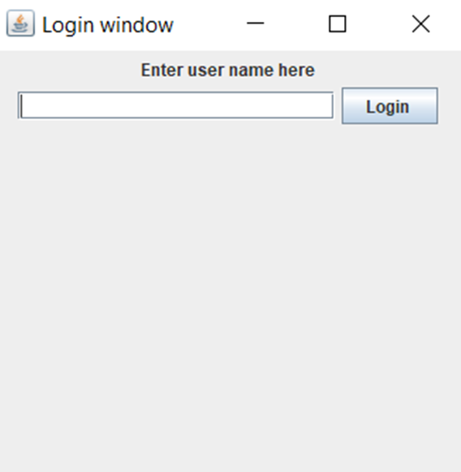
FRONT END #GUI
LOGIN WINDOW
JFRAME
JTEXTFIELD
JLABEL
JBUTTON

Slide 85
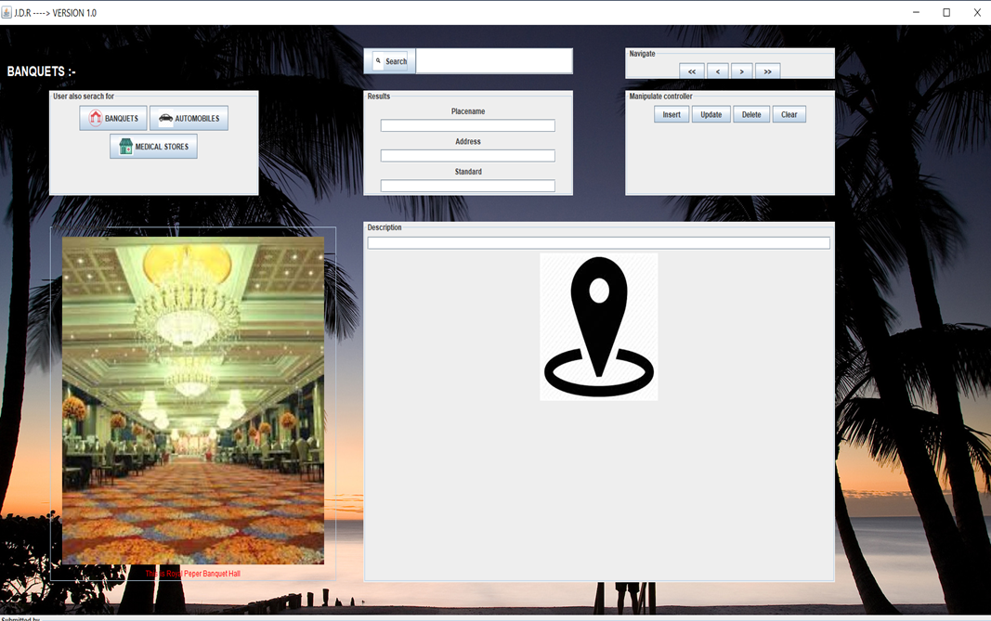
MAIN FRAMES
SWITICHING FRAMES
PANEL FOR RESULTS
C.R.U.D OPERATIONS

Slide 86
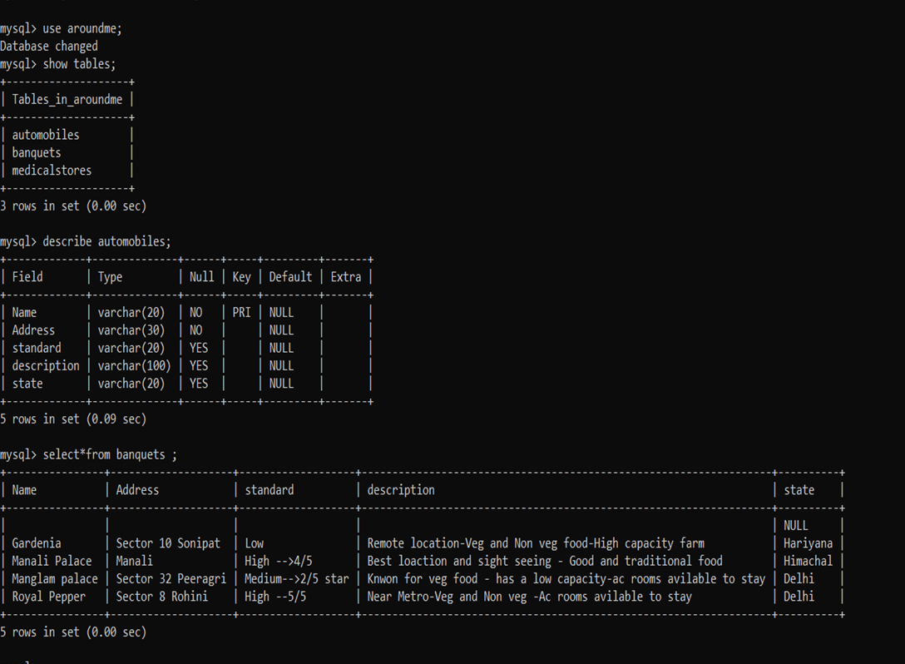
Back end #mysql

Slide 87
THANK YOU….
ANY QUERIES….?

