Slide 1
JavaEE Concepts
Avaloq Innovation Ltd
15th November 2016
Simon Nattrass
Avaloq Evolution AG | Allmendstrasse 140 | 8027 Zurich | Switzerland
T +41 58 316 10 10 | F +41 58 316 10 19 | www.avaloq.com

Slide 2
Agenda
Why?
Limitations and Expectations
What is JavaEE?
CDI
Java Persistence Architecture (JPA)
Enterprise Java Beans (EJB)
Java Message Service (JMS)
Interfaces – WebServices (JAX-WS)
Interfaces – REST (JAX-RS)

Slide 3
Why?
To work with many of our code bases a grounding in JavaEE concepts is a prerequisite.
The manner in which we use the platform is not always clear enough to be leveraged as an example.
The core concepts are relatively static, while our patterns, by comparison are in a state of flux.

Slide 4
Expectations
This is a whistle-stop introduction to JavaEE concepts, with the aim to reduce the ramp-up for becoming with familiar with Avaloq JavaEE code.
It is no way comprehensive and omits much.
Considerable personal effort will still be required, but you will have now have some idea of where to look for answers.
Familiarity with Java is a pre-requisite.
Detail of supplementary tools (Ant, Maven, IDEs, JBoss etc…) is not covered.
Details of design approaches may be mentioned in passing but are not explicitly covered.
Avaloq specific approaches are likely to be mentioned, but not specifically convered.

Slide 5

“It is no way comprehensive and omits much”

Slide 6
Huh?
What is Java Enterprise Edition (JavaEE)?

Slide 7
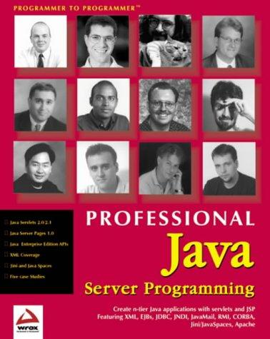
Groan

Slide 8
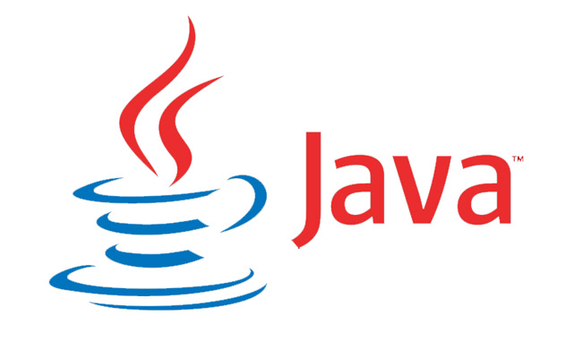
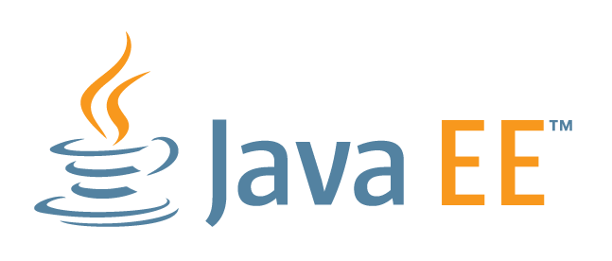
JavaSE & JavaEE

Slide 9

Don’t nod off!

Slide 10
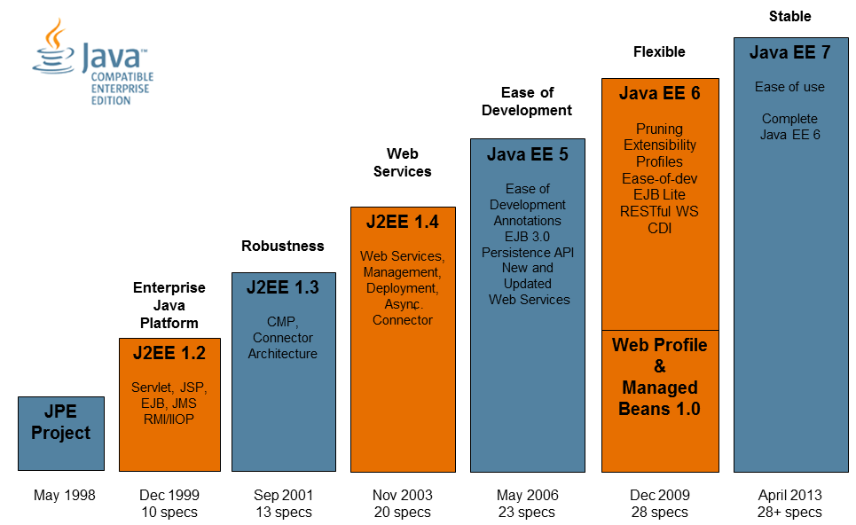
Java EE History

Slide 11
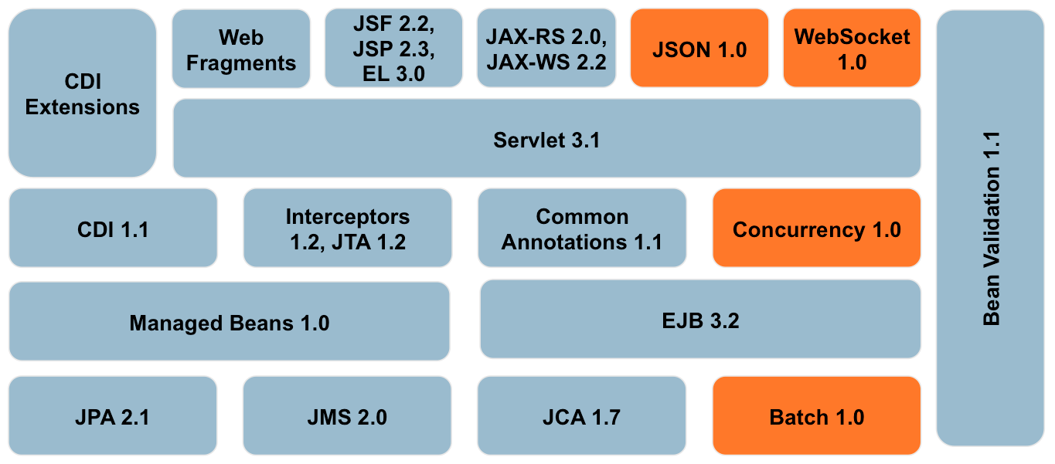
Java EE Specs

Slide 12
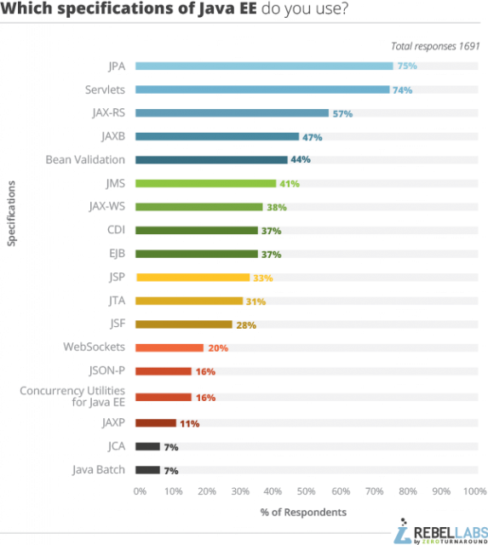
Spec Popularity

Slide 13
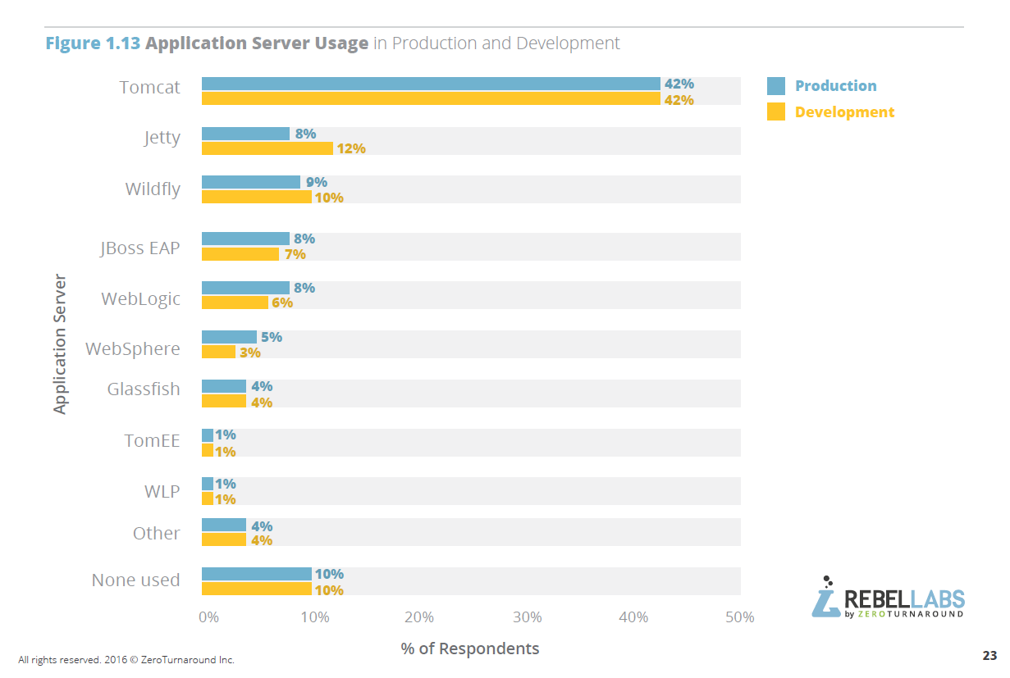
Java “Application Server” / Java EE Server / The Container

Slide 14
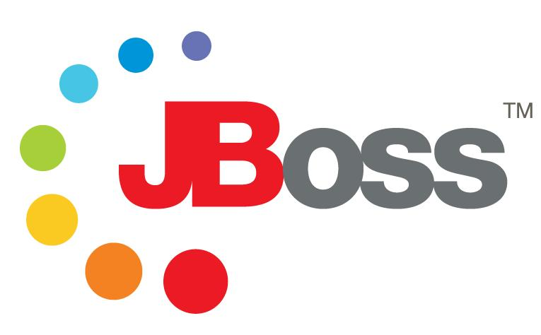
Avaloq Front Platform

Slide 15
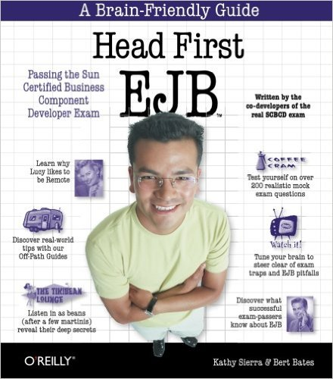
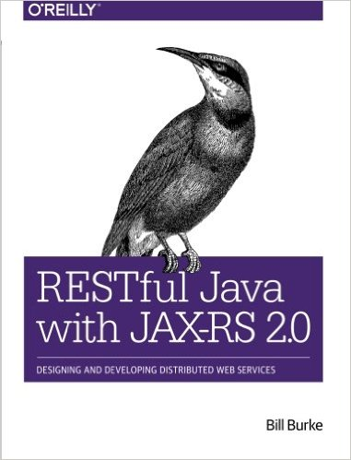
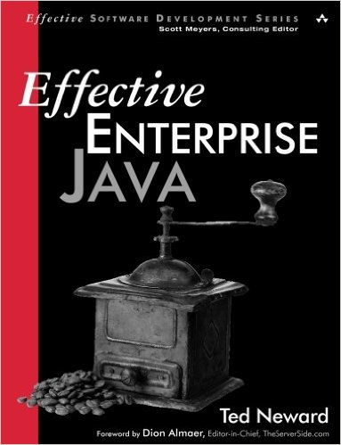
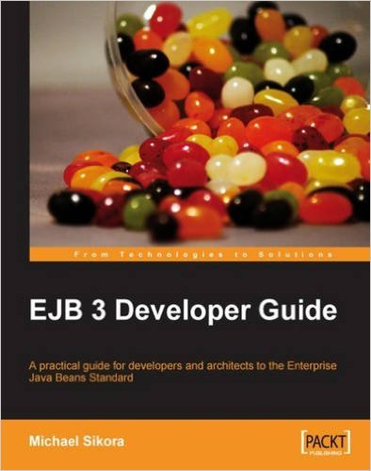
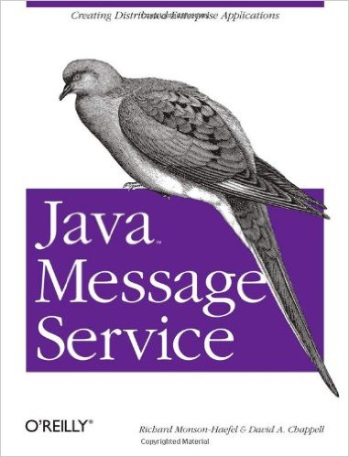

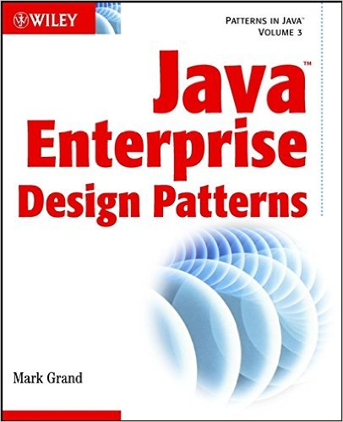
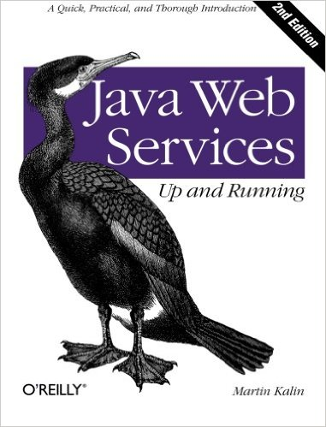
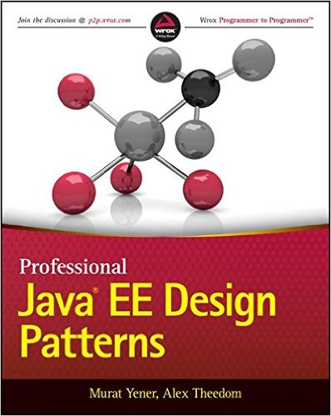
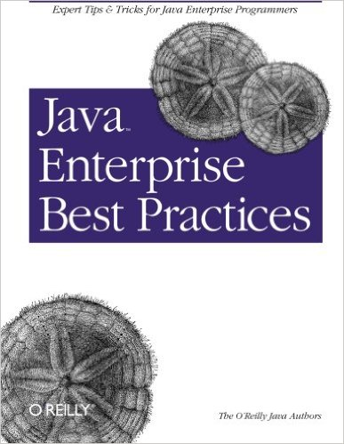
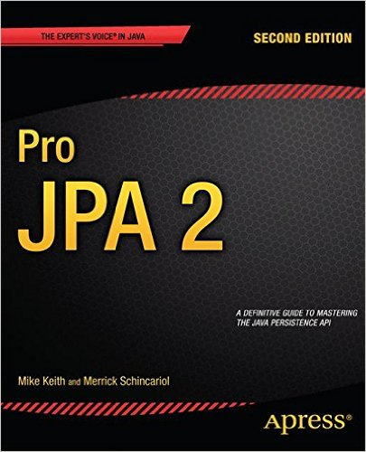
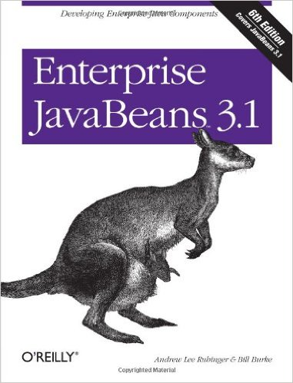
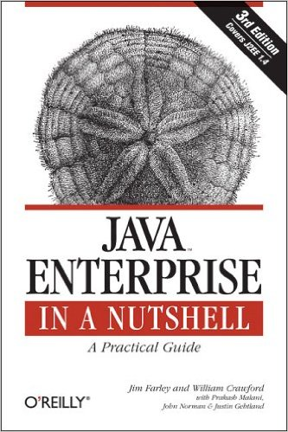
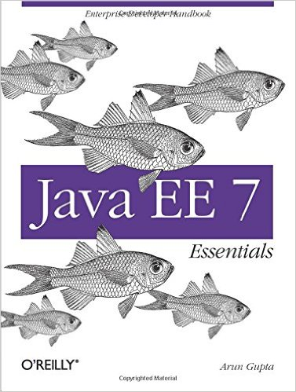
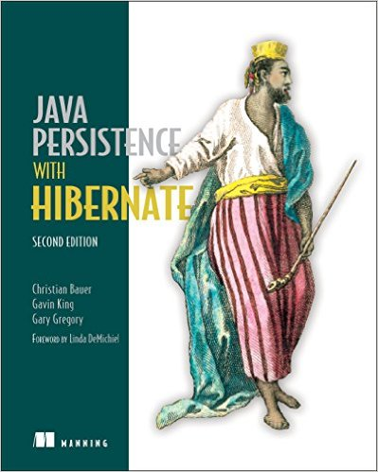
Agenda

Slide 16




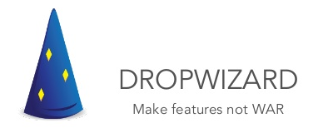
Not the only kid on the block

Slide 17
The wiring…
Context and Dependency Injection (CDI)

Slide 18
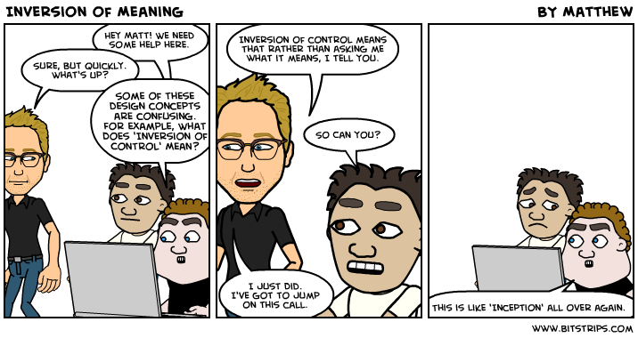
Inversion of Control

Slide 19
Context and Dependency Injection
Injection points
Interceptors
Scopes / Contexts
Lifecycle

Slide 20
Injections Points
Inversion of control, separation of concerns.
You can @Inject a bean at a field, method or constructor.
SOLID.
DI provided by the container.
public interface Greeting {
String greet(String name);
}
public class SimpleGreeting implements Greeting {
public String greet (String name) {
return "Hello " + name;
}
}

Slide 21
Manual creation
public class GreetingService {
private Greeting greeting = new SimpleGreeting();
public String greet(String name) {
return greeting.greet(name);
}
}

Slide 22
DI via @Inject
import javax.inject.Inject;
public class GreetingService {
@Inject
private Greeting greeting;
private Greeting greeting = new SimpleGreeting();
public String greet(String name) {
return greeting.greet(name);
}
}

Slide 23
Interceptors
Aspect Orientated Programming (AOP).
Useful for cross-cutting concerns.

Slide 24
BeforeAndAfterLoggingInterceptor
@AroundInvoke
public Object logBeforeAndAfter(InvocationContext context) throws Exception {
String methodName = context.getMethod().getName();
System.out.println("Before calling method " + methodName);
Object response = context.proceed();
System.out.println("After calling method " + methodName);
return response;
}

Slide 25
BeforeAndAfterLoggingInterceptor
@Inject
private Greeting greeting;
@Interceptors(BeforeAndAfterLoggingInterceptor.class)
public String greet(String name) {
return greeting.greet(name);
}

Slide 26
Scopes and Contexts
Foo

Slide 27
Scopes and Contexts
@RequestScoped
Bean is scoped to the request and is destroyed once the request is complete.
@ApplicationScoped
Bean is scoped to the application. The bean is created when the application is started, holds state throughout the application and destroyed when the application shuts down.
@Dependent
This is the default scope if none is provided. The bean takes the scope of the creating bean.
@SessionScoped
@ConversationScoped

Slide 28
Lifecycle
Life cycle intro – diagram.s

Slide 29
Lifecycle
public class LifecycleBean {
public HelloBean() { // constructor }
@PostConstruct
private void postConstruct() { // ... }
@PreDestroy
private void predestroy () { // ... }
}

Slide 30
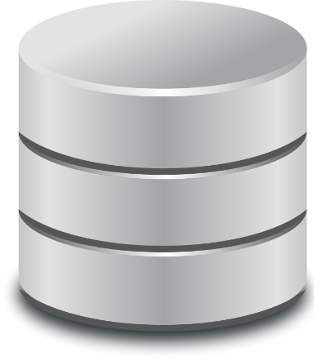
Working with the database
Java Persistence Architecture (JPA)

Slide 31

Java Persistent Architecture (JPA)
Intro
ORM
Entities
Persistence Unit, Persistence Context Entity Manager
Hibernate Session

Slide 32
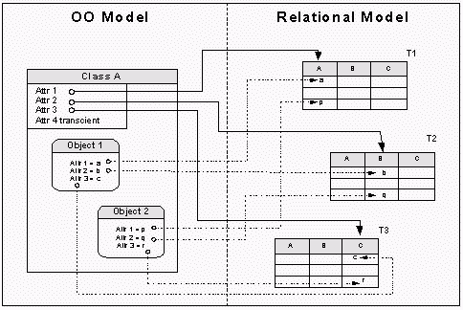
Object Relational Mapping
Used to map between RDBMs and OO.
Abstracts away from relational model.
Database independency.

Slide 33
Entities
Objects which live in memory = object.
Object which map to a relational database, live in memory and may be persisted = Entity
@Entity
public class Book {
@Id @GeneratedValue
private Long id;
private String title;
private String description;
public Book() {}
// Getters, setters
}

Slide 34
Entities and ORM
@Entity
@Table(name=“Books”)
public class Book {
@Id @GeneratedValue
private Long id;
@Column(name=“book_title”)
private String title;
private String description;
public Book() {}
// Getters, setters
}

Slide 35
ORM - Relationship Mapping
@OneToOne
@OneToMany
@ManyToOne
@ManyToMany

Slide 36
Persistence Unit, Persistence Context and Entity Manager
An entity is managed within a Persistence Context.
Within a persistent context, the instances of an entity are managed by the Entity Manager.
The Entity Manager manages the state and life cycle of the entities in addition to creating, querying, updating and deleting the entity instances.
The Entity Manager together with the configuration of the connection to the database is packages as the Persistence Unit.

Slide 37
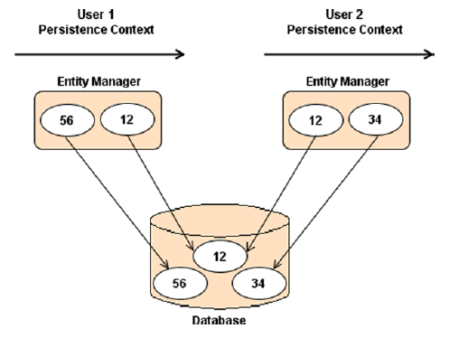
Persistence Unit, Persistence Context and Entity Manager

Slide 38
Entity Manager
Main interface for working with the database.
Used for all CRUD operations.
persist()
find()
merge()
remove()
Obtained from “the container”.
CRUD
Java Persistence Query Language (JPQL) / Hibernate Query Language (HQL)
Criteria API (OO queries)
Native SQL
Provides a first level cache

Slide 39
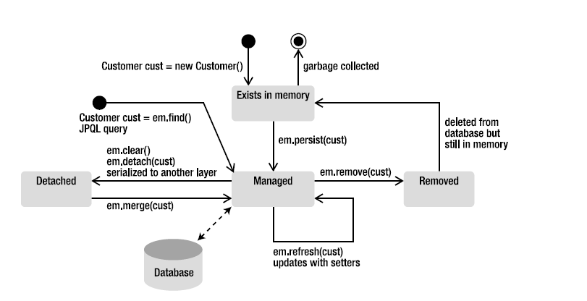
Entity Lifecycle

Slide 40
Your business logic
Enterprise Java Beans (EJB)

Slide 41

Java Beans ?
In computing based on the Java Platform, JavaBeans are classes that encapsulate many objects into a single object (the bean). They are serializable, have a zero-argument constructor, and allow access to properties using getter and setter methods.
JavaBeans - Wikipedia
https://en.wikipedia.org/wiki/JavaBeans

Slide 42

Java Bean == Component
Building block.
Easy defined and standarised interface.
Easy to work with. Nothing too tricky…

Slide 43

Enterprise Java Beans ?
EJBs are server-side components which encapsulate business logic.
EJB == Component++
A bean with all the trimmings expected in an “enterprise”.
Transactions
Concurrency
DI
State Management
Pooling
Lifecycle
Remote connectinos
Messaging
Security
AOP
JNDI

Slide 44
EJB Types
@Stateless
So can be used by anyone.
@Stateful
Holds conversational state.
@Singleton
One per application instance.
@MessageDrivenBean
Used to implement Messaging (more later).

Slide 45

EJB Services
DI
Lifecycle
Remote Communication
Pooling
AOP (Interceptors)
Concurrency
Tx
Security
Messaging
Registered with JNDI
Some overlap with CDI.

Slide 46
EJB Views
Remote (@Remote)
Local (@Local)
No-Interface

Slide 47
Concurrency
foobar

Slide 48

Java Naming and Directory Interface (JNDI)
JNDI is a Java API for a directory service that allows Java software clients to discover and look up data and objects via a name.
Beans are registered with JNDI.
JNDI is the old fashion way of “wiring” beans together via explicit lookup.
Looser coupling but not quite IoC.
Still useful for remote access.
RMI across JVMs
JMS binding.

Slide 49
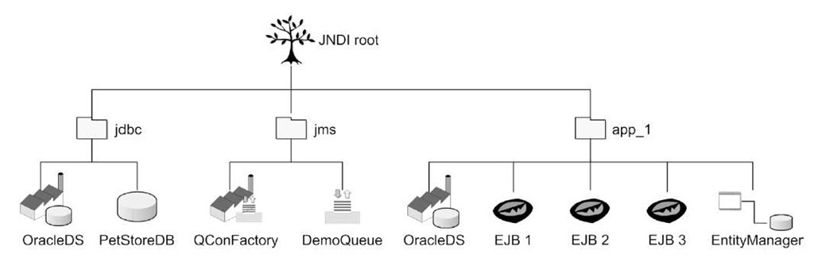
Java Naming and Directory Interface (JNDI)
JNDI is a component registry.

Slide 50
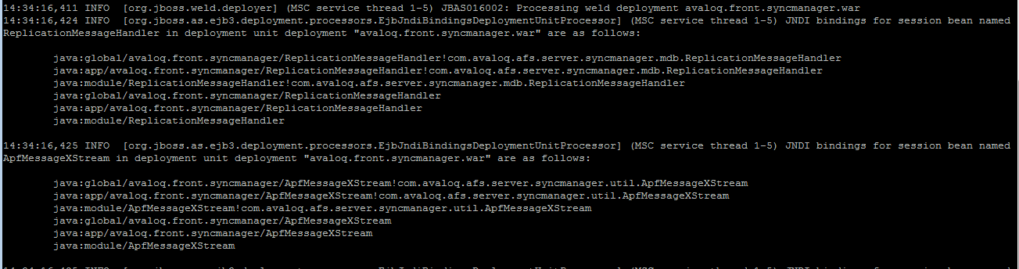
JNDI Naming
foo

Slide 51
Reliable messaging
Java Messaging Service (JMS)

Slide 52
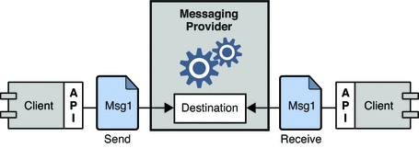
Messaging
Message Oriented Middleware (MOM) is an infrastructure component supporting communication between distributes systems via the sending and receiving of messages.
MOM creates a distributed communications layer that insulates the application developer from the details of the various operating systems and network interfaces.
Provides loose coupling.

Slide 53
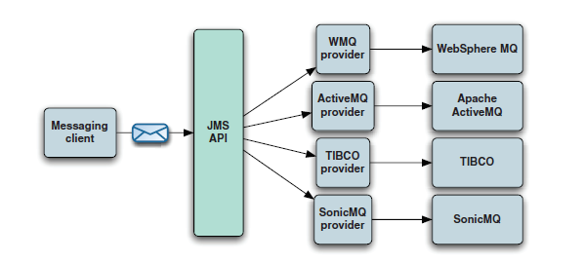
Java Messaging Service (JMS)
JMS is a Java API that allows applications to create, send, receive, and read messages.
AFP reference implementation = Apache ActiveMQ.

Slide 54
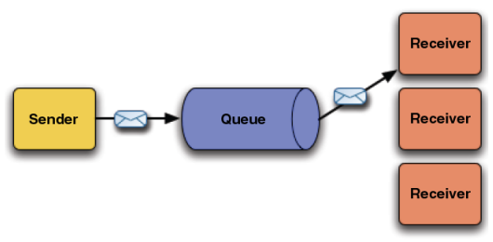
JMS Destinations – Queues and Topics
Queues - for point to point messaging.
Messages are consumed by a single receiver.

Slide 55
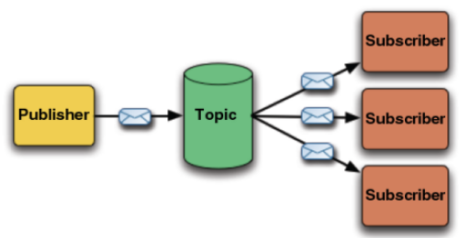
JMS Destinations – Queues and Topics
Topics - for publish/subscribe messaging.
Messages are may be consumed by a multiple receivers.

Slide 56
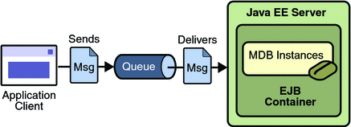
Message Driven Beans (MDB)
A Message Driven Bean is a stateless, server-side, transaction-aware component that is driven by a Java message ( javax.jms.message ).
It is invoked by the EJB Container when a message is received from a JMS Queue or Topic. It acts as a simple message listener.
MDB are EJB.

Slide 57
MDB
@MessageDriven(
activationConfig = {
@ActivationConfigProperty(
propertyName = "destination",
propertyValue = "java:/jms/queue/SomeQueue")
})
public class SomeMDB implements MessageListener {
public void onMessage(Message message) {
try {
System.out.println("Received message" + message);
} catch (JMSException e) {
//...
}
}
}

Slide 58
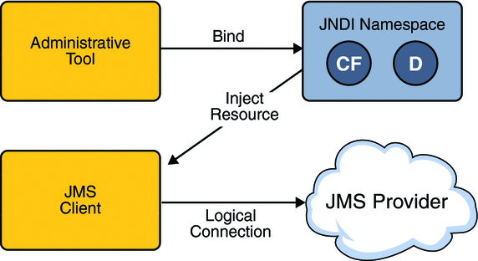
Administered Objects
In addition to server and client code, the container needs to be aware of Administered Objects - objects containing configuration information that are created by an administrator and later used by JMS clients.
Typically configured objects in a JNDI namespace, clients then access via Resource Injection.

Slide 59
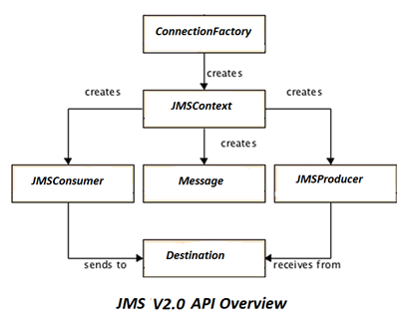
Administered Objects
Foobars

Slide 60
JMS Client
// Lookup the admin objects from JNDI space
ConnectionFactory connectionFactory = (ConnectionFactory) jndiContext.lookup("jms/RemoteConnectionFactory");
Destination queue = (Destination) jndiContext.lookup("jms/javaee-concepts/queue/BookOrderQueue");
// create the JMS Context
try (JMSContext context = connectionFactory.createContext("user", “password")) {
// send an object message to the queue
JMSProducer producer = context.createProducer();
producer.send(queue, msgBody);
}

Slide 61
Interfacing
Web Services - SOAP

Slide 62
Web Services
A standardized way of integrating Web-based applications using the XML, SOAP, and WSDL over an Internet protocol backbone.
XML is the data format used to contain the data and provide metadata around it.
SOAP is used to transfer the data.
WSDL is used for describing the services.

Slide 63
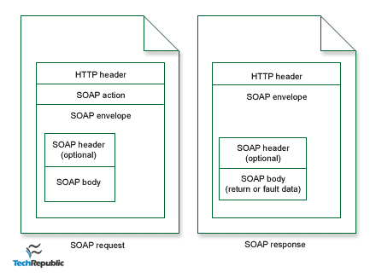
Simple Object Access Protocol - SOAP
A messaging protocol that allows programs that run on disparate operating systems (such as Windows and Linux) to communicate using Hypertext Transfer Protocol (HTTP) and its Extensible Markup Language (XML).

Slide 64
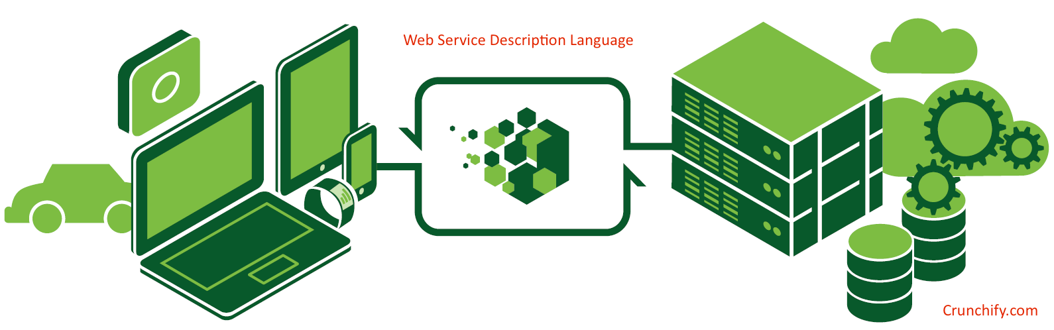
Web Service Definition Language – WSDL
An XML format for describing network services as a set of endpoints operating on messages containing either document-oriented or procedure-oriented information.
Forms a contract between the consumer and the service.

Slide 65
Web Service Definition Language – WSDL
Top down / contract first.
Start with the WSDL and generate the code for the service and consumer from that.
Bottom up
Start with the service implementation, generate the WSDL from this.

Slide 66
JAX-WS and Creating a Web Service
The Java API for XML Web Services (JAX-WS) is the component of JavaEE for creating SOAP Web Services.
JAX-WS supports the bottom-up approach, annotating the service implementation to identify it to be exposed as a Web Service.
@WebService
public class CardValidator {
@WebMethod
public boolean validate(CreditCard creditCard) {
return isEven(creditCard.getLastNumber());
}
}

Slide 67

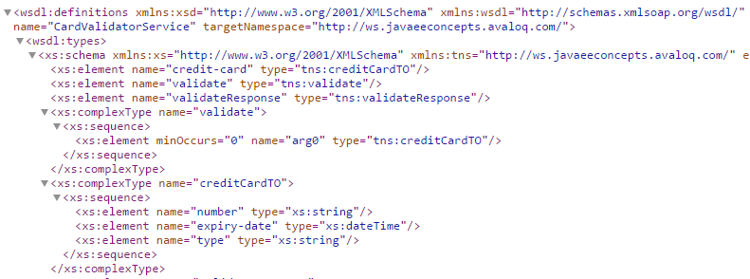
JBoss and Apache CXF
JBoss used Apache CXF for it’s WebService implementation.
http://localhost:8080/ws/CardValidator?wsdl

Slide 68
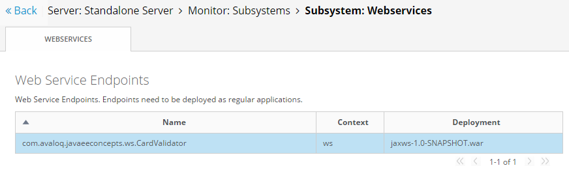
JBoss and Apache CXF
JBoss used Apache CXF for it’s WebService implementation.
http://localhost:8080/ws/CardValidator?wsdl

Slide 69
Top Down (WSDL to Client Implementation)
The wsimport tool is used to parse an existing Web Services Description Language (WSDL) file and generate required files (JAX-WS portable artifacts) for web service client to access the published web services
WSDL -> Java skeleton code for client.

Slide 70
Interfacing
REST

Slide 71
Representational State Transfer - REST
REST stands for Representational State Transfer. (It is sometimes spelled "ReST".) It relies on a stateless, client-server, cacheable communications protocol -- and in virtually all cases, the HTTP protocol is used.
An architecture style.
JAX-RS

Slide 72
JAX-WS and Creating a Web Service
Foo

Slide 73
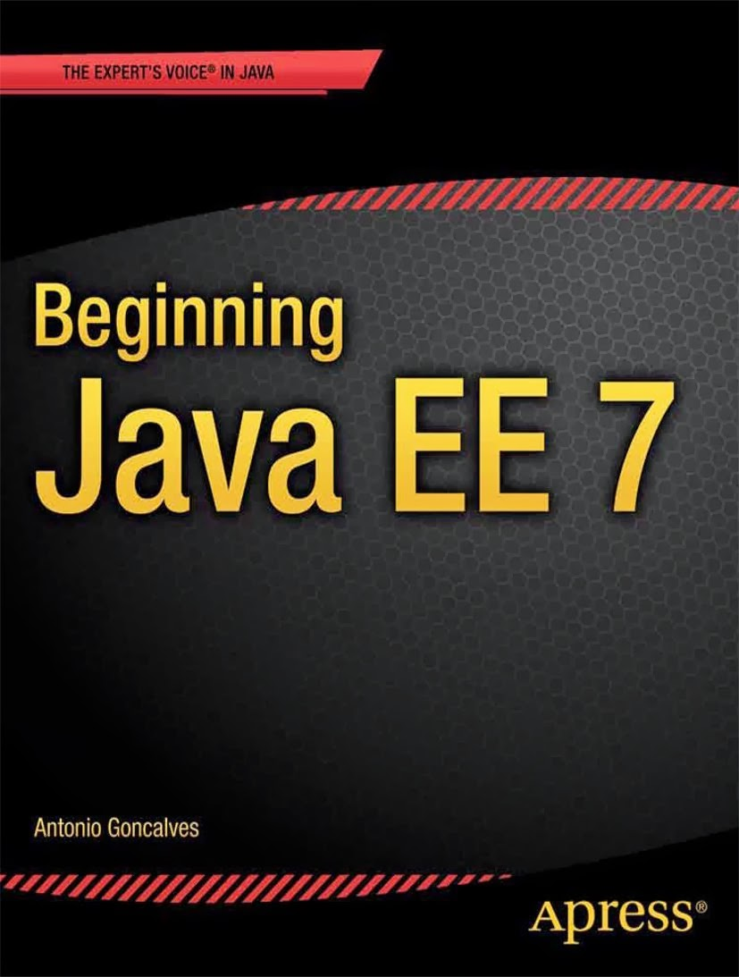
Your journey has just begun…
Find it in the your nearest library

Slide 74
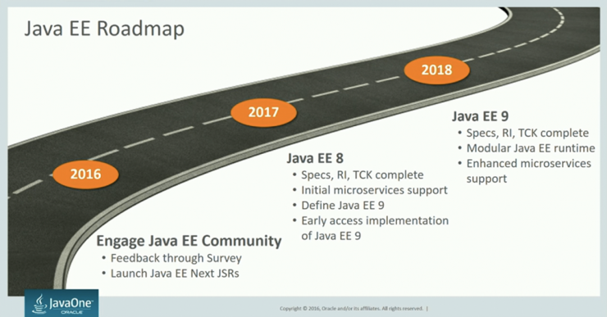
The Future ?

Slide 75
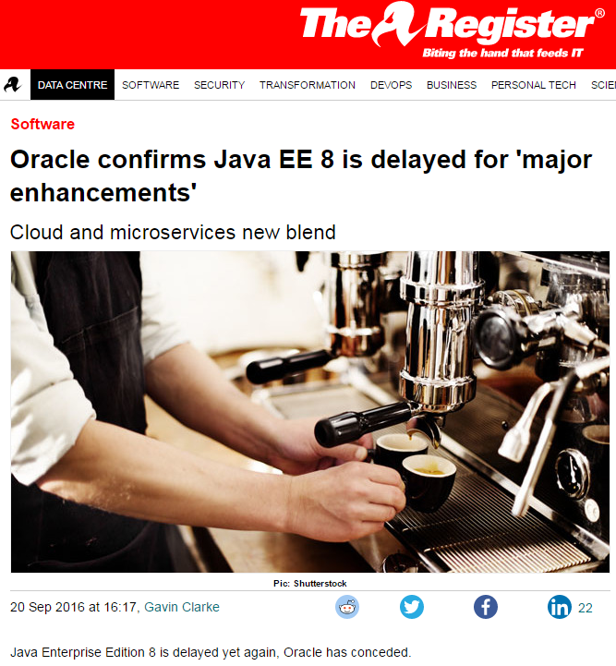
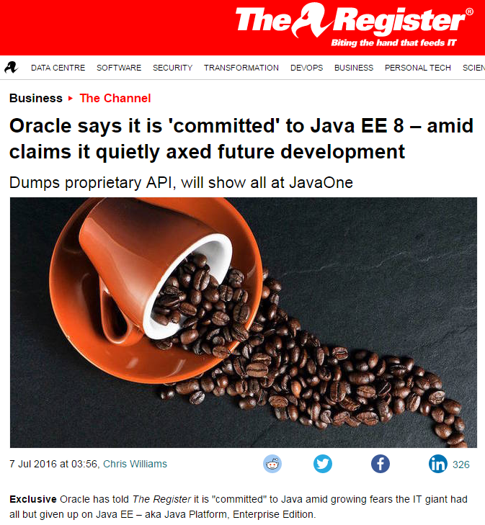
But…

Slide 76
Thank you for your attention.
Simon Nattrass
Simon.Nattrass@avaloq.com

