Slide 1
AZURE STORAGE DEEP DIVE
The Azure Foundation

Slide 2



Sergio Navarro Pino @snavarropino
Sergio León González @panicoenlaxbox
We work as Software Development Engineers at AnalyticAlways
We also have blogs:
http://panicoenlaxbox.blogspot.com.es/
http://www.serginet.com

Slide 3


Slide 4
What is Azure Storage?
An storage Microsoft managed service that is highly available, secure, durable, scalable, and redundant.
Services:
Disk: Storage for your VM’s
Files: Simple, distributed, cross-platform file system
Blob: Massively-scalable object storage for unstructured data
Queue: Durable queues for large-volume cloud services
Table? Flexible Key-Value NoSQL database
Notes:
Navarro

Slide 5
Azure Storage Highlights
Security:
The storage account can be secured using Role-Based Access Control and Azure Active Directory.
Transport level encryption (HTTPS) may be forced
Client side encyption: https://blogs.msdn.microsoft.com/windowsazurestorage/2015/04/28/client-side-encryption-for-microsoft-azure-storage-preview/
Delegated access to the data objects in Azure Storage can be granted using Shared Access Signatures.
The authentication method used by someone when they access storage can be tracked using Storage analytics
Files and disk can be encrypted, in a transparent way
Durability: will not degrade over the time
Notes:
5 m

Slide 6
Azure Storage Highlights
Availability: data always available with a minimum SLA of 99.9%
99.9% means that storage won’t be available 1 minute per week
https://azure.microsoft.com/en-us/support/legal/sla/storage/v1_0/
Scalability: the service automatically scale up
When your application reaches the upper limits, Azure Storage begins to return error code 503 (Server Busy) or error code 500 (Operation Timeout) responses. If these errors are occurring, then your application should use an exponential backoff policy for retries that may allow the load to decrease.
If the needs of your application exceed the scalability targets of a single storage account, you can build your application to use multiple storage accounts.
Notes:
5 m

Slide 7
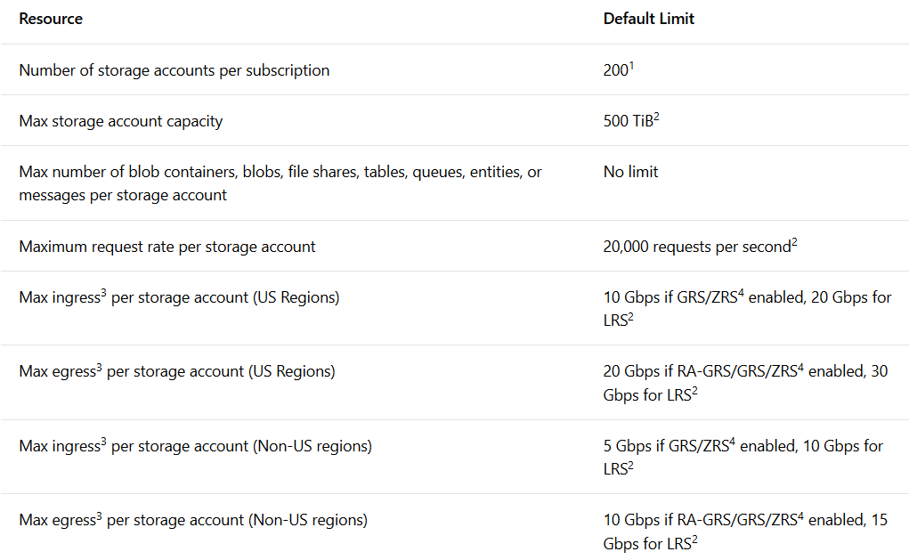
Azure Storage limits
https://docs.microsoft.com/en-us/azure/storage/common/storage-scalability-targets
Notes:
5 m

Slide 8
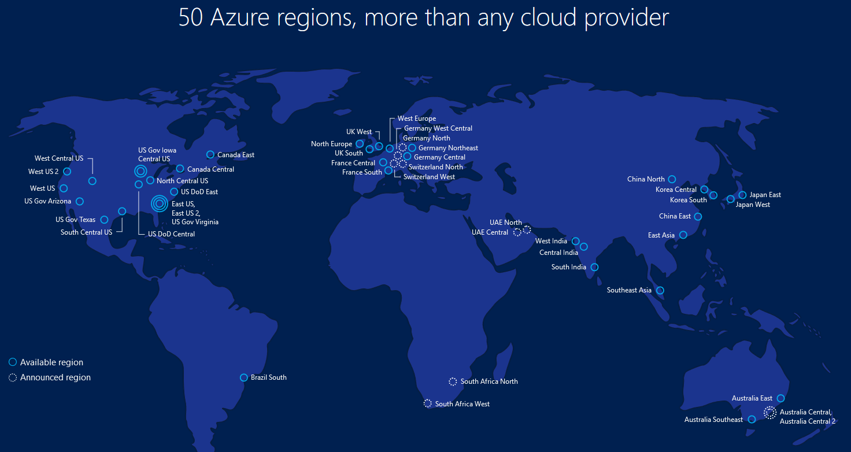
Geographies & Regions
Azure regions are organized into geographies.
An Azure geography ensures that data residency, sovereignty, compliance, and resiliency requirements are honored within geographical boundaries.
Notes:
Leon
Una geografía de Azure asegura que los requisitos de residencia, soberanía, cumplimiento y resistencia de datos se respeten dentro de los límites geográficos.

Slide 9
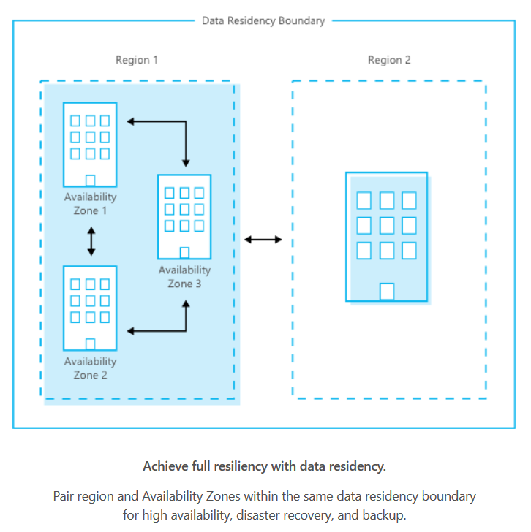
Regions & Availability zones
A region is a set of datacenters deployed within a latency-defined perimeter and connected through a dedicated regional low-latency network.
Availability Zones are physically separate locations within an Azure region. Each Availability Zone is made up of one or more datacenters equipped with independent power, cooling, and networking.
Availability Zones allow customers to run mission-critical applications with high availability and low-latency replication.
Notes:
Availability Zone = Alta disponibilidad en VMs
Al menos 3 en cada región
FD - Fault Domain, protegerse contra el fallo de hardware/rack
UD - Update Domain, no actualizar todo a la vez, si no por grupos
No en todas las regiones, en Europa, West Europe sólo
No todos los servicios, los más relevantes VMs (Managed disks), SQL Azure

Slide 10
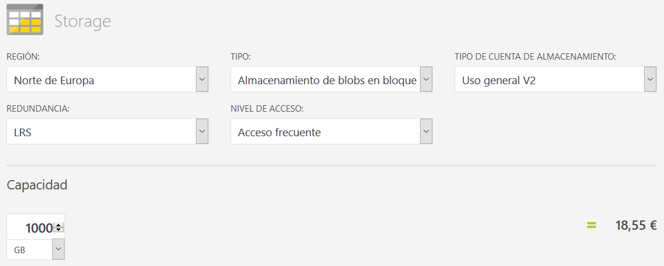
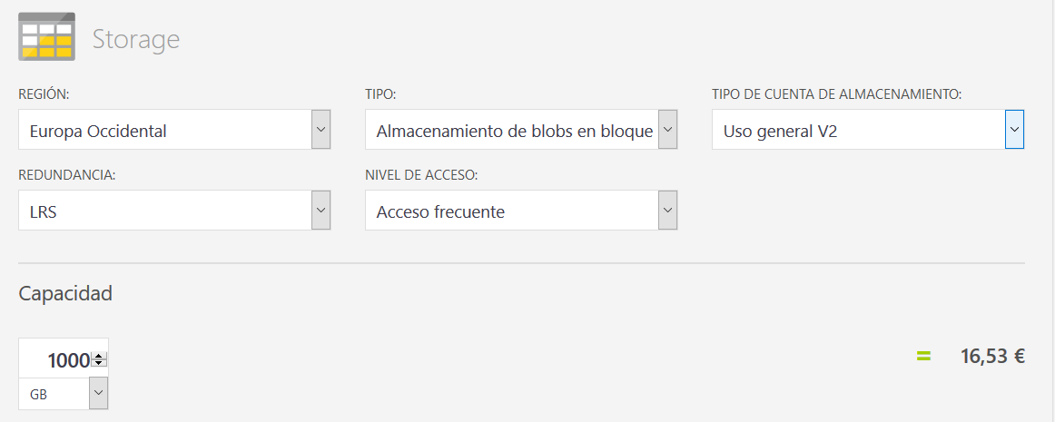
Tips for choosing a regions
Take in account following points:
Latency to the region:
http://www.azurespeed.com/
Services you do wish to consume: https://azure.microsoft.com/en-gb/global-infrastructure/services/
Price:
https://azure.microsoft.com/es-es/pricing/calculator
Data Sovereignty issues.

Slide 11
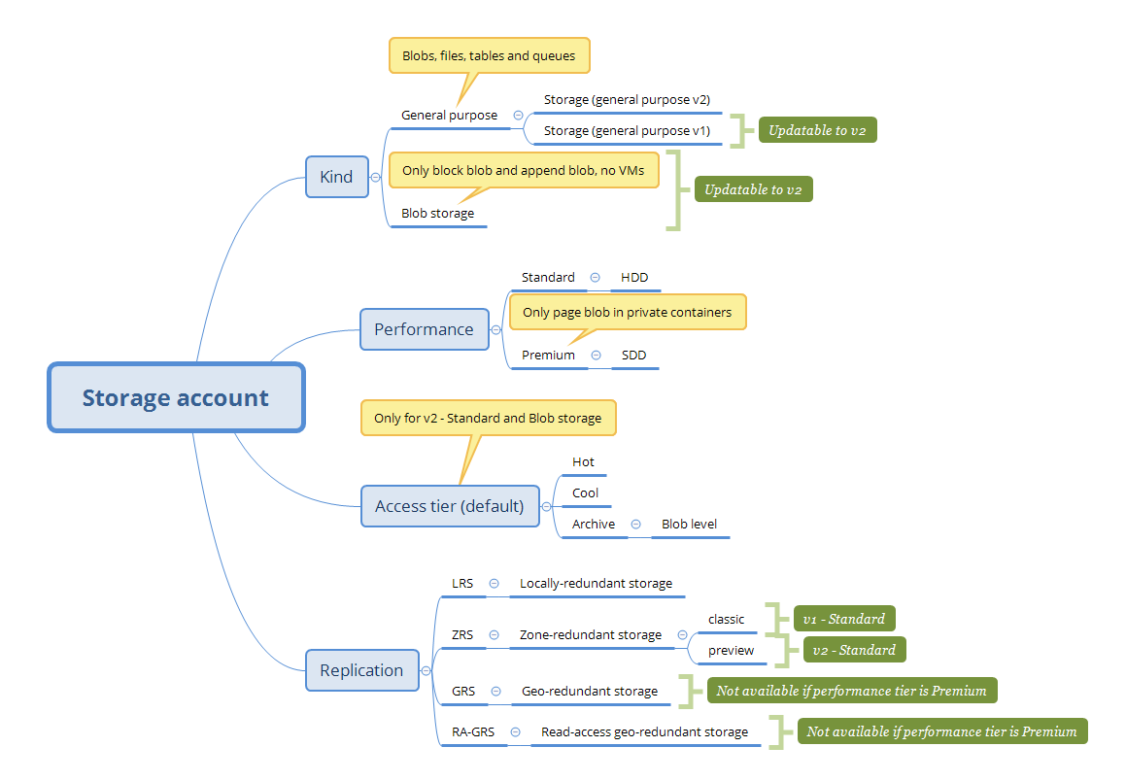
Sorts of storage accounts 5 m
Recommendation:
v2
Standard
Hot
LRS
Notes:
Use “General purpose v2” but taking in account that there are pricing differences: v2 has lower storage prices but higher transaction prices

Slide 12
Access tiers: hot/cold/archive (blobs)
Hot / cold must be set on account creation, in order to set default blob tier
In any case we can set the desired tier for each blob
Archive (the coolest one) can only be set at blob level.
Expensive storage
Cheap transactions
Account type | Performance | Tier can be set?
General purpose | Standard | No
General purpose | Premium | No
Blob storage | Only standard is allowed | Yes
General purpose v2 | Standard | Yes
General purpose v2 | Premium | No (WTF!)
Cheap storage
Expensive transactions
cooler
Notes:
5m León

Slide 13
Access tiers: hot/cold/archive (blobs)
All operations among hot and cools are 100% consistent
However in order to read or modify the blob must be rehydrated (ask for a change to tier hot or cold)
Long-term data retention
Up to 15 hours to rehydrate an archived blob
Reference: https://docs.microsoft.com/en-us/azure/storage/blobs/storage-blob-storage-tiers

Slide 14
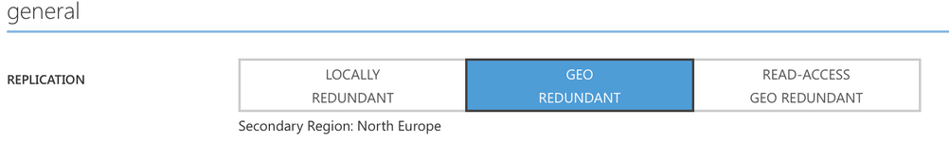
Azure Storage Replication
The data in your Microsoft Azure storage account is always replicated to ensure durability and high availability. Replication copies your data so that it is protected from transient hardware failures, preserving your application up-time.
Replication is not a backup system!
If you want a backup system use third party tools (Cerebrata for example) or tools like azcopy
Locally redundant storage (LRS)
Zone-redundant storage (ZRS *)
Geo-redundant storage (GRS)
Read-access geo-redundant storage (RA-GRS)
Notes:
10 m NAVARRO

Slide 15
Azure Storage Replication
Locally redundant storage (LRS):
3 replicas in same datacenter.
Lowest price, highest performance
Offers least durability compared to other options.
Synchronous write
Zone-redundant storage (ZRS *):
3 replicas in 2 or 3 facilities, usually across 2 regions
Designed to simplify the development of highly available applications
Inserts and updates to data are made synchronously and are strongly consistent
Classic ZRS only supports Block blobs
New version currently in preview in some regions
Geo-redundant storage (GRS)
3 additional replicas in a secondary datacenter (pairs are already defined)
Asynchronous write on secondary datacenter
A failover process is required in order to allow data to be accessed in secondary datacenter
Read-access geo-redundant storage (RA-GRS)
Secondary read-only endpoint
A failover process is required in order to allow data to be written in the secondary datacenter
Notes:
10 m

Slide 16
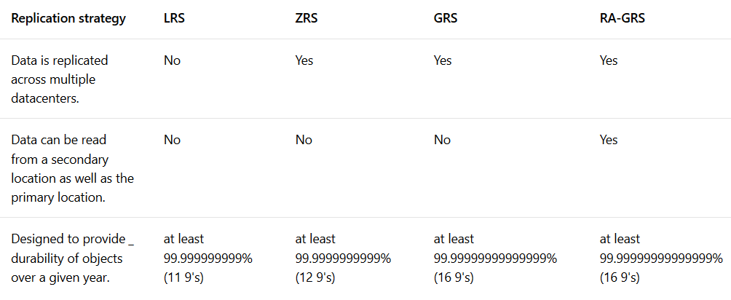
Azure Storage Replication

Slide 17
Pricing
It depends on several factors:
Region
Amount of stored data (Gb’s)
Acces tier in caso of blob (hot/cold/archive)
Performance tier (standard/premium) in case of page blobs
Replication option
Transactions (operations)
Data transfer
https://azure.microsoft.com/en-us/pricing/details/storage/
https://azureprice.net/

Slide 18

Demo, crear cuenta geo-replication

Slide 19
Tooling
PowerShell
CLI
https://azure.microsoft.com/es-es/downloads/
Storage Explorer
https://azure.microsoft.com/en-us/features/storage-explorer/
Storage Emulator
https://go.microsoft.com/fwlink/?linkid=717179&clcid=0x409
Storage Tools
https://docs.microsoft.com/en-us/azure/storage/common/storage-use-azcopy
REST API
https://docs.microsoft.com/en-us/rest/api/
Visual Studio
Cloud Explorer
Server Explorer
Templates
Notes:
10 minutes

Slide 20
PowerShell
Get-Module PowerShellGet -ListAvailable
Install-Module -Name AzureRM -AllowClobber
Get-Command -Module AzureRM.*
Notes:
10 minutes

Slide 21
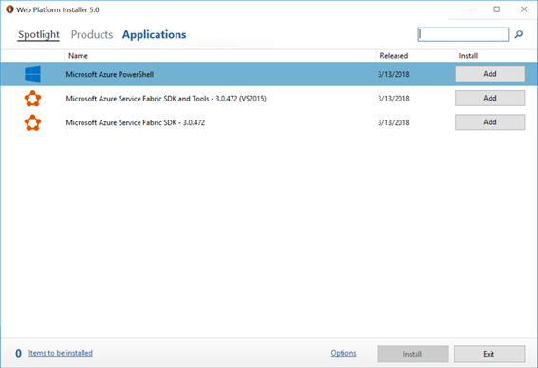
PowerShell
https://www.microsoft.com/web/downloads/platform.aspx
Notes:
10 minutes

Slide 22
PowerShell
Login-AzureRmAccount
New-AzureRmResourceGroup -Location "West Europe" -Name <resource_group_name>
New-AzureRmStorageAccount -Location "West Europe" -Name <storage_account_name> -ResourceGroupName <resource_group_name> -SkuName Standard_RAGRS -Kind Storage
Get-AzureRMStorageAccount
Remove-AzureRmResourceGroup -Name <storage_account_name> -Force
Remove-AzureRmAccount
Notes:
10 minutes

Slide 23
PowerShell non-interactive login
Login-AzureRmAccount
$password = ConvertTo-SecureString "foo" -AsPlainText -Force
$app = New-AzureRmADApplication –DisplayName "foo" –IdentifierUris "http://foo.bar" –Password $password
New-AzureRmADServicePrincipal -ApplicationId $app.ApplicationId
New-AzureRmRoleAssignment –RoleDefinitionName Contributor –ServicePrincipalName $app.ApplicationId
# en otra ventana
$password = ConvertTo-SecureString "foo" -AsPlainText -Force
# 98486e3b-1508-4f20-b0ef-34382c4c32b0@sergioleonanalyticalways.onmicrosoft.com
# ApplicationId@<your_tenant_name>
$credential = New-Object -TypeName System.Management.Automation.PSCredential –ArgumentList "83483cd8-ecf5-4fd1-91d7-d52636885357@sergioleonanalyticalways.onmicrosoft.com", $password
Login-AzureRmAccount -Credential $credential -ServicePrincipal –TenantId d1ae8242-a985-4d12-ad41-afd92012af18
Get-AzureRMStorageAccount
Remove-AzureRmAccount
Notes:
10 minutes

Slide 24
CLI
1.0 | 2.0
Also know as X-Plat CLI
ASM | ARM
Node.js | Python
npm i -g azure-cli | Installer
azure | az
Notes:
10 minutes

Slide 25
CLI - Docker
https://docs.microsoft.com/en-us/cli/azure/run-azure-cli-docker?view=azure-cli-latest
docker run -it microsoft/azure-cli
az
az login
Notes:
10 minutes

Slide 26
CLI non-interactive login
az login -u <usuario_azure_active_directory> -p <password>
az login --service-principal -u 83483cd8-ecf5-4fd1-91d7-d52636885357@sergioleonanalyticalways.onmicrosoft.com -p foo --tenant d1ae8242-a985-4d12-ad41-afd92012af18
Notes:
10 minutes

Slide 27
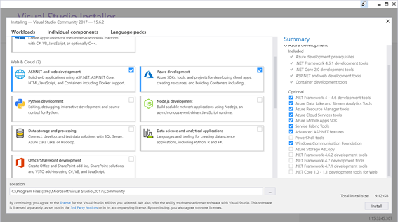
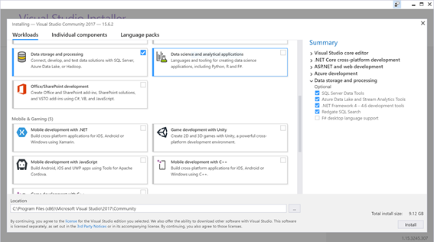
Visual Studio
Notes:
10 minutes

Slide 28
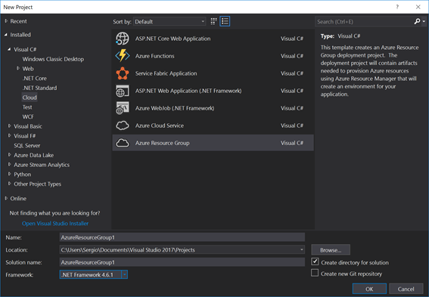
Visual Studio
Notes:
10 minutes

Slide 29
Files
Azure Files offers fully managed file shares in the cloud that are accessible via the industry standard SMB 3: we can mount the file share and see it as an standard disk
Benefits:
Shared access (mont same share in several places)
Fully managed
Resilient
Scriptable (powershell & Azure CLI)
Cache in Win Server with Azure File Sync (preview)
Familiar programmability:
System.IO API's (SMB)
Azure Storage REST API.
Azure Storage Client Libraries (several languages)
We can manage them from web apps or other PaaS and serverless technologies !
Usage:
Replace or supplement on-premises file servers
"Lift and shift" applications
Support and simplify cloud development
http(s)://<storage account>.file.core.windows.net/share
Notes:
10 minutes

Slide 30
Create a file share
Azure portal
Or
CLI for example:
current_env_conn_string = $(az storage account show-connection-string -n <storage-account> -g <resource-group> --query 'connectionString' -o tsv)
az storage share create --name files --quota 2048 --connection-string $current_env_conn_string 1 > /dev/null
Quota: from o to 5TB (5120)
Notes:
10 minutes

Slide 31
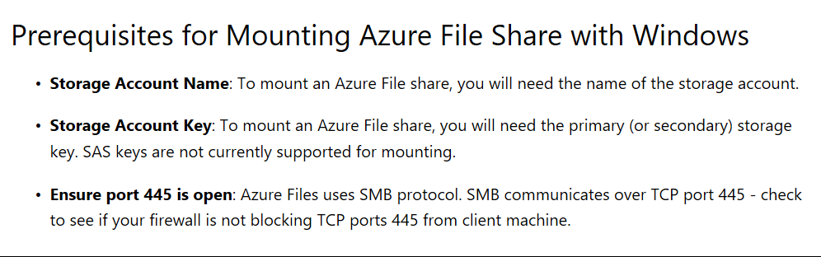
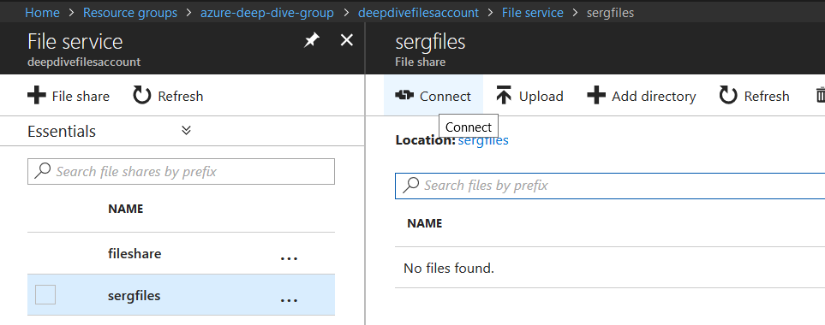
Mount a file share
\\<storage account>.file.core.windows.net\share
Or
Navigate to share in azure portal, click on connect and follow instructions
Notes:
10 minutes se puede montar con sas

Slide 32
Some disadvantages
There is no support in Azure Storage emulator
Read-access geo-redundant replication is not available
Premium tier (SSD) is not yet supported
Access tiers other than hot are not yet supported
More info in Azure Files faqs:
https://docs.microsoft.com/en-us/azure/storage/files/storage-files-faq
Notes:
10 minutes

Slide 33
Create a share, mount on windows and finally manage via REST

Slide 34
Blobs
BLOB – Binary Large OBject
Three types of blobs, block blobs, append blobs, and page blobs.
You specify the blob type when you create the blob.
https://myaccount.blob.core.windows.net
https://myaccount.blob.core.windows.net/mycontainer
https://myaccount.blob.core.windows.net/mycontainer/myblob
https://myaccount.blob.core.windows.net/myblob
https://myaccount.blob.core.windows.net/$root/myblob
Container ACL
Private (no anonymous access)
You can only access the blobs and containers if you have the storage account name and key, or you use a shared access signature.
Blob (anonymous read access for blobs only)
If you set the permission to Blob, anybody with the URL to a blob in the container can read the blob and the blob properties and metadata.
Container (anonymous read access for containers and blobs)
If you set the permission to Container, the container and blobs are publicly readable.

Slide 35
Blobs
Any blob can be duplicated in a snapshot (checkpoint, backup).
Readonly (although it can be deleted, moved or copied).
It can be promoted to origin blob or another blob.
https://myaccount.blob.core.windows.net/mycontainer/myblob?snapshot=<DateTime>
Any blob can be leased for exclusive write access (concurrency)
LeaseDuration – Fixed, Infinite, Unspecified.
LeaseState – Available, Breaking, Broken, Expired, Leased, Unspecified.
LeaseStatus – Locked, Unlocked, Unspecified.
Acquire, to request a new lease.
Renew, to renew an existing lease.
Change, to change the ID of an existing lease.
Release, to free the lease if it is no longer needed so that another client may immediately acquire a lease against the blob.
Break, to end the lease but ensure that another client cannot acquire a new lease until the current lease period has expired.

Slide 36
Blobs
Metadata for a container or blob resource is stored as name-value pairs associated with the resource.
Other
CacheControl
ContentDisposition
ContentEncoding
ContentLanguage
ContentMD5
ContentType

Slide 37
Blobs
Shared access signature
URI
Time expiration
Allowed operations
An optional shared access policy
Types
Service-level
The service SAS delegates access to a resource in just one of the storage services: Blob, Queue, Table, or File service.
Account-level
The account SAS delegates access to resources in one or more of the storage services.
Shared access policies, by container.
Resource types.
Services.
Access to service-level APIs.
Get/Set Service Properties, Get Service Stats.
Container.
Access to container-level APIs
Create/Delete Container.
Object.
Access to object-level APIs for blobs.
e.g. Put Blob

Slide 38
Blobs
CORS
Custom domain
CDN
Azure Search
etc.

Slide 39
Demo SAS y CDN

Slide 40
Queues
Azure Queue storage is a service for storing large numbers of messages that can be accessed from anywhere in the world via authenticated calls using HTTP or HTTPS.
http(s)://<storage account>.queue.core.windows.net/<queue>
Myth buster
Queue = FIFO? Nope
At least one? Yes
At most one? Nope
Common uses:
Process jobs asynchronously
Passing messages between components (microservices?) in an asynchronous manner
Notes:
15 mins… incluida DEMO

Slide 41
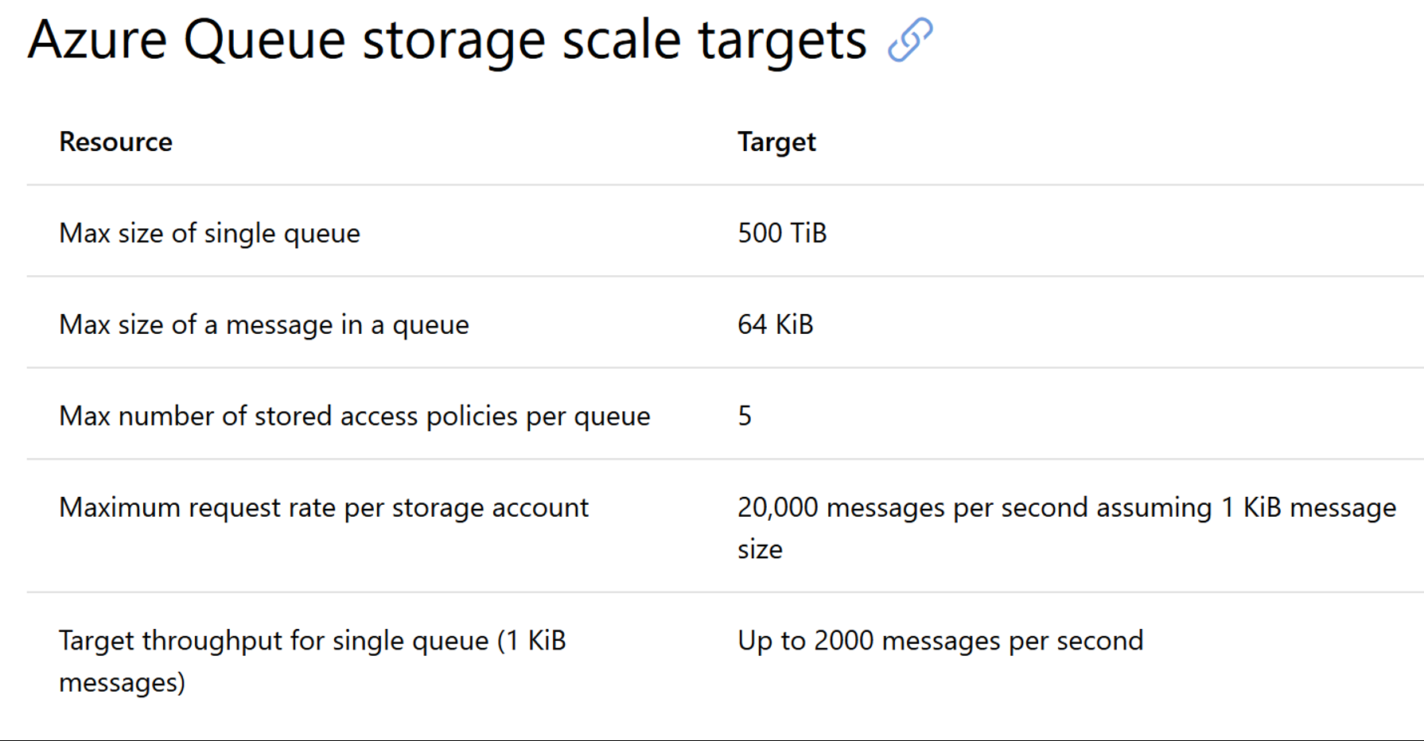
Queue limits and supported operation
Over the queue
Create
Delete
Count messages (Aprox)
Over the messages
Queue
Get
Delete
Peek
Update
* Read operations are non-blocking

Slide 42
vs Azure Service Bus
Service Bus queues are part of a broader Azure messaging infrastructure that supports queuing as well as publish/subscribe, and more advanced integration patterns
Services bus queues advantages:
first-in-first-out (FIFO) ordered deliver
Your solution must be able to support automatic duplicate detection.
Dead letter queue
The time-to-live (TTL) characteristic of the application-specific workload can exceed the 7-day period.
You want to use the AMQP 1.0 standards-based messaging protocol.
Your messaging solution must be able to support the "At-Most-Once" delivery guarantee without the need for you to build the additional infrastructure components
You require a programming model that support blocking operations and callbacks
And much more ...

Slide 43
So... why choose storage queues?
Storage queues are cheap (https://azure.microsoft.com/es-es/pricing/details/storage/queues/)
Easy programming model
Storage queues provide support for updating message content. You can use this functionality for persisting state information and incremental progress updates into the message so that it can be processed from the last known checkpoint, instead of starting from scratch. In services bus this is more complicated
Clients have the ability to only peek at the messages from the queue, without removing or locking them.
Logging capabilities: Users have the ability to activate the loggings mechanism and track all the actions that are happening on the queue. Tracking information like client IP are tracked and stored as an out of the box solution.
As always, it depends on your context!

Slide 44
Queue operations
Notes:
Activar el logging en azure para demostrarlo

Slide 45
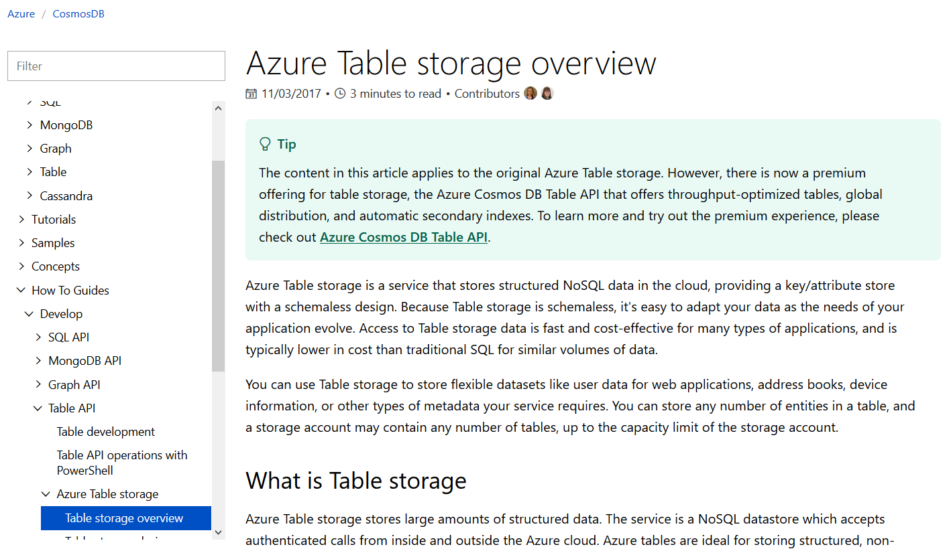
Azure Table Storage

Slide 46

"Yo... he visto cosas que vosotros no creeríais: Atacar naves en llamas más allá de Orión.
He visto rayos C brillar en la oscuridad cerca de la Puerta de Tannhäuser.
Todos esos momentos se perderán... en el tiempo... como lágrimas en la lluvia. Es hora de morir"
- Roy Batty

Slide 47
Available services per account type
Account type | Performance | Available services
General purpose | Standard | All: Files, Tables, Queues, Blobs
General purpose | Premium | Blob, just supporting Page Blobs in private containers (For old VM disks)
Blob storage | Only standard is allowed | Blob, just supporting Block and Append blobs
General purpose v2 | Standard | All: Files, Tables, Queues, Blobs
General purpose v2 | Premium | Blob, just supporting Page Blobs in private containers (For old VM disks)
Recommendation: Use “General purpose v2” but taking in account that there are pricing differences: v2 has lower storage prices but higher transaction prices

