Slide 1

Nancy
El supper dupper happy path

Slide 2



Sergio Navarro Pino
I work for NEC, in its Cloud Computing Centre of Competence
Sometimes I write some tweets ( @snavarropino )
I also have a blog…Not yet forgotten…
http://serginet.blogspot.com

Slide 3
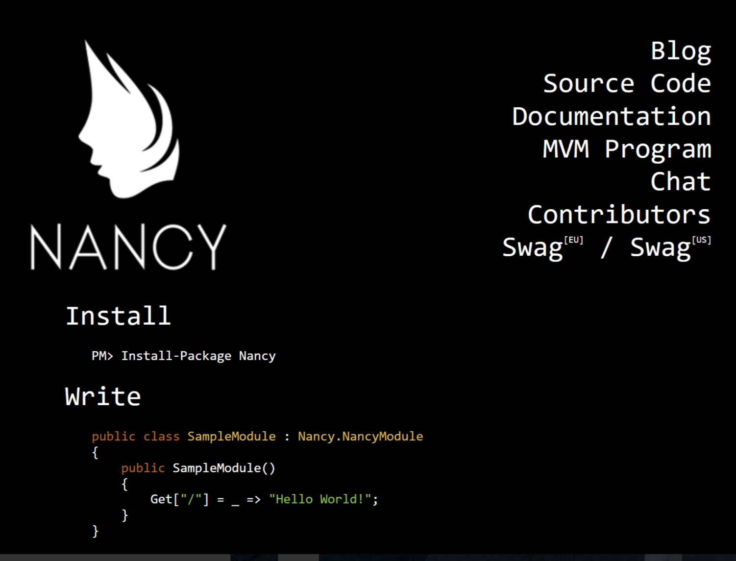
What is Nancy ?
NANCY (OR NANCYFX) is a microframework for the web, inspired in sinatra ruby framework

Slide 4
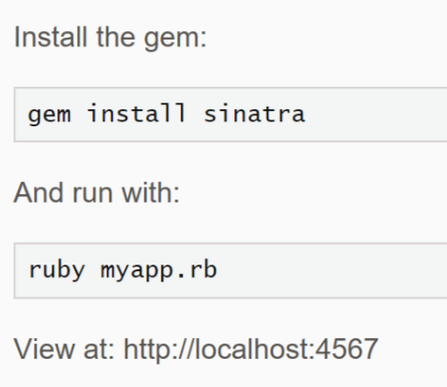
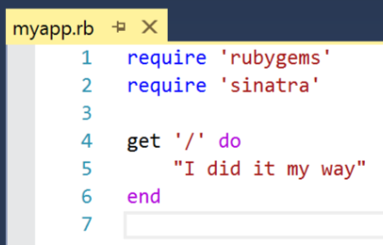
Sinatra sample

Slide 5
What is Nancy?
Nancy is a lightweight, low-ceremony, framework for building HTTP based services on .NET and Mono. The goal of the framework is to stay out of the way as much as possible and provide a super-duper-happy-path to all interactions.

Slide 6
The super duper happy path
This means that everything in Nancy is setup to have sensible defaults and conventions, instead of making you jump through hoops and go through configuration hell just to get up and running. With Nancy you can go from zero to website in a matter of minutes. Literally.
“It just works”
“Easily customisable”
“Low ceremony”
“Low friction”
Notes:
It just works” - you should be able to pick things up and use them without any mucking about. Added a new module? That’s automatically discovered for you. Brought in a new View Engine? All wired up and ready to go without you having to do anything else. Even if you add a new dependency to your module, by default we’ll locate that and inject it for you - no configuration required.
“Easily customisable” - even though “it just works”, there shouldn’t be any barriers that get in the way of customisation should you want to work the way you want to work with the components that you want to use. Want to use another container? No problem! Want to tweak the way routes are selected? Go ahead! Through our bootstrapper approach all of these things should be a piece of cake.
“Low ceremony” - the amount of “Nancy code” you should need in your application should be minimal. The important part of any Nancy application is your code - our code should get out of your way and let you get on with building awesome applications. As a testament to this it’s actually possible to fit a functional Nancy application into one single Tweet
“Low friction” - when building software with Nancy the APIs should help you get where you want to go, rather than getting in your way. Naming should be obvious, required configuration should be minimal, but power and extensibility should still be there when you need it.

Slide 7

Product catalogue microservice
Notes:
Vamos a hacer un microservicio (aunque no quiero polémicas) con .NET core. Sera un api para gestionar un catalogo de un eCommerce (ncbs??)

Slide 8
What we have seen so far
Modules, routes and http verbs
ROUTE parameters and query string parameters
Model binding
Content negociation
Dependency injection (Tiny IOC)
Module hooks
Asynchronous actions

Slide 9
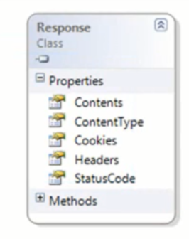
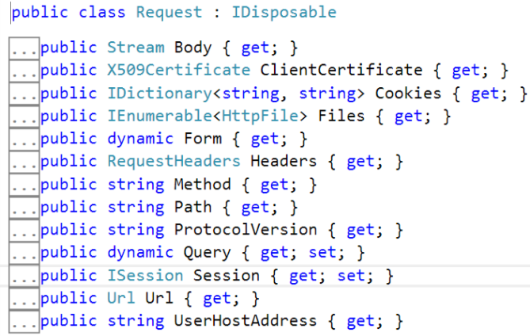
Routes, request and response
ROUTE = vERB + paTTern + condiTION (OPTIONAL)
oRDER: convention: most specific first, order second
Request and response mapping
REQUEST
GET /Products/5?Stock=true
Host: localhost
RESPONSE
200 OK HTTP/1.1
Content-Type: text/html
Headers
Body

Slide 10
Don’t trust developers that don’t create tests
Notes:
Vamos a hacer un microservicio (aunque no quiero polémicas) con .NET core. Sera un api para gestionar un catalogo de un eCommerce (ncbs??)

Slide 11
What we have seen so far
How to test
The CONFIGURABLE bootstrapper

Slide 12
Views & view engines
Notes:
Vamos a hacer un microservicio (aunque no quiero polémicas) con .NET core. Sera un api para gestionar un catalogo de un eCommerce (ncbs??)

Slide 13
What we have seen so far
THE suPER SIMPLE VIEW ENgine
How to override (configure) conventions: BOOTSTRAPPER
How to test html pages

Slide 14
What we MISSED
VALIDATIONS
AUTHENTICATION
Caching
The Application Before, After and OnError pipelines
Razor view engine
Localization
Other hosting mechanisms (self hosting)
OTHER IOC engines
SESSION
Etc…

Slide 15
resources
NancyFx: http://nancyfx.org/
V2 (core support) changes and documentation: https://github.com/NancyFx/Nancy/issues/2396
Books:
NancyFx Succinctly: https://www.syncfusion.com/resources/techportal/details/ebooks/nancyfx
Microservices in .Net Core: https://www.manning.com/books/microservices-in-net-core
Online courses:
Pluralsight: Introduction to Nancy (https://www.pluralsight.com/courses/Nancy)
Pluralsight: Building Web Applications With NancyFX (https://www.pluralsight.com/courses/building-web-apps-nancyfx)
Code samples of this session:
https://github.com/snavarropino/nancyFxSession

Slide 16

"Yo... he visto cosas que vosotros no creeríais: Atacar naves en llamas más allá de Orión.
He visto rayos C brillar en la oscuridad cerca de la Puerta de Tannhäuser.
Todos esos momentos se perderán... en el tiempo... como lágrimas en la lluvia. Es hora de morir"
- Roy Batty

