Slide 1

Nancy
El supper dupper happy path

Slide 2
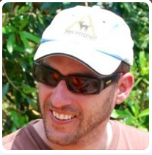


Sergio Navarro Pino
I work for NEC, in its Cloud Computing Centre of Competence
Sometimes I write some tweets ( @snavarropino )
I also have a blog…Not yet forgotten…
http://serginet.blogspot.com

Slide 3
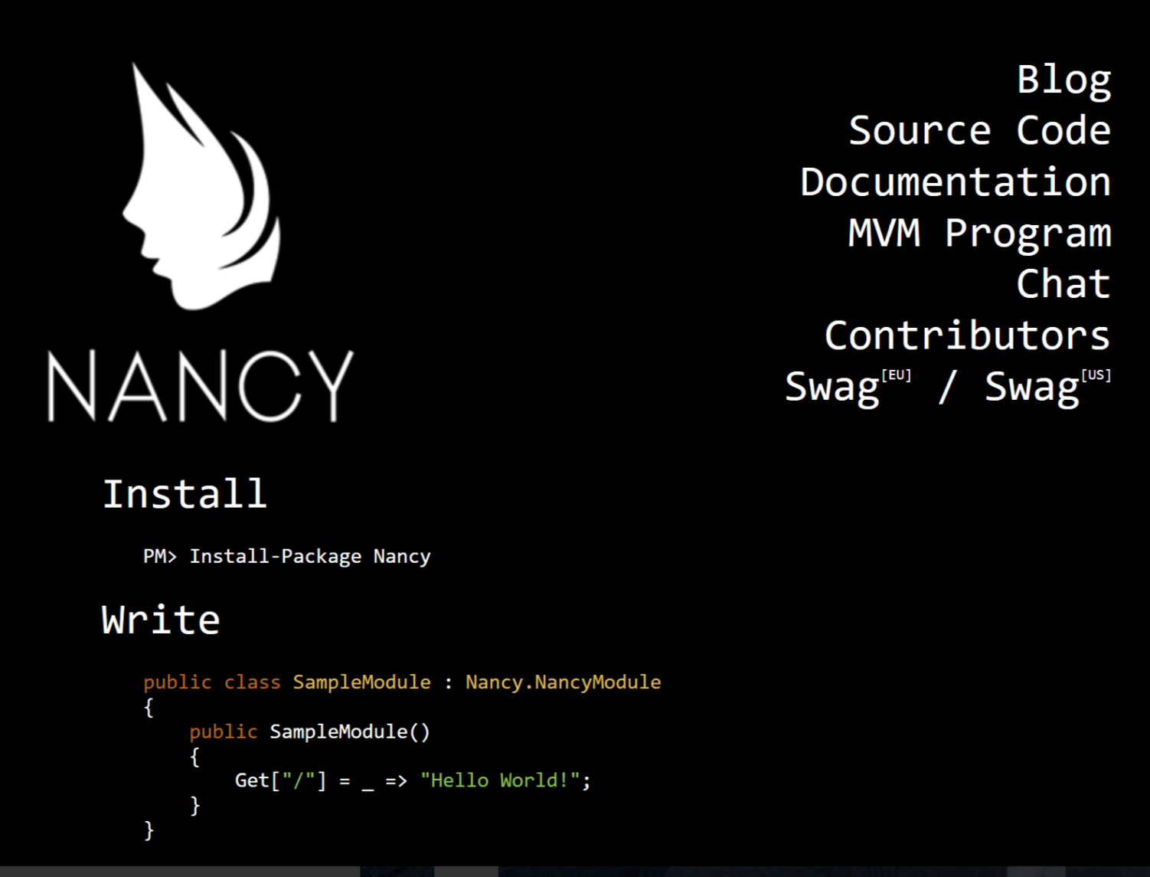
What is Nancy ?
NANCY (OR NANCYFX) is a microframework for the web, inspired in sinatra ruby framework

Slide 4
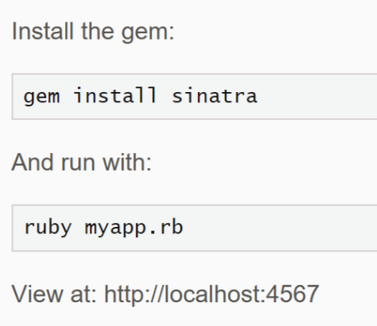
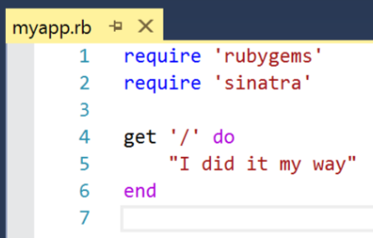
Sinatra sample

Slide 5
What is Nancy?
Nancy is a lightweight, low-ceremony, framework for building HTTP based services on .NET and Mono. The goal of the framework is to stay out of the way as much as possible and provide a super-duper-happy-path to all interactions.

Slide 6
The super duper happy path
This means that everything in Nancy is setup to have sensible defaults and conventions, instead of making you jump through hoops and go through configuration hell just to get up and running. With Nancy you can go from zero to website in a matter of minutes. Literally.
“It just works”
“Easily customisable”
“Low ceremony”
“Low friction”
Notes:
It just works” - you should be able to pick things up and use them without any mucking about. Added a new module? That’s automatically discovered for you. Brought in a new View Engine? All wired up and ready to go without you having to do anything else. Even if you add a new dependency to your module, by default we’ll locate that and inject it for you - no configuration required.
“Easily customisable” - even though “it just works”, there shouldn’t be any barriers that get in the way of customisation should you want to work the way you want to work with the components that you want to use. Want to use another container? No problem! Want to tweak the way routes are selected? Go ahead! Through our bootstrapper approach all of these things should be a piece of cake.
“Low ceremony” - the amount of “Nancy code” you should need in your application should be minimal. The important part of any Nancy application is your code - our code should get out of your way and let you get on with building awesome applications. As a testament to this it’s actually possible to fit a functional Nancy application into one single Tweet
“Low friction” - when building software with Nancy the APIs should help you get where you want to go, rather than getting in your way. Naming should be obvious, required configuration should be minimal, but power and extensibility should still be there when you need it.

Slide 7


Slide 8
Background tasks
Sorts of background tasks
Fire & Forget
Send an email due to an action
Delayed
Automatic subscription renewal
Periodic & schedulled
Invoice generation at the end of very billing period
How to?

Slide 9

"Yo... he visto cosas que vosotros no creeríais: Atacar naves en llamas más allá de Orión.
He visto rayos C brillar en la oscuridad cerca de la Puerta de Tannhäuser.
Todos esos momentos se perderán... en el tiempo... como lágrimas en la lluvia. Es hora de morir"
- Roy Batty

Slide 10
Avaliable posibilities
Azure Scheduler ( https://azure.microsoft.com/en-us/services/scheduler/ )
Quartz.NET ( http://www.quartz-scheduler.net/ )
HangFire! ( http://hangfire.io/ )
Develop from scratch

Slide 11
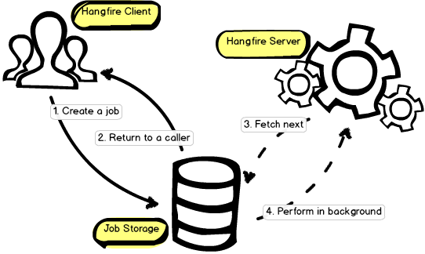
HANGFIRE Architecture
Fire & Forget Jobs
Delayed Jobs
Recurrent Jobs
All of them running in a background thread on same server or other one
ASP.NET Thread Pool safe!

Slide 12
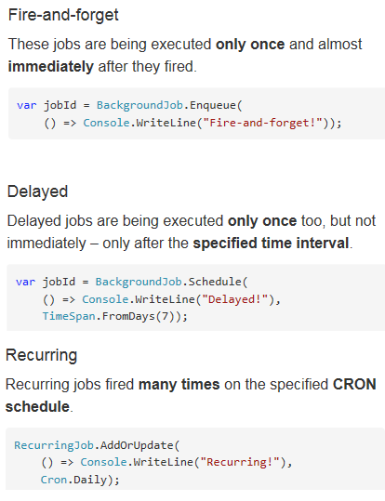
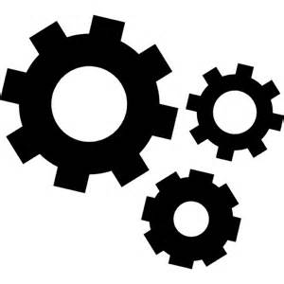
Launching tasks

Slide 13
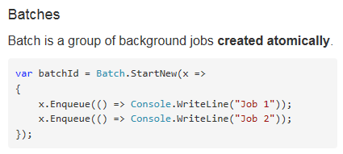
Launching BATCHES

Slide 14
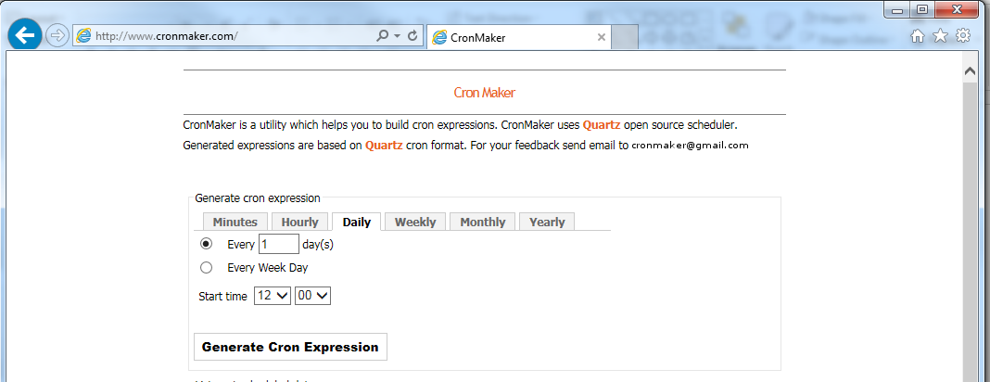
Cron expressions?

Slide 15
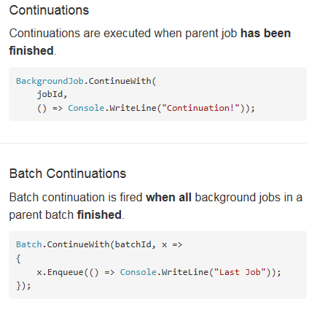
CONTINUING TASKS

Slide 16
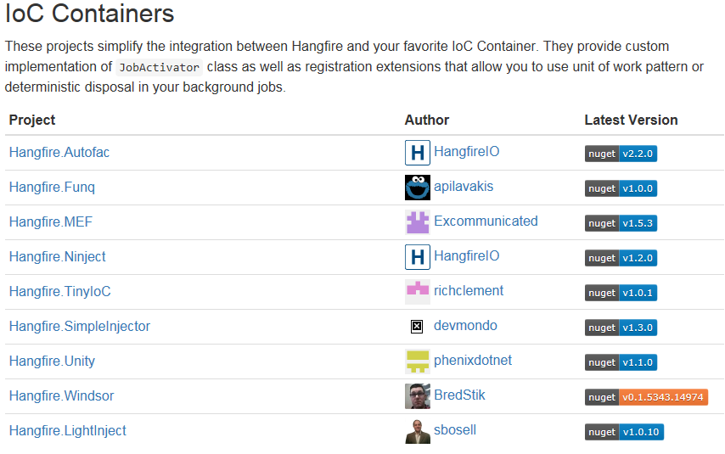
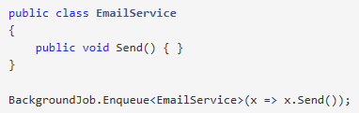
Method resolution
Statics are easy…
But instance methods are also supported
By default, the Activator.CreateInstace method is being used, so only classes with default constructors are supported by default.

Slide 17
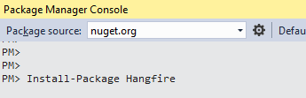
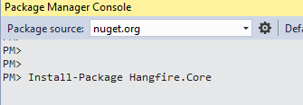
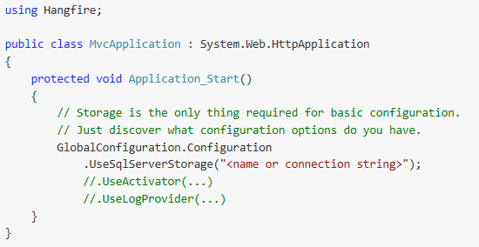
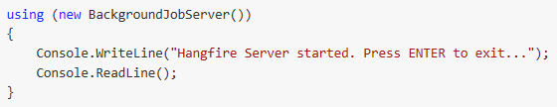
Hosting the hangfire server
IN ASP.NET
In a dedicated server (win srv, console app, etc…)

Slide 19
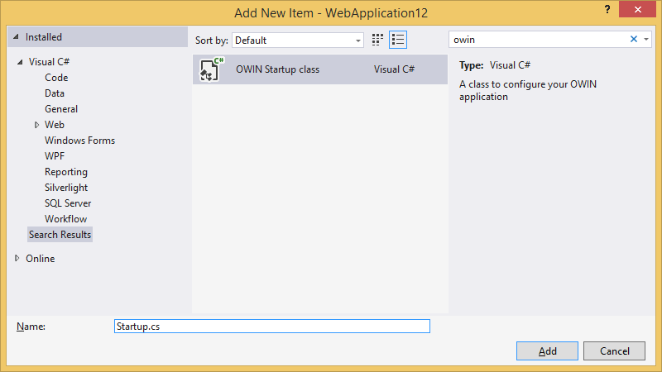
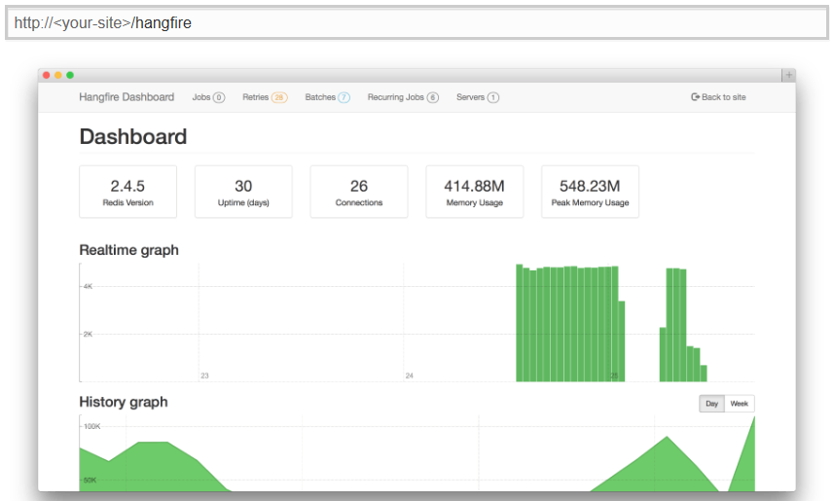
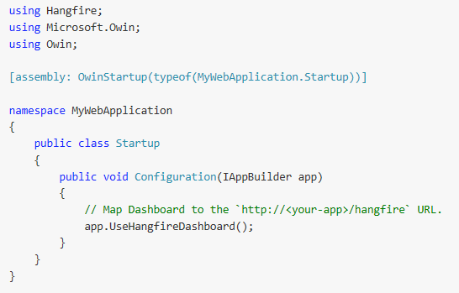
The dashboard

Slide 21
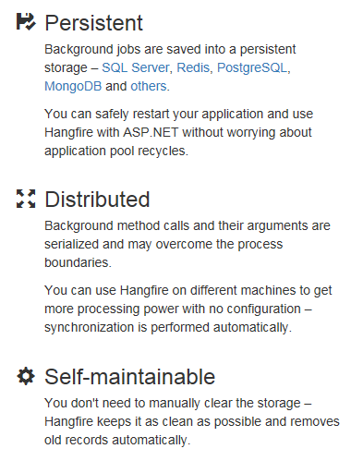
DIStributed task?

