Slide 1


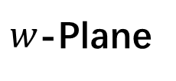
$w$-Plane
$$α_{2}$$
$$α_{1}$$

