Slide 1
House Price Estimation (Improvement vs. Dr. Williams' model)
Author: Stephen Barnes

Slide 2
Introduction
My project improved upon Dr. Williams' model by taking the following steps:
1.) Incorporating a broader range of independent x-variables;
2.) Cleaning the csv file to 'drop' and/or 'impute' data as necessary;
3.) Addressing the issue of multicollinearity;
4.) Calculating correlation and linear regression, and;
5.) Plotting the results in a scatter graph.

Slide 3
The Data
Data Overview
The project’s data related to home sales, including sale price.
The project’s goal was to determine the relationship between “SalePrice” and the other house characteristics (independent, x-variables).
Using multiple linear regression, I predicted house prices based on 14 “cleaned” house characteristics.
The independent x-variables in my model provided > 96% predictability to “SalePrice”, thereby improving on Dr. Williams’ model.

Slide 4
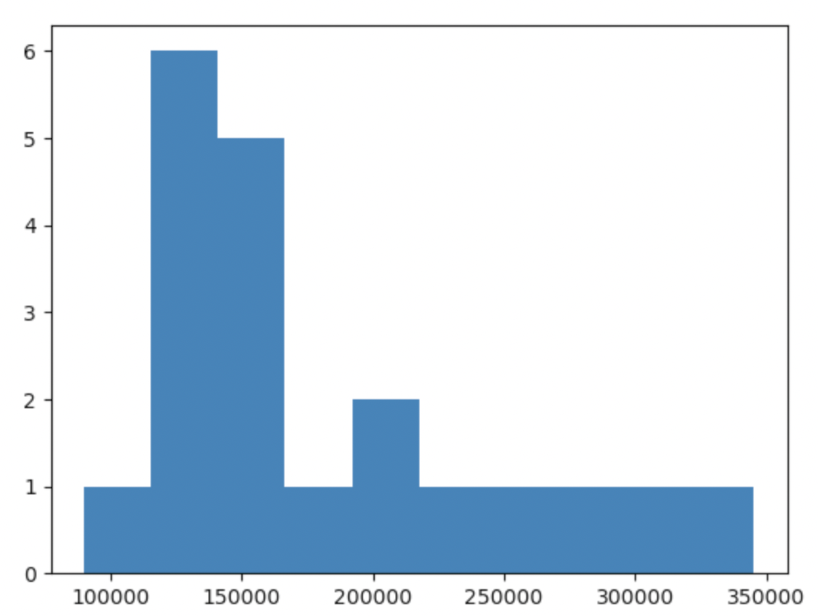
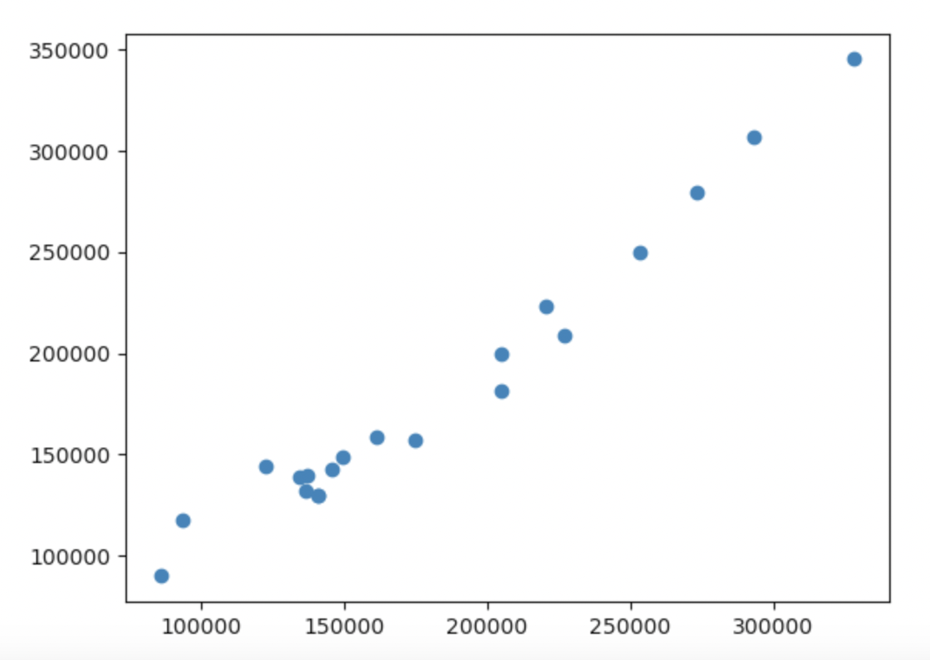
Data Exploration
The most significant graphs I produced to display the relationships between variables was:
Histogram
Shows where most houses are priced. Starts process to identify variables that place houses in their respective bins.
Scatter Graph
Shows linear relationship between the house characteristics in my model and their impact on sale price.

Slide 5
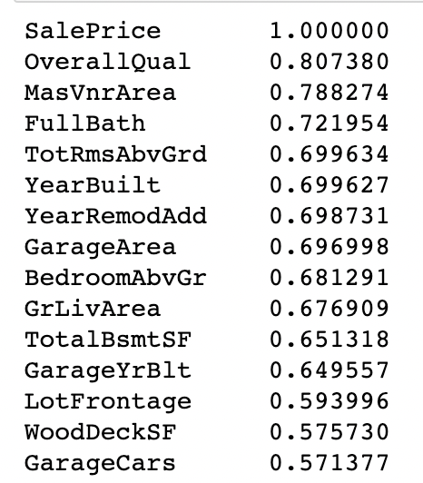
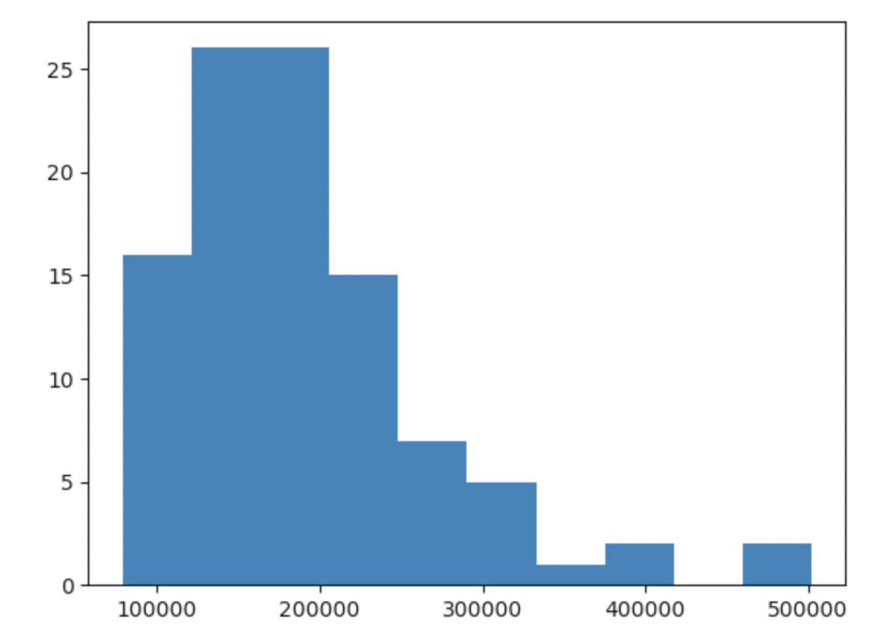
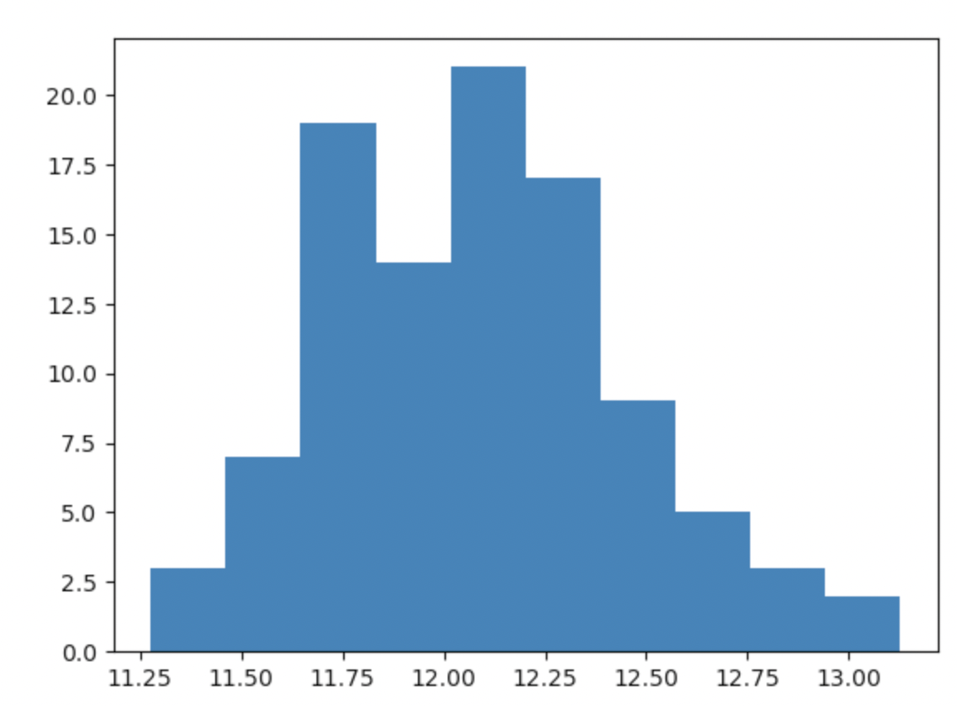
Data Preparation
Cleaning the data:
1.) Identify columns with missing data and impute them; 2.) Address multicollinearity
3). Deal with skewed data
Create a histogram and, if the data is skewed, re-run the histogram using the log of your variable (e.g. SalePrice in our case).

Slide 6
Correlation
Summary of correlation results:
The table below shows the house characteristics most correlated to “SalePrice”.
I predicted house prices based on “cleaned” variables with more than 50% correlation to “SalePrice”.
My project highlights the importance of: - including multiple independent ‘x’ variables to predict a dependent ‘y’ variable - including strongly correlated variables - excluding variables that have multicollinearity

Slide 7
Project Description
The most important algorithm used in this project was Multiple Linear Regression.
LMR is a predictive modeling approach for estimating the relationship between several independent variables and one dependent variable.
Once we determine correlation
Use a scatter graph to visualize relationships

Slide 8
Analysis and Results
The variables I used for my model were those with > 50% correlation to ”SalePrice”
However, I cleaned the data by imputing missing values and removed variables with possible multicollinearity before calculating final correlation and linear regression

Slide 9
Verification
My model performed well with test data.
The data itself needed a lot of cleaning and was skewed, which I corrected using the log of SalePrice.
I ran into several challenges using test data but, in the end, I got my python code to execute the prediction model.
(* Please note that I used GPT4 extensively to figure out why I kept getting errors)

Slide 10
Conclusion
My project successfully implemented a step-by-step analysis from data preparation to feature selection, and model training to evaluation.
The model achieved an impressive score of slightly over 96%, confirming its reliability and robustness in predicting house prices – and outperforming Dr. Williams’ model from Module 7.
Key Take-Aways:
1.) It’s very important to include multiple independent ‘x’ variables to predict the dependent ‘y’ variable.
2.) A good model should always include clean, strongly correlated variables (e.g. for our analysis: OverallQual, MasVnrArea, and FullBath to SalePrice).
3.) Make sure the data is clean (e.g. remove variables that have multicollinearity)

Slide 11
References
The only reference material I used was provided by:
OpenAI’s GPT4 (https://openai.com) – used to help find code to clean the data, regardless of data type.
*Please add slides as required.

