Slide 1

Insights
Pre-work - 1

Slide 2
Agenda
Inheritance
Demo
Queue Case Study
Rectangle and Square Case Study

Slide 3
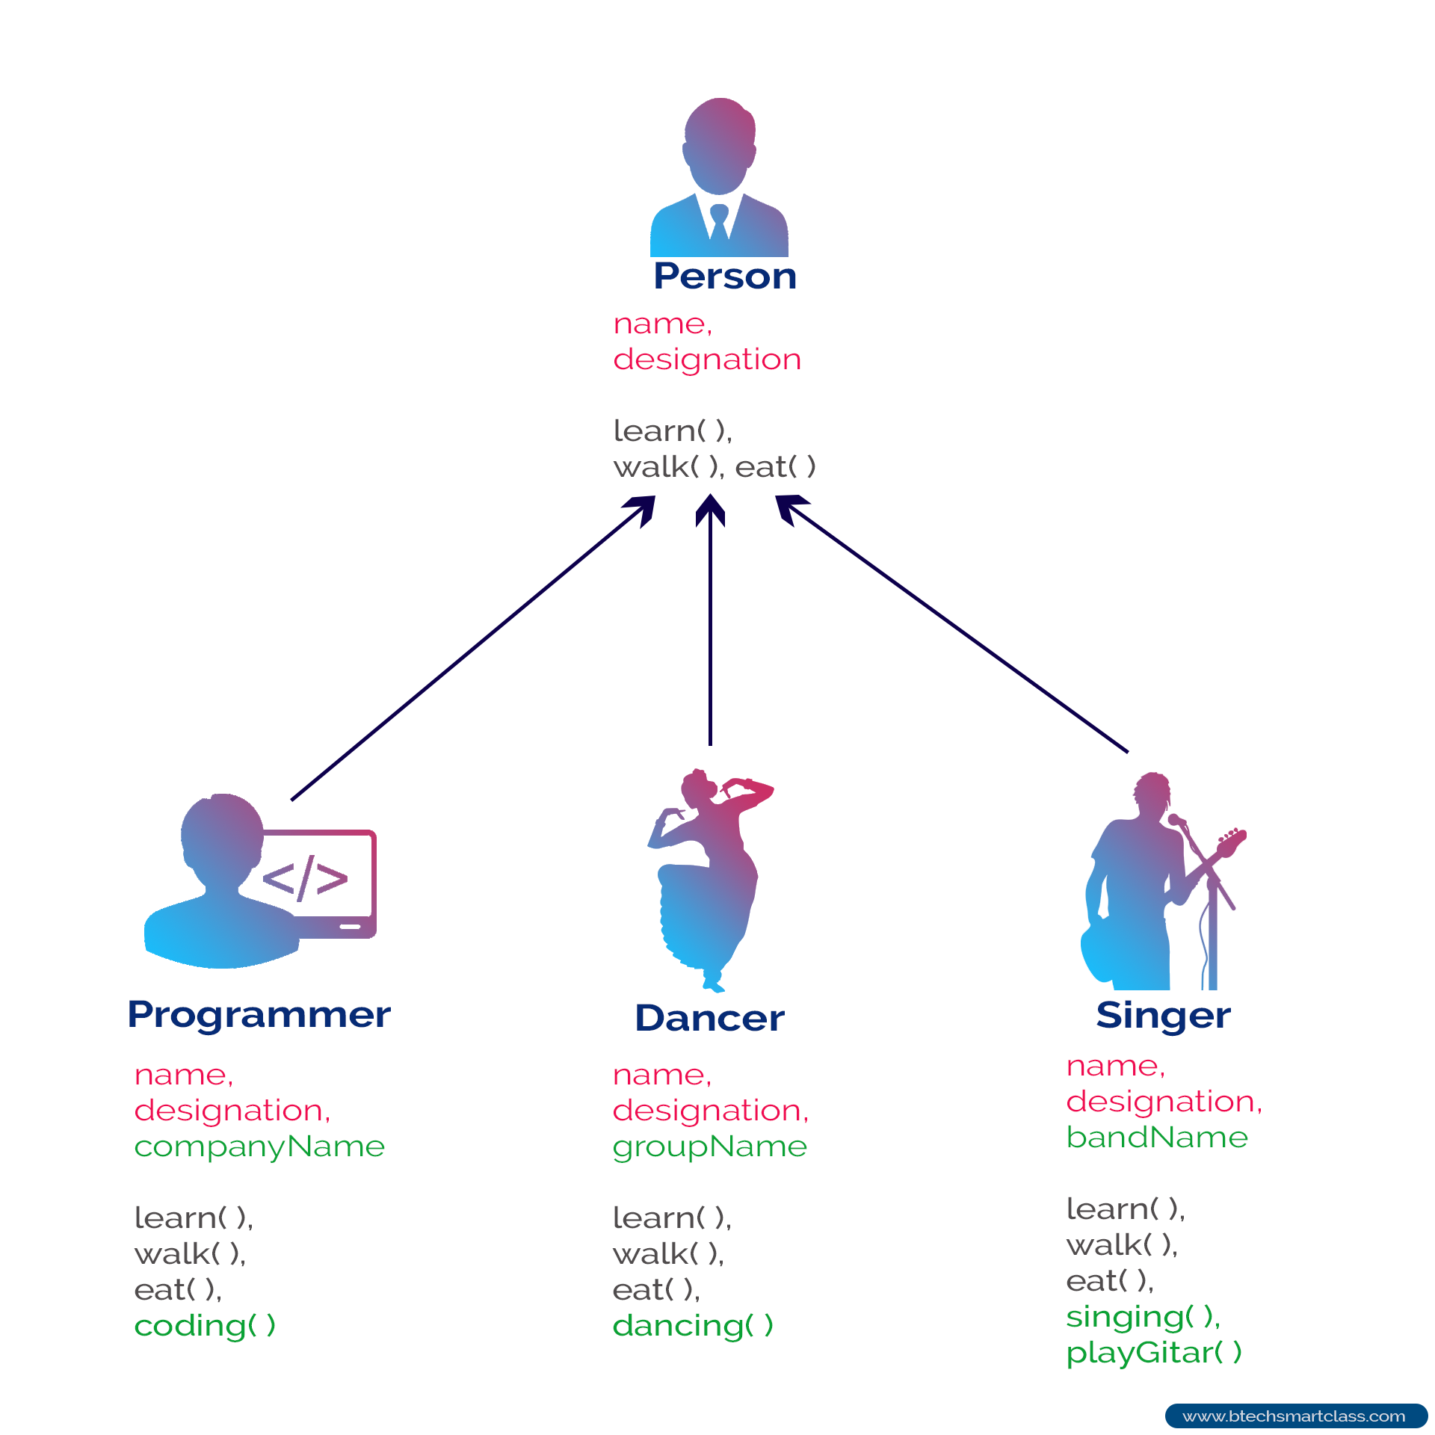
Inheritance

Slide 4
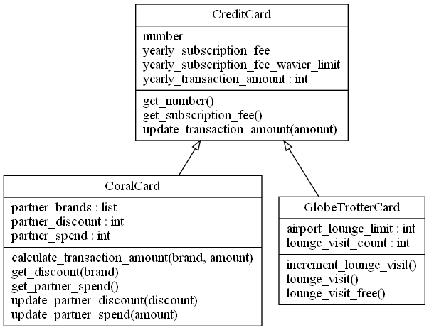
Is-a relationship

Slide 5
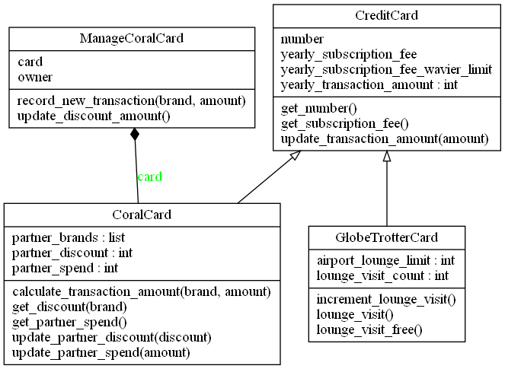
has-a relationship

Slide 6
Queue
Code walkthrough

Slide 7
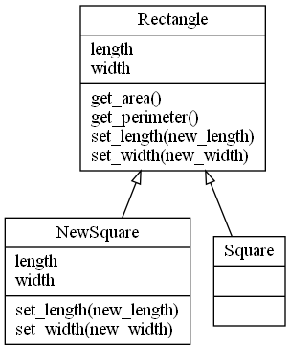
Rectangle and Square
Code walkthrough

Slide 8
References - https://www.w3resource.com/java-tutorial/inheritance-composition-relationship.php - https://www.c-sharpcorner.com/UploadFile/3614a6/is-a-and-has-a-relationship-in-java/ - https://www.scientecheasy.com/2021/02/has-a-relationship-in-java.html/
- https://www.edureka.co/blog/coupling-in-java/
- https://www.jetbrains.com/pycharm/download/#section=windows

