Slide 1
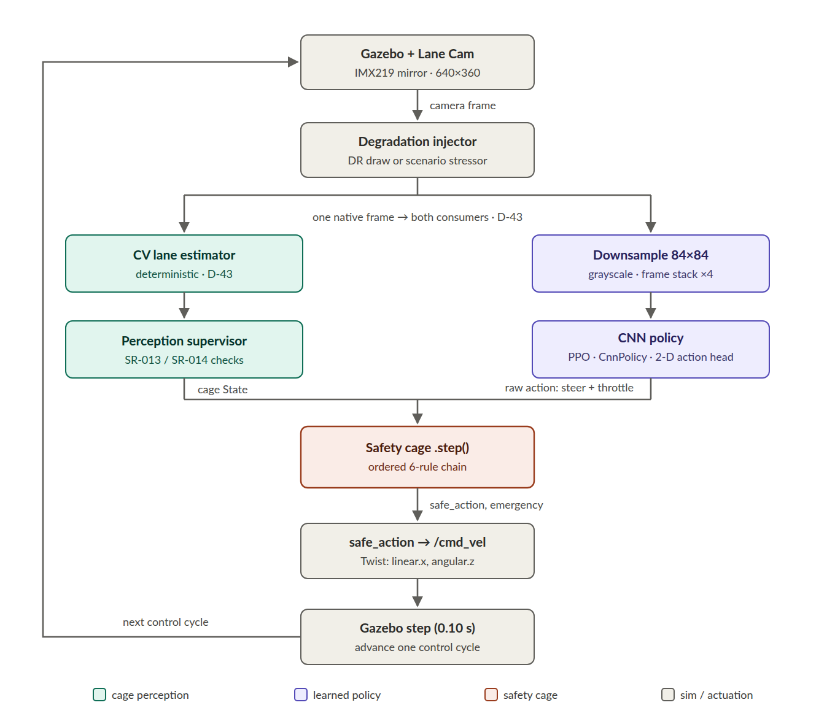
Policy under safety-cage
Decoupled architecture
The CNN consumes the camera feed and proposes the action.
In parallel, a deterministic CV estimator computes the safety state.
The cage applies six rules before /cmd_vel and logs every intervention.
The figure shows the 1‑D predecessor; the 2‑D trunk preserves this separation and adds throttle.
Notes:
Message: the learned controller never acts on the vehicle directly; the safety cage retains final authority. The figure shows the 1-D predecessor and is labeled accordingly.
[Sources]
- B:/SE4AI/thesis_repo/docs/00_v_model_adapted.md
- B:/SE4AI/thesis_repo/docs/04_cage_specification.md
- B:/SE4AI/thesis_repo/docs/DECISIONS.md (D-43)
- B:/SE4AI/thesis_repo/manuscript/figures/etrack_camera_control_loop.png

Slide 2
End-to-end traceability
Hazard → Safety Requirement → Cage Rule → Scenario → Metric → Logged Evidence → Verdict.
Traceability
12 hazards and 14 linked SRs
Runtime assurance
Six policy-independent rules
Verdict spine
28 scenarios, 19 metrics
Notes:
Message: the main contribution is a traceable, executable assurance chain—not an isolated policy.
[Sources]
- B:/SE4AI/thesis_repo/docs/05_scenario_library.md
- B:/SE4AI/thesis_repo/docs/07_traceability_matrix.md
- B:/SE4AI/thesis_repo/docs/15_implementation_inventory.md

Slide 3
RL policy state
F - State vector
Methodological control arm. 1,260 runs · 0 errors. Global SATISFIED; cage latent in‑ODD.
E - Camera · 1‑D action
CNN + independent CV. 1,970 runs · G4 closed. The cage becomes decisive.
Latest - Camera · 2-D action
PPO 550k · verdict of record
1,890 runs · 0 errors
Simulation programme closed.
MAY–JUN 2026
JUN–JUL 2026
JUL 2026
Notes:
Message: F validates the method, the 1-D camera arm supplied the frozen G4 record, and the competent 2-D PPO arm is now the verdict of record for the completed simulation programme.
[Sources]
- B:/SE4AI/thesis_repo/docs/07_traceability_matrix.md
- B:/SE4AI/thesis_repo/docs/11_camera_rl_training.md
- B:/SE4AI/thesis_repo/docs/DECISIONS.md (D-66, D-67, D-69)
- B:/SE4AI/thesis_repo/docs/CHANGELOG.md (31 July 2026)

Slide 4
Controlled experimentation
The camera, environment, reward, cage, seed, and evaluation spine stayed fixed.
Each branch changed one main axis.
1‑D PPO · baseline
State vector → camera
peaks + multiseed
1‑D SAC · algorithm probe
early sample efficiency
entropy + replay isolated
2‑D PPO · action authority
throttle + random starts
0.22 cap → stable plateau
2‑D SAC · stress test
canonical tuning + entfix
safe, but weaker driver
Notes:
Message: the sequence was a controlled search, not four competing headline results. Each branch changed one main axis and kept the evaluation spine comparable wherever the contract allowed it.
[Sources]
- B:/SE4AI/thesis_repo/docs/DECISIONS.md (D-49, D-59, D-60, D-66, D-67)
- B:/SE4AI/thesis_repo/docs/11_camera_rl_training.md
- B:/SE4AI/thesis_repo/manuscript/chapters/chapter_07_training_specification.md (§7.5.5)

Slide 5
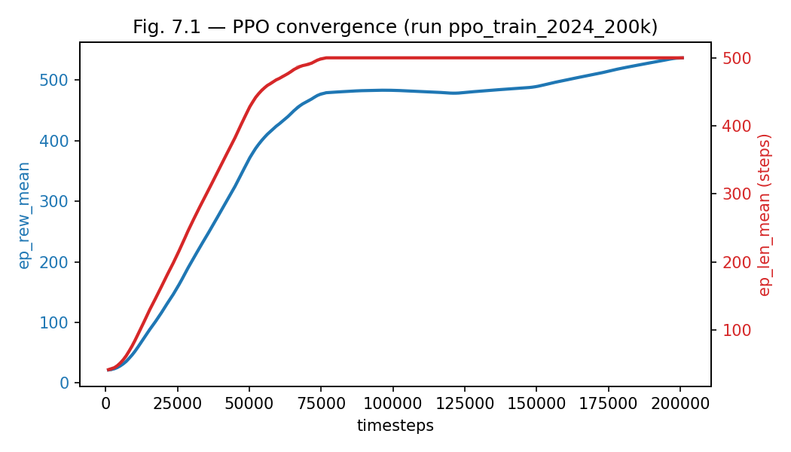
GT 1‑D PPO
PPO achieved perfect driving
Cage activity fell from ≈90% early to ≈4%, safety rules disappeared and C‑06 remained.
Nominal eval: 11.2 laps, 9.9 mm mean |ey|, 0 emergencies.
Conclusion: the method worked when perception was perfect.
Notes:
Message: the frozen F-track was the methodological control. It established that the training, cage, logging, and verdict pipeline worked with perfect state information.
[Sources]
- B:/SE4AI/thesis_repo/manuscript/figures/fig_7_1_convergence.png
- B:/SE4AI/thesis_repo/manuscript/figures/fig_7_2_intervention.png
- B:/SE4AI/thesis_repo/manuscript/chapters/chapter_07_training_specification.md (§7.4–§7.5)
- B:/SE4AI/thesis_repo/experiments/sim/runs/rl_eval_2024_200k_4k4/summary.json

Slide 6
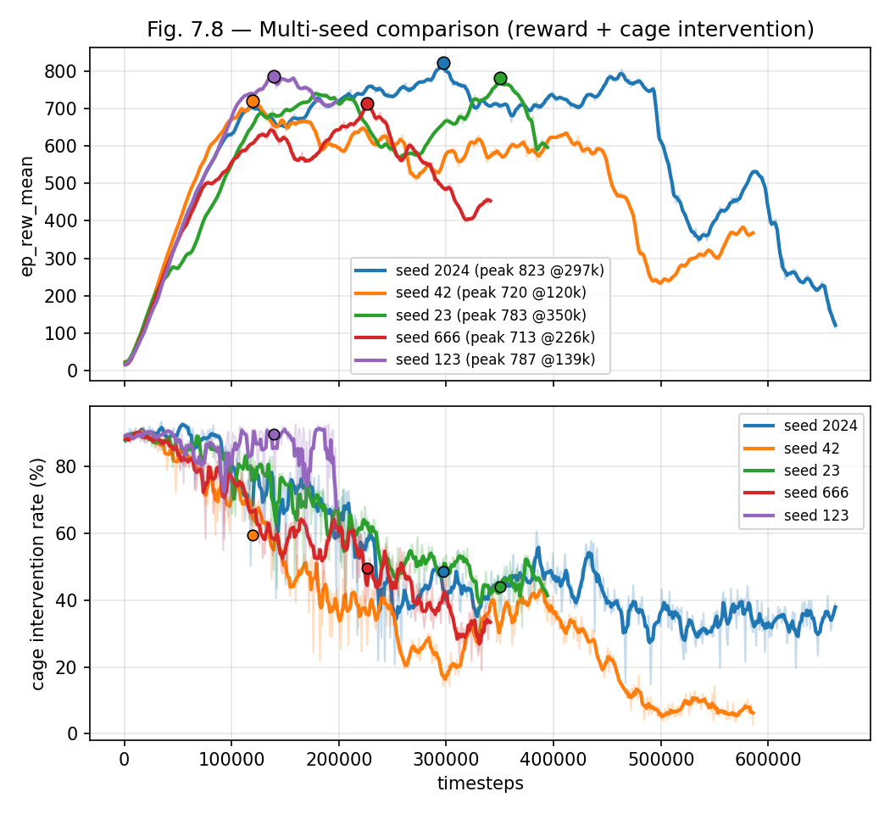
E2E 1-D PPO
Every seed peaked, then decayed
Peak checkpointing was essential, the final step was never trusted.
Evaluation found 3/5 constraint-respecting; seed 666 cage-dependent, seed 23 cage–CV conflict.
Notes:
Message: camera PPO learned the task for every seed, but training curves alone hid two qualitatively different closed-loop basins. Behavioural evaluation classified the result.
[Sources]
- B:/SE4AI/thesis_repo/manuscript/figures/fig_7_8_multiseed_newcam.png
- B:/SE4AI/thesis_repo/docs/11_camera_rl_training.md (§8.5)
- B:/SE4AI/thesis_repo/manuscript/chapters/chapter_07_training_specification.md (§7.5.3–§7.5.4)
- B:/SE4AI/thesis_repo/docs/CHANGELOG.md (13 July 2026)

Slide 7
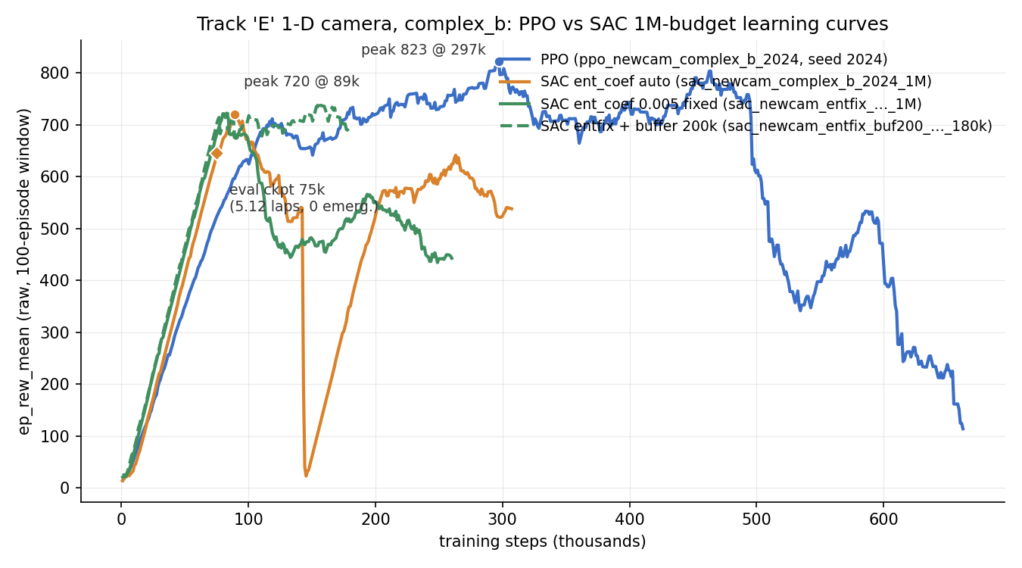
E2E 1‑D SAC test comparison
SAC reaches its peak earlier than PPO
PPO still achieves better driving over time
The trade-off is time versus final performance
Notes:
Message: SAC was more sample-efficient, but it revealed two separable degradation mechanisms. The abrupt cliff tracked the learned temperature approaching zero; the slower decay was prevented within the bounded probe by a larger replay buffer.
Comparison caveat: the 25k pair is an early matched pilot, not an algorithm verdict. The long runs were stopped once their mechanisms were characterised.
[Sources]
- B:/SE4AI/thesis_repo/experiments/sim/training/sac_newcam_complex_b_2024_1M/ppo_vs_sac_1d_1M_curve.png
- B:/SE4AI/thesis_repo/docs/11_camera_rl_training.md (§4.2)
- B:/SE4AI/thesis_repo/docs/DECISIONS.md (D-60)
- B:/SE4AI/thesis_repo/docs/CHANGELOG.md (15–20 July 2026)

Slide 8
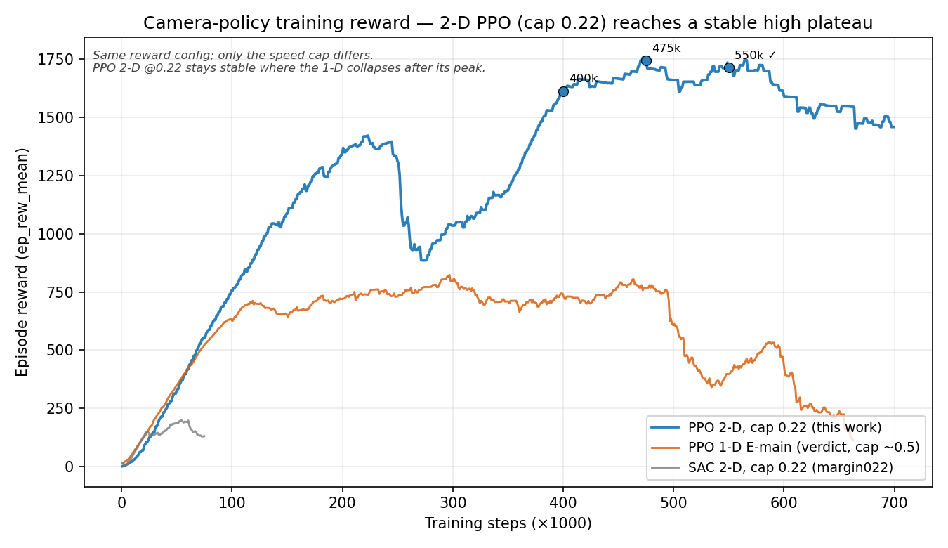
E2E 2-D PPO vs SAC
Action-space study
Throttle authority made speed selection and the stall test explicit.
PPO 0.22 reached a stable 1,755 plateau; 550k drove 5.32 laps at 8.6 mm with 0 emergencies and no C-01/02/03/05 activations.
Conclusion: PPO won; closed-loop checkpoint selection beat reward alone.
Notes:
Message: the first qualified 2-D SAC policy was too weak; a properly trained 2-D PPO policy recovered the driver quality. Deterministic closed-loop evaluation selected 550k, not the 475k reward peak.
Qualification: the nominal run had no C-01/C-02/C-03/C-05 activations, but C-06 was active. The final campaign later measured this rate-limiter dependence explicitly.
Reward caveat: 1-D and 2-D totals are not directly comparable because the action/reward contract, random-start curriculum, and episode horizon differ.
[Sources]
- B:/SE4AI/thesis_repo/manuscript/figures/auto/fig_ppo2d_training_curve.png
- B:/SE4AI/thesis_repo/docs/DECISIONS.md (D-59, D-60, D-65, D-66)
- B:/SE4AI/thesis_repo/experiments/sim/campaign_2d_margin022/CAMPAIGN_2D_ANALYSIS.md
- B:/SE4AI/thesis_repo/experiments/sim/campaign_2d_ppo550k/CAMPAIGN_2D_PPO550K_ANALYSIS.md
- B:/SE4AI/thesis_repo/experiments/sim/runs/rl_ppo2d_cap022_550000_nom_4k4/summary.json

Slide 9
Final 2-D campaign preserved safety
Verdict campaign
1,890 runs · 0 errors across 27 scenarios.
Cage on: 0 in-ODD road-edge contacts; cage off: 60. All 12 perturbation scenarios passed under enforcement.
Notes:
Message: the final campaign answers the weak-SAC uncertainty. Better training recovered availability while the cage still removed every in-ODD road-edge contact committed by the bare policy.
Literal result: NOT SATISFIED only through SR-002/003 and SC-EDGE-01's <2 s recovery-performance clause. The campaign recorded 0 emergencies there and no SR-CL-A safety predicate was breached.
Residuals: recovery ringing remains a performance limitation, and SR-010 co-activation remains a cage-arbitration design issue.
Chart data: final 2-D PPO 550k road-edge contacts — enforcement 0 in-ODD / 56 out-of-ODD; monitoring 60 in-ODD / 217 out-of-ODD.
[Sources]
- B:/SE4AI/thesis_repo/experiments/sim/campaign_2d_ppo550k/CAMPAIGN_2D_PPO550K_ANALYSIS.md
- B:/SE4AI/thesis_repo/experiments/sim/campaign_2d_ppo550k/campaign_report.json
- B:/SE4AI/thesis_repo/experiments/sim/campaign_2d_ppo550k/failure_mode_breakdown.json
- B:/SE4AI/thesis_repo/experiments/sim/campaign_2d_ppo550k/rescore_recovery_clause_d68.json
- B:/SE4AI/thesis_repo/docs/DECISIONS.md (D-66, D-68, D-69)

Slide 10
With camera input, the cage became decisive
Safety rules C-01/02/03/05 stayed latent in short nominal runs.
Over 300 s, however, 25/25 runs finish with enforcement, while 17/25 cage-off runs leave the lane.
Across the full campaign, the cage removes all 60 in-ODD road-edge contacts.
Cage enforcement
0 in-ODD contacts
25/25 endurance PASS
406 controlled stops overall
Monitoring
60 in-ODD contacts
8/25 endurance PASS
17 runs left the road
All 12 perturbations pass
Safety rules latent in short nominal runs
C-06 remains active
Same policy
Same scenarios
Causal contrast
Notes:
Message: the final 2-D evaluation sharpens the cage claim. C-01/C-02/C-03/C-05 stay latent in short nominal operation, but C-06 is load-bearing over long endurance and the cage removes all 60 in-ODD contacts seen with monitoring only.
Interpretation limit: dependence on C-06 is measured; co-adaptation during training is an inference that would require an unrun ablation to establish causally.
[Sources]
- B:/SE4AI/thesis_repo/experiments/sim/campaign_2d_ppo550k/CAMPAIGN_2D_PPO550K_ANALYSIS.md
- B:/SE4AI/thesis_repo/experiments/sim/campaign_2d_ppo550k/campaign_report.json
- B:/SE4AI/thesis_repo/experiments/sim/campaign_2d_ppo550k/failure_mode_breakdown.json
- B:/SE4AI/thesis_repo/docs/DECISIONS.md (D-66, D-69)

Slide 11
Status as of 31 July 2026
The simulation programme is complete. The 2-D PPO 550k campaign is the verdict of record
Physical validation is now the next evidence step.
Campaign closed
1,890 runs · 0 errors
verdict of record
Safety invariant
0 vs 60 in-ODD contacts
all 12 perturbations pass
Literal NOT SATISFIED
SR-002/003 · recovery clause only
no SR-CL-A safety breach
What remains
SR-010 co-activation · 16/85
Phase 5 physical verdict still TBD
Notes:
Closing: the simulation programme is complete and the 2-D PPO 550k campaign is the verdict of record. The literal NOT SATISFIED result is reconciled because its only SR-CL-A blockers are the recovery-time performance clause; no safety limit was breached.
The one simulation requirement recorded as Not satisfied is SR-010 (CL-B, non-vetoing): 16/85 in-ODD co-activation grid points breach M-S1. Physical deployment and the hardware-only ODD-3.A_LAT_MAX evidence remain open.
[Sources]
- B:/SE4AI/thesis_repo/docs/DECISIONS.md (D-68, D-69)
- B:/SE4AI/thesis_repo/docs/07_traceability_matrix.md
- B:/SE4AI/thesis_repo/docs/17_physical_deployment.md
- B:/SE4AI/thesis_repo/experiments/sim/campaign_2d_ppo550k/CAMPAIGN_2D_PPO550K_ANALYSIS.md
- B:/SE4AI/thesis_repo/docs/CHANGELOG.md (31 July 2026)

