Slide 1
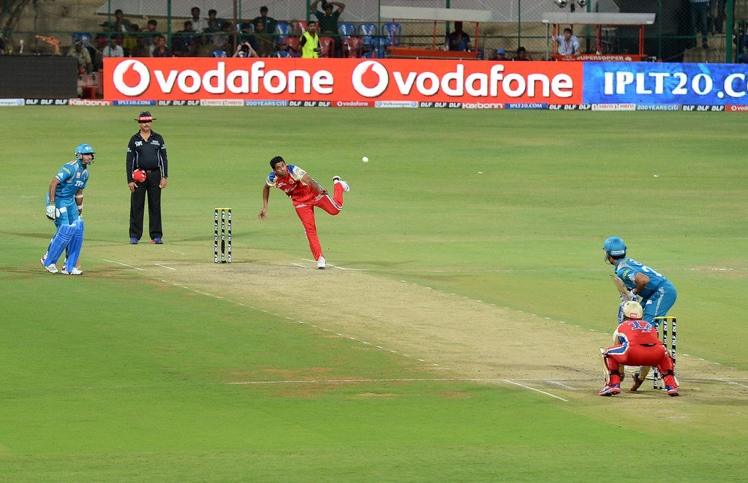

AUCTION

Slide 2
Copy and Create table Query
Deliveries table
Matches table
create table deliveries (id bigint, inning int, over int, ball int, batsman varchar, non_striker varchar, bowler varchar, batsman_runs int, extra_runs int, total_runs int, is_wicket int, dismissal_kind varchar, player_dismissed varchar, fielder varchar, extras_type varchar, batting_team varchar, bowling_team varchar);
copy deliveries (id , inning , over , ball , batsman , non_striker , bowler , batsman_runs , extra_runs , total_runs , is_wicket , dismissal_kind , player_dismissed , fielder , extras_type , batting_team , bowling_team ) from 'C:\IPL Dataset\IPL_Ball.csv' delimiter ',' csv header;
create table matches(id bigint, city varchar, date date, player_of_match varchar, venue varchar, neutral_venue int, team1 varchar, team2 varchar, toss_winner varchar, toss_decision varchar, winner varchar, result varchar, result_margin int, eliminator varchar, method varchar, umpire1 varchar, umpire2 varchar);
copy matches (id, city, date, player_of_match, venue, neutral_venue, team1, team2, toss_winner, toss_decision, winner, result, result_margin, eliminator, method, umpire1, umpire2) from 'C:\IPL Dataset\IPL_matches.csv' delimiter ',' csv header;

Slide 3
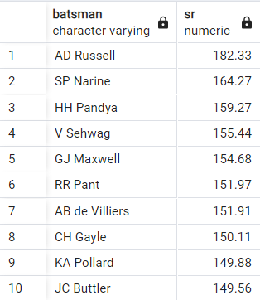
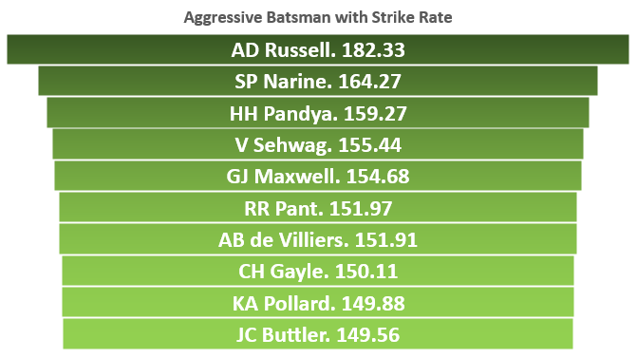
TOP 10 AGGRESSIVE BATSMAN
The best 2-3 aggressive batsman can be Russell, Narine, Pandya who have strike rate 182.33, 164.27, 159.27 respectively.
select batsman, round((sum(batsman_runs*1.0)/count(ball))*100,2) as sr from deliveries where extras_type not in('wides') group by batsman having count(ball)>500 order by sr desc limit 10;

Slide 4
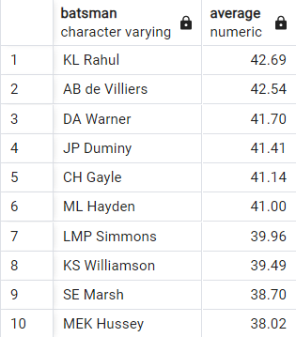
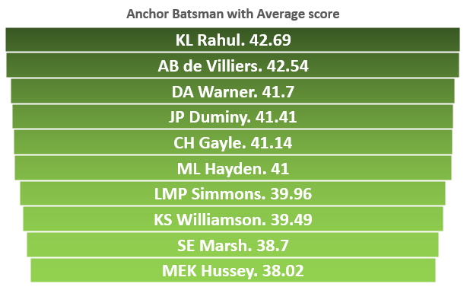
TOP 10 ANCHOR BATSMAN
The best 2-3 anchor batsman can be Rahul, AB De, Warner who have average score of 42.69, 42.54, 41.7 respectively.
select batsman, round(sum(batsman_runs*1.0)/sum(is_wicket),2) as Average from deliveries group by batsman having sum(is_wicket)>0 and count(distinct id)>28 order by Average desc limit 10;

Slide 5
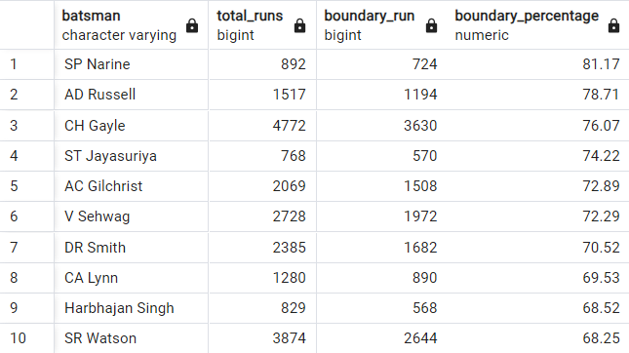
TOP 10 HARD HITTERS
The best 2-3 hard hitters can be SP Narine, AD Russell, CH Gayle.
select batsman,sum(batsman_runs) as total_runs,sum(case when batsman_runs in(4,6) then batsman_runs else 0 end) as boundary_run, round(sum(case when batsman_runs in(4,6) then batsman_runs else 0 end)*1.0 / sum(batsman_runs)*100,2) as boundary_percentage from deliveries where extras_type not in ('wides') group by batsman having count(distinct id) > 28 order by boundary_percentage desc limit 10;

Slide 6
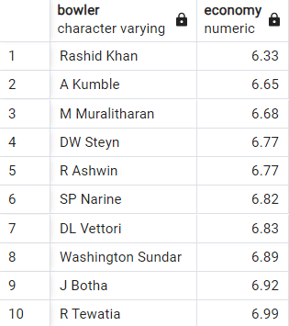
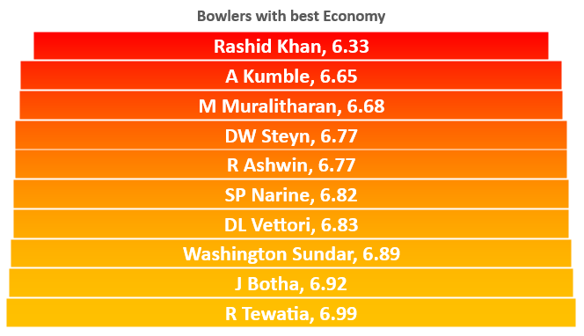
TOP 10 Economy Bowler
The best 2-3 economy bowler can be Rashid Khan, A Kumble, Muralitharan with strike rate 6.33, 6.65,6.68 respectively.
select bowler, round(sum(total_runs)/(count(over)/6.0),2) as economy from deliveries group by bowler having count(ball) >500order by economy asc limit 10;

Slide 7
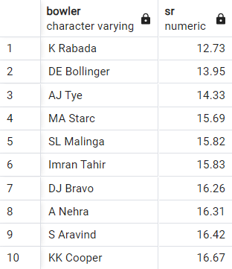
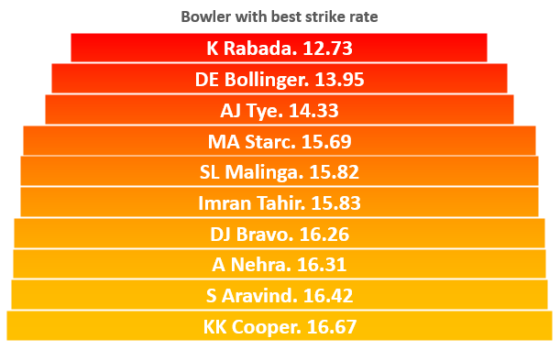
TOP 10 Wicket Taking Bowlers
Top 2-3 bowler with best strike rate can be K Rabada, DE Bollinger, AJ Tye with strike rate 12.73, 13.95, 14.33 respectively.
select bowler, round(count(ball)*1.0/sum(is_wicket),2) as sr from deliveries group by bowler having count(ball)>500 order by sr asc limit 10;

Slide 8
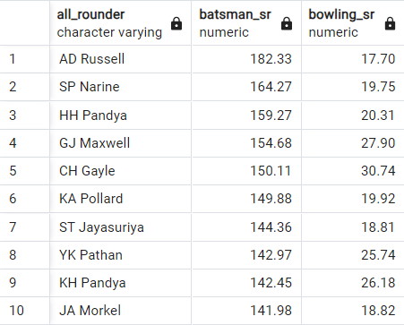
TOP 10 All Rounder
Top 2-3 All Rounder with best strike rate can be AD Russell, SP Narine, HH Pandya with best bowling strike rate.
with batsmen as (select batsman, count(ball) as balls_faced, round(sum(batsman_runs * 1.0) / count(ball) * 100, 2) as batsman_sr from deliveries where extras_type not in ('wides') group by batsman having count(ball) > 500), bowlers as (select bowler, count(ball) as balls_bowled, round(count(ball) * 1.0 / sum(is_wicket), 2) as bowling_sr from deliveries group by bowler having count(ball) > 300) select b.batsman as all_rounder, b.batsman_sr, bw.bowling_sr from batsmen b join bowlers bw on b.batsman = bw.bowler order by b.batsman_sr desc, bw.bowling_sr asc limit 10;

Slide 9
Criteria For Best Wicketkeeper in IPL
Effective Dismissals: High number of stumped and caught dismissals.
Aggressive Batting: Ability to score runs quickly, focusing on boundaries.
Runs Contributed: Significant contribution to the team's run total.
Quick Reflexes: Excellent reflexes and agility behind the stumps.
Versatility: Capability to play in various batting positions.
Consistent Performance: Steady and reliable performance throughout the tournament.
Stamina and Endurance: High physical fitness to endure the demands of T20 matches.
Strong Communication: Effective communication skills to coordinate with bowlers and fielders.
Crucial Saves: Ability to save crucial runs and prevent overthrows.
Experience and Calmness: Maintaining composure under pressure situations.

Slide 10
Additional Questions for Final Assessment

Slide 11

1. Get the count of cities that have hosted an IPL match
select count(distinct(city)) city_count from matches;

Slide 12
2. Create table deliveries_v02 with all the columns of the table ‘deliveries’ and an additional column ball_result containing values boundary, dot or other depending on the total_run
create table deliveries_v02 as(select *, (case when total_runs>=4 then 'Boundary' when total_runs = 0 then 'Dot' else 'Other' end) as ball_result from deliveries);

Slide 13
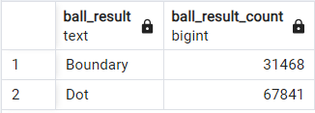
3. Write a query to fetch the total number of boundaries and dot balls from the deliveries_v02 table.
select ball_result,count(ball_result)as ball_result_count from deliveries_v02 where ball_result in('Boundary','Dot') group by ball_result;

Slide 14
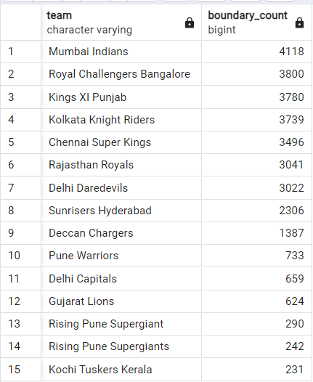
4. Write a query to fetch the total number of boundaries scored by each team from the deliveries_v02 table and order it in descending order of the number of boundaries scored.
select batting_team as team,count(ball_result) as boundary_count from deliveries_v02 where ball_result='Boundary' group by batting_team order by boundary_count desc;

Slide 15
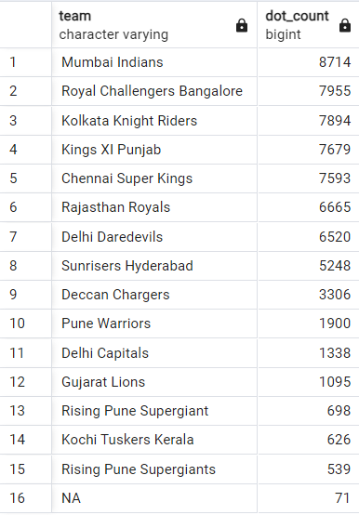
5. Write a query to fetch the total number of dot balls bowled by each team and order it in descending order of the total number of dot balls bowled.
select bowling_team as team,count(ball_result) as dot_count from deliveries_v02 where ball_result='Dot' group by team order by dot_count desc;

Slide 16
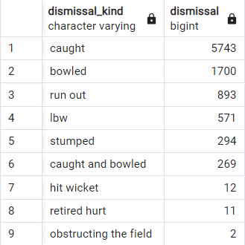
6. Write a query to fetch the total number of dismissals by dismissal kinds where dismissal kind is not NA
select dismissal_kind,count(dismissal_kind) as dismissal from deliveries_v02where dismissal_kind not in ('NA') group by dismissal_kind order by dismissal desc;

Slide 17
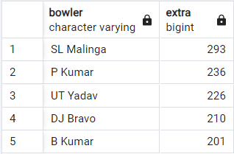
7. Write a query to get the top 5 bowlers who conceded maximum extra runs from the deliveries table
select bowler,sum(extra_runs) extra from deliveriesgroup by bowler order by extra desc limit 5;

Slide 18
8. Write a query to create a table named deliveries_v03 with all the columns of deliveries_v02 table and two additional column (named venue and match_date) of venue and date from table matches
create table deliveries_v03 as ( select deliveries_v02.*, matches.venue, matches.date from deliveries_v02 join matches on matches.id = deliveries_v02.id);

Slide 19
9. Write a query to fetch the total runs scored for each venue and order it in the descending order of total runs scored.
select venue,sum(total_runs) as runs from deliveries_v03 group by venue order by runs desc;

Slide 20
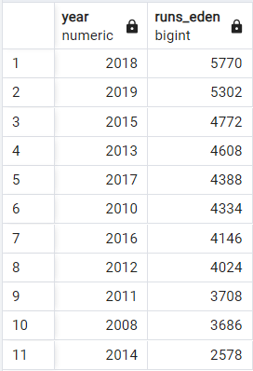
10. Write a query to fetch the year-wise total runs scored at Eden Gardens and order it in the descending order of total runs scored.
select extract(year from date) as year,sum(total_runs) as runs_eden from deliveries_v03 where venue ='Eden Gardens'group by year order by runs_eden desc;

Slide 21
Thank You

