Slide 1
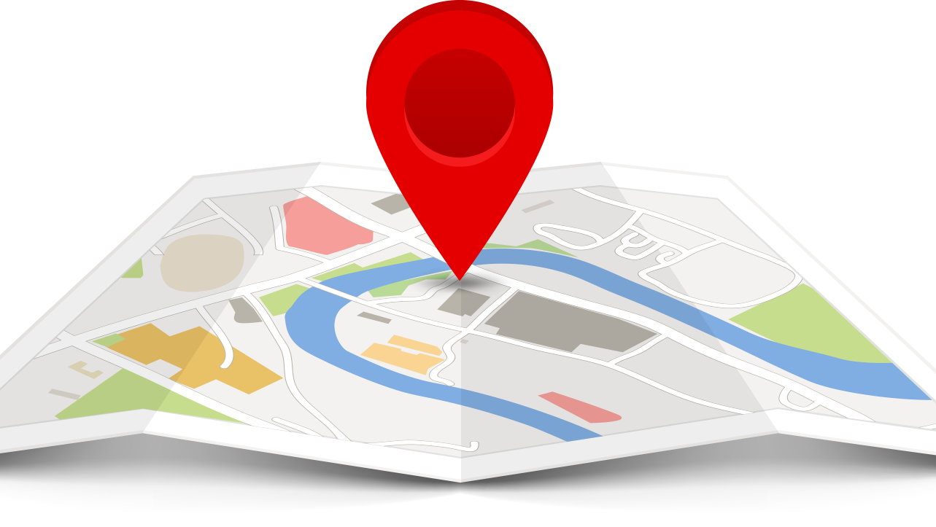
MOBILE TRACKING SYSTEM
BY – GROUP 28
1) SUDIPTA NARAYAN DHAR
2) MD RISHER ALI
3) ANIMESH PRASADI
4) SWARNAVA HALDER
5) SUBHAM BHATTARCHARYYA
6) SOURAV SARKAR

Slide 2

What is Mobile Tracking system?
Mobile phone tracking refers to the attaining of the current position of a mobile phone either stationary or moving
Localization may occur either via multilateration of radio signals b/w(several) radio towers of the network and the phone, or simply via GPS.

Slide 3
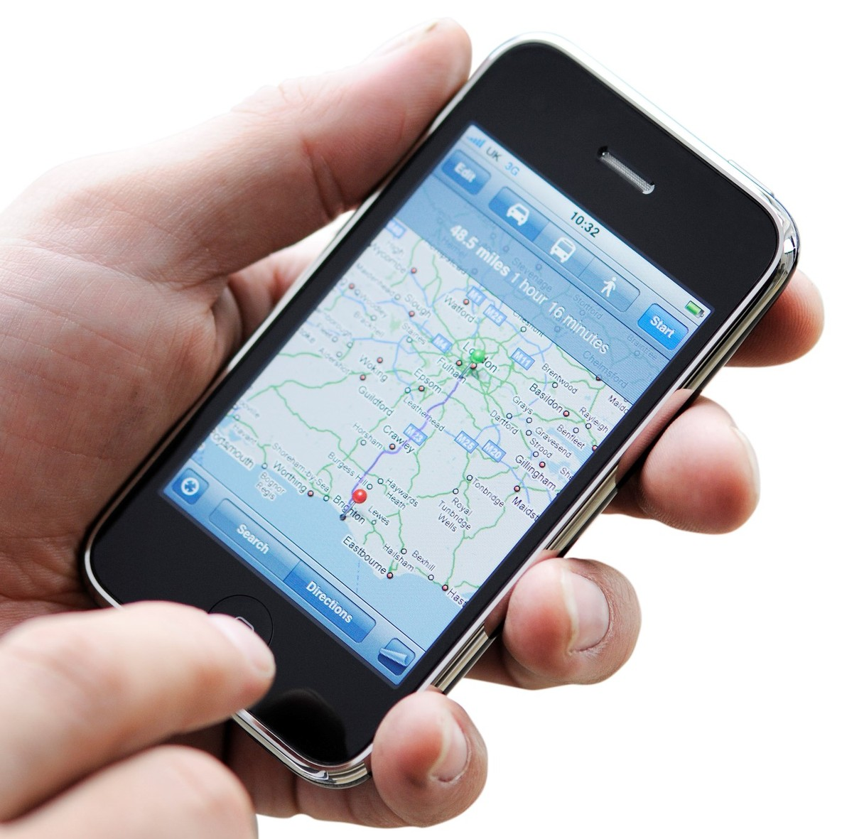
What is mobile positioning?
Mobile positioning refers to technology used by telecommunication companies to approximate the location of a mobile phone

Slide 4

Needs for Mobile Tracking system
Location based services
Cellular fraud detection
Driving directions
Emergency service for subscriber safety
Traffic information
Tracking criminals and stolen mobiles

Slide 5

Positioning techniques
It is classified on where the data is processed
1) Mobile based positioning
2) Direction based positioning
3) Distance based positioning

Slide 6
Mobile Based Positioning
There are two types of mobile based positioning
GPS
Cell Identity

Slide 7
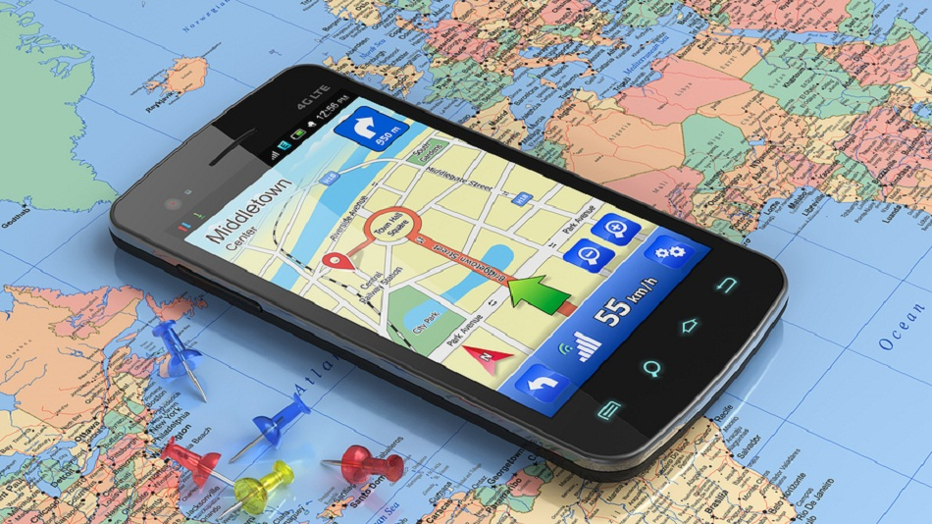
Global Positioning system (GPS)
To locate the mobile telephone by itself the mobile telephone is provided with a GPS receiver
To calculate its location in latitude and longitude coordinates based on the location information received from a satellite through the GPS receiver
This Photo by Unknown author is licensed under CC BY-NC-ND.

Slide 8
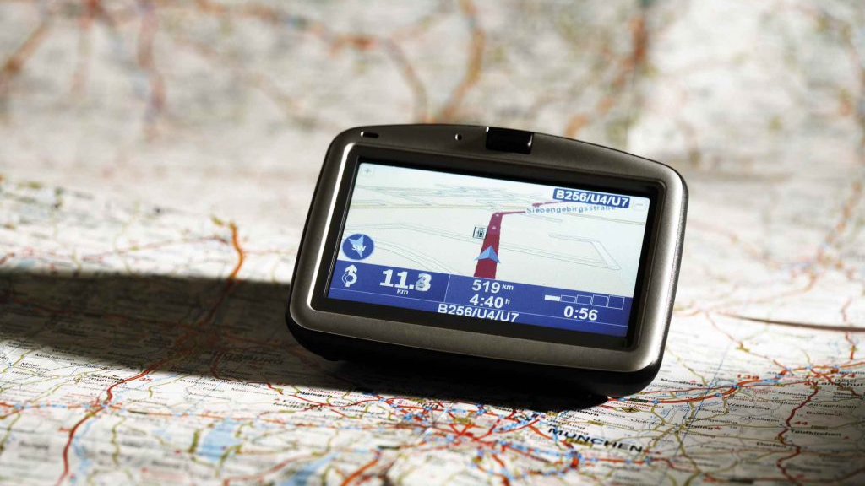
How does GPS work in cell phones?
The receiver calculates the distance between one satellite and the receiver.
To find the distance and locations of the satellite and receiver, the parameter time is computed( t = time taken by the signal to reach from satellite to the GPS receiver).
The time is multiplied by the speed of light to get distance between the satellite and receiver.
A method called Trilateration is used to find the exact location of a mobile
Trilateration takes the known distances three different object and finds out where you are w.r.t the objects.
Intersection of three circles gives the exact position of the mobile.
This Photo by Unknown author is licensed under CC BY-SA-NC.

Slide 9

Cell identity
Most simplistic and cost-effective way to provide position information
Simply determines which cell of wireless network the device is using
Since BS for each cell is fixed, cell identity can easily translated into the location of a mobile user
It gives the general location of where the user is but not the exact location.
The ways to improve the accuracy of cell identity is by reducing the total area of a possible location by dividing the cell into sectors either 120 degree or 60 degree.
This Photo by Unknown author is licensed under CC BY-NC-ND.

Slide 10
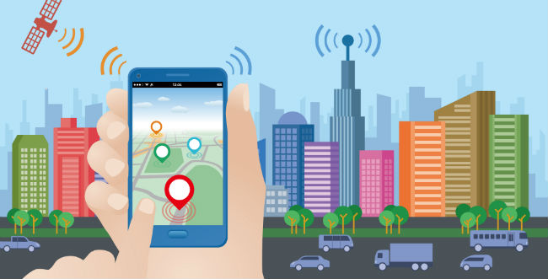
Direction Based Positioning Angle of Arrival(AOA)
Calculate the angle of arrival of signal receiving at the base stations.
It measures the direction of signal falling on the base station and measures the angle of incidence with respect to a normal and determines the position of the system
Use two or more base stations.
This Photo by Unknown author is licensed under CC BY-SA-NC.

Slide 11
Distance Based Positioning Time of Arrival (TOA)
It is also based on Trilateration
The TOA method calculate the distance of a Mobile tower and a Base station based on the TOA of a signal transmitted from the MT at the BS.
Distance between the MS and BS is found by just multiplying the calculated time by speed of light.
This Photo by Unknown author is licensed under CC BY-SA-NC.

Slide 12

Time Difference of Arrival (TDOA)
The TDOA method assumes that the signal transmitted from the mobile telephone at the three base stations define a set of points on a hyperbola.
The mobile telephone is located at the intersection point of hyperbolas.
Position of base stations defines a foci and intersection of hyperbolas defines the location of MS.

Slide 13
Advantages of Mobile Tracking System
Business Management
Emergency services
Colleague and Friend tracking
Child safety

Slide 14

How to Block Mobile Tracking
Check for physical GPS tracking devices that may be attached to your phone.
Remove any tracking software that is installed on your handset.
Contact your cellular phone company.
Remove the battery from your phone. This is the only way to guarantee the phone is untraceable.
This Photo by Unknown author is licensed under CC BY-NC.

Slide 15
Conclusion
The location of a mobile telephone can be accurately tracked even in the multipath fading and the NLOS environment, by using more accurate tracking curves connecting the intersection points among circles with the radii being the distances between corresponding base stations and the mobile telephone in a cellular mobile communication system

Slide 16


