Slide 1
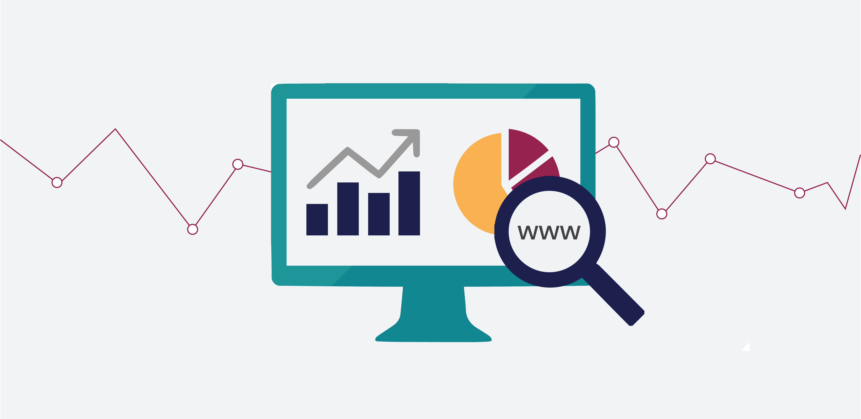

DataTao
Empower businesses to achieve data engineering efficiency.

Slide 2
DataTao
Context Setting
Business invest significantly today to modernize their data lake using cloud technologies. Yet, building and managing enterprise data lake today is very challenging. It involves a lot of manual effort, involving complicated, time-consuming, ever-changing & confusing (plethora of technologies to choose from) tools & technologies.
It takes many months to build the lake and huge engineering team for support & maintenance. This is not only inefficient, but also very costly and highly sluggish, causing very high time to deliver value.
Notes:
Business invest significantly today to modernize their data lake using cloud technologies. Yet, building and managing enterprise data lake today involves a lot of manual effort, involving complicated, time-consuming, ever-changing & confusing (plethora of technologies to choose from) tools & technologies.
It takes many months to build the lake and huge engineering team for support & maintenance. This is not only inefficient, but also very costly and highly sluggish, causing very high time to deliver value.

Slide 3
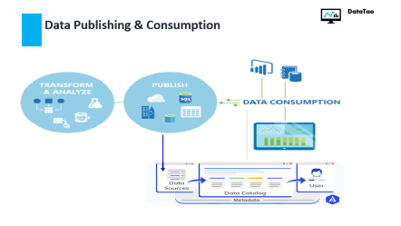
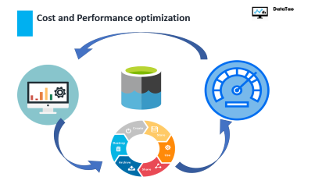
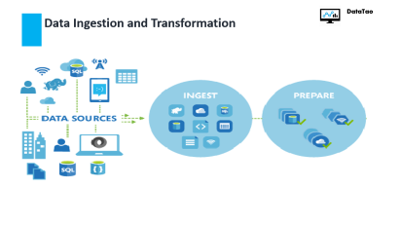
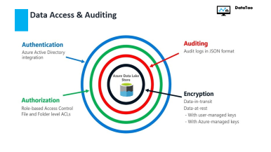
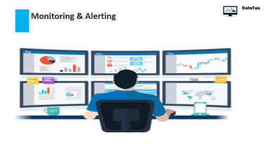
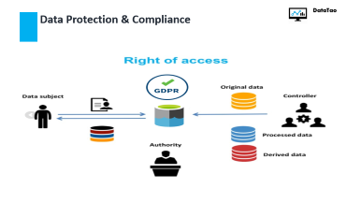






DataTao
Challenges and failures in building and Maintaining a DataLake
Data Pipeline
Service Health
Security & Compliance
Notes:
Challenges and failures in building and Maintaining a DataLake

Slide 4
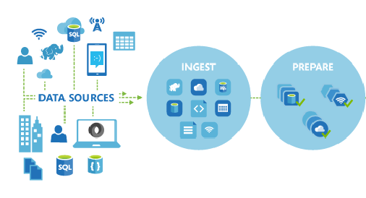
DataTao
Data Ingestion and Transformation
Notes:
In an enterprise platform, data needs to be ingested from varied sources. The complexity increases with types of sources, number of entities in each source and ingestion patterns(like full and incremental). Traits of big data, volume, velocity and variety further add sustenance and maintenance challenges. Subsequently, the ingested data is then subjected to conformance by de-duping it, data quality checks and then, structuring it.
In most of the organization, all this is done by creating hand-coded custom ETL pipelines and ingestion logics.

Slide 5
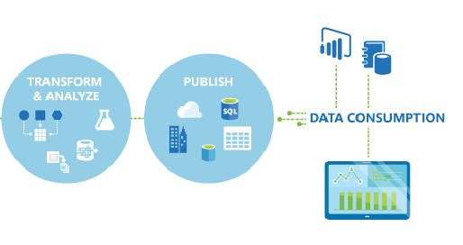
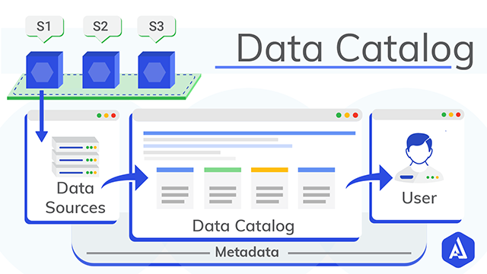
DataTao
Data Publishing & Consumption
4
Notes:
Data consumption is where most of the sub-standard data lake implementations fail to deliver real business value.
First, it becomes very hard for consumers to discover relevant data, after tedious manual effort (email communication with data engineering team) once consumer know about data, the next challenge is to identify data lineage and relationships, causing a spiral of dependencies between the Business Intelligent team and the data engineering team.
Most of the cases data not being in directly consumable by downstream reports & applications, and create problem of data proliferation, leading to formation identical of sub-lakes & cost replication at consumers end.
Lack of a unified sematic layer and standard publish patterns is the main bone of contention between the BusinessIntelligent team and data engineering team.

Slide 6

DataTao
Monitoring & Alerting
Monitoring & Alerting data flows
Monitoring & Alerting data flows
Notes:
Monitoring is an important day to day aspect of data engineering team. Due to no stitching across the data lake ecosystem, DRI or Livesite engineer must go to multiple places to get the overall health of the system.
Absence of advance alerting mechanism can lead to failed state of data lake ecosystem for many hours or day, increases time to response to an incident, causing a degradation of service to business users and impacts business decision making which defeat the very purpose of formation of data lake.

Slide 7

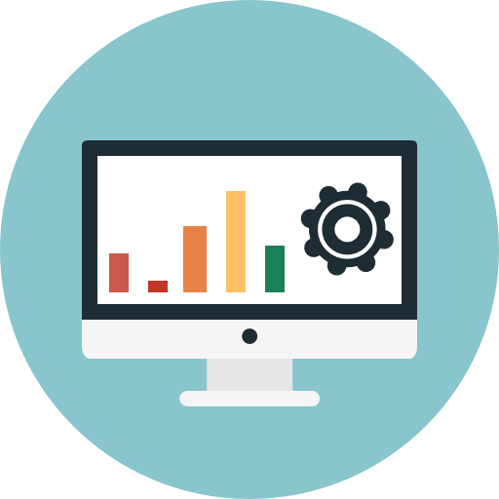

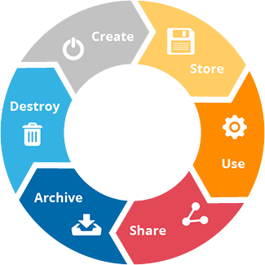
DataTao
Cost and Performance optimization
Notes:
Cost Optimization
Performance Enhancement
Data Drainage

Slide 8
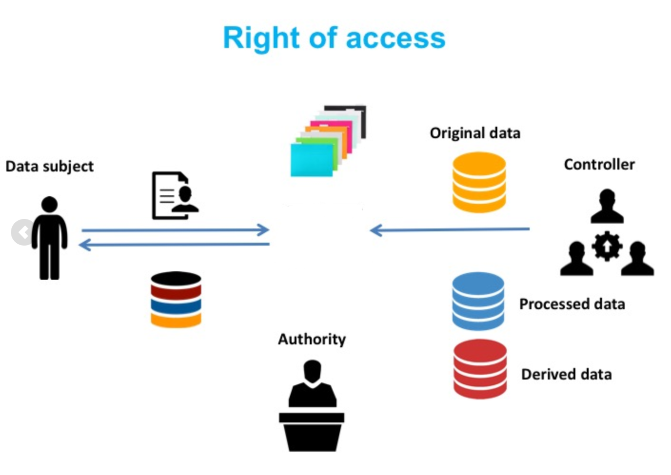

DataTao
Data Protection & Compliance
3
Notes:
This is a growing concern for data engineering. With more and more regulatory compliances coming up everyday, enterprises have to invest heavily on forming specialized compliance teams. Even with this, in case there are any implementation gaps, companies end up paying fortunes on these breach.
There are data protection regulations stated that requires you to enable data protection in your system
GDPR compliance
SOX compliance
Fines are upto 4% of the total turnover
Masking & Encryption of Data

Slide 9
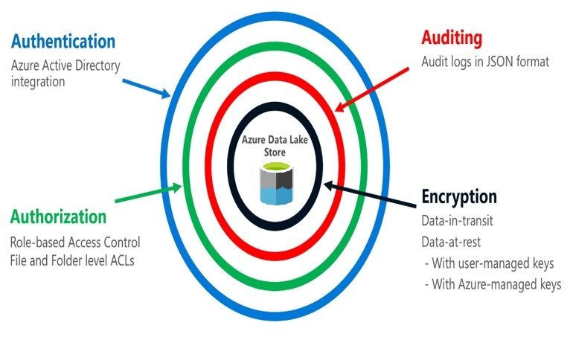
DataTao
Data Access & Auditing
6

Slide 10
DataTao
Enter DataTao
We are offering an enterprise scale ‘Data Lake Formation Solution’ to build your data lake in days and with no maintenance. All this leveraging your own cloud infrastructure.
DataTao provides a fully managed solution to create and manage your cloud data lake implementation in a nearly code free manner so that even business users can do it without any technical knowledge.

Slide 11


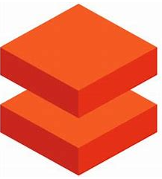


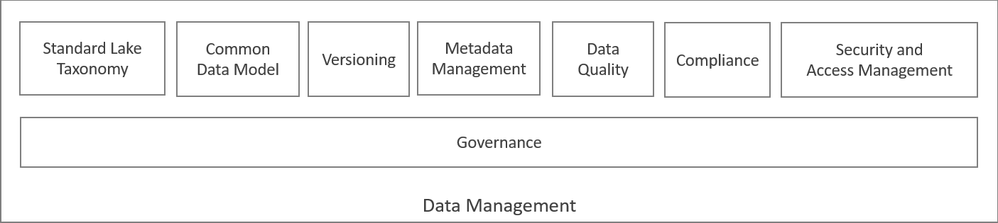
High Level Architecture
DataTao
Ingestion
Lake
Storage
Compute
Analytics
ML/AI
Cubes
Dashboards
Reports
Federated Analytics
Multi-Tenant
Fit for Purpose Enterprise Connected Data Fabrics
Consistent and Scalable Data Management
Single Location for Data Discovery and Subscriptions (One Catalog)
Modern Engineering System Capabilities
Optimization recommendation engine
Monitoring & Alert
Extension to complex business scenario
Leveraging customer ecosystem for autonomy and transparency.
BCDR Business continuity and disaster recovery
Code free
Tenants Onboarding
Business Units
Business Partners
Data Discovery
and Subscriptions
Onboard
BYO Compute to Data Option
BYO Compute to Data Option
1
3
Datatao
Data Discovery
Services
Data Sources
Ingest
Data Lake
Data Assets
Metadata
Access
Management
Just in time
access
Notes:
Here is the brief overview of high-level architecture. DataTao’s ‘Lake Formation Solution’ use the leading cloud technologies to create the enterprise data lake ecosystem and provide a cool user interface-based abstraction on top of its powerful engine.
We will cover this more in depth but first let us look into the things in action.

Slide 12
Benefits Summary
DataTao
1. Reduction in Engineering team Spends – by up to 75%.
2. Reduce Time to Value – Instead of months, make your data “analytics-ready” in hours.
3. Infrastructure transparency : Complete transparency of cloud infra and spending.
4. Umbrella of offering, complete ecosystem, partner in their complex business requirements, bring your own patterns
5. Complimenting the market leaders: Datatao sits on top of the existing products of cloud providers.
6. Compliance: GDPR, data localization, SOX compliance data.

