Slide 1
Smart Contact Manager System
Proposal develop for the partial fulfillment of
Project of fourth semester(CAPJ-256)
By Sandip chapagain

Slide 2
Introduction
Name : smart contact Manager System
Manages contact/phNo efficiently.
Especially Keeping contact details of staff.

Slide 3

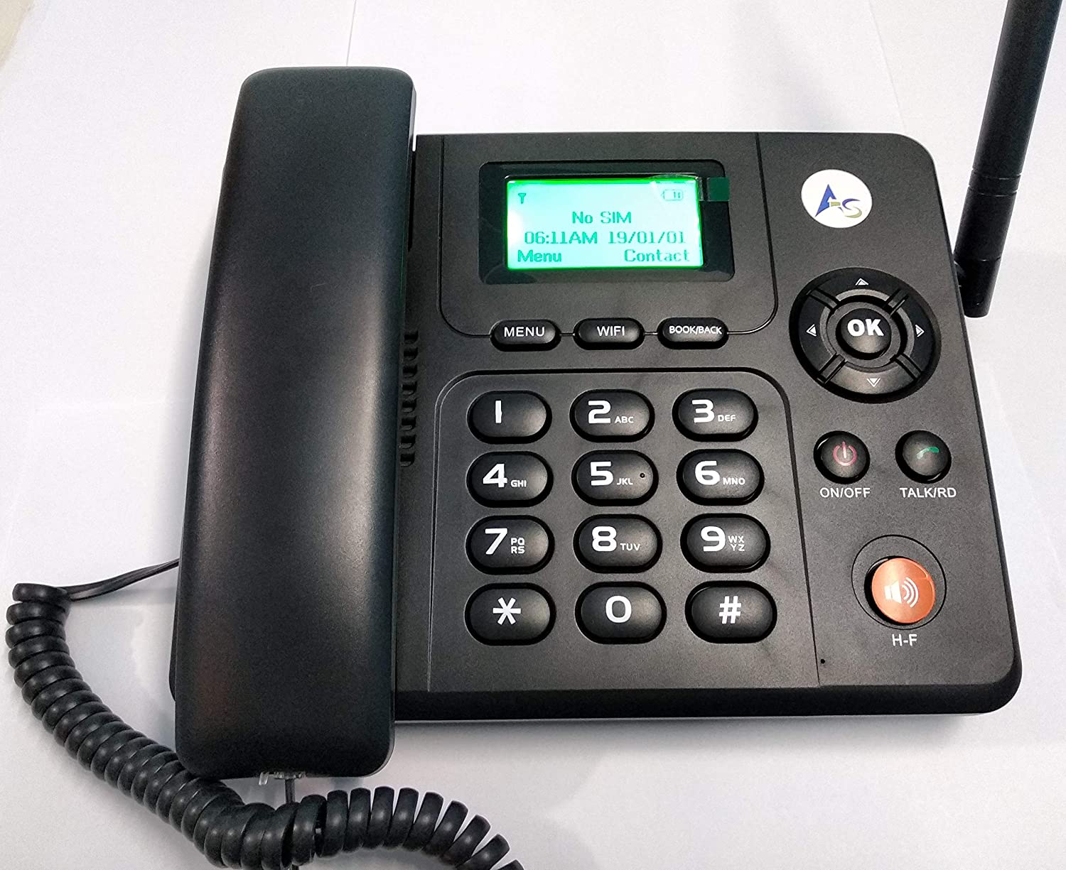
In previous days people use notebook to keep record

Slide 4


Now a days

Slide 5
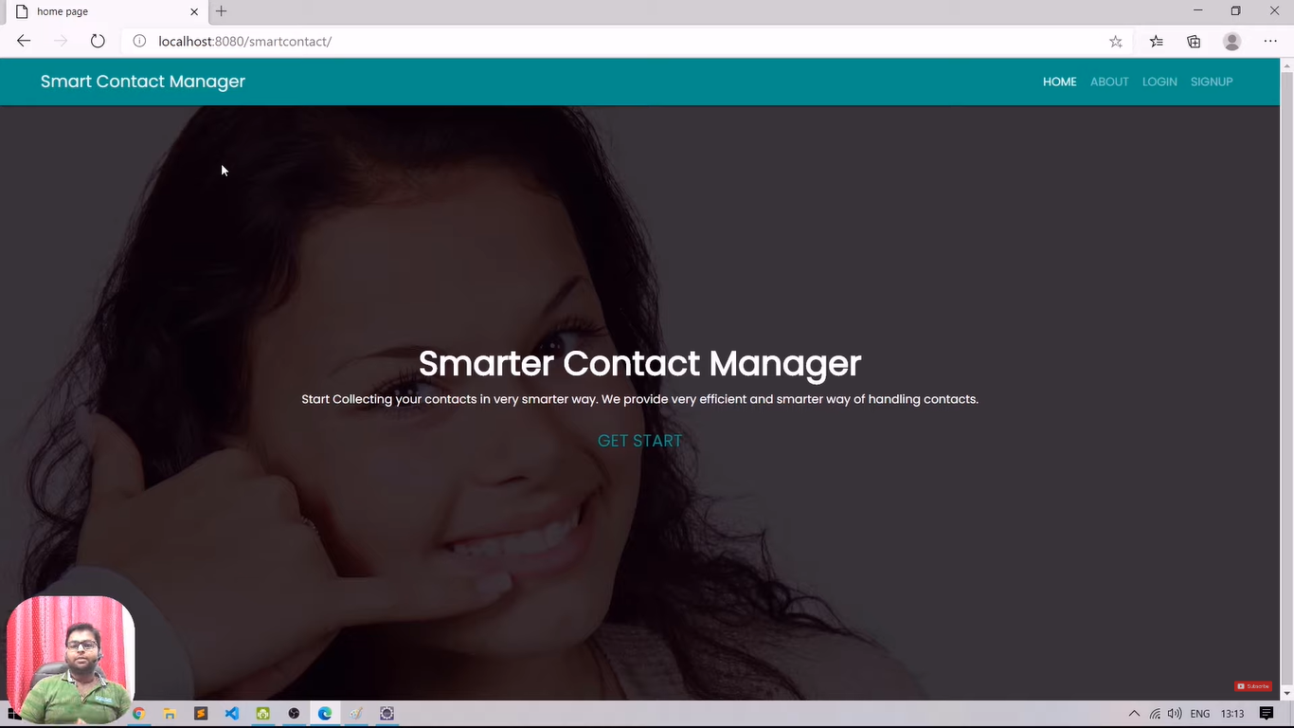
Now My smart contact manager was introduce

Slide 6
Why this project will be developed ?
To overcome the time consuming traditional approach of general record keeping.
To increase the productivity of the company.
To track contact details,ph,email, // employee name in short period of time.
To digitalize the company.
To improve the quality of record keeping.
Backup

Slide 7
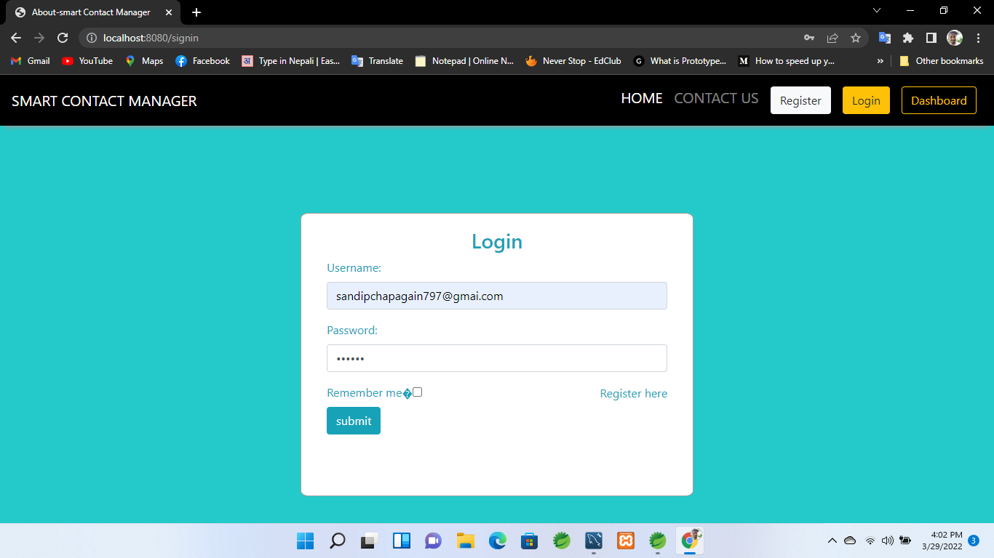
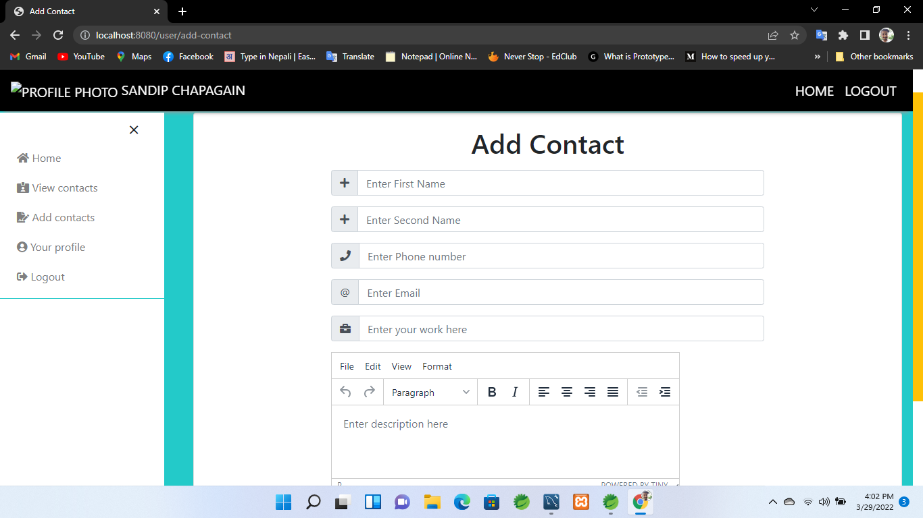
Expected Outcomes

Slide 8
In my perspective
Smart Contact manager is the process of recording contacts’ details and tracking their interactions with a business. Such systems have gradually evolved into an aspect of customer relationship management (CRM) systems, which allow businesses to improve sales and service levels leveraging a wider range of data.

Slide 9
THANK YOU !!!!

