Slide 1

CTF – Flow Override
Group 2:
Sree jignash bonthu
Son dang
preeshan kayastha
ujjwal rana magar

Slide 2
Challenge Scenario
Flow Override:
A trusted friend gives you full access to his water treatment plant for a security test. The Siemens PLCs use S7comm — Can you break in and disrupt at least three pieces of equipment?

Slide 3
Tools Used/Attempted
Tools that provided preliminary data
Dig
Traceroute
Curl
Python
nmap
Tools attempted but were incompatible for challenge
Nikto
Metasploit (no S7 libraries)
Sn1per

Slide 4
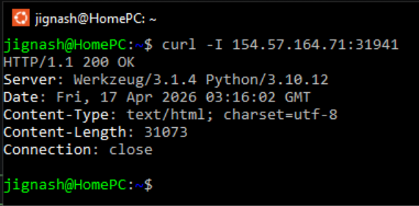
Curl gave the server type and python version.

Slide 5
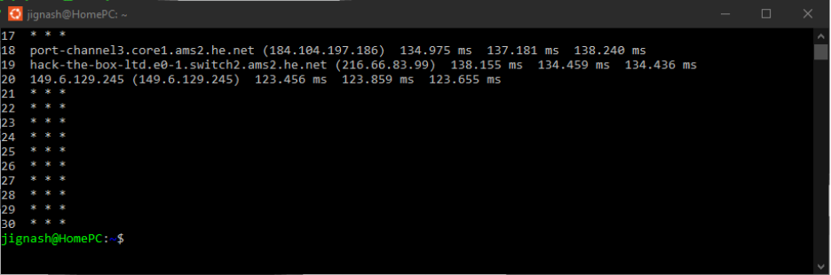
Traceroute provided all network hops, below are the last few starting with the HackTheBox host.

Slide 6
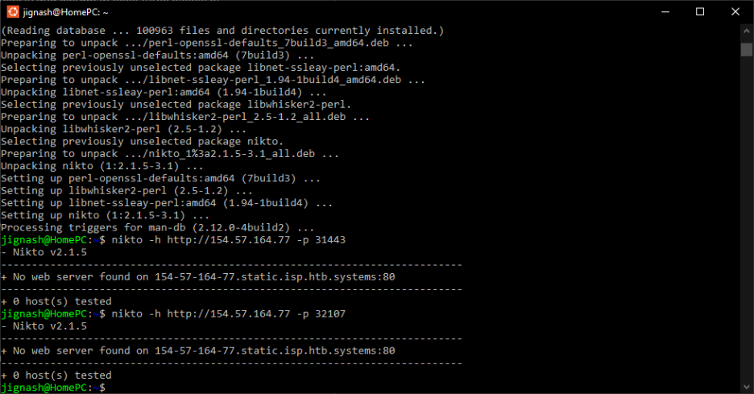
Nikto
Nikto was unable to find vulnerabilities

Slide 7
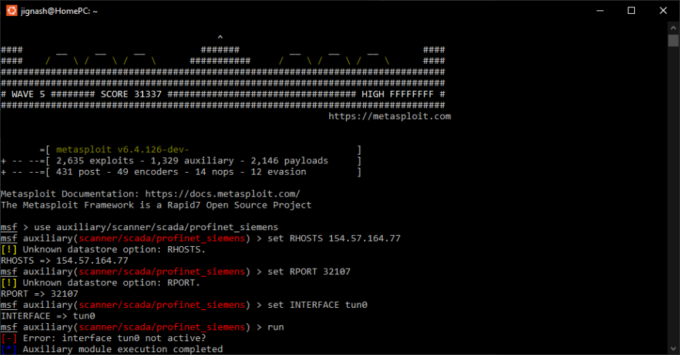
Metasploit
Attempted modbusdetect and profinet_siemens modules with and without tun0 adapter with VPN setup as they were the close but they do not fit the S7 protocol usecase

Slide 8
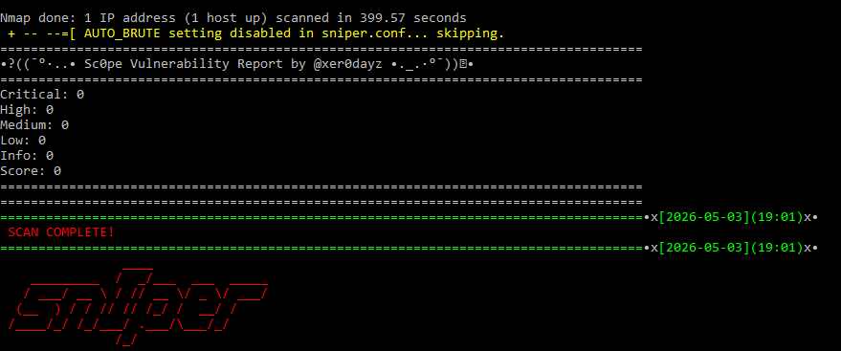
Sn1per
No vulnerabilities detected

Slide 9
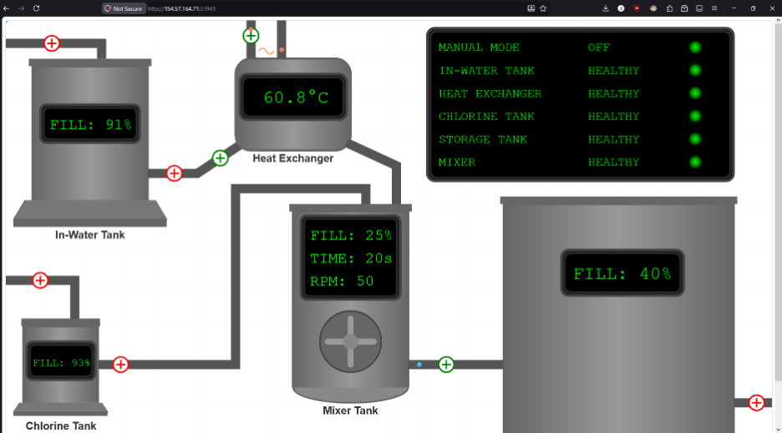
Useful Data Found
On Wireshark.com, “S7comm (S7 Communication) is a Siemens proprietary protocol that runs between programmable logic controllers (PLCs) of the Siemens S7-300/400 family.” Started with one IP and two ports – one accessible to machinery status page, other times out.

Slide 10
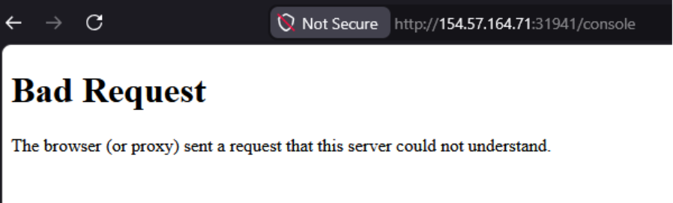
/console which gave a 400 Bad Request error
Guessing possible directory names was an option. Attempted common names like admin, ui, dashboard, mail, login which led a 404 page except for /console

Slide 11
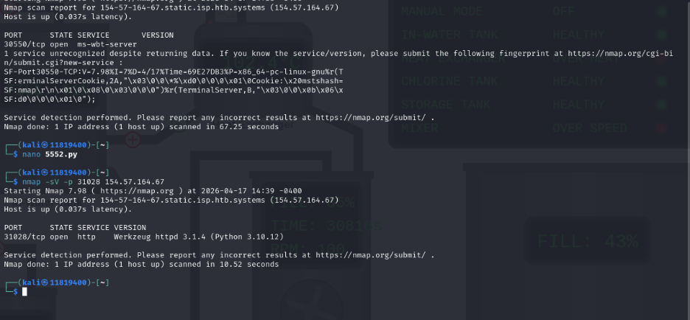
Capturing the Flag

Slide 12
Capturing the Flag contd.
2 ports were shown when we start the challenge with the same ip address but different ports.
by using nmap we can see one is http and the other one is using a service called ms-wbt-server. When we search google, we can figure out that the service is for remote connection.

Slide 13
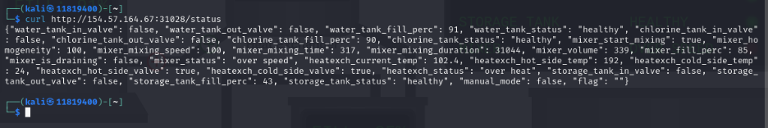
Capturing the Flag contd.
Used curl to check the html information

Slide 14
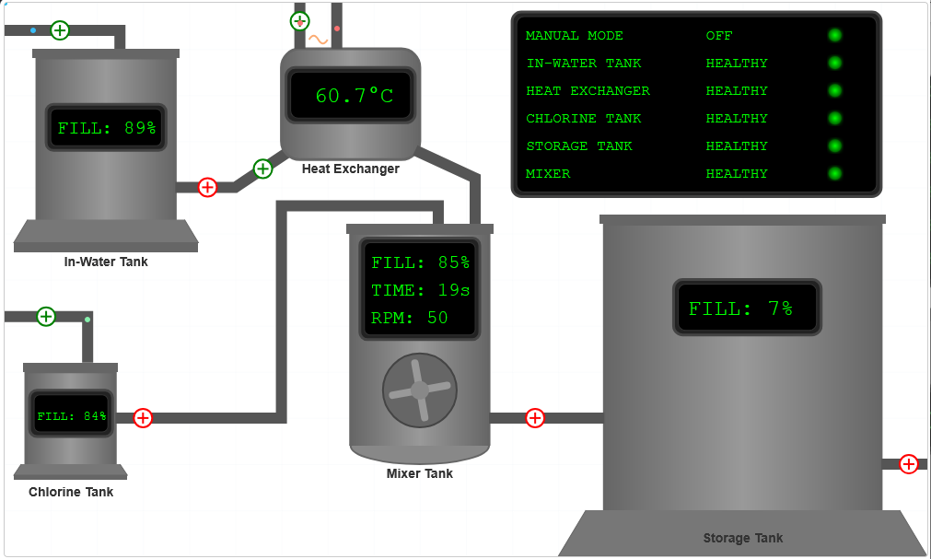

Slide 15
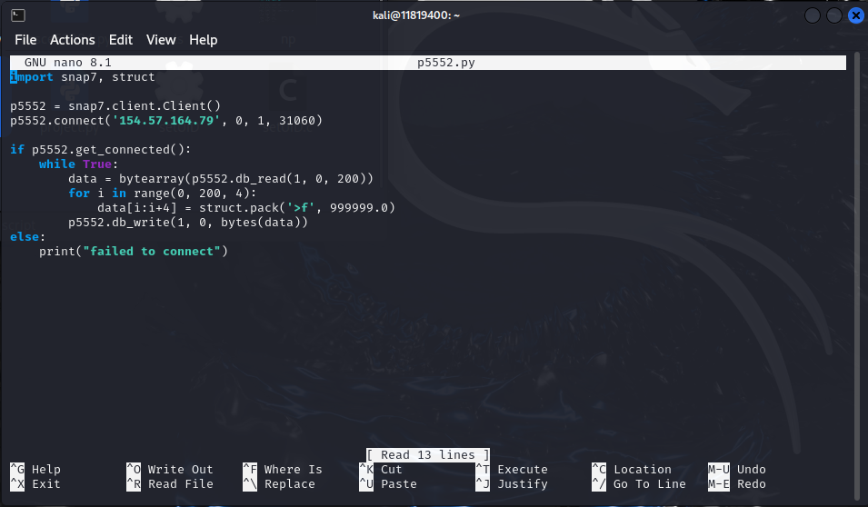
Capturing the Flag contd.

Slide 16
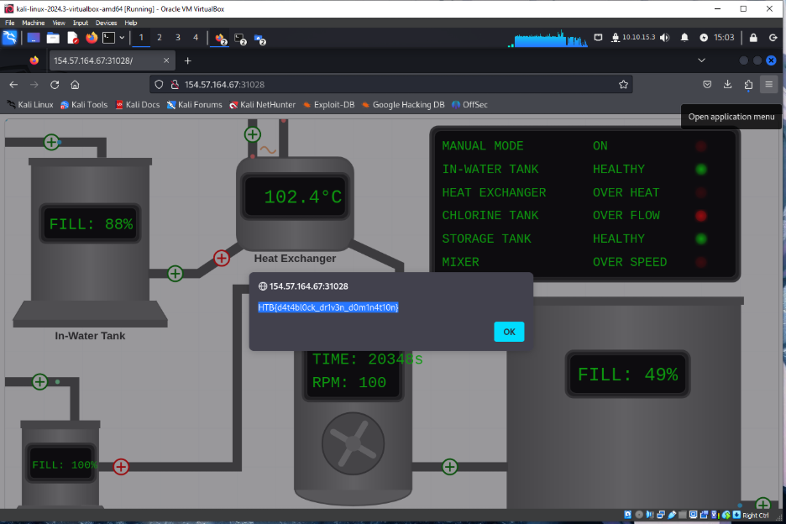

Slide 17
Security Recommendations
Disallow programmatic access over the internet
Lock down PLC controls with least-privilege account permissions
The PLC logic only overrides three of the 100 bytes we chose to override. It should have an implementation to backup and halt access if commands cause failure

Slide 18
References
https://www.solisplc.com/tutorials/introduction-to-snap7-integration-into-siemens-tia-portal
https://www.freecodecamp.org/news/python-for-loop-for-i-in-range-example/

