Slide 1
SHADOWFOX
Data Science Internship
Beginner · Intermediate · Advanced
A complete walkthrough of all three internship levels — the tasks, the
approach, and what the data actually showed.

Slide 2
What This Covers
Three levels, three datasets, one growing skill set.
1
Beginner
Documenting Pandas & Matplotlib using real IPL match data
2
Intermediate
Analysing Delhi's air quality, hour by hour
3
Advanced
A scratch exploratory analysis of Indian cinema, 2001–2019
Overview
ShadowFox Data Science Internship

Slide 3
About the Internship
The ShadowFox Data Science Internship is structured in three levels. Every task uses a real dataset so the conclusions are grounded in something checkable.
Datasets analysed
3
20+
Charts & visuals built
The three levels build on each other: charting fundamentals, then a full exploratory analysis with real research questions, then an open-ended final project — choosing a dataset and defining the questions myself.
16
Research questions answered
Introduction
ShadowFox Data Science Internship

Slide 4
1
Beginner Level
Visualization Library Documentation — Pandas & Matplotlib

Slide 5
The Task & Approach
20 chart types covered
What was asked
Python visualization libraries — the chart types each one supports, with working code for every one.
Line
Bar
Horizontal Bar
Histogram
KDE
Box Plot
Pie
Area
Stacked Bar
Scatter
Grouped Bar
Annotated Scatter
What I chose
Pandas + Matplotlib, documented side by side using a real IPL match dataset (2008–2022, 950 matches) instead of dummy numbers.
4-Panel Dashboard
Why together
Pandas plotting runs on Matplotlib underneath — so this shows the quick way and the fully-controlled way of building the same chart.
Beginner Level
ShadowFox Data Science Internship

Slide 6
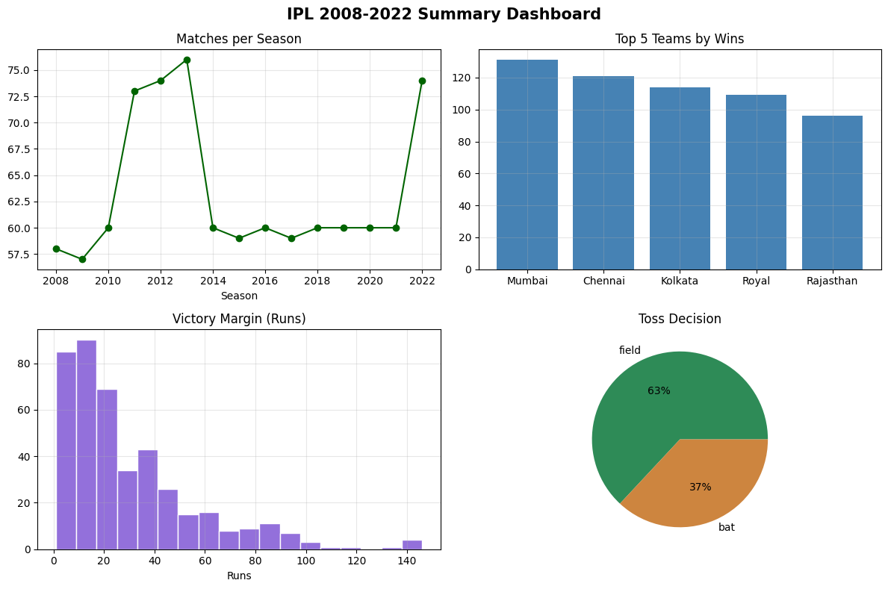
What the Data Showed
Mumbai Indians and Chennai Super Kings have won clearly more matches than any other IPL team.
Teams now choose to field first after winning the toss about 63% of the time — a habit that's grown fast since 2014.
Most wins by runs are narrow — the median margin is just 22 runs.
Figure — 4-panel dashboard built entirely in Matplotlib
Pandas for speed, Matplotlib for control — and combining both beats picking one.
Beginner Level
ShadowFox Data Science Internship

Slide 7
2
Intermediate Level
Delhi Air Quality Index Analysis — Pandas, Matplotlib & Seaborn

Slide 8
The Task & Approach
Dataset
How bad was the air, by official AQI category?
Hourly Delhi air quality readings, 1–24 January 2023 (561 hourly readings)
1
The honest adjustment
Does pollution follow a pattern across the day?
The brief asked about seasonal variation — but 24 days of January can't support that. So the research questions were reshaped around what the data could actually answer: daily patterns, pollutant relationships, and weekday vs weekend differences.
2
Which pollutants move together — and why?
3
Method
Converted raw PM2.5 / PM10 readings into the real CPCB AQI scale, then broke the data down by hour, by pollutant, and by day.
How do weekdays compare to weekends?
4
Intermediate Level
ShadowFox Data Science Internship

Slide 9
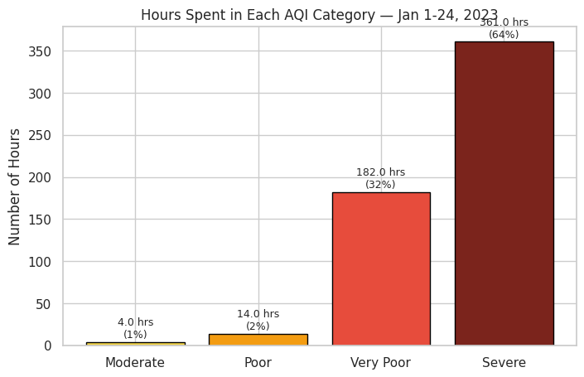
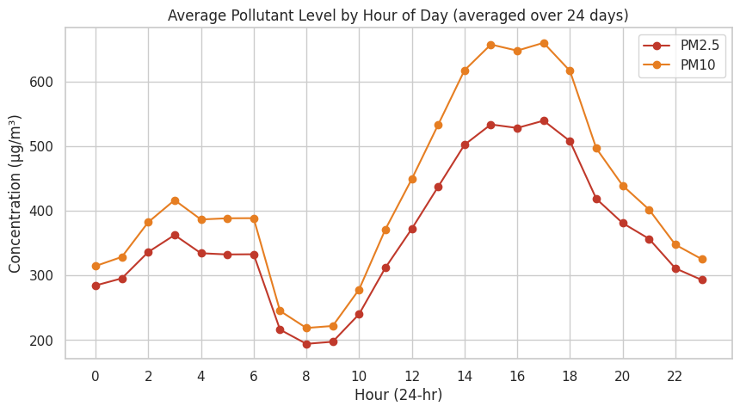
What the Data Showed
Figure — Hours by AQI category
Figure — Pollution level by hour of day
97%
8–9 AM
0.99
of all hours were Severe or Very Poor
the cleanest window of the day
correlation between PM2.5 and PM10
Intermediate Level
ShadowFox Data Science Internship

Slide 10
3
Advanced Level
Indian Cinema Exploratory Data Analysis — a final project, dataset of choice

Slide 11
The Task & Approach
Dataset
1,629 Indian films released between 2001 and 2019 — ratings, votes, genres, cast, runtime, and awards data.
Seven Research Questions
1
How has the genre mix shifted, 2001–2019?
Defining my own questions
2
Does vote count align with rating?
After exploring the columns, I settled on seven research questions the data could genuinely answer, from genre trends to what actually predicts a higher rating.
Which genres rate highest?
3
4
Does runtime affect rating?
5
Do prolific actors mean better films?
Cleaning required
6
Does award recognition relate to rating?
Genres were one pipe-separated string per film; awards were free text like "3 wins & 5 nominations" — both parsed into structured numbers before analysis.
7
How has average rating trended by year?
Advanced Level
ShadowFox Data Science Internship

Slide 12
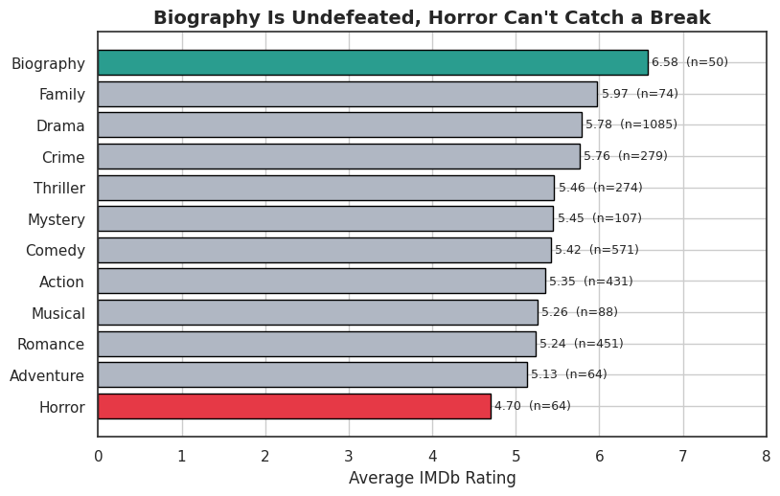
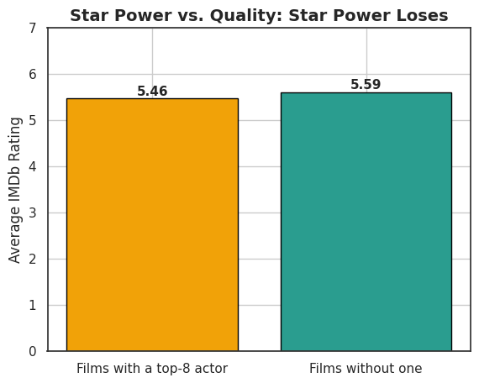
Results
Figure — Rating: prolific-cast films vs. the rest
The counter-intuitive finding
Figure — Average rating by genre (50+ films)
Films with a top-8 prolific actor rated 5.46 on average — slightly below the 5.59 for films without one. A familiar cast didn't mean a better film.
0.44
correlation: votes vs. rating
0.02
correlation: runtime vs. rating
Advanced Level
ShadowFox Data Science Internship

Slide 13
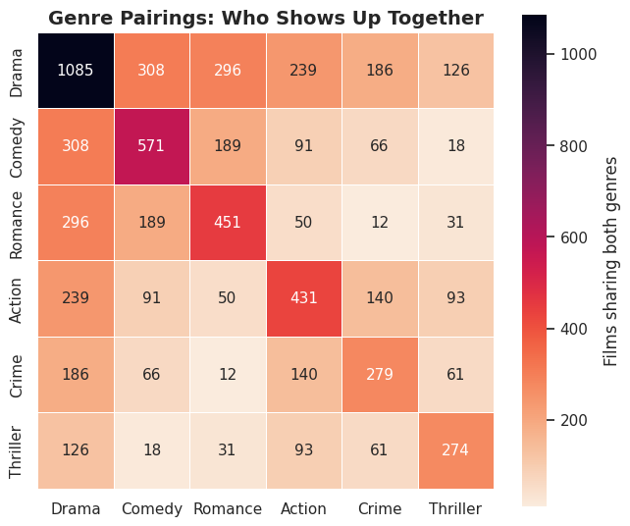
Hidden Gems & Glorious Bombs
Hidden Gems
Most-Watched Worst-Rated
23 films rate 7.5+ on fewer than 1,000 votes — genuinely great, almost nobody's seen them.
Big budgets, big vote counts, brutal ratings. Popularity got these watched — not liked.
Family of Thakurganj (2019)
9.4 · 895 votes
Aag (2007)
1.7 · 6,421 votes
Final Solution (2004)
8.7 · 333 votes
Race 3 (2018)
2.0 · 30,038 votes
Raag Desh (2017)
8.3 · 341 votes
Gunday (2014)
2.3 · 56,670 votes
Figure — Which genres actually show up together (Comedy + Romance = 189 films, the rom-com formula)
Advanced Level
ShadowFox Data Science Internship

Slide 14
Thank You
All code and notebooks are available in the
GitHub repository: https://github.com/sne-hue/ShadowFox-Data-Science-Internship

