Slide 1
Harnessing Helpfulness: Amazon Product Reviews to Elevate Marketplace Experience
DATA 270
Under guidance of Dr. Linsey Pang
Group 5
Presented by:
Eshita Gupta
Monica Lokare
Sneha Karri
Veena Ramesh Beknal

Slide 2
Project Background and Execute Summary

Slide 3
In ecommerce marketplaces such as Amazon, 98% of consumers say reviews are their essential resource for making purchase decisions
Amazon is the US e-commerce leader and accounts for ~38% market share (source)
Amazon reported its annual Net sales as $574.8 billion in 2023, a 12% increase compared with $514.0 billion in 2022 (source)
Recent research suggests that 77% of shoppers specifically seek out websites with ratings and reviews (source)
The same study mentioned that 98% of surveyed consumers say reviews are their essential resource for making purchase decisions, a claim attested by Amazon in its official blog (link)
Therefore, reviews are critical drivers of informed buying decisions and understand the underlying aspects of what makes reviews helpful is critical for customer experience

Slide 4
We are focusing on ‘objective’ categories and consciously avoiding categories for which reviews can have a spectrum of opinions
Our research uses a unique approach to identify the product categories that will be studied as part of our project
We focussed on product categories for which the reviews can be considered ‘objective’
To elaborate, we're consciously avoiding categories for which reviews can have a spectrum of opinions and a lot of subjectivity, like books, fashion, beauty products, etc.,
The decision to segment categories based on the subjectivity of their reviews was arrived at through heuristic methods

Slide 5


We aim to infer insights from predicting helpfulness of product reviews on Amazon which can help customers and sellers
+
=
Helpful review
Meaningful volume of helpful votes
Verified buyer
We hypothesize that helpful reviews (by verified buyers and voted by customers) are crucial in influencing buying decisions
Enabling customers to write more helpful reviews and these can improve their engagement and experience on the platform
Customers can benefit by being prompted with appropriate keywords that result in writing helpful reviews
These insights can also help sellers enhance their product listings, aiding the platform and sellers in redefining their marketing strategies and customer satisfaction

Slide 6
This study can benefit all stakeholders in an ecommerce marketplace - benefit buyers, sellers and the platform (i.e. Amazon)
This study can inspire customers to write more helpful reviews, thereby enriching content and enhancing the overall shopping experience
For sellers, these insights can help augment listing content to suit customer needs
Applications of this study are:
Automated feedback prompting system i.e. customers can be prompted on the platform or post-purchase communication via email to provide helpful feedback based on identified signals
Sellers can address customers’ concerns more proactively, thereby improving their ratings, which in turn can lead to enhanced product discoverability and, therefore, sales
Another significant benefit of this study is the ability for sellers to improve their buy-box presence, the key to which is speculated to be influenced by ratings and reviews (link)
From a platform application point of view, Amazon can play a vital role in providing a web-based solution or monthly report published for the sellers to manage feedback provided by the customers, allowing them to access the insights captured and optimize their listing and product strategies

Slide 7
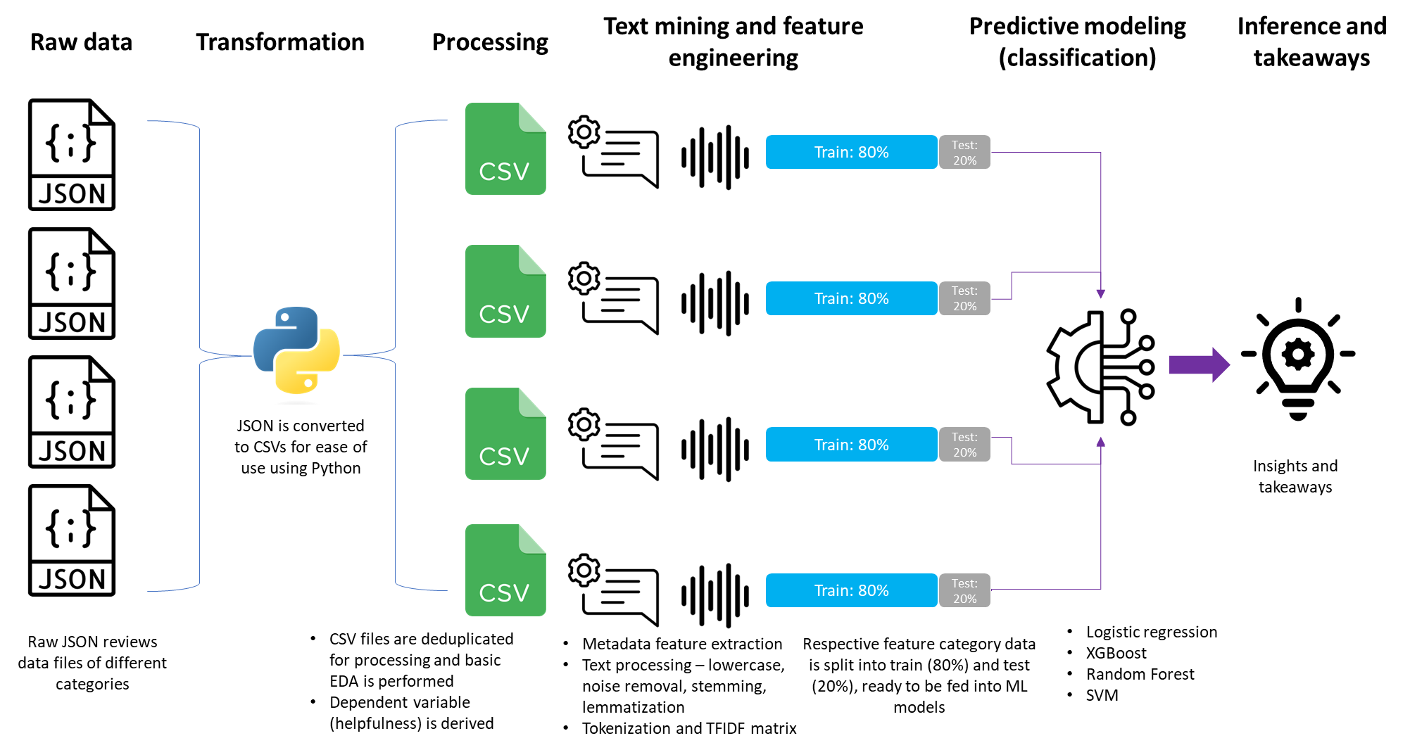
Our proposed working model includes multiple processing tasks to convert raw text into numeric representation, required for modeling

Slide 8
Project Requirements

Slide 9
We select only objective categories and predict helpfulness using features that are generated by TF-IDF of the review text
Objective categories such as Appliances, Automotive, Cell Phones and Accessories, and Tools and Home Improvement have been chosen
We will label our target variable i.e., helpfulness, by merging two features from the review data: they are ‘votes’ and ‘verified’ - votes refer to the volume of helpful votes assembled by the review
Our project utilizes TF-IDF, which stands for Term Frequency-Inverse Document Frequency as the primary method for feature extraction from raw review text
It calculates how vital a word or term is in a large text corpus
Our project will integrate the classification machine learning models listed in the next slide
Performance will be evaluated using metrics such as accuracy, precision, recall, receiver operating characteristic curve (ROC)-area under the curve (AUC), and F1 Scores

Slide 10
We’re using 4 supervised machine learning algorithms to classify reviews as being helpful or not
Logistic Regression:
In our research, we aim to use logistic regression to predict whether the log odds of a review are helpful or not, which can then be converted to a probability
Support Vector Machine (SVM):
In our project, we aim to use SVM to find the optimal hyperplane that separates reviews between being helpful or not with a maximum margin
Random Forest:
In our study, we use Random Forest classification to find the optimal separation between helpful or not reviews
XGBoost (Extreme Gradient Boosting):
In our study, we use XGBoost classification to find the optimal separation ration between helpful or not reviews

Slide 11
We’ve chosen Amazon review data published by UCSD and focusing on 4 key categories for the timeframe of 2010-2018
The dataset we have chosen is a subset of the "Amazon Review Data" published by Jianmo Ni, UCSD
The dataset contains a total of 233.3 million reviews and different categories, and these reviews are in the range of May 1996 to Oct 2018
We are considering only 2010 to 2018
There are two sets of data: raw review data, which contains 233.1 million reviews, and a 5-core subset of data in which all the users and items have at least five reviews, which includes 75.26 million reviews
Column Name | Description
reviewerID | ID of the reviewer
asin | ID of the product
reviewerName | Name of the reviewer
vote | Helpful votes of the review
style | A dictionary of the product metadata
reviewText | Text of the review
overall | Rating of the product
summary | Summary of the review or title
unixReviewTime | Time of the review (unix time)
reviewTime | Time of the review (raw)
image | Images that users post after they have received the product
Link to original dataset

Slide 12
Project Deliverables

Slide 13
We have multiple deliverables as part of our study and we plan on using Agile methodology for project management
Detailed analysis of reviews in the data collection phase and employ a rule-based approach for labeling the data for binary classification
Agile methodology will be used for project management, with each sprint lasting two weeks, and will accomplish specific deliverables during each sprint
The Python notebook code components will comprise data extraction, data transformation, data treatment, exploratory data analysis (EDA), data preprocessing and model training, and evaluation metrics as part of the deliverables
We aim to explore in our study the evaluation metrics, including recall, accuracy, F1 score, precision, and area under the curve (AUC) of the receiver operating characteristics (ROC) curve
A comprehensive research report on the approach used to predict helpfulness utilizing a combination of multiple independent features will be delivered and we’re aiming to achieve an accuracy of above 90%
The project also aims to identify critical keywords that will aid sellers in understanding customer needs, ultimately improving the customer experience on the platform and facilitating sellers to enhance their listings on Amazon

Slide 14
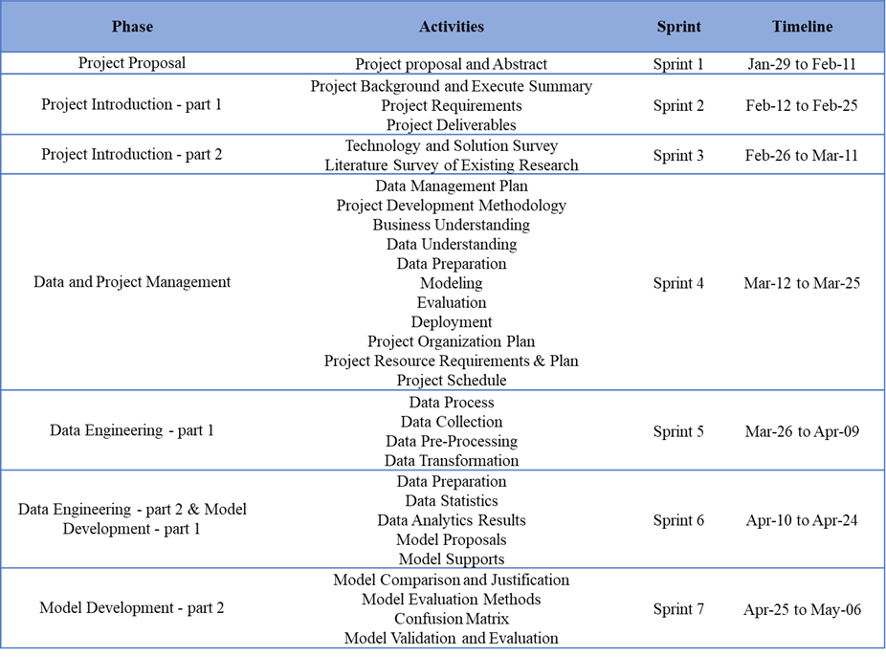
Project Deliverables and Timelines

Slide 15
Technology and Solution Survey

Slide 16
Published papers and research work evaluated
References:
Aljuhani, Sara & Alghamdi, Norah. (2019). A Comparison of Sentiment Analysis Methods on Amazon Reviews of Mobile Phones. International Journal of Advanced Computer Science and Applications. 10. 10.14569/IJACSA.2019.0100678. http://dx.doi.org/10.14569/IJACSA.2019.0100678
Li, H. (2017). Amazon Product Reviews Helpfulness Prediction. https://doi.org/10.17615/jxj5-jt77
Maryam Mahdikhani (2023). Exploring commonly used terms from online reviews in the fashion field to predict review helpfulness. International Journal of Information Management Data Insights, Volume 3, Issue 1, 2023, 100172. https://doi.org/10.1016/j.jjimei.2023.100172
Park, Y.-J. (2018) Predicting the Helpfulness of Online Customer Reviews across Different Product Types. Sustainability 2018, 10, 1735. https://doi.org/10.3390/su10061735
Nguyen, L. T. K., Chung, H.-H., Tuliao, K. V., & Lin, T. M. Y. (2020). Using XGBoost and Skip-Gram Model to Predict Online Review Popularity. Sage Open, 10(4). https://doi.org/10.1177/2158244020983316
Kim, S. M., Pantel, P., Chklovski, T., & Pennacchiotti, M. (2006, July). Automatically assessing review helpfulness. In Proceedings of the 2006 Conference on empirical methods in natural language processing (pp. 423-430). https://aclanthology.org/W06-1650.pdf

Slide 17
Research by Sara et.al (2019) - A Comparison of Sentiment Analysis Methods on Amazon Reviews of Mobile Phones
Sara et al. (2019) classified mobile phone reviews based on sentiment where reviews categorized as positive, negative, or neutral based on customer sentiment.
Preprocessing Techniques: Deduplication | Tokenization | Stop words removal | Stemming & Lemmatization | Lowercasing | Punctuation elimination
Feature Extraction: Bag of Words (BOW), Term Frequency (TF), Utilization of unigrams, bigrams, and trigrams
Models: Logistic Regression, Naive Bayes, Gradient Descent, and Convolutional Neural Networks (CNN).
Experimental Results:
Increase in n-grams size improves accuracy.
Naive Bayes: Accuracy from 83.34% to 88.90% with trigrams using TF-IDF.
Logistic Regression: Accuracy from 86.63% (unigram) to 88.90% (trigrams) with TF-IDF as compared to Li, H. (2017) with 79% accuracy with LR using 56% baseline with Naive Bayes.
Review length influences sentiment classification accuracy.
Conclusion:
Review sentiment classification accuracy improves with larger n-grams.
Length of review is a crucial feature for sentiment classification models.

Slide 18
Research by Maryam Mahdikhani (2023) - Exploring commonly used terms from online reviews in the fashion field to predict review helpfulness.
Maryam (2022) analyzed 828,700 Amazon fashion reviews.
Feature Extraction: Employed topic modeling (LDA) and lexical features like TF-IDF n-grams.
Models: Random Forest, SVM, Logistic Regression, and Gradient Boosting evaluated.
Experimental Results:
Combined feature set of LDA topics and TF-IDF weighted n-grams used.
Random Forest achieved 0.81 accuracy (highest) in predicting review helpfulness with a combined feature set of LDA topics and TF-IDF weighted n grams.
Gradient boosting with LDA topics only achieved 0.7 accuracy.
Other models ranged from 0.56 to 0.65 accuracy.
Conclusion:
Combining TF-IDF and topic modeling enhances predictive accuracy.
Linguistic analysis enables extraction of crucial attributes for customers.

Slide 19
Park, Y.-J. (2018) - Predicting the Helpfulness of Online Customer Reviews across Different Product Types
Yong-Joon Park et.al - treated review helpfulness prediction as a regression problem. Focused on product categories: beauty, cellphone, clothing, grocery, and video.
Feature Modelling: Categorized the features into 3 broad buckets.
Psychological: Analytic, Clout, Authentic, Cognitive processing, Perception, Positive Emotion, Negative Emotion
Linguistic: Word count, Words per sentence, Comparison words
Metadata: Customer ratings from 1-5
Models: Support Vector Regression (SVR), M5P, Random Forest, and Linear Regression
Experimental Results: Criteria that was used for evaluation of performance between different models was mean absolute error. SVR demonstrated superior performance, with an error rate of 11.7203 as compared to (M5P: 12.0229, LR: 12.1396, RandF: 12.1729) for beauty products.
Outcome: This study emphasized the importance of feature modeling and data pre-processing to enhance predictive accuracy, especially for specific product categories. Also, sentiment and comparative expressions impact review helpfulness only for some categories.

Slide 20
Nguyen, L. T. K., Chung, H.-H., Tuliao, K. V., & Lin, T. M. Y. (2020) - Using XGBoost and Skip-Gram Model to Predict Online Review Popularity
Nguyen et al. (2020): Explored online review popularity's influence on customer decisions using XGBoost and skip-gram models.
Features Extraction: Textual (sentiment, relevance) and Non-textual (reviewer demographics, product details).
Models: XGBoost and Ridge Regression
Experimental Results: Evaluation criteria used was root mean squared logarithmic error (RMSLE). XGBoost outperformed Ridge Regression, achieving an RMSLE of 1.168 vs. 1.471.
Conclusion: The value of non-linear feature combinations and ensemble tree methods for popularity prediction for textual reviews was demonstrated effectively by the accuracy rating for XGBoost. This study shows that Skip-gram and XGBoost approach provides a framework with high degree of accuracy for using text based data for predicting review helpfulness

Slide 21
Kim, S. M., Pantel, P., Chklovski, T., & Pennacchiotti, M. (2006, July) - Automatically assessing review helpfulness
Soo Min Kim et al. Investigated the helpfulness of Amazon reviews for MP3 players and digital cameras using SVM.
Features Extraction & Modelling: Features encompassed star rating, structural attributes like review length, sentence count, average length, syntactic patterns and formatting.
Using TF-IDF, lexical n-gram features were prepared like unigrams and bigrams
Natural language processing techniques like sentence breaking, part-of-speech tagging, parser tokenization and syntactic parsing were used to extract these diverse features
Models: The study primarily evaluated the SVM (Support Vector Regression) model with a variety of feature extraction techniques.
Experimental Results: The study was able to derive promising results with rank correlations of 0.66. Extensive parameter tuning was performed and was measured using Spearman correlation coefficient with scores 0.656 +/- 0.033 for the MP3 players dataset and 0.595 +/- 0.028 for the digital cameras.
Conclusion: They experimented with different kernels within the SVM framework and identified that Radial Basis Function (RBF) had the best performance. With effective feature modeling, SVM can help achieve a high degree of accuracy..

Slide 22
Inference from Technology Survey
Review data exhibits significant variations influenced by factors such as product category, sentiment, and textual length.
Understanding the product categories is crucial for tailored data cleansing and pre-processing techniques.
Data cleaning and preprocessing steps will include deduplication, null identification, removal of emojis, URLs, and non-ASCII characters, and conversion to lowercase.
Natural language processing techniques like stemming, lemmatization, Bag of Words (BOW), and TF-IDF can be employed effectively for feature extraction.
Long tail consolidation will be achieved using Principal Component Analysis (PCA).
Evaluation will encompass multiple algorithms including Logistic Regression, SVM, Random Forest, and XGBoost to predict review helpfulness.
Comparative analysis will be conducted to assess each model's performance with similar feature sets.
Performance evaluation will be conducted across multiple review categories to understand model behavior variations.

Slide 23
Literature Survey of Existing Research

Slide 24
Research by Tomas Pranckevicius et al. (2018). Exploring Machine Learning Classifiers for Sentiment Analysis of Online Product Reviews: A Comparative Study
Summary: The study by Tomas Pranckevicius et al. (2018) compares machine learning algorithms like Naive Bayes, Random Forest, Decision Tree, SVM, and Logistic Regression for sentiment analysis of online product reviews. It finds Logistic Regression to be the most effective classifier, highlighting the importance of selecting suitable algorithms for optimizing sentiment analysis outcomes in textual content.
Feature Classification: It stresses on the role of sentiment analysis in interpreting customer feedback across industries and is focused on sentiment classification using machine learning techniques like Naive Bayes, Random Forest, Decision Tree, Support Vector Machines (SVM), and Logistic Regression. This paper is focused on executing large-scale data classification tasks with the MLlib library in Apache Spark and also delves into the difficulties of classification based on sentiment. It seeks to determine the most efficient classifier among the above mentioned methods. Using a dataset of 20,000 chosen online reviews, the study highlights the feature extraction from textual content to train the classifiers. Logistic Regression achieves the highest accuracy ranging from 32.43% to 58.50%, while Decision Tree has the lowest accuracy. Although Naive Bayes is little better when compared to Random Forest and Support Vector Machine in average classification accuracy, the difference is not very significant.
Justification and Contribution: The justification of this paper it addresses the critical need for advanced sentiment analysis to interpret customer feedback across global platforms and industries effectively. The contribution demonstrates Logistic Regression superior effectiveness in sentiment classification, providing guidance on selecting optimal classifiers for sentiment analysis tasks.

Slide 25
Research by Kaushik et al. (2018). Exploring reviews and review sequences on e-commerce platform: A study of helpful reviews on Amazon.in
Summary: Kaushik et al. (2018) studied how review statistics and content, and the sequence in which reviews were presented. These factors played a significant role in molding consumer perceptions and their decision-making, highlighting the complexity of online e-commerce transaction behavior. The data for the testing was collected from Amazon for 57 smartphones over nine months.
Feature Classification:The model included eight input variables, five control variables, and one dependent variable. Model 1 checks how sales are impacted by control variables. Model 2 helps test hypotheses 1 to 7.
Dependent Variable was Sale. Control Variables were Sale Price, Savings, Product Age, Average Rating and Number of reviews. Independent Variables were Percentage of verified reviews, Helpfulness count of helpful reviews, Balance of helpful reviews, Sequence of negative review, Number of helpful reviews, Average informativeness, and Sequence of Informativeness.
The author introduced seven hypotheses on product sales for testing the effect of persuasiveness, informativeness, and sequence of review. Hypothesis 1 - Number of helpful reviews that influence positively. Hypothesis 2 - Average informativeness of helpful reviews. Hypothesis 3 - Products with higher average informativeness reviews will likely have lower sales than products with lower average informativeness. Hypothesis 4- Percentage of verified reviews. Hypothesis 5 - Helpfulness Count. Hypothesis 6 - Balance of helpful reviews. Hypothesis 7- Sales are likely to be lower for products with more negative reviews, and the hypotheses proposed using a linear regression model were tested. The hypotheses proved to be supported.
Justification and Contributions:The existing study on consumer behavior and sales primarily focuses on summary statistics of reviews, such as ratings, without considering the impact of the sequence of reviews. The proposed framework outlines Message Persuasiveness, Informativeness, and Valence of reviews' helpfulness and variables contributing to online product sales. To avoid cognitive overload, this research suggests reordering less information-dense reviews at the beginning and reorganizing reviews to emphasize positive feedback and mitigate negative reviews.

Slide 26
Research by Pumrapee Poomka et al. (2021). Machine Learning Versus Deep Learning Performances on the Sentiment Analysis of Product Reviews
Summary: The study by Pumrapee Poomka et al. (2021) evaluates the performance of machine learning and deep learning methods in analyzing sentiments of Amazon.com book reviews, demonstrating the superior accuracy of Bag of Words (BoW) combined with neural networks. It contrasts various techniques, ultimately highlighting the effectiveness of combining appropriate data preprocessing and model development to enhance sentiment analysis in product reviews.
Feature Classification: The dataset comprises 2000 records, that are split evenly between 1000 positive and 1000 negative reviews, with a training set of 70% and a testing set of 30%. Machine learning techniques include Logistic Regression, Naive Bayes, Support Vector Machines (SVM), and Neural Networks with Bag of Words (BoW) preprocessing, and deep learning approaches like word embedding followed by Long Short-Term Memory (LSTM) and Gated Recurrent Unit (GRU) models. The BoW with the combination of neural networks achieved the highest accuracy at 82%, with a training time of one-minute. The next best was BoW with logistic regression, reaching a 76% accuracy in under a second of training time. Word embedding with deep learning algorithms stands third, showing 74% accuracy and a two-minute training time.
Justification and Contribution: The paper addresses the need to discern and evaluate the sentiments expressed in online product reviews accurately, crucial for understanding consumer behavior and improving product offerings. The paper contributes by demonstrating the effectiveness of combining Bag of Words preprocessing with neural networks in sentiment analysis, offering insights into the optimal methodologies for processing and analyzing textual data in product reviews.

Slide 27
Research by Rathor et al. (2018). Comparative Study of Machine Learning Approaches for Amazon Reviews
Summary: Online reviews influence e-commerce customer behavior, and the review system is currently unstructured and unorganized. This research focused on using natural language processing analysis to classify and analyze online reviews into positive, neutral, and negative using Sentiment Analysis.
Feature Classification: The dataset was extracted using the Amazon API. A total of 21,000 reviews were used in training, of which both positive and negative reviews were 9,500 each and 2,500 reviews were neutral. To test the model, 3,000 randomly selected reviews were considered. This analysis of sentiments process was conducted in five steps- Product Reviews,Sentiment Identification,Feature Selection, Sentiment Classification and Sentiment Polarity. This was classified using Sentiment analysis classification, that had three levels - Document level, Sentence level, and Aspect level. Different machine learning classifiers were used to classify Amazon's reviews, such as Support Vector Machines (SVM), Naive Bayes (NB), and Maximum Entropy (ME).Unigrams and weighted unigrams were used to train the classifiers.
Justification and Contributions: It was found that the classifiers performed average and comparable for the three techniques for unigrams. However, with the weighted unigrams, the SVM method yielded the highest accuracy (81.2%) (p. 1557). It was concluded that product reviews are essential for both buyers and sellers. Textual product reviews are unorganized, and they need to be classified appropriately into positive, negative, and neutral. User reviews need to be more effective for accurate predictions.

Slide 28
Research by Yen-Liang Chen et al. (2021). Predicting eWOM's Influence on Purchase Intention Based on Helpfulness, Credibility, Information Quality, and Professionalism.
Summary: The study by Yen-Liang Chen et al. (2021) investigates the role of electronic word-of-mouth (eWOM) attributes such as professionalism, helpfulness, credibility, and information quality on consumer purchase intentions, employing machine learning models like SVM, which showed the highest accuracy. It elucidates eWOM's complex impact on consumer behavior and provides insights for businesses and consumers on leveraging online reviews effectively.
Feature Classification: Using an ensemble technique and feature filtering algorithms, the study aims at accurately predicting eWOM's impact on consumers intention to purchase with various machine learning models. The Support Vector Machines show the highest accuracy at 72.17%, among other machine learning models which include Random Forest, Logistic Regression, RepTree, and Multilayer Perceptron. This study helps both consumers and businesses in understanding online reviews better by showing how complex the effect of electronic word of mouth (eWOM) is on what people buy and how effective it is to include different factors in a model that predicts behavior.
Justification and Contribution: The justification of the paper is it tackles the crucial task of understanding how electronic word-of-mouth influences consumer purchase decisions in the digital age, a vital aspect for both consumers making informed choices and businesses seeking to enhance their marketing strategies. The contribution of this paper offers a novel analytical framework that employs machine learning techniques, mainly SVM, to accurately predict the impact of various eWOM characteristics on consumer buying intentions, providing actionable insights for optimizing online review systems and eWOM marketing strategies.

Slide 29
Comparison Between Literature Survey Existing Research
Kaushik et al. (2018) explained how review sequence influences the consumers perceptions and purchase decisions and proposed seven hypotheses that impact the review characteristics on sales of products. Whereas, Rathor et al. (2018) used sentiment analysis, where machine learning classifiers worked the best for the classification of reviews into positive, neutral, and negative sentiment analysis.
The study by Tomas Pranckevicius et al. (2018) finds Logistic Regression to be the most effective classifier, highlighting the importance of selecting suitable algorithms for optimizing sentiment analysis outcomes in textual content. Whereas, the study by Pumrapee Poomka et al. (2021) compares the efficacy of machine learning and deep learning techniques in sentiment analysis of Amazon.com book reviews, having BoW with the combination of neural networks achieved the highest accuracy at 82%, followed by BoW with logistic regression, reaching a 76% accuracy, and then word embedding with deep learning algorithms showing 74% accuracy.

Slide 30
References

Slide 31
References for Literature Survey of Existing Research
Abhilasha Singh Rathor, Amit Agarwal, Preeti Dimri (2018). Comparative Study of Machine Learning Approaches for Amazon Reviews, Procedia Computer Science. Volume 132, 2018, Pages 1552-1561, ISSN 1877-0509. https://doi.org/10.1016/j.procs.2018.05.119
Kapil Kaushik, Rajhans Mishra, Nripendra P. Rana, Yogesh K. Dwivedi (2018). Exploring reviews and review sequences on e-commerce platform: A study of helpful reviews on Amazon.in. Journal of Retailing and Consumer Services, Volume 45, 2018, Pages 21-32, ISSN 0969-6989. https://doi.org/10.1016/j.jretconser.2018.08.002
Chatterjee, I.; Zhou, M., Abusorrah, A., Sedraoui, K., Alabdulwahab (2021). A Statistics-Based Outlier Detection and Correction Method for Amazon Customer Reviews. Entropy 2021, 23, 1645. https://doi.org/10.3390/e23121645
MSI Malik, & Ayyaz Hussain (2018). An analysis of review content and reviewer variables that contribute to review helpfulness. Information Processing & Management, Volume 54, Issue 1, 2018, Pages 88-104, ISSN 0306-4573. https://doi.org/10.1016/j.ipm.2017.09.004
Robert Ireland, & Ang Liu (2018). Application of data analytics for product design: Sentiment analysis of online product reviews. CIRP Journal of Manufacturing Science and Technology, Volume 23, 2018, Pages 128-144, ISSN 1755-5817. https://doi.org/10.1016/j.cirpj.2018.06.003

Slide 32
Li, H. (2017). Amazon Product Reviews Helpfulness Prediction. https://doi.org/10.17615/jxj5-jt77
Sara Ashour Aljuhani and Norah Saleh Alghamdi. A Comparison of Sentiment Analysis Methods on Amazon Reviews of Mobile Phones. International Journal of Advanced Computer Science and Applications(IJACSA), 10(6), 2019. http://dx.doi.org/10.14569/IJACSA.2019.0100678
Mahdikhani, M. (2023). Exploring commonly used terms from online reviews in the fashion field to predict review helpfulness. International Journal of Information Management Data Insights, 3(1), 100172. https://doi.org/10.1016/j.jjimei.2023.100172
Park, Y. J. (2018). Predicting the helpfulness of online customer reviews across different product types. Sustainability, 10(6), 1735. https://www.mdpi.com/2071-1050/10/6/1735
Nguyen, L. T. K., Chung, H.-H., Tuliao, K. V., & Lin, T. M. Y. (2020). Using XGBoost and Skip-Gram Model to Predict Online Review Popularity. Sage Open, 10(4). https://doi.org/10.1177/2158244020983316
Kim, S. M., Pantel, P., Chklovski, T., & Pennacchiotti, M. (2006, July). Automatically assessing review helpfulness. In Proceedings of the 2006 Conference on empirical methods in natural language processing (pp. 423-430). https://aclanthology.org/W06-1650.pdf
Tomas Pranckevicius, & Virginijus Marcinkevicius (2017). Exploring Machine Learning Classifiers for Sentiment Analysis of Online Product Reviews: A Comparative Study. Baltic J. Modern Computing, Vol. 5 (2017), No. 2, 221-232. http://dx.doi.org/10.22364/bjmc.2017.5.2.05

Slide 33
Subhashini, L.D.C.S., Li, Y., Zhang, J. et al. (2021). Mining and classifying customer reviews: a survey. Artif Intell Rev 54, 6343–6389. https://doi.org/10.1007/s10462-021-09955-5
Pumrapee Poomka , Nittaya Kerdprasop, & Kittisak Kerdprasop (2021). Machine Learning Versus Deep Learning Performances on the Sentiment Analysis of Product Reviews. International Journal of Machine Learning and Computing, Vol. 11, No. 2, March 2021. https://www.ijmlc.org/vol11/1021-DY026.pdf
Thomas L. Ngo-Ye, & Atish P. Sinha (2012). Analyzing Online Review Helpfulness Using a Regressional ReliefF-Enhanced Text Mining Method. ACM Transactions on Management Information Systems, Volume 3, Issue 2, Article No.: 10pp 1–20. https://dl.acm.org/doi/10.1145/2229156.2229158
Sobia Wassana , Xi Chenb , Tian Shenc, Muhammad Waqard , NZ Jhanjhie (2021). Amazon Product Sentiment Analysis using Machine Learning Techniques. Revista Argentina de Clínica Psicológica 2021, Vol. XXX, N°1, 695-703. https://doi.org/10.24205/03276716.2020.2065
Yen-Liang Chen 1,Chia-Ling Chang 2, ORCI and An-Qiao Sung (2021). Predicting eWOM's Influence on Purchase Intention Based on Helpfulness, Credibility, Information Quality, and Professionalism. Sustainability 2021, 13(13), 7486. https://doi.org/10.3390/su13137486
Miao Fan et al. (2019). Product-Aware Helpfulness Prediction of Online Reviews. WWW '19: The World Wide Web Conference, May 2019, Pages 2715–2721. https://doi.org/10.1145/3308558.3313523
Hudgins, Triston, Joseph, Shijo, Yip, Dougla, and Besanson, Gaston (2023). Identifying Features and Predicting Consumer Helpfulness of Product Reviews. SMU Data Science Review: Vol. 7: No. 1, Article 11. https://scholar.smu.edu/datasciencereview/vol7/iss1/11

Slide 34
Thank You

